Slide 1

Discussion on Future Mission Planning
Copernicus Evolution
Committee on Earth Observation Satellites
Mauro Facchini
CEOS SIT-33
Session 1.7
24 April 2018

Slide 2
CSC Evolution
  Copernicus is the EU Earth Observation and monitoring programme driven by treaties, policies and resp. user needs and managed by the EC with a well established partnership of the EC, ESA and EUM.
  Sentinel Expansion
  Shorter horizon; additional observation capabilities in support of emerging needs
  Sentinel Next Generation
  enhanced continuity of current (and expanded) observation capabilities to meet user requirements
  Copernicus Space Component is co-funded by the EU and ESA with complementary roles. Proper funding through programme subscriptions by ESA Member States and by the EU within the next Multiannual Financial Framework (MFF) is a requisite for a successful implemention of the evolution scenario.

Slide 3
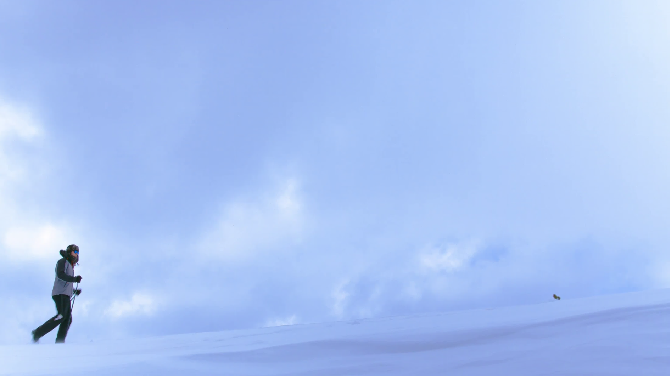
Copernicus Space Component Evolution
Next-Gen. missions will replace current & expansion missions
2014
Current Sentinels
Sentinel Next Generation
Sentinel Expansion
Copernicus for Security
Notes:
Funding Decisions:
ESA Ministerial Council 2016
Initial Development Sentinel Expansion
Mission Concept Study Sentinel SG
ESA Ministerial Council 2019
Development of Sentinel Expansion
Main development Sentinel SG
EU MFF 2021-2027
Operation/Launcher/Recurrent Cost; Data Access
ESA Ministerial Council 2022
Development Completion for Sentinel SG
EUMETSAT
TBD

Slide 4
Top priority: Stability of the programme and long term commitment
- (Enhanced) continuity of current data and services;
- Continuity of full, open and free data policy for the environmental domain;
•Additional services will be considered to meet emerging needs
- Climate change and sustainable development;
- Monitoring CO2 and other greenhouse gas emissions;
- Changes in the Arctic;
- Land use and forestry;
- Security and Defence: Improving the EU's capacity (border controls and maritime surveillance);
Policy Needs and stated priorities: Space Strategy for Europe

Slide 5
The (enhanced) continuity of existing observation capacity is the overarching priority;
Conclusions on major gaps :
CO2 measurements to estimate anthropogenic emissions (top priority)
High-Resolution Thermal observations
SAR L-band observations
Monitoring of sea ice and ice sheets in the polar region (PMR Imaging, Altimeter)
Hyper-spectral measurements
The results of these planned six studies will serve as input to iterate further the LTS but do not present any commitment of the Commission at this stage.
The next Copernicus Regulation will frame the implementation of the Copernicus Space Component in the next programme period and spell out the missions to be part of the future programme.

Slide 6
CSC Expansion Mission Candidates
( all currently in Phase A/B1)
Mission | Objective | Techn Concept | CEOS support
CO2 Mission | Paris agreement, anthropogenic CO₂ MRV support | VNIS/SWIR Spectrometer and multi-angle polarimeter, 4km2, 2-3 days revisit via a constellation | CEOS AC-VC White Paper on GHG
Thermal Mission | Addressing policies related to water and food security – EU Water Framework EU Directive, Common Agriculture Policy, UN SDGs, UNFCCC, UNCCD | 30-50 m, daily (goal) via a constealltion, 3-5 TIR bands & minimum VNIR/SWIR | Potential cross calibration /validation activities with Landsat, Trishna, Sentinel-3, preparation studies as part of Ecostress
Polar Ice and Snow Topographic Mission | Monitoring of critical climate signals: ice sheet (sea ice and land ice elevation and thickness), ice cap melting and sea level; Support applications related to coastal and inland waters; contribute to the observation of ocean topography. | Ku-band and Ka-band interferometric radar altimeter, a laser retro-reflector array, a GNSS receiver | Cal/Val (e.g. Altika and IceSat-2 when operational)
Passive Microwave Imaging Mission | Integrated EU Arctic Policy, sustainable development in and around the Arctic | multifreq.microwave radiometer (CMIR) which sustains AMSR2 type capability and SMAP/SMOS capability | Direct response to SST-VC Prevents gap in MW capability @~7GHz
Hyperspectral Mission | management of natural resources. Supports services for food security, agriculture and raw materials. | 400-2500nm; 10nm;<30m, 10d via a constellation; | Cal/Val, synergy with LSI-VC and OCR-VC for inland/coastal water
L-Band SAR Mission | vegetation cover, biomass and surface soil moisture. Enhanced monitoring polar regions (sea and land ice) and ground movement and deformation due to hazards. | L-band imaging SAR, full-pol, 5-30m, revisit TBD | Cal/Val, synergy with LSI -VC

Slide 7
Current Sentinels relevance for CEOS VCs
Operational:
Sentinel-1 A & B -> (C & D) | C-Band SAR | LSI-VC
Sentinel-2 A & B -> (C & D) | Multispectral Optical | LSI-VC, OCR-VC (coastal)
Sentinel-3 A (& B) -> (C & D) | Medium Resolution Imaging and Altimetry | OCR-VC, OST-VC, SST-VC, (LSI-VC)
Sentinel-5p | LEO Atmos Chemistry Precursor | AC-VC
Under implementation:
Sentinel-4 A & B (MTG-S) | GEO Atmos Chemistry | AC-VC
Sentinel-5 A & B & C (MetOp SG) | LEO Atmos Chemistry | AC-VC
Sentinel-6 (Jason-CS) A & B | Altimetry | OST-VC
Notes:
Note: not covered is the CEOS OSVW-VC (Ocean Surface Vector Wind) which is covered operationally by EUM missions (MetOp)

Slide 8
BackUp Slides

Slide 9

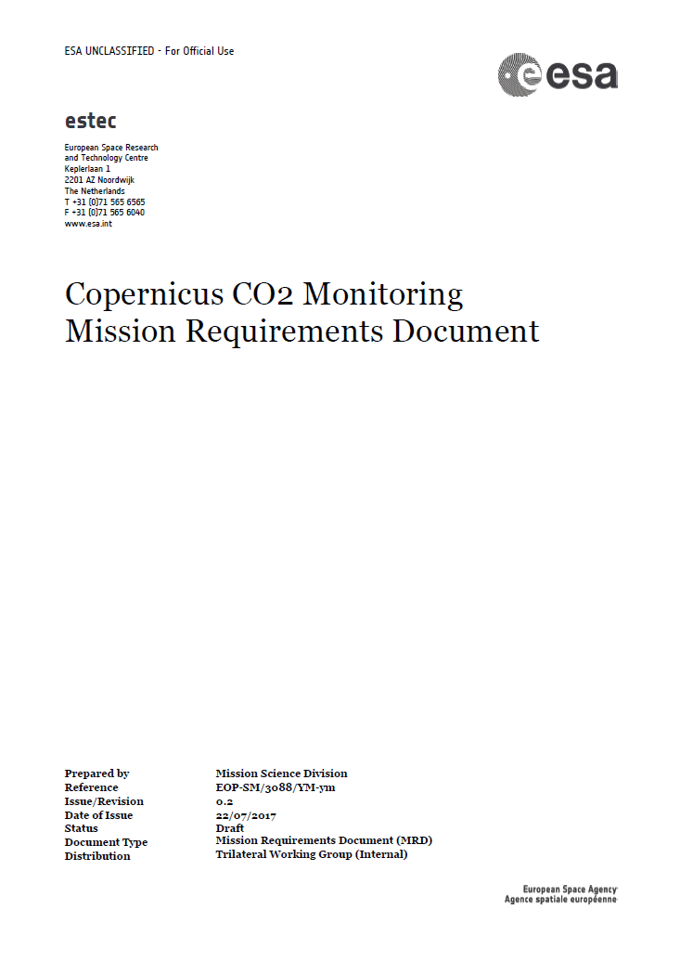
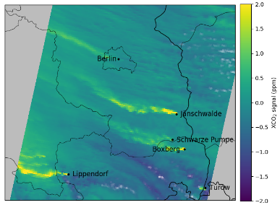
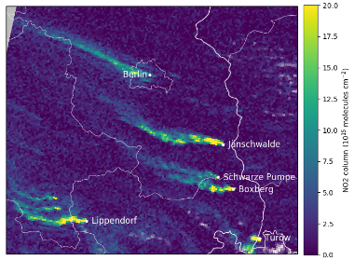

CO₂ Monitoring Mission Objectives & Requirements
In support of the Paris agreement and required national policies, an
anthropogenic CO₂ monitoring & verification support capacity shall allow
to detect future new hot spots,
to monitor and assess hot spots,
to assess emission changes, as expected from the NDCs,
to assess the emissions trends (change in stocktake with 5 year timesteps)
Observation Requirements (MRD version 1, 04-2018):
Spatial resolution 4 km² over swath width of ~250 km
Revisit of 2–3 days (poleward of 40 deg), equator crossing time 11:30 hrs
XCO₂ product with 0.5–0.7 ppm precision & syst. bias <0.5ppm
NO₂ product with 1–2·10¹⁵ molec/cm²
Multi-angle polarimeter (MAP) aerosol & cloud observations
MRD
Band | Spectral range | Spectral resolution
VIS | 405–490 nm | 0.6 nm
NIR | 747–773 nm | 0.1 nm
SWIR-1 | 1590–1675 nm | 0.3 nm
SWIR-2 | 1925–2095 nm | 0.55 nm
MAP | 385–770 nm | 20 nm (polarisation)
CO₂
NO₂
Credits: C. Bottea/EEA
Credits: EMPA

Slide 10
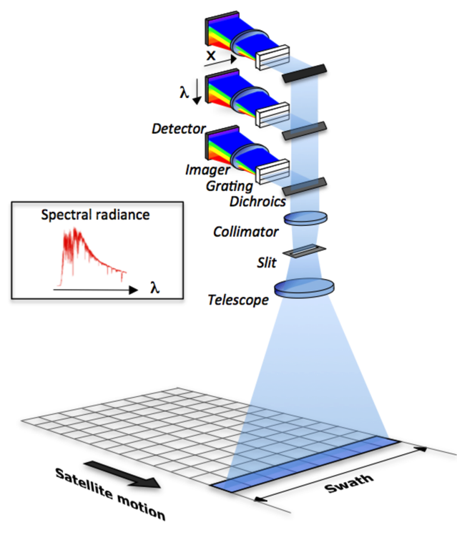
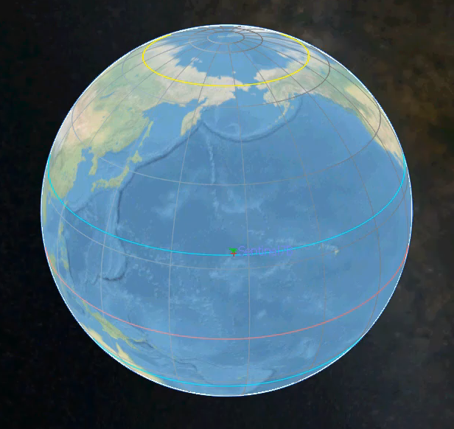
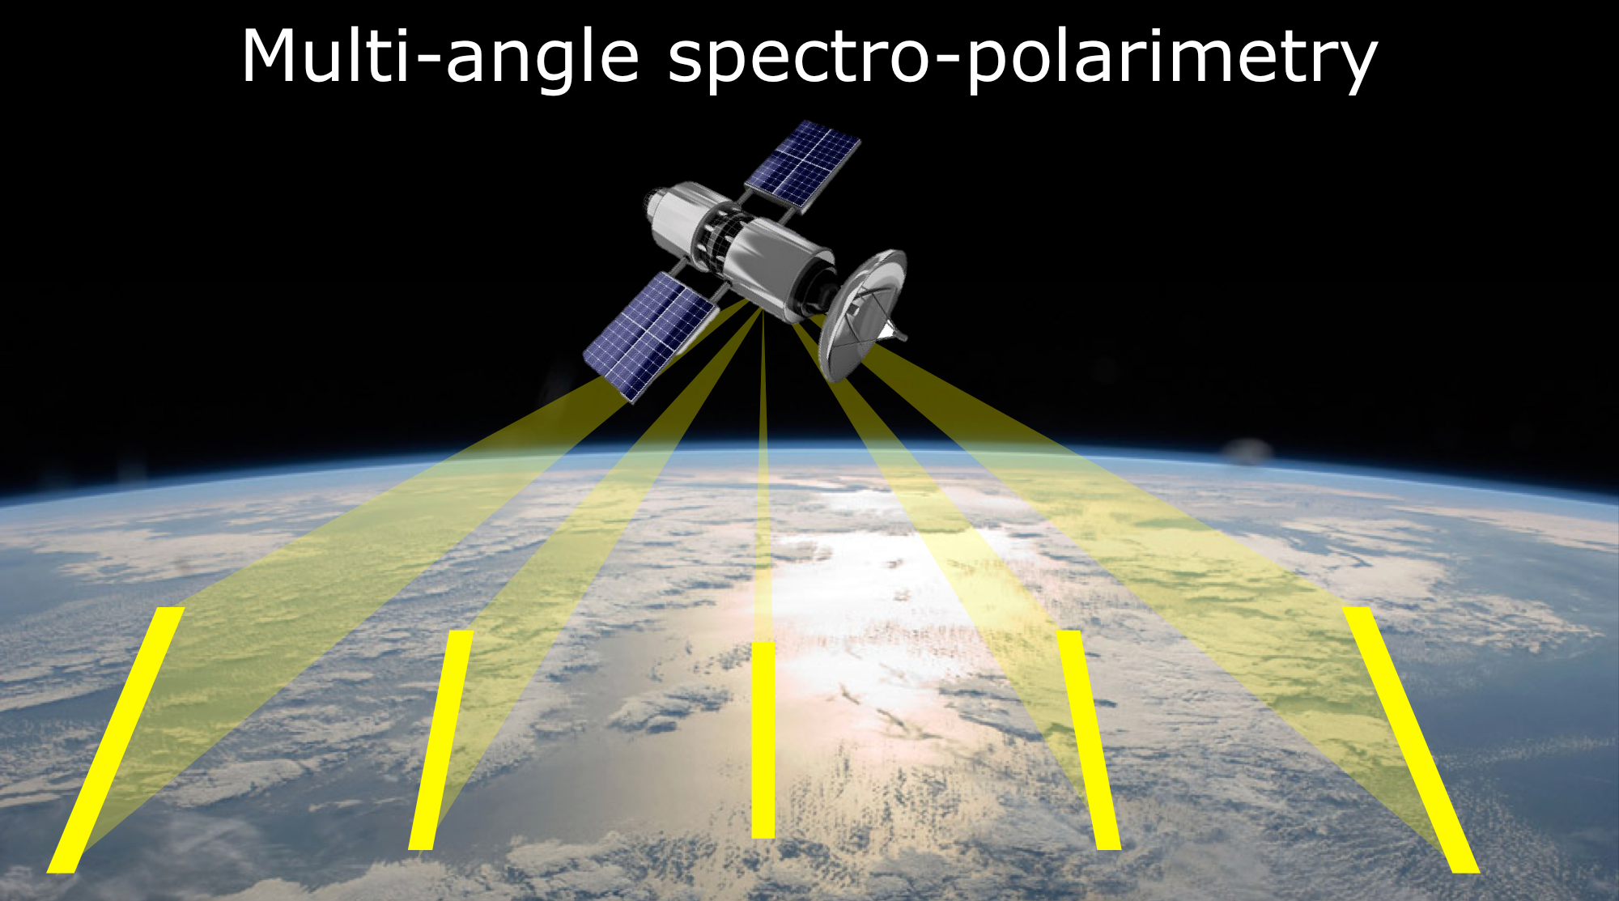
CO₂ monitoring mission concept, status & planning
CO₂ & NO₂: technical concept deploys a push-broom imaging spectrometer (as heritage missions)
Aerosol & clouds: polarimeter measuring degree of linear polarization multiple angles along the flight track
Satellite constellation: to reach the coverage requirement a constellation of 3 satellites with about 250 km swath is expected
Two parallel Phase A/B1 system studies: started 03-2018 to mid ’19
Mission Advisory Group established with first meeting 06-2018
Start implementation (after confirmation at C-MIN19) → Q1-2020
Launch target in 2025–2026
CEOS AC-VC White Paper on GHG is
applicable and offers opportunities
Several ESA and H2020 support studies
Push-broom imaging spectrometer concept
Animation of constellation with 3 satellites each having
250 km swath
Credits: SRON

Slide 11
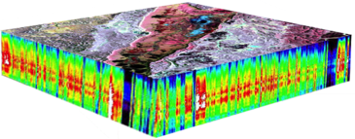
Copernicus CHIME - Copernicus Hyperspectral Imaging Mission for the Environment
Mission Objective: To provide routine hyperspectral observations through the Copernicus Programme in support of EU- and related policies for the management of natural resources, assets and benefits. This unique visible-to-shortwave infra-red spectroscopy based observational capability will in particular support new and enhanced services for food security, agriculture and raw materials. This includes sustainable agricultural and biodiversity management, soil properties characterization, sustainable mining practices and environment preservation
Spectral coverage: Contiguous spectral coverage between 400 and 2500 nm
Spectral sampling: ≤ 10 nm at FWHM
Spatial resolution: 20m - 30m
Temporal resolution: Geometric Repeat observations needed every 10 days
Status / Launch date: Currently in Phase A/B1, Launch foreseen for mid-twenties (2025/26)
CEOS support through: Cal/Val, synergy with LSI-VC and OCR-VC for inland/coastal water

Slide 12

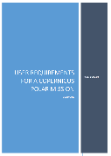
Copernicus Polar Ice and Snow Topographic Mission
Monitoring the polar regions has been identified as a priority by the European Commission.
Mission Objectives: Addressing top priority parameters identified in the Copernicus PEG I and II reports, this mission monitors variability in the polar regions by providing
  High-resolution sea ice and land ice elevation and thickness measurements;
  Properties of snow cover on ice and other surfaces;
  Monitoring of critical climate signals: ice sheet, ice cap melting and sea level;
  Support applications related to coastal and inland waters and contribute to the observation of ocean topography.
Copernicus PEG I and II reports
Mission Concept: A) The satellite embarks a payload forming a complete measurement system, comprising of a high spatial resolution Ku-band and Ka-band interferometric radar altimeter, a laser retro-reflector array, a GNSS receiver and a microwave radiometer. B) The mission draws from the heritage experience of several in-orbit missions and from the on-going development of the Sentinel-6 and MetOp-SG programmes.
Mission status and launch date: Currently in Phase A. Anticipated launch date is mid 2020s.
Possible Support through coordinated CEOS actions: Potential cross calibration/validation activities with Sentinel-3, Sentinel-6, CryoSat-2, Altika and IceSat-2 (if operational)

Slide 13
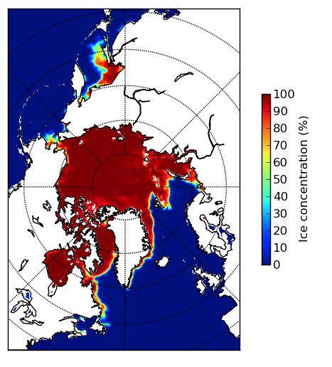
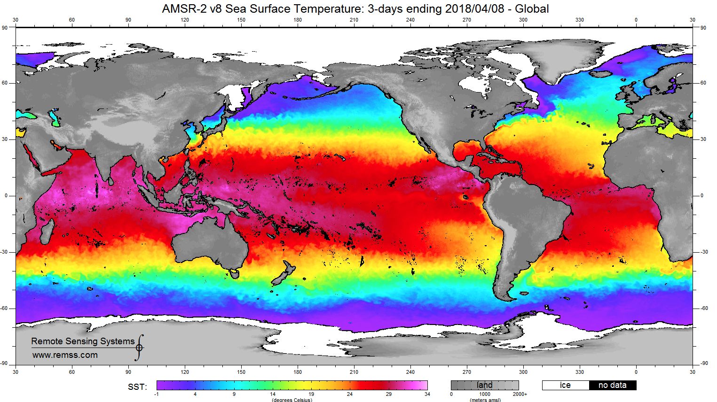
Copernicus Imaging Microwave Radiometer (CIMR)
Mission Objective
Respond's directly to the Integrated EU Arctic Policy
Climate Change and Safeguarding the Arctic
Environment Sustainable Development in and around the Arctic
International Cooperation on Arctic Issues
Characteristics
Conically scanning Multifrequency Microwave radiometer
Loose convoy flight with MetOp-SG(B)
Single satellite
99% global coverage every day, mean 6 hourly -revisit in Arctic Areas
In Phase A/B1, Launch: 2025
Channels (GHz): 1.4, 6.9, 10.65, 18.7 36.5
Resolution (km): 50 10 ≤10 ≤5 ≤5
Products
Sea Ice Concentration
Sea Surface Temperature
Thin Sea Ice Thickness
Sea Ice Drift
Ice Type
Sea Surface Salinity
Extreme Wind
Additional land products (eg. soil moisture, precipitation…)
Support to CEOS
Direct Response to SST-VC
Sustains AMSR2 type capability
Prevents gap in MW capability @~7GHz
Sustains SMAP/SMOS capability
Integrate and enhance performance of Sentinel-1 and Sentinel-3 in high latitudes
Notes:
Note: 1.4, 36.5 are secondary channels

Slide 14
High spatio-temporal resolution LST Monitoring (LSTM) Copernicus Candidate Mission
Main Mission Objective:
To complement Sentinel observation capabilities with high spatio-temporal resolution Thermal Infra-Red observations over land and coastal regions in support of agriculture management services, and possibly a range of additional applications and services
Addressing policies related to water and food security – EU Water Framework EU Directive, Common Agriculture Policy, UN SDGs, UNFCCC, UNCCD
User requirements: timely management information at field scale for irrigation, water abstraction, water pollution, land degradation
Primary mission requirements:
Land surface temperature and emissivity at 30-50 m, daily (goal), 3-5 TIR bands & minimum VNIR/SWIR
Mission Status: Currently in Phase A/B1. Anticipated launch date is mid 2020s.
CEOS support: Potential cross calibration/validation activities with Landsat, Trishna, Sentinel-3, preparation studies as part of Ecostress
Notes:
Primary objective: to support monitoring evapotranspiration (ET) rate at European field scale to capture the intra-field variability of Land Surface Temperature (LST) (and hence ET) enabling more robust estimates of field-scale water productivity.
Secondary objective: to support mapping and monitoring the soil composition (mineralogy and organic matter) and its dynamics through emissivity estimates.
Complementary objective: to support a range of additional services benefitting from TIR observations (e.g. coastal zone management, High-Temperature Events (HTE), urban heat island).

