Slide 1

7.2 Carbon and GHG Monitoring
Committee on Earth Observation Satellites
Mark Dowell, European Commission, Chair Team
David Crisp, NASA/JPL, AC-VC GHG Lead
Kerry Sawyer, NOAA, SIT Chair Team
CEOS SIT-33
Session and Agenda Item #
Boulder, CO, USA
24 – 25 April 2018

Slide 2
CEOS Chair 2018 priority A
Specific Chair Initiative : Laying the foundation for an international CO2 and GHG monitoring system
Three specific activities are foreseen for advancing this effort in 2017-2018:
Facilitate the completion and follow-on activities of the AC-VC whitepaper on defining an optimum constellation for CO2 and GHG monitoring, including the joint competences of CEOS and CGMS, and in the general framework of the continued implementation of the CEOS Carbon Strategy
Advance the relationship with CGMS for an operationally implemented and sustained observation capability. Consider establishing a formal working relationship between CEOS and CGMS as with the successful ongoing relationship on Systematic Observations of ECVs in support of UNFCCC.
Place the space segment in the broader context of a fully sustained system for CO2 monitoring. Individual CEOS Agencies have counterparts in their individual countries/regions who have responsibility for Inventories, the required modelling, in-situ infrastructure and the ground segment elements.

Slide 3
Action in GCOS IP 2016
“Specifically CEOS and CGMS will undertake, over the next few years, dedicated preparatory work in a coordinated international context…:
The definition of an architecture of space component elements to address the requirements of a CO₂ and GHG monitoring system , … This will provide a global holistic perspective both from the point of view of existing and planned space segment assets as well and that for an optimum global constellation.
The documentation of best practices on the relationships between individual space agencies and their counterparts working on the modelling aspects, the inventories and in-situ data provision, …
The further consolidation of partnerships and collaborations between the relevant international entities including: the relationship between CEOS and CGMS on the space component aspects, the partnership with the WMO and GEO on the broader framework, … and finally the relationships with GCOS itself, UNFCCC and IPCC TFI process in better defining the role for space-based observation in the inventory guideline process.”

Slide 4
COP-23/SBSTA-47

Slide 5
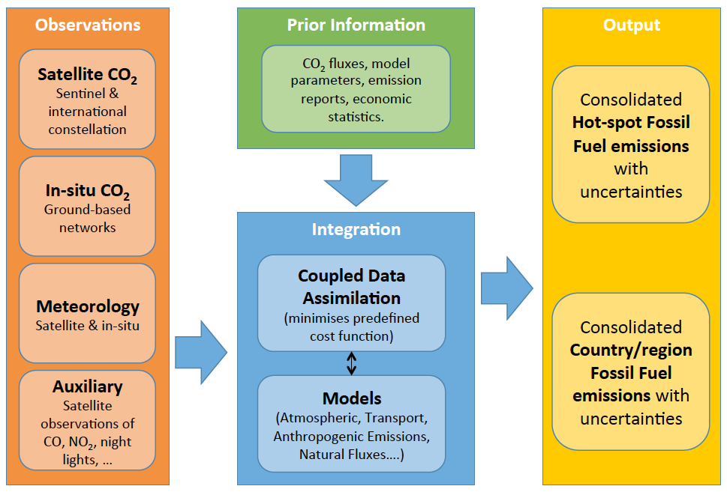
Overview of the Core Elements of the Copernicus CO₂ Emission Monitoring & Verification Support capacity

Slide 6
CEOS Chair Workshop - GHG
On “placing the space segment in the broader context of a fully sustained system for CO2 monitoring”
The EC proposes to organise a dedicated discussion workshop:
Bringing together these different stakeholders to define best practices and synergies
Exploring possibilities for common approaches to some of the system development.
This would also require the strong engagement of CGMS as well as CEOS Associate members such as the WMO.
June 18-19th European Commission – JRC , Ispra (IT)
9 CEOS Agencies confirmed attendance 2-4 people each, 3 CEOS associates – around 40 attendees in total

Slide 7
CEOS Chair GHG Workshop
Monday 18th June
Tuesday 19th June
Introduction & Objectives
Review of Previous Day
International Programmes:
WMO, GCOS, GEO
Break out Groups:
Space-Modelling,
Space-In-situ,
Space-Inventory
AM
AM
Ongoing Activities:
AC-VC Whitepaper, Inversion Modelling Workshop, IPCC TFI, Copernicus…
Agencies Perspectives:
CNES, CSA, CMA, DLR, NOAA, NASA,
JAXA, EU (EC, ESA, EUM), UKSA
Reports from Breakout Groups
PM
PM
Consolidation of Recommend-
ations and Identified
Best Practices
General & Crosscutting Aspects: discussion on issues such as terminology
System defn., needs and requirements
Conclusion and Follow-up

Slide 8
GHG White Paper
Committee on Earth Observation Satellites
David Crisp, NASA/JPL, CEOS AC-VC
CEOS SIT-33
Session 7: Partnerships 7.3
Boulder, CO, USA
24 – 25 April 2018

Slide 9
AC-VC White Paper
Chapters
Contributions from participants at the CGMS and CEOS AC-VC meeting were incorporated into the White Paper structure:
Executive Summary
1: Introduction
2: Using atmospheric GHG measurements to improve inventories
3: Space-based GHG measurement capabilities and near term plans
4: Lessons Learned from SCIAMACHY, GOSAT and OCO-2
5: Integrating GHG Satellites into Operational Constellations
6: Towards an operational constellation measuring anthropogenic CO₂ emissions
7: The Transition from Science to Operations
8: Conclusions

Slide 10
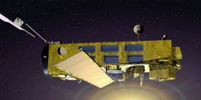
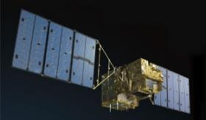
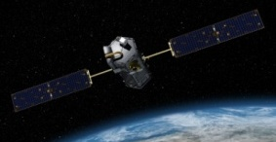
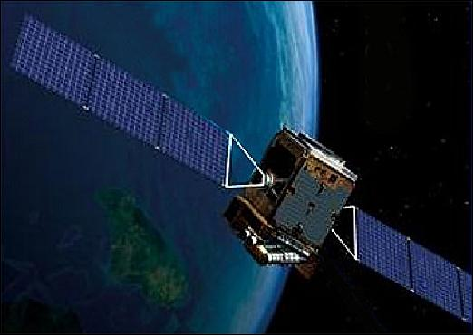
Past and Present GHG Satellites
SCIAMACHY (2002-2012) – First sensor to measure O₂, CO₂, and CH₄ using reflected NIR/SWIR sunlight
  Regional-scale maps of X_{CO2} and X_{CH4} over continents
GOSAT (2009 …) – First Japanese GHG satellite
  FTS optimized for hgh spectral resolution over broad spectral range, yielding CO₂, CH₄, and chlorophyll fluorescence (SIF)
OCO-2 (2014 …) – First NASA satellite to measure O₂ and CO₂ with high sensitivity, resolution, and coverage
  High resolution imaging grating spectrometer small (< 3 km²) footprint and rapid sampling (10⁶ samples/day)
TanSat (2016 …) - First Chinese GHG satellite
  Imaging grating spectrometer for O₂ and CO₂ bands and cloud & aerosol Imager
  In-orbit checkout formally complete in August 2017

Slide 11
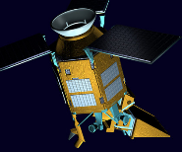
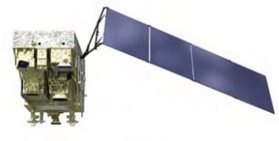
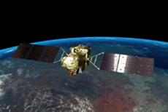

The Next Generation
Feng Yun 3D (2017) – Chinese GHG satellite on an operational meteorological bus
  GAS FTS for O₂, CO₂, CH₄, CO, N₂O, H₂O
Sentinel 5p (2017) - Copernicus pre-operational Satellite
  TROPOMI measures O₂, CH₄ (1%), CO (10%), NO₂, SIF
  Imaging at 7 km x 7 km resolution, daily global coverage
Gaofen 5 (2018) - 2nd Chinese GHG Satellite
  Spatial heterodyne spectrometer for O₂, CO₂, and CH₄
GOSAT-2 (2018) – Japanese 2nd generation satellite
  CO as well as CO₂, CH₄, with improved precision (0.125%), and active pointing to increase number of cloud free observation
OCO-3 (2019*) – NASA OCO-2 spare instrument, on ISS
  First CO₂ sensor to fly in a low inclination, precessing orbit
In orbit Checkout

Slide 12
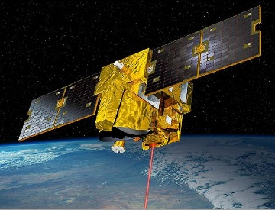
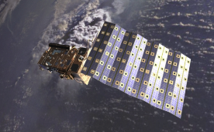
Future GHG Satellites (2)
CNES/UK MicroCarb (2021+) – compact, high sensitivity
  Imaging grating spectrometer for O₂ A, O₂ ¹Δ_{g}, and CO₂
  ~1/2 of the size, mass of OCO-2, with 4.5 km x 9 km footprints
CNES/DLR MERLIN (2021+) - First CH₄ LIDAR (IPDA)
  Precise (1-2%) X_{CH4} retrievals for studies of wetland emissions, inter-hemispheric gradients and continental scale annual CH₄ budgets
NASA GeoCarb (2022*) – First GEO GHG satellite
  Imaging spectrometer for XCO2, XCH4, XCO and SIF
  Stationed above 85° E for North/South America
Sentinel 5A,5B,5C (2022) - Copernicus operational services for air quality and CH4
  Daily global maps of XCO and XCH4 at < 8 km x 8 km

Slide 13


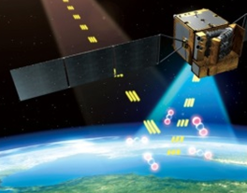
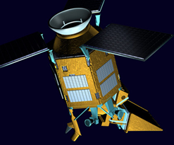
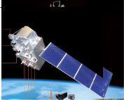

GHG Mission Timeline
A broad range of GHG missions will be flown over the next decade.
Most are “science” missions, designed to identify optimal methods for measuring CO₂ and CH₄, not “operational” missions designed to deliver policy relevant GHG products focused on anthropogenic emissions

Slide 14
Future GHG Constellations in the Planning Stages
Copernicus Sentinel CO₂ (2025+)
  3 or 4 LEO satellites in an operational GHG constellation
  Primary instruments measure O₂ (0.76 μm A-band), CO₂ (1.61 and 2.06 μm), and NO₂ (0.450 μm) at a spatial resolution of 2 km x 2 km along a broad (200-300 km) swath
  A dedicated cloud/aerosol instrument is also under consideration
TanSat-2 Constellation
  6 satellites, with 3 flying in morning sun-synchronous orbits and 3 flying in afternoon sun-synchronous orbits
  primary GHG instrument on each satellite with measure CO₂ (1.61 and 2.06 µm), CH₄ and CO (2.3 µm) as well as the O₂ A-band (0.76 µm) across a 100-km cross-track swath

Slide 15
GCOS CO₂ and CH₄ Requirements.
The CO₂ and CH₄ measurement requirements in the 2011 update for the Global Climate Observing System (GCOS) Systematic Observation Requirements for Satellite-Based Data Products for Climate (GCOS, 2011) and GCOS 2016 Implementation Plan (GCOS, 2016) were adopted as targets for a future GHG constellation.
Variable / Parameter | Horizontal Resolution | Vertical Resolution | Temporal Resolution | Accuracy | Stability/ Decade* | Stability/ Decade**
Tropospheric CO₂ column | 5-10km | N/A | 4 h | 1 ppm | 0.2 ppm | 1.5 ppm
Tropospheric CO₂ | 5-10 km | 5 km | 4 h | 1 ppm | 0.2 ppm | 1.5 ppm
Tropospheric CH₄ column | 5-10 km | N/A | 4 h | 10 ppb | 2 ppb | 7 ppb
Tropospheric CH₄ | 5-10 km | 5 km | 4 h | 10 ppb | 2 ppb | 0.7 ppb
Stratospheric CH₄ | 100-200 km | 2 km | Daily | 5% | 0.30% | 0.30%
* from GCOS 2011
** from GCOS 2016

Slide 16
A Candidate GHG Constellation Architectures
The coverage, resolution, and precision requirements could be achieved with a constellation that incorporates
A constellation of 3 (or more) satellites in LEO with
  A broad (> 200) km swath with a mean footprint size < 4 km²
  A single sounding random error near 0.5 ppm, and vanishing small regional scale bias (< 0.1 ppm) over > 80% of the sunlit hemisphere
  One (or more) satellites carrying ancillary sensors (CO, NO₂, CO₂ and/or CH₄ Lidar)
A constellation with 3 (or more) GEO satellites
  Monitor diurnally varying processes (e.g. rush hours, diurnal variations in the biosphere)
  Stationed over Europe/Africa, North/South America, and East Asia
This constellation could be augmented with one or more HEO satellites to monitor carbon cycle changes in the high arctic

Slide 17
Merging Science and Operations
Because of the unprecedented requirements for precision and accuracy, the space based elements of the an operational GHG constellation architecture must be accompanied by
  Rigorous pre-launch and on-orbit measurement calibration and product validation methods that evolve to meet emerging needs
  Continuous refinements in remote sensing retrieval and flux inversion modeling methods that improve the products over time
CEOS could play an essential role in coordinating these activities among its partner agencies
Any operational architecture will also have to address
  orbit and mission coordination, data distribution, data exchange, and data format requirements
  Training and capacity building and public outreach will be needed to fully exploit the value of the space based GHG measurements
CEOS should collaborate with CGMS and other operational organizations to foster the development of these capabilities

Slide 18
Timely inputs to policy makers
Global Stock
Take 1
Global Stock
Take 2
Paris
Agreement
using inventories of 2026
using inventories of 2021
CO₂ Task Force
2015
2017
2021
2023
2026
2028
CO2 Follow-up Report
Initial system capacity built up
Mission Requirement Document
Launch target for
Copernicus S-7
constellation

Slide 19
CEOS CGMS Coordination on GHG monitoring - options
Continue adhoc collaboration in context of CEOS Carbon Strategy Actions e.g. as-in joint efforts on AC-VC Whitepaper
Establish a sub-group (with dedicated resources) in context of existing standing WG i.e. Joint WG on Climate
Extend the current CEOS Atmospheric Composition Virtual Constellation to be a Joint CEOS-CGMS Virtual Constellation
Establish a dedicated Joint WG specifically on Carbon /GHG observations
Assess/discuss these different options both within CEOS and CGMS - propose a preferred option

Slide 20
Pros and Cons of Options 3 & 4
 | Option 3 Subgroup to Joint WGClimate | Option 4 Joint AC-VC
Pros | The Joint CEOS-CGMS WGClimate already exists, just need to decide on assigning subgroup lead maybe update ToR Existing and strong working relationship with GCOS and UNFCCC/SBSTA May provide basis for longer-term home for CEOS Carbon Strategy Action Will Ensure that the GHG products requirements/improvement process follows same being implemented for other ECVs/CDRs Take advantage of other ECVs associated to the natural Carbon Cycle | Could build on existing adhoc collaboration started in context of GHG Whitepaper If focus is primarily on building physical constellation, based on GHG Whitepaper, then competence are within VC Would provide an additional “model” of collaboration between CEOS and CGMS GHG may not be only area of CEOS-CGMS collaboration within AC-VC e.g. Air Quality
Cons | Enlarges scope/mandate of WGClimate Would definitely need additional resources competences fro CEOS agencies to WGClimate Would need strong dialogue between WGClimate and AC-VC | Concern on creating parallel track with SBSTA and GCOS Risks to remain disconnected to other activities of CEOS Carbon Strategy

Slide 21
Option Paper and timeline
Timeline:
  Discussion at SIT-33
  Draft note/options paper(end May)
  Follow up discussion with WGClimate and AC-VC (end May)
  Presentation/Discussion CGMS- 46
  Revised option paper for SIT TW – seeking opinion to go to Plenary
  CEOS Plenary 2018 for decision
  …
Options paper:
  Context/Background
  History of Discussions CEOS/CGMS on GHG
  Successful example of WGClimate
  Options for formalised Collaboration
  Pros and Cons of different Options
  Preferred Option and reasoning
  Annex: proposed ToR for VC
  Annex: any proposed revisions to ToR for WGClimate
  Annex: update to VC process paper (if needed)

Slide 22
GEO Carbon and GHG Steering Committee
Slides from Kerry

Slide 23
Backup slides

Slide 24
COP-23/SBSTA-47

Slide 25
Option 3
GCOS/UNFCCC
GEO Carbon & GHG
(WMO IG3IS)
Reporting SBSTA, formal GCOS link
Space Agency input to GEO Initiative
Initiatives on Carbon relevant ECVs, input for SBSTA
Joint
WGClimate
CEOS Carbon Strategy (CCS)
WGClimate Subgroup on GHG/carbon monitoring
Addressing GHG relevant GCOS Actions e.g. T71
CCS Actions for the Atmospheric Domain
Joint meetings AC-VC - WGClimate
Atmospheric Composition - VC

Slide 26
Option 4
GCOS/UNFCCC
GEO Carbon & GHG
(WMO IG3IS)
Reporting SBSTA, formal GCOS link
Space Agency input to GEO Initiative
Initiatives on Carbon relevant ECVs, input for SBSTA
Joint
WGClimate
CEOS Carbon Strategy (CCS)
Addressing GHG relevant GCOS Actions e.g. T71
CCS Actions for the Atmospheric Domain
Joint
Atmospheric Composition - VC

