Slide 1
Observations for Coasts
Committee on Earth Observation Satellites
Paul M. DiGiacomo, NOAA, SIT Chair Team
CEOS SIT-34
Session 6: Oceans and Water Cycle, #6.8
Miami, FL, USA
4 April 2019

Slide 2
2018 SIT Technical Workshop
Outcomes: Ocean and Water
Potential to combine VC/WG/AHT efforts focused on coastal research and observations.
Consider a CEOS Coastal Strategy assessment, to enhance coordination across Ocean elements and the land/ocean boundary
Freshwater from Space WS Opportunity
Direct need for in-situ data access, and potential for leveraging GEO activities
Potential to target specific projects (intersection of needs) in coastal and delta zones
Disasters (floods, HAB, water quality impacts)
Aquaculture
Global Delta management
GEO 2020 Work Plan
Possibility for new ad-hoc team on coastal issues
Notes:
Combined VC / AHT / WG effort(e.g. AHWG) focused on Coastal research and applications.
Need for a CEOS Coastal strategy, bringing in multiple parameters / teams, including coordinating on Cal/Val along coasts (e.g. SS Temp/Ocean Color/SS Height/Salinity/OVW)
VCs already have a start on fresh / coast / ocean strategies but there is a need to coordinate with other AHTs and groups on progressing.
Freshwater from Space workshop should recognize CEOS VC’s/WG’s are have active water efforts which could use coordination.
Emphasize in-situ needs to CEOS agencies AND GEO/applications
Opportunity for inclusion aspect in GEO 2020 work plan, and CEOS work plan.
Possibility for new ad-hoc team on coastal issues focused on the organization and planning.
Target potential coastal applications e.g. aquaculture / disasters / Global Delta management / Harmful Algal Bloom’s. Intersection of need and capabilities.
Emphasize forecasting (integrated observations) versus monitoring (often single datasets)

Slide 3
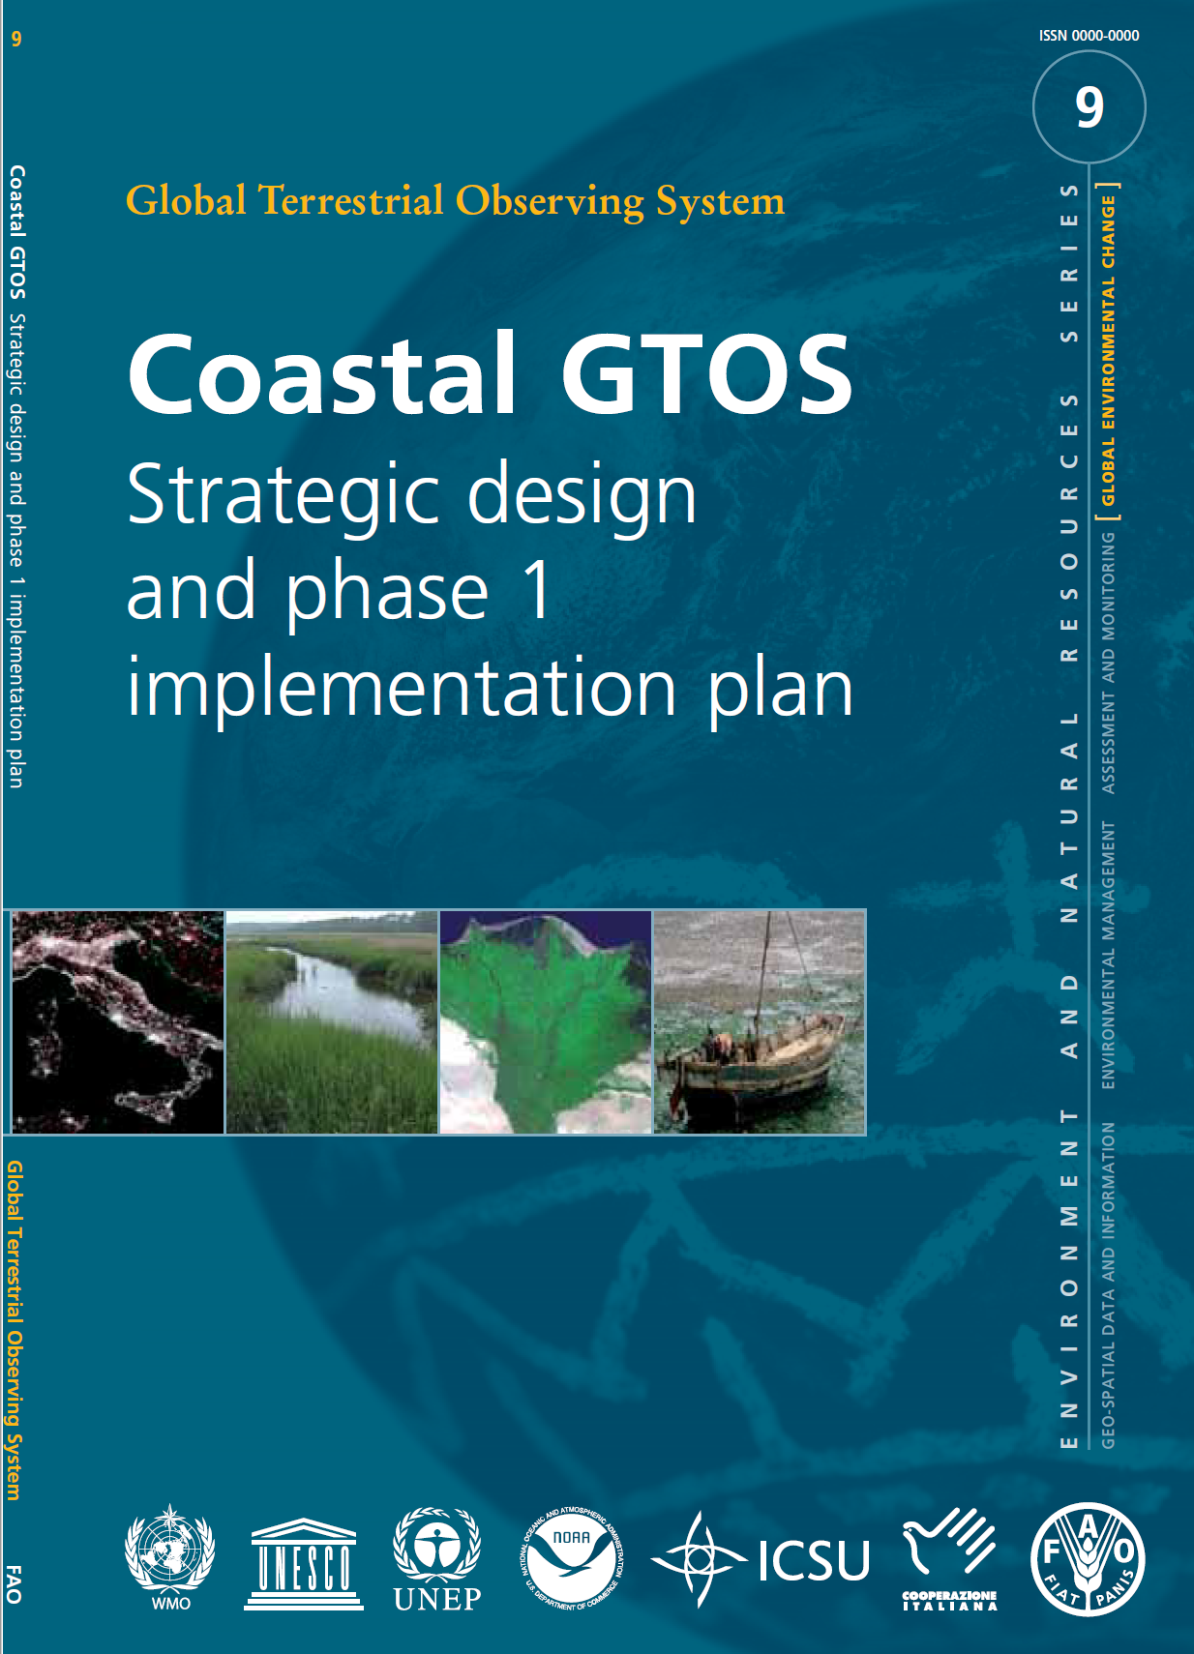
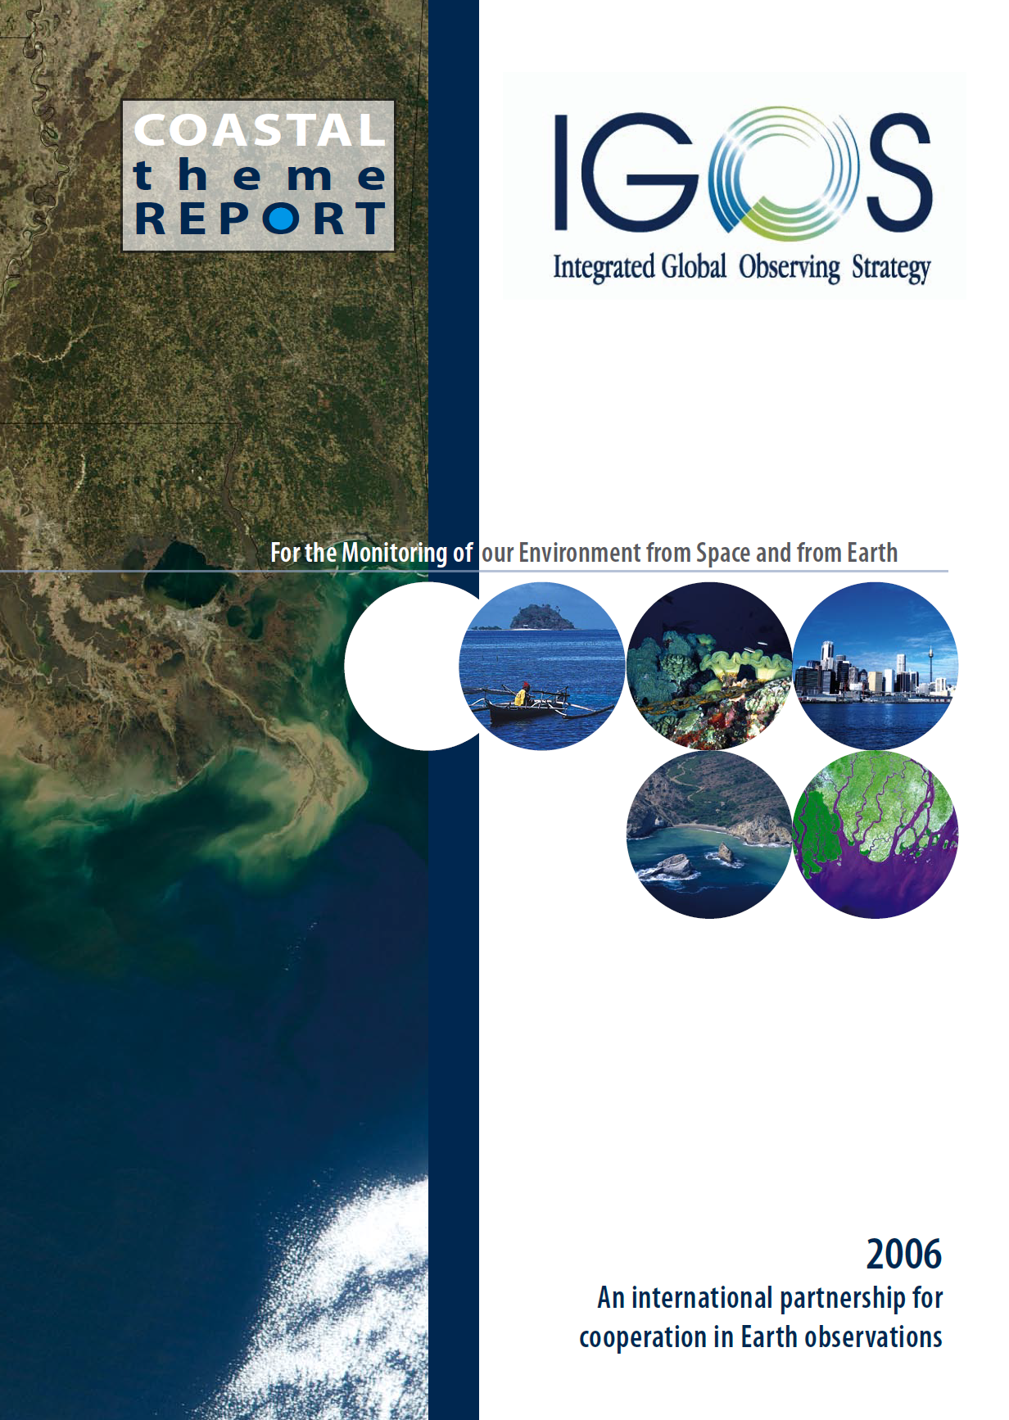
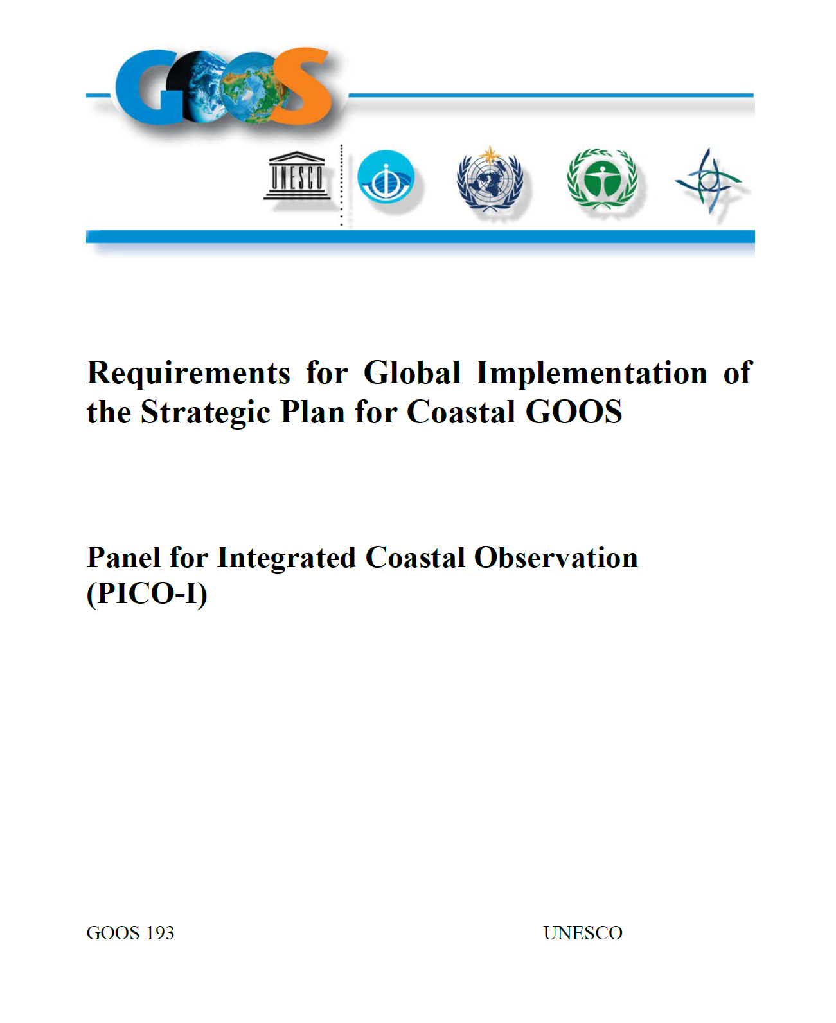
Previous Coastal Observing Reports
Coastal GTOS, 2005
e.g., deltaic systems;
urbanization and changes
in coastal land use/cover
IGOS Coastal Theme, 2006
e.g., land-sea interface;
coastal populations &
ecosystems at risk
Coastal GOOS, 2012
eutrophication/hypoxia;
pathogens; HABs; benthic
habitats; flooding; acidification,
fisheries; integration

Slide 4
Coastal Observations & Applications
→
→
GEO Coastal Zone Community of Practice (CZCP): Active 2006-2016
The CZCP brought together scientific and non-scientific experts in an effort to support
coastal zone management through utilization of Earth observations & derived products
Activities included a series of regional workshops entitled: “GEOSS Support for Decision-
Making in the Coastal Zone: Managing and Mitigating the Impacts of Human Activities and
Natural Hazards in the Coastal Zone” – held in Greece, Benin and Puerto Rico
The CZCP ultimately transitioned into GEO Blue Planet as one of its foundational pillars.
The GEO Blue Planet Initiative has several coastal-related activities and projects, including:
Early Warning System for Marine Flooding of Reef-lined Islands Project
Multi-hazard Information and Alert System for the Wider Caribbean Project
There is also a Blue Planet water associated diseases working group that will coordinate
with the related activities of the GEO Health, AquaWatch (water quality) et al. initiatives.

Slide 5
Proposed Way Forward
Initiate an (ad hoc) coastal observing and applications working group under the auspices of GEO Blue Planet, bringing together interested data providers (e.g., CEOS agencies) and users (e.g., UN Environment, Future Earth Coasts).
Request this WG revisit and update the coastal observing requirements previously articulated in the IGOS Coastal Theme Report and produce an associated CEOS Coastal Strategy Assessment to enhance coordination across the land-sea boundary.
Initiate targeted demonstration project/s focusing on flooding, water quality, eutrophication, HABs, and/or other ecosystem impacts, addressing coastal urban regions, deltaic/estuarine, and heavily impacted (natural/anthropogenic) regions in both developed and developing areas (e.g., Puerto Rico, Vietnam, Great Barrier Reef, Chesapeake Bay)

Slide 6
Proposed Way Forward (continued)
3) Initiate targeted demonstration project/s focusing on flooding, water quality, eutrophication, HABs, and/or other ecosystem impacts, addressing coastal urban regions, deltaic/estuarine, and heavily impacted (natural/anthropogenic) regions in both developed and developing areas (e.g., Puerto Rico, Vietnam, Great Barrier Reef, Chesapeake Bay)
a. Development of synergistic higher resolution datasets, combining radar (e.g., S1, RCM) & visible imagery (e.g., S2, L8) along with other multi-sensor physical/biological products
b. Focus on event-driven as well as climatological anomalies in both retrospective and NRT modes, including new and improved validation approaches (e.g., drones, saildrones)
c. Initiate prototype coastal knowledge hub in support of emerging GEO vision, including cloud-based, server-side and integrated community best practices and demonstration efforts (e.g., Horizon 2020 Coastal Waters Research Synergy Framework (http://co-resyf.eu/))
4) Generate detailed prospectus for No. 1-3 above and submit for consideration by next SIT Technical Workshop (Sept 2019) and 33rd CEOS Plenary (Oct 2019)

