Slide 1
CEOS 2022-2024 Work Plan
Marie-Claire Greening
CEOS Executive Officer
Agenda Item 2.1
SIT-37, Virtual Meeting
29-31 March 2022

Slide 2
Governance & Work Planning
Four key governing documents primarily guide the work of CEOS:
CEOS Terms of Reference defines the mission and scope of CEOS activities
CEOS Strategic Guidance document articulates the overarching long-term (7-10 years) purpose and goals of CEOS
CEOS Governance and Processes document provides guidelines on the structure, operations, and processes CEOS employs to achieve its goals
CEOS Work Plan (3-year rolling) sets forth near-term actions to achieve the goals outlined in the CEOS Strategic Guidance document
The CEO is the custodian of all CEOS Governing Documents, including the annual update of the 3-year CEOS Work Plan and the definition and monitoring of the deliverables it informs

Slide 3
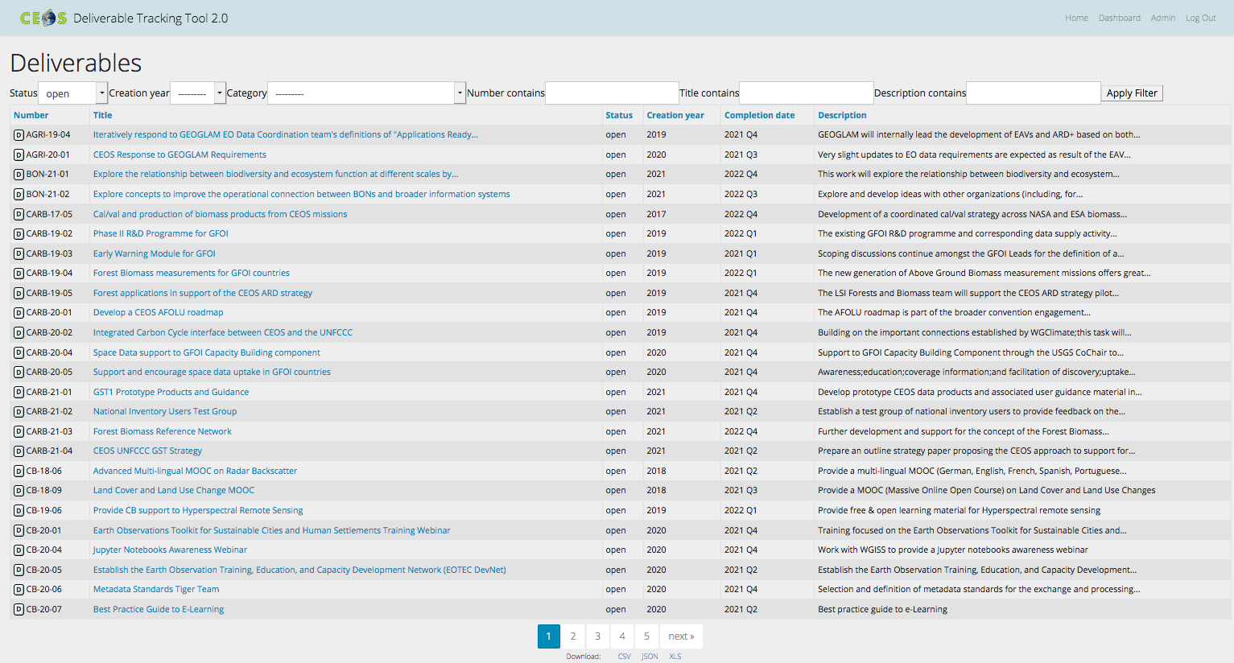
CEOS Work Plan
3-year plan updated by all CEOS entities every year and put forward for formal endorsement at SIT in March. Rigorous work planning, execution and monitoring is critical to CEOS’s credibility.
Jan
Dec
Feb
SIT
Nov
Mar
Plenary
Oct
Apr
Sep
May
SIT TW
Aug
Jun
Jul
Detailed work defined as deliverables: outlined in the WP, reconciled and tracked in CEOS deliverable tracking tool

Slide 4
CEOS Work Plan Structure
 | Chapter in Work Plan | Responsible
1 | Climate Monitoring, Research, and Services | WGClimate
2 | Carbon Observations in Support of Climate Science and Policy
3 | Observations in Support of the Global Stocktake of the UNFCCC
4 | Observations for Agriculture
5 | Observations for Disasters | WGDisasters
6 | Observations for Water
7 | Data Quality | WGCV
8 | Capacity Building and Data Democracy | WGCapD
9 | Data Discovery, Access, Preservation, Usability and Exploitation: approaches, systems, tools and technologies | WGISS
10 | Advancement of the CEOS Virtual Constellations | VCs (includes ARD Oversight Group)
11 | Support to Other Key Stakeholder Initiatives | SDG Coordination Group, Biodiversity experts, COVERAGE, COAST AHT
12 | CEOS Services

Slide 5
2021-23 vs 2022-24
Chapter |  | Closed from 2021-23 WP | Carried over from 2021-23 WP | New for 2022-24 WP
1 | Climate Monitoring, Research, and Services | 2 | 3 | 4
2 | Carbon Observations in Support of Climate Science and Policy | 3 | 10 | 1
3 | Observations in Support of the Global Stocktake of the UNFCCC | - | - | 10
4 | Observations for Agriculture | 1 | 1 | 3
5 | Observations for Disasters | 3 | 9 | 4
6 | Observations for Water | 0 | 0 | 0
7 | Data Quality | 5 | 6 | 2
8 | Capacity Building and Data Democracy | 17 | 13 | 14
9 | Data Discovery, Access, Preservation, Usability and Exploitation: approaches, systems, tools and technologies | 5 | 1 | 6
10 | Advancement of the CEOS Virtual Constellations | 8 | 23 | 6
11 | Support to Other Key Stakeholder Initiatives | 1 | 12 | 2
 | Totals | 45 | 78 | 52

Slide 6
Deliverable deadlines
Chapter |  | 2022 | 2023 | 2024 & beyond
1 | Climate Monitoring, Research, and Services | 4 | 2 | 1
2 | Carbon Observations in Support of Climate Science and Policy | 3 | 8 | 0
3 | Observations in Support of the Global Stocktake of the UNFCCC | 6 | 4 | 0
4 | Observations for Agriculture | 3 | 1 | 0
5 | Observations for Disasters | 5 | 4 | 4
6 | Observations for Water | 0 | 0 | 0
7 | Data Quality | 6 | 1 | 1
8 | Capacity Building and Data Democracy | 18 | 8 | 1
9 | Data Discovery, Access, Preservation, Usability and Exploitation: approaches, systems, tools and technologies | 4 | 3 | 0
10 | Advancement of the CEOS Virtual Constellations | 19 | 5 | 5
11 | Support to Other Key Stakeholder Initiatives | 13 | 1 | 0
 | Totals | 81 | 37 | 12

Slide 7
CEOS Work Plan links to SIT-37
 | Chapter in Work Plan | SIT-37 Session links
1 | Climate Monitoring, Research, and Services | 1, 2, 4, 7
2 | Carbon Observations in Support of Climate Science and Policy | 1, 2, 7
3 | Observations in Support of the Global Stocktake of the UNFCCC | 1, 2, 7
4 | Observations for Agriculture | 1, 5, 7
5 | Observations for Disasters | 1, 2, 3, 4, 7
6 | Observations for Water | 1, 5, 6, 7
7 | Data Quality | 1, 2, 4, 5, 7
8 | Capacity Building and Data Democracy | 1, 4, 5, 7
9 | Data Discovery, Access, Preservation, Usability and Exploitation: approaches, systems, tools and technologies | 1, 2, 4, 5, 7
10 | Advancement of the CEOS Virtual Constellations | 1, 2, 5, 6, 7
11 | Support to Other Key Stakeholder Initiatives | 1, 3, 6, 7
12 | CEOS Services | 1, 2, 3, 4, 5, 6, 7

Slide 8
Thank you!
Marie-Claire Greening
CEOS Executive Officer
Agenda Item 2.1
SIT-37, Virtual Meeting
29-31 March 2022

