Slide 1
SIT-37 “New geometries in the satellite EO sector” : CNES experience
10 Mins
Selma Cherchali, CNES Chair
Agenda Item 4.2
SIT-37 Virtual Meeting
29-31 March 2022

Slide 2
CNES in the French industrial environment Main trends
Drastic changes in our environment
Space industry becomes more and more mature,
Increased investment capacity in Earth Observation initiatives (from Space infrastructure to services),
Development and operations of services using Earth Observation data : digital companies are more and more involved,
More and more users can benefit from EO missions,
Start-ups appear in all areas (satellites, launchers, services, …)
CNES is constantly adapting to this rapidly changing environment
Changes in our relationship with the Space industry,
Development of relations with many companies, including new actors,
Provide easy access to space technology for all categories of actors (private companies of all sizes including start-ups, institutional partners) : the « Connect by CNES » initiative,

Slide 3
The evolution of CNES relation with Industry : The French high resolution optical satellites
CNES in the French industrial environment An illustration -> Anticipation
Increased resolution
Spot 1
Spot 2
Spot 3
Spot 4
Spot 5
Spot 6
Spot 7
1980
1990
2000
2010
2020
Public funding
Private funding
PHR1
PNEO3
CO3D
Public/Private Partnership
PHR2
PNEO4
Increased resolution,
agility …
3D products

Slide 4
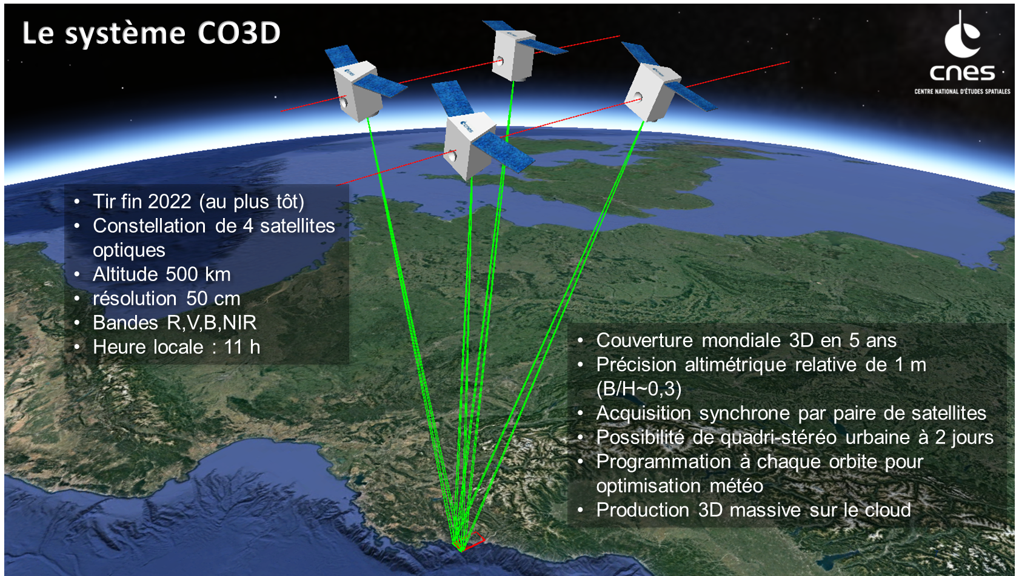
CO3D
PPP Objectives :
Support the industry for the development of low cost 0,5 m imagery satellites
Access to Optical DEM (~1m resolution) at global scale, via massive cloud production
Access to 3D products :
CNES owns the rights of all data acquired in the initial demonstration phase,
Beyond the initial phase, access to all data at low cost for CNES and their institutional partners
In parallel with the CO3D development, several initiatives have started to promote the use of CO3D products (e.g. AIGEO)

Slide 5
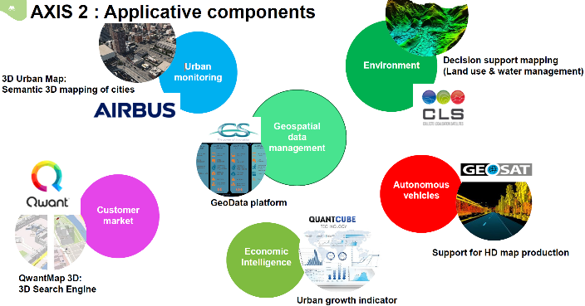
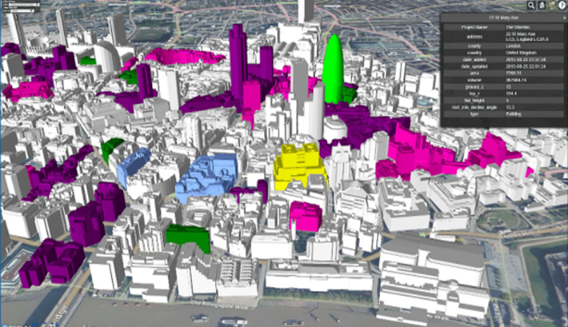
CNES in the French industrial environment An example
AI4GEO
Co-funded by French public investment funds, private companies and public entities (incl. CNES)
Axis 1 (lead : institutional partners)
development of software tools to extract 2D & 3D information automatically and at large scales from satellite products, and of the production platform
Axis 2 (lead : industry)
development of services based on 3D products in various application fields

Slide 6
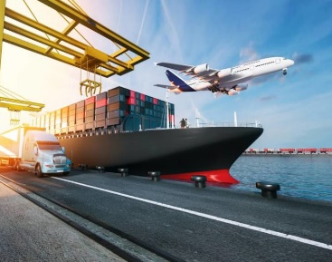
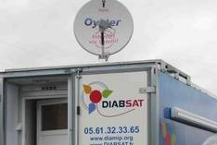
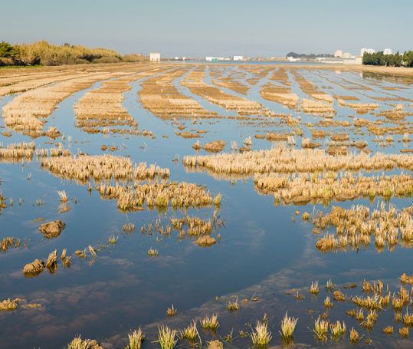
Developing the space user community
The objectives of “Connect by CNES”
In order to stimulate National Economic Development, through the innovative use of satellite data and systems
Contributing to the Social and Environmental Development of France, thanks to the use of satellite technologies
Three priority sectors: Mobility, Health and Environment
5 key targets : International, Start-ups, SMEs, Large Groups and Communities
https://www.connectbycnes.fr/

Slide 7
Some figures
160 start-up incubed with CNES support since 5 years
Private funding
50 training courses in 2020
Ambassadors
14 partnerships with regions and key accounts
229 technical support and expertise interventions
since 5 years
140 events in 3 years

Slide 8
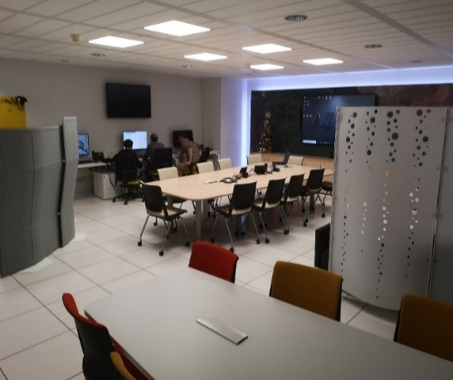
Developing the space user community
The objectives of “Connect by CNES”
EO Lab, created in 2018 to support Connect by CNES in the promotion of Space solutions for public institutes, local authorities, start-ups, SMEs, …
Technical support to users on the following topics
Choice of Space data depending on user needs,
Data processing : which information can be derived from the data ?
Access to data and processing platforms,
Training sessions

Slide 9
Towards a CEOS strategy to better work with commercial initiatives ?
Some questions …
Each CEOS agency develops their own strategy for supporting the commercial sector
Cooperation between Space agencies / competition between private companies ?
Data policy :
Co-existence of « Open Data » for public missions and private data ownership for commercial missions ?
Space infrastructure : how can CEOS members include private initiatives in their analysis ? E.g. integration of commercial missions in VC ?
Difficult to rely on commercial initiatives which are risky. Can only be considered (today) as complement to institutional systems,
“Paths to sustainability” : interaction with the private sector is a key issue in the process to develop services based on demonstrators. Need to involve private companies early. What is the most efficient way ?
CEOS mutualization/standardization efforts are very beneficial for the downstream industry (interoperability, ARD, data quality, …) ; we should feel encouraged to develop these activities even further.

