Slide 1
Case Studies from CEOS Agencies: NOAA
Dr. Stephen Volz, NOAA
Agenda Item #4.2
SIT-37
Virtual Meeting
29-31 March 2022

Slide 2
NESDIS “New Space” Initiatives
NOAA seeks to leverage recent innovations by the commercial aerospace industry in small satellite technology, access to space, communications and ground services (aka “New Space”) in order to:
Improve the agility and resiliency of the architecture
Shift from using large, multi-instrument satellites flown on a set cadence, toward a disaggregated architecture of smaller satellites to place observational capabilities in the desired locations when needed.
Allow for rapid and efficient replenishment of on-orbit assets and responsive to changes in observational needs
TOPICS
LEO Distributed Constellation
Joint Venture
Commercial Data Program

Slide 3
“New Space” and LEO Constellation
LEO will validate the merits of commercially based disaggregated architecture with a QuickSounder mission, demonstrating disaggregation, agility, and operational observations can be achieved through the exploitation of new business models, including revised approaches to hardware procurement, mission authorization, and mission development oversight.
Scientific and Programmatic Objectives of the mission include:
Advance aspects of agile, disaggregated architecture: from authorization to launch in ~3 years; employing greater risk tolerance in individual mission elements
Understand and establish NOAA best practices for leveraging elements of commercial space, to potentially include acquiring “off the shelf” spacecraft and launch vehicle and commercial mission operations
Challenge and revise mission authorization methodologies, including review processes at multiple levels
Validate program cost and schedule estimates, and models for similar future satellites.
Demonstrate small satellites can provide observations that meet our mission requirements

Slide 4
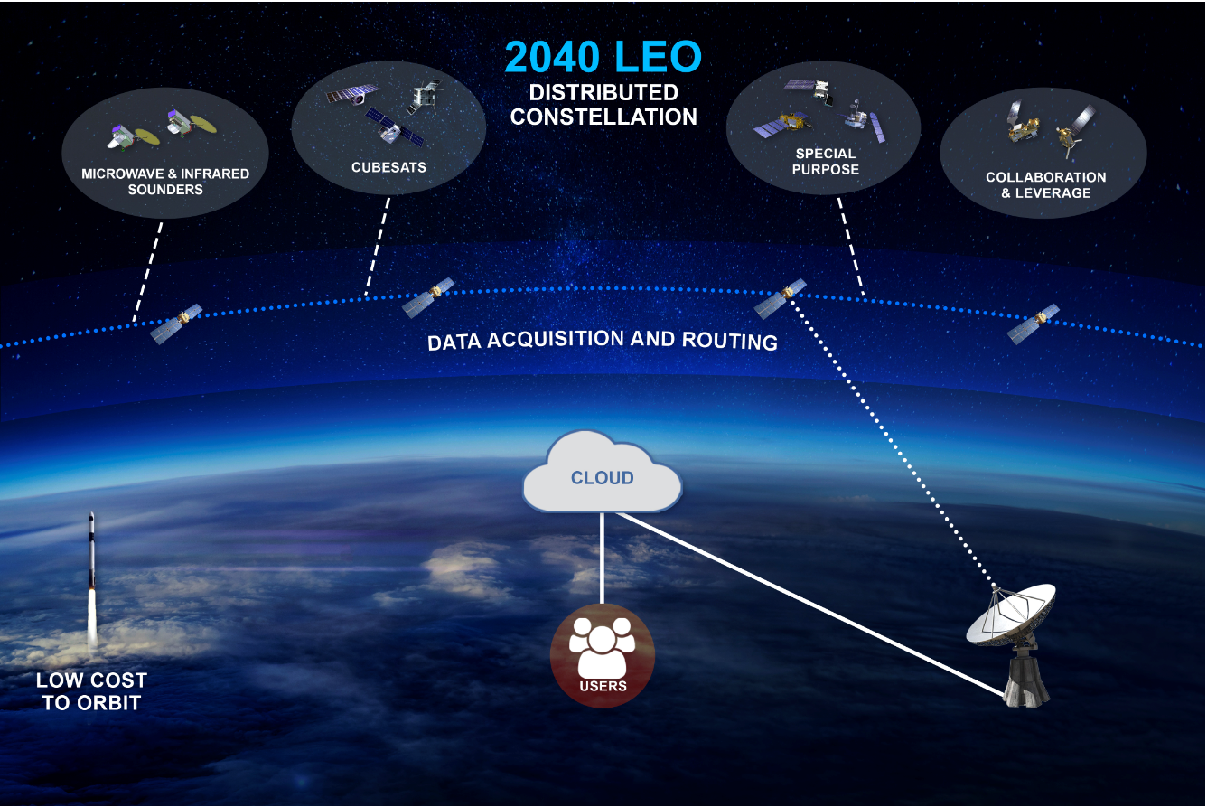
2040 LEO Vision
Sample System capabilities needed to accomplish this:
Rapid on-orbit asset replenishment, ATP to launch in ~3 years
Quality instruments calibrated and validated to meet mission science
Flexible ground system(s) to add or delete assets with little modifications
Common algorithms for similar measurements, to allow for evolution and continuous improvement

Slide 5
Joint Venture Co-Investments
Joint Venture Program is co-investing in technology development by government agencies and industry. For example, we are considering SPIR Phase III contracts with new space companies, as well as CRADA* and OTA* contracts
JV program has identified ~20 projects for FY 2022 Tech Exploitation
JV will also exploit observations made by other government agency satellites
These are generally high risk / high return and small dollar investments
Example: EPIC/Athena Partnership
Partnership between NASA, SSC, and NESDIS to implement an innovative and unique small-sat mission
NESDIS team will observe and learn COTS approach to satellite integration and test
NASA Langley provides Athena radiation balance test payload and seed funding
Space Force SSC provides contract with innovative NovaWurks sat-let vendor and STP launch
*CRADA = Cooperative Research And Development Agreement
*OTA = Other Transactional Authority

Slide 6
NESDIS Commercial Data Program (CDP)
Commercial Data Exploration
Issued a “Request for Information” (RFI) to general space community to determine industry capability to provide operational quality terrestrial weather (in 2016, 2018, 2020) and space weather (2020, 2021) observations.
Conducted pilot procurements for terrestrial weather candidates
Will continue to conduct additional RFI market research calls annually
Commercial Data Exploitation (for terrestrial weather only at this time)
Awarded IDIQ (indefinite delivery/indefinite quantity) contracts to two small companies to provide Radio Occultation observations for use in NOAA weather and space weather operations.
Currently executing our 4th delivery order (DO-4); purchasing 6000 RO observations per day over a six month duration
NOAA’s Commercial Weather Data Operational Buy IDIQ contract includes a range of options for data sharing license options ranging from unlimited rights to distribution to NOAA only.
The data sharing license for DO-4 allows NESDIS to share the near-real time data with US Government Agencies, international WMO meteorology and hydrology centers, and CGMS partners for non-commercial use only.
After 24 hours, NESDIS can distribute all data to any entity with no restriction on use or further distribution

