Slide 1
Update on Aquatic Carbon
Marie-Helene RIO, ESA
Ewa Kwiatkowska, EUMETSAT
Conference Agenda Item 5.2
SIT-37
Virtual Meeting
29-31 March 2022

Slide 2
OCR-VC contribution to the CEOS 2020-2022 Workplan
CEOS GHG (Green House Gas ) Roadmap
CEOS AFOLU (Agriculture, Forestry and Other Land Uses) Roadmap
CEOS Aquatic Carbon Roadmap ?
CEOS Global Stocktake strategy paper
-> demonstrate the value of Earth Observation satellite datasets to support the Global Stocktake process

Slide 3
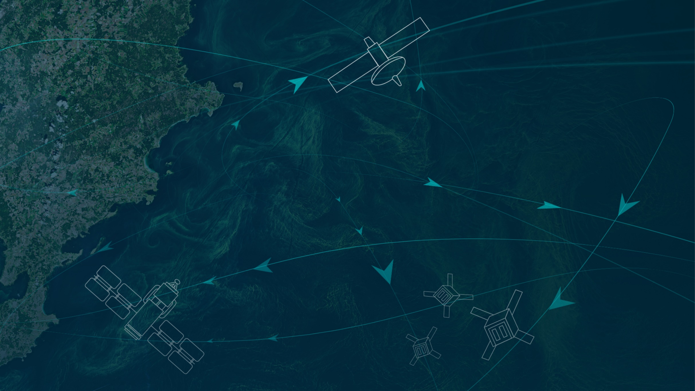
https://oceancarbonfromspace2022.esa.int/

Slide 4
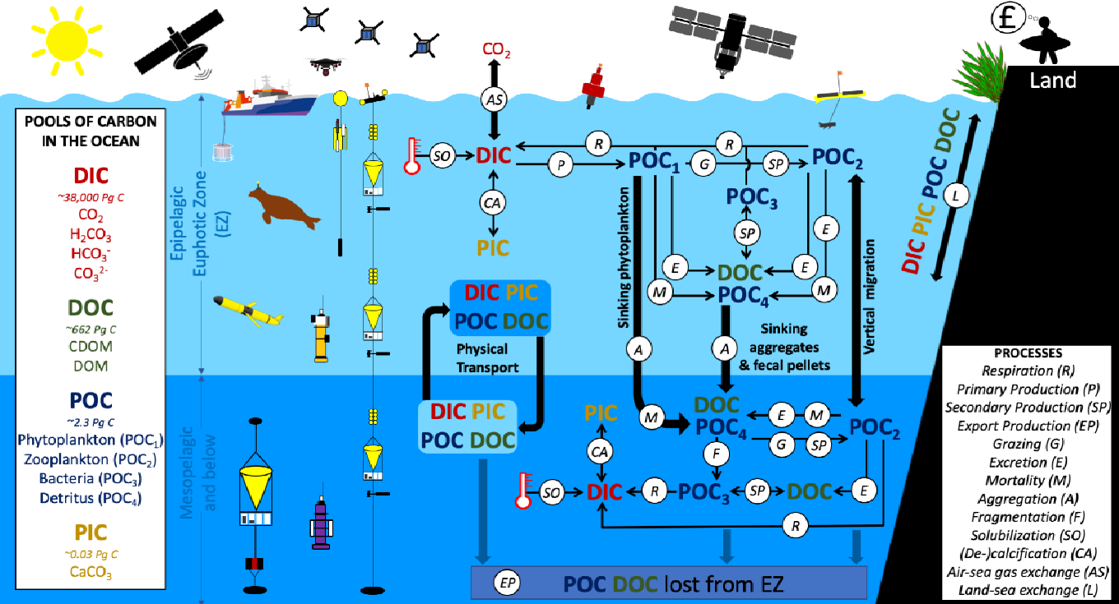
Pools, fluxes and processes that form the ocean solubility and biological carbon pump
From Brewin et al, 2021. Sensing the ocean biological carbon pump from space: A review of capabilities, concepts, research gaps and future developments, Earth-Science Reviews 217 (2021) 103604.
*BICEP= Biological Pump and Carbon Exchange Processes

Slide 5
Ocean Carbon From Space 2022 Workshop
Community white paper gathering the workshop’s outcome and recommendations to be published in Aquatic Carbon From Space Earth Science Reviews special issue.

Slide 6
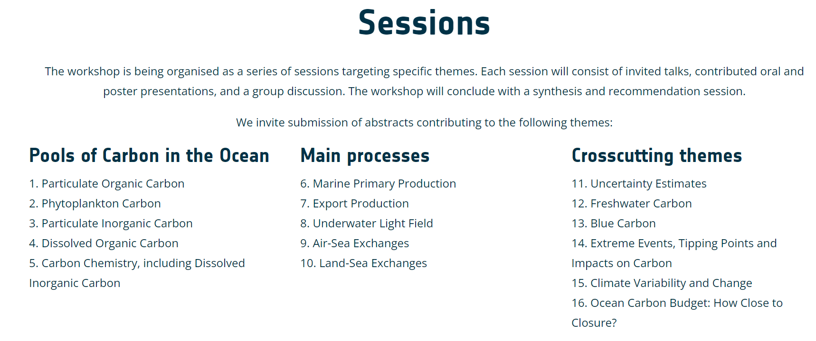
Ocean Carbon From Space 2022 Workshop
100 abstracts submitted

Slide 8
https://padlet.com/JavierAlonsoConcha/OceanCarbonFromSpace

Slide 9
The Workshop in Numbers
Gender Distribution
Prepared by: Javier Alonso Concha and Sabrina Lodadio

Slide 10
Workshop Outcomes
All presentations and posters are available on the workshop website, together with the synthesis, by every chairs of their session’s discussion outcomes.
https://oceancarbonfromspace2022.esa.int/
Challenges
Gap
Opportunities

Slide 11
Next steps
Community white paper gathering the workshop’s outcome and recommendations
To be published in the upcoming Earth System Reviews Aquatic Carbon From Space Special Issue (to be submitted in May 2022) <-> VC-20-24

Slide 12
Community white paper outline
1- Introduction
2- Workshop details and approach to capture collective view of the status of the field
3- Session-specific theme outcomes
In the following sections, we begin by providing a brief description of each session-specific themes, briefly highlight the current state of the art, then focus on a number of priorities for which scientific challenges, gaps and opportunities are identified, to be targeted over the next decade.
3.1 Particulate Organic Carbon (POC)
3.2 Phytoplankton Carbon (C-phyto)
3.3 Phytoplankton and Primary Production
3.4 Dissolved Organic Carbon (DOC)
3.5 Dissolved Inorganic Carbon (DIC)
3.6 Particulate Inorganic Carbon (PIC)
3.7 Fluxes at the Ocean Interface
3.8 Cross-cutting activities: Blue Carbon
3.9 Cross-cutting activities: Extreme Events
3.10 Cross-cutting activities: Carbon Budget Closure
4- Common outcomes
5- Emerging concerns and broader thoughts
6- Summary
3.1.1 State of the art in POC
3.1.2 POC Priority 1: In situ POC measurement methodology
Challenges, Gaps, Opportunities
3.1.3 POC Priority 2: In situ data compilation
Challenges, Gaps, Opportunities
3.1.4 POC Priority 3: Satellite retrieval of POC
Challenges, Gaps, Opportunities
3.1.5 POC Priority 4: Partitioning of POC into components
Challenges, Gaps, Opportunities
3.1.6 POC Priority 5: Vertical Profiles of POC
Challenges, Gaps, Opportunities
3.1.7 POC Priority 6: Biogeochemical processes and the biological carbon pump
Challenges, Gaps, Opportunities

Slide 13
Workshop Outcomes: Challenges
Limitations of algorithms retrieval and validation in coastal/shelf sea environments/optically complex waters
Understanding uncertainty budget including propagation from satellite and in-situ observations to L3/L4 products
Linking surface satellite measurements to vertical distribution. High frequency and high spatial resolution satellite observation coupled with in-situ underwater measurement of time and place matching
Capturing the high spatial and temporal variability, in particular in coastal areas, including diurnal or sub-diurnal processes with temporal resolution of current sensors
Using coupled physical/BGC/Carbonate ecosystem models combined with Satellite/in situ data to better study the ocean biological pump.
…
Better understand differences between models and observations
Better understand the different sensing depths between remote sensing and in-situ data
Bridging spatial and temporal scales between satellite data, in situ observations and models
Improve Predictability
Reduce the (Ocean) Carbon Community Carbon footprint
…

Slide 14
Workshop Outcomes: Gaps
Lack of high quality in-situ data (coastal, at depth, high latitudes, under-ice, seasonal gaps, higher spatial and temporal resolution) for validating and improving satellite products
Need for standardisation of methods, good reporting of protocols used in measuring the in-situ data in current data repositories
Need for higher spatial and temporal resolution products
Need for higher spectral resolution of satellite measurements
Need for consistent Open Ocean – Coastal – Land products
Need for Long-term consistency of satellite records (->Recommendation to continue the ESA CCI program, designed to fulfil this need) and biogeochemical data products
Need for better connecting biology and physics
Lack of Pixel-by-pixel uncertainty in satellite products / Flagging
…
Lack of integrative and systematic observations in both physical and biogeochemical parameters;
Need for improved upper-ocean dynamics/high resolution coastal circulation models
Improve connection between the communities
Need for better atmospheric corrections in nearshore/coastal waters
Need for enhanced observation-based model development/ Data assimilation /Nesting approaches
…

Slide 15
Workshop Outcomes: Opportunities
Upcoming sensors with improved spectral range/resolutions (UV, hyperspectral) and temporal resolutions (geostationary): PACE (2024) and GLIMR (2027), EnMAP (DESIS, PRISMA), ESA Fluorescence Explorer (FLEX, 2023), S-4 UV/Visible/Near-infrared Geostationary over European waters (2022), S-5 (2024), S2-Next Generation, Copernicus Hyperspectral Imaging Mission for the Environment (CHIME, 2030),
Lidars (Aeolus, EarthCare (2023))
Upcoming Wide-Swath altimetry SWOT (2022)
New in-situ platforms (Ferrybox, coastal Argo floats,…)
Further exploit synergies between sensors (in-situ, satellites), multi-platform approach
Exploitation of existing satellites to further understand the interactions between the different components of the Earth System
Use of models to perform Observing System Simulation Experiments (OSSE), to evaluate the impact of undersampled observing systems on obtained results, or evaluate the value of new observing systems / design optimal sampling strategies
…
Further leverage on AI/ML methods (But: in a changing climate, validity of the approach for future projection when based on training dataset at a given time period)
Intercalibration and intercomparison exercise with goal of establishing standard measuring protocols for key parameters
Use existing capability to demonstrate capability/prepare exploitation of future missions (GOCI, GOCI II, PRISMA,…)
…

Slide 16
Action resulting from this Agenda Item
Development by OCR-VC of the Aquatic Carbon Roadmap in the time frame of next 2-3 years
- Summarize what is known right now about the Aquatic Carbon and its role in the global carbon cycle,
- Identify which variables can be provided in the context of global integrated carbon monitoring,
- Provide a roadmap towards filling the main knowledge gaps, focusing on a few major gaps to which all agencies can contribute.
Slide ‹#›

