Slide 1
AC-VC Atmospheric Composition Virtual Constellation Whitepaper: “Monitoring Surface PM2.5: An International Constellation Approach to Enhancing the Role of Satellite Observations” B. Veihelmann, ESA, AC-VC Co-Chair S. Kondragunta, NOAA, AC-VC Topical Lead AQ Aerosol
Conference Agenda Item 5.3
SIT-37
Virtual Meeting
29-31 March 2022

Slide 2
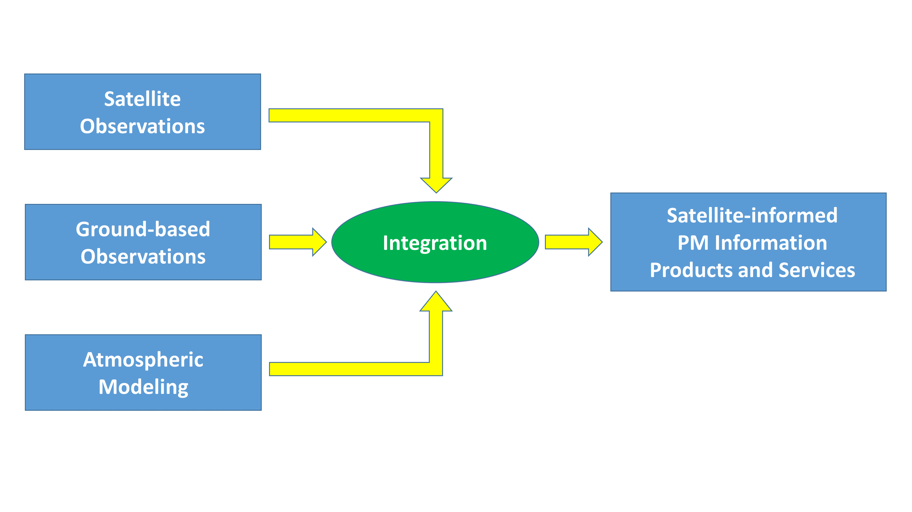
Purpose
Objective: Strengthen the role of satellite missions with aerosol observation capabilities in monitoring particulate pollution of air
Room for improvement
Collaborative constellation approach
Not covered by other inter-agency coordinating groups
AC-VC gathered experts on
aerosol observations
air quality modelling
Whitepaper with actionable recommendations

Slide 3
White Paper
Title: “Monitoring Surface PM2.5: An International Constellation Approach to Enhancing the Role of Satellite Observations”
Authors: 35 from academia and space agencies, led by S. Kondragunta (NOAA) and B. Veihelmann (ESA)
Executive Summary (1/2 page)
Recommendations (1 page)
Detailed discussion: status, needs, best practices
Satellite sensors that bring PM information
Satellite products and consistency
Approaches to constrain particulate pollution levels
Validation
References
Appendices

Slide 4
Recommendations
Exploit NRT information from meteorological imagers
Exploit information from multi-angle polarimetric imagers
Exploit vertical information from spectrometers
Develop synergetic aerosol retrievals from multiple sensors
Enhance consistency of aerosol products (→ AEROSAT)
Enhance radiometric consistency of space-borne sensors (→ GSICS)
Develop fast forward operators for assimilation of satellite observations
Improve consistency of aerosol representation in models and satellite products
Improve uncertainty estimates in satellite aerosol products,
Improve aerosol models Level-2 assimilation schemes (→ AEROCOM)
Develop schemes for assimilation of Level-1 satellite data
Develop data processing tools incl. machine learning
Create ground-based validation supersites with comprehensive sets of sensors
Enhance ground-based observation infrastructure including low-cost PM sensors
Facilitate data access
Satellite Products
Interface with Model
Validation

Slide 5
Way Forward
Provide WP to CEOS for discussion and review at SIT Technical Workshop (Sep 2022)
Present WP at CEOS Plenary Meeting for endorsement (Nov/Dec 2022)

