Slide 1
Oceans and Coasts
Session 6
CEOS SIT-37
Virtual Meeting
29-31 March 2022

Slide 2
Session Overview
Session 6
CEOS SIT-37
Virtual Meeting
29-31 March 2022

Slide 3
Session Agenda
6.1 Oceans Coordination Team [10 mins]
Potential CEOS level actions
Next Steps
6.2 Update on Contributions to the UN Decade [CEOS-COAST:5 mins, COVERAGE: 5 mins]

Slide 4
Oceans Coordination Team
Ivan Petiteville, SIT Chair Team Agenda item 6.1
CEOS SIT-37
Virtual Meeting
29-31 March 2022

Slide 5
Oceans: Many Actors …
External Key Stakeholders and activities include:
GOOS (Global Ocean Observing System), IOC (Intergovernmental Oceanographic Commission of UNESCO)
UN Decade of Ocean Science for Sustainable Development (2021-2030)
UNFCCC: New ocean and climate change dialogue in SBSTA
UNFCCC: CEOS’ support to Global Stocktake (incl. recommendation / action related to ocean)
Sustainable Development Goals Stakeholders incl. SDG 14 "Life below water"
GEO Blue Planet
Thematic groups: GHRSST, IOCCG, IOVWST, OSTST, …
Key CEOS internal groups dealing with oceans include (but not limited to):
Ocean VCs: Ocean Colour Radiometry (ORC), Sea Surface Temperature (SST), Ocean Surface Topography (OST), Ocean Surface Vector Winds (OSVW)
COVERAGE & COAST
WGCV
Several Users & Initiatives with different requirements. Which ones should be addressed first by space community ?
Several CEOS activities run independently. Need for prioritising & coordinating ?

Slide 6
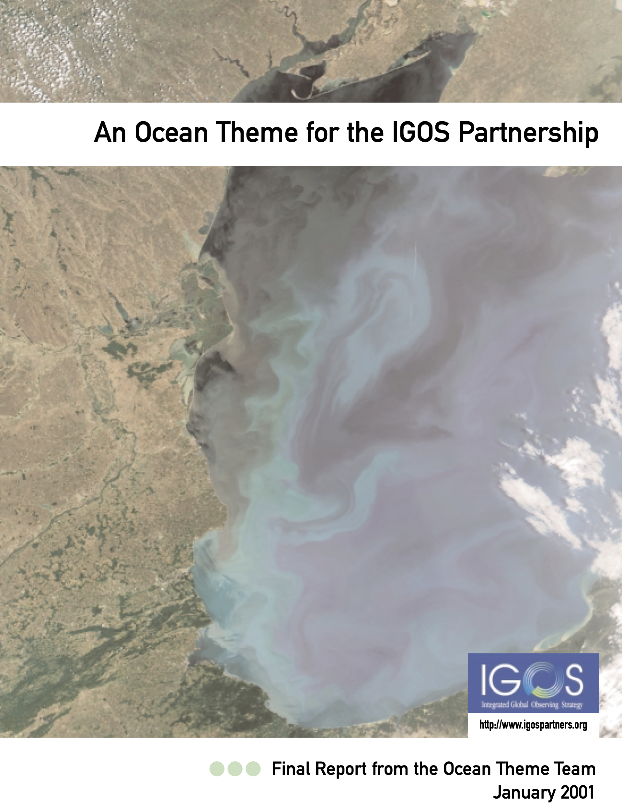
Oceans: Way Forward …
Prerequisite is clear user need and counterpart(s)?
IGOS report on Ocean (2001): “Crucial lesson was for the key user
bodies to engage and coordinate the definition of requirements”
How can CEOS respond to the IOC Decade of the Oceans?
How can CEOS align to SDGs and statistical office needs? Others ?
Options moving forward include:
Better coordination and linking of existing activities?
Identifying new opportunities wrt Key External Stakeholders?
Ocean-related activities across both CEOS and externally would benefit from a strong coordination & collaboration.
Create a Small Working Team to scope options for improved coordination and communication of the full range of CEOS ocean-related activities and groups. Oversight by SIT Chair team.

Slide 7
Ocean Coordination Team
18 Members:
COAST: Paul DiGiacomo (NOAA), Ludovic Brucker (NOAA)
COVERAGE: Jorge Vazquez (NASA/JPL)
OCR-VC: Laura Lorenzoni (NASA), Carolina Tauro (CONAE)
OST-VC: Estelle Obligis (EUMETSAT), Annick Sylvestre-Baron (CNES)
OSVW-VC: Stefanie Linow (EUMETSAT), Paul Chang (NOAA), Raj Kumar (ISRO)
SST-VC: Ed Armstrong (NASA/JPL), Christo Whittle (CSIR)
WGClimate: Albrecht von Bargen (DLR), Jeff Privette (NOAA),
WGCV: Philippe Goryl (ESA),
CEO: Marie-Claire Greening
SIT Chair Team: Ivan Petiteville (ESA), George Dyke (Symbios)
First meeting on 9 March, 10 participants. Next meeting after SIT-37.

Slide 8
Next steps ?
Each CEOS group to fill a questionnaire to list the main activities of the group, indicating:
The added value for CEOS
Who are the beneficiaries (external or internal to CEOS)
The general context of each activity (e.g. GEO Blue Planet or CEOS Support to GST,..)
Each group to identify the main external stakeholders and initiatives to serve in priority.
Priority schema based on a list of metrics (to be defined)
Next two months
The “CEOS Ocean Coordination Group” to collectively identify the commonalities, synergies and gaps , and agree on set of priorities for CEOS 🡪 Issue a Study report with Findings & Recommendations
CEOS Plenary

Slide 9
Update on Contributions to the UN Decade
Paul M. DiGiacomo, CEOS-COAST & Vardis Tsontos and Jorge Vazquez, COVERAGE Agenda item 6.2
CEOS SIT-37
Virtual Meeting
29-31 March 2022

