Slide 1
WGClimate Update
Agenda item 2.8
J. Privette, NOAA
W. Su, NASA
SIT-38, ESA/ESRIN
28-30 March 2023

Slide 2
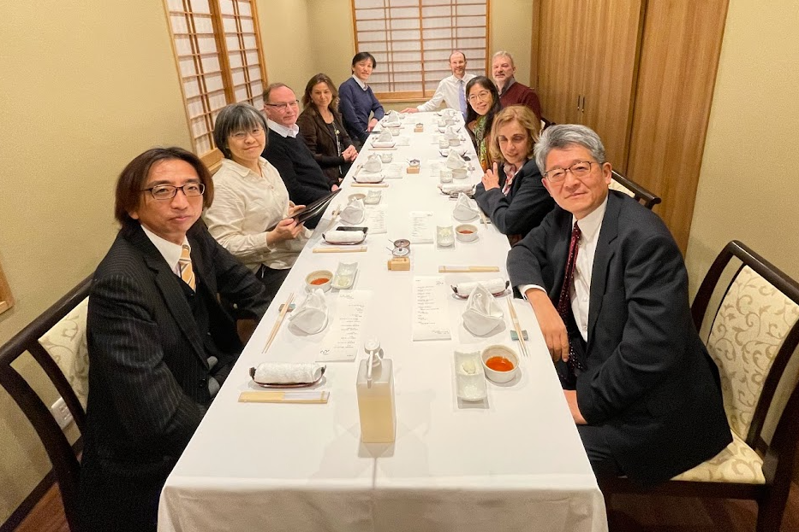
Outcomes from WGClimate-18
JAXA kindly hosted WGClimate-18 in Tokyo (28 Feb–2 Mar 2023)
Focus: 2023 Work Plan
Prioritize initiatives, tasks, opportunities
Staffing activities, partnerships
Top 2023 Priorities
Space Agency Response to GCOS Implementation Plan (2022)
Release Gap Analysis Report (v3/4.1)
Update Coordinated Action Plan (© 2016)
ECV Inventory update and restructuring
Statement for UNFCCC COP-28
Contributions to Earth Information Day

Slide 3
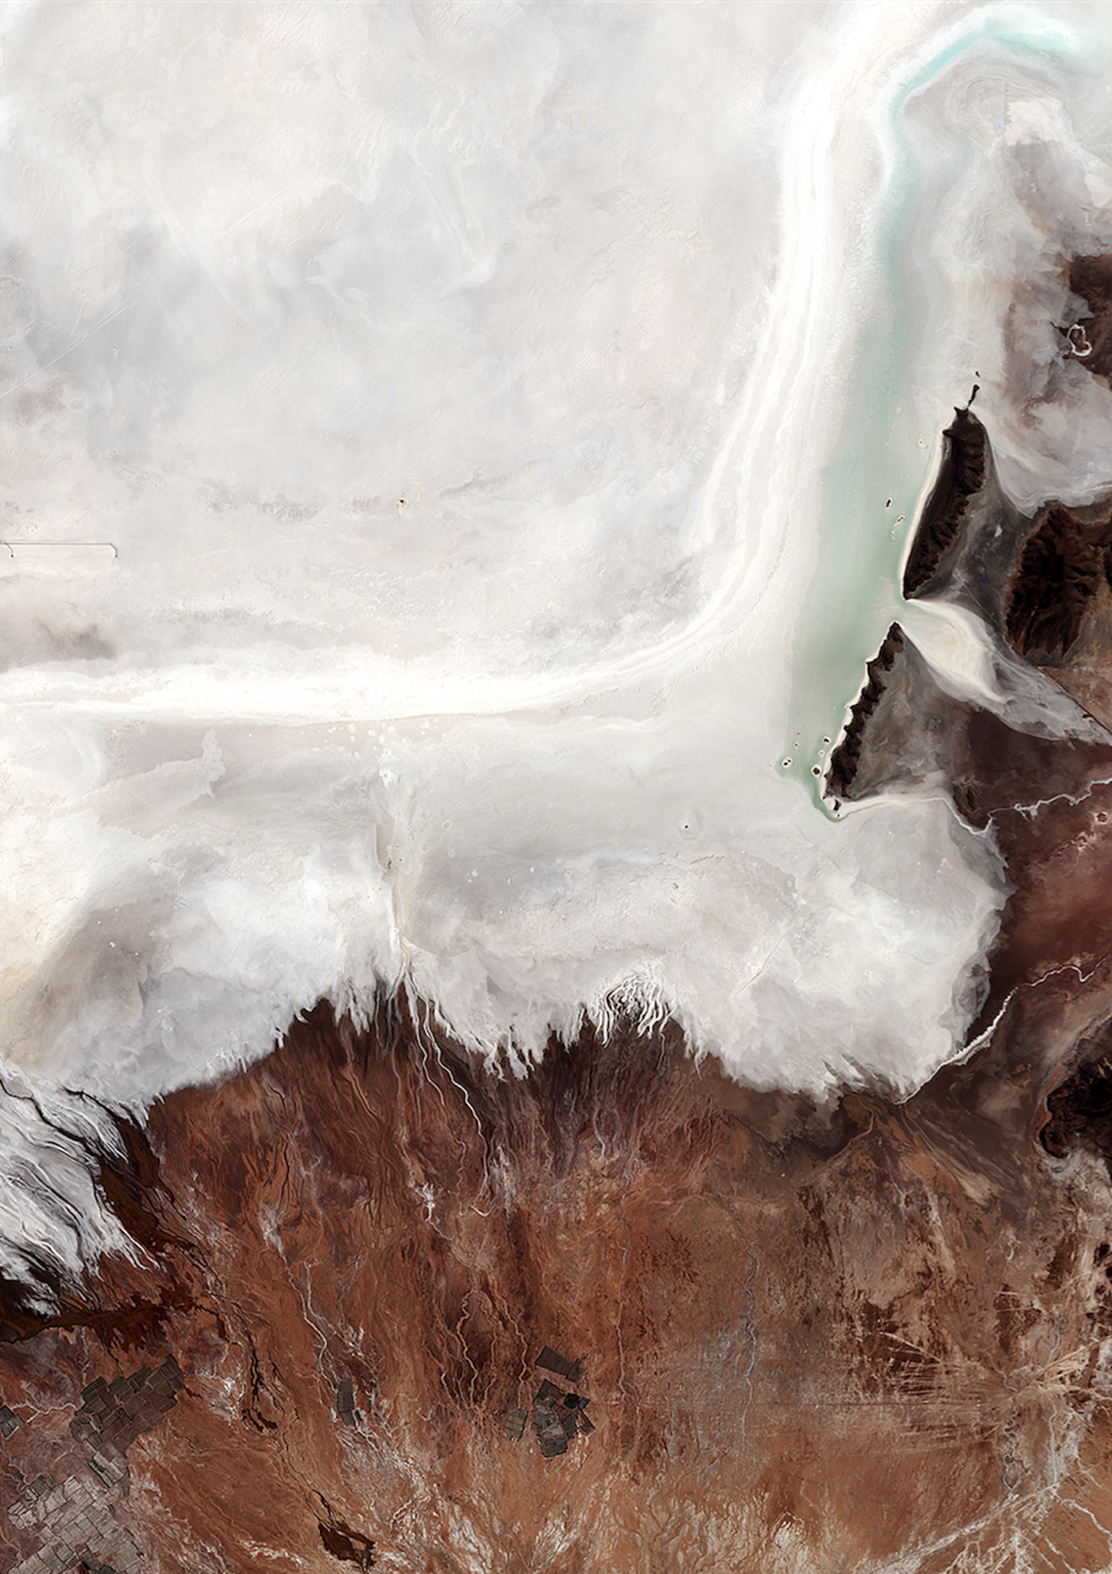
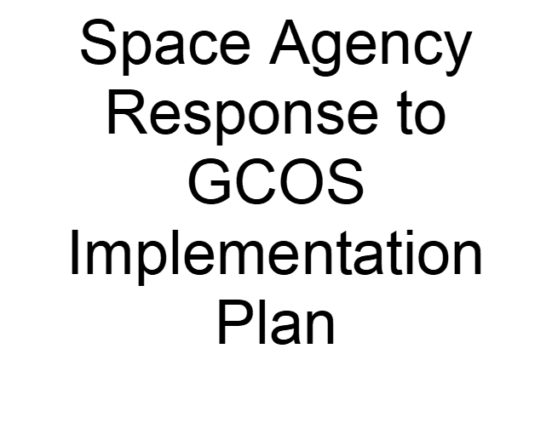
New Response Approach to GCOS IP (2022)
Last version: 2017 Response to 2016 GCOS IP
Initiated routine coordination with GCOS leadership
New Response approach
Goal: More responsive, timely and balanced in workload
Expert teams co-develop responses with GCOS Panel experts
Stagger start dates and delivery schedule as appropriate
Identified leads for each relevant GCOS Action
Virtual kick-off event in mid-April
Currently prioritizing Actions per space agency activities
© 2017

Slide 4
ECV Inventory Update and Restructuring, 1/2
Critical review conducted
Costs include development, support, updates, oversight, agencies, experts
Inventory grew much larger than first anticipated (200 🡪 2000)
Conclusions
Unique compendium serves many roles
Links CDRs to instruments and space architecture
Agency planning, responding to GCOS, UNFCCC, GEO
Searchable library for users, researchers, developers, modelers, agencies
Provides “state of the system” snapshot – e.g., evaluating Global Stocktake readiness
Challenge to maintain, update Inventory, and conduct gap analyses
EC / EUMETSAT provide active development and support team
Requires iterative training and hand-holding with CDR providers: slow
Gap analyses requires effort from limited pool of domain experts: fatigue
Full potential not yet realized for users/uses outside of WGClimate

Slide 5
ECV Inventory Update and Restructuring, 2/2
Path forward
Release Version 5 in 2023 by adding ~45 already-submitted records
Revamp ECV processes and infrastructure based on lessons-learned
Reconsider its users and uses
Develop simpler access and discoverability-focused public-facing front end
Reduce complexity
Keep fields required to meet known needs
Minimize fields whose content changes more often
Send (link) users to providers for details
Decrease burden on providers to (re-)learn definitions, tools, useful inputs
Inventory Support Team will take greater role in the submission, update processes
Submitters will provide only most basic information, Support Team combs accessible information to develop draft record, Submitter completes/validates final record
Work with WMO/OSCAR team to modify API to meet our Gap our needs

Slide 6
Statement to UNFCCC COP-28
Helpful discussions with UNFCCC/SBSTA (Jo Post) in October
Better understanding of COP processes, negotiations, drafting steps
Late adjustments to COP-27 EID posters advocating observation network
Role: Advocate Agencies’ observation needs and findings
Statement to SBSTA
Earth Information Day materials
Jo Post moved to a new position, replacement not yet named
WGClimate will coordinate messaging with new lead once seated

Slide 7
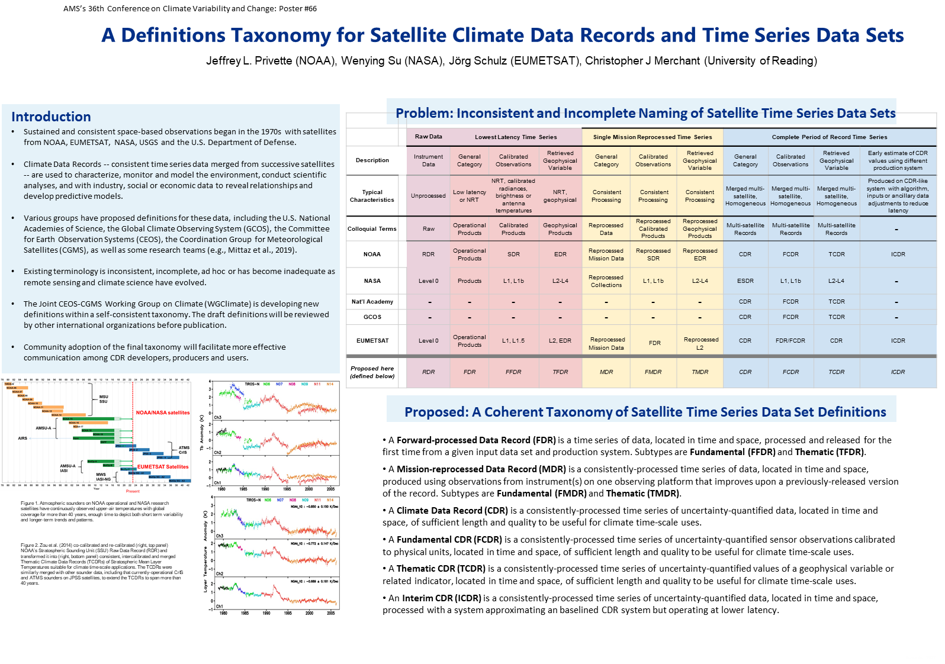
Recent Advocacy: COP-27, AMS

Slide 8
WGClimate-18: Other developments
GEO seeking WGClimate collaboration on many specific events
Space for Climate Observations (SCO) may partner on CDR Use Cases
CEOS Precipitation VC provided helpful review of precipitation CDRs
WGClimate will seek additional reviews via VCs, GEWEX, etc.
Issue
More invitations and activities to support than active membership allows
Unable to further support NewSpace, CEOS ARD and Oceans Coordination presently
Request to agencies
Consider naming representative to WGClimate if none currently exists
Offer additional support to WGClimate tasks (e.g., IP Response, Gap Analysis)

Slide 9
CDR Use Cases Update
Purpose
Show CDR end-value to stakeholders, public
Show links from observations to societal benefit
Support capacity development
Background
Latest effort began in 2020
Builds on original collection in 2015
Current status
22 received
15 published online

Slide 10
CDR Use Cases Update
Purpose
Show CDR end-value to stakeholders, public
Show links from observations to societal benefit
Support capacity development
Background
Latest effort began in 2020
Builds on original collection in 2015
Current status
22 received
15 published online

Slide 11
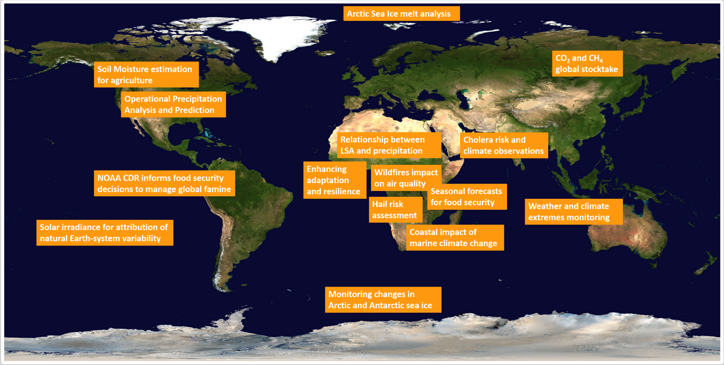
Use Cases Geographical Distribution
http://climatemonitoring.info

Slide 12
Use Cases: Next Steps
Engage other organizations (e.g., GEO, ECMWF CAMS, GFCS, SCO, IMEO)
Seek contributions or link existing Use Case portfolios
Request to agencies
Continue contributing Use Cases that leverage CDRs from ECV Inventory
Special call out to VCs and Working Groups
Stand ready to assist with reviewing submitted cases

Slide 13
2023 Top-line Schedule
January
February
GHG TT meeting
WGClimate-18
March
CEOS SIT-38
April
CGMS WG II
Kickoff: Response to GCOS IP*
May
June
CGMS-51
August
COP-28 Statement
September
October
WGClimate-19
SIT Technical Workshop
November
CEOS-37 Plenary
COP Earth Information Day
December
* Dates for Responses to GCOS IP Actions will vary

Slide 14
Thank You

