Slide 1
CEOS 2024-2026 Work Plan
Steven Ramage
CEOS Executive Office
Agenda Item 1.3
SIT-39 Tokyo, Japan
9 - 11 April 2024

Slide 2
Governance & Work Planning
Four key governing documents primarily guide the work of CEOS:
CEOS Terms of Reference defines the mission and scope of CEOS activities
CEOS Strategic Guidance document articulates the overarching long-term (7-10 years) purpose and goals of CEOS
CEOS Governance and Processes document provides guidelines on the structure, operations, and processes CEOS employs to achieve its goals
CEOS Work Plan (3-year rolling) sets forth near-term actions to achieve the goals outlined in the CEOS Strategic Guidance document
The CEOS Executive Office is the custodian of all CEOS Governing Documents, including the annual update of the 3-year CEOS Work Plan and the definition and monitoring of the deliverables it informs.

Slide 3
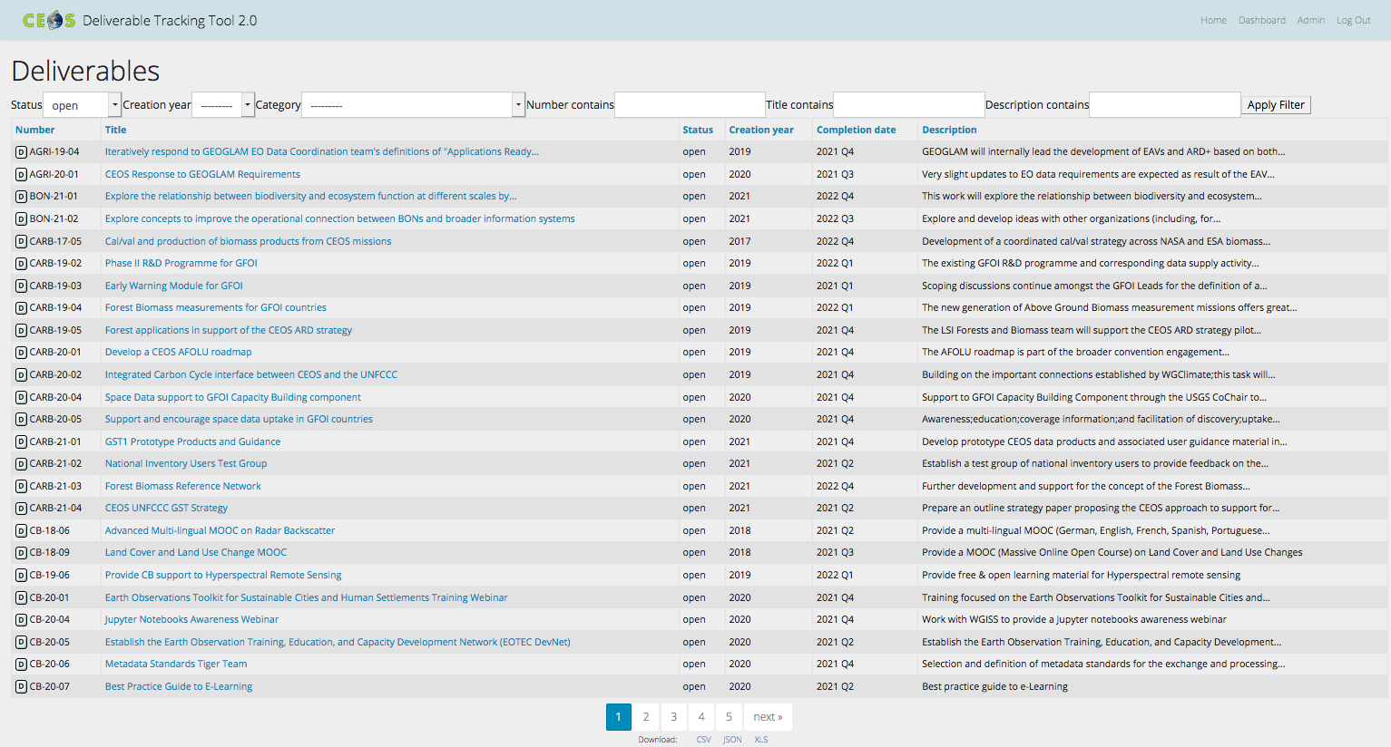
CEOS Work Plan
The 3-year work plan is updated by all CEOS entities every year and put forward for formal endorsement at the SIT in April. Rigorous work planning, execution, and monitoring are critical to the credibility of CEOS.
Jan
Dec
Feb
Nov
Mar
Plenary
Oct
SIT
Apr
Sep
May
SIT TW
Aug
Jun
Jul
Detailed work defined as deliverables: outlined in the WP, reconciled and tracked in the CEOS deliverable tracking tool

Slide 4
CEOS Work Plan Structure
 | Chapter in Work Plan | Responsible
1 | Climate Monitoring, Research, and Services | WGClimate
2 | Carbon Observations in Support of Climate Science and Policy | GHG Task Team, GFOI, AFOLU
3 | Observations in Support of the Global Stocktake of the UNFCCC | UNFCCC
4 | Observations for Agriculture | GEOGLAM, AFOLU
5 | Observations for Disasters | WGDisasters
6 | Observations for Water | WGISS, GEO AquaWatch & others
7 | Data Quality | WGCV
8 | Capacity Building and Data Democracy | WGCapD
9 | Data Discovery, Access, Preservation, Usability and Exploitation: approaches, systems, tools and technologies | WGISS
10 | Advancement of the CEOS Virtual Constellations | VCs, ARD Oversight Group
11 | Observations in support of the United Nations Sustainable Development Goals | SDG Coordination Group, EETT
12 | Support to Other Key Stakeholder Initiatives | SDG Coordination Group, COAST AHT, UN SDGs, GEOBON, GEO Blue Planet, MBON
13 | CEOS Services

Slide 5
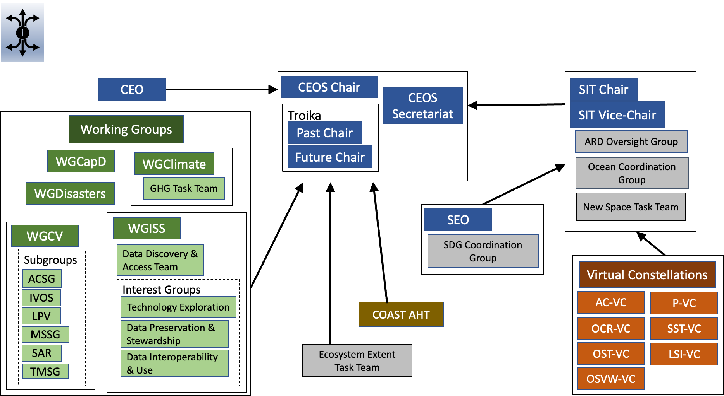

Slide 6
2024 Progress
Chapter |  | Closed from 2023-25 WP | Carried over from 2023-25 WP | New for 2024-26 WP
1 | Climate Monitoring, Research, and Services | 6 | 2 | 7
2 | Carbon Observations in Support of Climate Science and Policy | 6 | 10 | 5
3 | Observations in Support of the Global Stocktake of the UNFCCC | 3 | 9 | 0
4 | Observations for Agriculture | 1 | 2 | 0
5 | Observations for Disasters | 3 | 6 | 5
6 | Observations for Water | - | - | -
7 | Data Quality | 0 | 12 | 4
8 | Capacity Building and Data Democracy | 6 | 13 | 3
9 | Data Discovery, Access, Preservation, Usability and Exploitation: approaches, systems, tools and technologies | 4 | 3 | 3
10 | Advancement of the CEOS Virtual Constellations | 0 | 19 | 3
11 | Observations in support of the United Nations Sustainable Development Goals | 0 | 0 | 7
12 | Support to Other Key Stakeholder Initiatives | 10 | 1 | 4
 | Totals | 39 | 77 | 41

Slide 7
Current deliverable deadlines
Chapter |  | 2023 | 2024 | 2025 & beyond
1 | Climate Monitoring, Research, and Services | 0 | 5 | 2
2 | Carbon Observations in Support of Climate Science and Policy | 0 | 2 | 3
3 | Observations in Support of the Global Stocktake of the UNFCCC | 4 | 1 | 0
4 | Observations for Agriculture | 0 | 2 | 0
5 | Observations for Disasters | 0 | 1 | 4
6 | Observations for Water | - | - | -
7 | Data Quality | 0 | 7 | 5
8 | Capacity Building and Data Democracy | 13 | 2 | 1
9 | Data Discovery, Access, Preservation, Usability and Exploitation: approaches, systems, tools and technologies | 0 | 3 | 3
10 | Advancement of the CEOS Virtual Constellations | 4 | 9 | 11
11 | Observations in support of the United Nations Sustainable Development Goals | 0 | 7 | 0
12 | Support to Other Key Stakeholder Initiatives | 0 | 5 | 2
 | Totals | 21 | 43 | 31

Slide 8
CEOS Work Plan links to SIT-39
 | Chapter in Work Plan | SIT-39 Session links
1 | Climate Monitoring, Research, and Services | 1,4
2 | Carbon Observations in Support of Climate Science and Policy | 1,4,8
3 | Observations in Support of the Global Stocktake of the UNFCCC | 1,2,4
4 | Observations for Agriculture | 1,2,3
5 | Observations for Disasters | 1,8
6 | Observations for Water | 1,8
7 | Data Quality | 1,8
8 | Capacity Building and Data Democracy | 1,8,3
9 | Data Discovery, Access, Preservation, Usability and Exploitation: approaches, systems, tools and technologies | 1,8
10 | Advancement of the CEOS Virtual Constellations | 1,3,6,2,5
11 | Observations in support of the United Nations Sustainable Development Goals | 1,8
12 | Support to Other Key Stakeholder Initiatives | 1,3,6

Slide 9
Linkages
Essential Variables
Essential Agriculture Variables
Essential Biodiversity Variables
Essential Climate Variables
Essential Land Variables
Essential Ocean Variables
Essential Water Variables

Slide 10
Linkages
New Space
LSI VC (ARD)
SDGs
Future demonstrator on VHR data for islands
SEO
Integrate New Space into CEOS Analytics Lab
WGClimate
GHG product development and standards setting
WGCV
Participation in VH-RODA and JACIE workshops

Slide 11
Linkages
WGISS Interoperability Framework
Interoperability Handbook 2.0
Best practice guidance for Jupyter Notebooks
AI/ML for EO research/apps white paper
Increase cross-cutting nature of activities

Slide 12
Linkages
Pilots and demonstrators
Flood pilot
Ecosystem extent demonstrators
Landslide demonstrator
Preparedness pilot (Tonga)
Wildfire pilot

Slide 13
Linkages
Roadmaps and strategies
AFOLU Roadmap
Aquatic Carbon Roadmap
GHG Roadmap
WGCV Roadmap for operational TIRCalNet
ARD Strategy
Communication Strategy
Notes:
For example under deliverable: CARB-24-05
Create a governance to collaborate across GHG, AFOLU and aquatic carbon roadmap activities
Projected completion: 2024 Q4
Across numerous CEOS entities: WGClimate GHG Task Team LSI-VC Forests Team OCR-VC SIT Chair

Slide 14
Thanks for all contributions
Steven Ramage
CEOS Executive Office
Agenda Item 1.3
SIT-39, Tokyo, Japan
9 - 11 April 2024

