Slide 1
AFOLU Roadmap Actions & Status
Ben Poulter
Osamu Ochiai
Frank-Martin Seifert
LSI-VC Forest&Biomass SG
Agenda Item 2.3
SIT-39 2024, Tokyo, Japan
10th - 11th April 2024

Slide 2
AFOLU Roadmap
A framework for long-term coordination of agency programmes in support of the needs of society for Agriculture, Forestry and Other Land Use (AFOLU)-related information, with a particular focus on the needs and ambition cycle of the Global Stocktake of the 2015 Paris Climate Agreement.
A guiding vision for long-term space agency coordination around AFOLU.
An effective means for communicating the intentions of CEOS
Address basic observation continuity and necessary agency coordination to achieve goals of sustained land-imaging of land-use and land cover change and biomass estimates

Slide 3
AFOLU Roadmap - Status
AFOLU Roadmap approved by CEOS Plenary Nov 2023
Remaining task to develop a suite of actions deriving from the 7 Recommendations of the Roadmap (Plus a Recommendation 0 – ensuring data access)
High level initial actions are set out in slides below

Slide 4
4 thematic AFOLU teams
Above-Ground Biomass (AGB) - Laura Duncanson/Neha Hunka
Land Cover (LC) - Martin Herold
Wetlands and Mangroves - Ake Rosenqvist/Richard Lucas
Agriculture (supported through GEO-GLAM)

Slide 5
Classes of actions
Actions across all Recommendations broadly fall into three categories:
Those pertaining to presently available data to support AFOLU procedures as in the 2006 IPCC Guidelines for National GHG Inventories vol.4, and their 2019 Refinement.
Actions to develop new or improved products that would allow more accurate and/or easier implementation of the Guidelines
Actions to facilitate greater interaction with the GHG Roadmap and hence improve characterisation of land management emissions through MVS based on satellite-based atmospheric inversions.

Slide 6
Immediate Actions
Only Recommendations / Actions (R.a) requiring action now are reported here: not a compendium of all ongoing relevant work (for this refer to underlying spreadsheet of all current efforts).
Recommendation 0: ensure data access…
ACTION 0.3 develop relevant high-level products (initially AGB, consistent land cover) for easy use by Parties
SIT 39 Action: Support work of 4 thematic AFOLU teams (AGB, Land Cover, Wetlands and Mangroves and Agriculture) in LSI-VC F&B SG

Slide 7
Immediate Actions
Recommendation 1: long term continuity of data…
Recommendation 1.a: Provide information and feedback on new missions for LUC and biomass e.g. BIOMASS, ALOS-4, NISAR< Landsat Next, Sentinel 1&2 NG. Support ongoing update of CEOS MIM database
Action: All CEOS Members to maintain information flow on new mission characteristics through CEOS MIM database.
Recommendation 1.b harmonise efforts of to improve consistent long-term activity data, and biomass estimates in relation to emission factors
Action: CEOS members to support ongoing research areas such as NASA GEDI/CMS, ESA CCI Biomass, JAXA Biomass mapping project
Recommendation 2: ensure communications of use of EO data in UNFCCC reporting….
Recommendation 2.0: Support UNFCCC actions and lessons learned throughout GST process…
Action: Ensure lessons learned from GST1 – SIT Chair
Recommendation 2.a: Ensure dialogue with TSU on use of EO data in inventory guidelines…
Action: report on status of progress with IPCC TFI, TSU and RSO/SBSTA (with WGClimate) – SIT Chair

Slide 8
Immediate Actions
Recommendation 2.b: Best practice guidance on use of EO…
Action: Develop demonstration studies with individual country GHG and forest Inventory agencies, jointly with GFOI workshops – GFOI leads, CEOS LPV biomass co-leads, Silvacarbon – report at SIT
Recommendation 2.c: establish international cooperation on Forest Biomass Reference Measurement program
Action: work with GFOI, GEO-TREES, MAAP and FRM4BIOMASS – AGB team., SIT Chair
Recommendation 2.d: align consistent terminology for forest biomass estimates and uncertainty
Action: Implement expert meetings to improve country guidance on NFI and forest regrowth emissions and removals – GFOI team & AGB team
Recommendation 2.e: improve traceability and consistency in land activity definitions
Action: undertake a concrete study on intercomparison of land activity definitions with those used in GHG inventories – LSI-VC, LC team. New initiative proposed at SIT

Slide 9
Immediate Actions
Recommendation 3.a: national inventory team training
Action: invest in local training of inventory agencies, aligned between CEOS and GFOI Capacity Building – GFOI CB team, LSI-VC Forest and Biomass(F&B) SG Leads
Recommendation 4.a: develop guidance and datasets to compare bottom-up and top-down methods of emission estimates in cooperation with GHG TF, including through Amazonas 2024 campaign (ESA, INPE, NASA…)
Action: work with GHG-TT, WMO G3W, EU CO2MVS, US-CMS, NIES (Japan) and others to ensure consistency - GHG TT Chair, LSI-VC F&B SG Leads.
Recommendation 5.a: Support activities to compare IPCC and FAO/LCCS land cover classes
Action: demonstration studies locally and globally to intercompare broad IPCC land classes and more detailed FAO/LCCS satellite -based classification – LSI-VC, LSI-VC F&B SG
Recommendation 5.d: improve mapping of wetlands including managed/unmanaged stratification
Action: support new wetlands mapping work (including Global Mangrove Watch) and ensure future missions take this into account - JAXA, ESA lead

Slide 10
Immediate Actions
Recommendation 6.a/6.b/6.c: consider how New Space Missions can support GHG inventories through improved AFOLU information:
Action: take outputs of NSTT report to understand how best to cooperate in relevant areas – LSI-VC
Recommendation 7 (see also Action 4.1): Ensure consistency of AFOLU and GHG RMs to support an integrated GHG+ inventory system
Action: support ongoing discussions with WMO on design and implementation of G3W – GHG-TT Chair, LSI-VC F&B SG leads

Slide 11
Next steps
Action: CEOS Agencies invited to review and feedback on the AFOLU Roadmap Actions
Especially those with or planning the relevant missions
Do the actions support your mission planning/justification?
Team will reflect feedback in updated Actions ahead of SIT TW
A living document updated annually to reflect context/progress/requirements
Monitor progress on implementing the actions

Slide 12
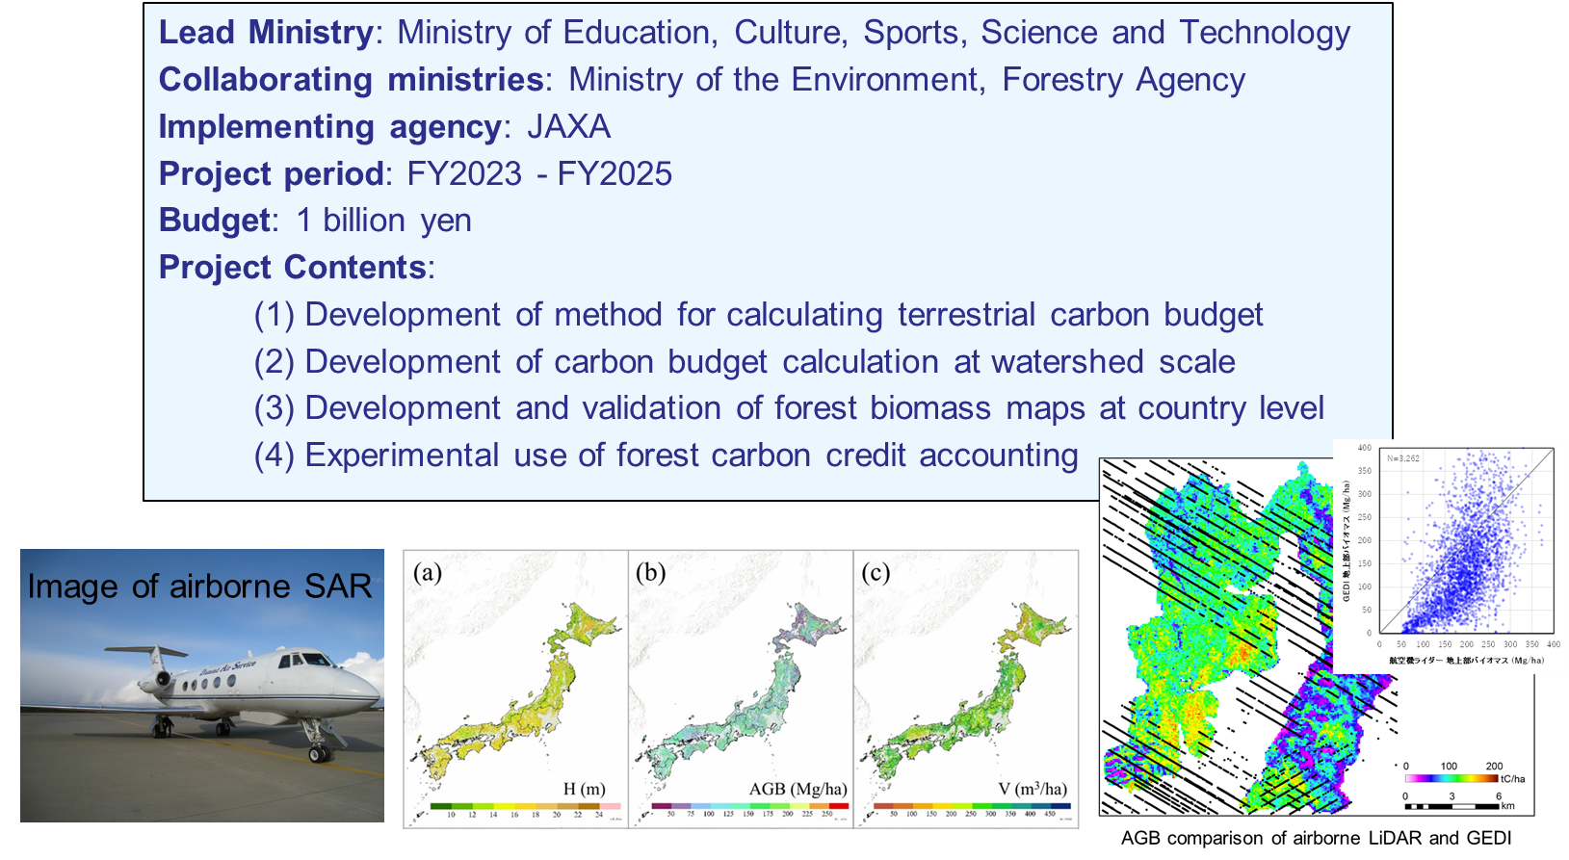
New JAXA Biomass Map project

