Slide 1
SIT-39 2024
Day 2 Objectives & Agenda
Osamu Ochiai, JAXA
Agenda Item #5.2
SIT-39 2024, Tokyo, Japan
10th - 11th April 2024

Slide 2
Session 6: Existing & Emerging Business II
Objectives: Advance existing and emerging business across the CEOS structure.
Session Discussion Points:
ESA PolInSAR workshop recommendations
Precipitation CEOS-ARD Product Family Specification
CEOS-ARD Strategy 2024
Virtual Constellations report from SIT Chair
WMO update
CEOS interactions with the commercial and ‘New Space’ sector.
Session Decision Points:
New Precipitation Virtual Constellation (P-VC) Terms of Reference

Slide 3
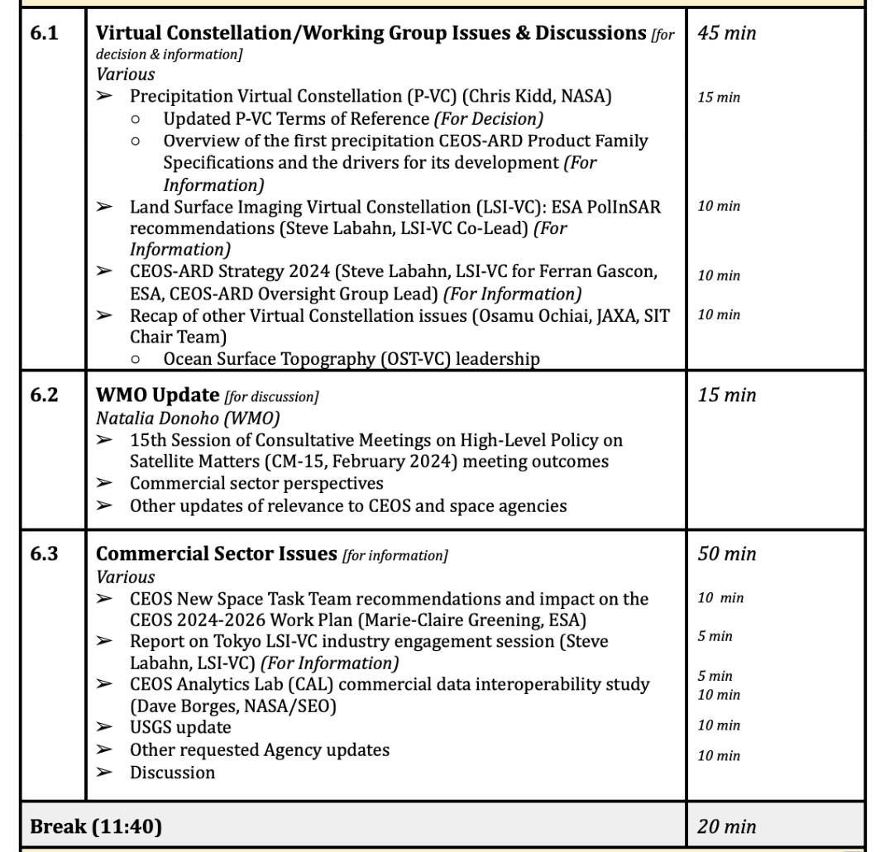
Session 6: Agenda Items

Slide 4
Session 7: Greenhouse Gas Observations
Objectives:
WMO Global Greenhouse Gas Watch (G3W) initiative
Identify collaboration opportunities for CEOS
Reflection in CEOS Greenhouse Gas (GHG) Roadmap (2020).
Agree changes needed to CEOS GHG Roadmap in 2024 + actions.
CEOS Agency GHG observation continuity and data supply to GST2 timeframe (2028).
Discuss best practices and standards for measurement of GHGs from space
Get consensus on coordination and goals for CEOS.
Discuss way forward for CEOS-IMEO.
Session Discussion Points:
CEOS Agency GHG activities and collective roadmap
Opportunities with partners WMO and IMEO.
Way forward towards GST2 (2028).
Session Decision Points:
Actions to update the CEOS GHG Roadmap for the 2024 CEOS Plenary.
Actions to further develop the CEOS-IMEO relationship.
Actions to ensure consistency across the measurement standards efforts.
Way forward on a GST2 target for public space agencies.
Actions for CEOS-WMO cooperation on G3W and more.

Slide 5
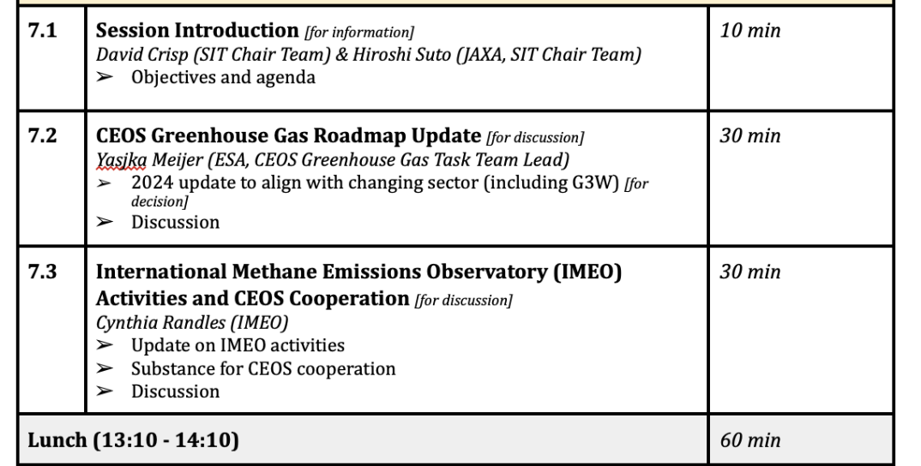
Session 7: Agenda Items

Slide 6
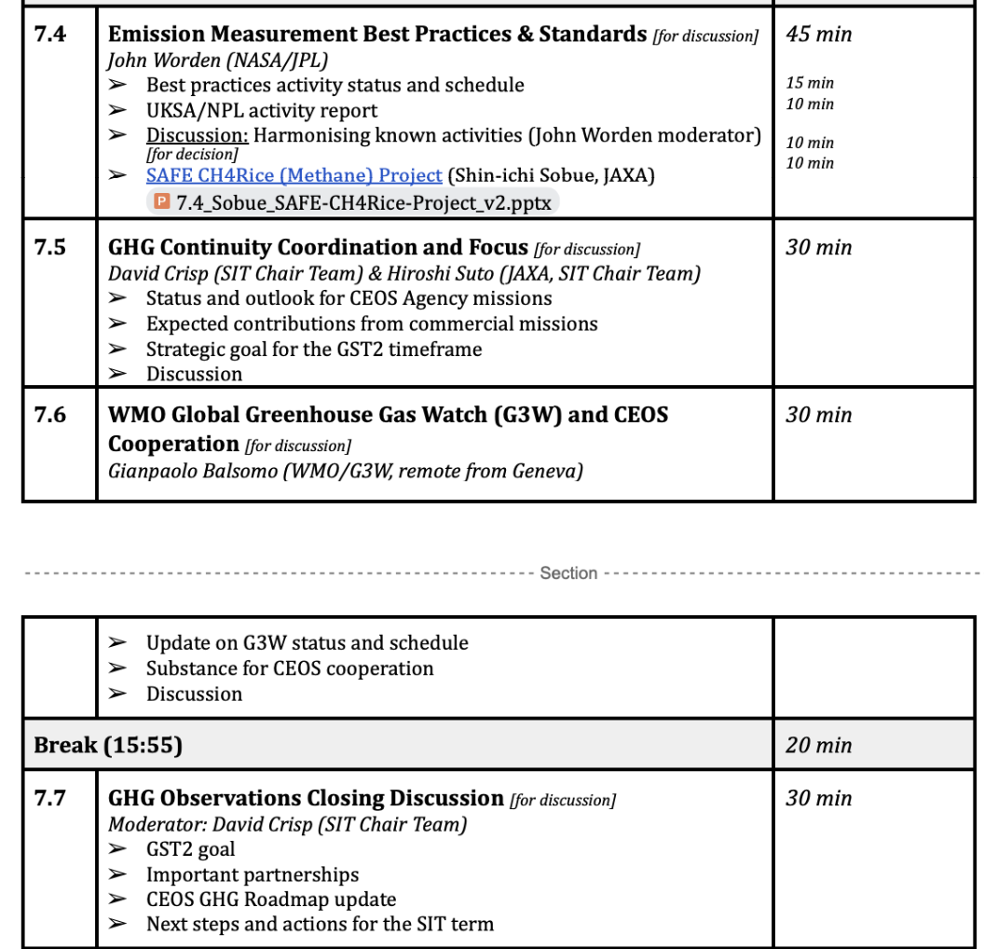
Session 7: Agenda Items

Slide 7
Session 8: Other Business and Wrap-Up
Objectives:
Review discussions and next steps from SIT-39.
Session Discussion Points:
Next steps on the Aquatic Carbon Roadmap.
CEOS communications – 40th anniversary of CEOS.
CEOS and International Coordination Group for Spaceborne Synthetic Aperture Radar (ICGS-SAR)
Session Decision Points:
Support requests for the CEOS Aquatic Carbon Roadmap.

Slide 8
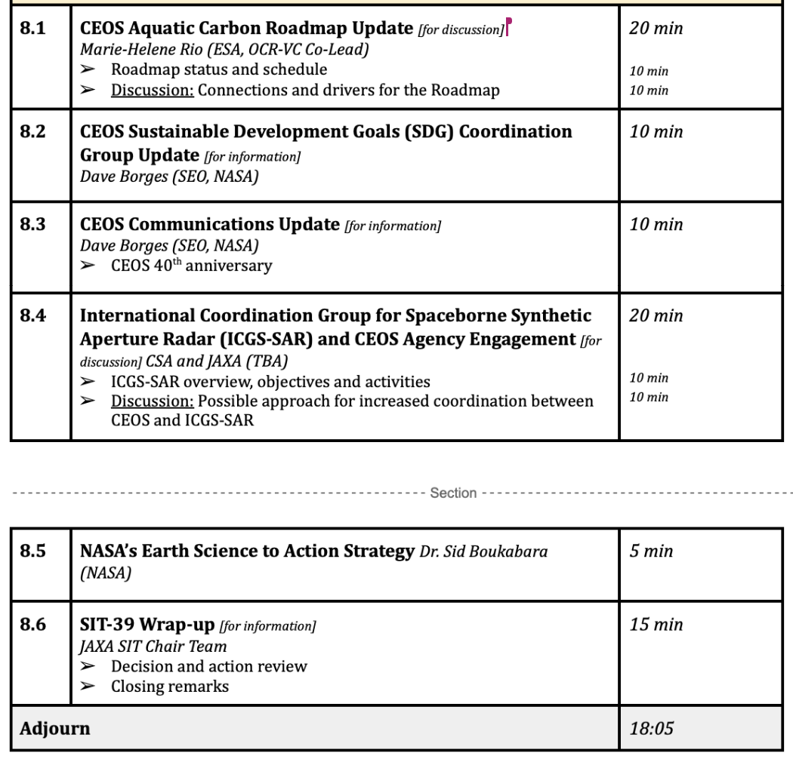
Session 8: Agenda Items

