Slide 1
6.1.3: CEOS-ARD Strategy 2024
Matt Steventon
CEOS-ARD Oversight Group & LSI-VC Secretariat
LSI-VC-15
3 April 2024

Slide 2
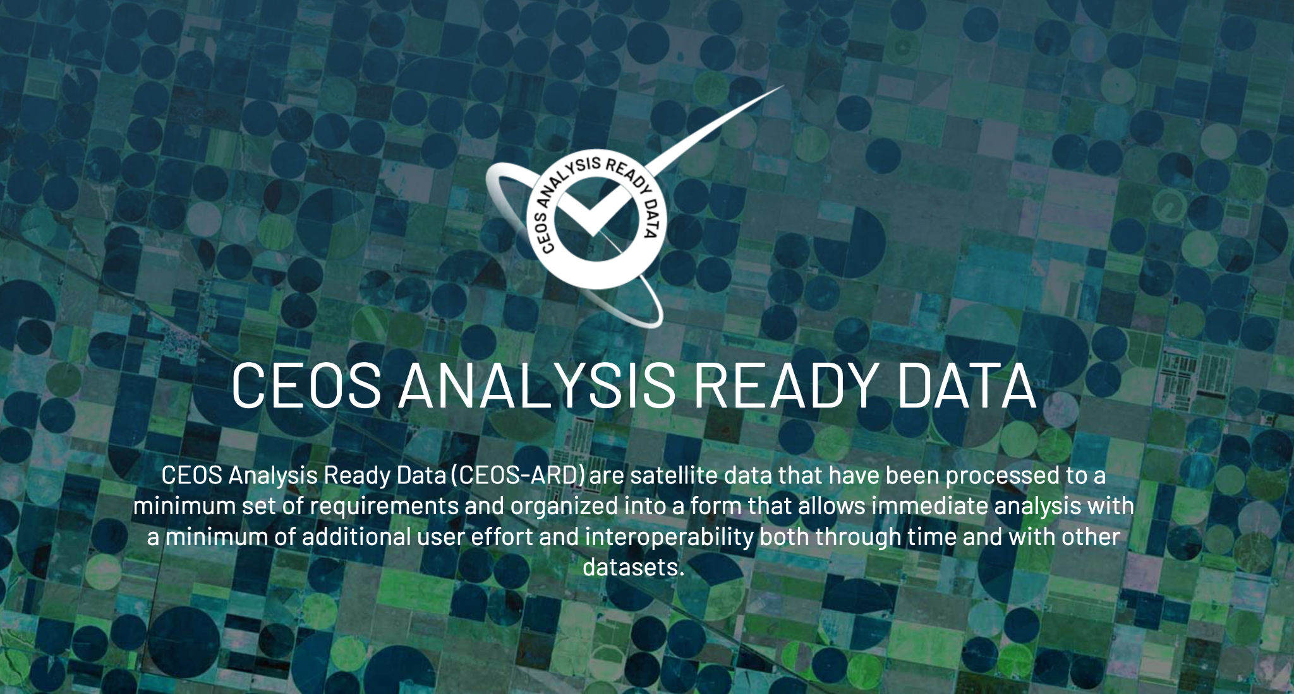
Motivations

Slide 3
Motivations
Easing the use of satellite EO data to reach new non-expert users and increase data uptake and use
Provision of analysis-ready geophysical measurements
Reduce pre-processing burden for users
Facilitate analysis in the cloud
Reduce egress and processing
Provide a first step for interoperability
Open and transparent
Common starting point; consistency
Promote clear documentation of processing steps
Capitalise on space agency expertise and experience
Best available science and high quality processes

Slide 4
Current + In-development CEOS-ARD Specifications
Land
Inland and Coastal Waters
Oceans
Harmonised to a single specification in 2023
Optical
Surface Reflectance
Surface Temperature
Nighttime Lights Surface Radiance
LiDAR Terrain and Canopy Top Height
Radar
Normalised Radar Backscatter
Polarimetric Radar
Geocoded Single-Look Complex (GSLC)
Interferometric Radar (INSAR)
Aquatic Reflectance
Ocean Radar Backscatter
Harmonised to a single specification in 2023
http://ceos.org/ard/index.html#specs

Slide 5
What next?
Sea Surface Temperature?
Precipitation?
Ocean Colour?
Atmospheric Composition Datasets?
Methane?
Active discussion by CEOS Virtual Constellations and CEOS-ARD Oversight Group. User demand is key.

Slide 6
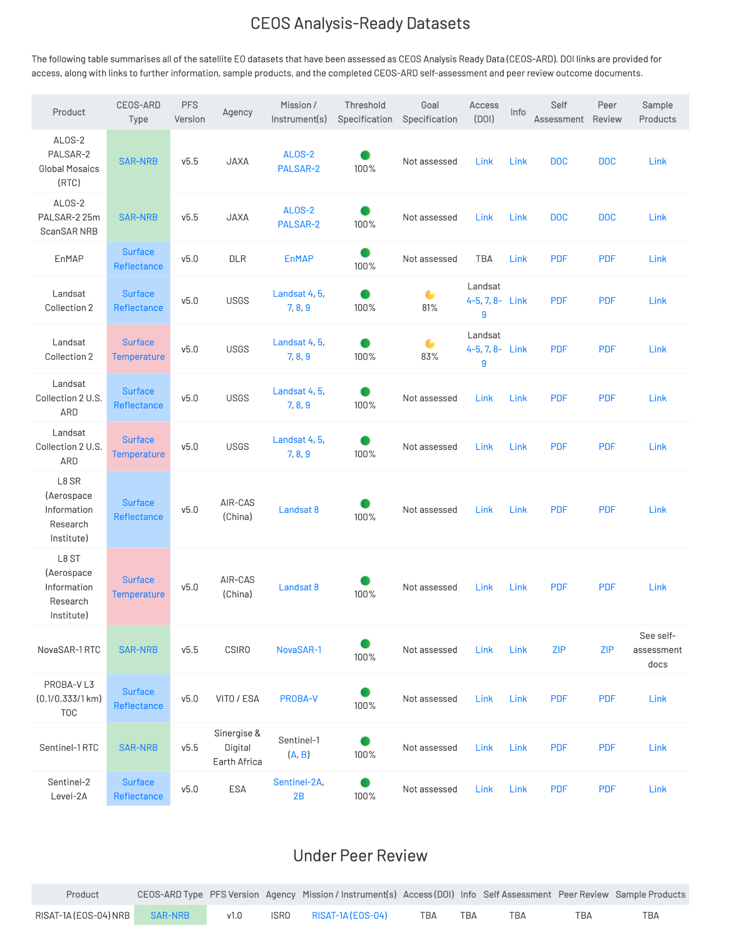
See: ceos.org/ard

Slide 7
Under Development
KOMPSAT-3/3A Surface Reflectance
KOMPSAT-5 Normalised Radar Backscatter
SPOT 1-7 Surface Reflectance
RISAT-1A (EOS-04) NRB SAR
Resourcesat-2/2A
NovaSAR
Gaofen-1/6 Surface Reflectance
SAOCOM
Radarsat-1 and 2
RCM
AVHRR LST Surface Temperature
DESIS L2A Surface Reflectance
EnMAP Aquatic Reflectance
Sentinel-1
OPERA project

Slide 8
Status of ESA CEOS-ARD Products
Mission | Product | PFS | Status | Availability Date
Sentinel-2 | L2A | SR | ✅ | January 2022
PROBA-V | Collection 2 | SR | ✅ | March 2023
Sentinel-2 | L2H | SR | Under Development | 2023 (pilot product), TBD (operational product)
Sentinel-2 | L2F | SR | Under Development | 2023 (pilot product), TBD (operational product)
Sentinel-2 | L2A | AR | Under Development | TBD
Sentinel-1 | NRB / ORB | NRB / ORB | Under Development | TBD
Sentinel-3 | SYN | SR | Under Development | TBD
ERS SAR | TBC | NRB | Under Development | TBD
ERS ATSR | TBC | LST | Under Development | 2024
Envisat ASAR | TBC | NRB | Under Development | TBD
Envisat MERIS | TBC | SR | Under Development | 2024
CHIME | L2A | SR | Under Development | 2029
CHIME | L2H/L2F | SR | Under Development | 2029 (pilot product), TBD (operational product)
LSTM | L2A | ST, SR | Under Development | 2029
LSTM | L2H/L2F | ST, SR | Under Development | TBD
ROSE-L | TBD | NRB…TBC | Under Development | TBD

Slide 9
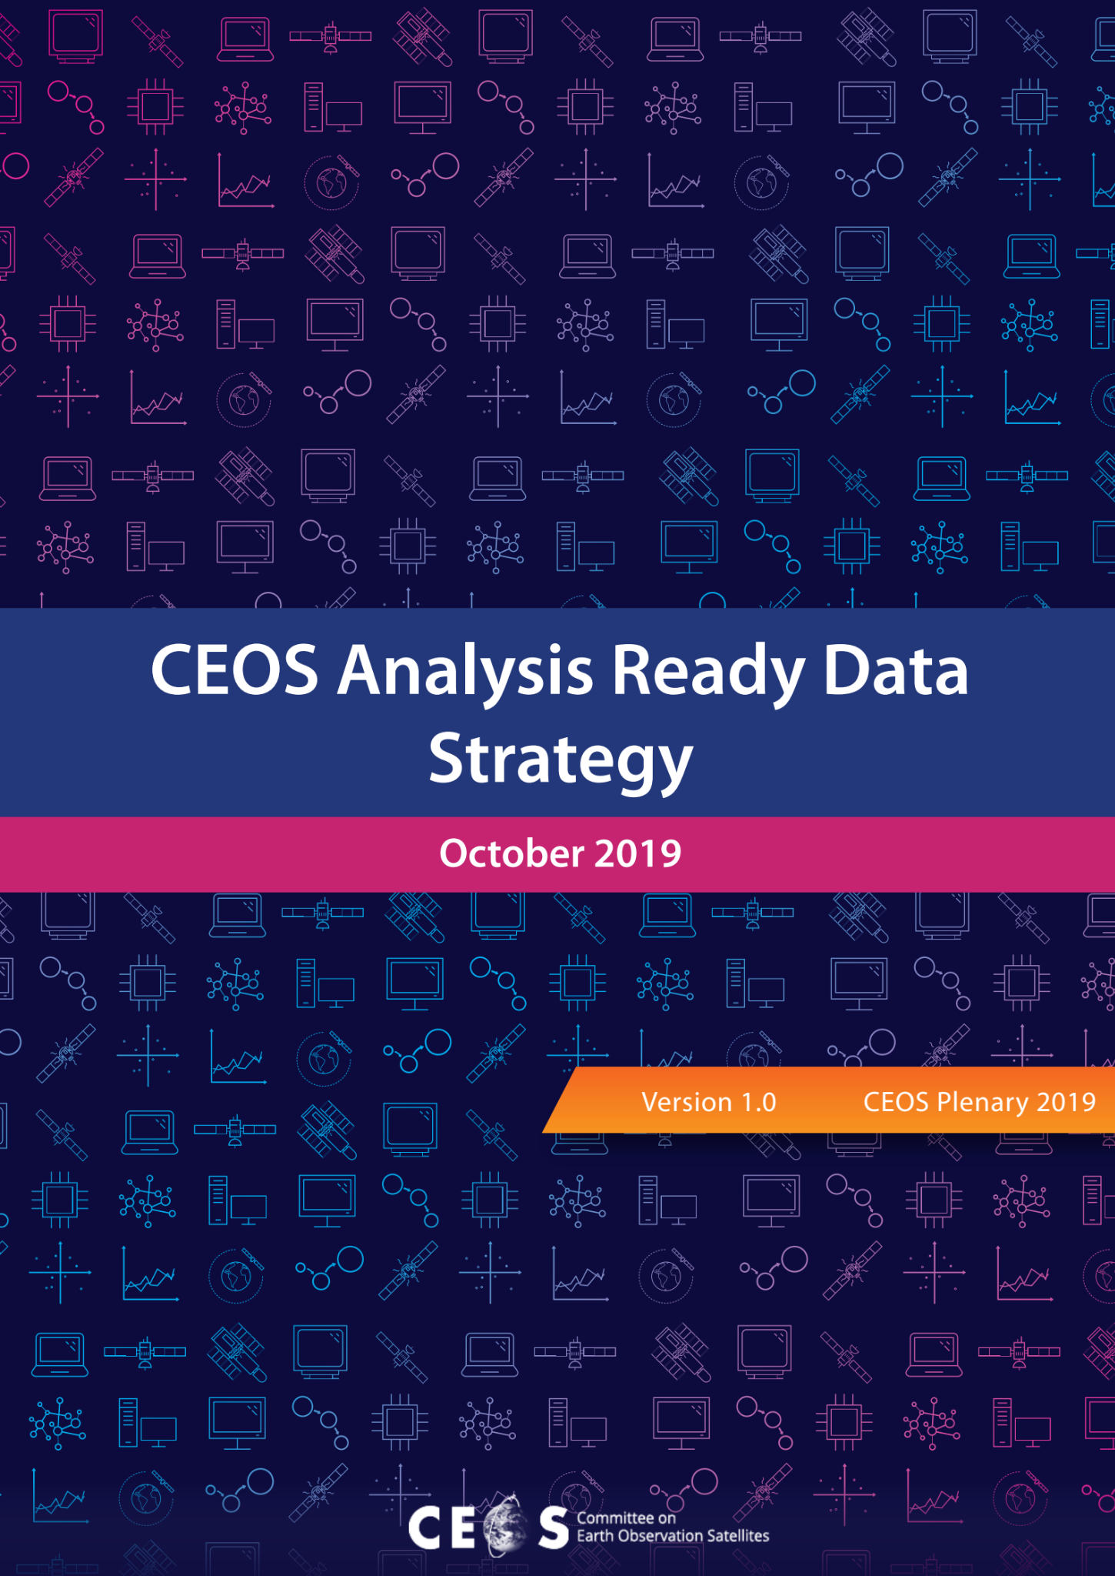
CEOS-ARD Strategy 2024
Update to past editions from 2019 and 2021
Reflect on the progress to date, take stock of future directions and needs, and confirm our strategy for the next few years
A broad portfolio of CEOS-ARD that is easily discovered, accessed and utilised is the ultimate goal.
Link: Draft CEOS-ARD Strategy 2024

Slide 10
CEOS-ARD Strategy 2024
The Strategy activities are categorised into six broad themes:
CEOS-ARD Availability, Product Diversity, and Representation
Framework and Specification Advancement
Discovery, Access, Utilisation, and Interoperability
Community Engagement
Research, Test Cases, and Pilot Activities
Commercial Engagement

Slide 11
1: CEOS-ARD Availability, Product Diversity, and Representation

Slide 12
Themes: CEOS-ARD Availability, Product Diversity, and Representation
More agencies making CEOS-ARD
CEOS Agency support to the VCs and CEOS-ARD Oversight Group
CEOS-ARD process from mission inception
Align similar activities with CEOS-ARD

Slide 13
2: Framework and Specification Advancement

Slide 14
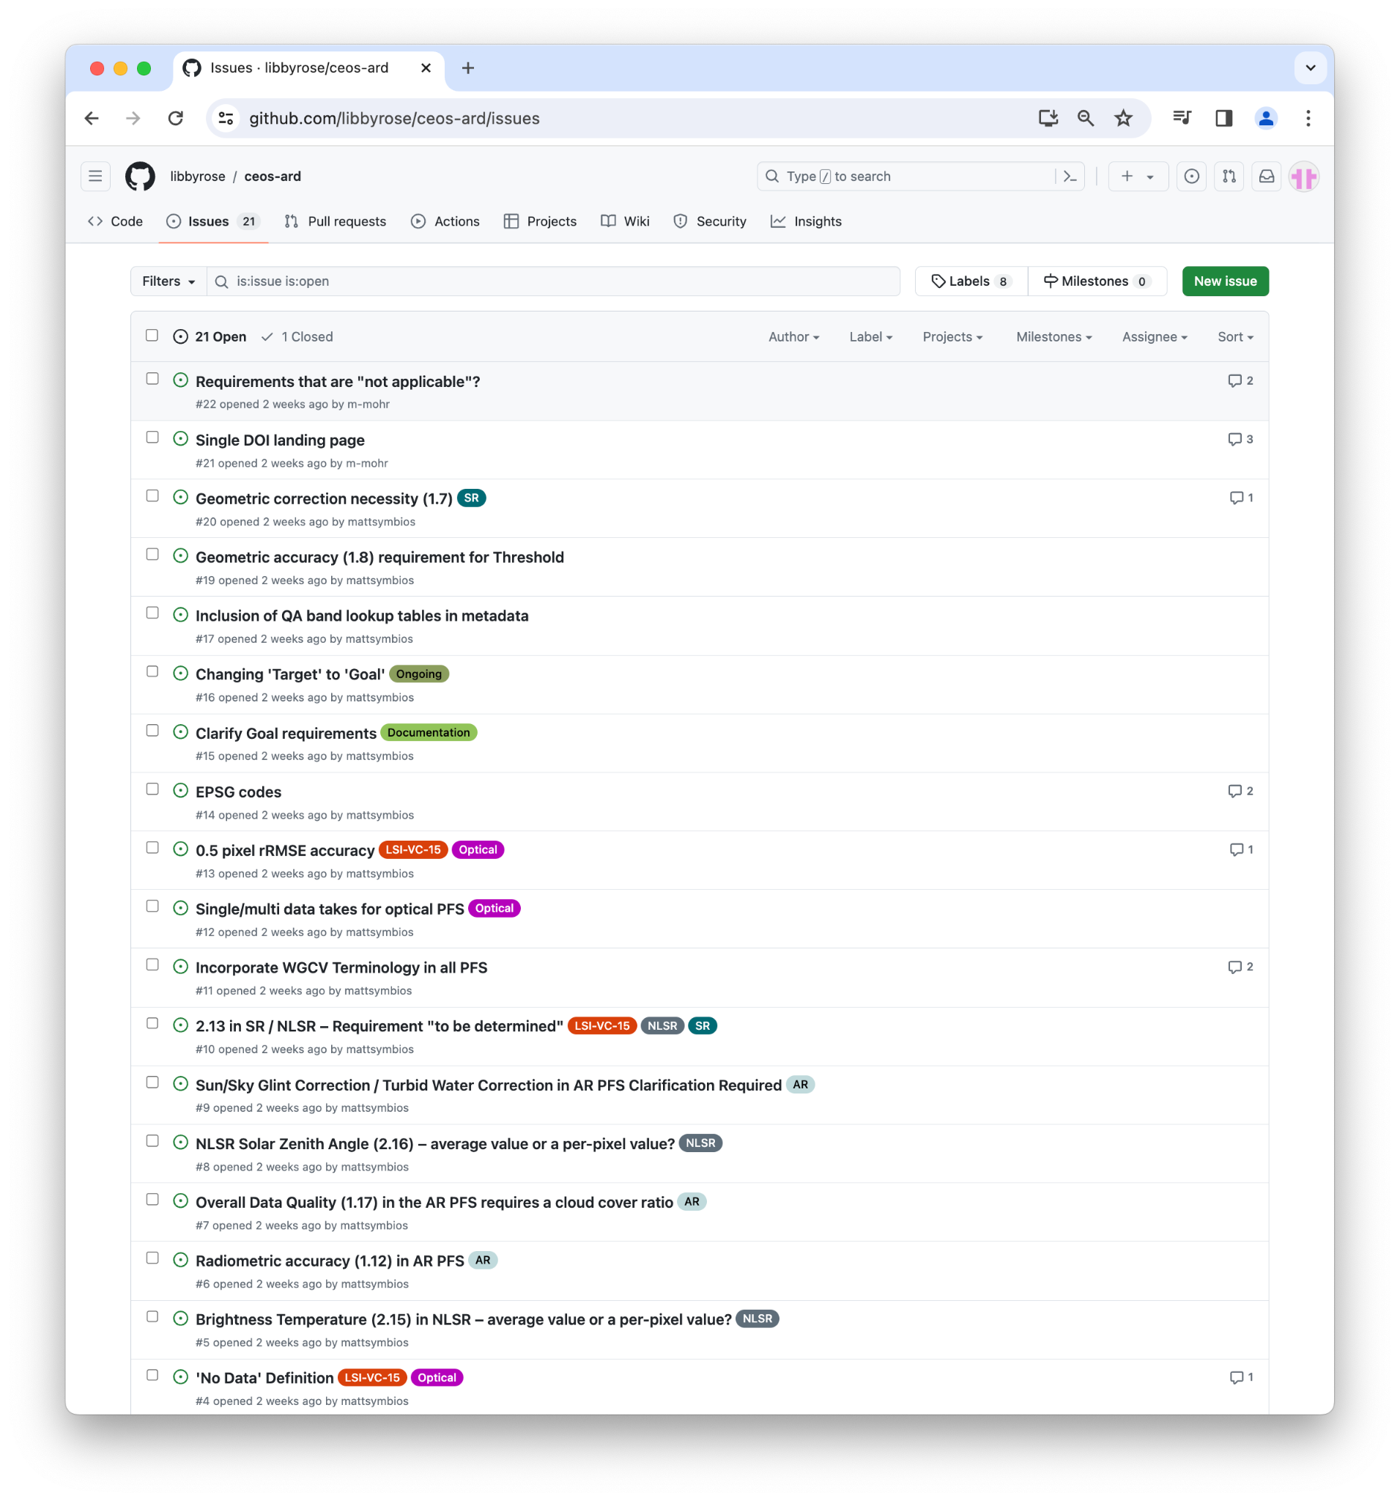
Themes: CEOS-ARD Framework and Specification Advancement
More technical section
Capturing major development priorities for CEOS-ARD specs

Slide 15
3: Discovery, Access, Utilisation, and Interoperability

Slide 16
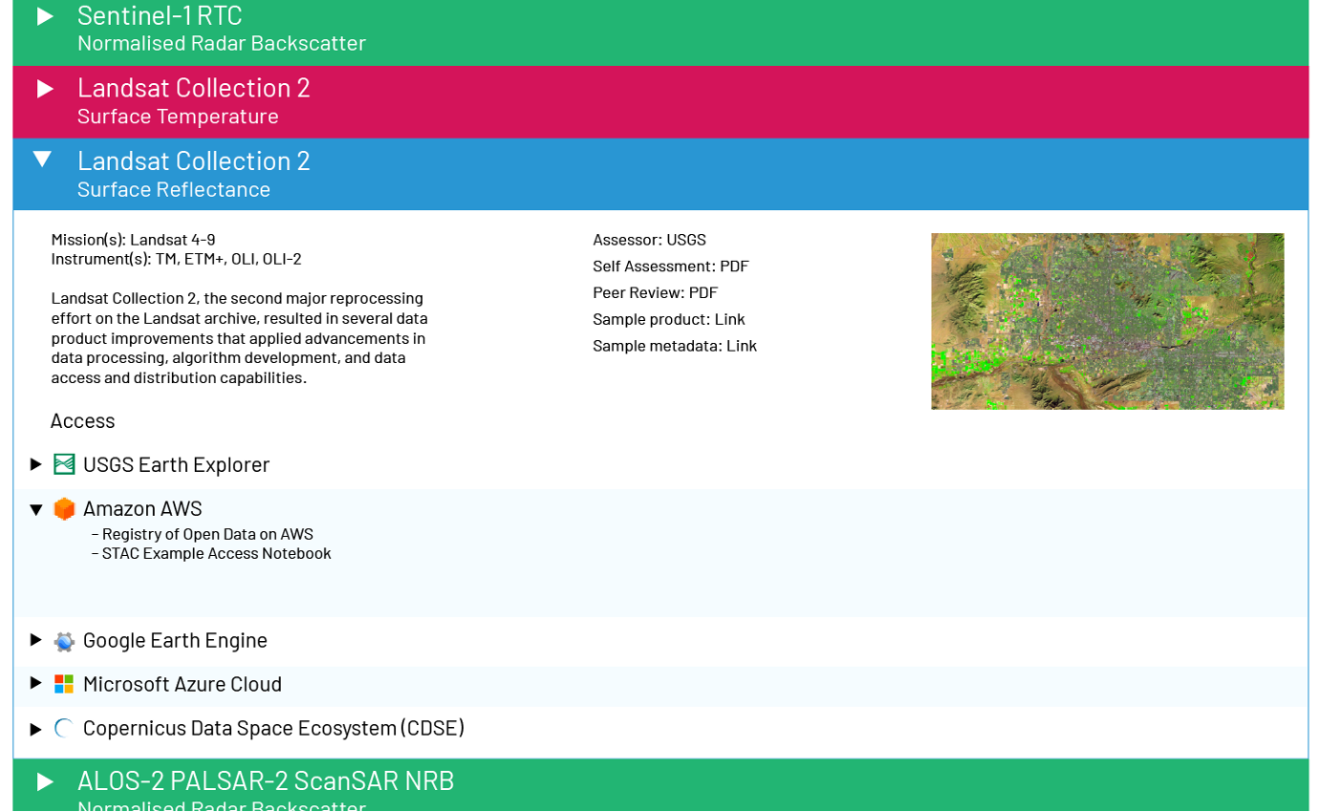
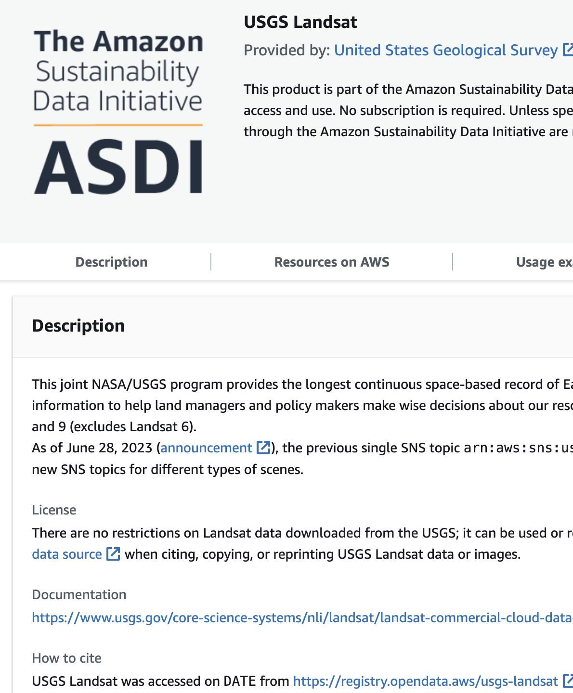
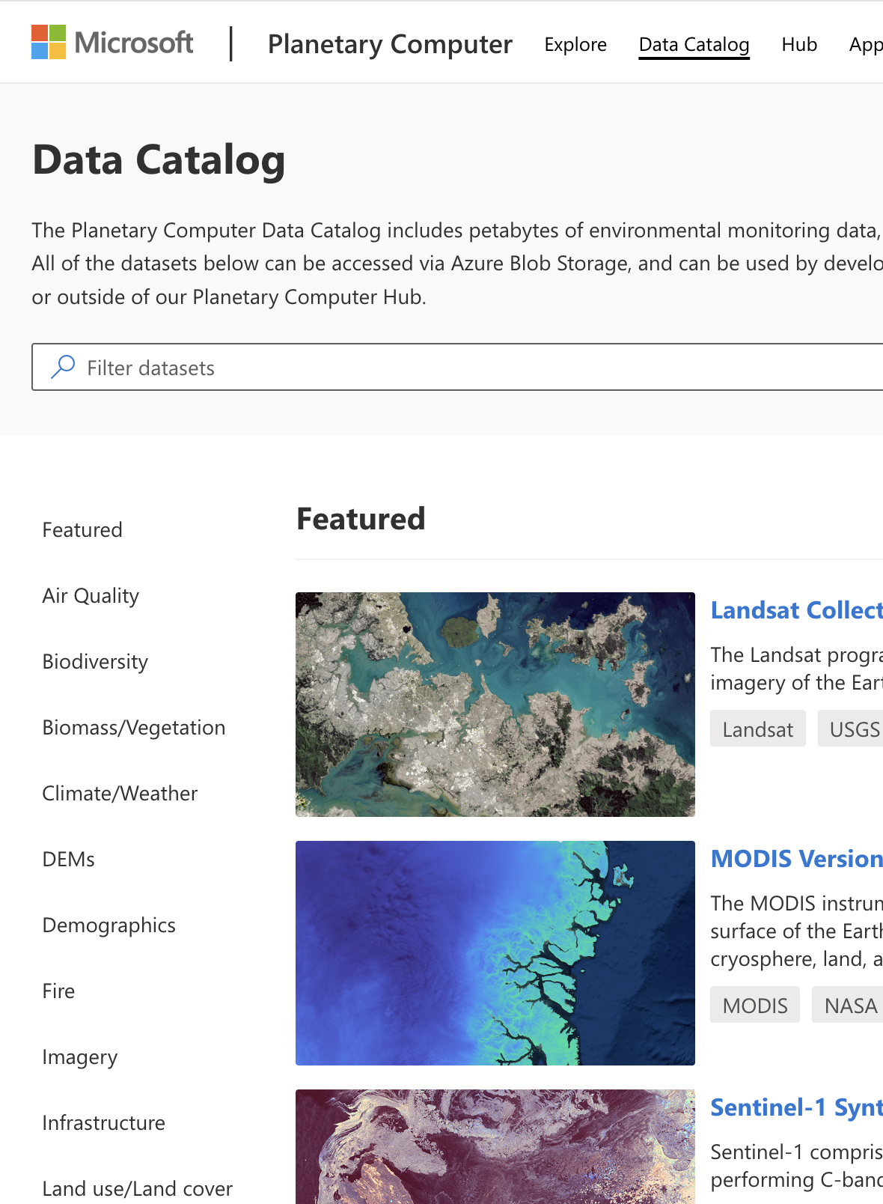
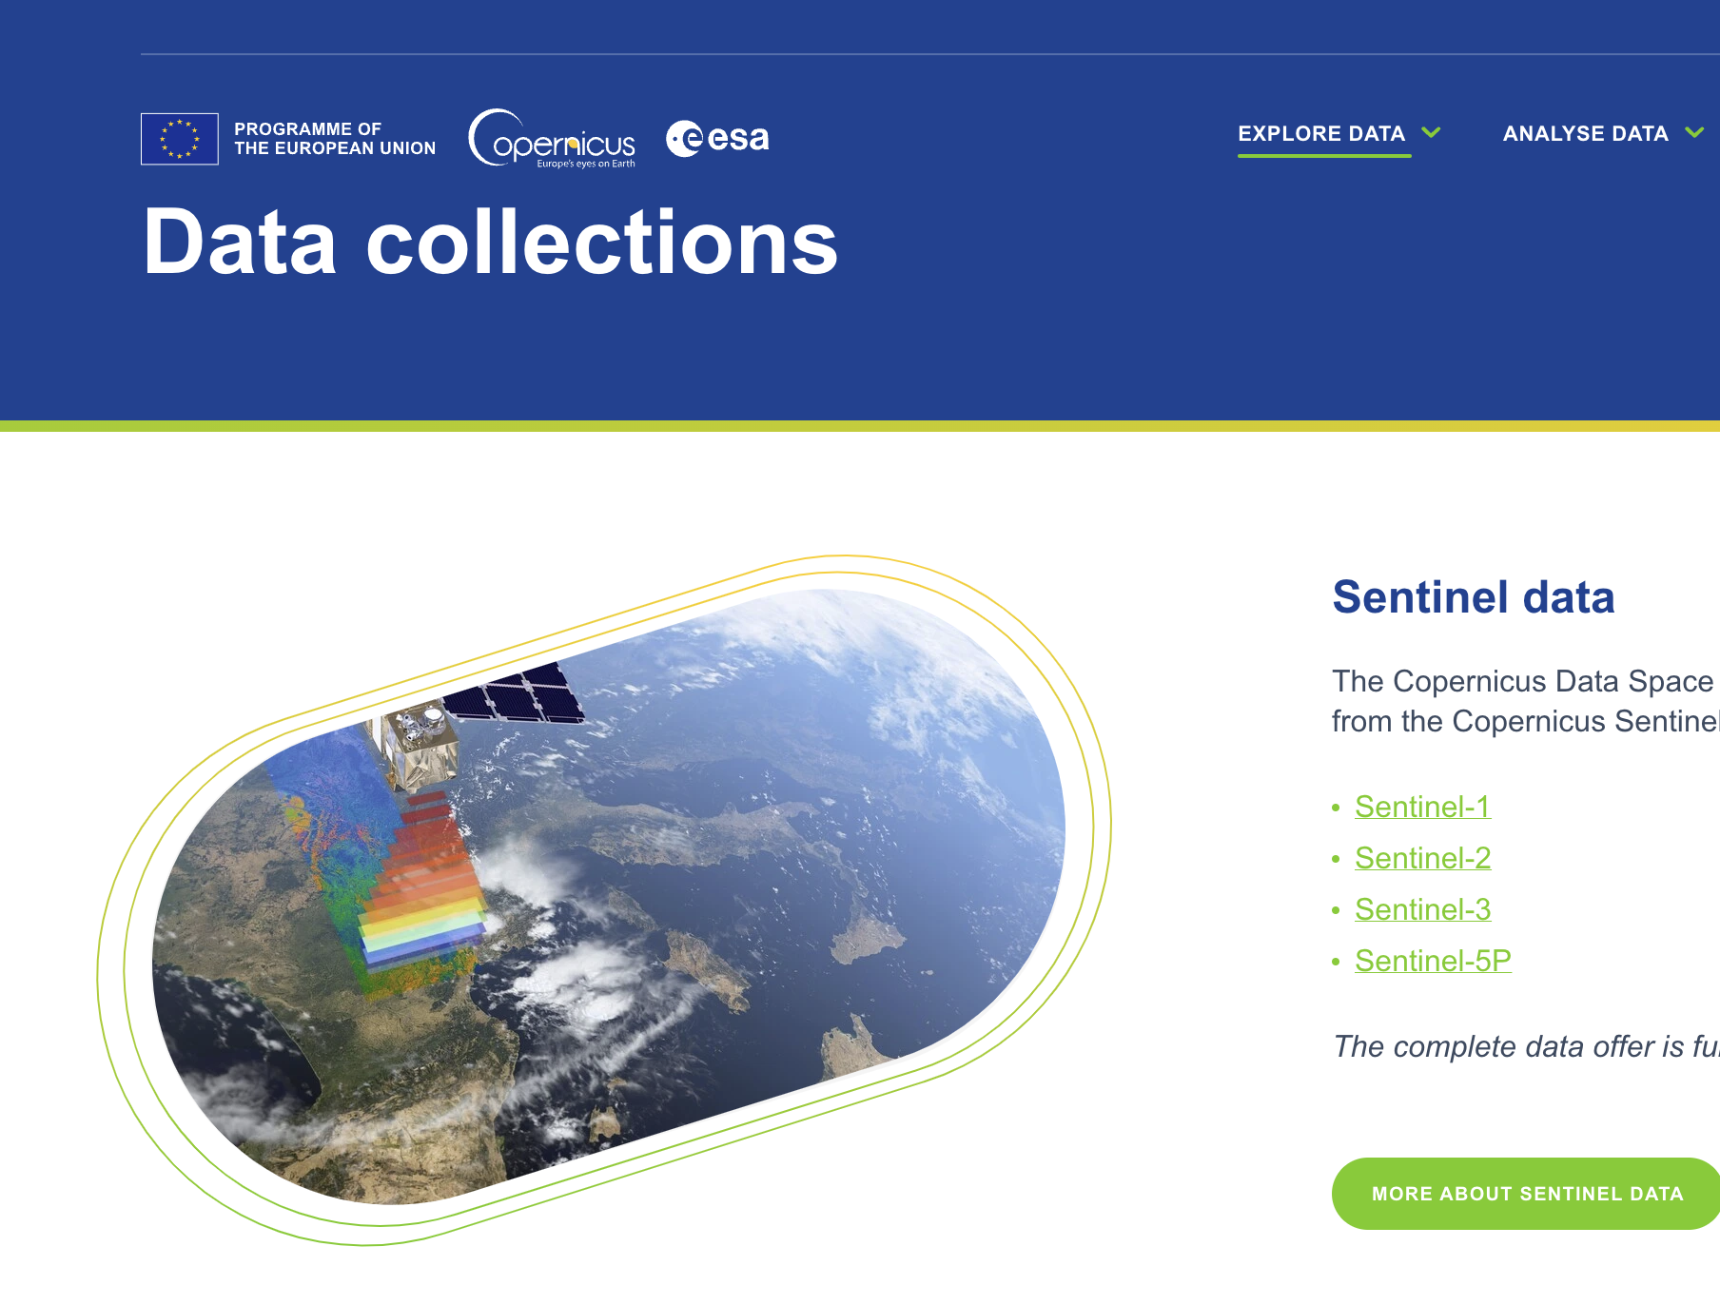
Themes: Discovery, Access, Utilisation, and Interoperability
Need to make this data easy to find and use
Leverage CEOS Interoperability Framework
Embrace cloud-native and machine-to-machine concepts
Technical Advisory Notes
Strong representation on the cloud
Branding and promotion

Slide 17
4: Community Engagement

Slide 18
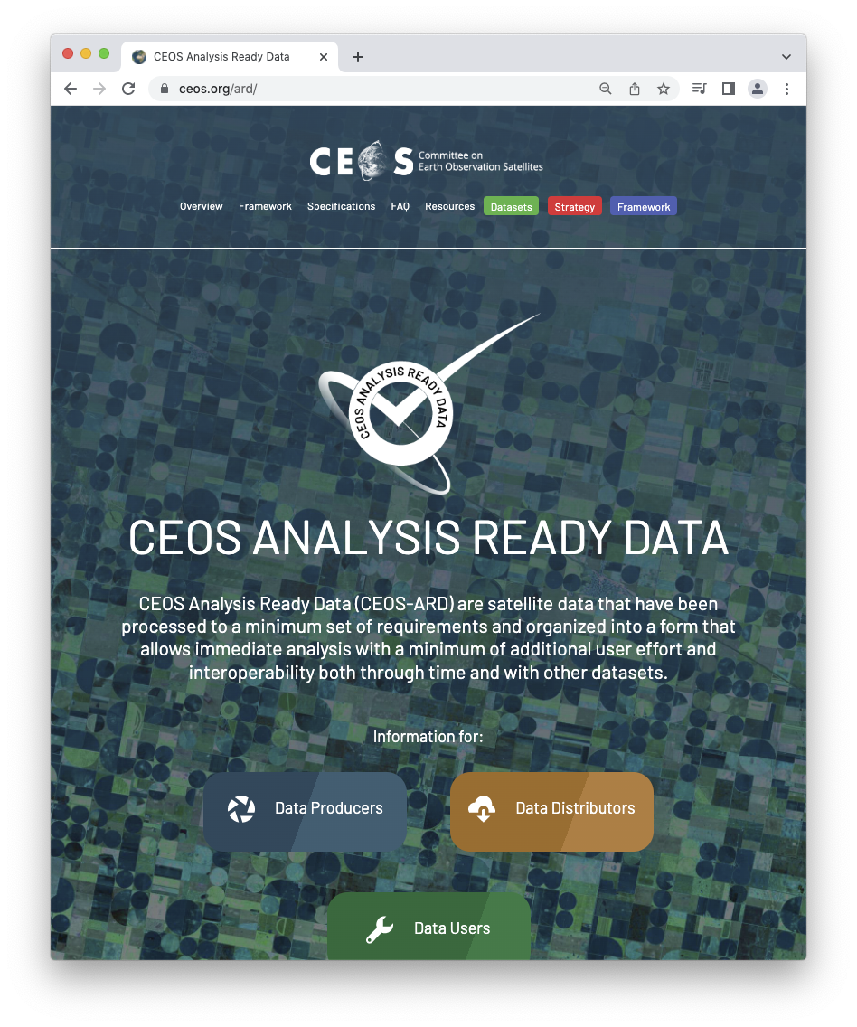
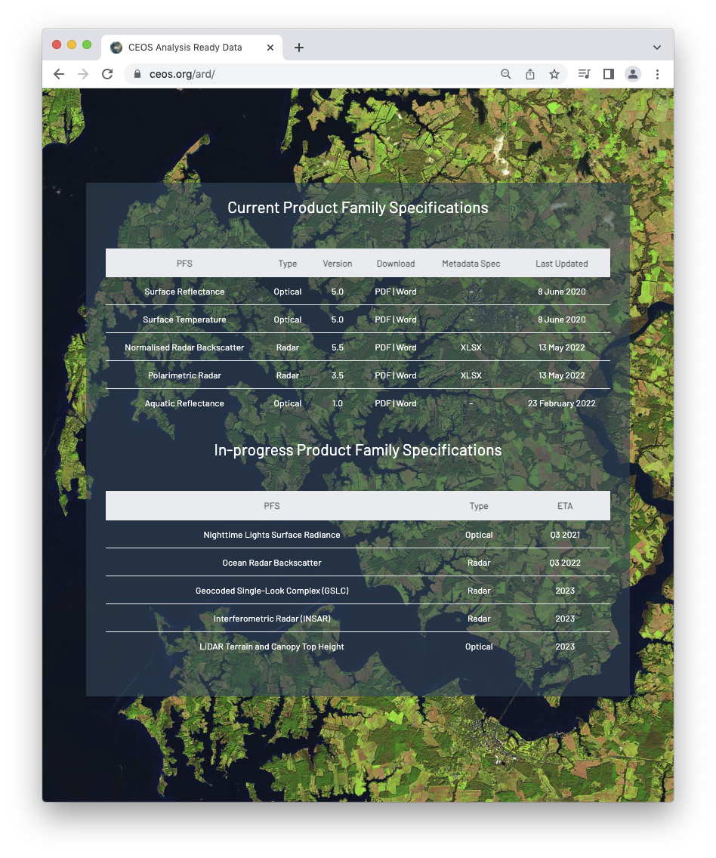
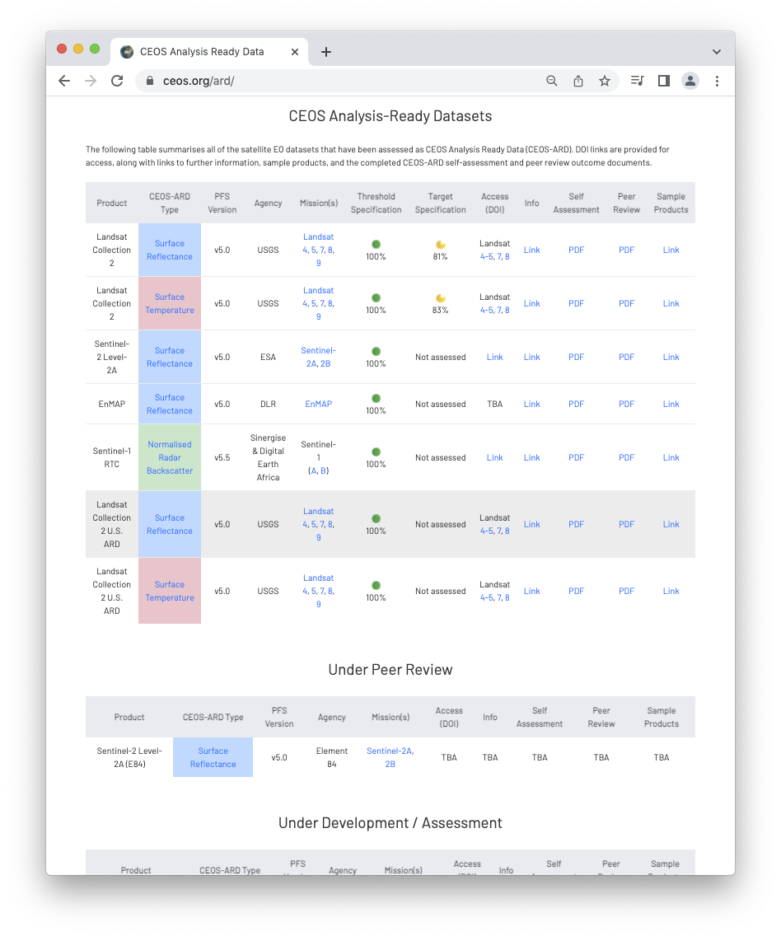
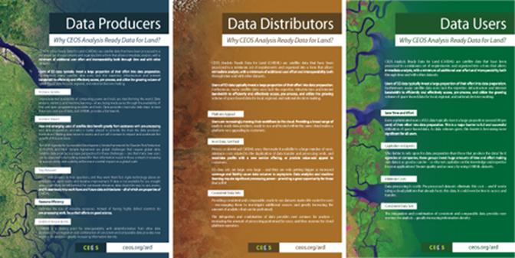
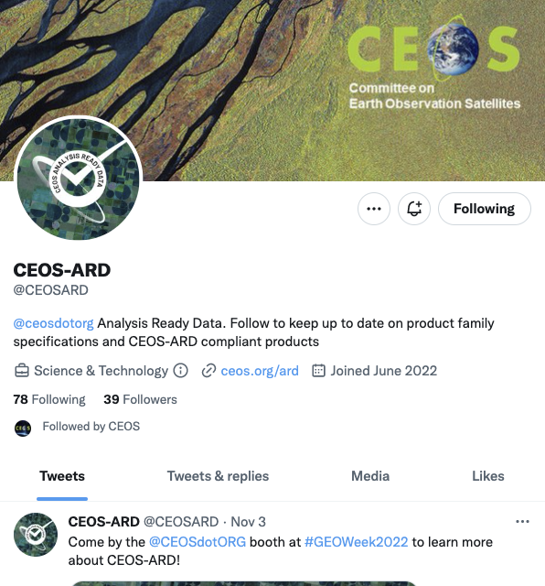
Themes: Community Engagement
OGC ARD SWG Co-Chair
Engagement with thematic groups in CEOS
Vibrant GitHub development environment
Comms, community events, etc.

Slide 19
5: Research, Test Cases and Pilot Activities

Slide 20
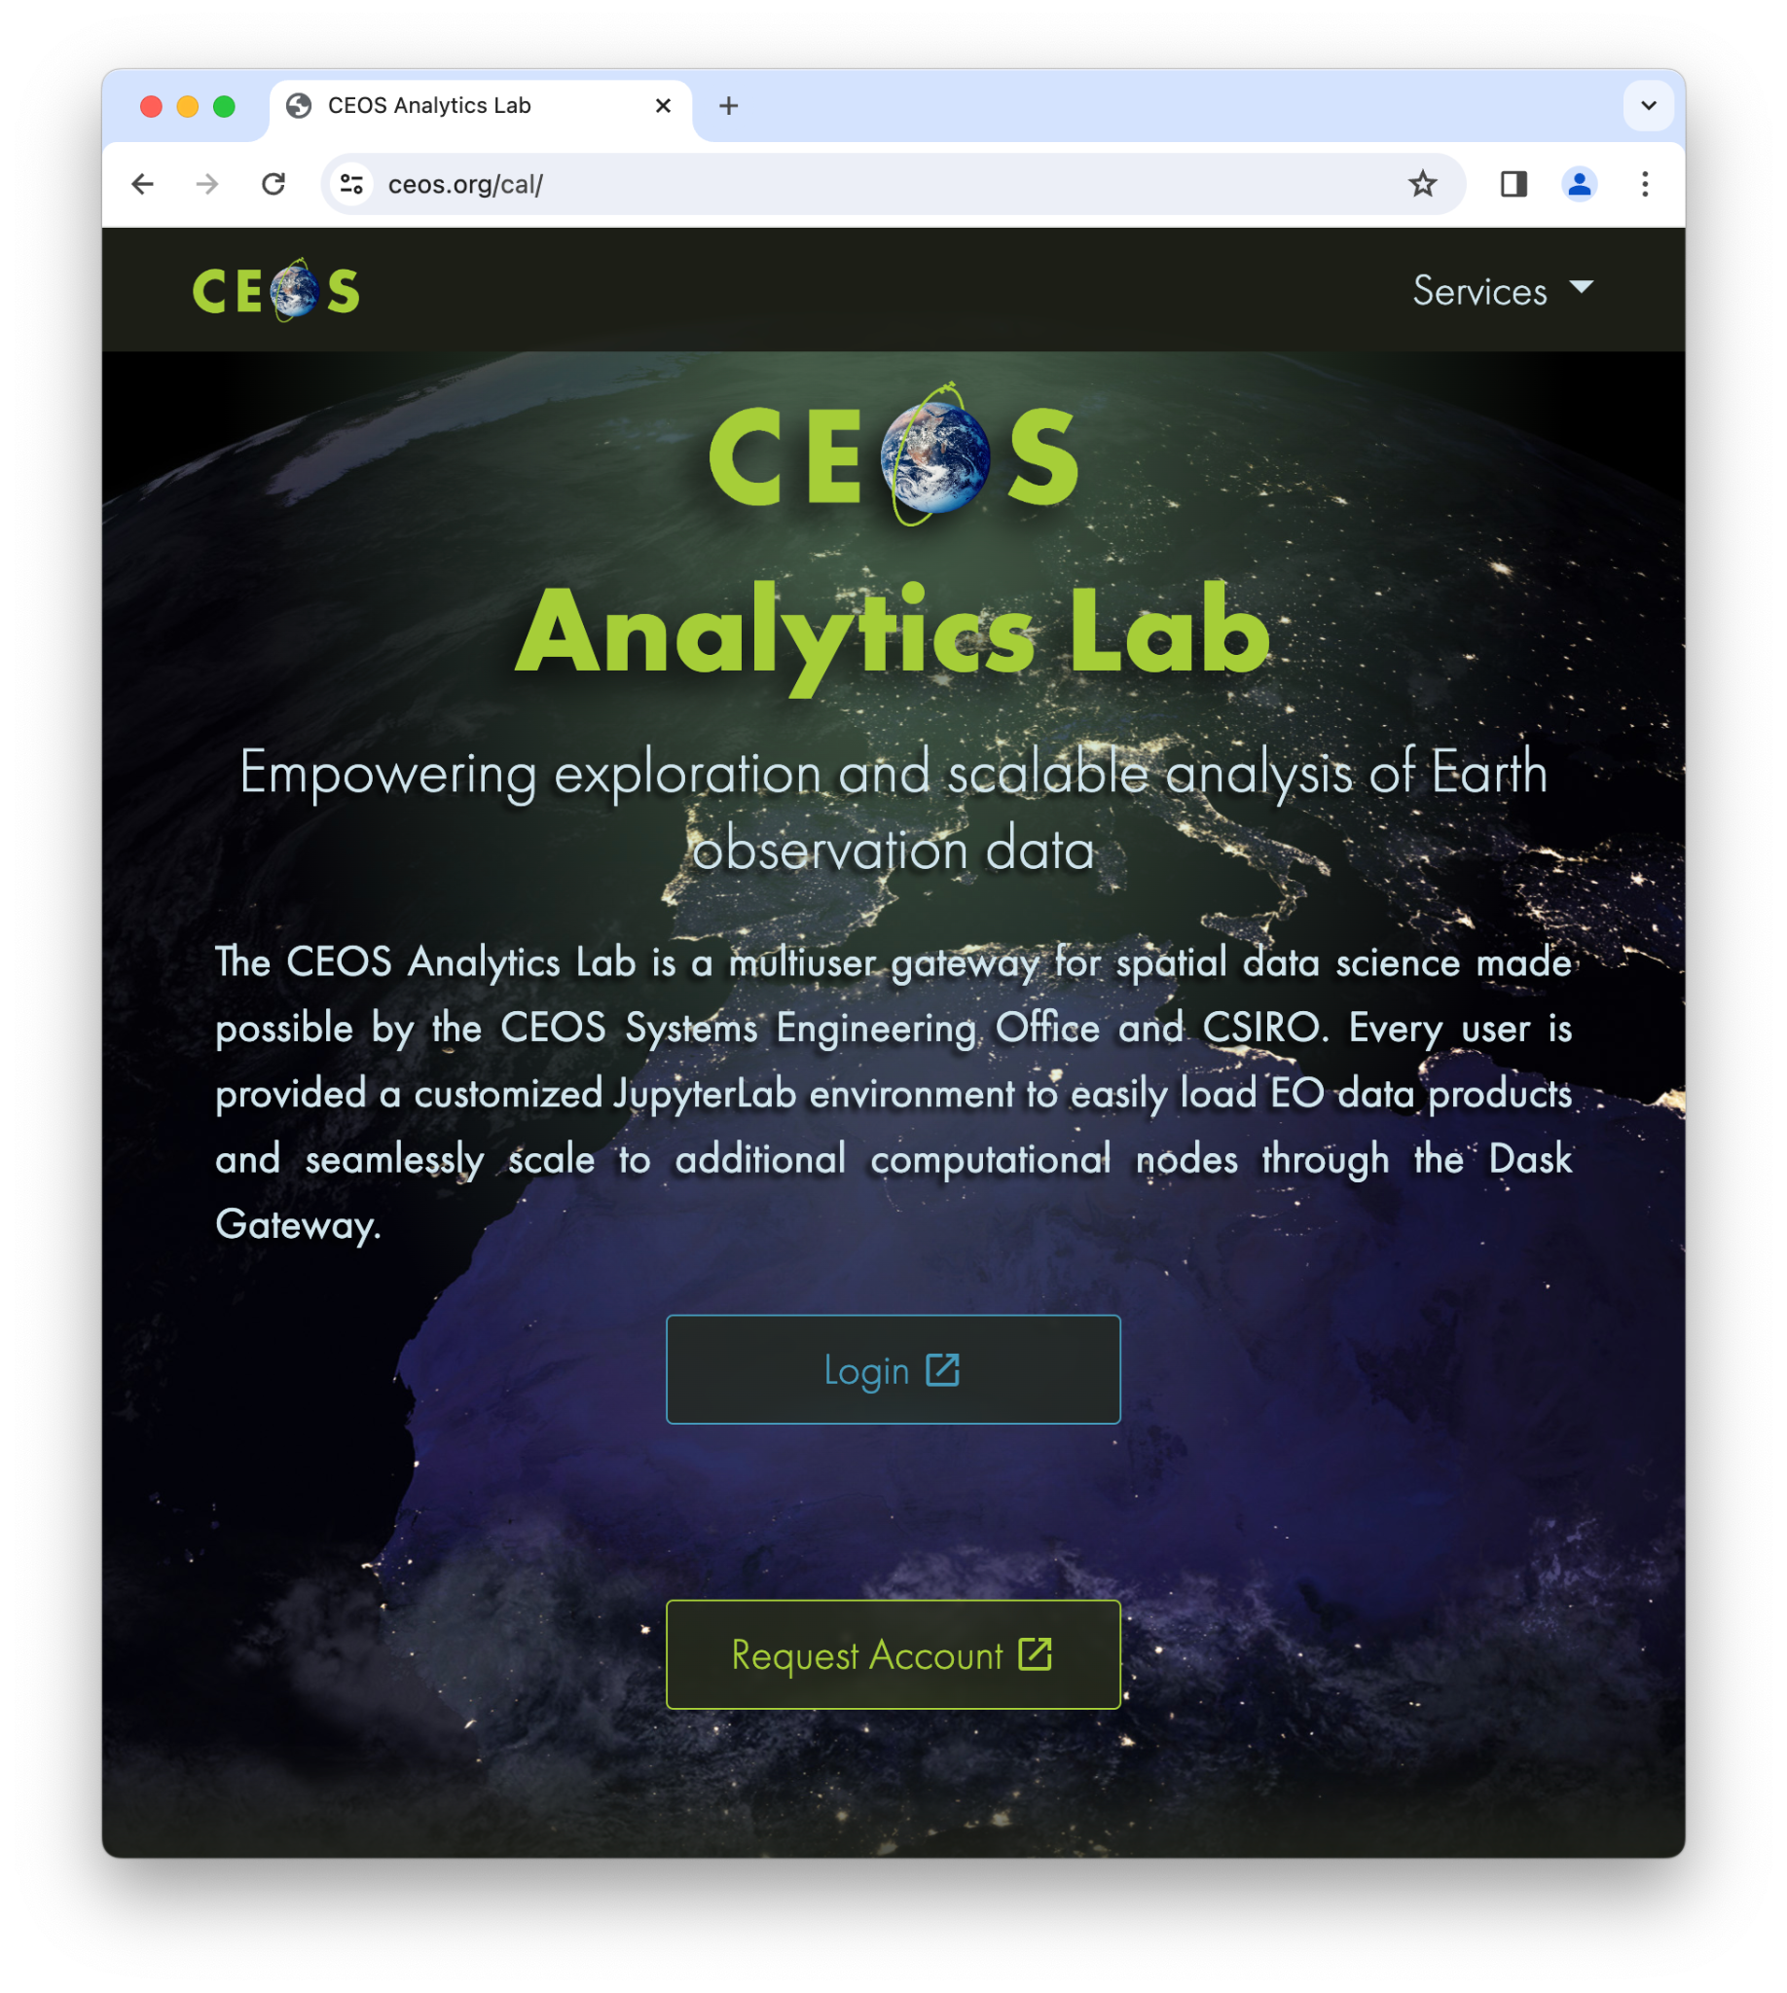
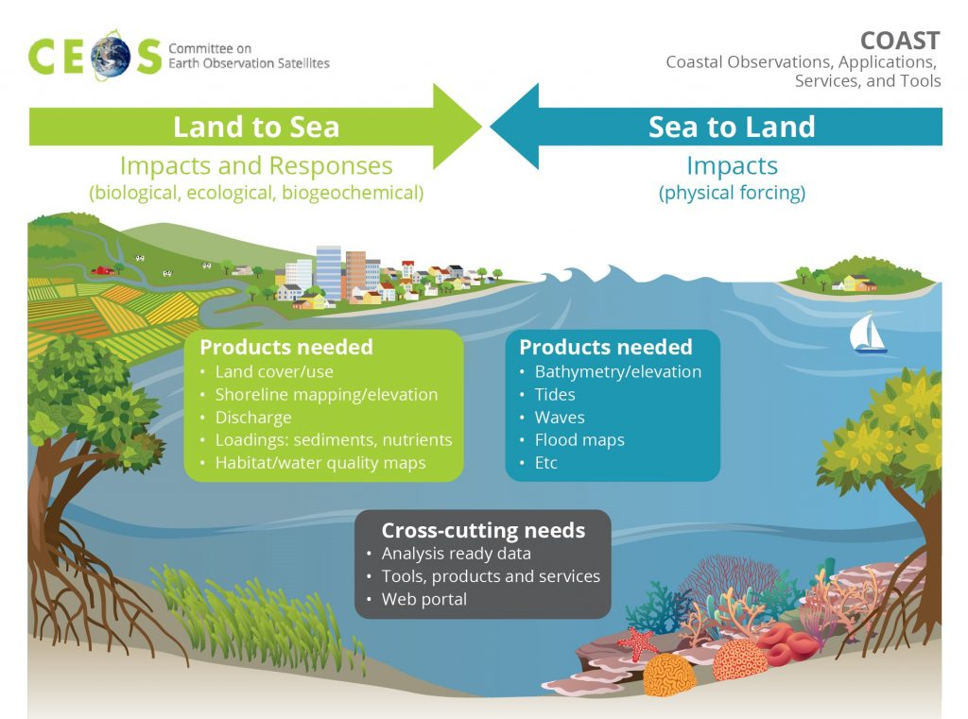
Themes: Research, Test Cases and Pilot Activities
Support and use CEOS Analytics Lab
Ecosystem Extent (Biodiversity) Demonstrators
COAST VC
Surface Reflectance Quality, Equivalency and Consistency Project
CSA Radarsat-2 Tropical Forest R&D Project
Welcome other opportunities to pilot and get feedback on CEOS-ARD

Slide 21
6: Commercial Engagement

Slide 22
6: Commercial Engagement

Slide 23
In closing…
CEOS-ARD has been a great success!
Catalysed a growing movement and recognition of the importance of providing satellite EO data that is easier to use
CEOS must continue to use its expertise to lead and shape the satellite EO landscape.
Maintain CEOS leadership of the satellite Earth observation Analysis Ready Data concept and its definition through CEOS-ARD.
New Strategy captures all of the discussions that have been happening and organises them
Link: Draft CEOS-ARD Strategy 2024
Will present for endorsement at the 2024 CEOS Plenary (and SIT TW for discussion)

Slide 24
More information
ceos.org/ard
CEOS-ARD GitHub (new!)
CEOS-ARD Newsletter Sign-up
Past issues: https://ceos.org/ceos-ard-newsletter/
https://twitter.com/CEOSARD
Contacts:
Ferran.Gascon@esa.int
matthew@symbioscomms.com
ard-contact@lists.ceos.org

Slide 25
Thank you!

