Slide 1
CEOS Analytics Lab & Commerical Interoperability Study
David Borges
Systems Engineering Office
Committee on Earth Observation Satellites
NASA Earth Science Division
LSI-VC-15 Agenda 3.1
05 April 2024

Slide 2
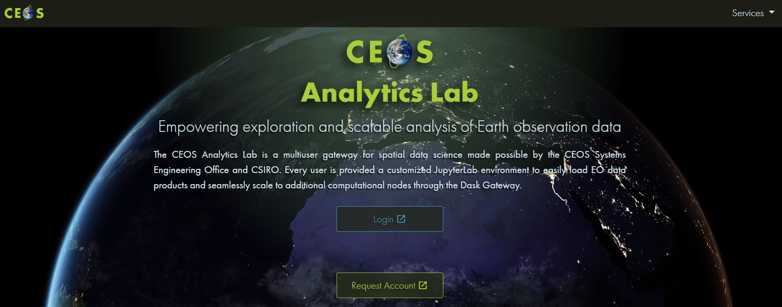
CEOS Analytics Lab
ceos.org/cal

Slide 3
Analytics Lab Architecture
Analytics Lab is an implementation of CSIRO’s Earth Analytics Science and Innovation platform (EASI)
Combination on several open-source projects:
JupyterHub
Open Data Cube (ODC)
AWS
Dask scaling
Scales individual user environments on demand.
Analysis can scale beyond the user environment using Dask workers that are used only when the analysis is run.

Slide 4
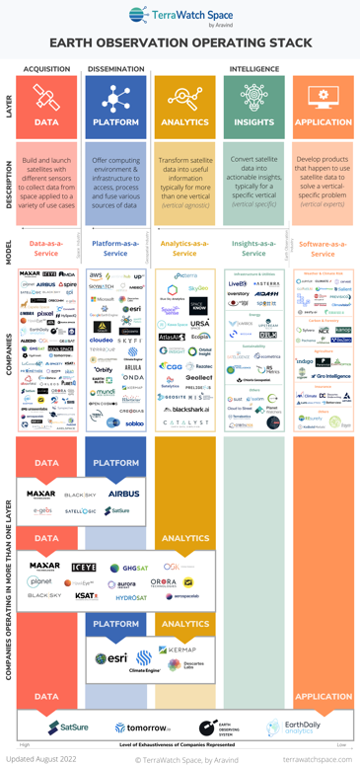
Commercial Interoperability Project
CEOS New Space Task Team (NSTT) Deliverable
D5) SEO should demonstrate the integration of New Space data into CEOS Analytics Lab and evaluate its interoperability with common CEOS datasets.
Optical
Landsat 8, 9
Sentinel-2
Maxar
Planet Planetscope
DESIS
SAR
Sentinel-1
ALOS
Umbra
ICEYE
Capella

Slide 5
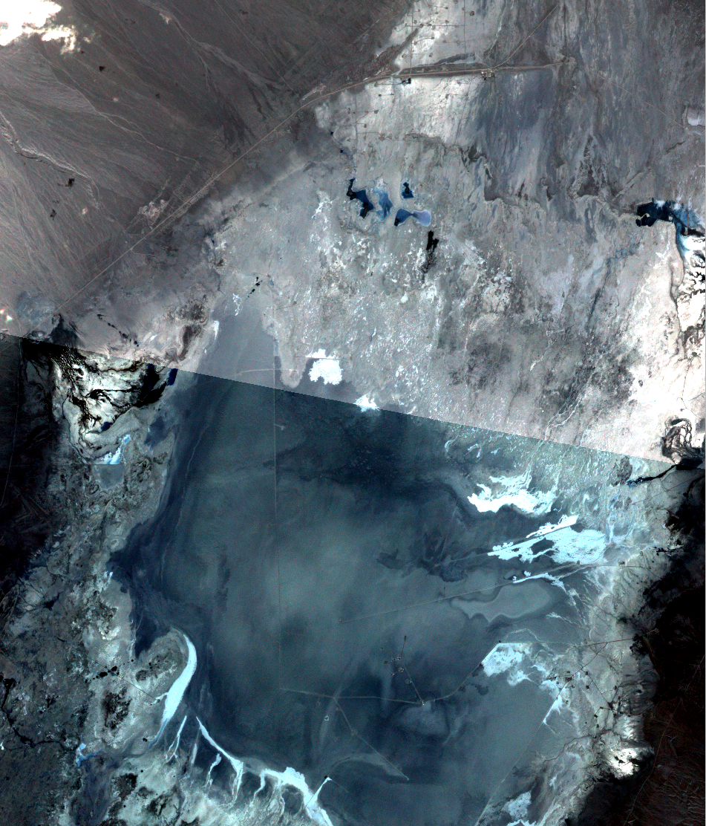
Commercial Interoperability Study Value
Importance:
Improve understanding of commercial image quality as compared to public imagery datasets
Explore challenges of working with data from both commercial and public platforms
End User Perspective: Understand workflows necessary to incorporate multiple data sources
Provide a foundation of knowledge to promote increased use of commercial data
Formulate future recommendations for guiding CEOS policy regarding commercial data
Test usage on the CEOS Analytics Lab (CAL) and the Open Data Cube
Delineate Interoperability of Systems vs Data

Slide 6
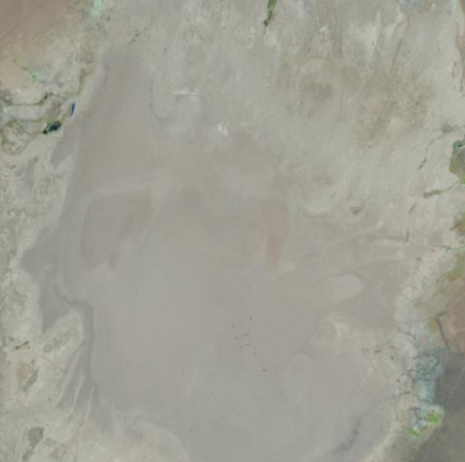
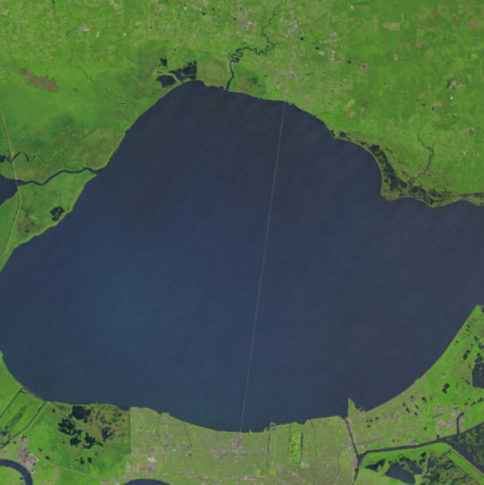
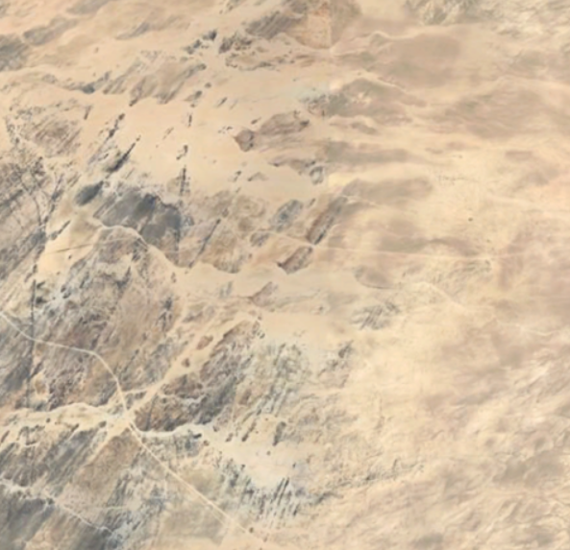
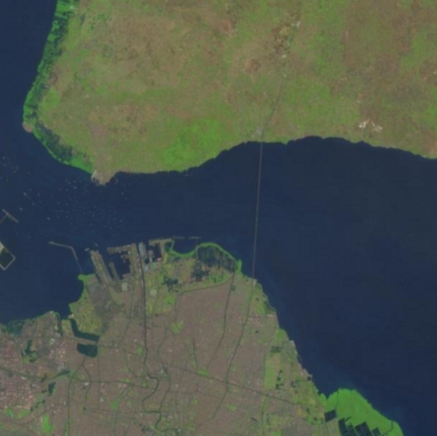
CEOS-SEO Preliminary Interoperability Analysis Sources
Level 2A Data (Monthly Comparisons, 2018-Present):
Cal/Val Sites
Commercial Platforms | Public Platforms
Planet Dove/SuperDove | Landsat 8/9
Maxar WorldView-02/03 | Sentinel 2
Teledyne DESIS | HLS
Railroad Valley
Lake Pontchartrain
Bridge
Cal/Val Sites | Northern Hemisphere | Southern Hemisphere
Radiometric | Railroad Valley Playa (Nevada, USA) | Gobabeb (Namibia, Africa)
Spatial | Lake Ponchartrain Causeway (Louisiana, USA) | Suramadu Bridge (Indonesia, Asia)
Gobabeb
Suramadu Bridge

Slide 7
Commercial Interoperability Project
Key Considerations and Challenges (Optical)
Sensor Variation
Impacts spectral band alignment, spatial detail, signal strength
Processing Biases
Differences in atmospheric correction and vendor-specific sharpening will influence direct comparisons
Situational Factors
Slight time offsets and viewing geometry differences create irreducible limitations
Commercial data compliance with CEOS-ARD PFS

Slide 8
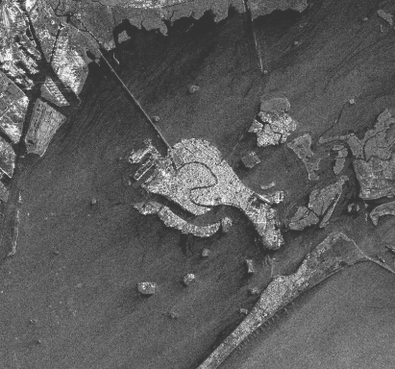
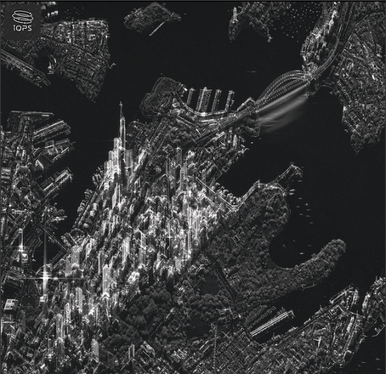
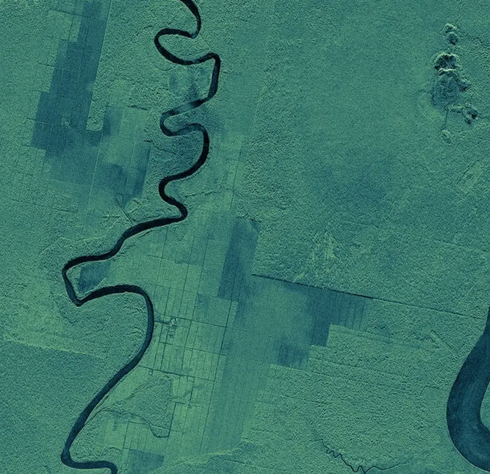
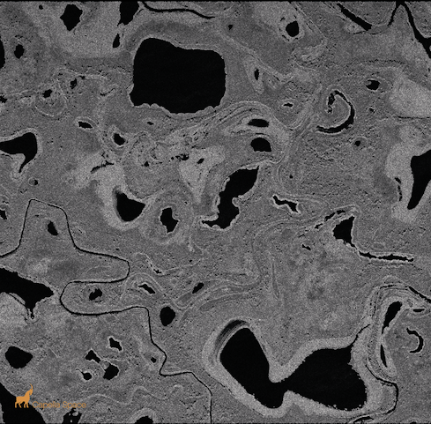
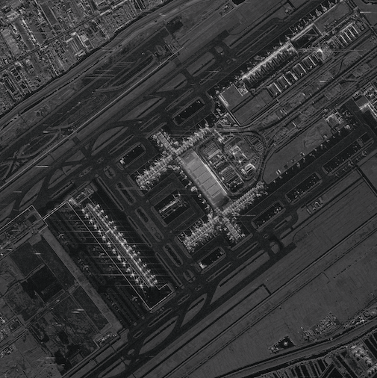
Commercial SAR – SEO Assessment
Increase in small commercial “New Space” SAR companies
X-band SAR systems
Light-weight, low cost
Large satellite constellations (10~50 satellites)
Very high spatial resolution (0.2~2 m)
Very high temporal revisit capacity (daily/sub-daily)
Main market segment: defence, security
Targeted observations per user requests
Strategic background observation plans - probably not
Current (SAR) actors:
Capella Space (USA) [9]
ICEYE (Finland) [32]
iQPS (Japan) [3]
Synspective (Japan) [2]
Umbra (USA) [7]
Others?...
Image credit: Synspective
Image credit: iQPS
Image credit: ICEYE
Image credit: Capella
Image credit: Umbra

Slide 9
Commercial SAR – SEO Assessment
SEO assessment (sample data)
Data quality
Geometry, Radiometry
User friendliness
Product levels
Documentation
Data accessibility
Sample data
Data for purchase
CEOS-ARD
Interest & relevance in providing CEOS-ARD product levels
Mock (self-)assessment of sample products
CEOS Analytics Lab (CAL)
Feasibility for inclusion of sample data
Additional processing?
Image credit: Synspective
Image credit: iQPS
Image credit: ICEYE
Image credit: Capella
Image credit: Umbra

