Slide 1
SIT-39
2024
Global Greenhouse Gas Watch - G3W
Gianpaolo BALSAMO,
Dr. Prof., D/G3W
Agenda Item 7.6
SIT-39 2024, Tokyo, Japan
10th - 11th April 2024

Slide 2




WMO – the World Meteorological Organization in a
To facilitate worldwide cooperation in the design and delivery of meteorological services, foster the rapid exchange of meteorological information, encourage research and training in meteorology.
United Nations specialized agency to address issues related to weather, climate, water and safeguarding the environment for present and future generations.
A world where all nations, especially the most vulnerable, are more resilient to the socioeconomic impact of extreme weather, climate, water and other environmental events, and empowered to boost their sustainable development through the best possible weather, climate and water services
WMO plays a role as a global coordinator for Member countries, harmonizing and supporting the work done across National Meteorological and Hydrological Services around:
Protection of Life and Property
Safeguarding the Environment
Contributing to Sustainable Development
Monitoring the earth system (collecting and sharing Data & Information)
Defining Best Practices
Promoting targeted Science to improve Infrastructure, Service delivery and supporting Policymaking
Contributing to Capacity development, seeking to reduce the development gaps
OUR MANDATE
OUR MISSION
OUR VISION
WMO convention
OUR FLAGSHIPS WMO

Slide 3
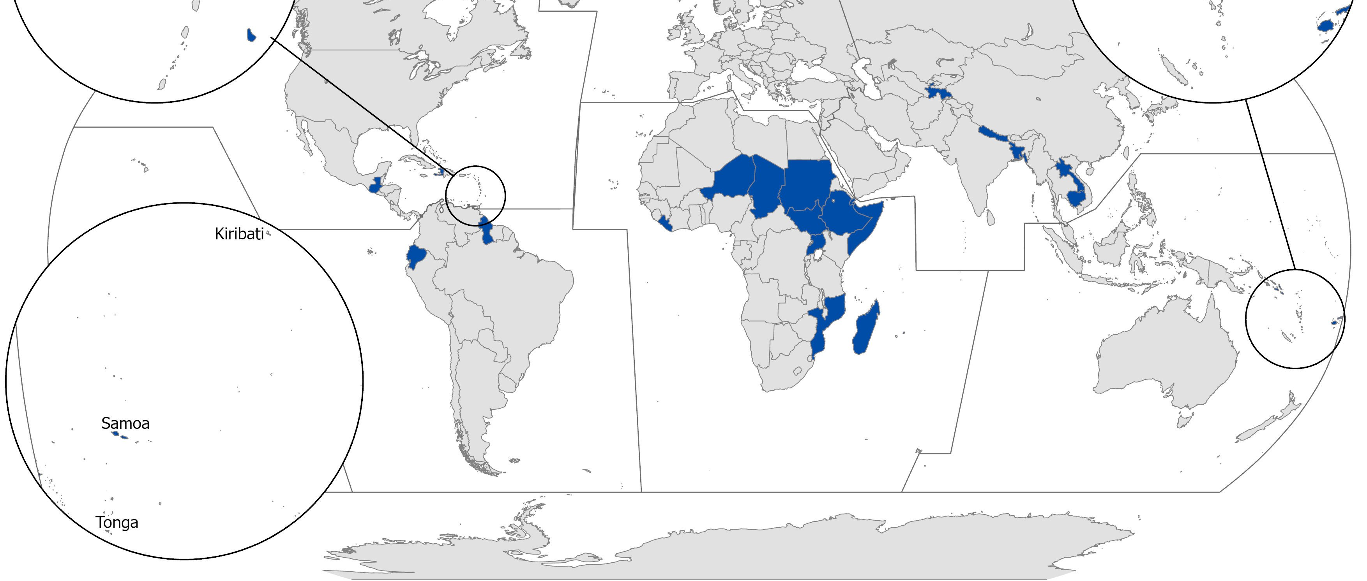






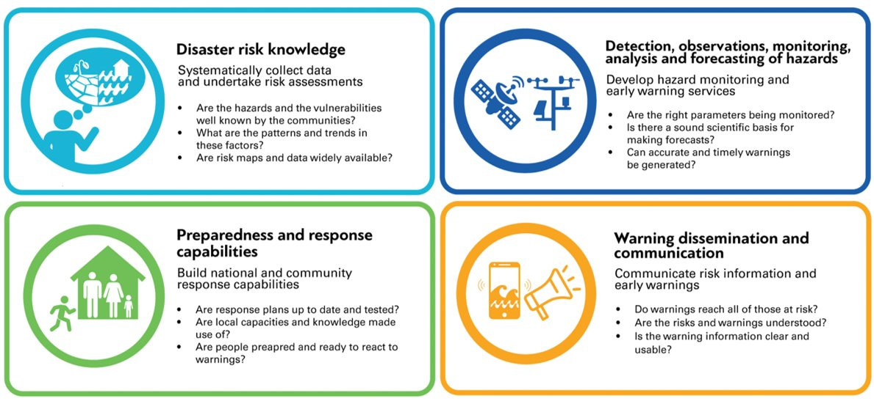



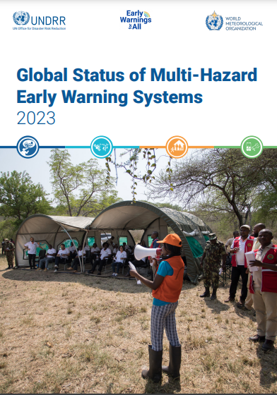


EW4All –the Early Warning for All Flagship in a
The EW4All Flagship will ensure every person on Earth is protected by lifesaving early warning systems by 2027
The delivery of Early Warnings for All requires scale up and coordinated investments and action across the four essential pillars of end to end, people-centred Multi-Hazard Early Warning Systems
How?
Pillar 2 is focused on delivering 5 outcomes:
Increased availability of quality observation data to assess and monitor priority hazards.
Enhanced data exchange and access for forecasting and warning systems.
Increased capabilities to forecast all priority hydrometeorological hazards.
Impact-based forecasts and warnings are produced for all priority hazards.
Strengthened relevant policy, institutional mechanisms, and stakeholder engagement processes in place to support MHEWSs

Slide 4
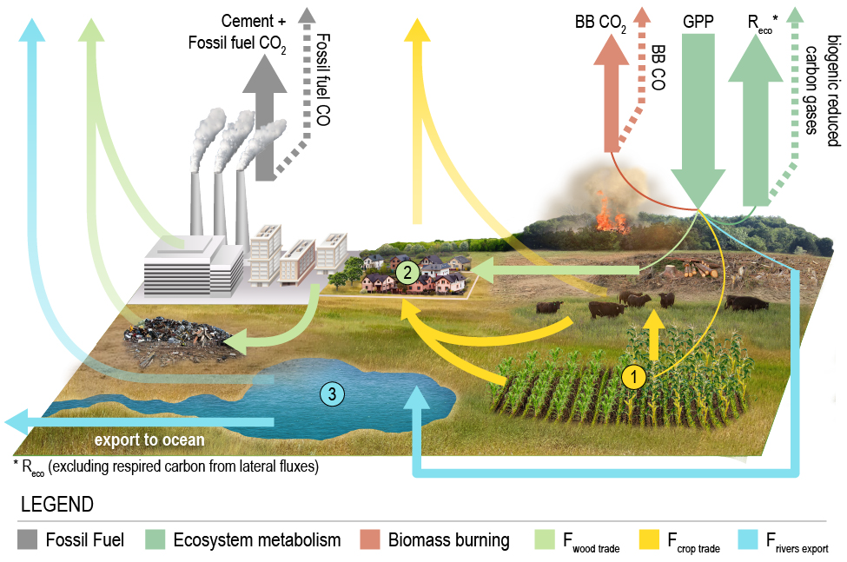
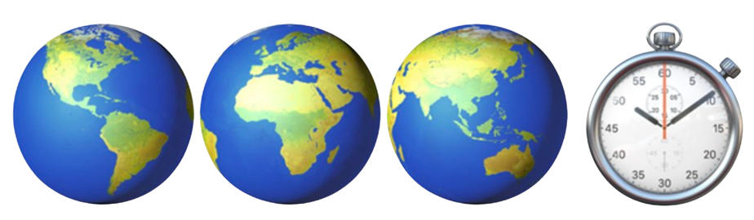
G3W – the Global Greenhouse Gas Watch Flagship in a
The G3W Flagship responds to UN sustainability’s call, via Climate Action (mitigation) for Climate Neutrality Goal
G3W Master-Plan
  G3W-IPP Implementation & Pre-Oper Phase 2024-27
  G3W-IOP Initial Operational Phase 2028-31 (GST-2)
  G3W-EOP Enhanced Operational Phases 2032-50
G3W Financial Sustainability
  WMO-RMS the Resources Mobilisation Strategy for G3W
  1 B$ : 70% Observations, 29% Integration, 1% Coordination
G3W Working Structure
  INFCOM-SC-ET Expert Teams
  INFCOM-AG from the WMO-G3W-SG
  WIGOS / WIPPS / WIS synergy
Byrne et al. 2022 ESSD
G3W – Global Greenhouse Gas Watch

Slide 5

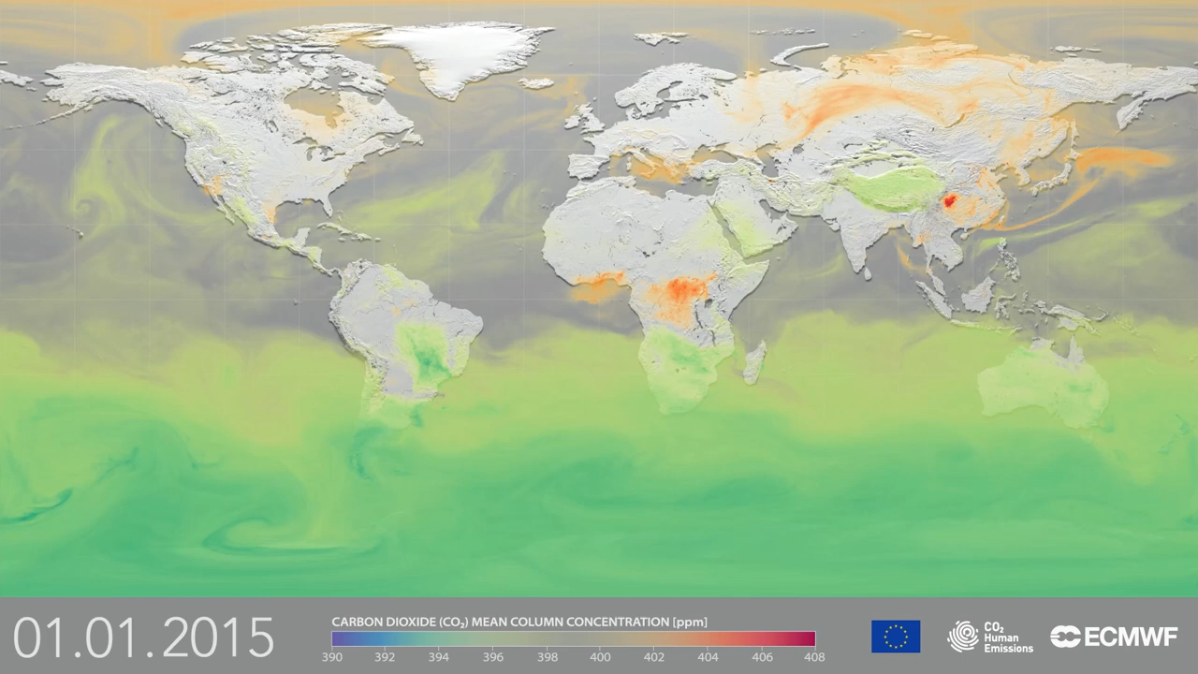
The “What, How & Why” for the G3W Flagship
COP21 Paris Agreement
What: The Global Greenhouse Gas Watch - G3W fills critical information
gaps on greenhouse gases (GHGs), via an integrated operational framework that optimally combine Earth Observations with Earth System Models
using Data Assimilation & Artificial Intelligence techniques to
reduce uncertainty in assessing the efficacy of Climate Action.
How: a Timely Policy-relevant information on GHGs concentrations and fluxes allowing to assess both the Natural & Human influence on climate change https://wmo.int/activities/global-greenhouse-gas-watch-g3w
Why : an Earth System Approach is a must-have because Earth’s climate responds to the laws of Climate Physics and depends Atmospheric GHGs,
NOT on Claimed Offset of Carbon emissions or to Good-will of Pledges.

Slide 6
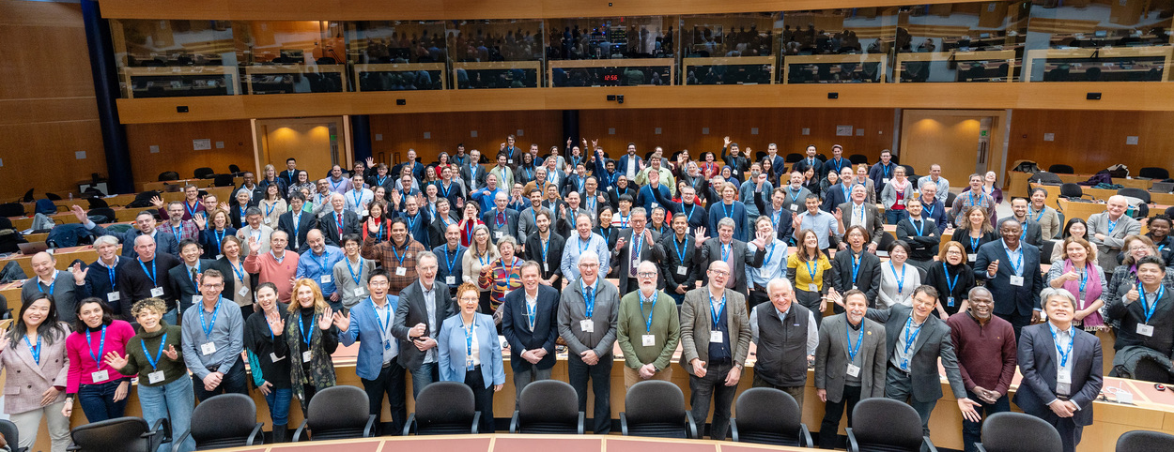
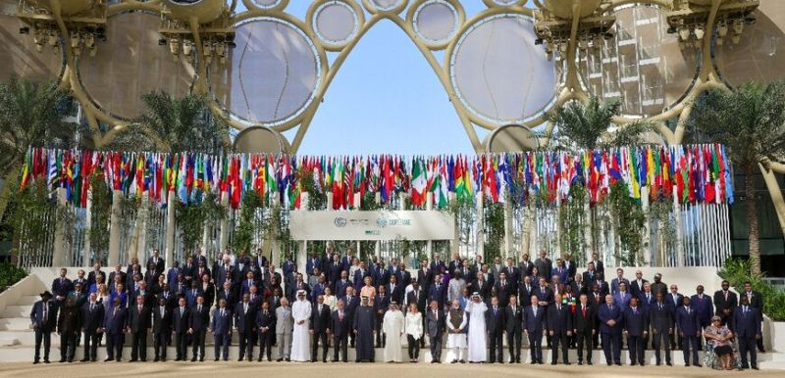

G3W Plan in Action
In 2023 two WMO key events
1st WMO GHGs Monitoring Symposium
G3W reaches broad science support
19th World Meteorological Congress intergovernmental agreement approved G3W proceeds with development
COP28 raised the profile of the
Global Greenhouse Gas Watch – G3W
WMO prominent exposure at COP28 in particular at the Earth Information Day
G3W is noted by 196 Nations
in the SBSTA-59, providing
a successful closure of COP28 for G3W

Slide 7
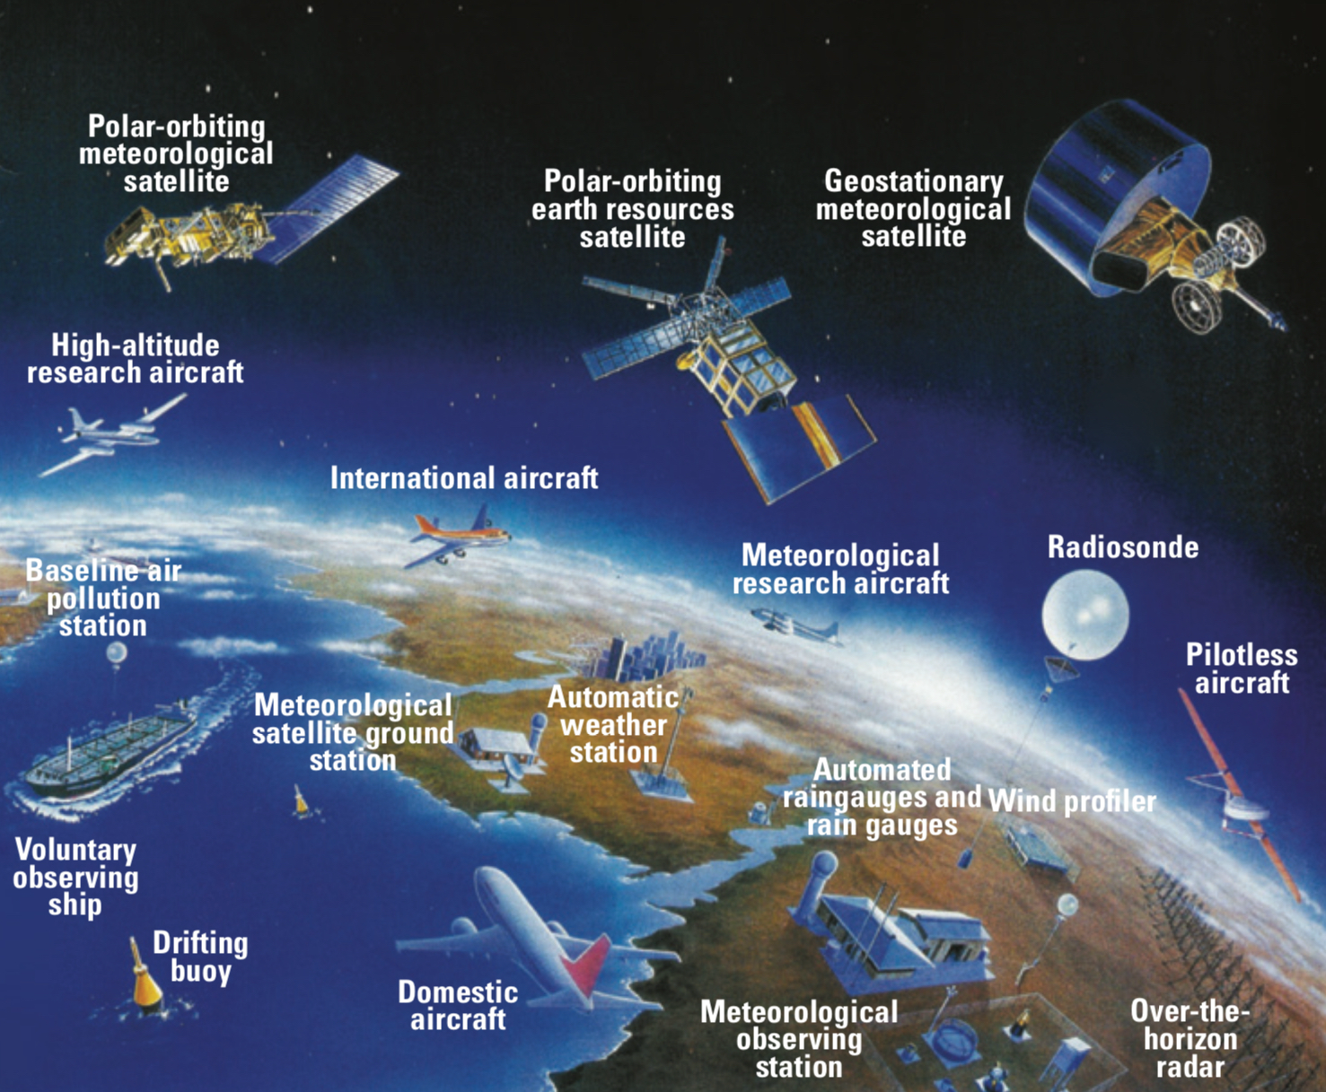

G3W – Global Greenhouse Gas Watch
2023 2024 -- 2027 2028 -- 2031 2032 -- 2050
Cg-19 → G3W
WMO Congress
G3W – IPP
Implementation Pre-Oper Phase
G3W – IOP
Initial Operational Phase
G3W – EOP
Enhanced Operational Phase
GST-1
Initial Monitoring Systems
GST-2
Enhanced Systems
GST-n
COP28
COP33
ETF, NDCs
“for Measuring, Understanding, and Managing the Earth’s Climate”
UN family
IPCC-IOC-
UNEP-UNFCCC-
WHO-WMO-WTO
UNFCCC
Public-Private Partnerships
COP-SBSTA
WMO
WIGOS-WIS-WIPPS
CO₂, Carbon dioxide
GHGs Earth’s Observing Systems is building on Weather experience

Slide 8
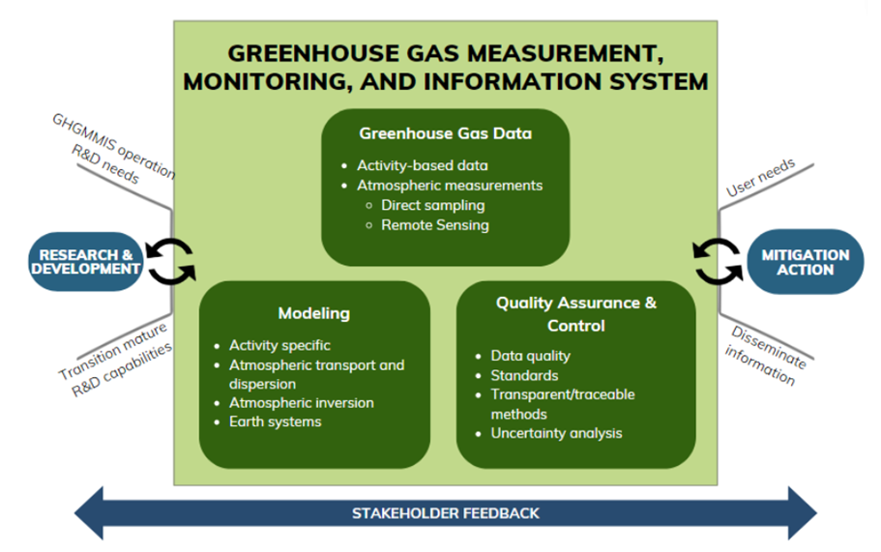
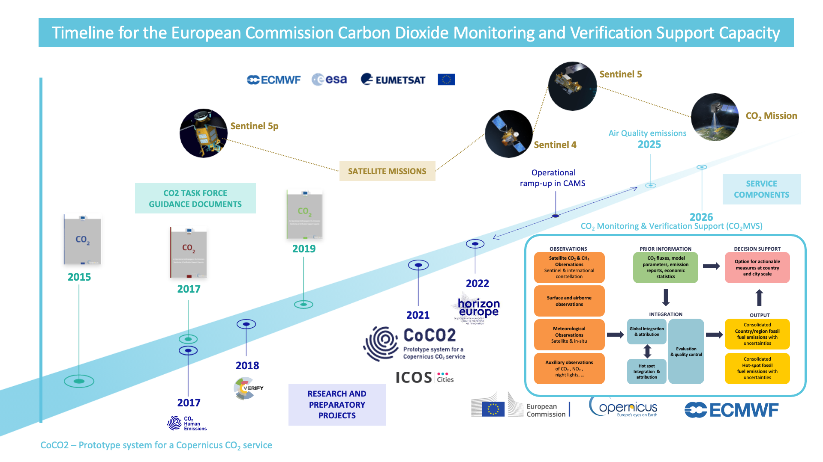
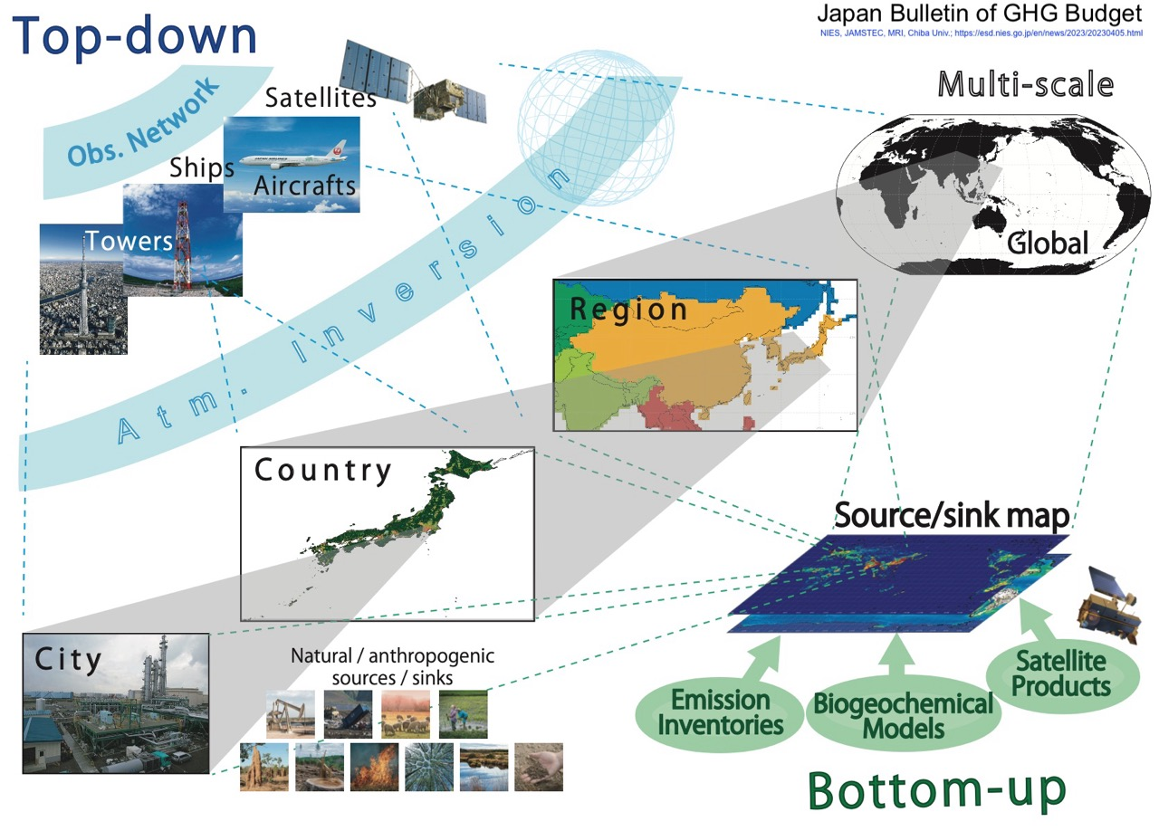
Synchronizing with National & Regional efforts
In 2024 the G3W Implementation Plan, the G3W Sustainability Strategy documents.
In 2025 & 2026 the Ramp up Operations with sustained funding sources (WMO + External).
This is in good alignment with fast-track GHGs information efforts, such as in EU, JAPAN, US, ...
US GHGMMIS, 2023
EU COPERNICUS, 2023
JAPAN NIES, 2023
G3W – Global Greenhouse Gas Watch

Slide 9
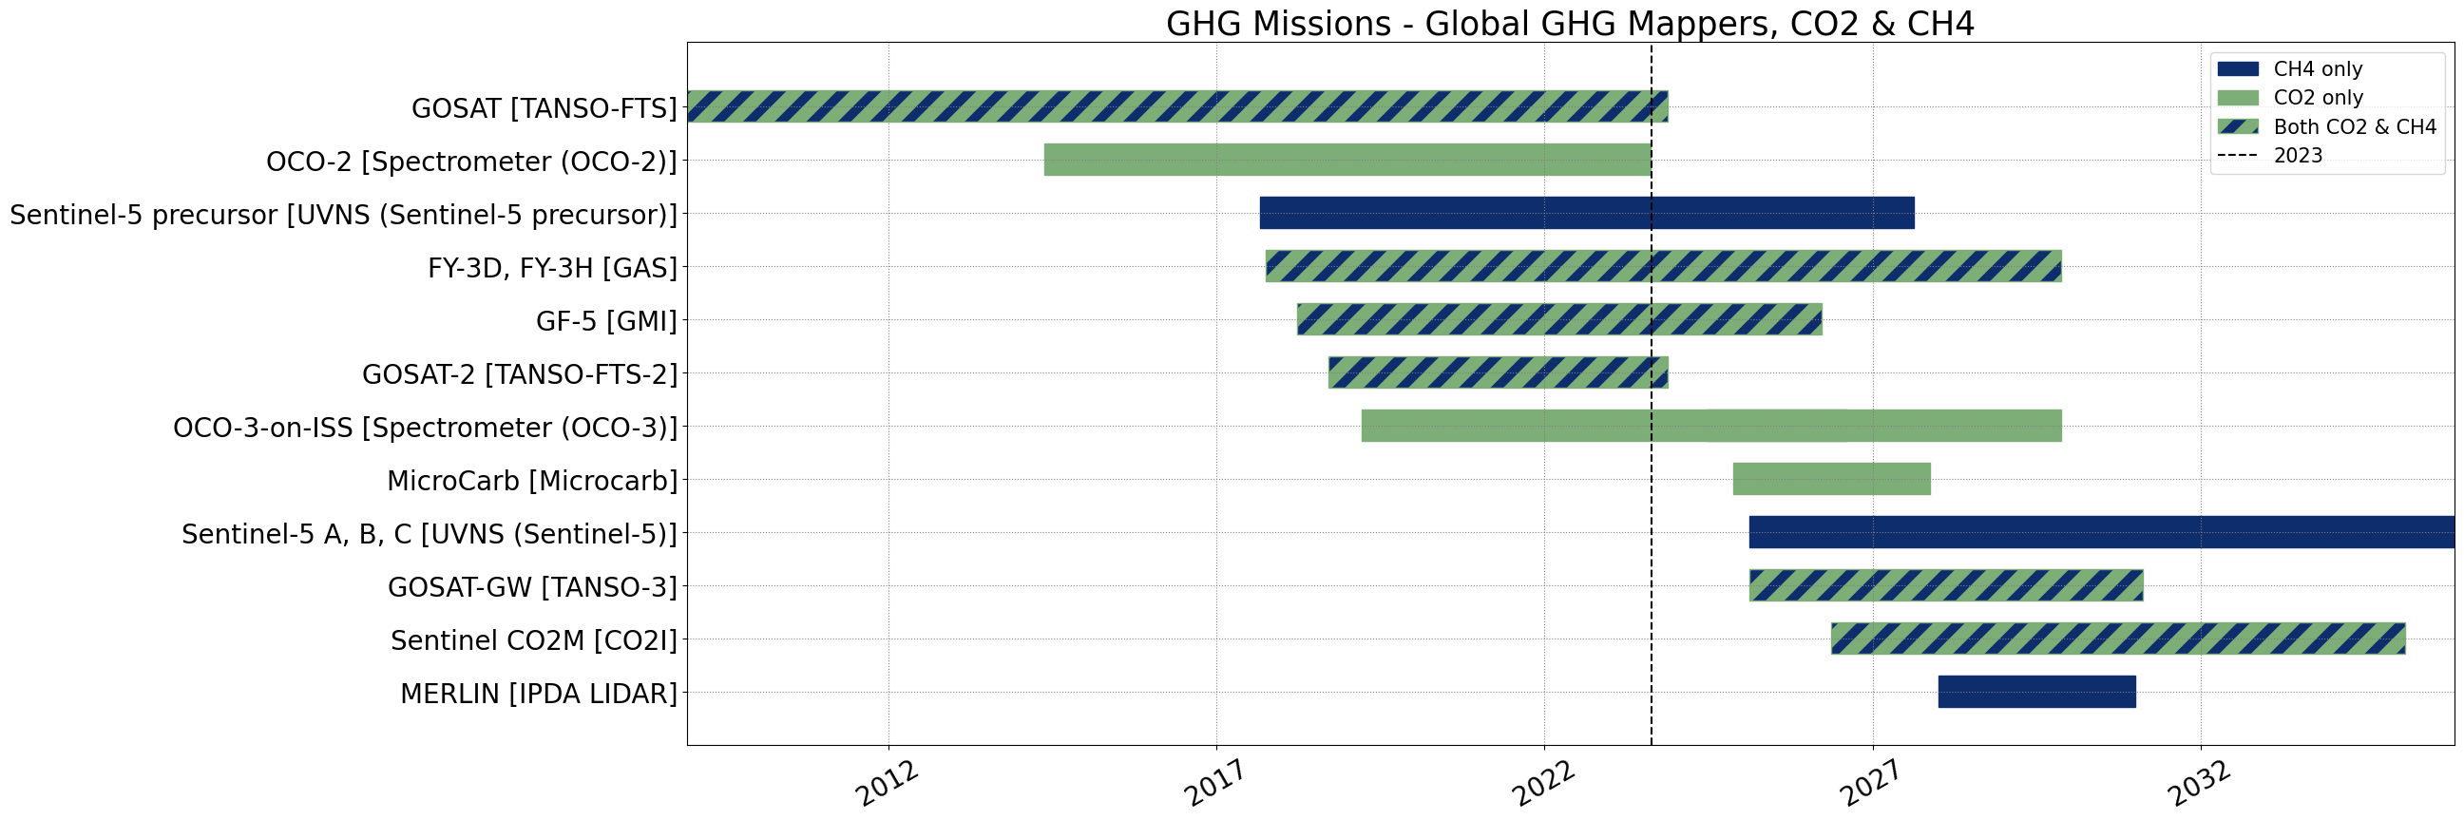
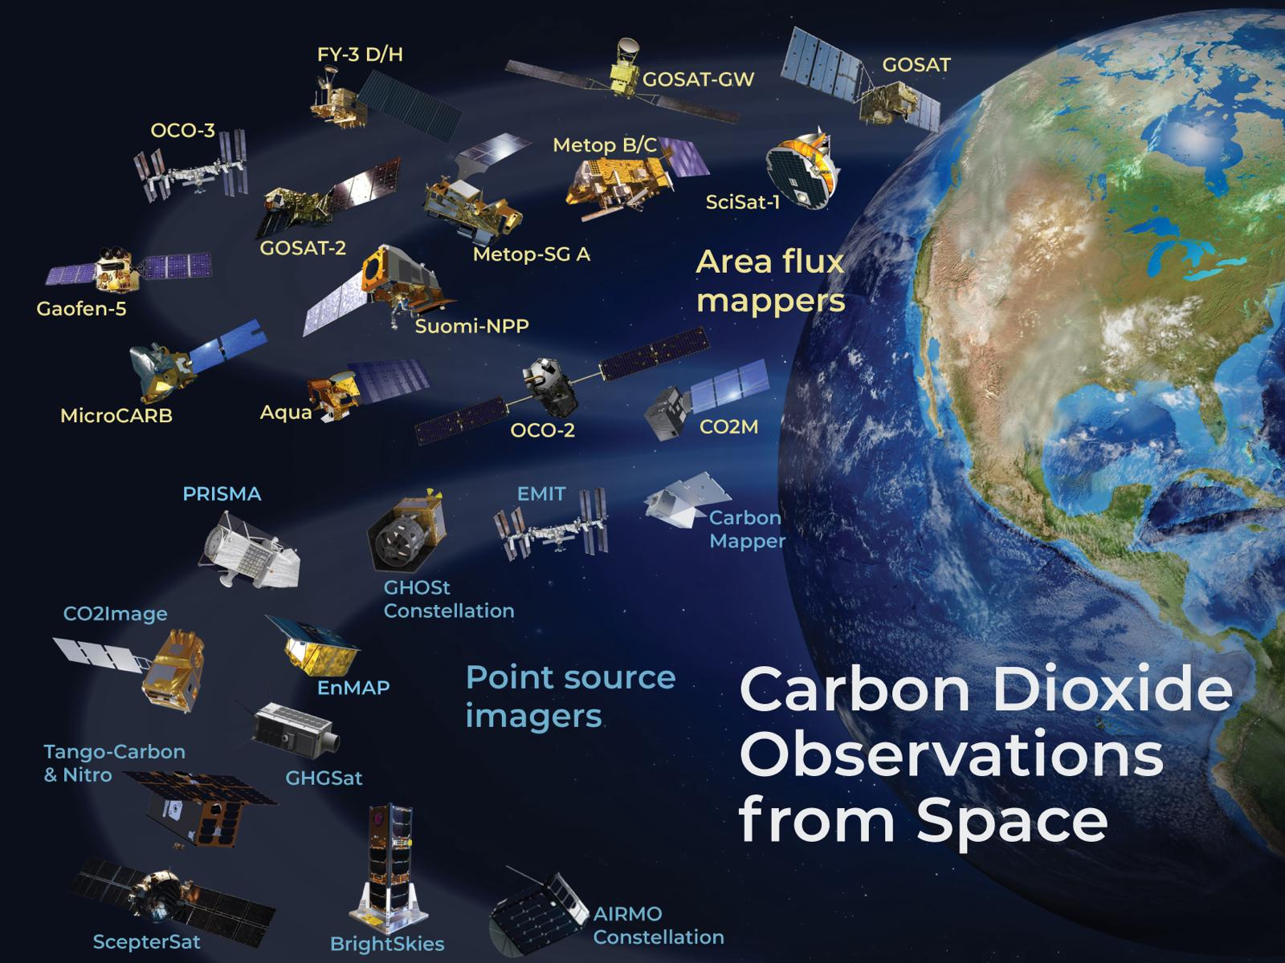
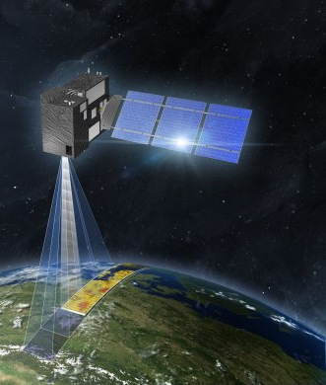
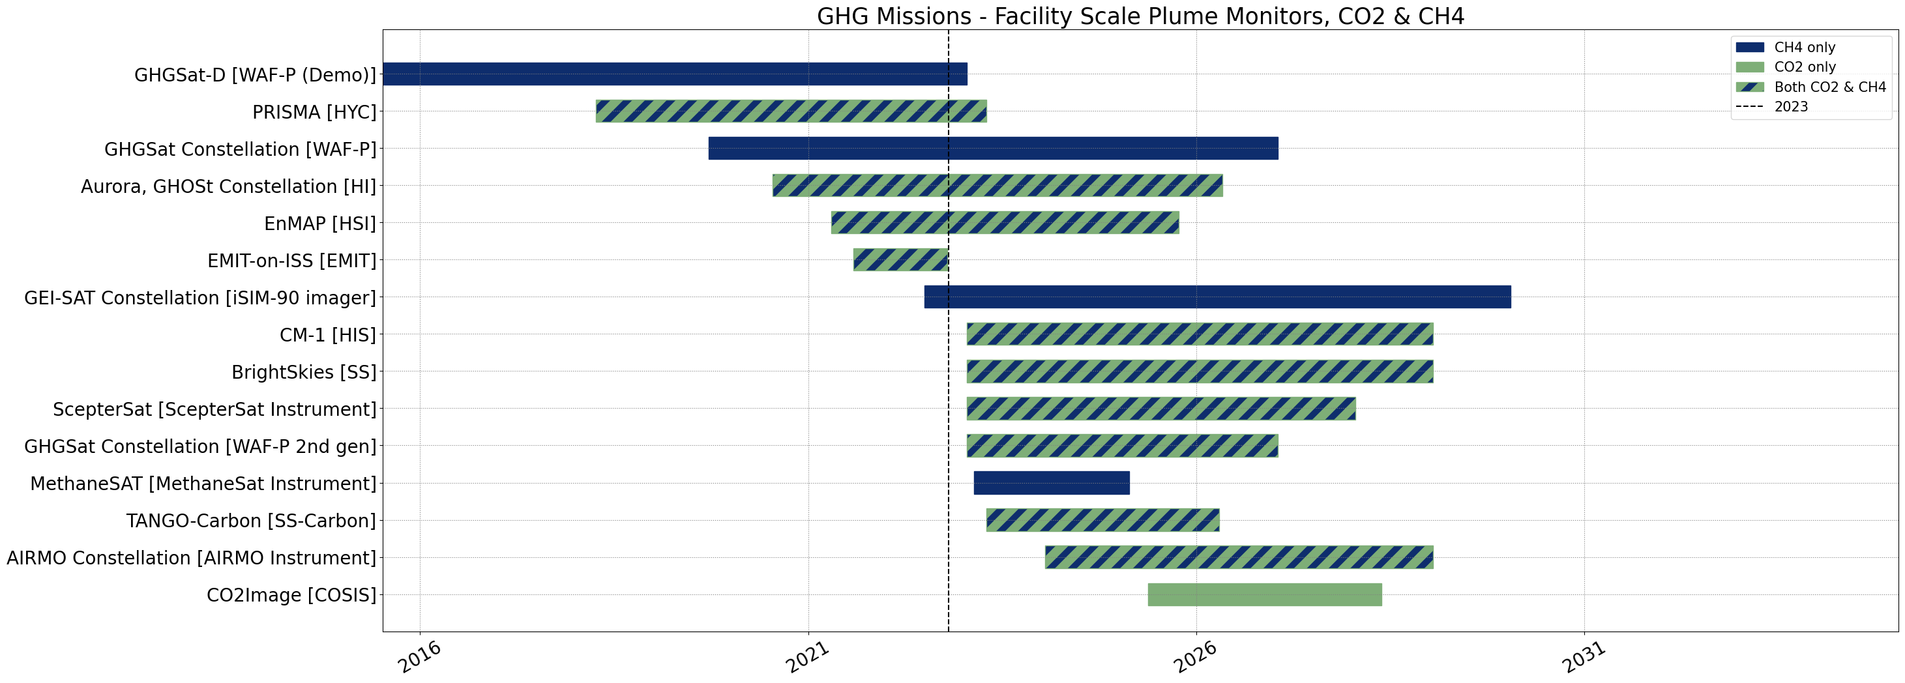
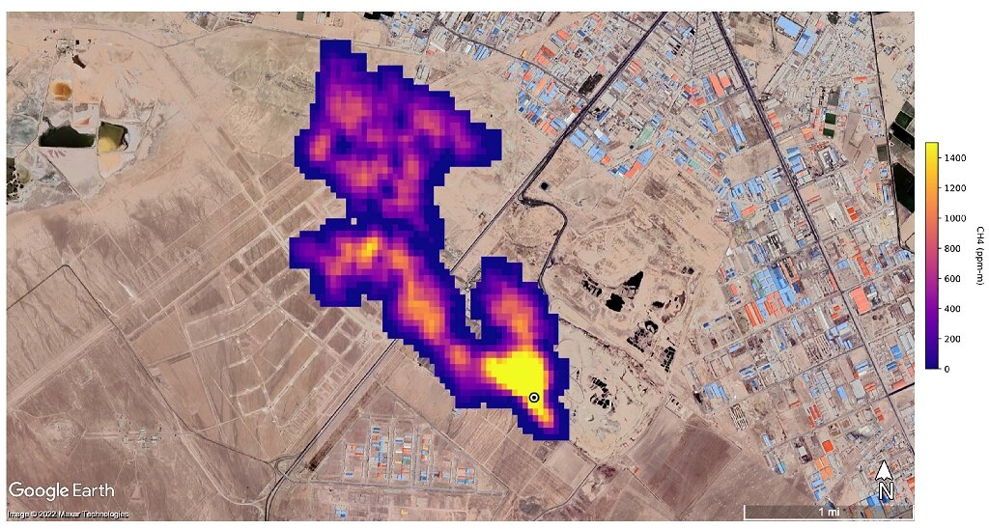
Synchronizing with Space Agencies
In 2024-27 the G3W IPP Implementation and Pre-operational Phase, it is crucial for the global coverage of local relevance that G3W Space Remote Sensing components are well coordinated.
This is thanks to CEOS and to CGMS
Mappers
Spotters
CEOS – Committee on
Earth Observations Satellites
+
CGMS – Coordination Group on
Meteorological Satellites

Slide 10
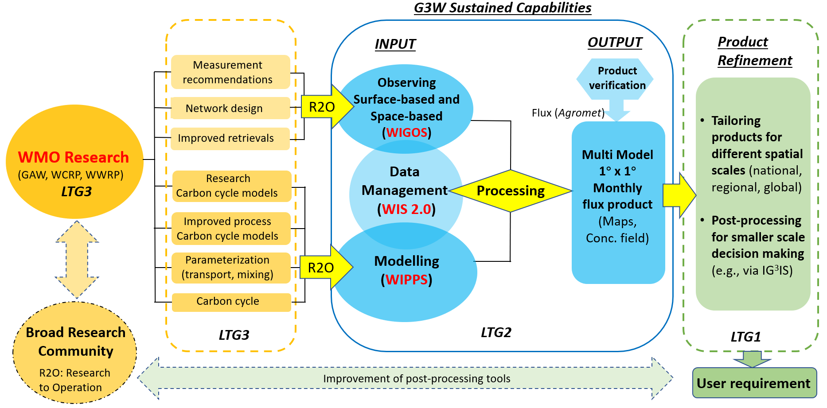
G3W Infrastructure, Service, and R&D capabilities
Notes:
R2O: research to operational

Slide 11
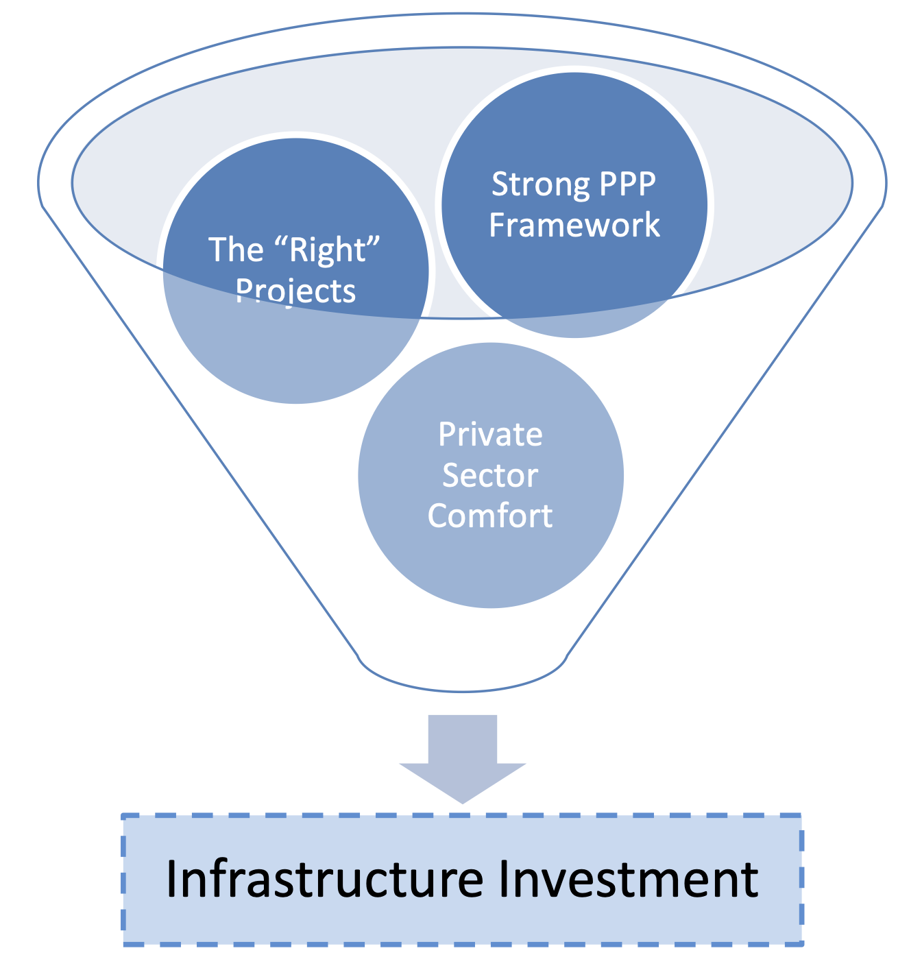
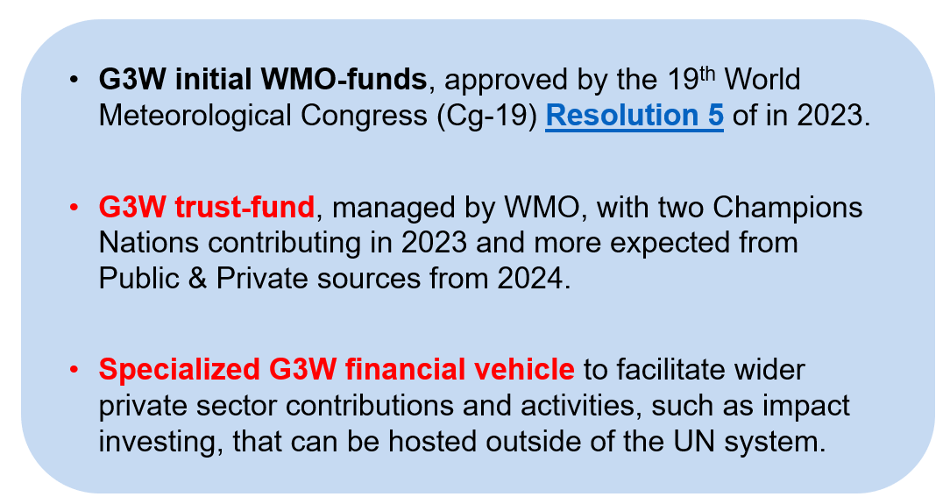
Synchronizing with Private Funding Opportunities
To address infrastructure / service needs G3W aims at
Mobilising significant resources increase in 2024-2027.
Funding mechanisms include 3 pathways:
World Bank, 2016a, #3553
G3W – Global Greenhouse Gas Watch

Slide 12
G3W potential contributions SIT-39
Draft of recommendations from G3W
1) EO Satellite-based and Surface-based requirements for (eg. timeliness) need to satisfy G3W Operating Centres
2) Regular updates communicating existing and upcoming GHGs satellites capabilities (public & private) is a necessity
3) G3W Cal/Val activities aim at co-development in collaboration with Satellite Agencies and National and Regional efforts

Slide 13
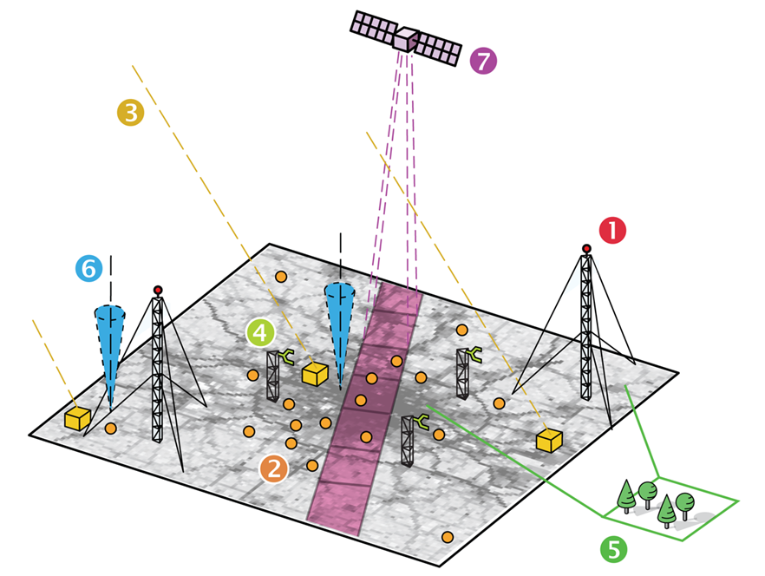
Role of Earth Observations in G3W concept
The list of observable parameters required for the realization of the G3W is extensive, but clear priorities can be identified. Here the priorities are listed within five categories, from A (highest) to E (lowest):
A. Ground-based measurements of GHGs
B. Remote-sensing and vertically resolved observations of GHGs
C. Ocean carbon cycle observations
D. Direct GHG flux observations
E. Higher tier observations
The minimum G3W system should have adequate observations from at least categories A, B and C. An adequate number of stations should provide observations of the lowest tier (category E), based on the overall network design
Tall towers (1), street level mid-cost sensors (2), roof level stations (3), eddy covariance flux stations (4), ecosystem parameters (5), total column GHG and meteorology (6) and satellite (7) observations, in many parts including co-emitted species (from: ICOS Cities)
 | 13

Slide 14
  Workshop recommendations: Status of observations and gaps
Spatiotemporal data gaps: over the Tropics, in Africa, over the open oceans, Arctic ecosystems, lack of vertically resolved measurements
Validation gap: Ground-based remote sensing even more sparse than in situ, satellite cross-validation
Operational concerns: No exhaustive inventory of available measurements, not timely for satellite validation, lack of definition of “good enough” measurements, planning of missions
Financial gap: lack of funds for maintenance, research-based funding
Workforce gap: not enough trained staff to support measurements
Communication gap: unclear how to make use of the observations
Satellite agencies can help in:
addressing spatial and temporal gaps
ensuring sustainability of the satellite observations
assisting with the training of personal
communication regarding use of integrated observing system in support of the decision-making products generation

Slide 15
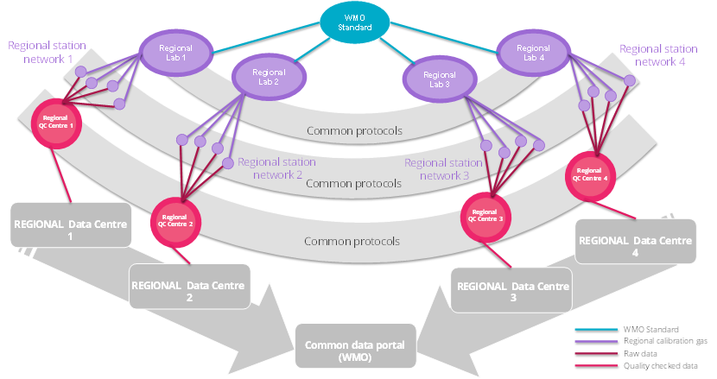
  Workshop recommendations: Integration and standardization
Key aspect of integration is the integration of remote-sensing and in situ information for the same variables
Integrated system needs an “all domains approach” which somehow retains the specific requirements of each individual domain (land, ocean, atmosphere).
Multi-purpose measurements programme: inclusion of additional variables to constrain better priors (inundation datasets, higher frequency burned area, anything that improves the temporal profile of priors, vegetation type)
Calibration is important, needs to be globally available (distributed calibration facilities)
Existing standards need to be used as much as possible
Metadata standards and metadata reporting needs to be consisted across and within domains
A tiered observing network, that includes a ‘reference’ quality component throughout the world can help provide a framework for integrated observing systems

Slide 16
  Workshop recommendations: Data systems & Data utilization
Data exchange is important for GGGW implementation;
Data management needs to be funded as an integral part of GGGW;
Guiding principle: FAIR and Open: leverage the existing WMO standards(WIS2 and WIGOS); maintenance of standards, sensitive to user communities, cloud friendly
Metadata/data reporting practice for uncertainty reporting and provenance are needed
Data access can be federated, but sufficiently centralized
Timeliness can be improved; will be easier if different data streams can be accommodated: (i) quick turn-around “NRT” data, as is, within days of measurement time; (ii) Final, quality-controlled data within months of measurement time;
Sustainability (also of data management systems) is important
Satellite agencies can provide free and unrestricted access to as much relevant data as possible with the latency of 3 days or better
Communication of the value of integrated system (both in situ and satellite) is critical for user support

Slide 17
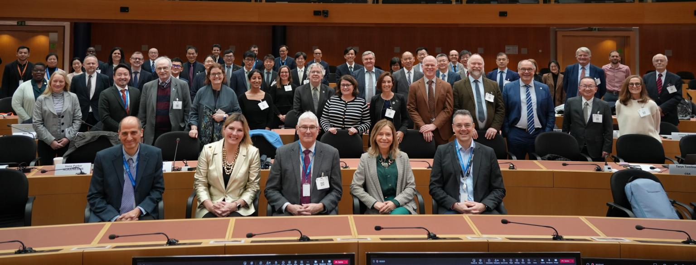
WMO Global-Coordination: Space Agencies in Geneva 2024
G3W presented at 15th Session of Consultative Meetings on High-Level Policy on Satellite Matters
G3W to be presented to CEOS and to CGMS and to INFCOM-3 Intergovernmental session in April 2024

Slide 18
GCOS-GAW & G3W synergies with relevance to SIT-39
The G3W Implementation Plan is to be presented to INFCOM-3 and here the official documents:
https://community.wmo.int/en/meetings/global-greenhouse-gas-watch-g3w-implementation-plan
There are 3 areas of potential synergies GCOS-GAW and G3W:
Observation Requirements differences within GAW and G3W with reference to GHGs observations entering in GCOS information products, and in G3W (e.g. NRT capability).
An analysis of the common gaps in GCOS and G3W (e.g. Deep-Oceans Carbon storage role, Cryosphere melting role with respect to GHGs)
Emerging Climate Indicators for Critical Tipping Points (e.g. Amazon CO2 absorption loss, Permafrost collapse CH4 release, others…) codesigned by GCOS & G3W to setup an early TP detection.
Optimal Network Design Workshop in Q3/Q4 2024 if possible.
COP30 Thematic programme of common interest to GCOS & G3W activity.
G3W communication via website and outreach activities. G3W is user-driven & science-driven.
GCOS & G3W resources via common projects (Horizon Europe)

Slide 19

G3W and Private Sector consideration for SIT-39
CEOS SIT-39 feedback on private sector engagement welcome
G3W initial reflections on private sector support
G3W costed plan will be presented to INFCOM-3
G3W value proposition refinement & ROI study
Public-Private-Partnership & Carbon Market

Slide 20
G3W Implementation Plan: Progress in 2024
A 1st complete draft of G3W IP with WMO RMS contribution on the 18th of January 2024.
G3W-SG & G3W-Team worked to consolidate the G3W IP up to the 22nd of January 2024
G3W IP v1.0 published on the web, for an Open-Community-Review on the 23rd of January 2024
G3W IP v2.0 presented to INFCOM-Management on the 7th of February 2024
G3W to be presented to WMO INFCOM-3 in the week of the 15th of April 2024.
G3W to be presented to WMO EC-78 in the week of the 10th of June 2024.
2023 2024 -- 2027 2028 -- 2031 2032 -- 2050
Cg-19 → G3W
WMO Congress
G3W – IPP
Implementation Pre-Oper Phase
G3W – IOP
Initial Operational Phase
G3W – EOP
Enhanced Operational Phase
GST-1
Initial Monitoring Systems
GST-2
Enhanced Systems
GST-n
COP28
COP33
ETF, NDCs

Slide 21
G3W Acknowledgements
THE G3W Study GROUP MEMBERS
Assoc. Prof. Ren, Chao - Member- ( Hong Kong, China )
Daniele Biron - Member- ( Italy )
Dr Anya Waite - Member- ( Canada )
Dr Bruce Ward FORGAN - Member- ( Australia )
Dr Dagmar Kubistin- Member- ( Germany)
Dr Erik ANDERSSON - Member- ( ECMWF )
Dr Frank E Muller-Karger - Member- ( United States of America )
Dr Gary Morris- Member- ( United States of America )
Dr Jocelyn Christine TURNBULL - Member- ( New Zealand )
Dr Joe Melton - Member- ( Canada )
Dr Kevin Cossel - Member- ( United States of America )
Dr Lucia Perugini - Member- ( Italy )
Dr Paolo Ruti - Member- ( EUMETSAT )
Dr Salah Mahmoud, Zeinab - Member- ( Egypt )
Dr Tobias FUCHS - Member- ( Germany )
Dr Toste Tanhua - Member- ( Germany )
Dr Tuula Aalto - Member- ( Finland )
Dr Vanda Grubišić - Member- ( United States of America )
Dr Vincent-Henri PEUCH - Chair/Co-chair- ( ECMWF )
Dr Ward Nolan SMITH - Member- ( Canada )
Dr Xingying ZHANG - Member- ( China )
Matthew Tully - Member- ( Australia )
Mr Alex Vermeulen - Member- ( Sweden )
Mr Dolman, Albertus Johannes (Han) - Member- ( Netherlands )
Mr Michel JEAN - Member- ( Canada )
Mr Paul Counet - Member- ( EUMETSAT )
Mr Xiaochun Zhang - Member- ( China )
Mr Yasjka MEIJER - Member- ( European Space Agency (ESA) )
Ms Shanna T.L. COMBLEY - Member- ( United States of America )
Prof. Alistair James Manning - Member- ( United Kingdom of Great Britain and Northern Ireland )
Prof. Greg CARMICHAEL - Chair/Co-chair- ( United States of America )
Prof. Manola BRUNET INDIA - Member- ( Spain )
Prof. Pierre FRIEDLINGSTEIN - Member- ( United Kingdom of Great Britain and Northern Ireland )
Prof. Thelma KRUG - Member- ( Global Climate Observing System (GCOS) )
Yousuke Sawa - Member- ( Japan )
THE G3W Study GROUP
The Executive Council (EC-75, June 2022) decided to form a joint Study Group between INFCOM, SERCOM and the Research Board.
INFCOM Executive meeting (Sept 2023) approved the updated ToR of the SG-GHG.
35 GHGs experts engaged for 8-month
Several writing teams have contributed
Expertise across all planetary spheres (biosphere, atmosphere, hydrosphere, cryosphere, anthroposphere)
Diversity of competencies & background with complementarity allowed to form a
Balanced Team

Slide 22
Thank you. 🌻
CLIMATE ACTION NEEDS
SCIENCE DRIVEN – CONSENSUS BASED
CLIMATE DATA – INFORMATION - KNOWLEDGE
Take Home 🏠 message
^{wmo.int}

