Slide 1
Lessons Learned and Recommendations from Space Agencies’ Support for the First Global Stocktake
WGClimate
Agenda Item 4.3
SIT-40
Fukuoka, Japan
8-10 April, 2025

Slide 2
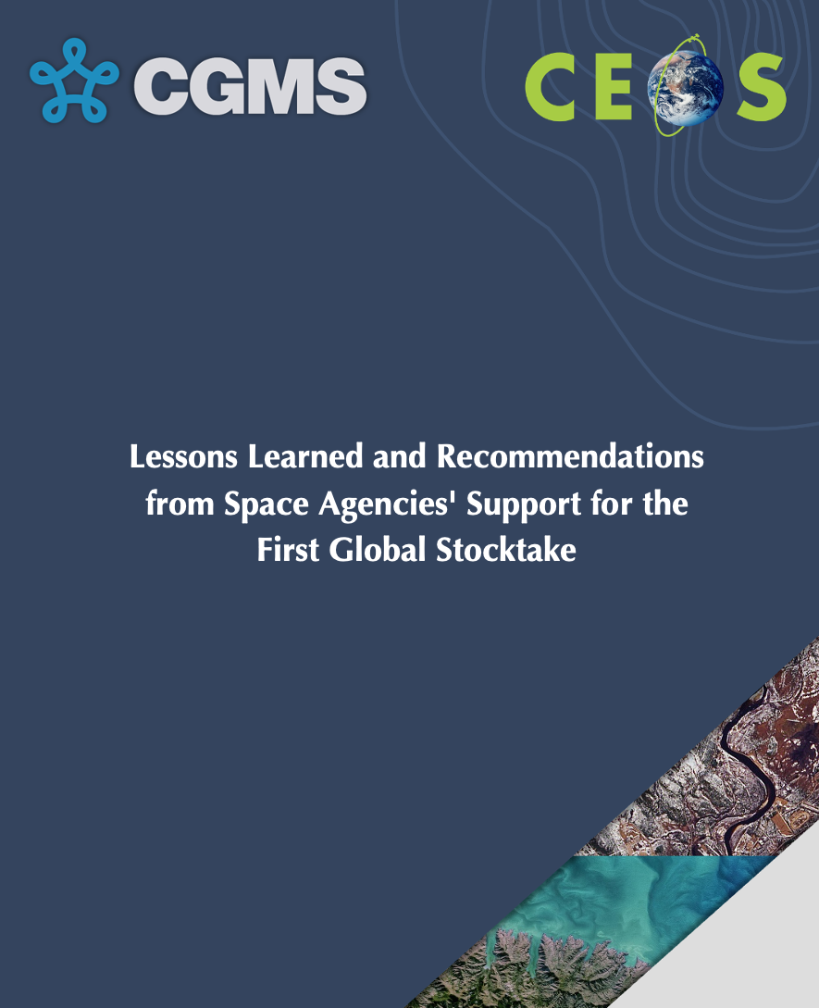
Lessons Learned and Recommendations – for Endorsement
Initial study findings were presented at SIT TW and CEOS Plenary in 2025
Draft report circulated for CEOS and CGMS colleagues’ review on February 18 and February 26.
Report was open for comments until March 14.
Document submitted for CEOS agency review on March 20.
Seeking CEOS endorsement at SIT-40.
Will submit for CGMS endorsement on shortly.

Slide 3
Background
CEOS provided the pilot top-down CO2 and CH4 inventories to support GST1 in 2023.
Received positive recognition at international settings, but few national inventory compilers have adopted these satellite-based data to support inventory development or for quality assurance or quality control.
CEOS & CGMS are reevaluating their approach to inform future efforts. The lessons learned and corresponding recommendations are categorized into three key areas:
GHG flux datasets
Stakeholder engagement
Communication

Slide 4
GHG Flux Datasets
Lesson 1.1: The Need for Reconciling GHG Estimates and Quantifying Uncertainties
Recommendation 1.1: Reconciling the Top-Down and Bottom-Up GHG Emission Estimates and Improve Uncertainty Evaluation
Lesson 1.2: Limited Utility for Smaller and Mid-Sized Countries
Recommendation 1.2: Develop Higher Spatial Resolution Atmospheric Inverse Models
Lesson 1.3: Sustainability of GHG Monitoring Systems and Data Provision
Recommendation 1.3: Operationalize the GHG Monitoring System for Long-Term Data Provision

Slide 5
Stakeholder Engagement
Lesson 2.1: Limited Advocacy and Fragmented Representation at UNFCCC Events
Recommendation 2.1.1: Build Stronger Relationships with COP Delegates and Leverage CEOS and CGMS Member Countries at Key UNFCCC Events
Recommendation 2.1.2: Identify Champions for Space-based data among COP Delegates
Recommendation 2.1.3: Leverage WMO as a Credible Central Channel for Communication at the COPs
Recommendation 2.1.4: Empower National Delegation to Champion Space-based Earth Observations at EID and throughout the COPs
Recommendation 2.1.5: Establish a Dedicated “Tiger Team” for Coordination

Slide 6
Stakeholder Engagement
Lesson 2.2: Lack of Collaboration with National Inventory Agencies
Recommendation 2.2: Enhance Country Engagement Through Targeted Support, Capacity Building, Strategic Partnerships, and Co-Development of GHG Flux Products
For developed countries: foster strong partnerships through "twinning" exercises - representatives from space agencies paired with counterparts from national inventory agencies
For developing countries: emphasis on building capacity and providing technical support through a dedicated initiative

Slide 7
Stakeholder Engagement
Lesson 2.3: Limited Engagement with IPCC Contributions to the Global Stocktake
Recommendation 2.3.1: Enhance CEOS-CGMS Support for the IPCC Assessment Reports
Recommendation 2.3.2: Foster Continuing Collaboration with IPCC-TFI to Enhance the Utility and Encourage the Use of Space-based Observations for Inventory Development and QA/QC
Lesson 2.4: Limited Engagement with the Global Carbon Project
Recommendation 2.4: Strengthen Relationship with International Scientific Inventory Developers

Slide 8
Communication
Lesson 3.1: Bridging Knowledge Gaps Among Inventory Compilers
Recommendation 3.1: Equip Inventory Compilers with Targeted Training and Resources
Lesson 3.2: Addressing Limited Awareness of Space-Based Data Among COP Delegates
Recommendation 3.2: Raise Awareness of Space-Based Data Through Targeted Communication

Slide 9
Concluding Remarks
Addressing these lessons and executing the recommendations outlined in this report will position satellite-derived observations as indispensable tools for accurate climate monitoring, reporting, and action.
Many of the recommendations have already been independently validated by others.
Each recommendation can be a multi-year project and prioritization is needed.
Work have already started to address some of the recommendations.
Increasing engagement with IPCC TFI (item 4.2)
Establishing a ‘Tiger Team’ for coordination (item 4.5)
National inventory engagement session at WGClimate #22 (item 6.1)
Step-by-step guides (item 6.2), interactive workshop, tailored training 🡪 regional satellite data experts for guidance
Reconciling and uncertainty quantification efforts are also underway
Notes:
detailed step-by-step guides, interactive workshops, and user-friendly documentation

