Slide 1
WGClimate-22 National Emission Estimates Session
Wenying Su
NASA, WGClimate Chair
Agenda Item 6.1
SIT-40
Fukuoka, Japan
8-10 April, 2025

Slide 2
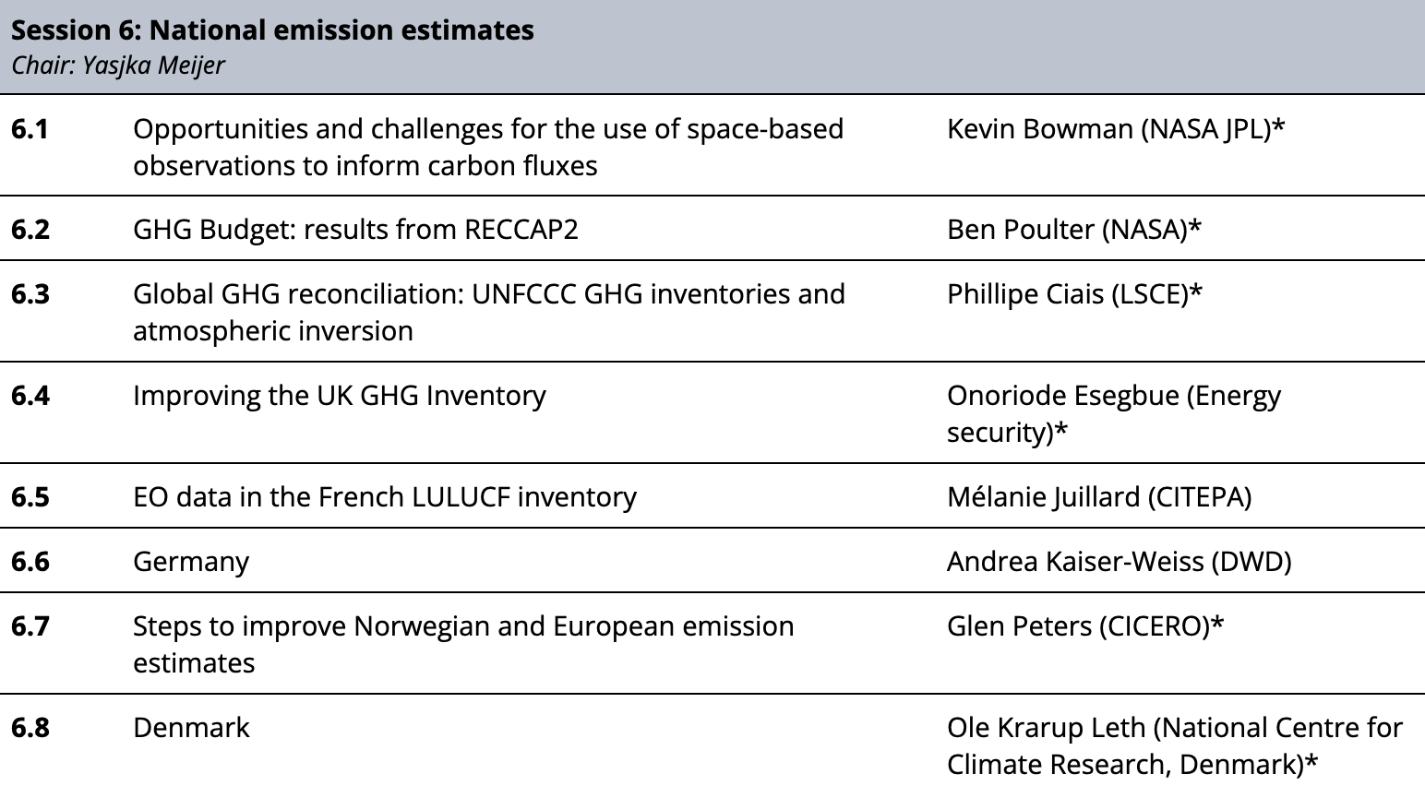
National Emission Estimate Session
Goals:
To initiate a dialogue between national inventory teams and space agencies
Understand opportunities and barriers for the uptake of EO for national inventories

Slide 3
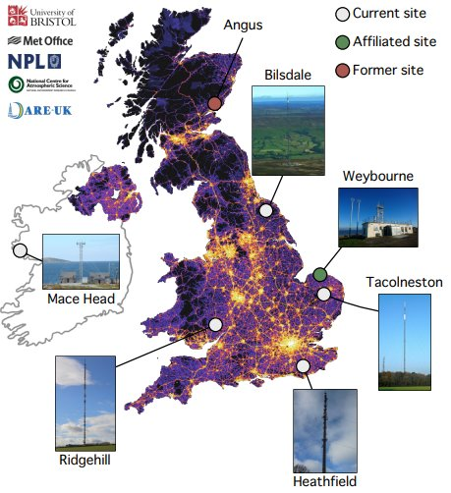
UK
Aiming to produce a transparent, complete, and accurate GHG Inventory that is fit to track progress towards net-zero emissions
GHGSat data is used for validation, comparing facility scale data with reported emissions
Collaborating with the GEMMA programme to exploring how ground-based and satellite-based EO data can be integrated into the inventories

Slide 4
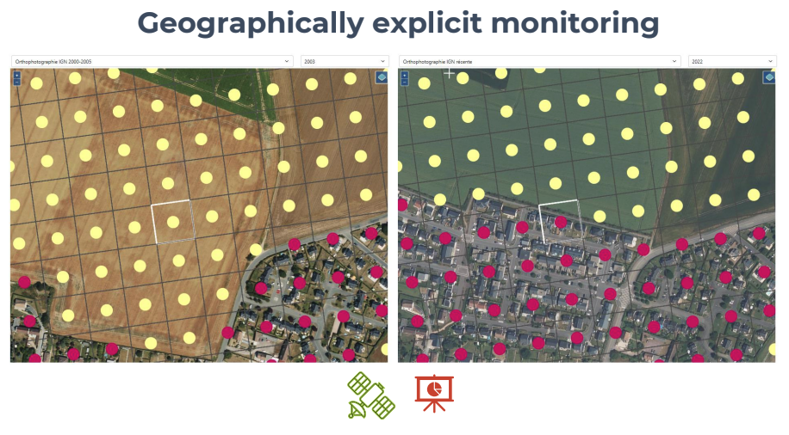
France
EO data is used for Land Use, Land-Use Change and Forestry (LULUCF) and shipping sectors.
Geographically explicit monitoring on a more precise grid based on Earth observations data and field survey statistic can help track changes and measure results on different scales
Main issues with Earth observation data:
Detect true changes (lots of false changes)
Ensure consistency in data quality, spatial resolution and land use categories
Allow interoperability and easy integration of new dataset
Understand the maturity of the datasets and choose where to begin can be challenging

Slide 5
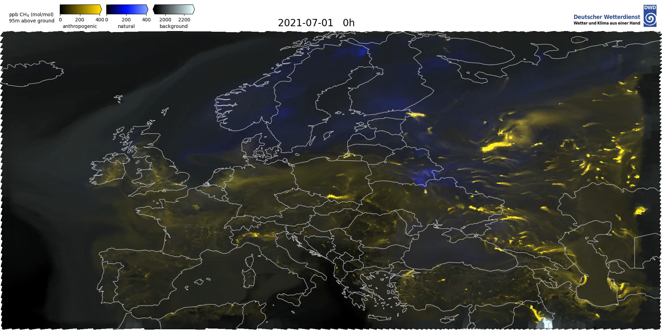
Germany
Developing an observation-based verification system, Integrated Greenhouse Gas monitoring System (ITMS): demo 🡪 1st gen 🡪 operation)
CAMS used to understand the methane arriving in German air space from other countries.
Verification started with using data from ICOS and TROPOMI, will gradually add more satellite data
Using Sentinel-5P for methane source detection and TROPOMI CO tracers to monitor the decarbonisation of the German steel industry.
Accuracy of satellite data is the key to evaluate the models.

Slide 6
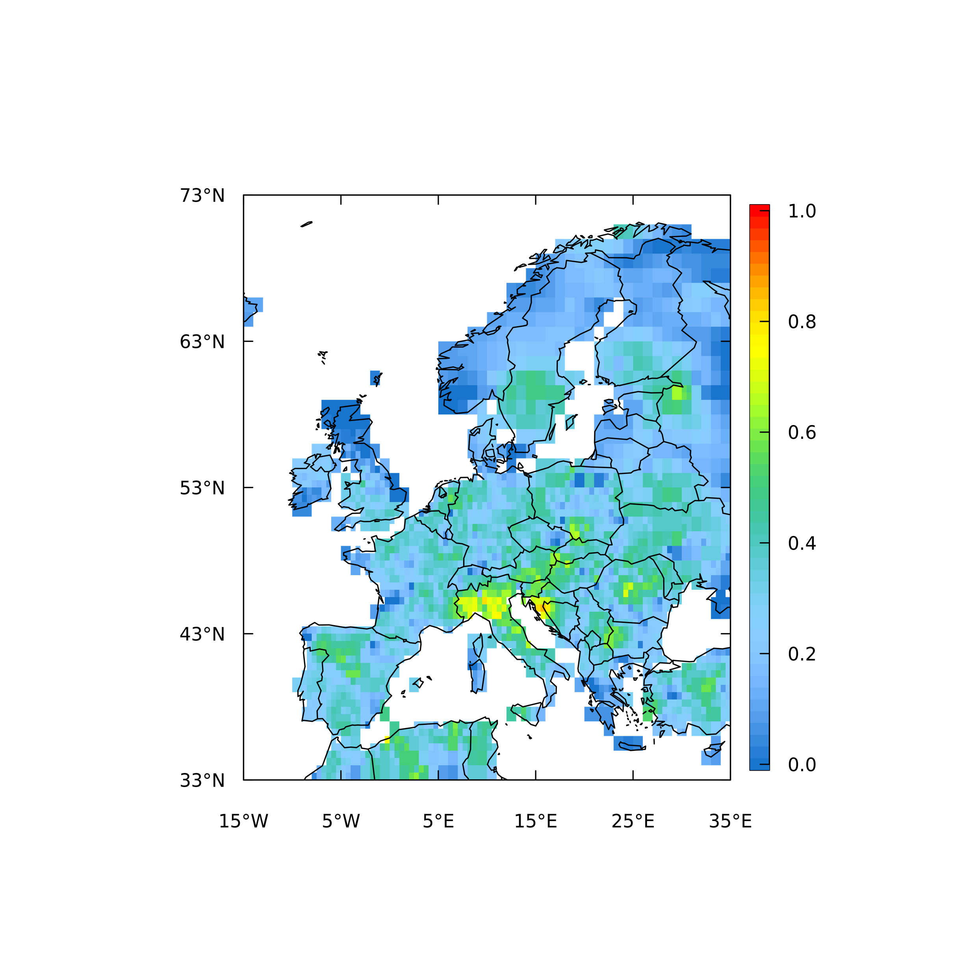
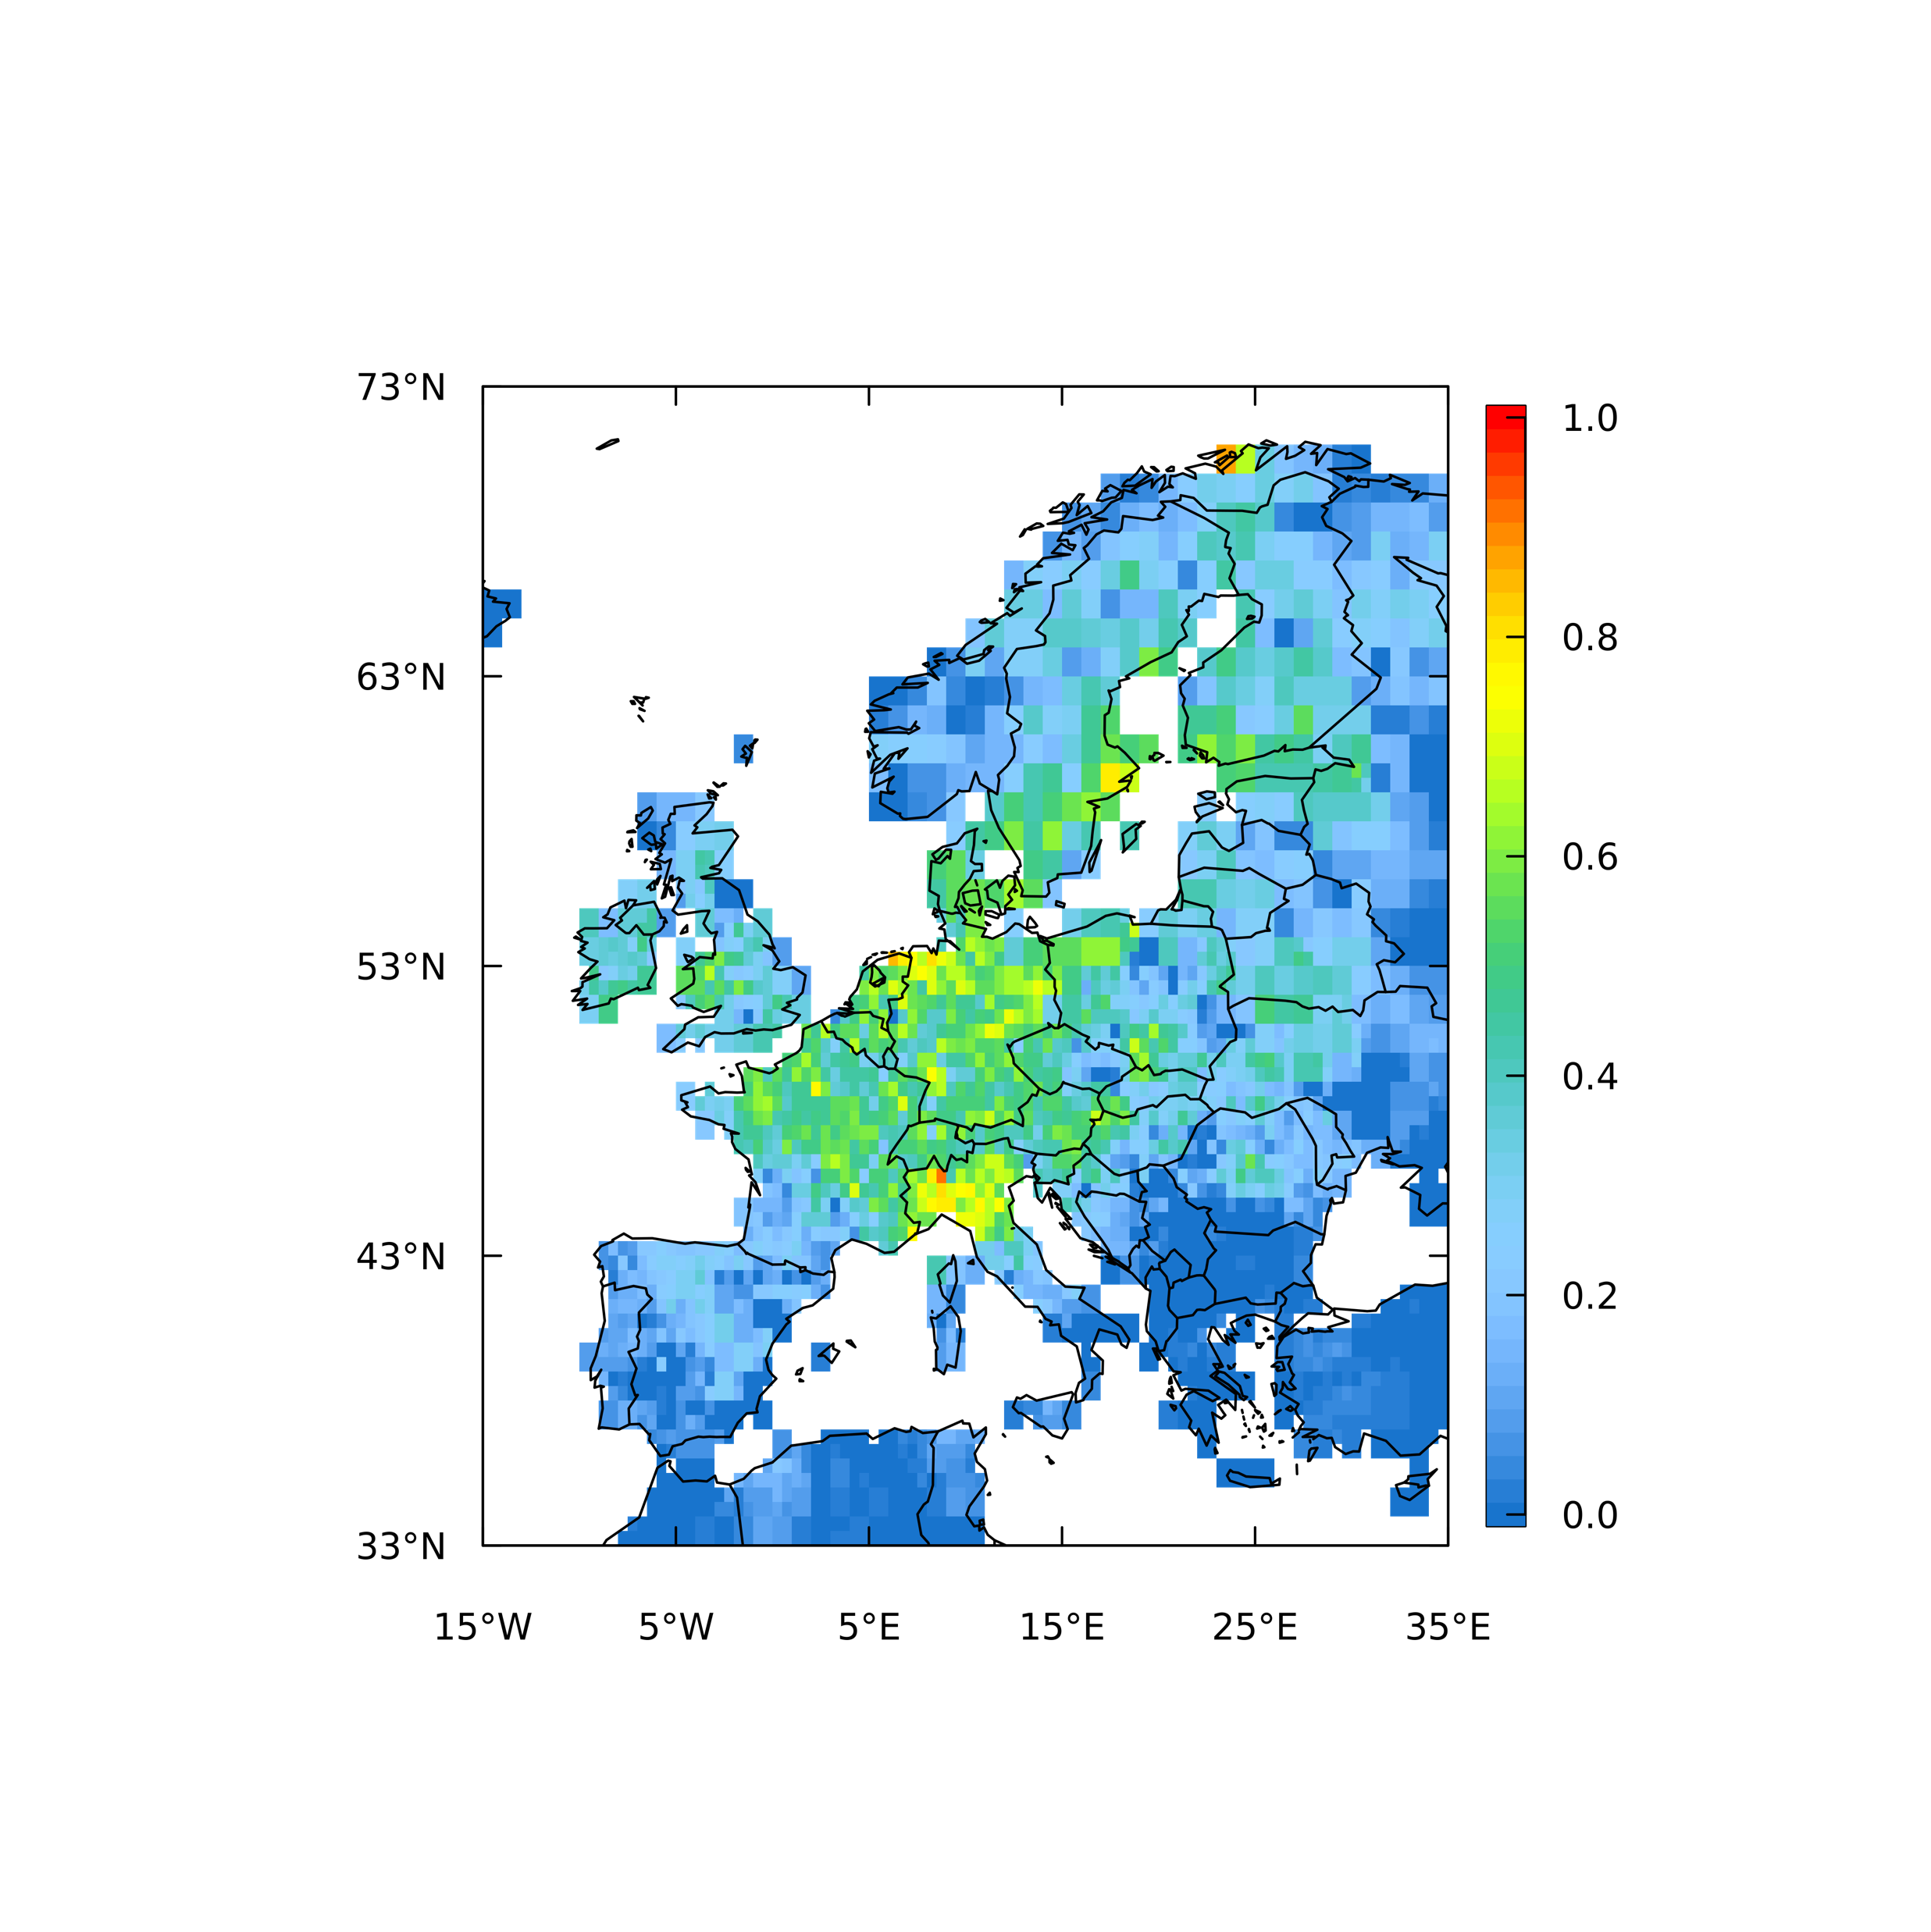
Norway
Norway currently does not have verification of national totals with independent data.
Research community working on observation-based verification using satellite data products for methane
Have developed the Norwegian roadmap for CO2M/CO2MVS, funded by the Norwegian Space Agency, to plan how best to use CO2M measurements once available.
CH4 emission estimates
TROPOMI-derived ICOS (ground-based)
Satellite-based approaches are constrained in Norway:
Less/no data during winter months
High cloud cover

Slide 7
Denmark
There are many Danish national competences on the processing of satellite data, but none specifically on greenhouse gases. Denmark is also lacking relevant national competences in inverse modelling.
Ongoing dialogues with relevant authorities to highlight the potential and future needs for satellite-based CO2 and CH4 observations for the verification of national emission inventories.
Looking to establish funding for building up and operating a national satellite-based monitoring activity.
The plan is to use the CAMS GHG Monitoring & Verification Support (MVS) as much as possible and adapt products to national needs and requirements to support national decision makers.
Mapping interests and potentials in satellite data for monitoring greenhouse gas emissions
http://dce2.au.dk/pub/SR523.pdf
Notes:
Co2M may be a game-changer
There is a great national demand for independent measurements for GHG emissions and land use
There is a great potential in using the data from CO2M to verify national emission inventories and the effect of new political initiatives

Slide 8
Session Outcomes
Feedback from National Inventory Teams:
Better guidance is needed on how to find and use EO datasets
It is unclear where to go for help with using EO data
New products are not necessarily needed, but rather a guidebook on how to find the right products and how to use them.
Each country is approaching the use of satellite data differently

Slide 9
Next steps
WGClimate would like to have more of these sessions in different regions - hosts and suggestions welcomed
Two actions recorded for follow up at WGClimate-23:
WGClimate-22-20 | WGClimate, with UNFCCC and IPCC TFI, to consider establishing regional satellite data experts to advise national inventory compilers. | Due: WGClimate-23
WGClimate-22-21 | WGClimate to consider how best to provide capacity development resources around using satellite data for national inventories. This could be done as an expansion to the CEOS GST Portal. | Due: WGClimate-23

