Slide 1
Country Engagement
Cambodia National Case Study for Forest Biomass Estimation
Takeo Tadono, JAXA
Agenda Item 6.3
SIT-40
Fukuoka, Japan
8-10 April, 2025

Slide 2
Background
JAXA is currently conducting a research project entitled “Establishment and Strategic Implementation of Forest Biomass Estimation Methodology for Realization of Carbon Neutrality” under the “Strategic Program for Acceleration of Space Utilization” (called Stardust Program) supported by Cabinet Office and MEXT, Government of Japan (FY2023-2025).
One of the tasks in the project is the development of a national-scale forest above-ground biomass (AGB) map by EO satellite data and its validation.
FY2023-2024: AGB maps Ver. 1 and Ver. 2 were created for the entire Japan.
FY2024: A collaboration agreement was concluded with the General Directorate of Environmental Knowledge and Information (GDEKI), Ministry of Environment (MOE) of Cambodia to develop the AGB map on a national scale in Cambodia, and Ver. 1 was created.
Based on this activity, JAXA conducted an on-job training on EO satellite dataset preparation and AGB estimation to the Department of Geospatial Information Services (DGIS) technical team, GDEKI in March 12-13, 2025 to transfer technical capacity. DGIS provided their knowledge and ground-based data of the national forest inventory (NFI).

Slide 3
DGIS-JAXA Training Satellite-based Forest Biomass Mapping Project in Cambodia
Objectives:
To strengthen DGIS, GDEKI's capacity on developing a satellite-based AGB map and study its potential use satellite data (ALOS-2, space-based LiDAR, etc.).
Provide a data access to the DGIS team on how to acquire and use satellite data.
Train DGIS on satellite dataset preprocessing for the AGB estimation.
Discuss on land-use and land-cover (LULC) classification including tree species.
To utilize satellite dataset for LULC and AGB estimation.
To discuss utilization of field survey and NFI data on AGB estimation and validation.
Contents:
Lectures: Introduction of SAR remote sensing, CEOS-ARD for SAR, ALOS-2, GEDI
Hands-on Training based on the cloud system i.e. Google Earth Engine and Colab.
Discussions: LULC, field survey, NFI issues etc.

Slide 4
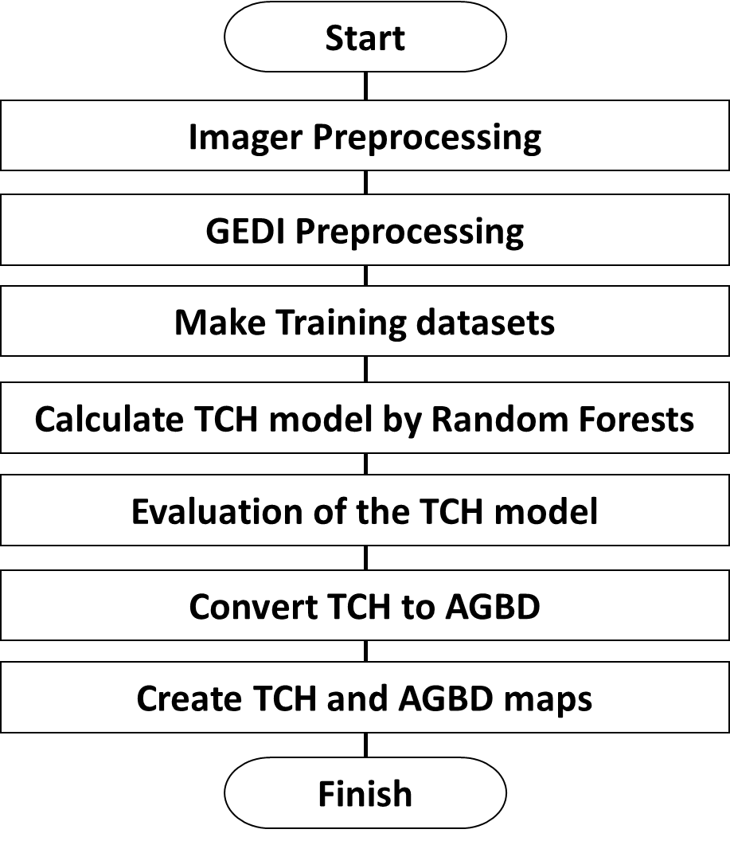
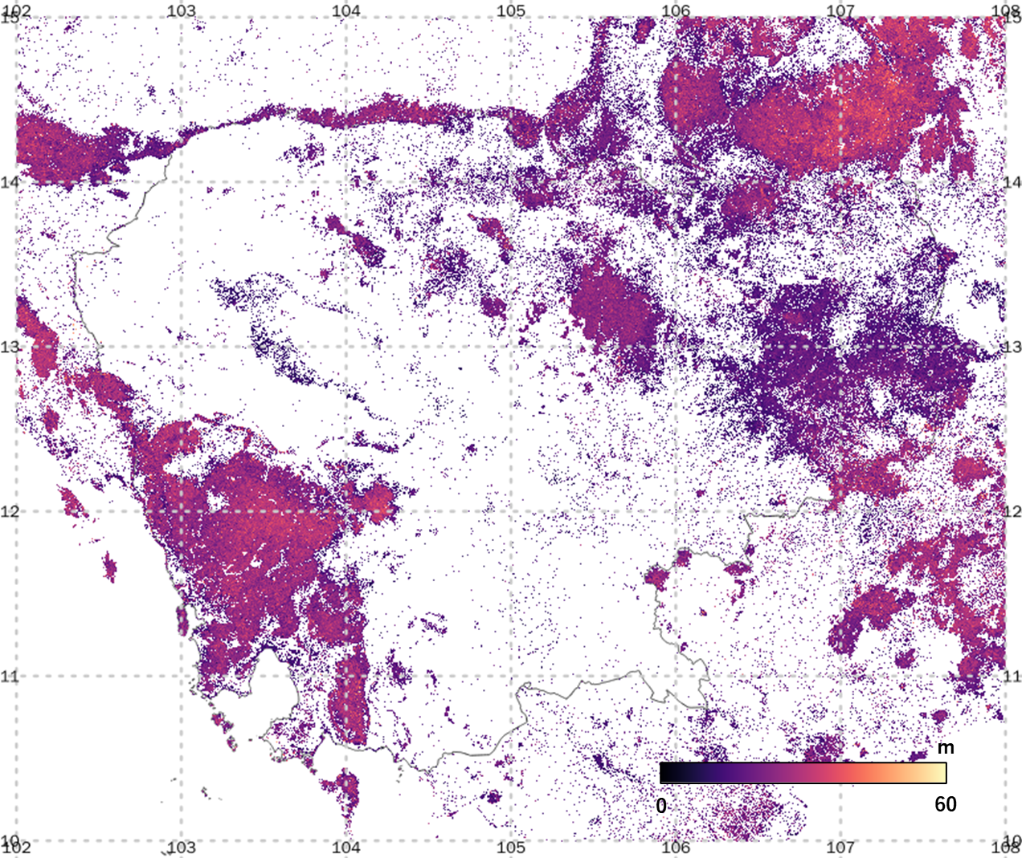
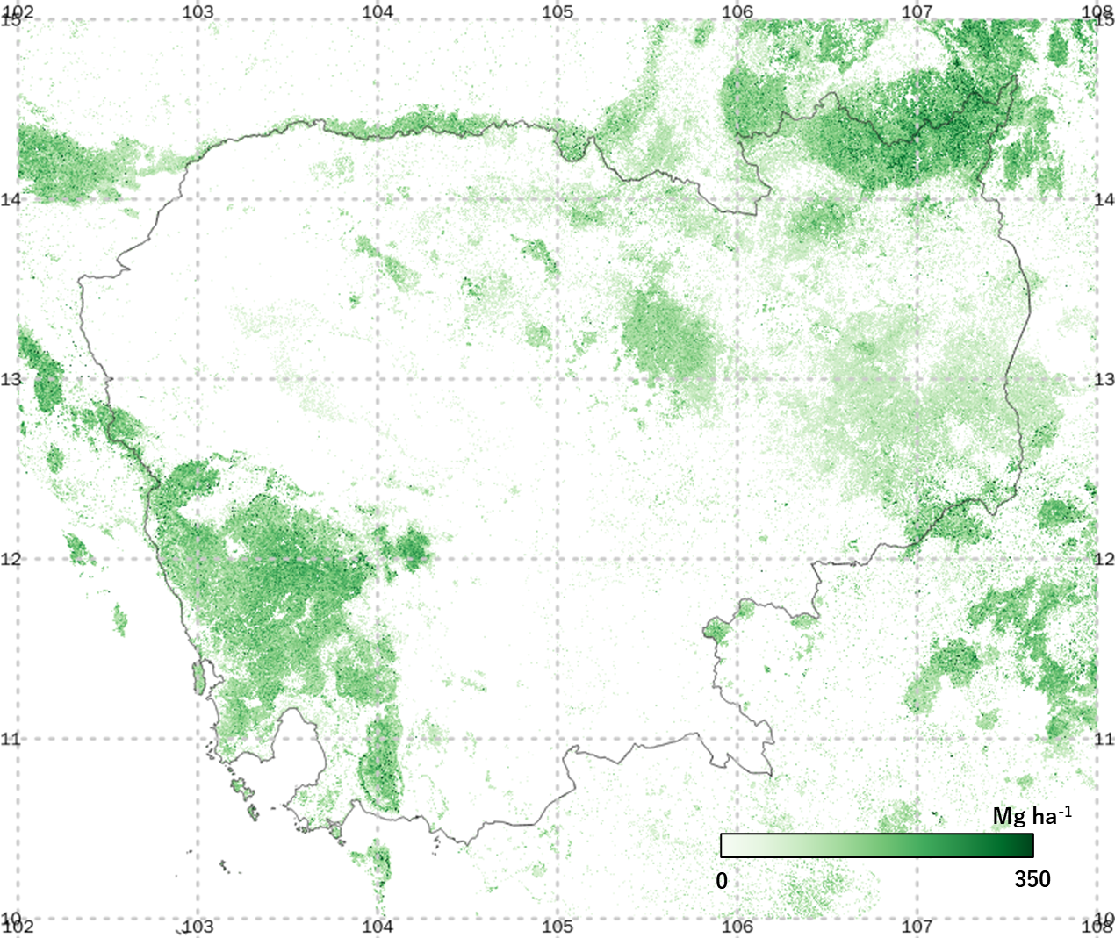
DGIS-JAXA Training Satellite-based Forest Biomass Mapping Project in Cambodia
Development of the Tree Canopy Height (TCH) and AGB Map Ver. 1 in Cambodia
Input: L-band SAR (ALOS-2), Optical (Sentinel-2); target year: 2023
Training data: Space-borne LiDAR (GEDI L2A TCH and L4A AGBD)
Ancillary data: LULC map (new development), digital surface model (AW3D30)
Processing flowchart
TCH (left) and AGB (right) map Ver. 1 in Cambodia.

Slide 5
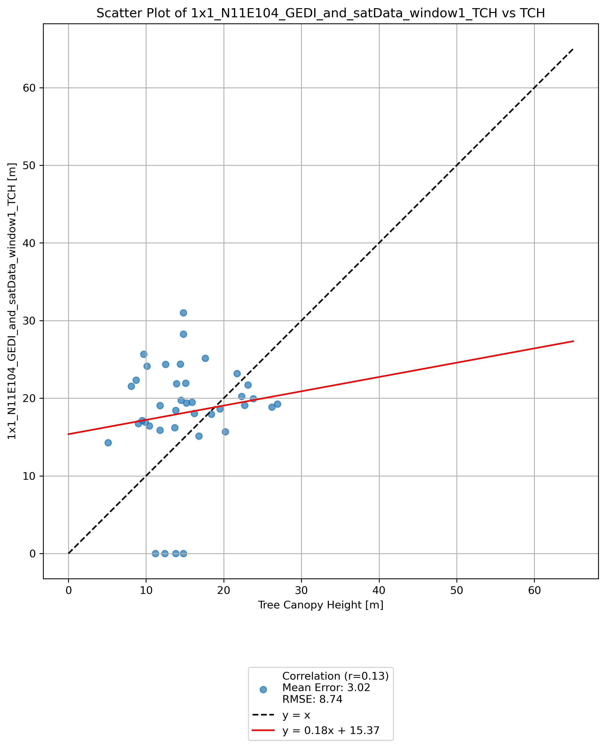
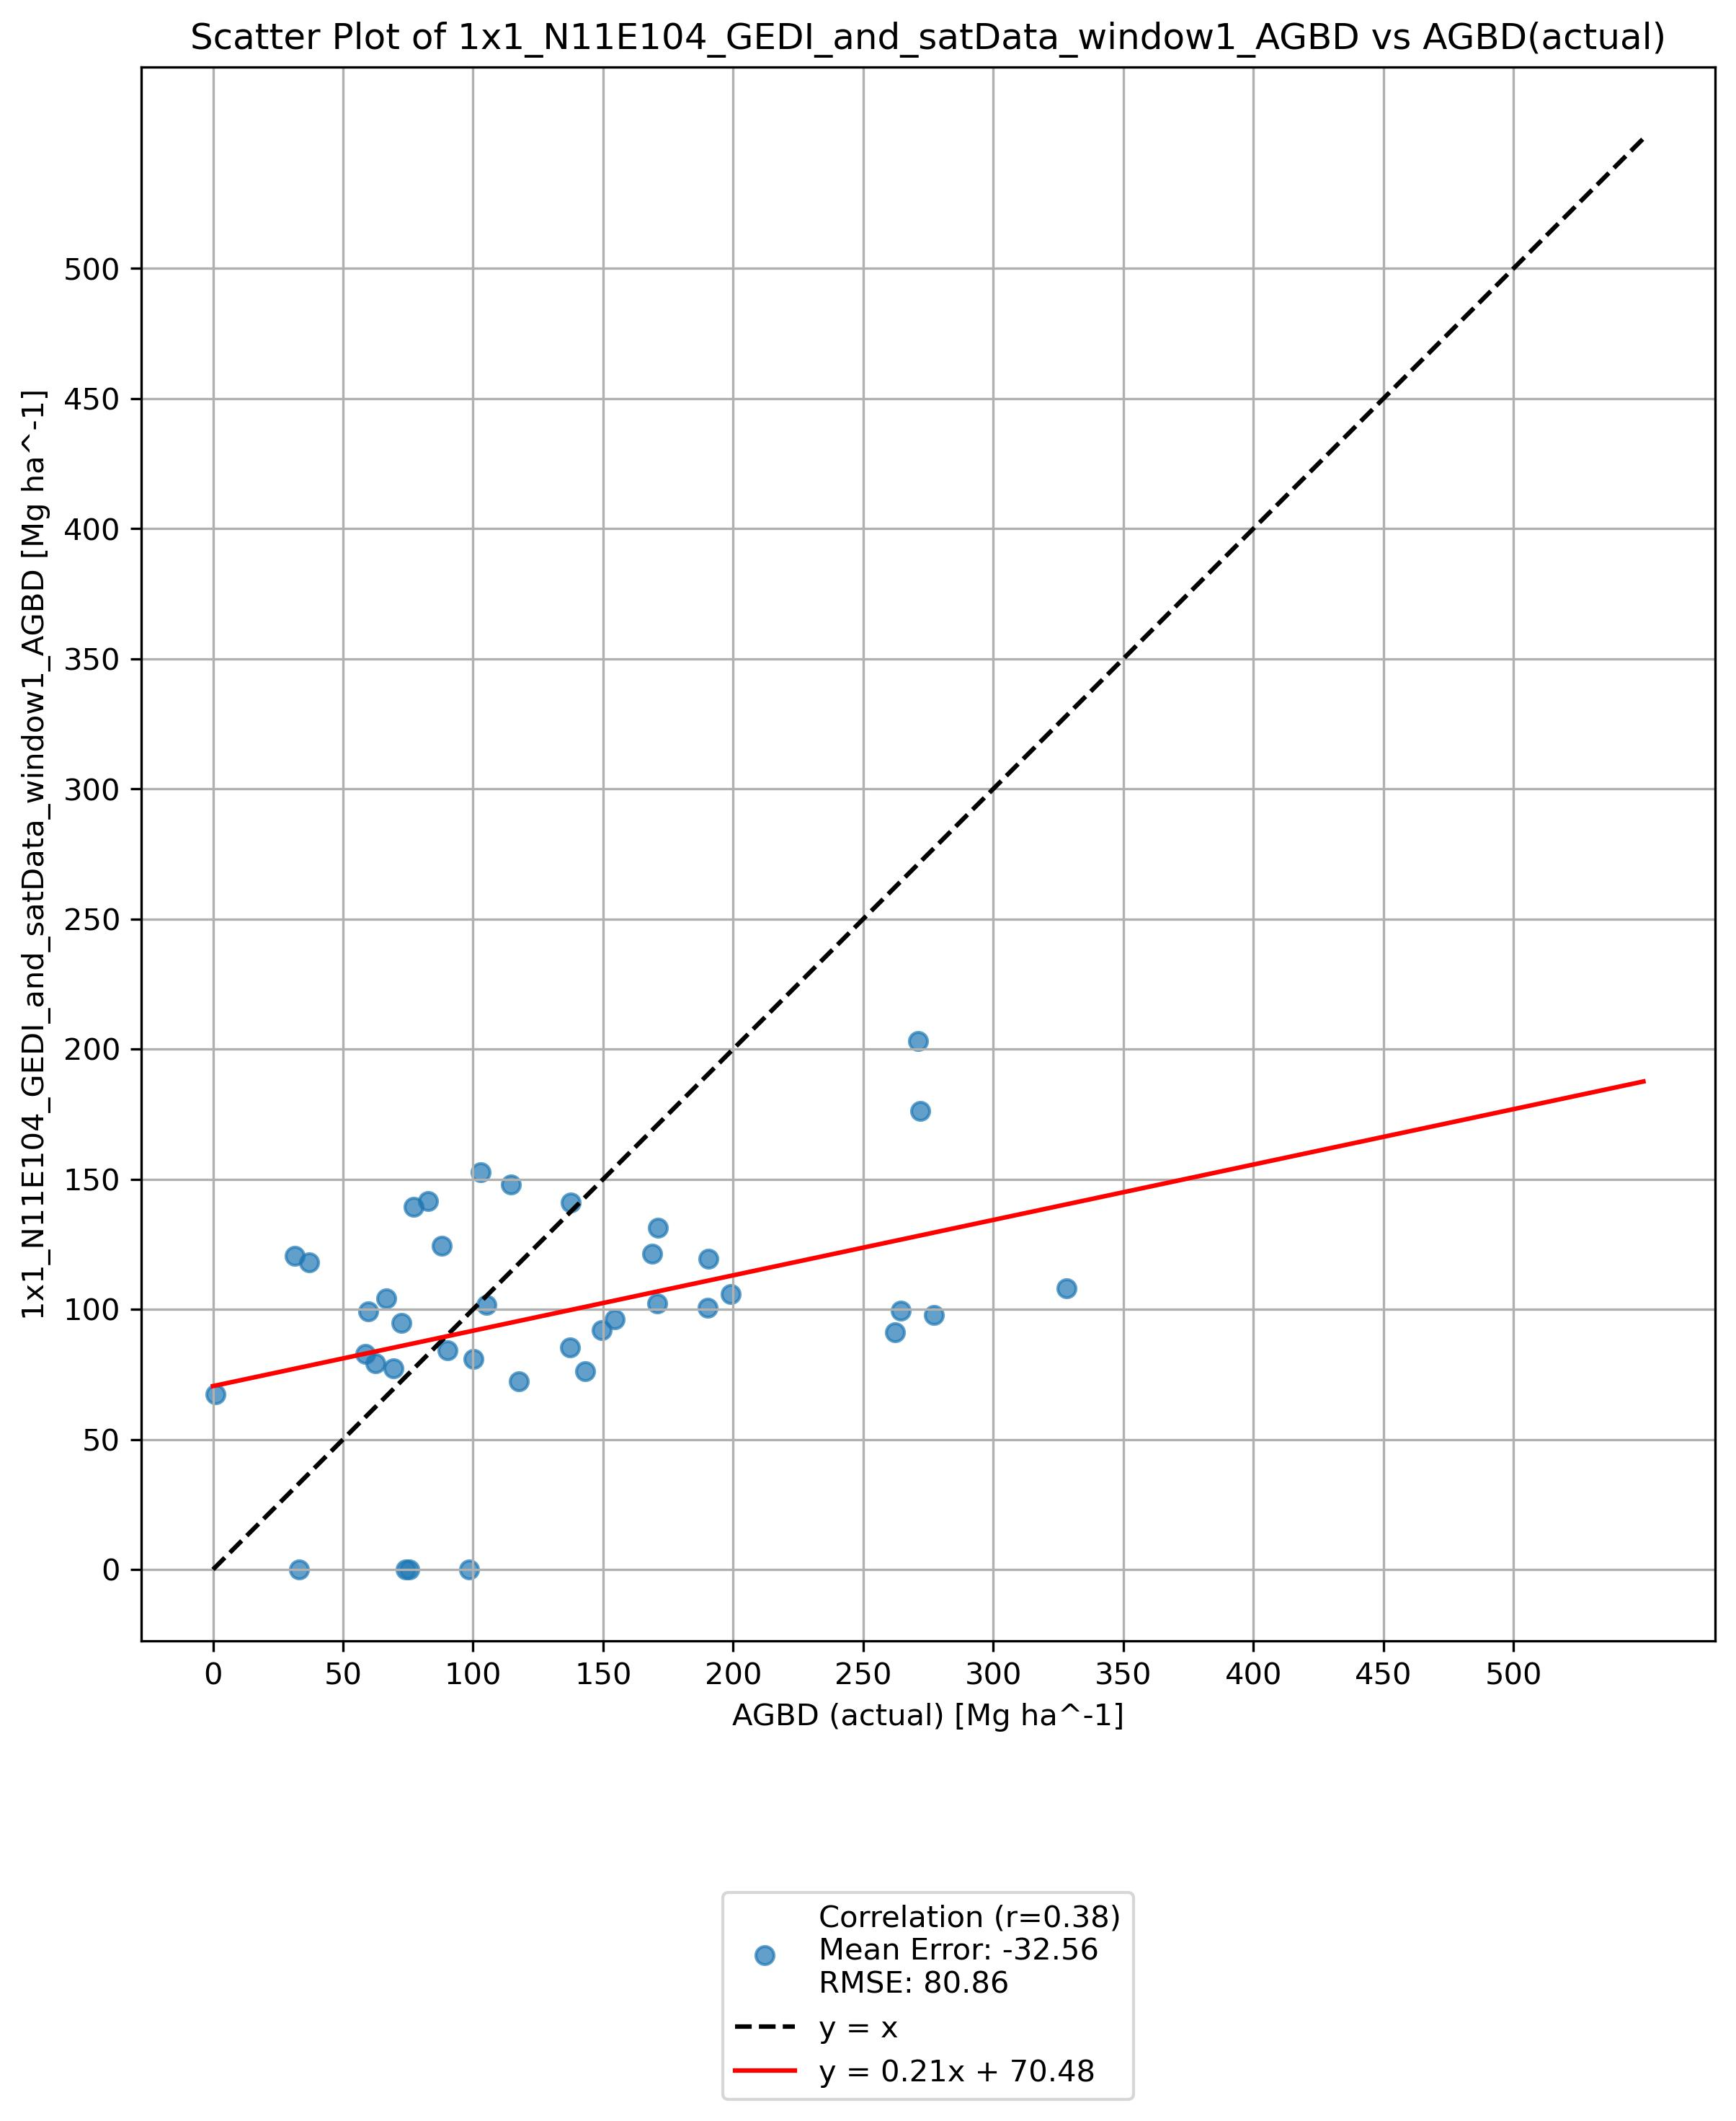
DGIS-JAXA Training Satellite-based Forest Biomass Mapping Project in Cambodia
Validation of the TCH and AGB Map Ver. 1 in Cambodia
Validation data: Ground-based plot measurement by Japan Forest Technology Association (JAFTA) in November 2024.
Accuracy was not satisfied both TCH and AGB yet. > Further investigation will be conducted to develop Ver. 2 dataset.
Validation of estimated TCH (left) and AGB (right) Ver. 1 with ground-based measurements.

Slide 6
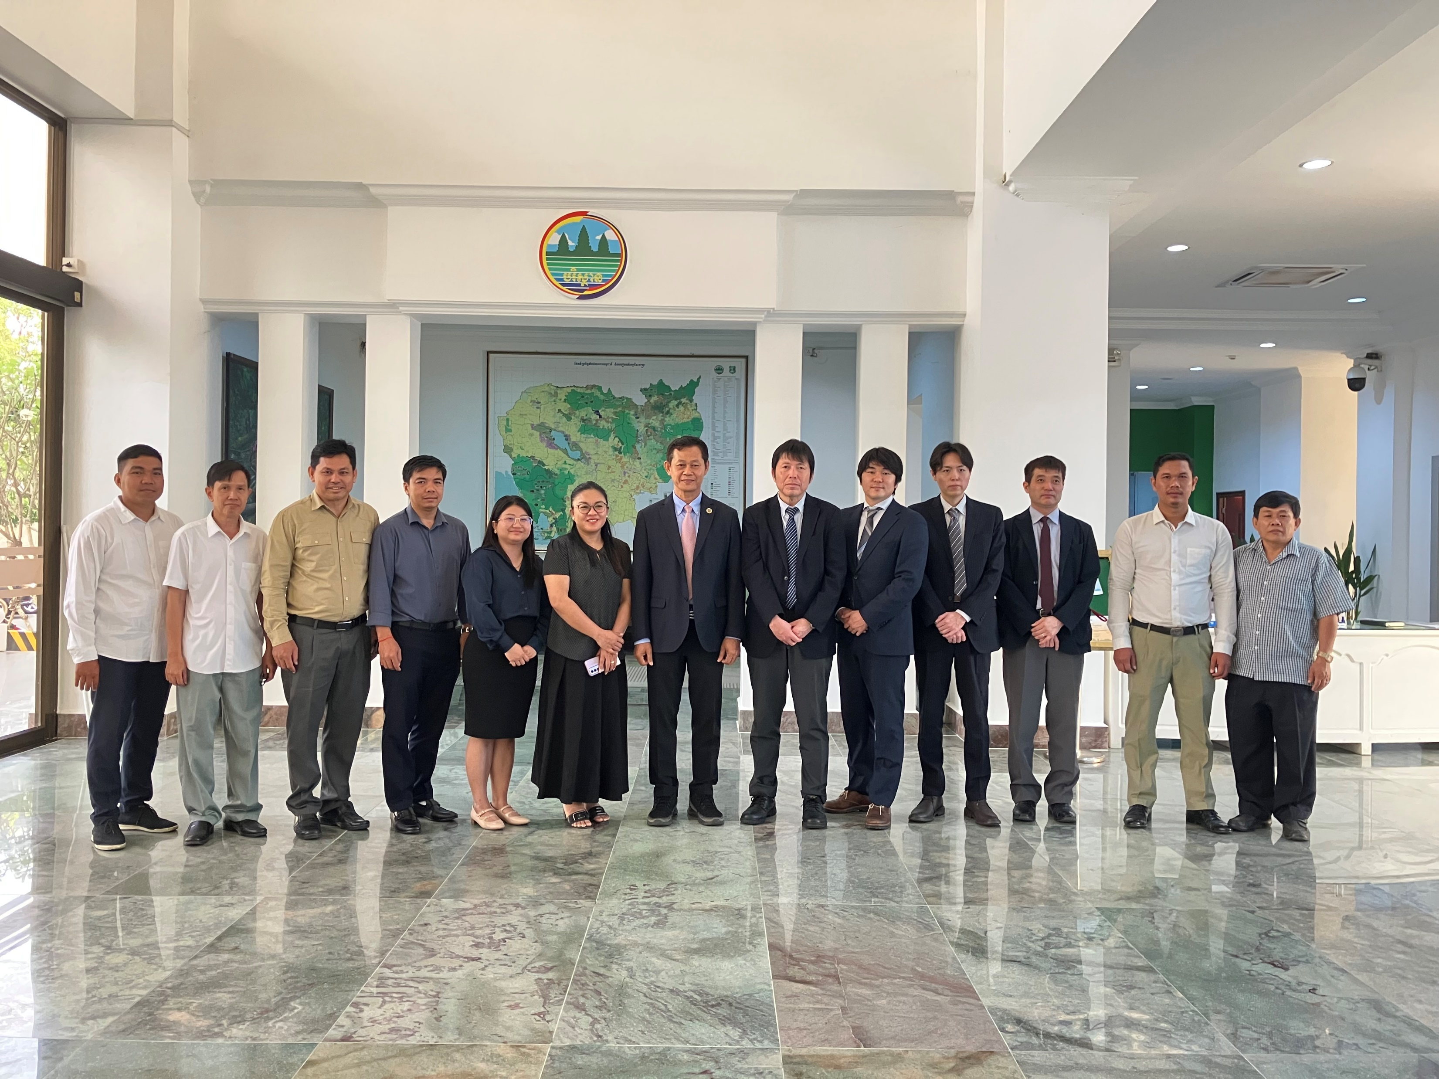
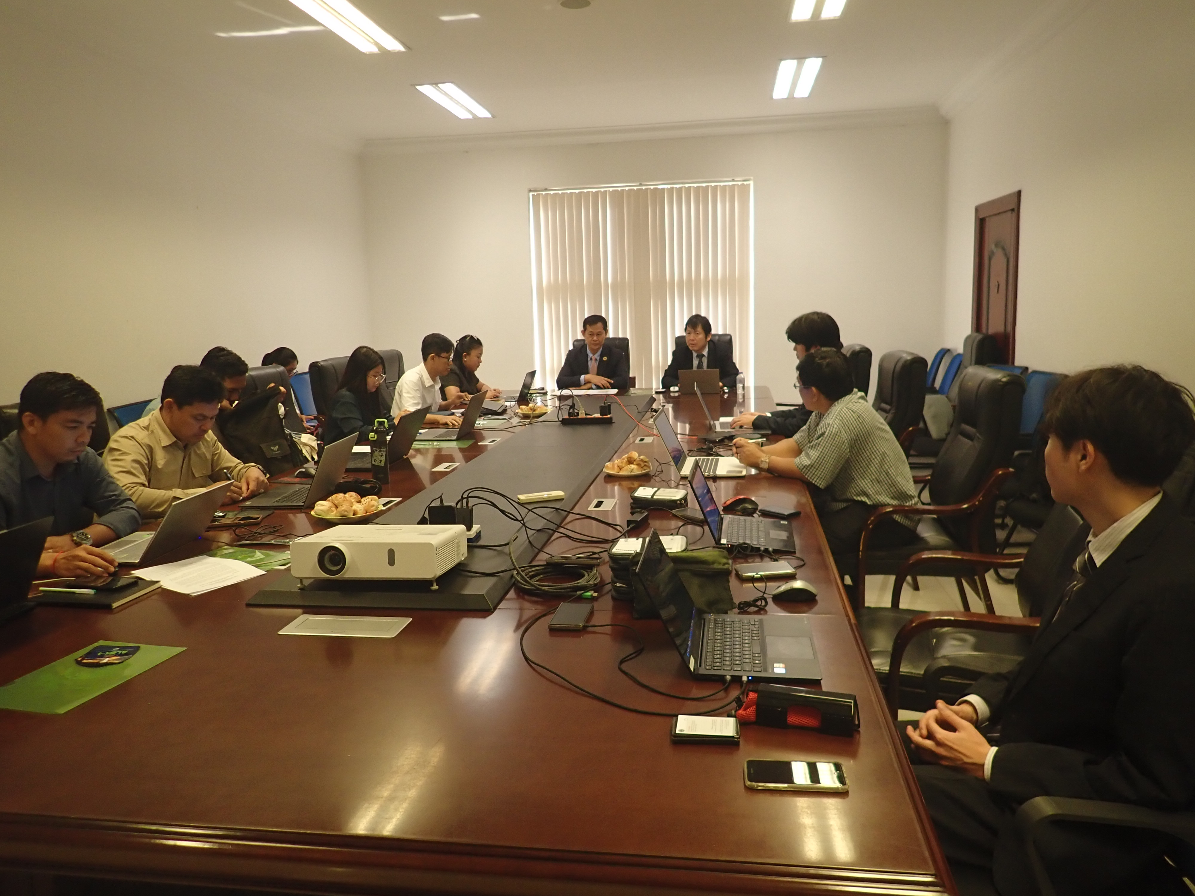
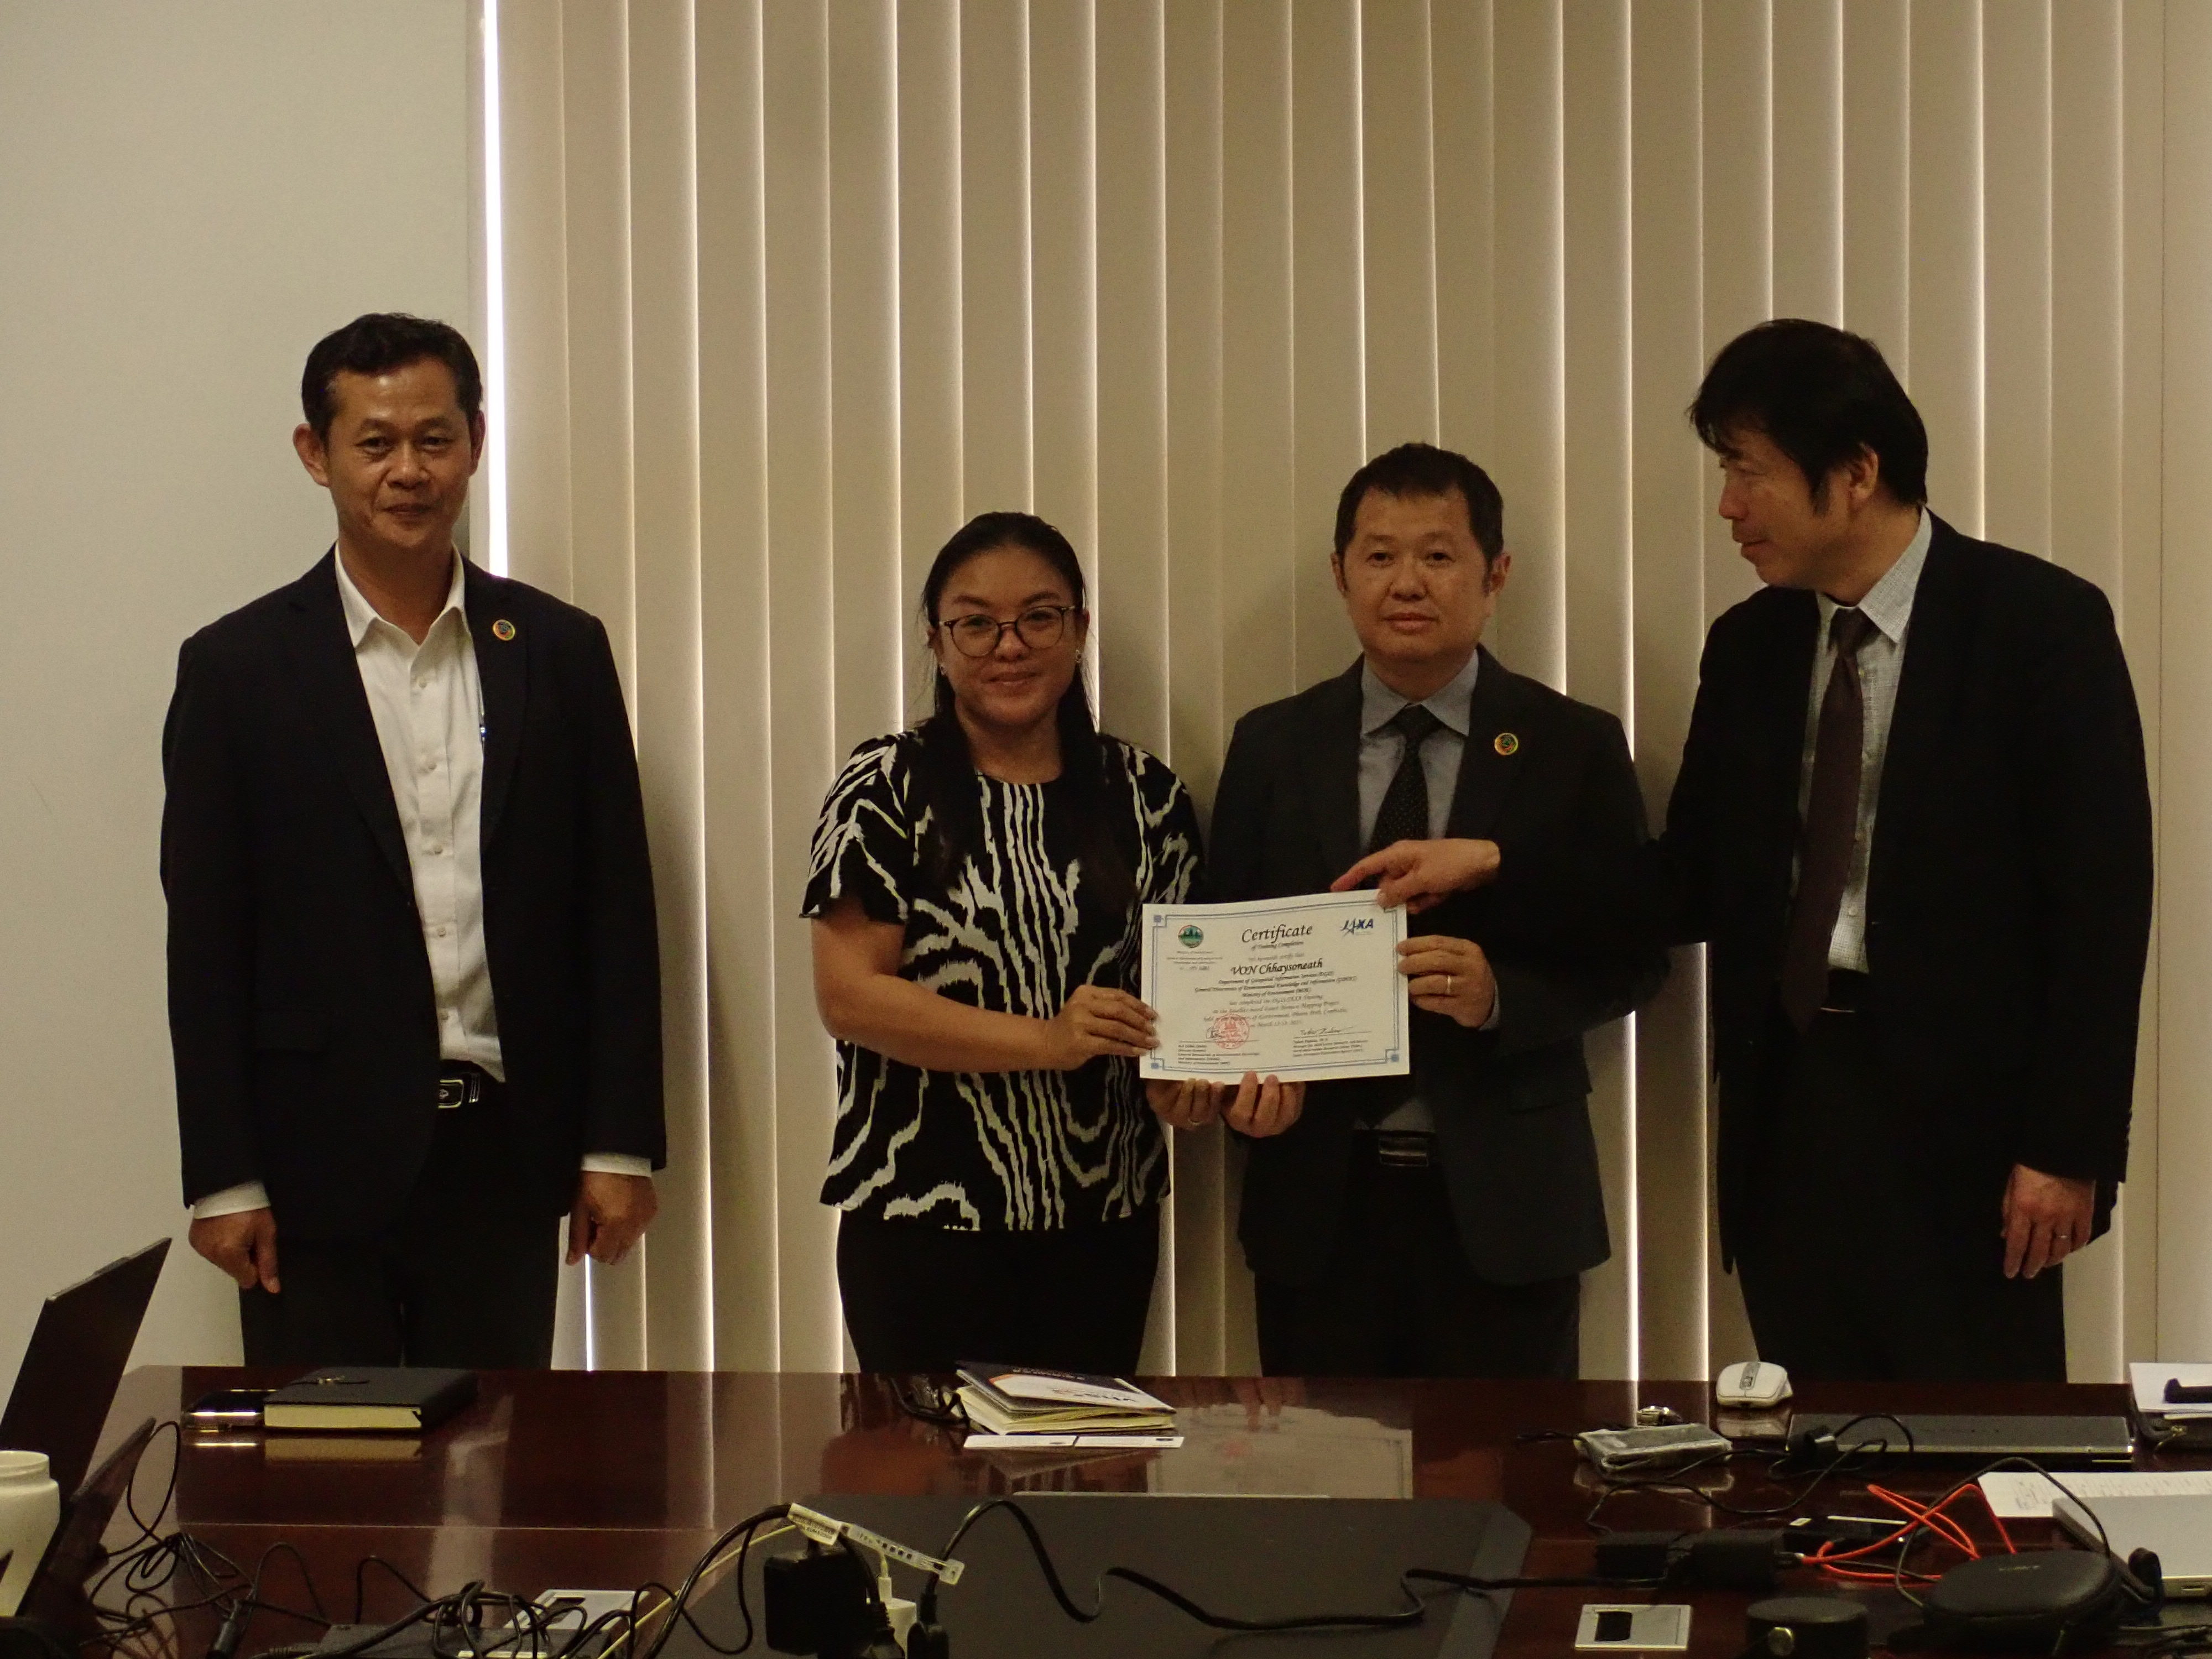
Summary
As an example of JAXA's country engagement, an effort to estimate forest biomass on a national scale using satellite data was introduced.
Since each country has different definition of forest types, and some forests are more important than others (e.g., natural forests, protected forests, etc.), it is important to discuss these issues with the partner countries.
Such discussion helps us to understand what data can be used as training data for estimation, as well as its accuracy and reliability.
JAXA hopes to expand these activities, especially to other Asian countries, to develop highly accurate biomass dataset and promote its utilization.

