Slide 1
CEOS SIT-41
April 2026
Welcoming Remarks
Dr. Julie Robinson
SIT Chair Team, NASA
Agenda Item 1.1
CEOS SIT-41 2026
Irvine, California, USA
14-16 April 2026

Slide 2
Hybrid Meeting Protocols
Presentations will be shared centrally using the slides uploaded to the Google Drive.
  Presenters are welcome to share their own slides by joining the Webex and sharing their screen if preferred. Please let the SIT Chair Team know.
  Presentations should be self-uploaded here (default view only, ask SIT Chair Team for edit access as required)
Online Participants
Please mute if you are not presenting or making an intervention
If you want to intervene, please, send a message in the chat or raise your hand
If your bandwidth is slow while presenting, please turn off your webcam
With questions, please email NASA’s SIT Chair Team:
nasa-sit-chair-2026-27@googlegroups.com
Notes:
Start with a few housekeeping notes to all participants and presenters both online and in the room:
Presentations will be shared centrally from the Google Drive, and the clicker will be passed around.
Presenters are welcome to share their own slides by joining the Webex and sharing their screen. Please let the SIT Chair Team know in advance.
Please make note of some best practices for online participation.
With questions or if you are having any difficulties, please send a note to the SIT Chair Team email listed on this slide.
We have a great team working with us from the Beckman Center: Dionna Wise and Andrea Rebholz. Big thank you to them and the rest of their team onsite.

Slide 3
NASA SIT Chair Priorities
Priority 1: Water Planet- Seeing Earth's Water from Space
Advance understanding of Earth's water cycle by monitoring terrestrial waters, coastal regions, and oceans from space. Transform this knowledge to actionable insights to enhance water use efficiency, improve water quality, and enhance resilience to water-related hazards such as droughts, floods, and storms.
Priority 2: Connected Data for Community Resilience
Advance community-level resilience by leveraging CEOS disaster risk reduction successes and partnerships to enhance cross-collaboration, data interoperability, and actionable information.
Notes:
Reminder to folks in the room that we kicked off our SIT Chair term with two priorities (listed).
(Following slides will give a brief, high-level update, before inviting the audience to listen in over the course of the next few days for more detailed updates).

Slide 4
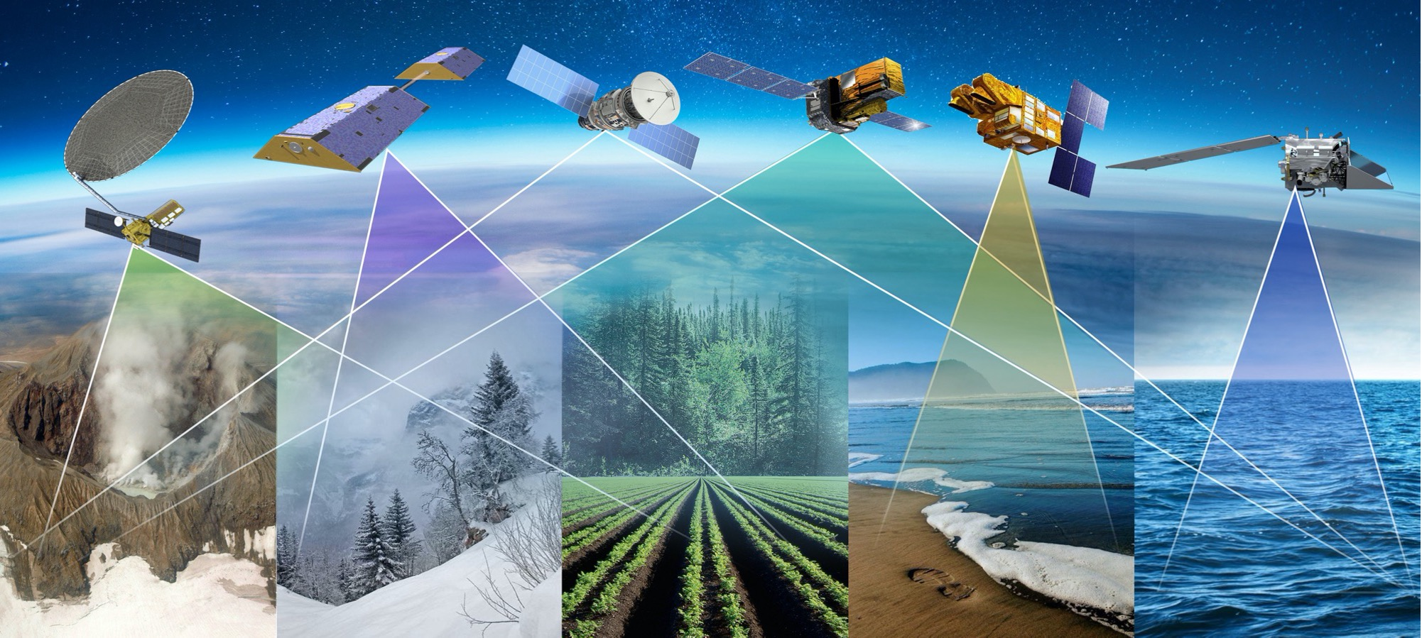
Priority 1: Key Objectives
Coordinated Water Observations
Accessible and Interoperable Water Data Products
User-Center Solutions for Water Challenges
Assessment of Socio-Economic Benefits
Notes:
I want to take just a moment to remind everyone of our shared vision for the Water Planet initiative. As you know, our collective water efforts are anchored by four core objectives:
Coordinated Observations: Strengthening our coordination across agencies to seamlessly integrate data and improve our understanding of the global water cycle to advance water solutions.
Accessible Data: Continuing to deliver open-access, analysis-ready water products that empower both researchers and decision-makers.
User-Centered Solutions: Co-developing targeted solutions using Earth observations to tackle pressing, real-world issues like water scarcity and degraded water quality.
Socio-Economic Benefits: Proving the tangible value of our collaboration—highlighting real cost savings, better decisions, and enhanced water resilience.

Slide 5
Priority 1: Deliverables Timeline
Seeing Earth’s Water from Space
Plenary
2025
SIT-41
SIT TW
2026
Plenary
2026
SIT-42
SIT TW
2027
Plenary
2027
Objectives
Coordinated Water Observations
Gap analysis of water variables
Best practice guidance for integrating multispectral (optical + SAR) data for water
Coordinate and promote multisource integrated water products
Accessible & Interoperable Water Data Products
Define application specific requirements for water variables
CEOS-ARD Self Assessments
CEOS-ARD for Water
Encourage and contribute CEOS ARD Water Products related to water supply and demand
Align and promote user-driven tools for water management and resilience
User-centered Solutions for Water Challenges
Water Quality Workshop Series
Advancing EO data for water resources solutions (TBD)
Assess data needs for water resources / water quality management
Assess Impact & Benefits
Impact assessment of existing CEOS activities related to water/resilience (w/ Priority 2)
Use cases on the benefits of EO for water
Notes:
Turning to the timeline, you’ll see the six key deliverables and activities driving Water Planet. Please note that the items in bold are our Priority One deliverables—our most critical targets during NASA’s SIT Chair term. The non-bold items highlight our essential ongoing and planned supporting activities.
Consider this just a brief refresher to ground our discussions this week. The Water Planet Team will be giving an in-depth update this Thursday, where we’ll dive much deeper into how we are executing on these objectives.

Slide 6
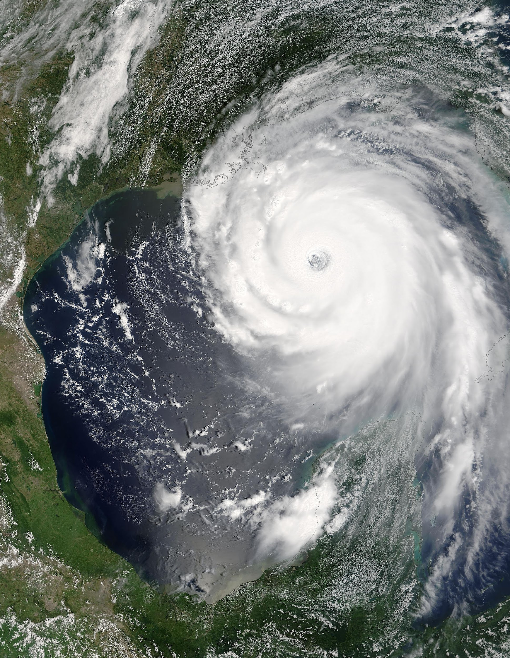
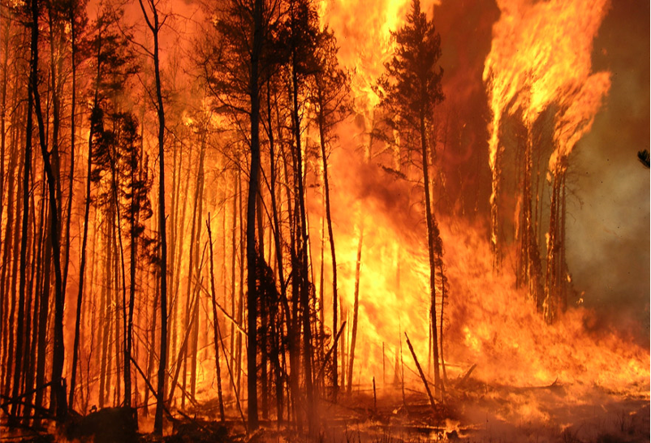
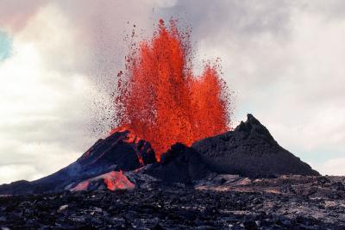
Priority 2: Key Objectives
Understand and enhance cross-CEOS collaboration towards impactful data value chain
Assess impact of existing activities
and end user requirements to build
community resilience
Enhance existing interoperability efforts to address data user needs
Improve capabilities to deliver actionable information built on resilience community input
Credit: NASA
Credit: Canadian Forest Service
Credit: USGS
Notes:
Our Priority on “Connected Data for Community Resilience” is closely aligned with the Chair’s priority on adaptation and resilience - and we are grateful to learn and collaborate with them.
These four priority objectives aim to address:
1) internal CEOS resilience via dataset interoperability and an updated data value chain
2) the external resilience impact of CEOS through an impact assessment of EO use cases and stakeholder input

Slide 7
Priority 2: Deliverable Timeline
Connected Data for Community Resilience
Objectives
SIT TW
2025
Plenary
2025
SIT-41
SIT TW
2026
Plenary
2026
SIT-42
SIT TW
2027
Plenary
2027
1. Understand and enhance cross-CEOS collaboration towards impactful data value chain
2. Assess impact of existing activities and end user requirements to build community resilience
3. Enhance existing interoperability efforts to address data user needs
4. Improve capabilities to deliver actionable information built on resilience community input
Improved data value chain
Conduct an impact assessment of key existing resilience-related activities and identify opportunities for further demonstrations and data interoperability (w/ Priority 1 team)
Support ongoing and emerging Civil/Commercial space Cal/Val & data quality standards meetings and services
Support GSNL Interoperability demonstrators in coordination with Priority 1 team
Host a workshop with key resilience data partners (e.g. EW4ALL, ESRI, etc.) to demo existing activities and inform Resilience Findings
Ongoing: Interoperability framework implementation
Ongoing: CEOS-ARD Strategy 2026
Deliver Resilience Findings: Scaling CEOS member impact
Notes:
I hope some of you were able to join the data value chain side meeting yesterday. The side meeting discussed different value chain components to better illustrate CEOS impact and relevant stakeholders, such as the commercial space industry.
We are pleased to support the WGISS/WGDisasters join interoperability demonstrator and conduct an impact assessment of resilience use cases in collaboration with the Chair and the Priority 1: Water planet team.
Ultimately, the SIT Chair team looks forward to delivering a resilience report and workshop next year to inform a conversation on CEOS’ role in connected data for community resilience..
Stay tuned to the rest of the SIT-41 to learn more about the progress made so far and the different ways to get involved - and how this fits in with the great work the 2026 Chair has been doing, and all the remarkable work across CEOS.
[Transition to Tour de Table]

Slide 8
Tour de Table
Round table introduction by Principals of members of their delegation (in person and online)
Notes:
Start the Tour de Table:
SIT Chair / NASA teams (below)
Chair will introduce Team Australia
CEO Team
JAXA… ESA… (follow seating arrangement around the room)
NASA SIT Chair Team
Dave Borges (SEO)
Sid Boukabara (Senior Program Scientist for Strategy)
Michelle Hanssen (CEOS Contact)
Erin Urquhart (Priority 1 lead)
Eleanor Pierel (Priority 2 lead)
Ayia Lindquist
Perry Oddo (online, Priority 1)
Thanks to the Symbios team: Matt Steventon, Stephen Ward, Harvey Jones, and Libby Rose.

Slide 9


Thank you to our host!
Notes:
Pass the mic to our host today, Dr. T Arul Mozhi, Senior Program Director for Aeronautics, Space and Astronomy at the Center for Advancing Science and Technology of the National Academies of Science Engineering and Medicine.
NASEM will not only be hosting this meeting, but all four of our SIT meetings and Technical Workshops over our 2-year SIT Chair term, at the National Academies’ various locations.

Slide 10
Backup
SIT Chair Team, NASA
Agenda Item 1.1
CEOS SIT-41 2026
Irvine, California, USA
14-16 April 2026

Slide 11
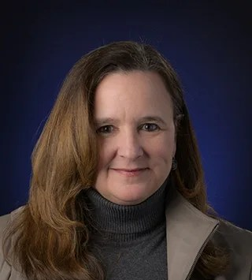


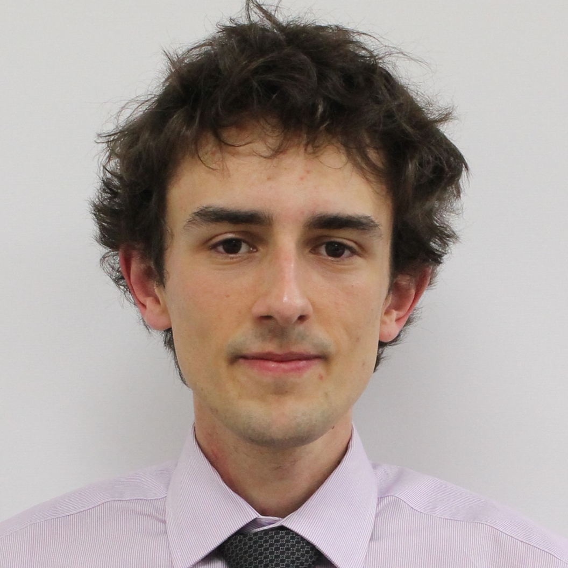
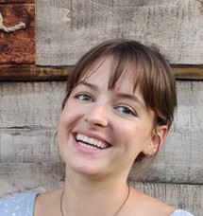
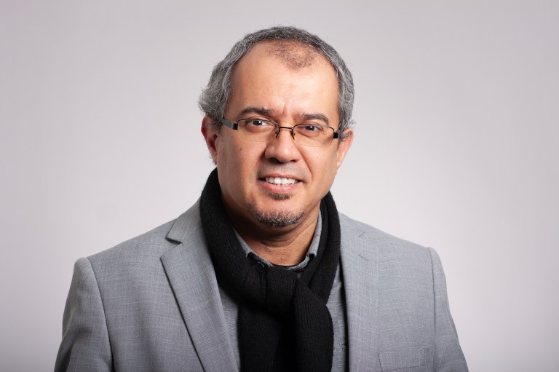
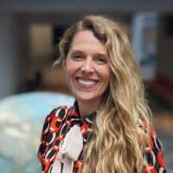
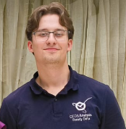
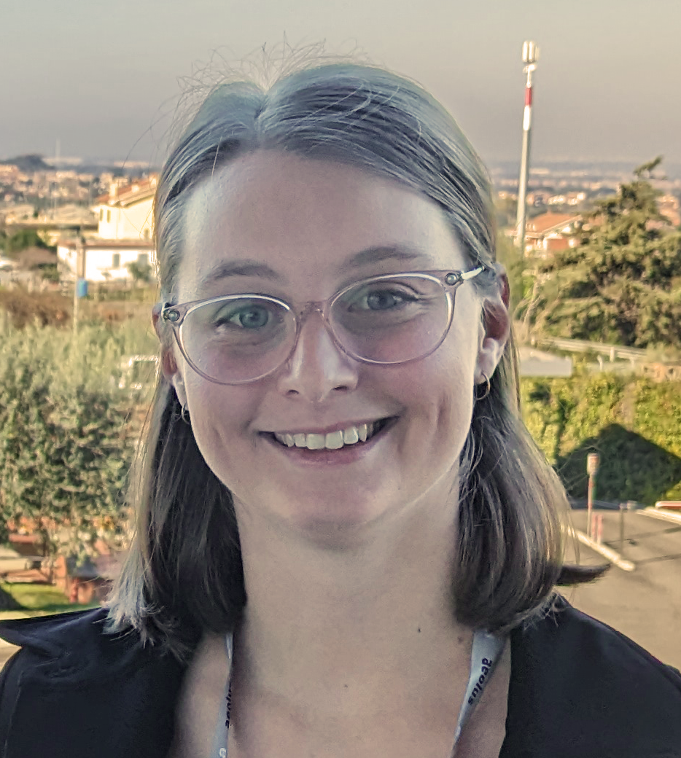
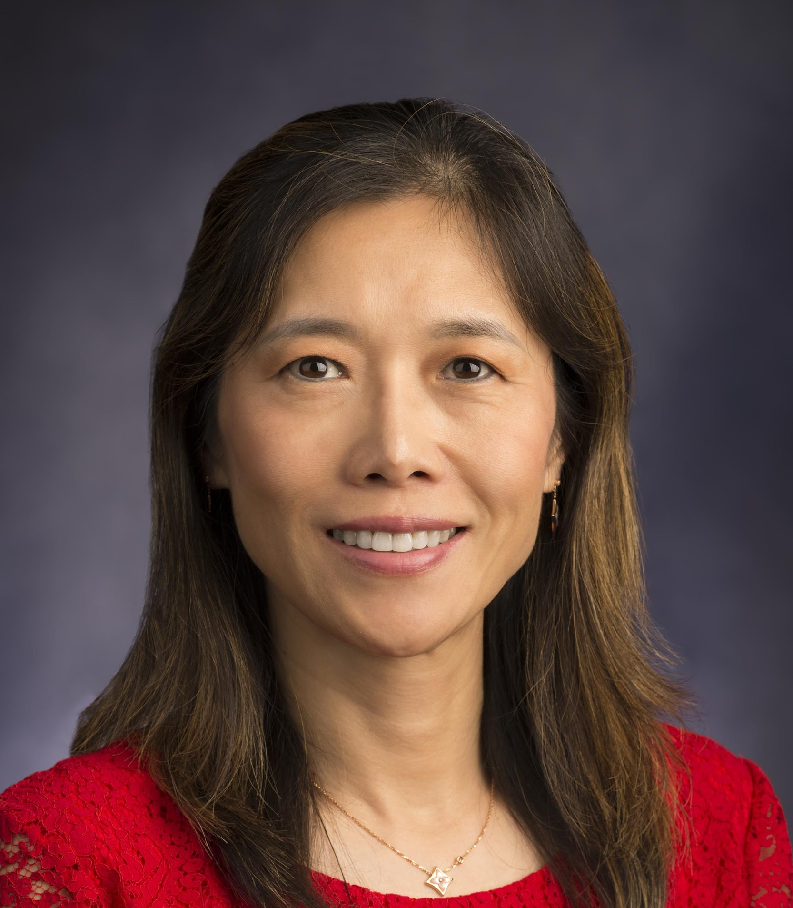
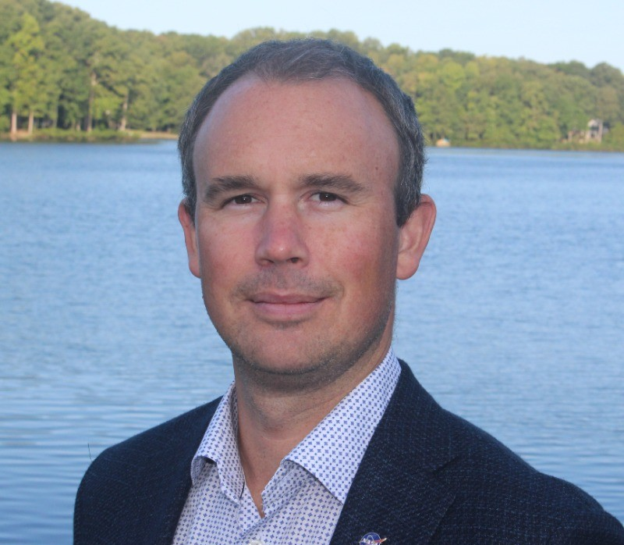

NASA SIT Chair Team
Karen St. Germain
Director, NASA Earth Science Division (ESD)
SIT Chair
Julie Robinson
Deputy Director, NASA ESD
SIT Co-Chair
CEOS SIT Chair Support
Priority #1
Water Planet: Seeing Earth’s Water from Space
Stephen Ward
Matt Steventon
Erin Urquhart
Priority #1 Lead
Michelle Hanssen
CEOS Contact
Sid Boukabara
Strategy Lead
Priority #2
Connected Data for Community Resilience
Harvey Jones
Libby Rose
Eleanor Pierel
Priority #2 Lead
Wenying Su
SIT Chair Core Team,
WGClimate Chair
NASA SIT Chair Team Email:
nasa-sit-chair-2026-27@googlegroups.com
Dave Borges
SIT Chair Core Team, SEO

Slide 12
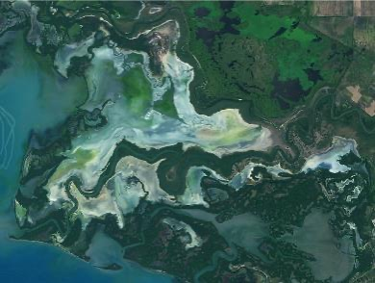
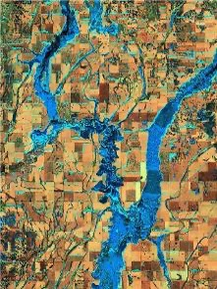
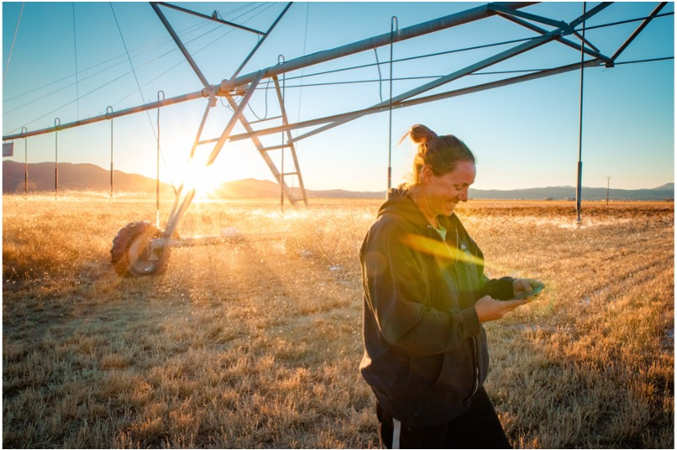
SIT Chair Priority 1: Water Planet
Water Planet- Seeing Earth's Water from Space
Water is fundamental to life on Earth yet increasing pressures on global water resources—combined with rising exposure to water-related extremes such as droughts and floods—demand innovative solutions to ensure a sustainable future.
Satellite observations play a critical role in advancing our understanding of the water cycle and monitoring changes over time. These observations provide essential data needed to address challenges in water availability, accessibility, quality, and hazards.

Slide 13
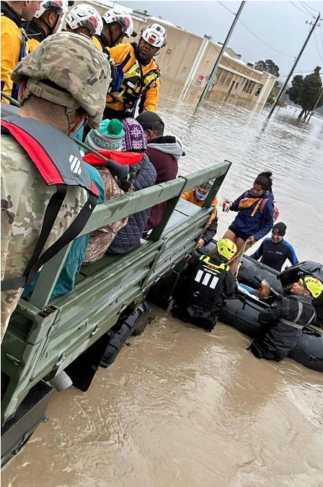

SIT Chair Priority 1: Water Planet
By integrating the capabilities of legacy and new missions, this priority focuses on delivering tailored water data and information designed to support research, inform water management decisions, and enhance preparedness for water-related hazards at a global scale.
CEOS offers valuable assets and collective strength to deliver multisource, integrated data and a user-driven approach to address Earth’s most pressing water challenges.

Slide 14
Priority 1: Deliverables
Impact Assessment Report on CEOS Water and Resilience Activities (in collaboration with Priority 2 Team)
Best Practice Guidance on Combining Multiplatform and Multispectral Data
Contribute a water thematic section to updated CEOS-ARD strategy (in collaboration with CEOS Chair)
Stakeholder Engagement & Capacity Building Initiatives
  Water Quality Workshop (co-led with CEOS Chair; 2026)
Best Practice Guidance for Scaling and Transitioning EO Data Into Actionable Water Solutions
Use Cases Illustrating Socio-economic Benefits and Applicability of Satellite-based Water Solutions Across Regions and Sectors
Notes:
Best Practice Guidance on Combining Multisource Data: Develop comprehensive best practice guidance for combining optical and SAR (Synthetic Aperture Radar) data to derive critical water variables. Include integration protocols for multisource datasets as part of an integrated water observatory framework.
Establish and promote a roadmap for the development of a multisource integrated water observatory. This will support the seamless integration of past, present, and future observational missions, combining diverse datasets to improve understanding of the global water cycle over time.
CEOS Analysis-Ready Data (ARD) for Water Strategy and Implementation Plan:
Create and deploy a CEOS-ARD for water strategy and implementation plan to guide the delivery of interoperable, open-access water data and products tailored to user needs. Include standards for analysis-ready datasets that integrate optical, SAR, and other satellite data to support global and regional water cycle monitoring.
Stakeholder Engagement Initiatives: Strengthen collaboration with OpenET, AquaWatch, CyAN, GEOGLOWS, and other partners through joint projects and stakeholder forums. Develop pilot projects to test tailored applications, such as water information systems or hazard monitoring tools, with direct community involvement.
Water Quality Workshop for Community and Stakeholder Engagement: Co-host a water quality-focused workshop, providing education and resources to increase community uptake of satellite-based data and solutions. Engage key stakeholders to develop clear application guides and materials aimed at enhancing water quality monitoring and decision-making.
Best Practice Guidance for Transitioning EO Data into Actionable Water Solutions: Provide guidance on leveraging Earth observation data to create decision-focused solutions for resilience to water-related hazards.
Use Cases Demonstrating Socio-Economic Benefits Across Sectors and Regions: Develop sector-specific and regional use cases that illustrate the socio-economic benefits of satellite-based water variables. Focus areas could include agriculture, emergency response, transportation, insurance, natural resource management, and energy. Demonstrate the applicability and value proposition of satellite-based water information by showing tangible socio-economic impacts. They bridge the gap between raw data or models and actionable solutions—helping a wide range of stakeholders understand the data's relevance and usability.

Slide 15
Priority 2: Deliverables
Impact assessment of key existing resilience-related activities (in collaboration with Priority 1 Team)
Updated data value chain
Interoperability Demonstrator (in collaboration with Priority 1 Team)
Resilience Data Partner workshop
Resilience Findings

