Slide 1
CEOS SIT-41
Review of Objectives
Dr. Julie Robinson
SIT Chair Team, NASA
Agenda Item 1.3
CEOS SIT-41 2026
Irvine, California, USA
14-16 April 2026

Slide 2
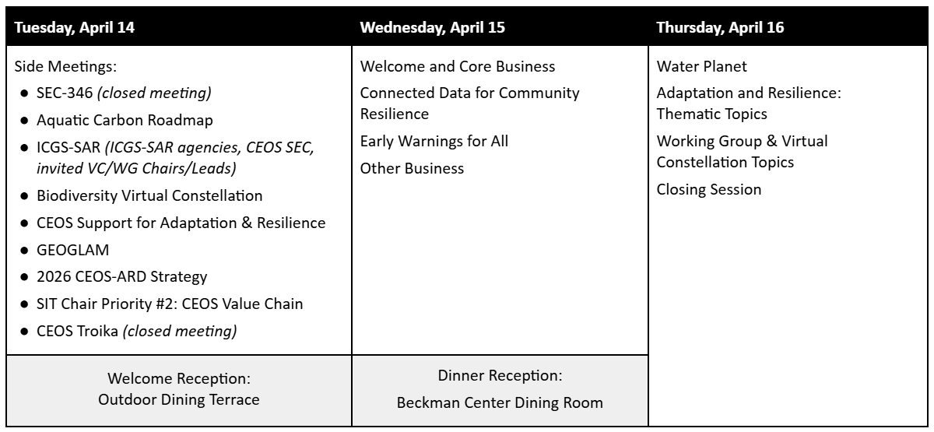
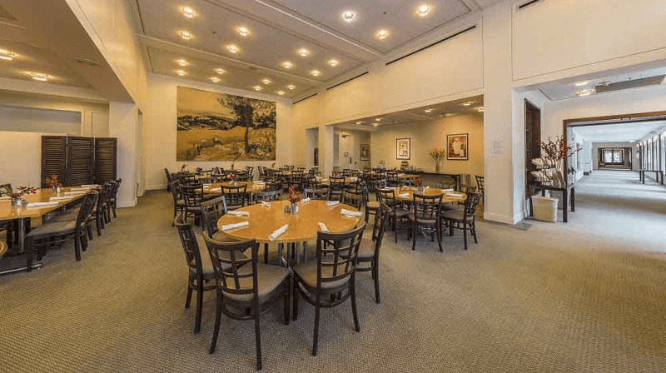
Week at a Glance
Notes:
We had a busy and productive day of side meetings yesterday. Thank you to all who participated in those discussions.
We have a busy two days looking ahead as well. Beyond covering several important CEOS-organizational discussion topics, we have a few thematic sessions related to Team Australia’s 2026 CEOS Chair Themes, NASA’s SIT Chair priorities, priorities of the WGs / VCs and other CEOS entities, - as well as areas where they all intersect.
This evening, we are excited to be working with the Beckman Center to host you all for a Dinner Reception, located in their dining room.

Slide 3
Items for Endorsement / Decision
[for endorsement] Full Proposal and final Implementation Plan for the proposed Biodiversity Virtual Constellation -> establish the B-VC.
Confirm initial leadership and membership of the B-VC.
[for endorsement] Endorse CEOS Organisational GitHub governance rules
Confirm https://github.com/ceos-org operating procedures
[for endorsement] Endorse the 2026-2027 CEOS Communications Strategy.
General update and new comms campaigns
[for endorsement] Endorse the WGCV Land Product Validation (LPV) Subgroup Land Cover and Change Map Accuracy Assessment and Area Estimation Good Practices Protocol.
Confirmed and adopted by WGCV, now seeking SIT-level endorsement
Notes:
Over the course of the next two days, we have 4 items up for endorsement.
[Summarize items as listed on slide]

Slide 4
Organisational Matters
Discuss the CEOS Decisions Types document
Gather feedback on the CEOS Digital Object Identifier (DOI) Process Paper
Review the 2026-2028 CEOS Work Plan.
Share an update on the new LSI-VC Wildfires Subgroup
Discuss membership as well as co-leadership alongside CSA/NRCan.
Notes:
Concerning organizational matters:
I would like to highlight today that we recognize that we are in a transition period at present, as a CEO-led team is working to clarify and formalize the organizational process and guidelines for CEOS Principal level decision-making and document disposition.
The team is working to ensure this process is appropriate, clear, and not burdensome, - and that it both highlights and enables the great work CEOS WGs, VCs, and other entities, do.
Importantly, this means the definitions of terms like “endorsement,” or “for information,” as reflected in this week’s agenda may change in the future. Your participation in this discussion is welcomed, as the CEO team will seek to finalize their guidelines at the 2026 Plenary.
This activity will inform the SEO’s ongoing DOI Process Paper effort, which the SEO will present today for information.
We will also review the 2026-2028 Work Plan virtually endorsed by CEOS Principals at the end of March, and tomorrow, hear an update about the new LSI-VC Wildfires Subgroup recently established, and currently working to expand its membership.

Slide 5
SIT Chair Theme:
Water Planet – Seeing Earth's Water from Space
Best Practice Guidance for Integrating Multiplatform/Multisensor Data for Water Science and Applications
Discuss steps to strengthen coordination across CEOS Agencies to promote the acquisition, integration, and delivery of diverse water-related data.
Gather feedback on the purpose, scope, and audience of guidance deliverables and identify potential contributors.
Present ideas for a water thematic contribution to the 2026 CEOS-ARD Strategy
Present outcomes from the April 13, CEOS Water Quality Workshop
Discuss workshop continuity @ SIT TW and beyond
Notes:
A few words on the thematic sessions over the next two days.
Tomorrow, we will hear from the team pushing forward the objectives for the Water Planet initiative. The team is busy making progress on their deliverables, and welcome your feedback - and participation:
Best Practice Guidance [Read from slide]
Water-thematic CEOS-ARD Strategy
Outcomes of the first part in the two-part CEOS Water Quality Workshop series, led by the 2026 CEOS Chair, co-hosted with NASA’s SIT Chair Team.

Slide 6
SIT Chair Theme:
Connected Data for Community Resilience
Share perspectives from the community
Early Warnings for All (EW4ALL)
International Wildfire EO Coordination Group
Californian stakeholders: Earth Fire Alliance & CalFire
The International Charter: Space And Major Disasters
Discuss how to leverage CEOS interoperability and ARD efforts
WGISS Interoperability Demonstrator activities
Discuss connections and opportunities for the SIT Chair theme.
Brief CEOS Agencies on the CEOS value chain and impact assessment
Notes:
Over the course of the next two days, we will also hear about progress on the SIT Chair’s 2nd priority: Connected Data for Community Resilience.
[Read from slides]

Slide 7
CEOS Chair Theme:
Positioning CEOS for Success in a Rapidly Changing Context
2026 CEOS Earth Observation Handbook update
Adaptation and resilience case studies overview
2026 CEOS-ARD Strategy
CEOS Principals to confirm overarching strategic direction
CEOS in Schools activities
Progress to date on webinars
Poster session planning for CEOS Plenary
Notes:
The CEOS Chair has also been working across CEOS to make progress on its headline theme: “Positioning CEOS for Success in a Rapidly Changing Context.” We will hear and discuss:
[Read from slides]

Slide 8
Working Group and Virtual Constellation Priorities
Continue consistent reporting on the status of the Virtual Constellations.
Aquatic Carbon Roadmap presentation, and timeline towards disposition at plenary.
Update on Agriculture, Forestry, and Other Land Uses (AFOLU) Roadmap implementation and taking stock of CEOS AFOLU activities.
Present four new WGDisasters pilots:
Landslides Follow-on, Wildfire II, Biodiversity, Drought
Discuss Essential Agriculture Variable (EAV) stocktake phase one report + plan for next phase
Joint WGCV Land Product Validation Subgroup and GEOGLAM “Joint Workshop on Good Practices for Evapotranspiration Validation”
Briefing and call for contributions
Present draft analysis from AC-VC on “Expanding the Geostationary Atmospheric Composition Constellation: Toward Global Coverage”.
Review progress of the Earth Observation Training, Education and Capacity Development Network (EOTEC DevNet) and consider connections to the SIT Chair priorities.
Revisit International Coordination Group for Spaceborne SAR (ICGS-SAR)
How to integrate their activities into the CEOS framework.
Notes:
WGs and VCs continue to keep busy, doing excellent work. By the end of the SIT-41 meeting, we will cover all the objectives as listed on the screen:
The NASA SIT Chair is continuing consistent reporting on the status of the VCs, working with co-leads from all groups to carry on JAXA’s tradition of creating one, cohesive presentation.
The Ocean Color Radiometry(OCR)-VC will present its recent draft of the Aquatic Carbon Roadmap - available linked to the SIT-41 agenda - and we will discuss its timeline toward its disposition at plenary.
The AFOLU team (LSI-VC Biomass and Forests Subgroup) will present an update on the Roadmap’s implementation, and the team’s plan to do a “stocktake” of all existing CEOS AFOLU activities.
WGDisasters will present 4 new pilots - Landslides, Wildfire, Biodiversity, Drought
GEOGLAM will present its Essential Agriculture Variable (EAV) stocktake Phase 1 report, and discuss the team’s plan for the next phase
GEOCLAM is also working with WGCV’s Land Product Validation (LPV) Subgroup to create a “Joint Workshop on Good Practices for Evapotranspiration Validation.” We will hear a briefing, as well as a call for contributions.
AC-VC will present a draft analysis of their paper, “Expanding the Geostationary Atmospheric Composition Constellation: Toward Global Coverage.”
WGCapD and EOTEC DevNet representative will present progress on EOTEC DevNet activities over the last 5 years, and consider connections to the SIT Chair priorities.
And last but not least, Paul Rosen, of the International coordination Group for Spaceborne SAR (ICGS-SAR) will give a presentation on how to integrate the group’s activities into the CEOS framework, following a lively discussion yesterday.
But before we dig in to all of these items, I will pass the mic to the CEOS Chair team, who will review several 2025 CEOS Plenary items.

