Slide 1
CEOS SIT-41
Document Status and Handling
CEOS Chair and CEO
Agenda Item 1.5
CEOS SIT-41 2026
Irvine, California, USA
14-16 April 2026

Slide 2
Raison d’être
The existing CEOS governance documents do not clearly specify how documents should be presented to CEOS leadership (Principals) or how they are managed afterwards.
To address this gap, Plenary Action 39-02 was undertaken, which has led to the development of a dedicated paper.

Slide 3
Reminder of Plenary Action 39-02
CEOS Chair will shepherd the CEOS Decision Types document to completion and potential presentation for endorsement as an addition to the permanent CEOS Governance and Processes document at the 2026 CEOS Plenary.
Timeline:
  Q1-2026: Iterations with interested CEOS colleagues
  Presentation of draft at SIT-41
  Next to final version at SIT-TW
  Update of Governing Documents brought for endorsement to CEOS Plenary 2026

Slide 4
Progress Thus Far
23/02/2026 – Working session on Decision Types
  Reviewed “CEOS Decision Types Paper” (SEO team draft)
  Discussed open issues, terminology, processes, decision tree, alignment with DOI
  Brainstorming with selected participants for feedback
25/03/2026 – Decision Types Update Meeting
  Reviewed status, CEOS governance updates, decision tree
  Shared new decision types paper and flowchart with 4 decision categories
  Key updates by CEO Team: Clarified consensus rules; Standardised terminology and reduced categories; Simplified decision tree; Defined DOI policy, sequential flow, WG vs Plenary authority; Conducted terminology/documentation audit
07/04 and 14/04/2026 – Discussion with CEOS Chair & SIT Chair
  Feedback collected for consolidated paper and flowchart

Slide 5
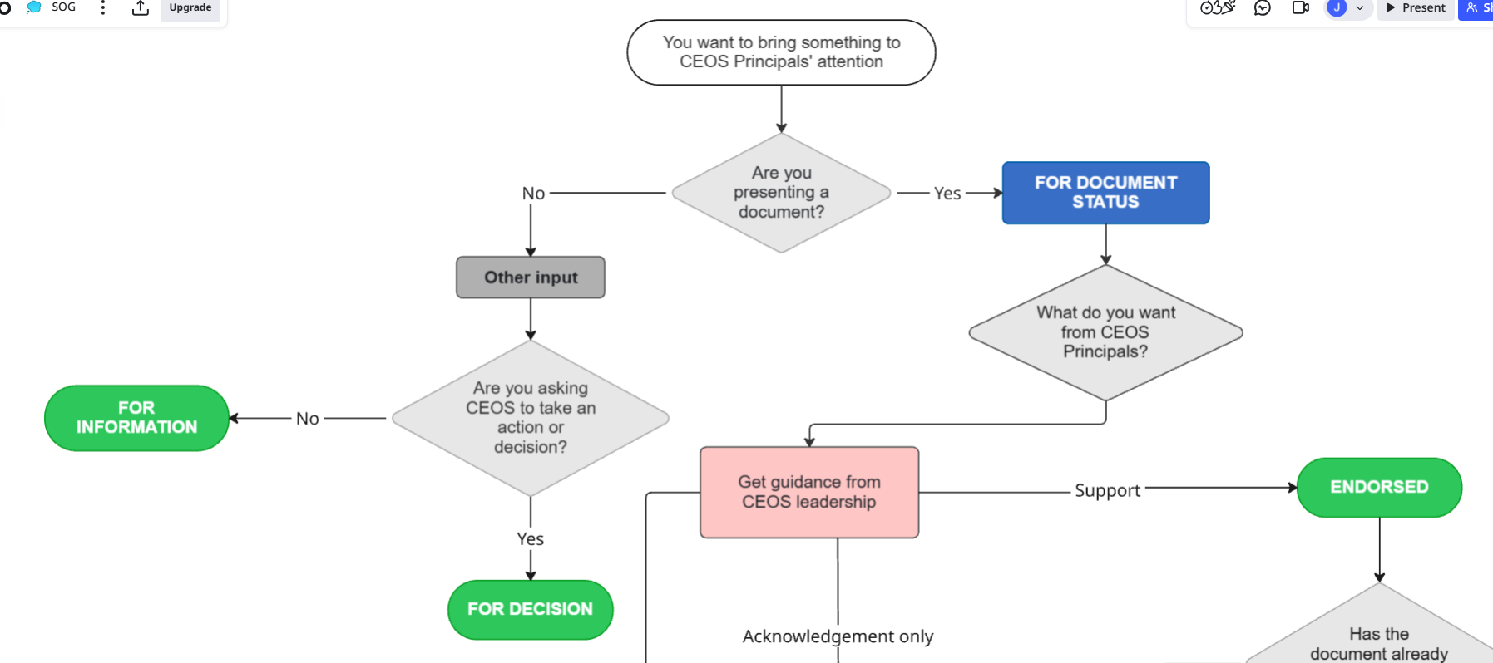
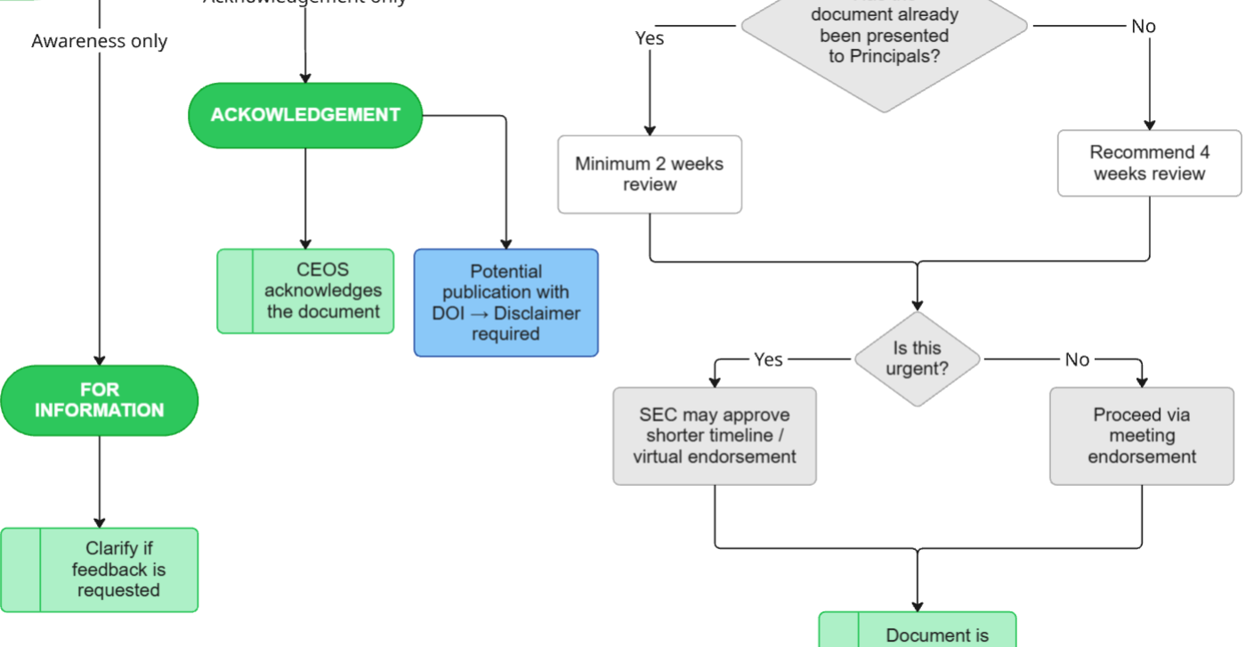
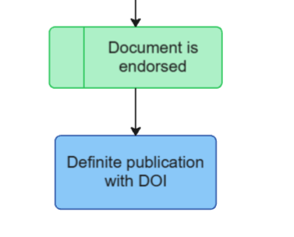
Flowchart

Slide 6
Types of Input vs Outcome
Type | Purpose | Outcome
For Information* | Share material for awareness | No formal status or decision
For Decision | Request internal CEOS direction or approval (incl. initiating activities, assigning actions, governance decisions) | CEOS action or mandate
For Document Status | Request formal recognition of a document | Document is Acknowledged or Endorsed
*When presenting items for information, presenters should explicitly clarify whether feedback or guidance is sought, and by when.

Slide 7
Status of documents
Status | Meaning | Implications | Examples
For information | CEOS Principals have been made aware of the document |  | Reports, Supporting Docs (e.g., Chair Themes, SIT Chair Priorities), WG/VC products not brought to Plenary [Special cover sheet, no DOI]
For acknowledgement** | CEOS Principals acknowledge the document | Principals recognize the value of the provided input. There may not be consensus on every component of the document. | Technical papers, White Papers, Long strategies [Can follow DOI Process Paper]
For endorsement*** | CEOS Principals publicly support the document | CEOS stands behind the output and encourages uptake. Represents a consensus of CEOS agencies. | Work Plan, Key Findings, Concise/abbreviated Strategies, Guidelines, Public Statements, Best Practices [Will follow DOI Process Paper]
**Allowing recognition of outputs while preserving agency independence | ***Requires sufficient review time and consensus.

Slide 8
Other Key Points
CEOS Consensus Principle
Roles and Governance
Branding, Publication, and Disclaimers

Slide 9
Proposed Next Steps
Open feedback period until 15 May 2026
Next to final draft presented at SIT TW
Reconvene once before finalising for Plenary endorsement
Ensure alignment across agencies and entities and consistent implementation of framework

Slide 10
Thank you!
CEOS Chair and CEO
Agenda Item 1.5
CEOS SIT-41 2026
Irvine, California, USA
14-16 April 2026

