Slide 1
CEOS SIT-41
DOI Process Paper
David Borges, SEO
Agenda Item 1.6
CEOS SIT-41
Irvine, CA, USA
15 April 2026

Slide 2
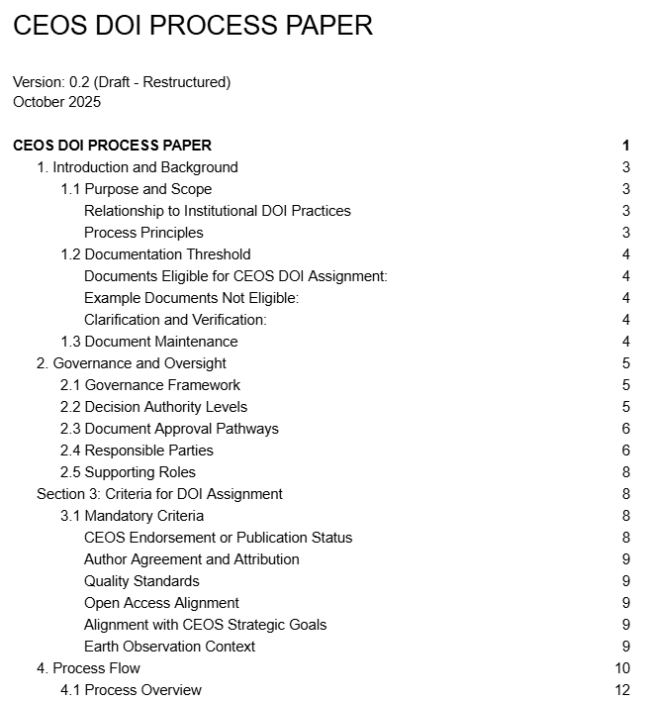
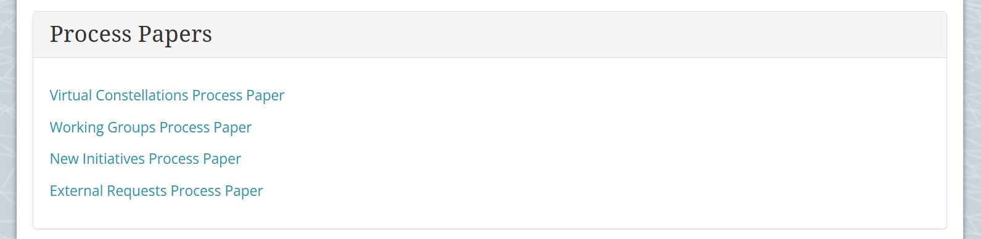
CEOS DOI Process Paper
Demand: SEO has received requests from multiple CEOS groups for a standardized mechanism to assign Digital Object Identifiers (DOIs) to official CEOS outputs. Currently, CEOS has no formal process for DOI registration, and important documents and papers lack persistent identifiers.
In Development: A new CEOS DOI Process Paper (currently v0.2) is under development, modeled on the structure and scope of existing CEOS process papers. The paper defines a lightweight, governance-integrated process for DOI assignment through Zenodo
Plan: Present here for discussion; target endorsement at CEOS Plenary 2026
Key Governance Dependency
The DOI Process Paper has been deliberately structured to be fully subordinate to the CEOS Governance. The outcome of the Document Handling Framework, particularly the status of which decision category/s may shape the DOI Process Paper's applicability criteria. The process paper will be finalized once governance is resolved.

Slide 3

Value of DOIs for CEOS
Persistent access: DOIs provide permanent, resolvable URLs for CEOS documentation. Unlike web links that break when sites are reorganized, DOIs guarantee long-term access through CERN-backed infrastructure.
Discoverability: Standardized metadata means CEOS outputs appear in global research indices (DataCite, OpenAIRE, Google Search), making them findable by the broader EO community.
Citation tracking: DOIs enable formal citation of CEOS work in peer-reviewed literature, allowing measurement of the reach and impact of CEOS outputs for the first time.
Open access alignment: DOI registration through Zenodo directly supports CEOS's commitment to open Earth observation data and aligns with FAIR data principles.

Slide 4

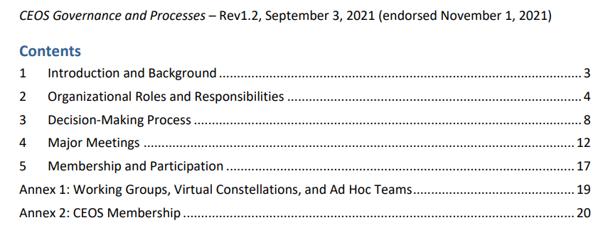
Design Principles
Document eligibility defers entirely to governance.
  The process paper will reference the Document Handling Framework for determining which documents qualify. It does not independently define what constitutes 'endorsement' or 'publication status.'
The process paper defines only the mechanism for DOI assignment
  Once a document has achieved the appropriate governance status. It covers how to submit, review, and publish, not whether a document should be published.
Roles are verification and execution functions only
  Neither the Documentation Lead nor the Technical Coordinator makes independent determinations about whether a document merits publication or endorsement. They confirm that documented governance processes were followed, and they execute the technical steps.
Governance changes flow automatically
  If the Document Handling Framework is updated (e.g., the status of a decision type changes), the DOI Process Paper's applicability criteria should update accordingly (hopefully) without requiring separate amendment.

Slide 5

Platform for Assigning DOIs
Why Zenodo is the Right Platform
CEOS Implementation Approach
Free, open-source platform operated by CERN and funded by the European Commission through OpenAIRE. No cost to CEOS and no vendor lock-in; data remains exportable.
Community curation model CEOS maintains a dedicated collection space with admin/curator controls. Only approved content appears in the CEOS community.
Flexible content types a single platform handles reports, datasets, software tools, presentations, and standards documents. All receive DOIs through DataCite.
Built-in review workflow Zenodo's 'Submit for Review' feature allows draft submissions to remain private until curator-approved. All review comments are tracked, providing a transparent audit trail.
GitHub integration automated DOI assignment for software releases, supporting technical documentation workflows in the future
Eligibility tied to CEOS governance only documents that have achieved 'For Endorsement' or 'For Publication' status under the CEOS Decision Types framework qualify for a CEOS DOI.
Two distinct oversight roles: A Documentation Lead verifies governance status (endorsement/publication); a Technical Coordinator manages Zenodo, metadata standards, and publication execution.
Standardized metadata requirements: mandatory CEOS keywords, author affiliations with CEOS agency identification, Earth observation context, and related identifier linkages.
Complements agency DOI practices: the CEOS process is for collaborative CEOS outputs only. Member agencies continue to assign DOIs through their own repositories for agency-specific work.

Slide 6
DOI Assignment Process
The draft process separates strategic endorsement verification (Documentation Lead) from technical implementation (Technical Coordinator), leveraging Zenodo's draft submission and review functionality. Goal of submission-to-DOI timeline around 4 weeks.
Governance Gate
Step 0
Step 1
Step 2-3
Step 4
Step 5
Step 6
Step 7
Pre-
Submission
Account
Setup
Draft &
Submit
Technical
Review
Endorsement
Verification
Publish &
DOI Assign
Post-Pub
Verify
Doc Lead
Tech Coord
Submitter
Tech Coord
Doc Lead
Tech Coord
Submitter
Step 0 — Pre-Submission: Documentation Lead confirms document is appropriate for CEOS DOI and endorsement documentation is available.
Step 1 — Account Setup: Submitter creates Zenodo account; Technical Coordinator grants CEOS community membership (1 week).
Steps 2-3 — Draft & Submit: Submitter creates draft in Zenodo (private/unpublished), completes metadata, and uses 'Submit for Review' to trigger Technical Coordinator review.
Step 4 — Technical Review: Technical Coordinator reviews metadata completeness, keywords, quality standards. Iterative feedback via Zenodo's review interface (~2 weeks).
Step 5 — Endorsement Verification: Documentation Lead verifies governance status by examining Plenary/SIT meeting minutes and formal communications. This is the governance decision gate. No document publishes without confirmed status.
Step 6 — Publication: Technical Coordinator accepts the submission and publishes. Zenodo automatically assigns the DOI; the record becomes publicly accessible in the CEOS community.
Step 7 — Post-Publication: Submitter verifies DOI resolution, metadata display, community visibility, and link functionality within one week.

Slide 7
Roles and Responsibilities
The DOI assignment process is managed by two key roles with distinct, non-overlapping responsibilities. Neither role has interpretive authority over governance decisions. They verify that documented processes were followed and execute the technical steps.
Documentation Lead
Technical Coordinator
Strategic coordination & governance verification
Technical implementation & platform management
Verification: Confirms that submitted documents have completed the governance-defined process for their claimed decision type by examining meeting minutes and formal communications.
Coordination: Works with submitters and CEOS Secretariat to gather endorsement documentation.
Referral: For unclear or contested governance status, refers the matter to CEOS leadership (CEOS Chair, SIT Chair, Secretariat).
Reporting: Annual reporting to Plenary on DOI process implementation.
Technical Review: Reviews submissions against CEOS metadata standards for completeness, resource type selection, mandatory keywords, related identifiers, professional presentation.
Platform Administration: Manages CEOS Zenodo community space, user permissions, community curation, and quality oversight.
Publication Execution: Publishes approved submissions after both technical compliance and governance verification are confirmed.
Support: Assists submitters with Zenodo interface and metadata requirements.
Submitter: Creates Zenodo account, prepares draft submission with complete metadata, submits for review, responds to feedback, provides endorsement documentation, and performs post-publication verification. Submitters are typically Working Group or Virtual Constellation members preparing documents on behalf of their CEOS entity.

Slide 8
Status and Next Steps
Current Status
Open Dependencies
Process Paper v0.2 draft restructured with enhanced governance alignment, complete process workflow (8 steps), metadata standards, checklists, and examples.
CEOS Zenodo community space established and ready to receive submissions once the process is endorsed.
Paper scope and structure modeled on existing CEOS process papers. Written to be concise, governance-integrated, and designed for practical use by WG/VC members.
Decision Types framework: The outcome of the Clarification of CEOS Decision Types discussion (SIT-41 and Plenary 2026) will determine the DOI Process Paper's eligibility criteria. Custom cover pages and verbiage per decision type to be confirmed.
Submission status: Whether 'For Publication' remains a standalone decision category or is absorbed into another framework directly affects which documents can receive CEOS DOIs
Role assignments: Identification and confirmation of individuals to serve as Documentation Lead and Technical Coordinator.
Path to Plenary 2026
SIT-41 (Apr 2026)
SIT Technical Workshop (Sep)
Plenary 2026
Update and discussion.
Solicit feedback on approach,
scope, and governance alignment.
Revise process paper to near final and align with Document Handling outcome. Confirm role assignments.
Present final draft of the
DOI Process Paper
for endorsement.
SIT is invited to provide feedback on the approach, scope, and governance alignment, and to flag any concerns for resolution before Plenary.

