Slide 1
CEOS SIT-41
CEOS 2026-2028 Work Plan
Lefteris Mamais
CEOS Executive Office
Agenda Item 1.7
CEOS SIT-41 2026
Irvine, California, USA
14-16 April 2026

Slide 2
Governance & Work Planning
Four key governing documents primarily guide the work of CEOS:
CEOS Terms of Reference defines the mission and scope of CEOS activities
CEOS Strategic Guidance document articulates the overarching long-term purpose and goals of CEOS
CEOS Governance and Processes document provides guidelines on the structure, operations, and processes CEOS employs to achieve its goals
CEOS Work Plan (3-year rolling) sets forth near-term actions to achieve the goals outlined in the CEOS Strategic Guidance document
The CEOS Executive Office is the custodian of all CEOS Governing Documents, including the annual update of the 3-year CEOS Work Plan and the definition and monitoring of the deliverables it informs.

Slide 3
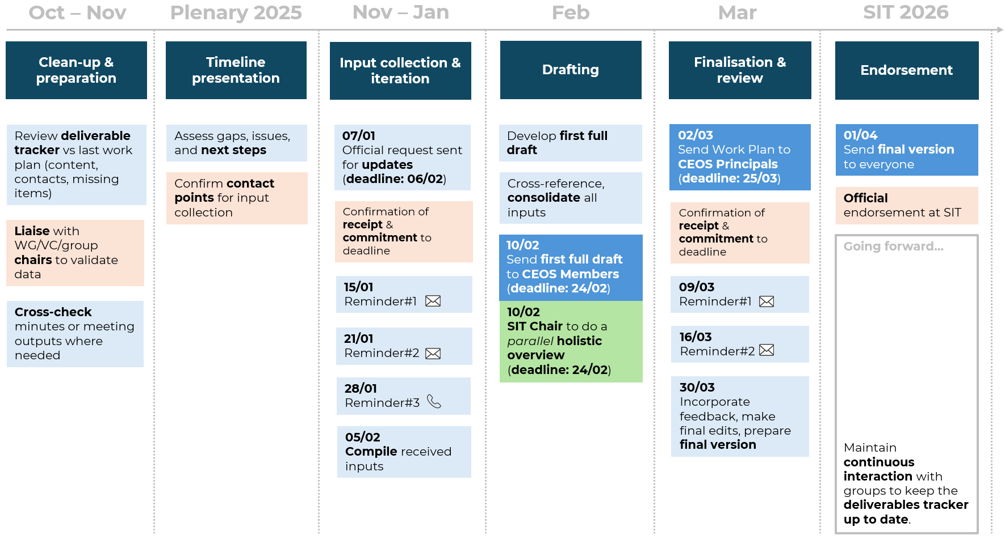
CEOS Work Plan
The 3-year work plan is updated by all CEOS entities every year and put forward for formal endorsement at the SIT in April. Rigorous work planning, execution, and monitoring are critical to the credibility of CEOS.
Notes:
We propose that virtual endorsement of the CEOS 2024-2026 Work Plan officially occur on Thursday 18th April 2024 subject to agreement and feedback.

Slide 4
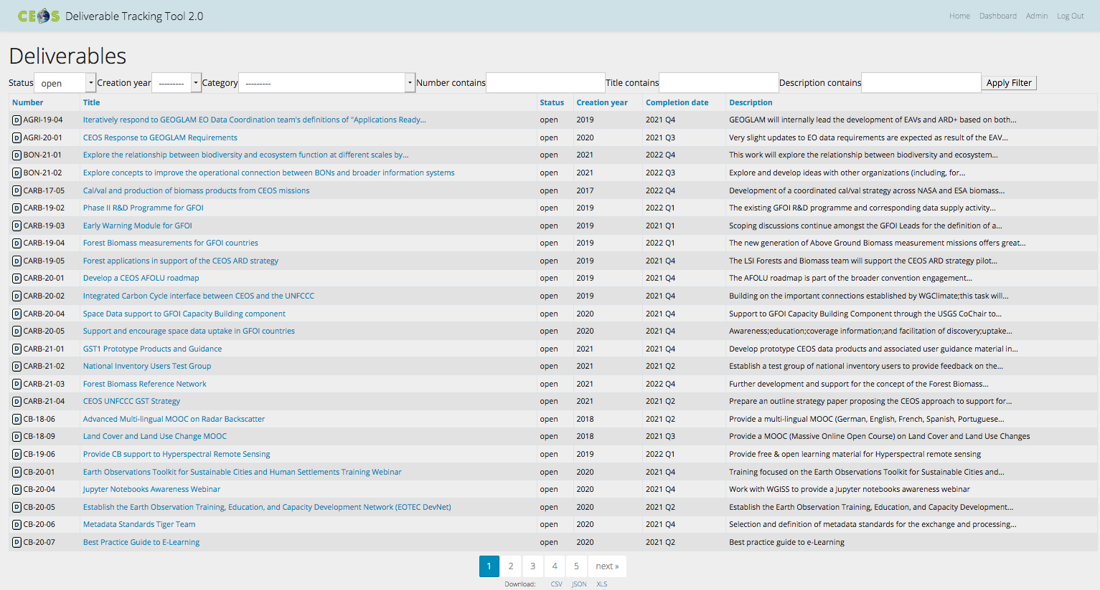
CEOS Work Plan
Detailed work defined as deliverables: outlined in the WP, reconciled and tracked in the CEOS deliverable tracking tool

Slide 5
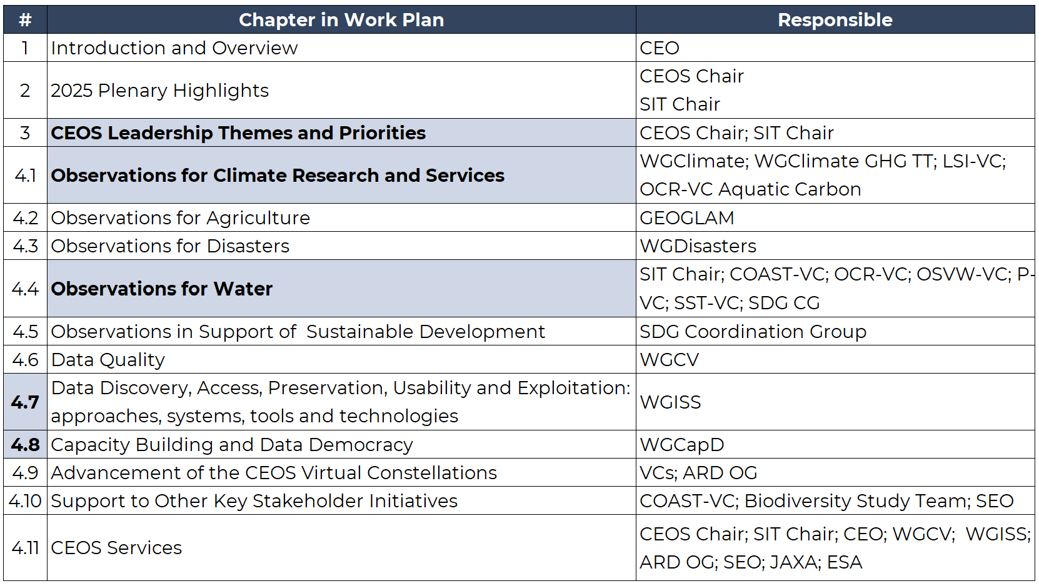
New Structure

Slide 6
New Structure Overview
Harmonised: Leadership sections (3.1, 3.2)
Moved: Carbon → under Climate
Removed as standalone: Global Stocktake
Expanded: Water and CEOS Services subsections
Organised: Presented the open deliverables separately for each VC
Cleaned: consistent numeric hierarchy across entire document
Reorganised: Acronyms → Annex

Slide 7
New Structure Breakdown
2025–2027 | 2026–2028 | Change
iii. CEOS Recent Developments | 2 2025 Plenary Highlights | Renamed, refocused, harmonised (Plenary-specific)
No equivalent section | 3 CEOS Leadership Themes and Priorities | New section introduced
3.2 Carbon Observations in support of Climate Science and Decision Making | 4.1.2 Observations for Carbon | Moved under Climate (no longer standalone section)
3.3 Observations in Support of the Global Stocktake process of the UNFCCC | No standalone equivalent | Removed as standalone (content redistributed)
3.6 Observations for Water | 4.4 Observations for Water | Significantly expanded
(no equivalent subsections) | 4.4.1–4.4.7 (Water substructure) | New detailed breakdown (priorities + VCs)
3.10 Observations in support of the United Nations Sustainable Development Goals | 4.5 Observations in Support of Sustainable Development | Renamed
(no equivalent subsections) | 4.11.1–4.11.8 (service-level subsections) | New structured breakdown
i. Acronyms | 5.1 Acronym List (Annex) | Moved to annex

Slide 8
2026 Progress
Category | Number
Completed on time (2025 deadline) | 22
Delayed (deadline extended) | 27
Other completed / removed | 7
Meant to carry over (on track) | 85
Category | Open Deliverables
Carried Over | 112
Completed | 29
New | 31

Slide 9
Open Deliverable Deadlines
# | Section Title | 2026 | 2027 | 2028 & beyond
1 | Climate Research & Services | 6 | 4 | 3
2 | Carbon Observations | 12 | 11 | 7
3 | Agriculture | 3 | 5 | 2
4 | Disasters | 4 | 3 | 1
5 | Water | 5 | 4 | 2
6 | Sustainable Development | 4 | 1 | 0
7 | Data Quality | 3 | 2 | 1
8 | Data Discovery & Exploitation | 6 | 3 | 1
9 | Capacity Building & Data Democracy | 8 | 2 | 0
10 | Virtual Constellations | 7 | 6 | 3
11 | Stakeholder Initiatives | 5 | 2 | 1
12 | CEOS Services | 5 | 1 | 1

Slide 10
Closing Remarks
Thank You!
Great work on timelines and results – we should all be proud.
Please keep the deliverable tracker updated.
Let’s continue collaborating on upcoming tasks.

Slide 11
Looking forward to continued collaboration.
Lefteris Mamais
CEOS Executive Office
Agenda Item 1.7
CEOS SIT-41 2026
Irvine, California, USA
14-16 April 2026

