Slide 1

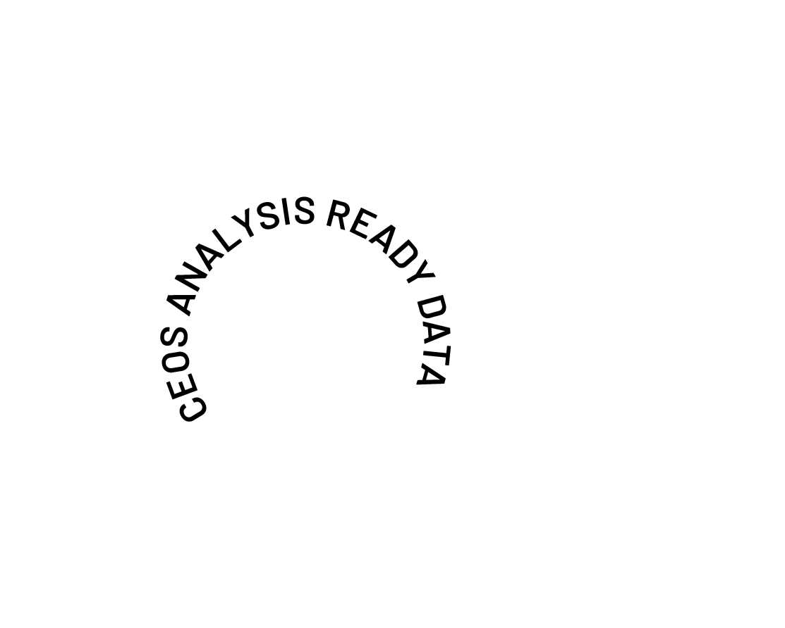
2026 CEOS-ARD Strategy Progress
Ferran Gascon, ESA
On behalf of the CEOS-ARD Oversight Group
Earth Observation for Everyone

Slide 2

Headlines for Today
Present an update on 2026 CEOS-ARD Strategy development
Ask CEOS Principals to confirm overarching strategic directions to enable subsequent technical decisions to take place
  In particular at the joint WGCV-56 and LSI-VC-19 meeting at USGS EROS next week!

Slide 3



In 2025 we asked: Can we do more?
The Earth observation sector has come a long way since CEOS-ARD was first conceptualised:
Changing technology
Evolving user base and expectations
Increasing demands for interoperability
Need CEOS-ARD to continue evolving
Ensure CEOS-ARD remains consistent with and relevant to the evolving user base and their expectations
Where are the opportunities to make CEOS-ARD better?

Slide 4

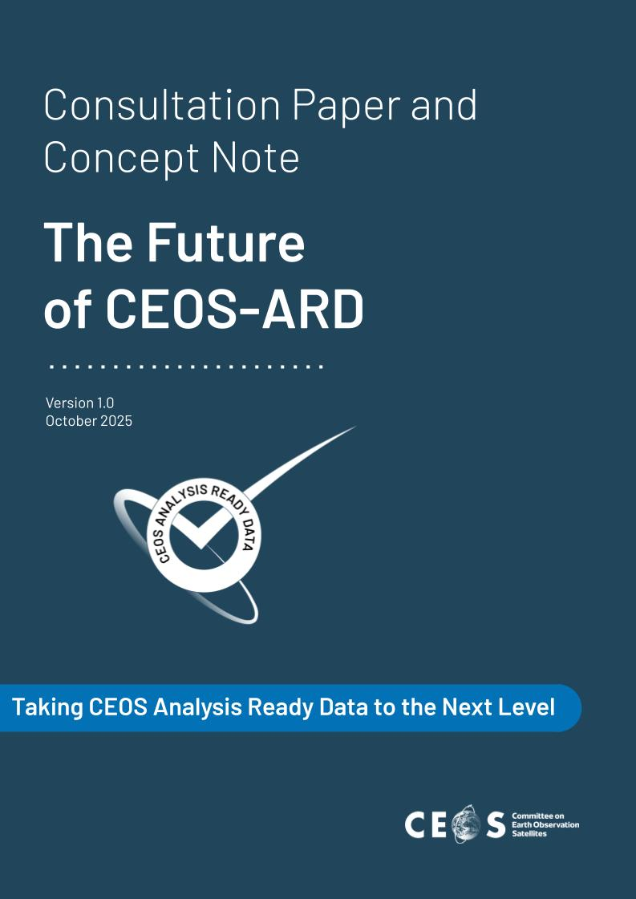
In 2025 we undertook a community engagement campaign and survey to understand needs
111 respondents
Findings are summarised in the paper available on ceos.org/ard
Identifies areas to develop further in CEOS-ARD Strategy 2026 and the dependencies / expertise needed
Survey remains open at: ceos.org/ard/survey

Slide 5
Progress
At the 2025 CEOS Plenary, Principals tasked the CEOS-ARD Oversight Group to develop the 2026 CEOS-ARD Strategy for delivery by the 2026 CEOS Plenary
    In collaboration with CEOS entities and external stakeholders
    Supported by the 2026 CEOS Chair team
Strategy will define the actions, resources, and commitments required to deliver the next level of ambition for CEOS-ARD and meet community expectations
Proposed vision statement: “Earth Observation for Everyone”
Decided on a two-part structure – following example of other CEOS Roadmaps
  High-level, five-year Strategy, which will set the overall vision and direction
  A more frequently updated annex of initiatives/tasks that achieve the Success Criteria and Outcome Signals of the Strategy
Potentially supplemented by a CEOS-ARD for water annex, supported by the NASA SIT Chair team.

Slide 6
2026 Timeline (1/2)
January
Initial conversations with CEOS-ARD Oversight Group in collaboration with various CEOS entities and in consultation with external stakeholders.
Agreed to develop a longer term strategy document separate to specific initiatives
March
Revised Strategy shared with an extended 100 member stakeholder list and engagement with Working Groups and Virtual Constellations has begun
February
Initial Strategy drafted and circulated to a core writing team of 53

Slide 7
2026 Timeline (2/2)
CEOS SIT-41
Submitted high-level, five-year strategy, which will set the overall vision and direction
Ask CEOS Principals to confirm overarching strategic directions
2026 SIT Technical Workshop
Near complete draft of high-level strategy and initiatives/tasks annex prepared for discussion
November
April
September
LSI-VC-19 / WGCV-56 Joint Meeting
Discuss each of the Strategic Pillars identified in the high-level Strategy and confirm initiatives and activities needed to realise the Success Criteria and Outcome Signals identified therein.
Critical milestone for data quality topics
2026 CEOS Plenary
Presentation for endorsement

Slide 8
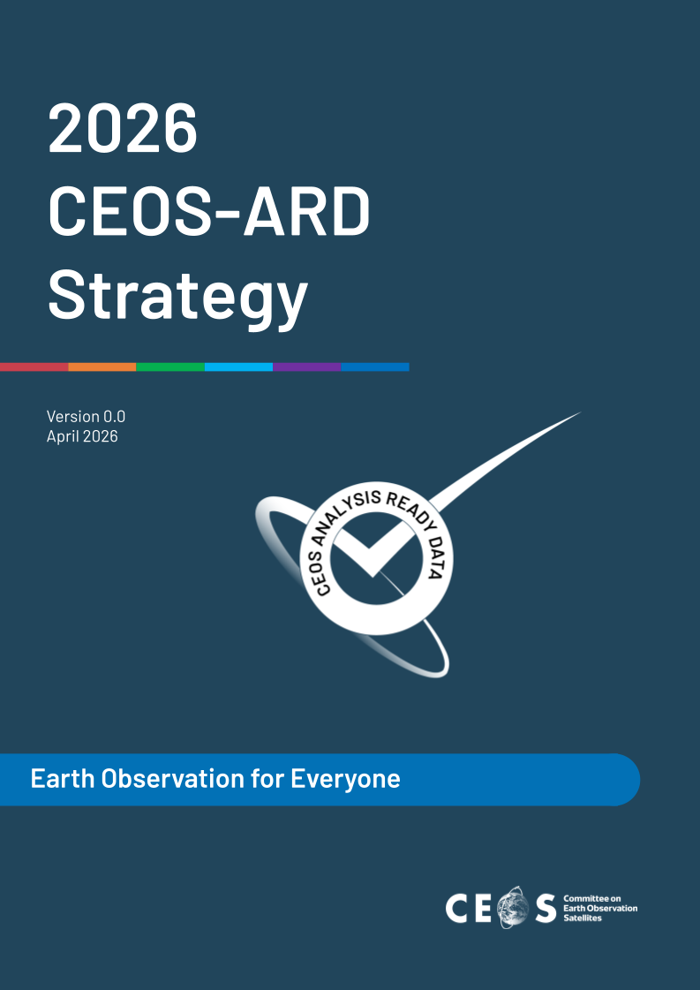
Provided at SIT-41

Slide 9
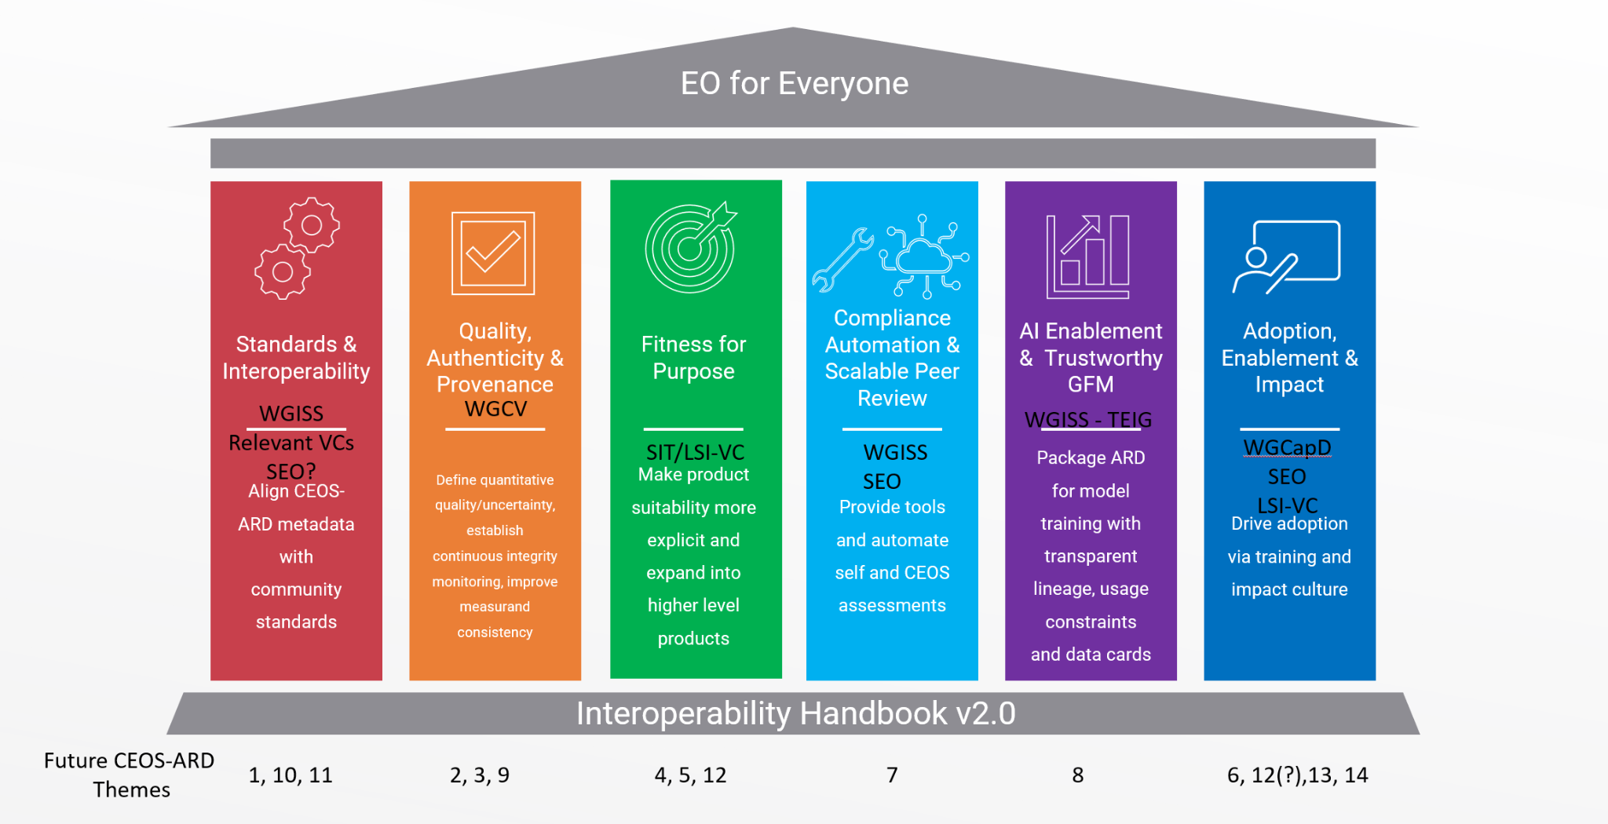
CEOS-ARD Strategy Pillars
Underpinned by CEOS Interoperability Handbook conventions

Slide 10
CEOS-ARD Strategy Pillars
1: Standards and Interoperability: Focus on ensuring CEOS-ARD metadata and data structures are interoperable across existing global standards.
2: Quality, Authenticity & Provenance: Addresses the need for measurable, transparent, and continuously verifiable data quality.
3: Fitness for Purpose: CEOS-ARD products are clearly classified for their suitability across different applications, supporting both non-expert users and scientific communities.
4: Compliance Automation & Scalable Peer Review: Reducing the burden of compliance assessments for data providers and assessors, enabling CEOS-ARD to scale across a growing number of providers.
5: AI Enablement & Trustworthy GFM: Position CEOS-ARD as the gold standard for AI applications, including Geospatial Foundation Models (GFMs).
6: Adoption, Enablement & Impact: Maximize CEOS-ARD adoption across public procurement, commercial markets, and end-user communities

Slide 11
Questions for Principals
Are these the correct strategic directions?
Are they actionable enough?
How do the pillars align with national / space agency priorities?
What can agencies and CEOS entities offer to develop and implement them?

Slide 12
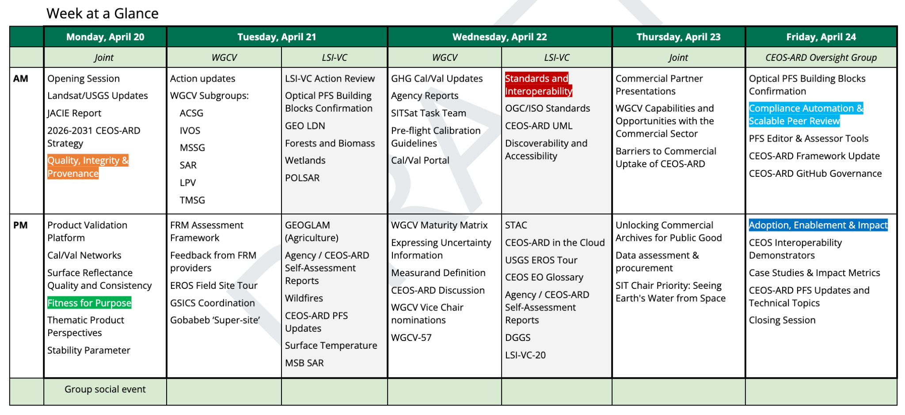
LSI-VC-19 / WGCV-56

Slide 13
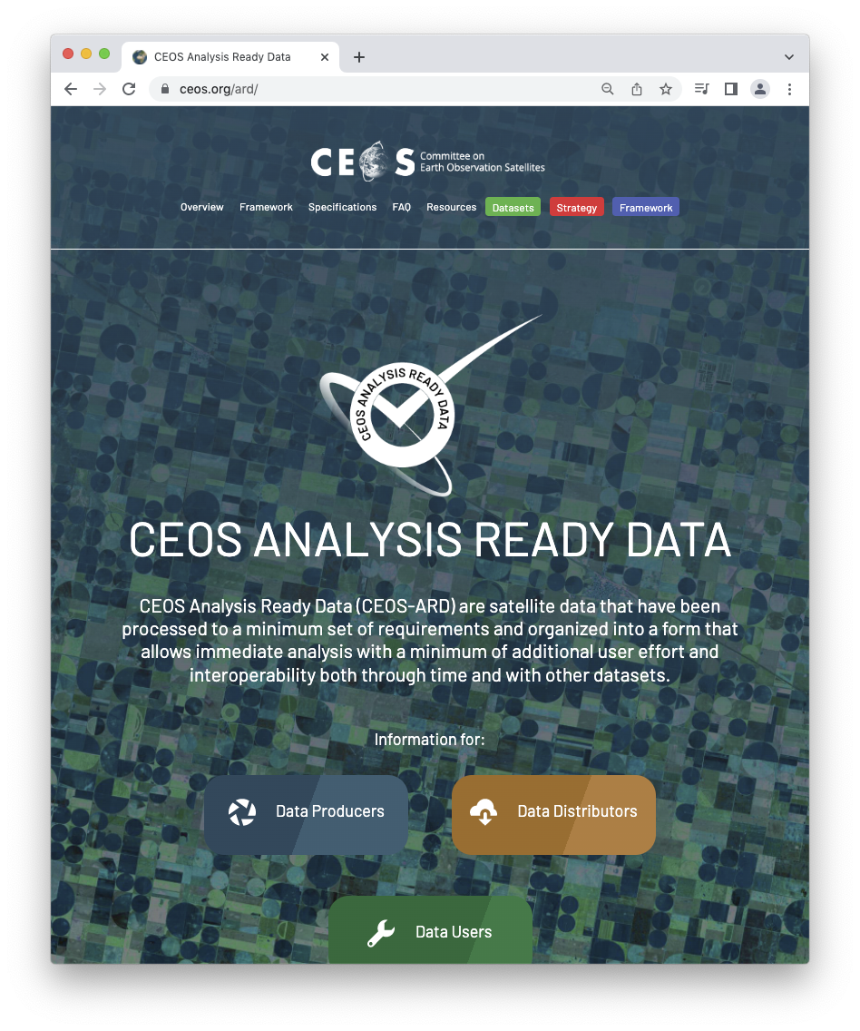
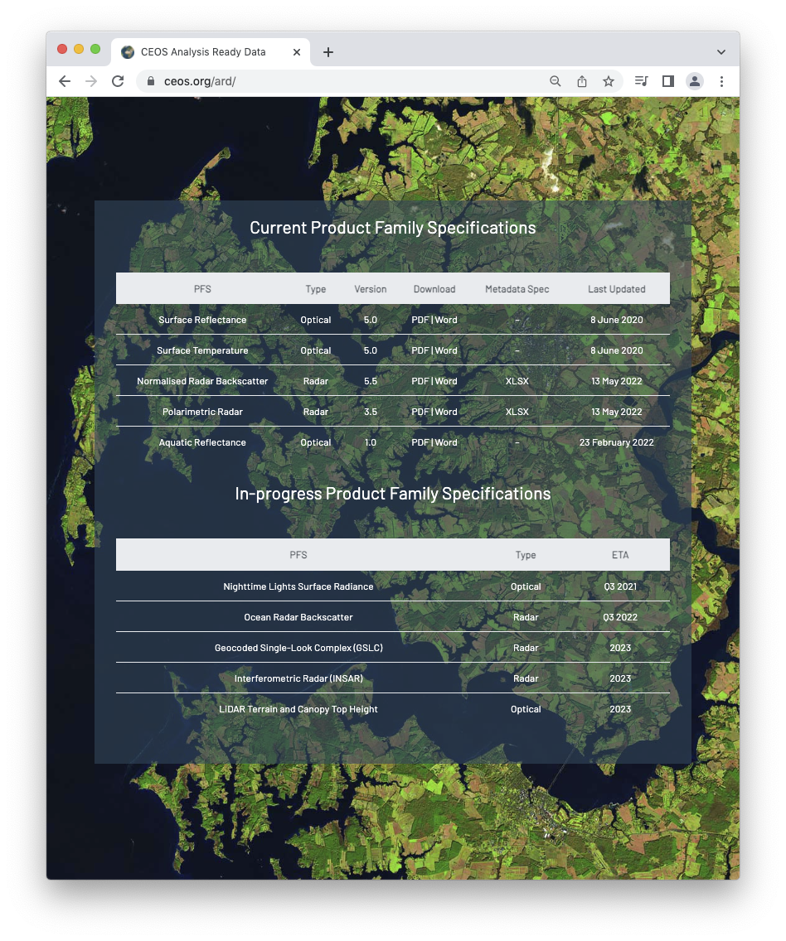
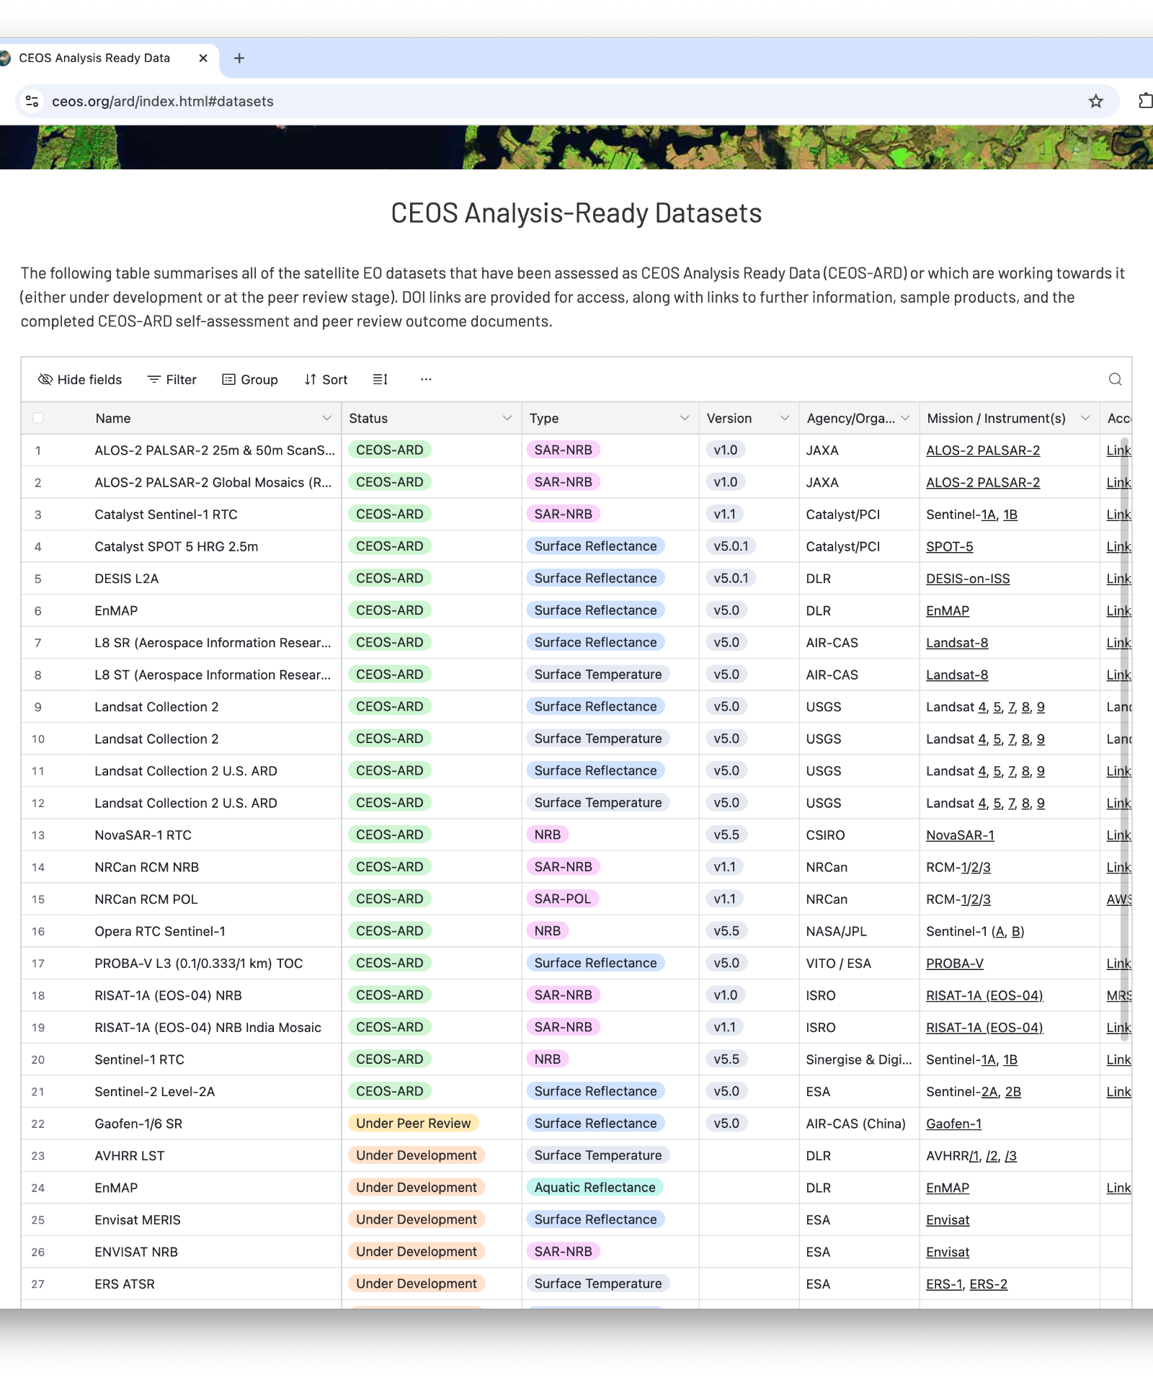
Closing
ceos.org/ard
Ferran.Gascon@esa.int
matthew@symbioscomms.com
Matthew.Adams@ga.gov.au
Thank you to everyone for supporting this effort!
Reception has been very positive and encouraging

Slide 14





Shaping the future of CEOS Analysis Ready Data

Slide 15
Supplementary Slides for SIT-41 Side Meeting
2026 CEOS-ARD Strategy Pillar Descriptions

Slide 16
Standards & Interoperability
Success Criteria:
CEOS-ARD metadata is consistently implemented across all Product Family Specifications, with a STAC-first, machine-readable and human-interpretable specification supported by OGC/ISO crosswalks.
CEOS-ARD data and metadata are natively understood by mainstream software tools (e.g., GDAL, QGIS, ArcGIS, cloud catalogues) without custom adapters.
CEOS-ARD is recognised as the de facto global community standard for satellite Analysis Ready Data, with a clear, endorsed roadmap toward formal standardisation.
Agencies, commercial providers, and distributors treat CEOS-ARD requirements as default interoperability baselines, not bespoke CEOS artifacts.
Outcome Signal: CEOS ARD datasets work seamlessly across mainstream geospatial tools and cloud-based processing environments. This means:
CEOS-ARD metadata and data work out-of-the-box in mainstream tools and cloud workflows.
Users don’t need custom scripts or manual schema mappings to use CEOS-ARD.
CEOS-ARD is seen as ready-to-use.

Slide 17
Quality, Authenticity & Provenance
Success Criteria:
CEOS-ARD products are accompanied by quantitative, consistent, and comparable quality and uncertainty information, not just descriptive compliance statements.
Ongoing integrity monitoring and reporting is routine, enabling early detection of degradation or loss of compliance. Note: Integrity means continuous, verifiable confidence that CEOS‑ARD data remains accurate, consistent, authentic, and traceable across its entire lifecycle.
Provenance, authenticity, versioning, and lineage of data are machine-readable and human-interpretable, and traceable across all mirrors, cloud platforms, and reprocessing cycles.
If a user is building a time series or multi-mission analysis, they can swap or mix CEOS-ARD products with no hidden biases or artifacts being introduced.
The CEOS-ARD label guarantees harmonized measurands, within specified uncertainties (note: not homogenised).
Outcome Signal: Trust in the CEOS-ARD label is based on evidence.

Slide 18
Fitness for Purpose
Success Criteria:
Users can clearly identify what each CEOS-ARD product is fit for, including limitations, uncertainty bounds, and appropriate application types.
CEOS-ARD supports long-term, stable, bias-aware data records suitable for long-term scientific applications.
Fitness-for-purpose distinctions help non-expert users avoid misuse, while giving providers clear pathways to improve product maturity.
CEOS-ARD products are increasingly cited as authoritative inputs to global frameworks, indicators, and assessments.
Outcome Signal: Users can select CEOS-ARD products with confidence.

Slide 19
Compliance Automation & Scalable Peer Review
Success Criteria:
CEOS-ARD assessments are largely automated, repeatable, continuous, and embedded in provider pipelines.
Peer review scales sustainably without relying on manual document checks.
Providers experience lower effort and faster turnaround for CEOS-ARD endorsement.
CEOS-ARD governance shifts from gatekeeping to continuous assurance.
Contribute to commercial ecosystem enhancement by enabling independent third parties to undertake compliance assessments.
Outcome Signal: CEOS-ARD can scale to many more providers without slowing down and third parties emerge to provide commercial compliance services.

Slide 20
AI Enablement & Trustworthy GFM
Success Criteria:
CEOS-ARD products are widely used as trusted training and benchmarking data for geospatial AI and foundation models.
CEOS-ARD defines product specifications for GFM-derived products, including embeddings, ensuring they carry the same quality and provenance guarantees as the source data.
AI users understand dataset limitations through clear provenance, uncertainty information, and data cards.
CEOS-ARD helps reduce AI risk, by discouraging use of poorly characterised data in high-impact applications.
CEOS agencies are recognised as stewards of high-quality training data.
Outcome Signal: CEOS-ARD is referenced as a quality baseline in AI research and operational deployment.

Slide 21
Adoption, Enablement & Impact
Success Criteria:
CEOS-ARD is routinely referenced in procurement, funding calls, and operational requirements as a baseline expectation.
CEOS-ARD is recognised as community-driven, being co-developed by CEOS and the broader community.
Derivative and thematic CEOS-ARD products directly support priority user communities (e.g. agriculture, biodiversity, disasters).
Commercial providers see CEOS-ARD endorsement as a market differentiator, not a compliance burden.
Training, outreach, and documented case studies clearly demonstrate real-world impact and return on investment.
Growing number of CEOS-ARD compliant datasets and a growing annual volume of CEOS-ARD compliant datasets across common ’data distributor’ platforms based on a 2026 baseline.
Outcome Signal: CEOS-ARD success is measured by use and impact including through increased citations in the scientific and general literature.

Slide 22
What do we need from Agencies and CEOS to help develop these areas?
Headline: Engagement of agency and CEOS experts
Standards and Interoperability
Expertise in geospatial standards development
Engagement with national standards bodies
Experience with STAC implementation and discoverability and accessibility standards (WGISS)
Connection to agency staff responsible for archives, data processing, metadata definition, etc.
Connections to software and tool developers including in private sector
Adoption of CEOS-ARD as an interoperability baseline
Pilot studies to demonstrate CEOS-ARD facilitation of interoperability
Quality, Authenticity & Provenance
Close engagement of WGCV experts and resourcing of agency experts to engage with CEOS-ARD
Implementation of the CEOS Interoperability Handbook Quality Chapter
Alignment of agency quality assessment frameworks with CEOS-ARD
Support to WGCV cal/val networks and Product Validation Platform
Connection to agency experts working on issues of data provenance and quality assurance

Slide 23
What do we need from Agencies and CEOS to help develop these areas?
Headline: Engagement of agency and CEOS experts
Fitness for Purpose
Application area experts to assess suitability of CEOS-ARD specifications and products
Engagement of thematic CEOS groups in areas such as biodiversity, forests and biomass, agriculture, disasters, etc.
Alignment with WGCV LPV protocols
Compliance Automation & Scalable Peer Review
Software and tool developers
Integration of CEOS-ARD assessments directly into production pipelines
Guidance, templates, and examples that support new providers in meeting requirements
AI Enablement & Trustworthy GFM
Advocacy for CEOS-ARD to be the gold standard for AI applications, including Geospatial Foundation Models (GFMs)
Engagement with AI research communities and platform providers to promote adoption and best practices

Slide 24
What do we need from Agencies and CEOS to help develop these areas?
Headline: Engagement of agency and CEOS experts
Adoption, Enablement & Impact
Capturing and documenting case studies and impact metrics that demonstrate CEOS-ARD’s value to funders and policymakers
Connections to end users (LSI-VC Forests and Biomass, GFOI, GEOGLAM)
conducting and developing training and outreach programs, supported by multilingual documentation to build capacity and awareness globally (WGCapD?)
Pilot projects that utilise CEOS-ARD and help refine specifications through feedback (WGDisasters?)
Positioning CEOS-ARD as a procurement baseline to reduce duplication and risk for agencies and vendors.
Expanding CEOS-ARD to thematic and higher-level products to meet evolving user needs in areas like agriculture, biodiversity, and atmospheric monitoring
Commercial sector engagement

