Slide 1
WGISS Interoperability Maturity Matrix
Mirko Albani, ESA
Agenda Item 2.2
CEOS SIT-41 2026
Irvine, California, USA
14-16 April 2026

Slide 2
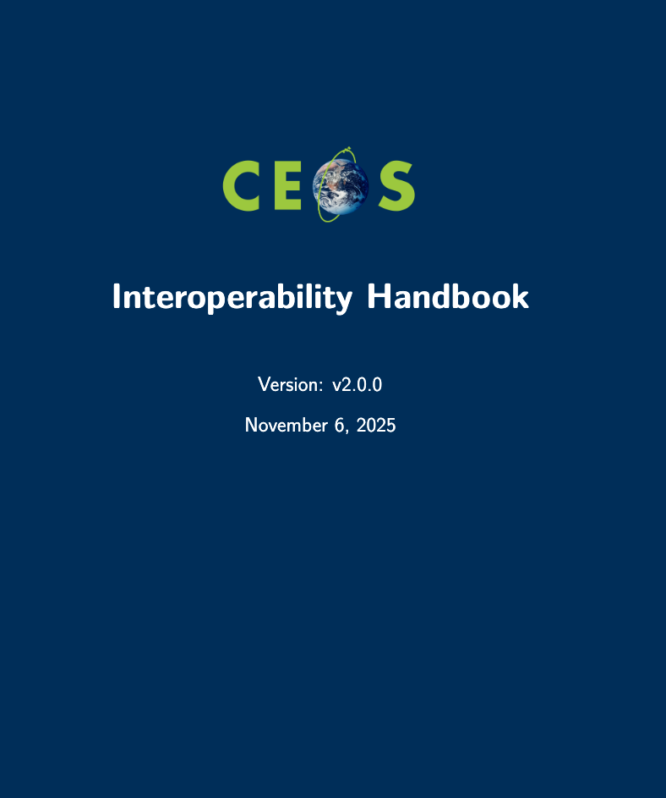
Interoperability Framework - Scope
Provide guidance to organizations for the development of Interoperable Data and Services.
Facilitate the integration of global EO data with other data sources.
Assist in creating a common understanding among stakeholders and users with different backgrounds, interests, and needs.
Foster collaboration and innovation by enabling the development of new applications, tools, and services that leverage EO data.

Slide 3
Interoperability Framework – Factors and Principles
Factors | Description | Principles
Vocabulary (Semantics) | The (narrow) semantic aspect refers to the naming and defining terms and expressions. It includes developing, harmonizing, and maintaining vocabularies, concepts, and schemata supporting provision, exchange, and analysis of data, information, and knowledge regarding Earth observation. It ensures that words and language are understood in the same way by all communicating parties. | Semantic Thesaurus
Architecture | Architecture describes the organizational structure of concepts, processes, and assets, including data. It comprises of the structural aspects of models and standards that govern the collection, storage, archiving, documentation and publication of data. | Preservation Architecture Data and Metadata Architecture Publishing Architecture
Interface (Accessibility) | Data exchange protocols and application interfaces from a consumption or user perspective. These provide the means necessary to search for collections, find and access data and information contained in those collections. | Data Discovery Data Access Authentication and Authorization
Quality | Indicators (parameters, metrics, etc.) for informing users of the trustworthiness (accuracy, uncertainty, consistency, etc.) of the data provided (measurands, measurements, observations, etc.). | Calibration and Validation
Policy | Legal frameworks, policies, rules, and strategies regulating the relation between the different stakeholders. | Policy

Slide 4
Interoperability Framework
Semantic (6)
Thesaurus (8)
Interoperability Handbook
5 Factors
10 Principles
76 Recommendations
Vocabulary
Policy (12)
Policy
Architecture
Preservation (9)
Data and Metadata (11)
Publishing (5)
CEOS Interoperability Framework
Calibration & Validation (9)
Quality
Interfaces
Data Discovery (10)
Data Access (3)
Authentication & Authorization (3)

Slide 5
WGISS Interoperability Maturity Matrix
The WGISS Interoperability Maturity Matrix (IMM) is an Assessment and Planning Tool.
It will help users in measuring how well interoperability factors and recommendations are implemented in their organizations and in monitoring progress with time.
It can be used at every level of the organization (e.g. data managers and curators, IT managers, organization managers).
It can be applied to all data and services made available by organizations that have the potential to be integrated, exchanged or shared.
Self-assess current level of interoperability maturity
Define Organization Targets and Perform Gap Analysis
Improvement Planning and Implementation
Progress Monitoring and Self-assessment update
How to use it

Slide 6
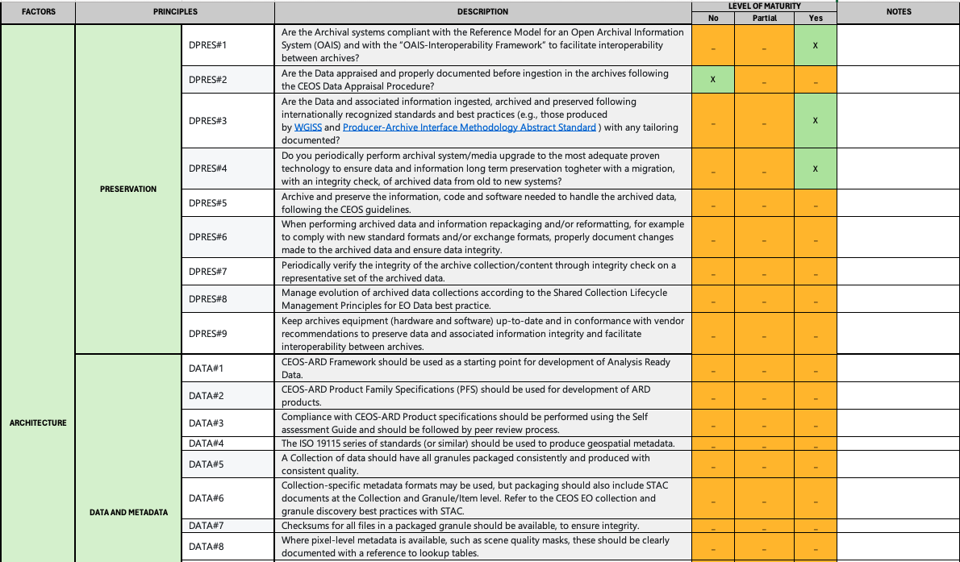
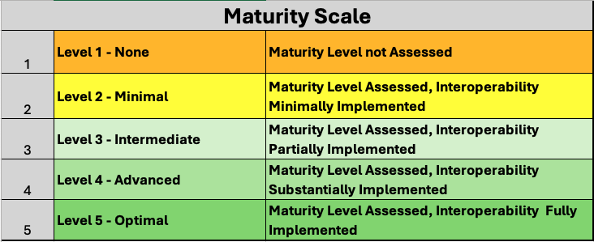
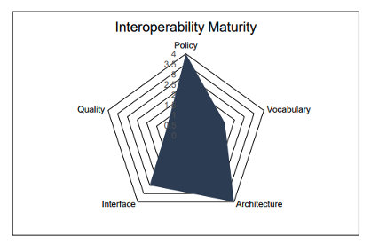

Maturity Scale
1 | Level 1 - Ad Hoc | Not Managed
2 | Level 2 - Minimal | Managed Limited
3 | Level 3 - Intermediate Managed | Defined & Partially Implemented
4 | Level 4 - Advanced Managed | Well-Defined & Fully Implemented
5 | Level 5 - Optimal | Level 4 + Measured, Controlled, and Audit
WGISS Interoperability Maturity Matrix
Definition of questions, maturity levels, scoring methodology and weighting factors, and other details is ongoing; WGISS Interoperability Maturity Matrix (IMM) planned to be finalized by September 2026.

Slide 7
Thanks
Mirko.Albani@esa.int

