Slide 1
Interoperability Demonstrators
Nitant, ISRO
Agenda Item #2.3
CEOS SIT-41 2026
Irvine, California, USA
14-16 April 2026

Slide 2
CEOS Interoperability Handbook V 2.0
The Big Picture
Interoperability Handbook V2.0
Maturity Matrix
Interoperability Demonstrators
Evaluate, Understand and Monitor level of Interoperability of Data and Services in your organization
Demonstrate the concepts discussed in the Interoperability Handbook by Converting concepts to practice

Slide 3
Interoperability Demonstrators: Goals
Demonstrate how CEOS Interoperability Recommendations 2.0 (vocabulary, architecture, Interface, quality and policy) can help in improving Interoperability of Data and services
Learn and Improve Interoperability Recommendations
Identify gaps/improvements in ARD, CEOS Vocabulary and other recommendations/initiatives from Interoperability perspective

Slide 4
Why Interoperability Demonstrators
Help Data and service providers for standard/s adoption
Demonstrate how concepts can be converted to practices
Provide Interoperable Reference code/software for implementation

Slide 5
Success Indicators
For Data and Service providers, improving their maturity score using the maturity matrix will be the success indicator
For End user, their ability to access data and services from multiple data providers and generate homogeneous analysis

Slide 6
Linkage to Handbook
Will try to map the deliverable to the Interoperability Recommendations ( usually will be more than one)
Interoperability demonstrator will help in refining/updating the recommendations based on real world problems and use-cases

Slide 7
Deliverables & Deployment
Deliverables
Jupyter Notebook
Software
Best Practices
Notes
Deployment
Deployment of Notebooks on github and execution link on Google Colab or Binder( github provides support for this)
Development of software with software repository on github

Slide 8
Resilience Interoperability Demonstrator
Demonstrators | Objective | Working Group/VC
Resilience Interoperability Demonstrator | Utilize concepts of Interoperability, CEOS Analysis-Ready Data, and Open Science to demonstrate the capability for monitoring Geohazard supersites SIT-Chair Priority-2 (Connected Data for Community Resilience) | SIT Chair Team, SEO,WGISS WGDisaster, Comms Team, ARD-OG, LSI-VC
Deliverables | Jupyter Notebook for Monitoring and Development of Science Products for Geohazard supersite

Slide 9
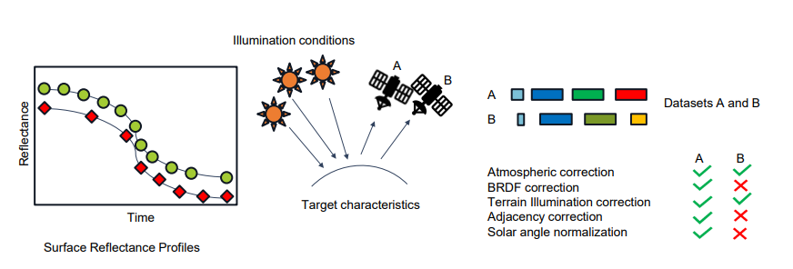
Surface Reflectance Interoperability Demonstrators
Demonstrators | Objective | Working Group/VC
Surface Reflectance Quality and Consistency | Demonstrate capability for generation of Interoperable Surface Reflectance using ARD from different satellite missions | WGCV, WGISS
Deliverables | Jupyter Notebook demonstrating WGCV SR quality and consistency Recommendations and Interoperability Handbook Recommendations for generation of Interoperable surface reflectance.
Image Credit WGCV

Slide 10
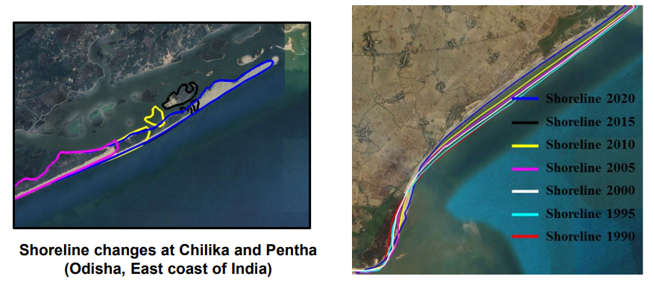
Shoreline Interoperability Demonstrators
Demonstrators | Objective | Working Group/VC
Shoreline Decision Ready Data | Develop Shoreline Decision Ready Data Specifications and develop sample products demonstrating Impact of Interoperability Recommendations | COAST-VC, WGISS
Deliverables | Product Specification for Shoreline Decision Ready Products. Shoreline Decision Ready Products for sample site
Image Credit ISRO

Slide 11
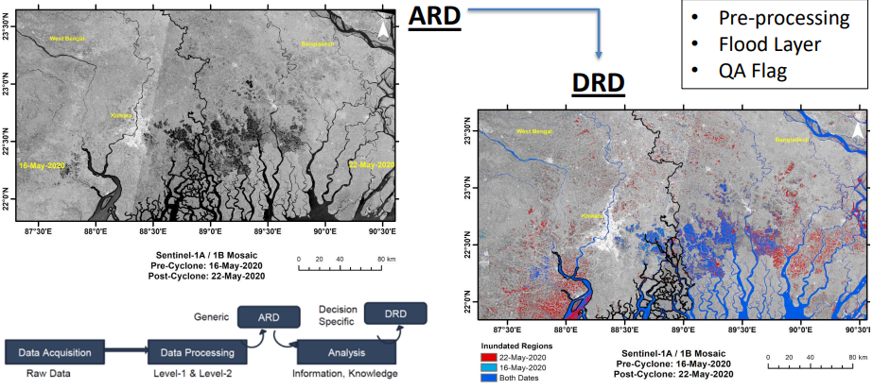
Surface Inundation Interoperability Demonstrators
Demonstrators | Objective | Working Group/VC
Decision Ready Data : Surface Inundation Product | Develop Specifications and Decision Ready Data data for Surface Inundation. SIT Chair Priority-1 (Guidance on integrating multiplatform, multispectral data for enhanced water variables and decision-support solutions) | WGISS, WG-Disaster
Deliverables | Surface Inundation Decision Ready Data Product Specifications Sample products on WGDisaster Flood Pilot site in India
Image Credit Dr Praveen Gupta ISRO

Slide 12
Vocabulary Interoperability Demonstrators
Demonstrators | Objective | Working Group/VC
Vocabularies | Enhance/Update Existing CEOS Vocabulary to support Climate Data Records (CDR) | LSI-VC, WGClimate, WGISS
Deliverables | Updates on CEOS Vocabulary on GitHub to include CDR related terms

Slide 13
Thanks nitant@sac.isro.gov.in

