Slide 1
CEOS SIT-41 Value Chain
David Borges, SEO
Agenda Item 2.5
CEOS SIT-41
Irvine, CA, USA
15 April 2026

Slide 2
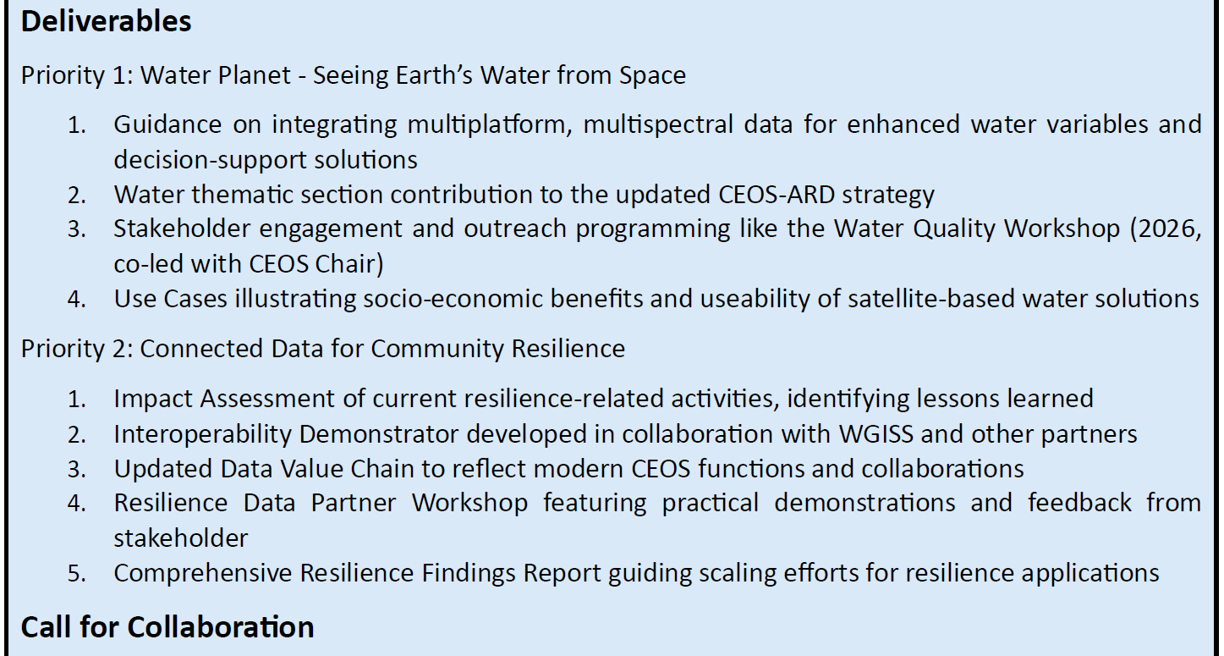
SIT Chair Priority 2

Slide 3
Why is this important?
Strengthen internal organizational resilience
Understand where new activities (biodiversity, wildfire, etc.) align
Understand gaps and roles where commercial engagement could be increased or improved
Realize and increase capture of downstream impact

Slide 4
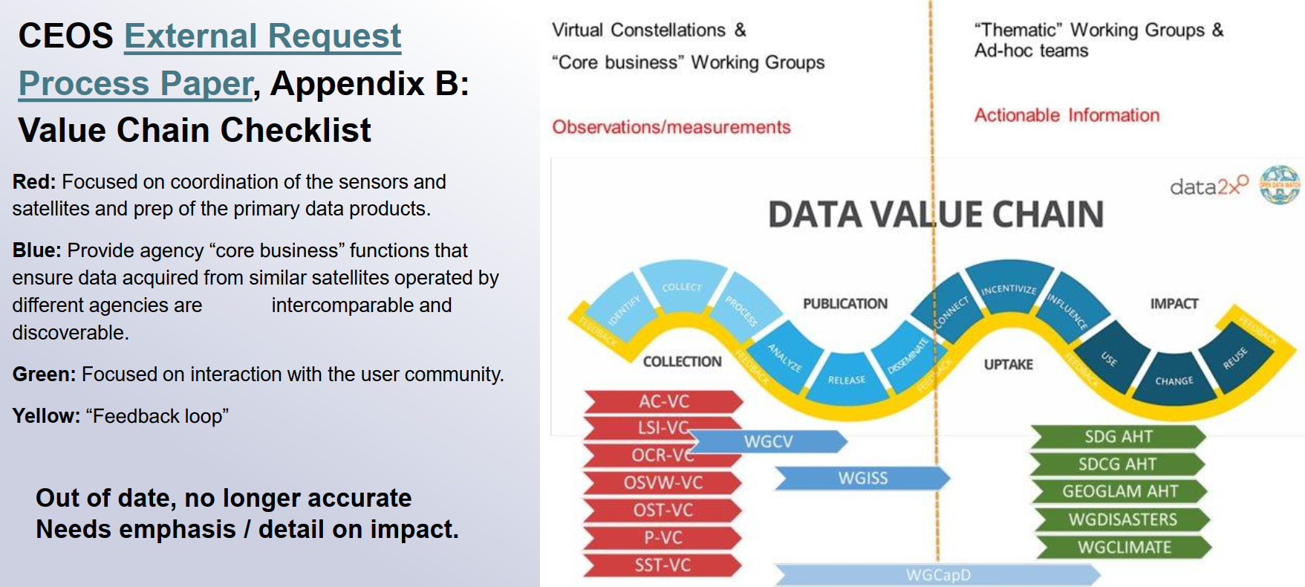
CEOS Data Value Chain

Slide 5
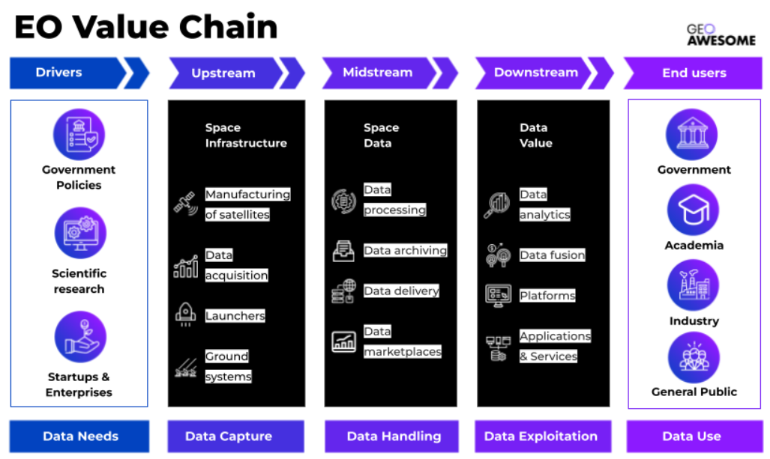
Example: GeoAwesome

Slide 6
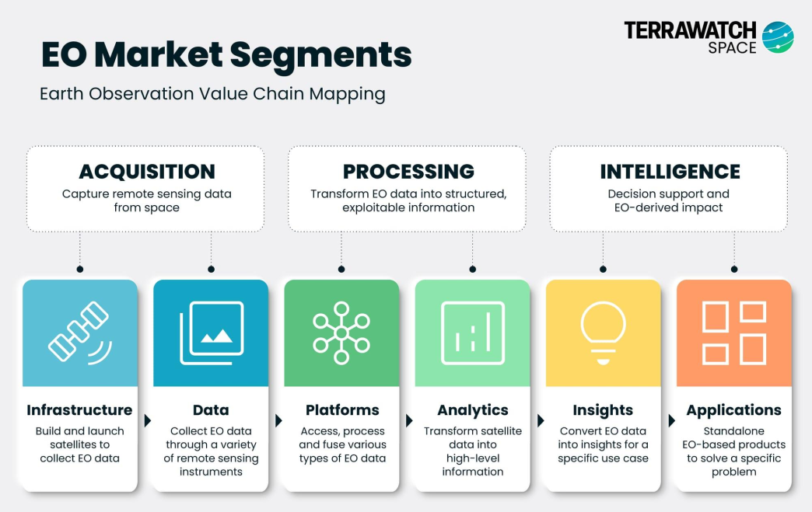
Example: Terrawatch EO Value Chain

Slide 7
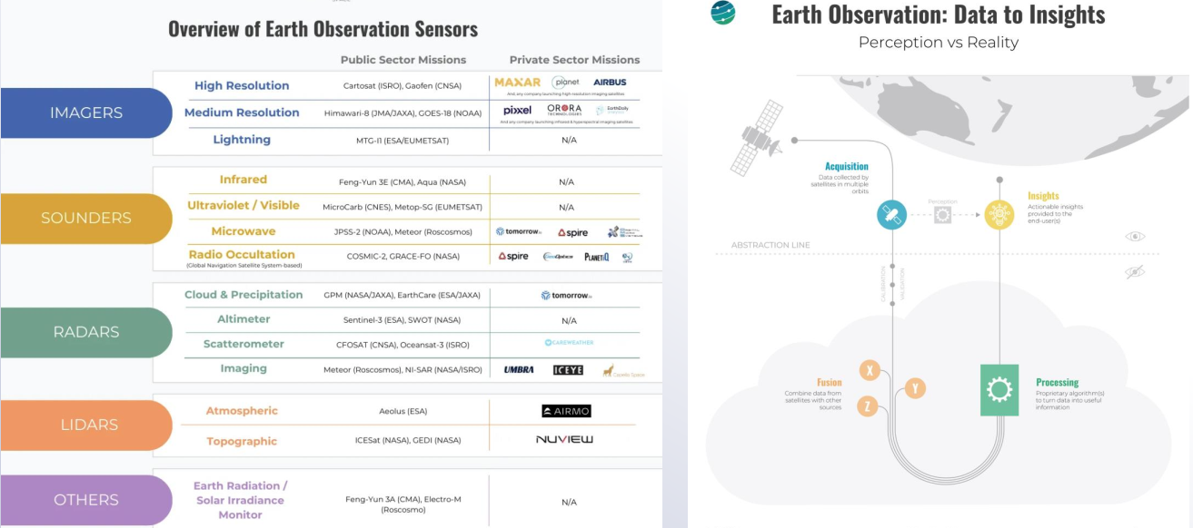
Example: Infographics from Value Chain

Slide 8
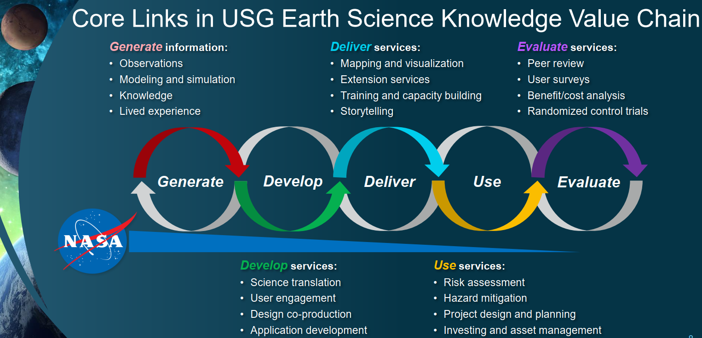
Example: NASA ESD

Slide 9
Value Chain: Targets & Indicators for Decision Making
Fitness for Purpose
European Commission (EC) Perspective
Decide
Apply
Data Production
Sense
Needs identified for Policy and Decision Making
Resulting requirements for applications, indicators, models and Services
Resulting requirements for Data Products
Resulting requirements for observations
Data/Information
Service
Evolution
Ground Segment
Evolution
Space Segment
Evolution
Evolution

Slide 10
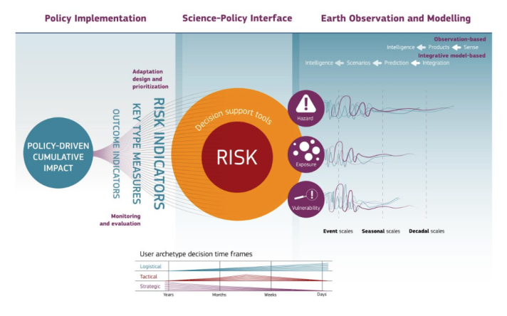


Extending the Value Chains
European Commission (EC) Perspective

Slide 11
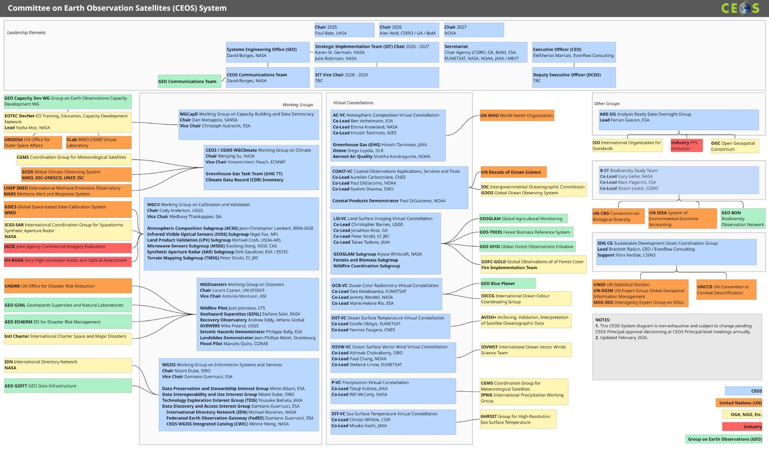

Slide 12
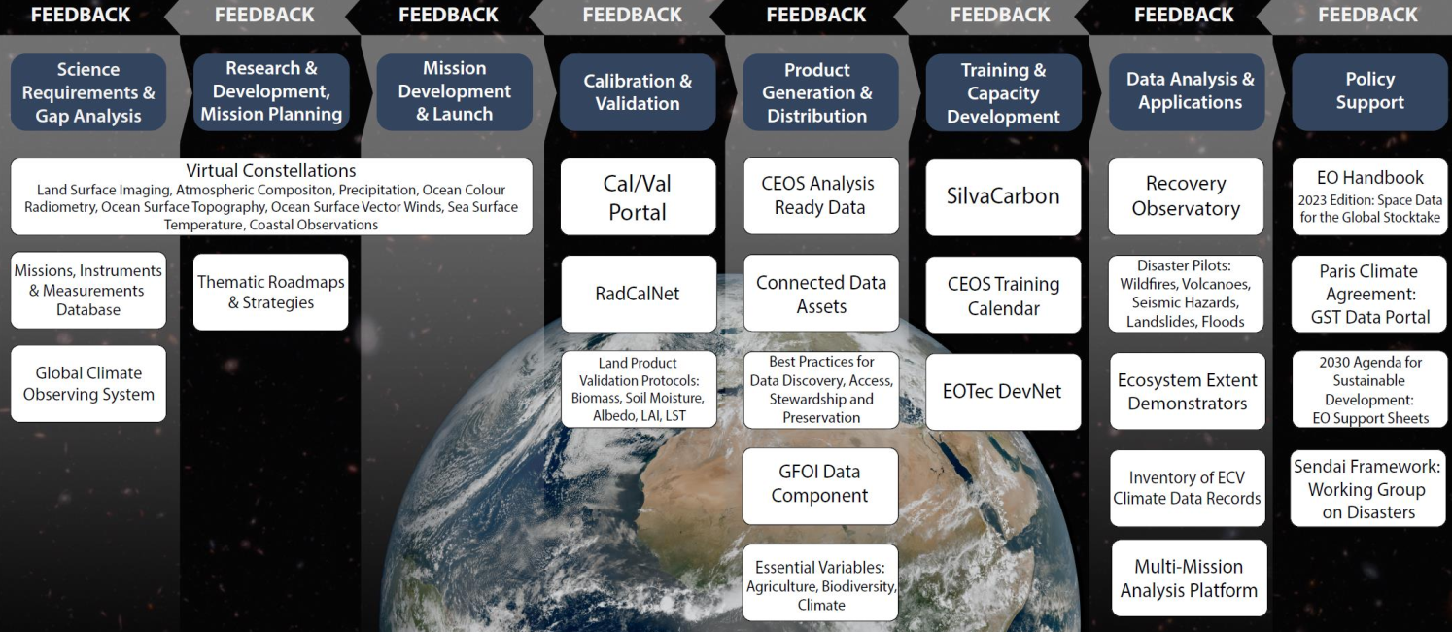
Internal CEOS Value Chain

Slide 13
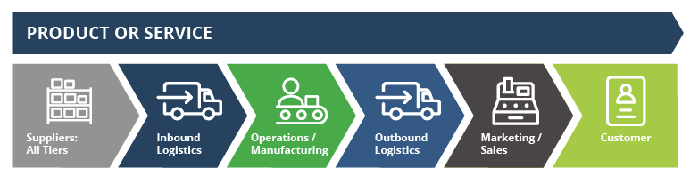
Often a linear visualization…

Slide 14
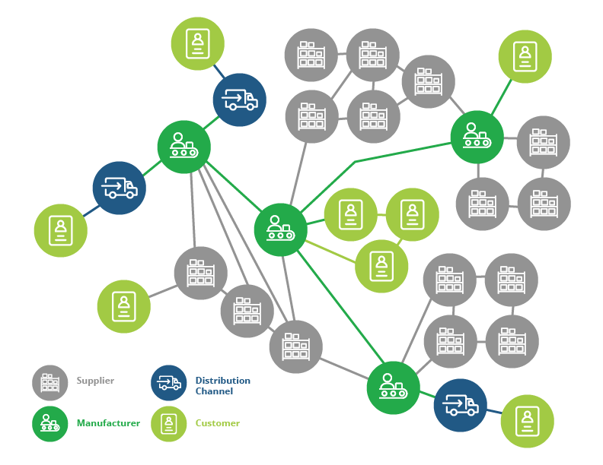
…but “value network” might be useful a metaphor

Slide 15



Next Steps
Independent lead will join SIT Chair Team to lead process
Curated series of interviews (CEOS internal and external)
Development of recommendations and visual products
Robert Cheetham, Abaca Labs
Founder of Abaca Labs, a research studio focused on building an open knowledge ecosystem for geospatial and Earth observation technology. He also publishes the Japan Earth Observer (JEO) newsletter and is the lead contributor to the OpenDataPhilly regional data catalog.
He was previously the founder and CEO of Azavea, an open-source geospatial software engineering firm.
In collaboration with Radiant Earth.

Slide 16

Timeline
Interview process begins now
Preliminary findings and products to be shared at SIT TW (September)
Final findings and deliverables will be shared for endorsement at CEOS Plenary 2026 (November)

