Slide 1
Impact Assessment
Value of EO for resilience and water focused use-cases
Ayia Lindquist, SSAI-NASA
SIT-41
4/15/26

Slide 2

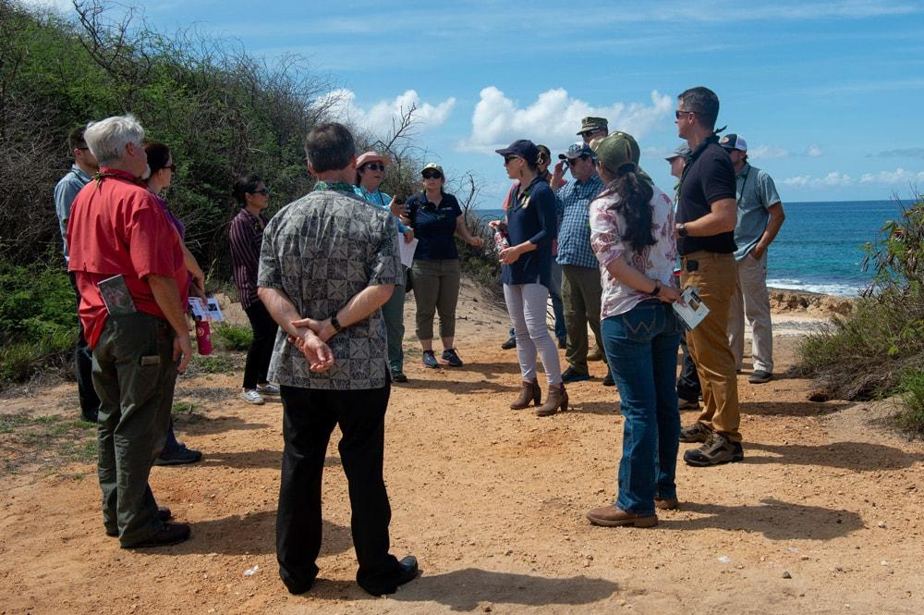

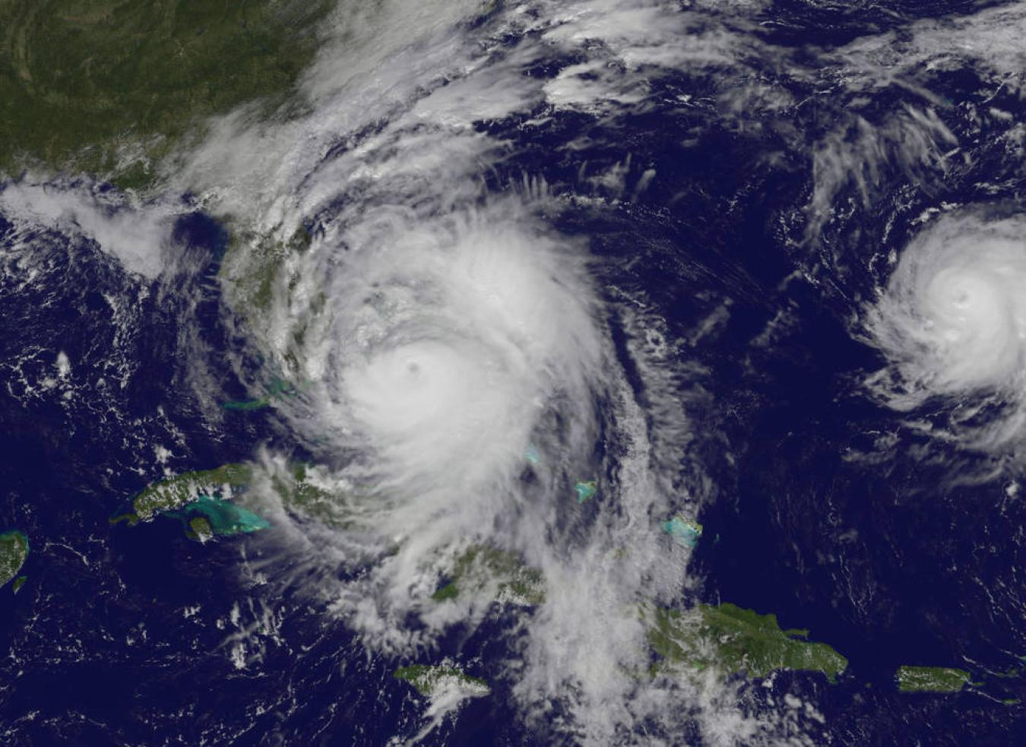
Goal of Impact Assessment
Assess impact of existing activities and end user requirements to build community resilience.

Slide 3
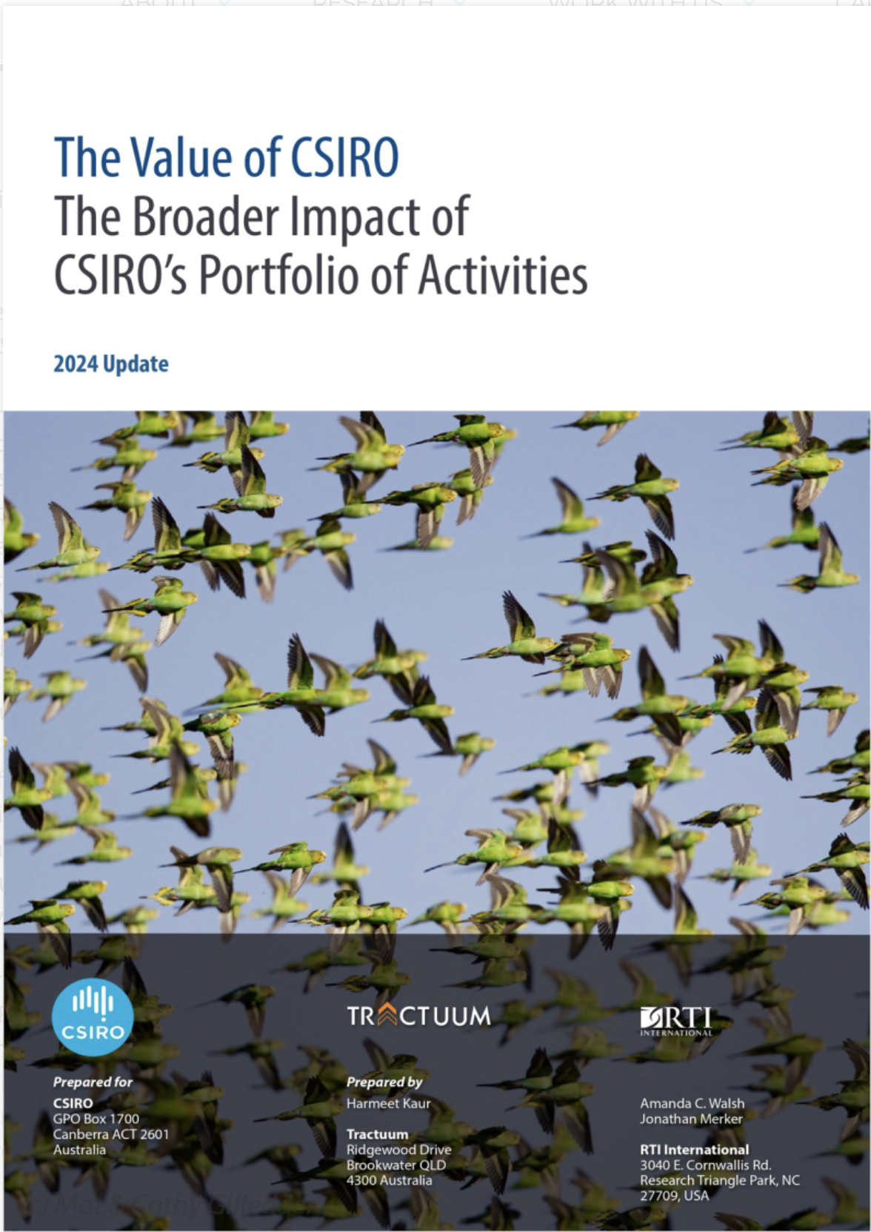
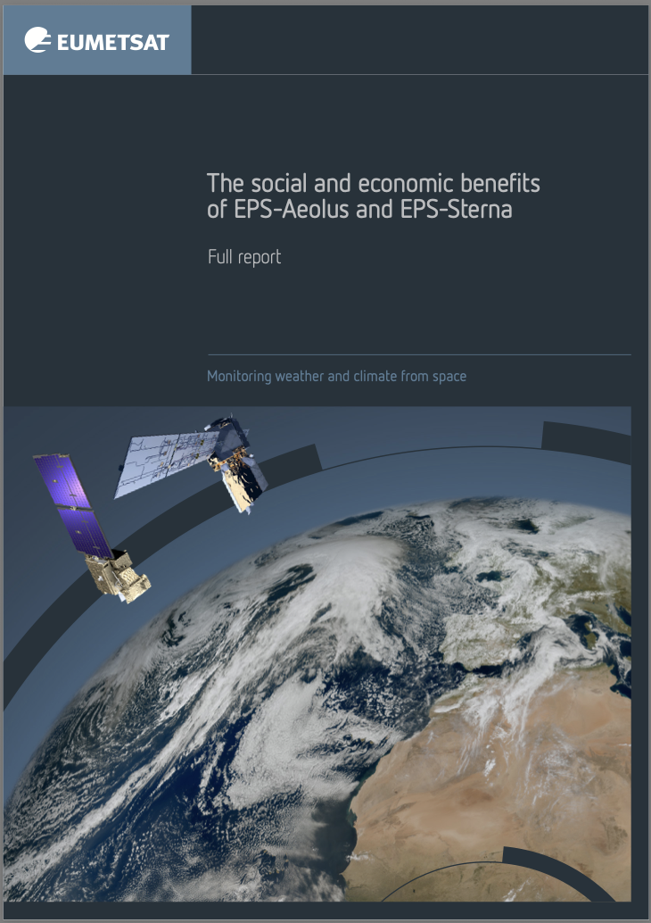
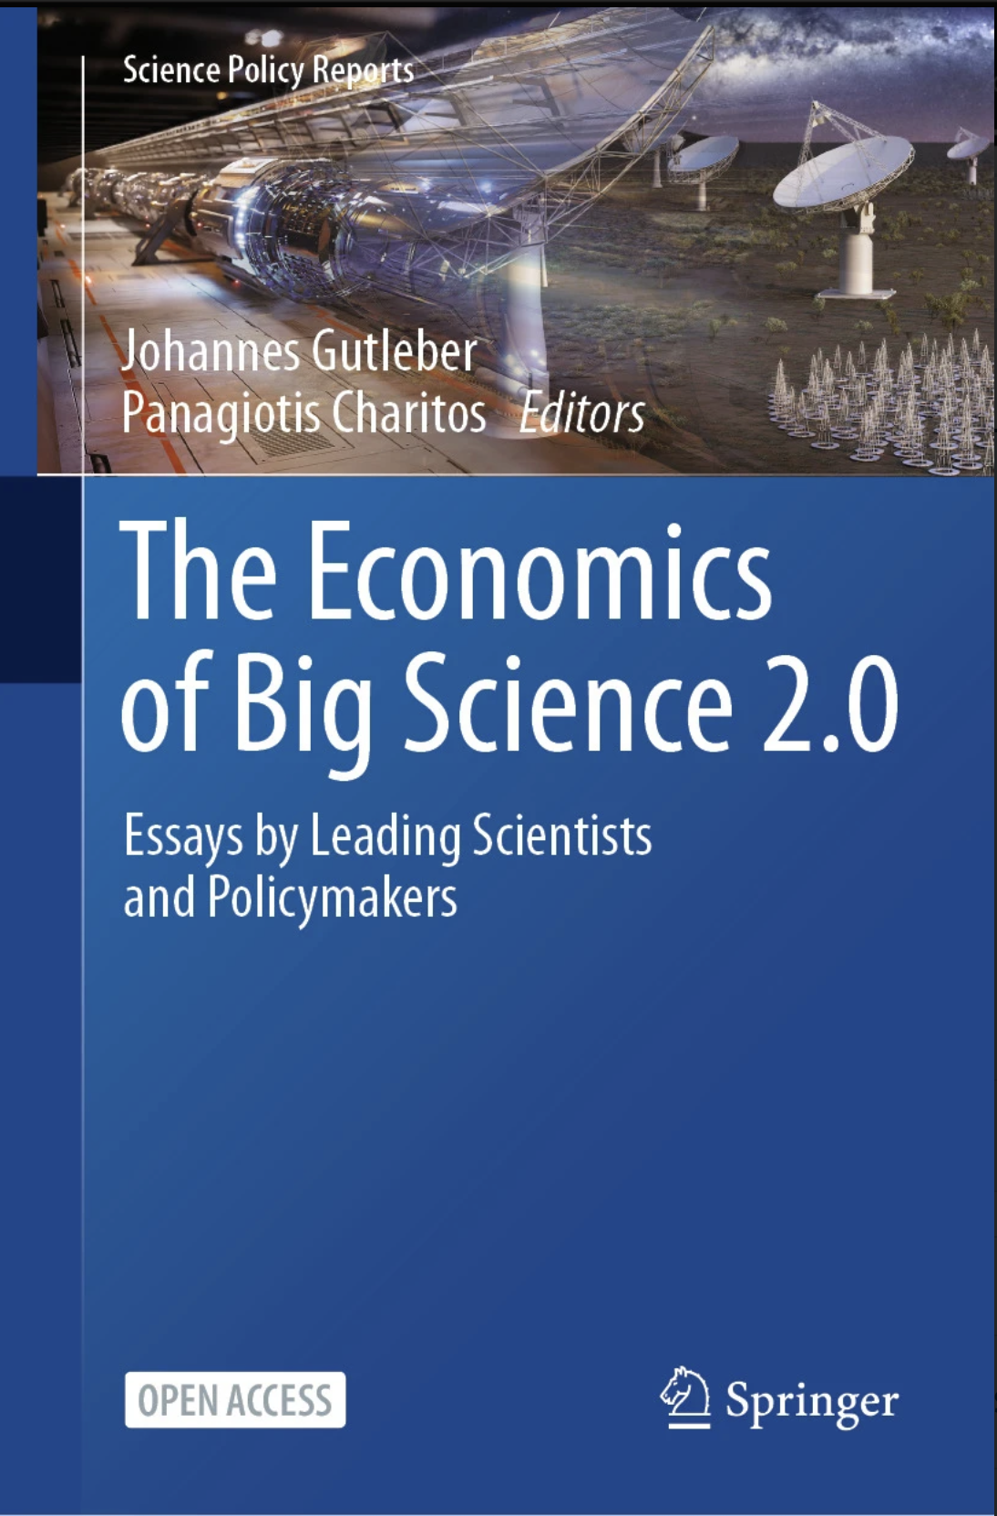

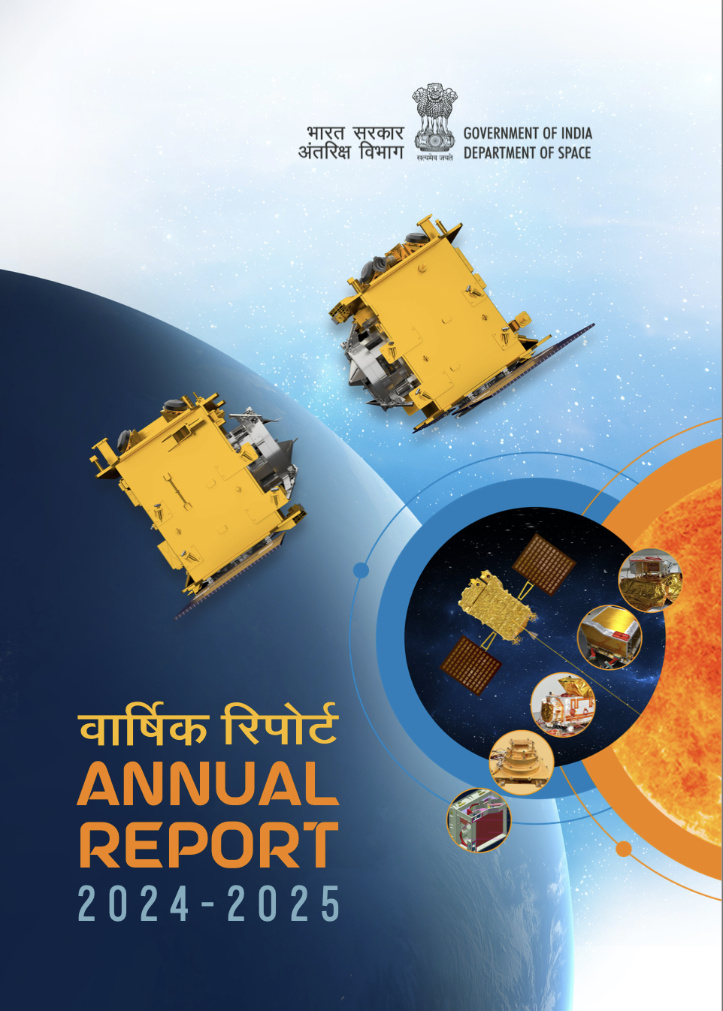
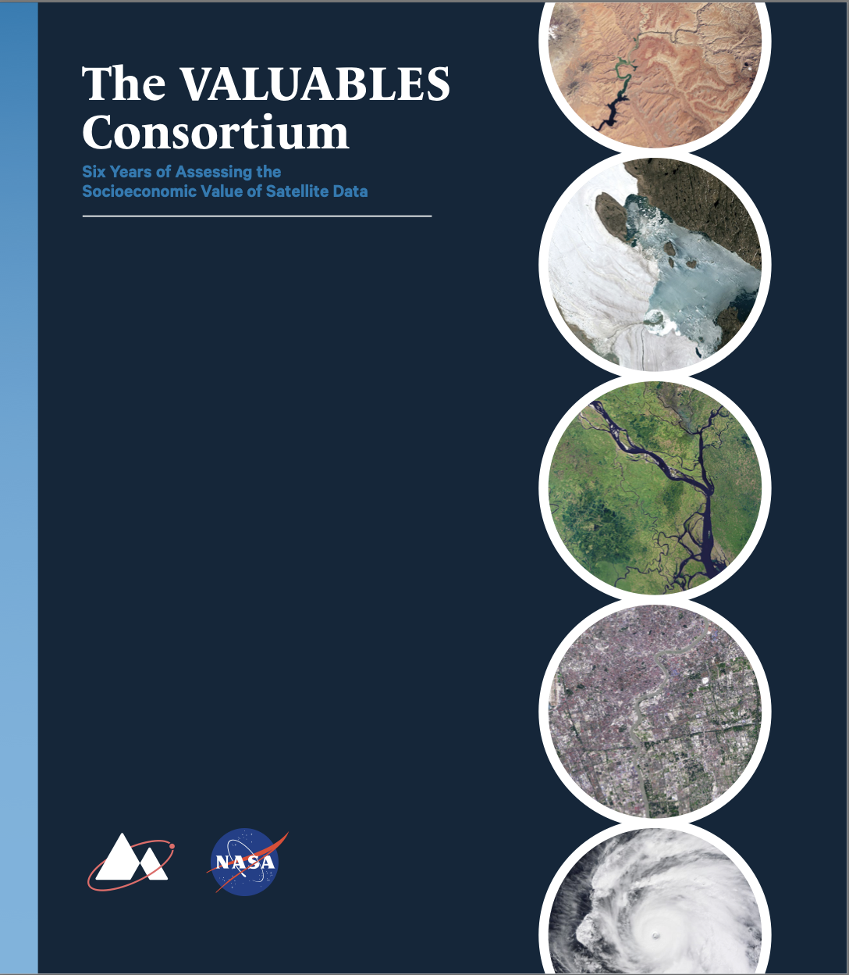

Overview of Literature Review
25 assessments and reports reviewed
21 agencies and groups represented
Reports ranged from 2012-2025

Slide 4
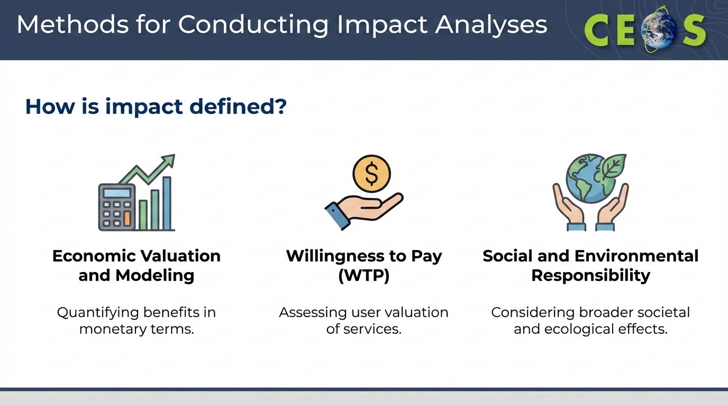

Slide 5
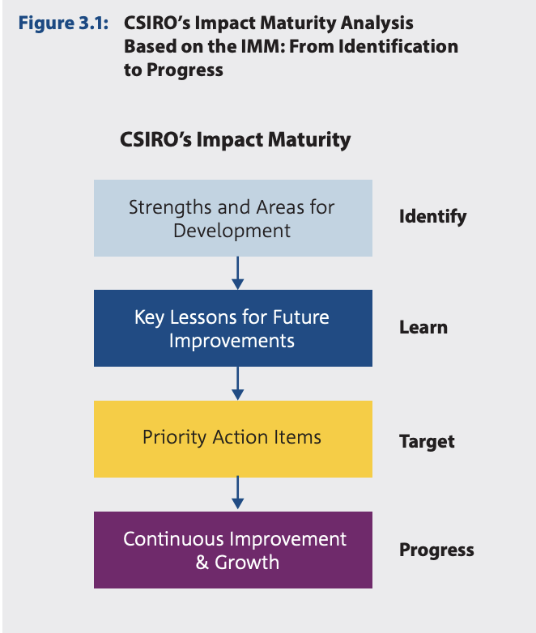
Economic Valuation and Modeling
Many agencies utilized economic valuation for evaluating impact.
  In NASA’s 2024 Economic Impact Assessment, state by state impact was measured through tax revenue and economic output
  Value of CSIRO report utilized Impact Maturity Model and high level investment return metrics, which quantified benefits for every dollar invested
  European Commission also assessed value over multiple dimensions leveraging value chain and catalytic methodologies, finding a 1.39 Euro Value for every Euro invested in 2016

Slide 6
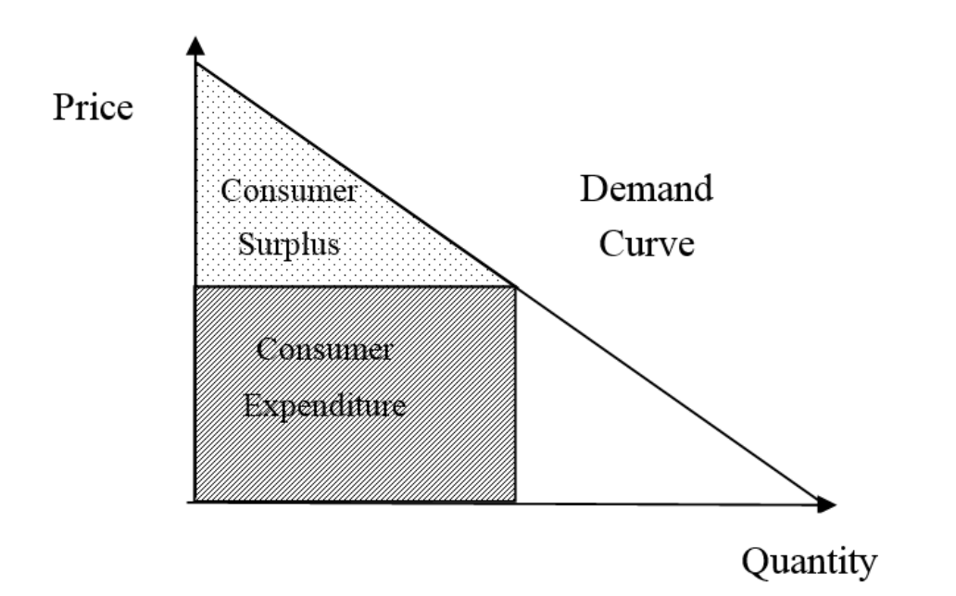
Willingness to Pay
Used as a metric for assessing value of EO to taxpayers and citizens
  Korean Meteorological Service found households were willing to pay $2.01 per month for weather and forecasting services
  NOAA’s Contribution to the Economy report, found U.S. households would pay $31 Billion nationally for accurate weather forecasts.
  USGS found WTP median to be $58 per Landsat scene, with the average being $158

Slide 7

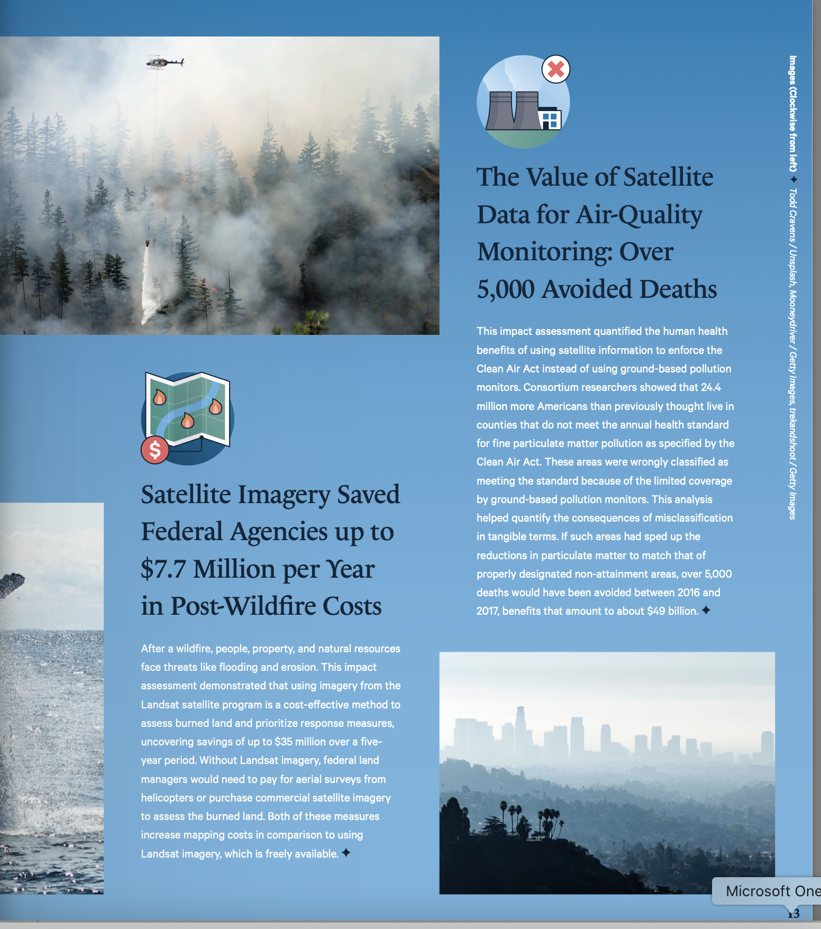
Social and Environmental Responsibility
In addition to economic metrics, measured impact through social and environmental metrics.
  JAXA’s 2024 Sustainability Report measured impact through greenhouse gases, waste, and worker satisfaction metrics.
  The Impact Maturity Model employed by CSIRO also utilized social, cultural, and environmental metrics.
  VALUABLES Consortium measured the societal benefits of EO through environmental, social, and economic parameters

Slide 8

Additional Frameworks in Development
Group on Earth Observations (GEO) is developing a framework for conducting impact assessments. Using metrics such as:
  Cost avoided
  Time saved
  Capital expenditure reductions
GEO Value Impact Assessment Toolkit

Slide 9



Key Sectors of EO Impact
Water Resource Management
Disaster Risk Reduction and Resilience
Agriculture
EO Handbook will highlight more of these case studies too!

Slide 10
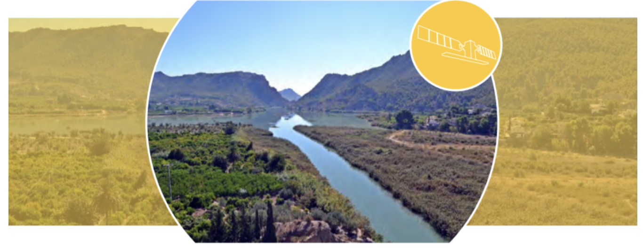


EO Impact on Water Resource Management
ESA Sentinel Benefits Study
  Aquifer Management in Spain
  Water Quality Management in Germany
  Clean Seas Initiative in the Mediterranean
  And many more!

Slide 11
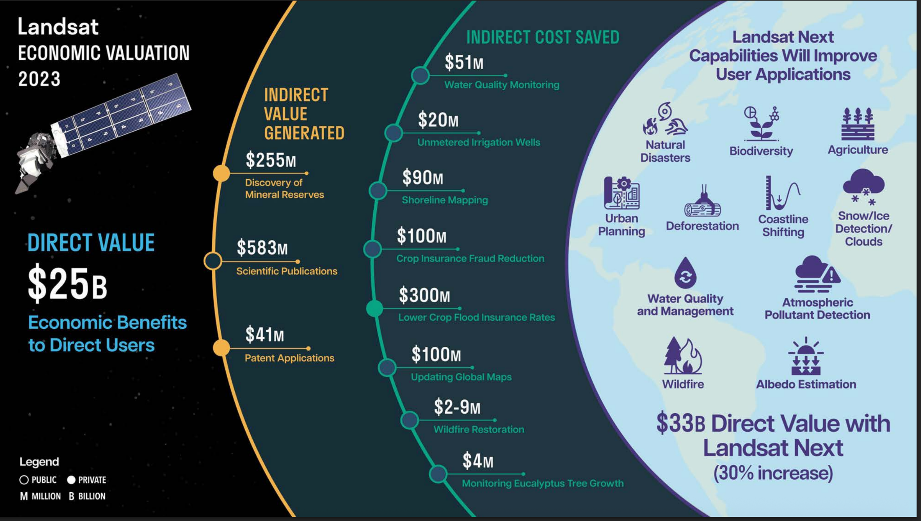
EO Impact on Water Resource Management
The Economic Valuation of Landsat and Landsat Next from USGS findings:
Landsat monitoring of water quality specifically chlorophyll-a saved $51 million in lab costs
Landsat monitoring of unmetered irrigation wells in Idaho saves $20 million per year

Slide 12

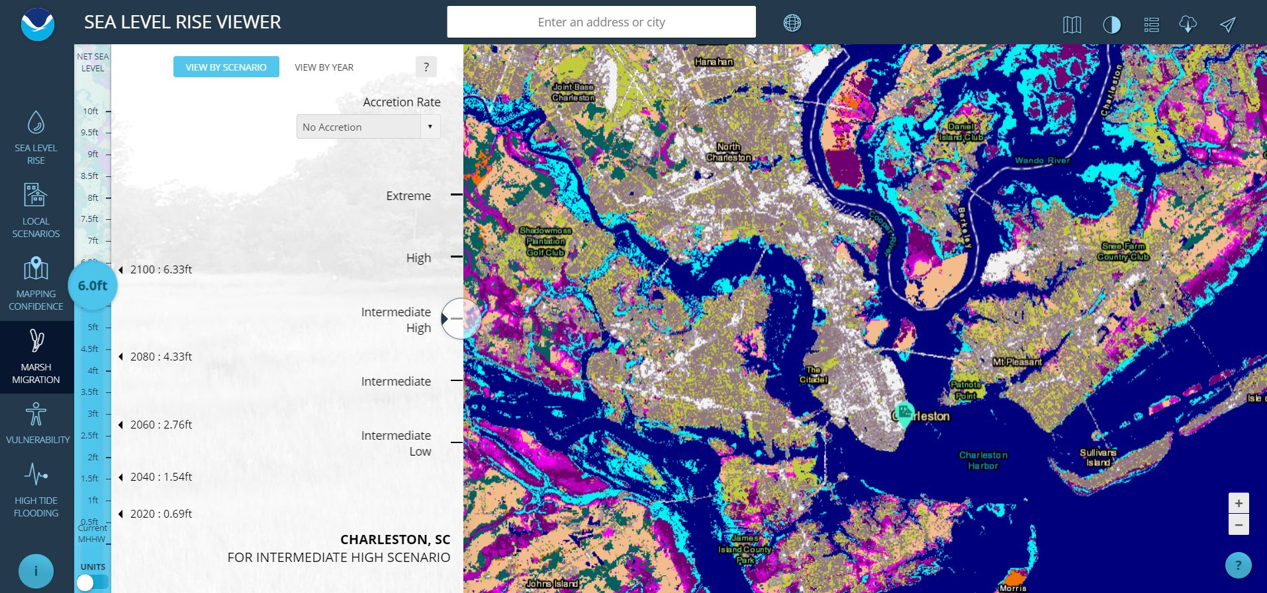
EO Impact on Disaster Risk Reduction
Disaster Risk Reduction was a strong generator of impact for EO
  WMO emphasized the role of early warning systems for reducing lives lost and economic impacts, role was more pronounced in developing countries
  NOAA’s Sea Level Rise Viewer and Coastal Flood Exposure Mapper directly supported community adaptation plans

Slide 13
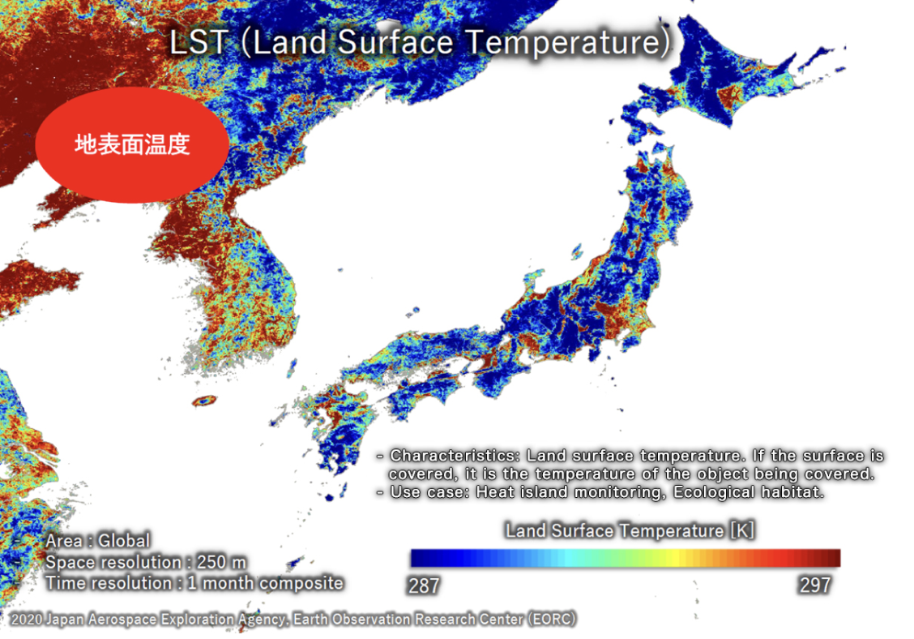
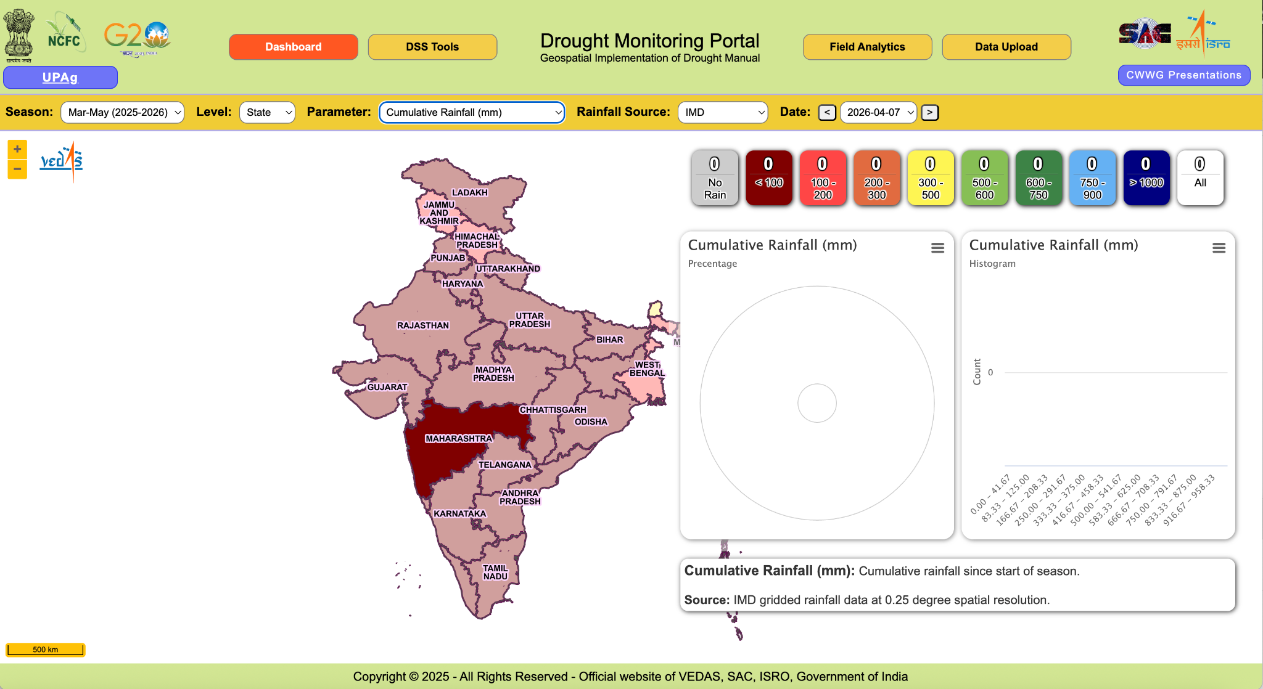
EO Impact on Resilience
Using EO for resilience as a goal of many agencies
  PhilSA focuses their EO capabilities on climate change adaptation and disaster risk reduction
  JAXA envisions using EO for resilience as a long term goal of agency.
  NOAA’s region-specific tools are actively supporting farmers and agriculture businesses plan and prepare for weather variability.
  ISRO’s Krishi-DSS drought monitoring portal was developed with their Ministry of Agriculture to support delivering results in real time.

Slide 14

Future of Impact Assessment
In the process of hiring a contractor to complete an in-depth impact assessment
In the meantime, Robert Cheetham will be conducting value chain interviews related to the data value chain and will include relevant questions for impact assessment.
Value chain and impact assessment work will be coupled and inform each other.

Slide 15
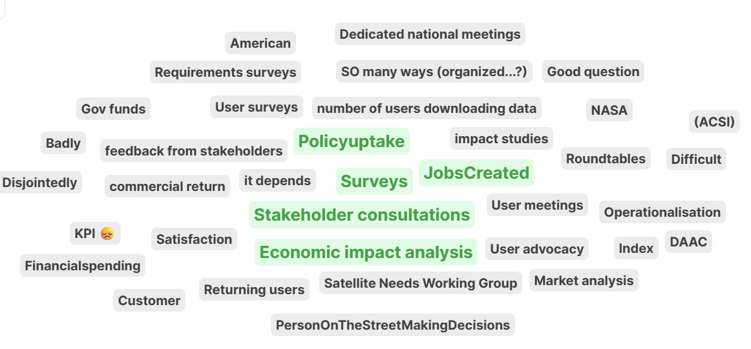
How does your agency gather feedback on impact?

Slide 16
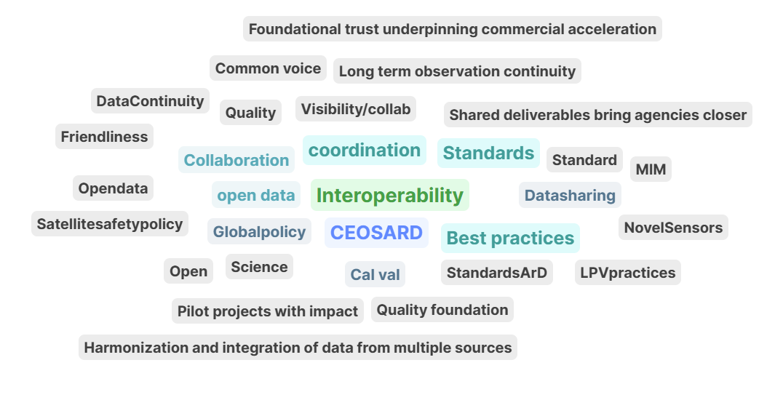
Where is CEOS having the greatest impact?

Slide 17
Have assessments to share?
ayia.f.lindquist@nasa.gov

