Slide 1
2026 Earth Observation Handbook
Marie-Claire Greening, ESA
Agenda Item 2.8
CEOS SIT-41 2026
Irvine, California, USA
14-16 April 2026

Slide 2
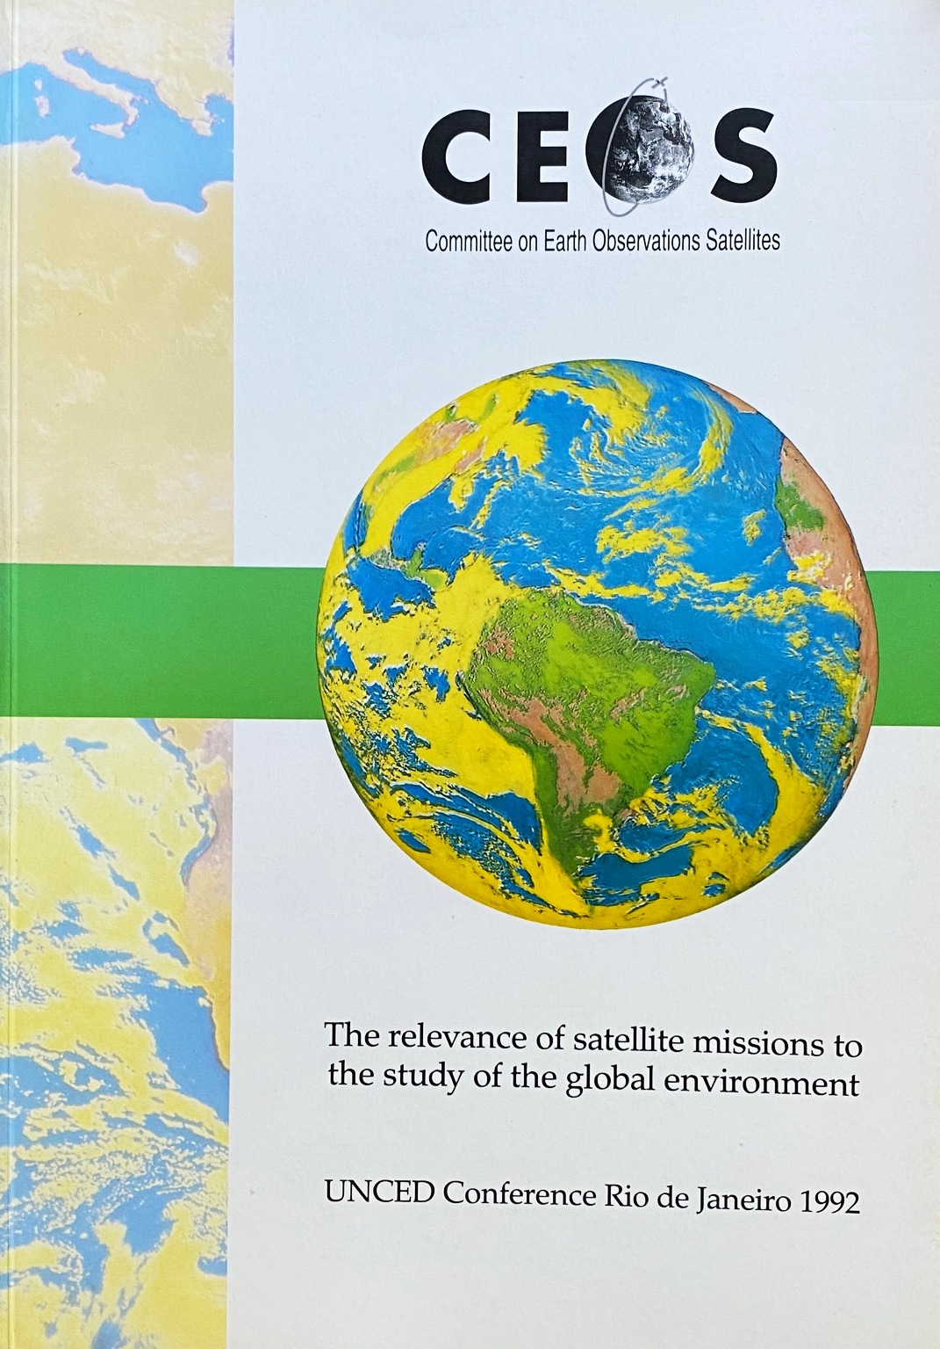
Context
CEOS Earth Observation Handbook has been produced for major
events related to CEOS priorities since 1992 (Rio Conference)
Promotes the role and importance of satellite EO for the thematic areas
Powered by the CEOS MIM database
A contribution from ESA to CEOS as permanent CEOS SEC member

Slide 3

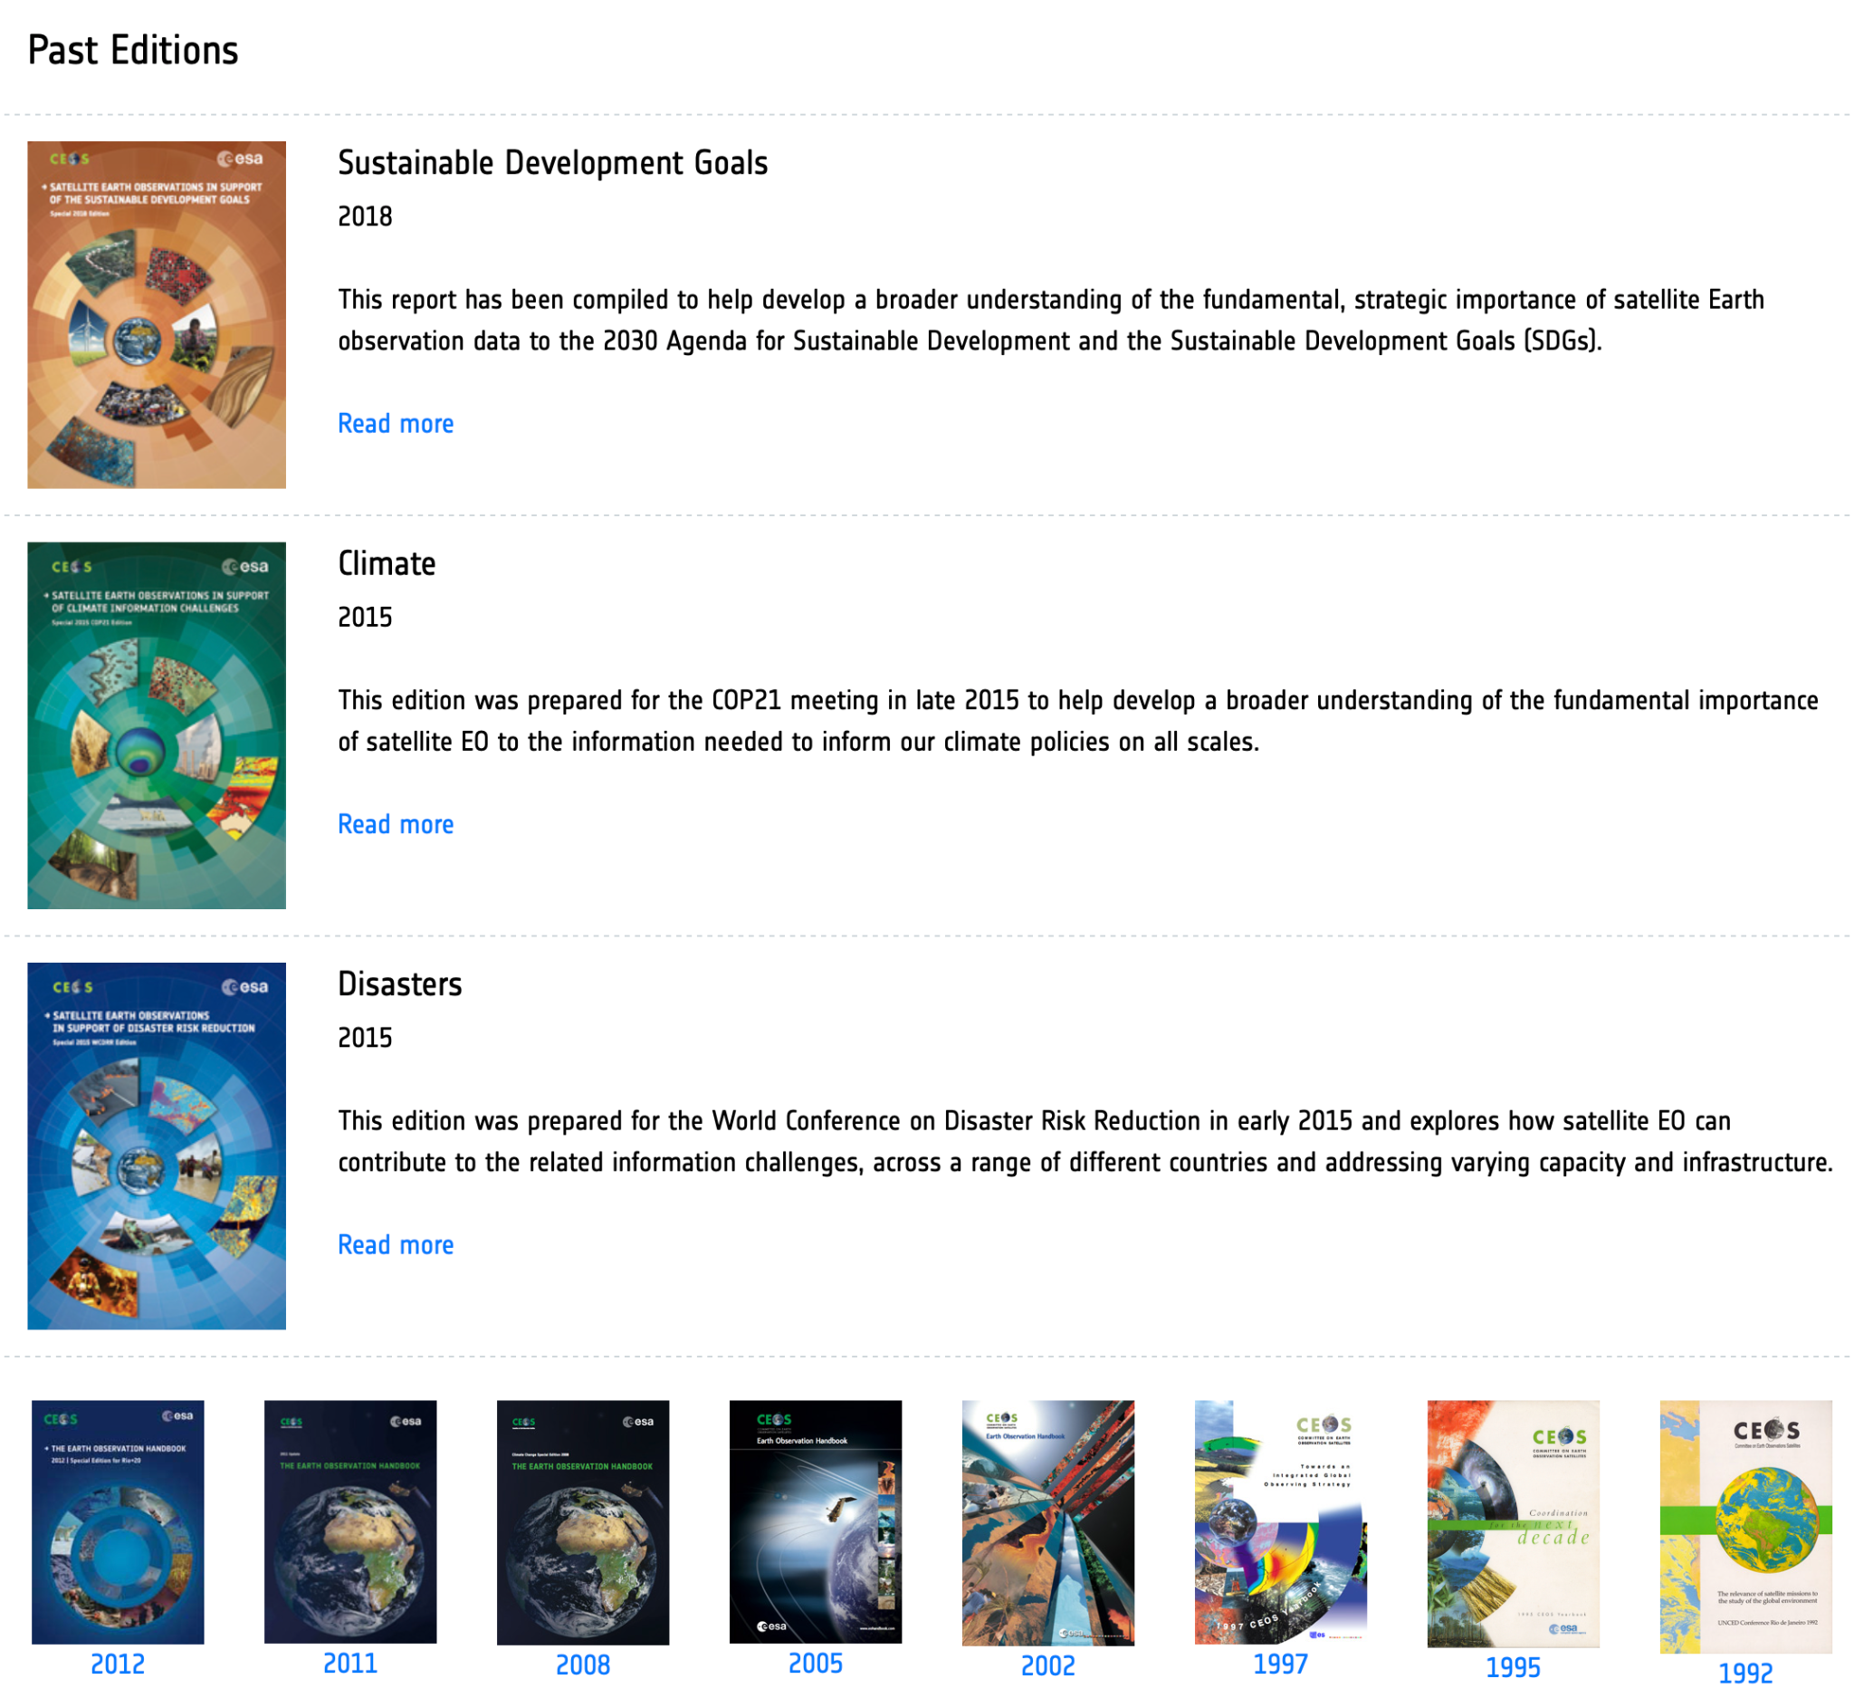
Past editions
https://eohandbook.com/

Slide 4
2026 Edition
Focus on satellite EO role for Adaptation and Resilience
Printed book and dynamic website (expandable in future)
Consistent with the CEOS Chair theme and SIT Chair teams priorities

Slide 5
Planned contents
Part I explains the various ways in which EO data are of value for the
different elements of adaptation and resilience
Part II features a global case study atlas, under the following headings:
Disasters Response
Water
Agriculture
Health and well-being
Ecosystems and Biodiversity
Infrastructure
Economic Security
Local Knowledge
Other

Slide 6
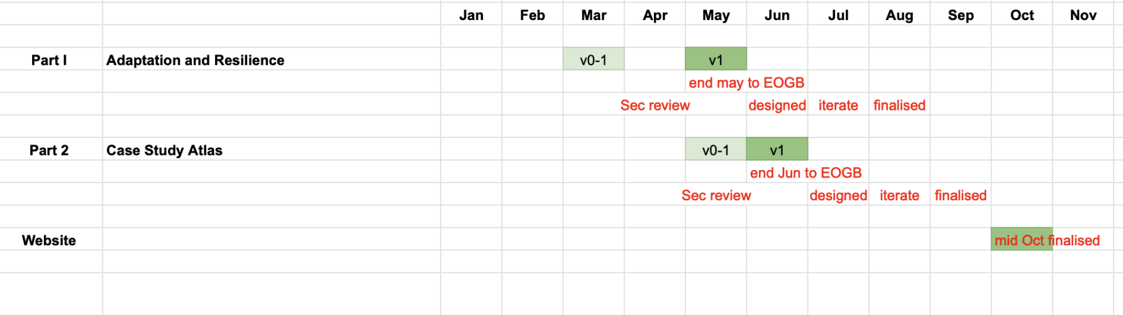
Schedule
Part 1 drafted in Feb - Apr window: usual SEC review opportunities
Case studies invited, compiled and edited by Jun
Printed and online ahead of CEOS Plenary

Slide 7
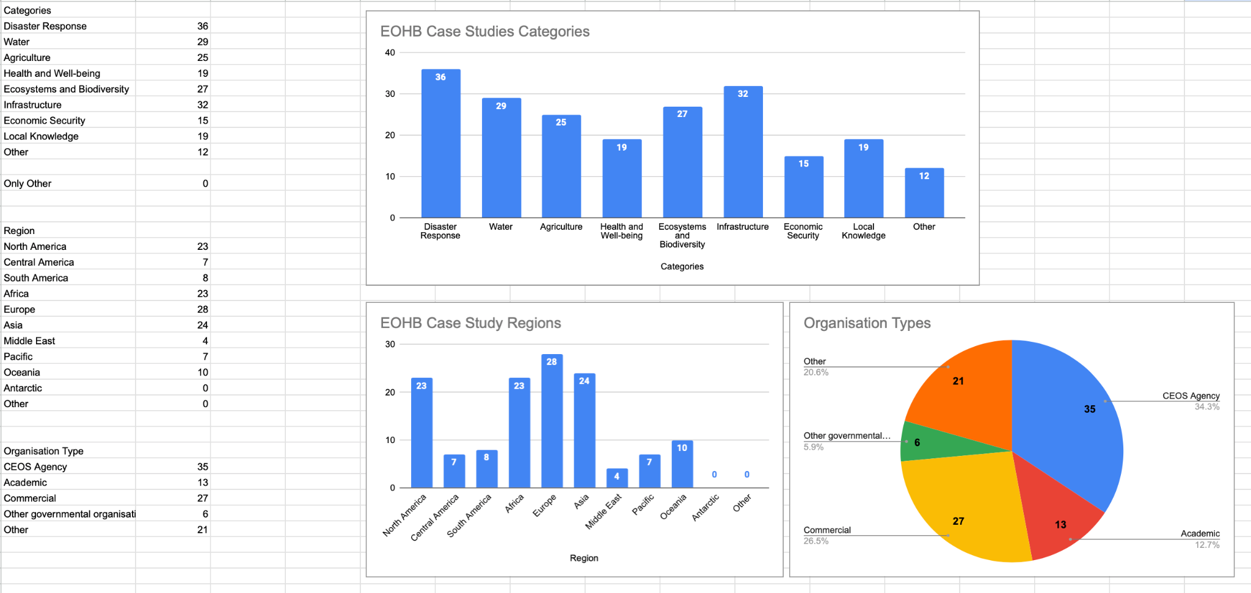
Case study contributions
A huge response! From CEOS agencies and much more broadly ~ 110 submissions
Will select 20 for print and around 20 more for web version
Thanks to all the contributors! Request draft full articles from chosen contributors in a few weeks

Slide 8
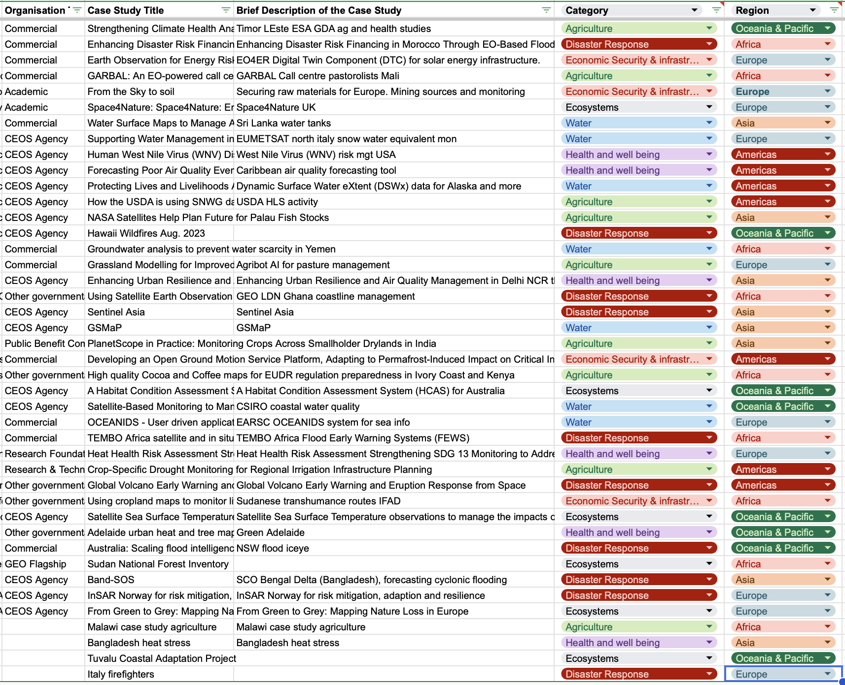
Working list for case study atlas

Slide 9
Missions, Instruments and Measurements (MIM)
Database Update

Slide 10


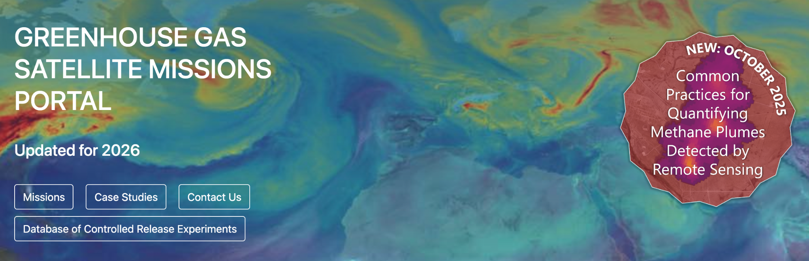
CEOS MIM – Role and Recent Updates
CEOS MIM provides the official, consolidated view of CEOS Agency missions, instruments, and plans, supporting coordination, gap analysis, and EO Handbook content. Maintained as a CEOS Service through annual agency survey inputs.
What’s New?
New thematic portals – Wildfire Missions Portal and continued GHG Portal development, supporting coordination and methane-focused applications
Expanded application-focused content – Added case studies and mission content in the GHG Portal, linking missions to real-world applications (e.g. methane monitoring)
Improved usability and performance – Faster performance and navigation across the site
ceos.org/mim-database
database.eohandbook.com/wildfire
database.eohandbook.com/ghg

Slide 11
2026 MIM Database Survey
Will shortly initiate the 2026 survey process in line with annual cycle
Ask that all agencies please note the deadlines below
Timeline:
Letter requesting Agency update
QA Checks Finished
2026 MIM Database published
Survey files distributed
Reviewed files due
Confirm POCs
Agency review period
CEOS Plenary
SIT TW
April-May | June | July | August | September | October
November
Standard annual CEOS Agency update schedule

Slide 12
Thank you

