Slide 1
2026 CEOS Chair Activity
Positioning CEOS for Success in a Rapidly Changing Context
Alex Held, CSIRO
Item 2.9
CEOS SIT-41 2026
Irvine, California, USA
14-16 April 2026
Credit: USGS/NASA Landsat 8

Slide 2
Key Side meeting highlights
Adaptation and resilience are a strategic opportunity for CEOS to strengthen EO impact, with growing policy demand and a clear need to rebalance CEOS focus beyond mitigation toward decision‑relevant, outcome‑oriented support.
The main challenge is scaling impact from observation to action, given diverse local requirements and fragmented products; CEOS is responding through value‑chain thinking, common typologies, indicators, interoperability and ARD, to better support boundary organisations and decision‑makers.
Two 2026 products will inform both external influence and internal strategy:
– Earth Observation Handbook supported by ESA demonstrating practical EO contributions through global case studies;
– Internal CEOS Adaptation Assessment outlining where CEOS could most effectively an inward‑looking assessment highlighting scalable opportunities for CEOS engagement in adaptation and resilience, designed to inform strategic direction.
Adaptation and resilience side meeting participant stats (5 online, 30 in person)
Notes:
We heard from Mark Dowell, Eleanor Pierel and Stephen Ward on the Adaptation and resilience Chair theme, and have

Slide 3
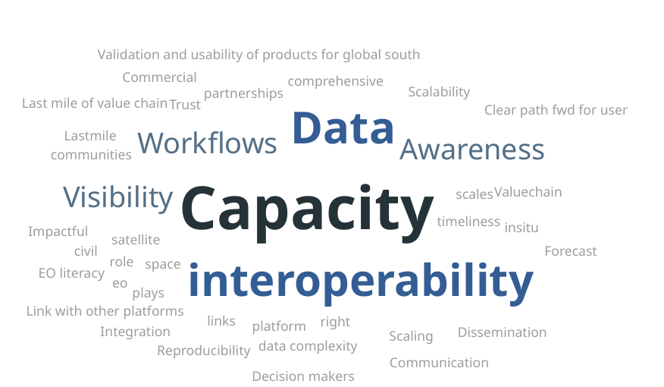
Biggest bottle necks (e.g. dataaccess, integration, capacity, partnerships)
Notes:
As a preview, responses to our question on bottle necks to the survey to the audience highlighted focus areas: capacity, interoperability, data, awareness, visibility and workflows.

Slide 4
Next steps
Survey to go out to CEOS representatives with questions like
  What does adaptation and resilience mean to CEOS members?
  Where are the biggest bottlenecks? (e.g. data access, integration, capacity or partnerships)?
  collect examples of gaps in impact in EO narratives
  Opportunities that exist in the current climate for EO
  Most critical partners in CEOS’s efforts to support adaptation and resilience

Slide 5
Table of contents
Title: CEOS support for adaptation and resilience in a changing global context
Purpose and Scope
Relevance of Satellite EO
Role of CEOS and CEOS Agencies
Existing Activities
Opportunities for CEOS Principal Discussion
DRAFT

Slide 6
Timeline and Process from here
April 2026
May – July 2026
Nov 2026
SIT-41 workshop
Opportunity to contribute!
Open survey to CEOS members
Present final report at Plenary
May 2026
Sept 2026
Editorial Advisory Team to draft questionnaire
Align questions with SIT Chair and Chair priorities
Present draft report at SIT-TW for final comment and review

Slide 7
CEOS Support to Environmental Adaptation and Resilience
Prepare information products that support Principals at the 2026 Plenary to strategically consider the role CEOS is playing, and can play, in supporting societal adaptation and resilience in the face of environmental change
  Multiple drivers of such change
  Applications rely on access to, and ability to integrate, multiple datasets at different spatial scales
    In particular at local scales.
  A lens through which to explore CEOS’s role in the EO ecosystem and value chain, including threads around commercial sector engagement and scalability of demonstrators/pilots
  Relevant across many parts of CEOS, as evidenced by efforts to date

Slide 8
Inward Focus: Challenges & Opportunities
Collation and analysis of challenges and opportunities that support Principals to consider strategic topics such as:
  Where can CEOS get the greatest ‘bang for buck’ and add the greatest unique value?
  Do we have the right partnerships? Are we leveraging existing partnerships effectively?
  Are existing CEOS activities/efforts connected and aligned to support greatest impact?
Key sources:
  CEOS’s efforts and experiences, e.g. WGDisasters, COAST-VC, GST Strategy, Biodiversity Study Team, Agriculture, etc
  Synthesis of issues and themes arising from the case study capture and analysis process

