Slide 1
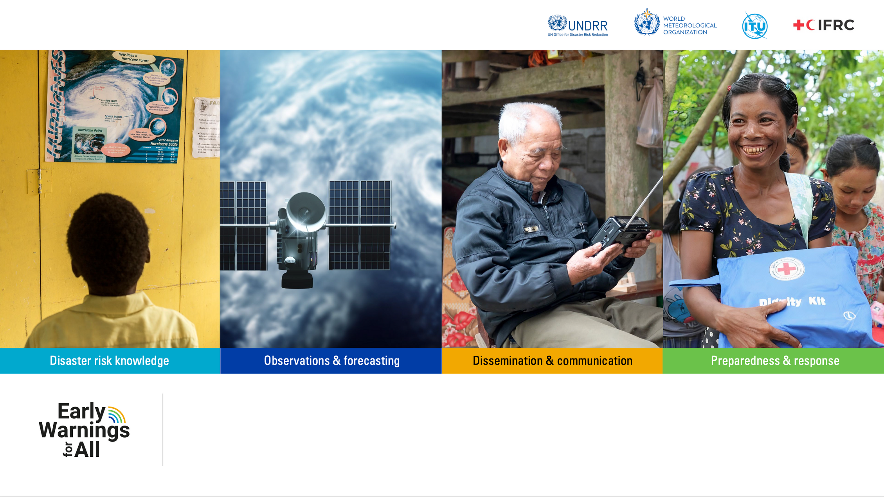
Overview of EW4ALL Initiative : current status and next steps
Dr Anthony Rea, Senior Director, Department of Earth System Data and Prediction, WMO

Slide 2
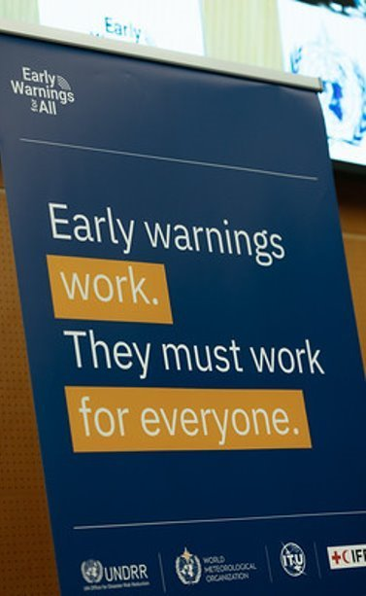
Content
WMO
What is EW4All?
What is WMO doing?
How does remote sensing fit?

Slide 3

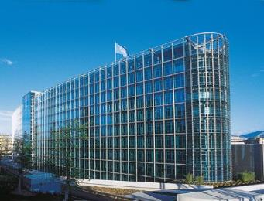
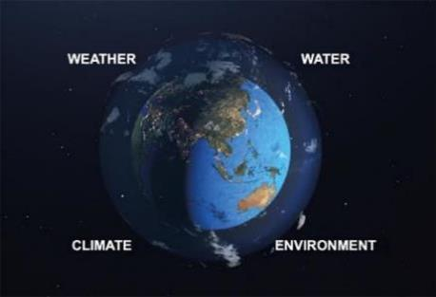
World Meteorological Organization
Originated from the International Meteorological Organization (IMO), established in 1879
In 1950, IMO was transformed into the World Meteorological Organization (WMO), when the WMO Convention entered into force
Since 1951, WMO is a UN specialized agency and the UN authoritative voice for weather, climate, water and related environmental services
See https://public.wmo.int/en/about-us/who-we-are/history-of-wmo

Slide 4
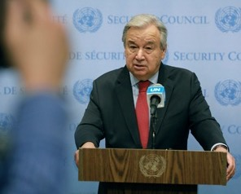
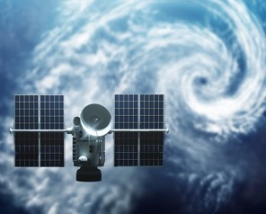
Early Warnings for All is a groundbreaking initiative that aims to protect everyone everywhere by 2027
Called for in 2022 by the UN Secretary-General as part of the Acceleration Agenda
Aligns with the priorities of the Paris Agreement
Supports key provisions of the Sendai Framework for Disaster Risk Reduction, particularly Target G on availability and accessibility of multi-hazard early warning systems
Contributes directly to the UN’s Sustainable Development Goals (SDGs), on poverty, hunger, health, water, clean energy, climate action and sustainable cities.

Slide 5
A UN-wide Initiative
WMO and UNDRR co-lead EW4All, with support from pillar leads, ITU and IFRC and additional implementing partners.
EW4All is also supported by an advisory panel consisting of the UN system, incoming and outgoing COP Presidents, key development agencies, and other relevant private and public organizations.
National implementation stands on a cross-government response and is made possible by National Meteorological and Hydrological Services (NMHSs), Disaster Risk Management agencies, Civil Society and Youth, and other relevant authorities.
Degree of implementation varies widely between countries – critical to improve regional and global support mechanisms.

Slide 6
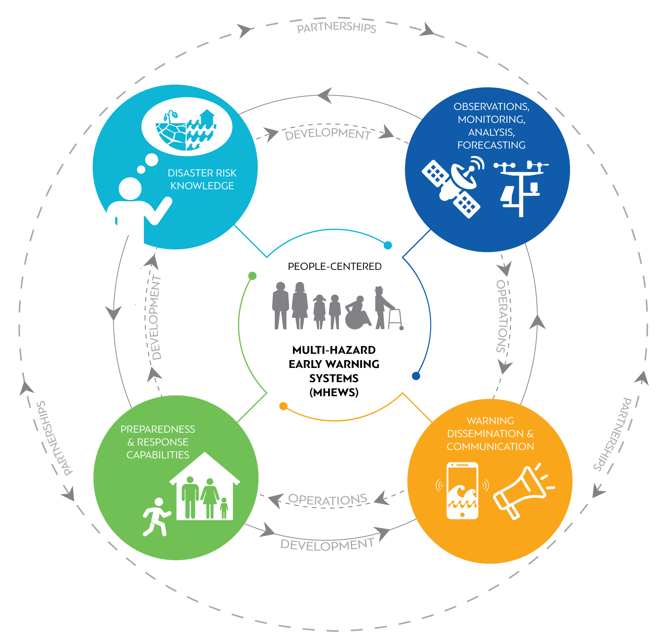
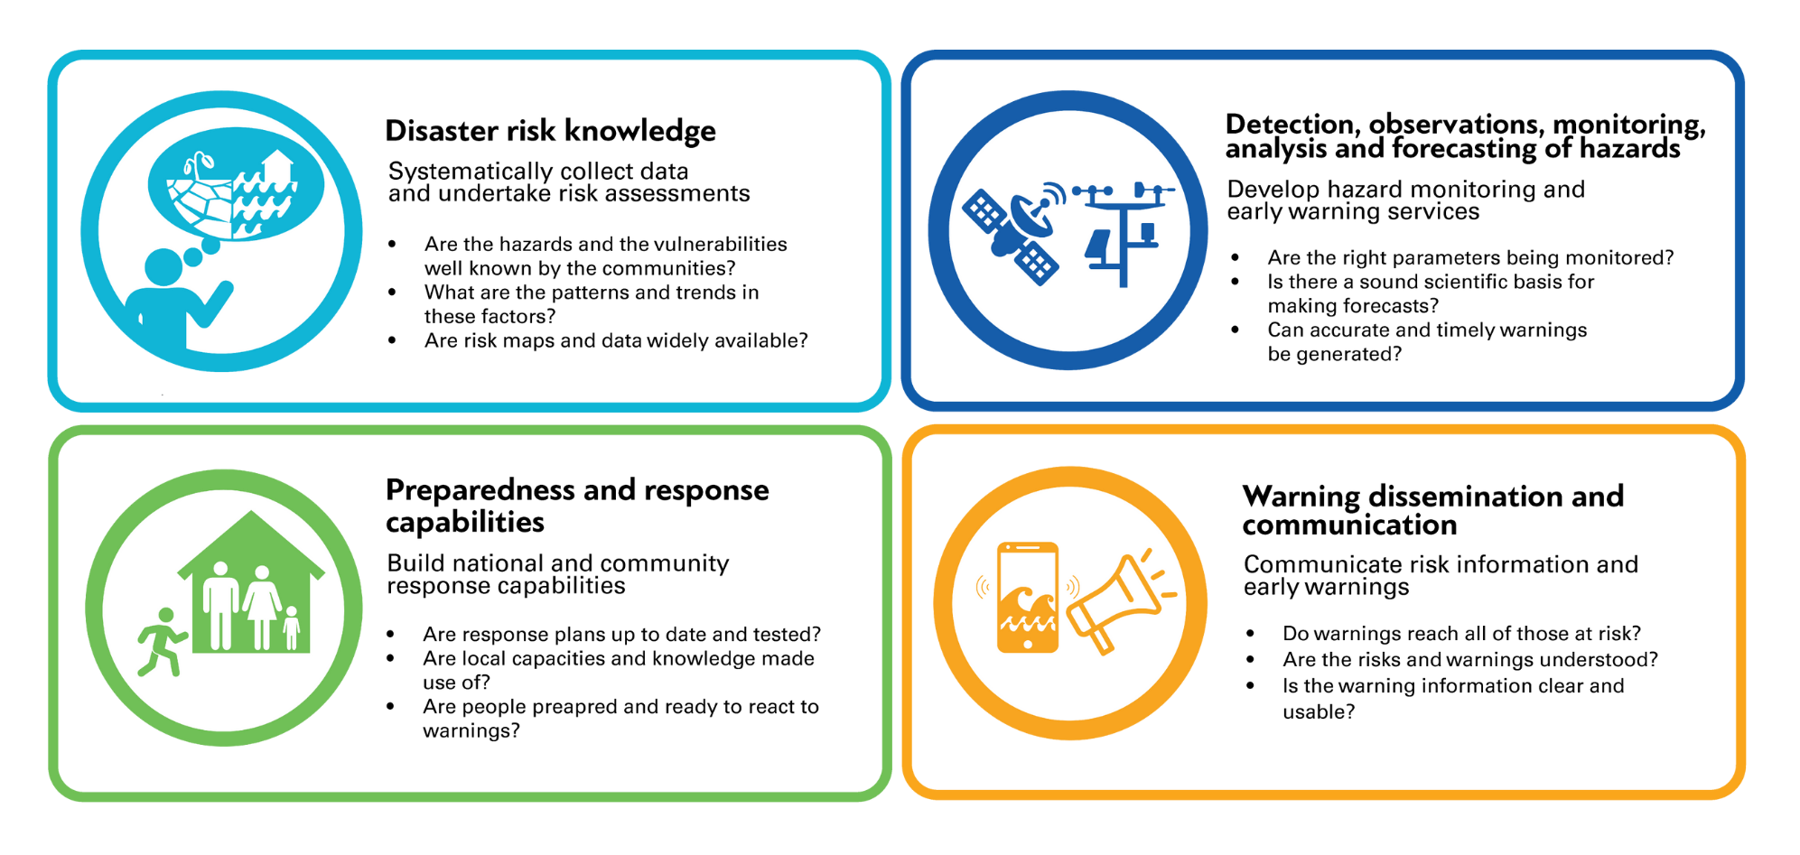

Four Pillars for Implementation
 | ‹#›
Notes:
The major opportunity this initiative brings us lies in the value of the partnerships, that will help us addressing the full value cycle to serve the people , as meteorologists and hydrologists alone cannot embrace that
Going together with our UN and other partners will also allow NMHSs to be better placed and recognized for the critical value of their work and be resourced to deliver it , also ensuring we are not mobilizing the best possible science, data and skills in vain
Why people centric – Climate/Weather cuts across boundaries, affects all race, gender rish and more but in most cases the most culnerable

Slide 7
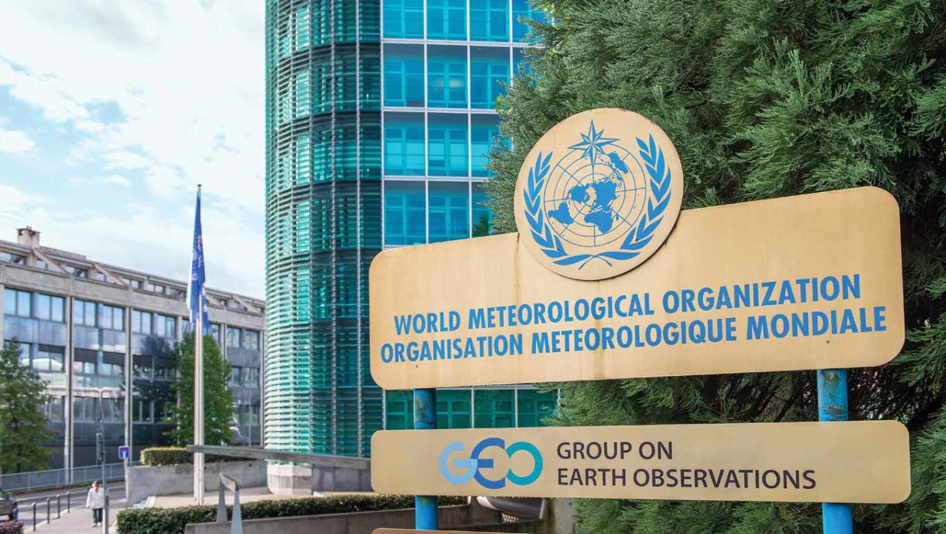
What is WMO doing about it?
Globally
Coordination across agencies and partners
Global Infrastructure – standards, open data, requirements
Hazard assessments, warning standards, impact-based frameworks
Competency frameworks
Advocacy
Regionally
Regional requirements gathering
Regional specialized centres
Coordination across countries
Nationally
Assessments and benchmarking
Capacity development projects

Slide 8

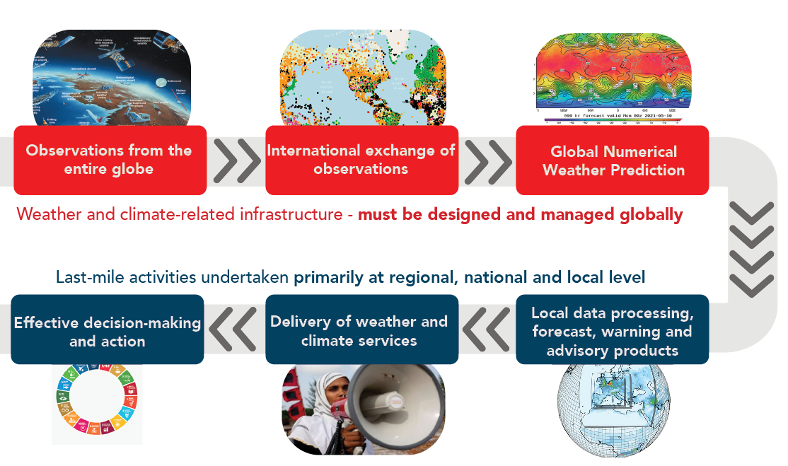
Global Meteorological Infrastructure
Global meteorological infrastructure designed and coordinated by WMO through INFCOM
 | ‹#›

Slide 9
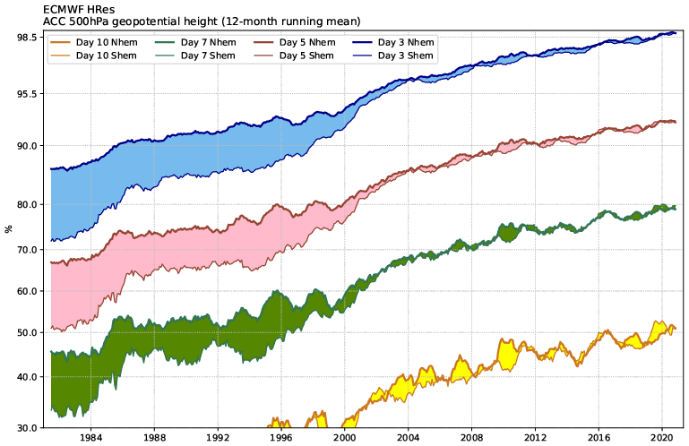
P Bauer et al. Nature 525, 47-55 (2015) doi:10.1038/nature14956 (updated)

Slide 10
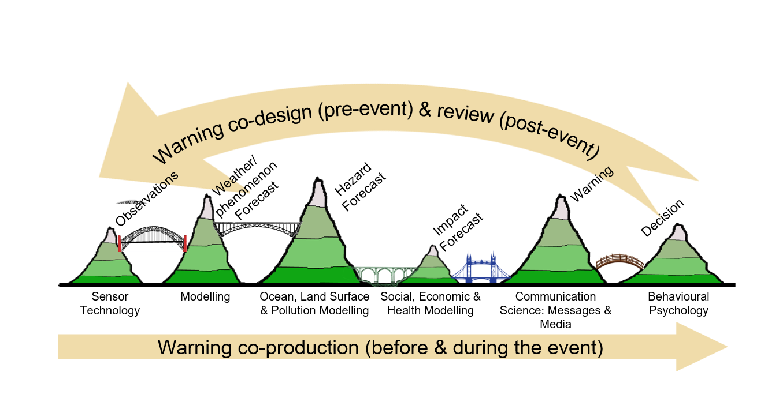
Remote sensing observations lie within a Value Chain that must be connected to be effective
Adapted from Golding et al (2019). See also Value Chain Approaches to Describe, Improve, Value and
Co-Design Early Warning Systems (WMO, 2024). The ‘bridges of death’ between critical capabilities
represent potential areas of warning chain failure.
Notes:
The Value Chain is a critical concept in multi-hazard early warning systems. Unless we are able to smoothly bring forward observations into effective warnings and responses, we are wasting investments and allowing ‘leakage’ in the system. Our challenge with remote sensing is often to have it used effectively in operations (can elaborate a lot on this point, obviously).

Slide 11
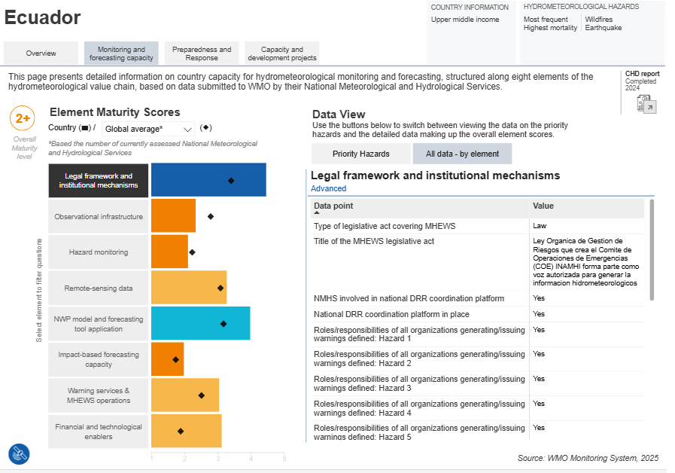
Notes:
We have created an EW4All dashboard to track progress in country capabilities. There is wide variation between regions and countries. Early Warnings for All Dashboard

Slide 12
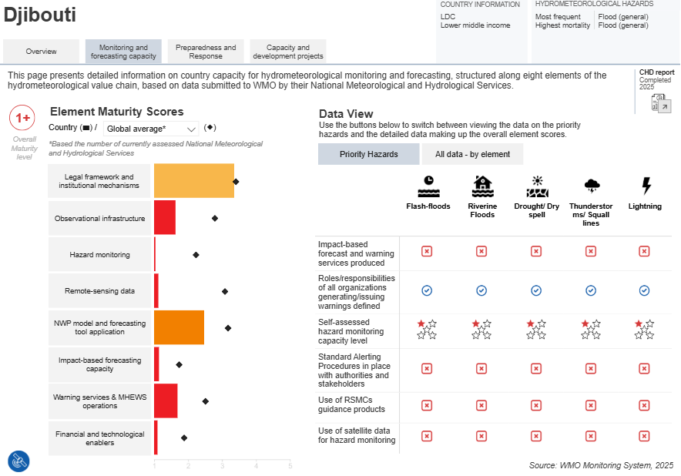
Notes:
We have created an EW4All dashboard to track progress in country capabilities. There is wide variation between regions and countries. Early Warnings for All Dashboard

Slide 13
Ongoing Challenges in EW4All
Gaps in Early Warning System Governance and Community engagement and feedback
Predictable and Sustainable Resourcing including access to national prearranged funds that enable early action that protect communities
Delivering EWS in Fragile Contexts
Multi-hazard approaches (across all natural hazards)
Empowering local populations.

Slide 14
Thank you

