Slide 1
CEOS SIT-41
EW4All in the Asia-Pacific Region: Ensuring Data Access
Agnes Lane
Bureau of Meteorology
Agenda Item 3.2
CEOS SIT-41 2026
Irvine, California, USA
14-16 April 2026

Slide 2
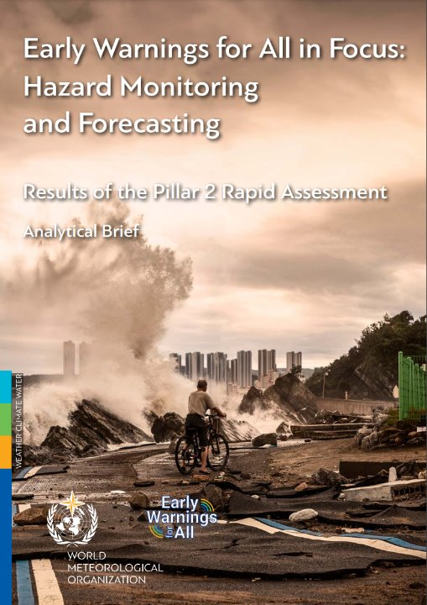
Priority Hazards
Floods, Drought, Tropical cyclones, and Thunderstorms are the top hazards.
Based on the results of the Rapid Assessment conducted by the WMO (Nov, 2023)

Slide 3
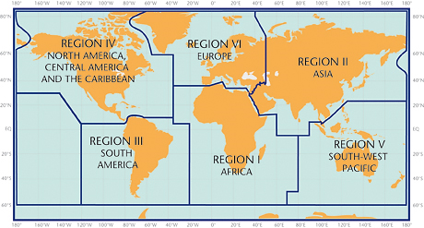
The Asia Oceania Region
Top hazards: thunderstorms / lightning, flash flood, tropical cyclones, riverine floods, drought, storm surge
Individual events can cause very significant losses – Tropical Cyclone Winston in 2016 affected over half of Fiji’s population resulting in USD 900 millon in losses. Tropical Cyclone Pam in 2015 reduced Vanuatu’s GDFP by 60%
Limited in-situ observations in the southern hemisphere. Satellite observations are essential for weather and warning services in the Asia-Oceania region

Slide 4
Importance of geostationary data
Most important products and parameters (not including NWP)
10 minute VIS, IR and water vapour observations for thunderstorms, tropical cyclones, fires, volcanic eruptions
RGB products have a large positive impact on work practices. Used for environmental monitoring including haze, sandstorms, volcanic eruption, etc
Rainfall products for floods, thunderstorms
Sea surface temperature data are used for oceanographic and climate purposes
For aviation services, cloud products including data on cloud cover and cloud top height, AMVs, low cloud and fog, lightning detection and volcanic ash are widely used
Observations and products to assist drought monitoring
2.5 min observations for localized convective thunderstorms and tropical cyclones that have a rapid development cycle. Also for forest fires

Slide 5
Importance of LEO data
Most important products and parameters
For Tropical Cyclones: sea surface winds and significant wave height
Precipitation products for flood monitoring, monitoring storms
Multi-sensor microwave imagery for tropical cyclones
Monitoring forest fire hotspots

Slide 6
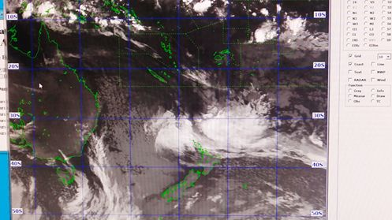
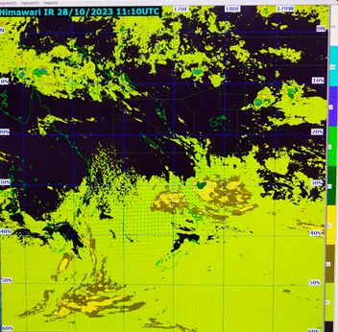
Showcase: Fiji
FMS is a leading weather agency in the region.
Satellite data used:
Himawari-9 via HimawariCast and GOES-West via internet.
Also using NOAA and METOP/ASCAT for TC tracking and analysis, and ocean surface winds
Essential for TC's, marine and aviation weather forecasts
Global model data from international partners are not fine enough resolution for Fiji. In-situ and satellite data are used together to cross-check for consistency and refine their own meteorological understanding. This is required in the tropics where subtle influences can be missed in model output.
Challenges: Quantitative precipitation forecasts at required resolution, ongoing training of forecasters, visualisation tools
Himawari used forTropical Cyclone Forecasting and Tracking
Notes:
FMS is a leading National Meteorological and Hydrological Service in the region
Fiji has 300 islands and hundreds of islets in the southwest Pacific, about 2,100 km north of New Zealand.
Population of approximately 900,000
Main Hazards: TCs, flash floods, riverine floods. Severe tropical cyclones have affected Fiji on numerous occasions, with the most severe impact from Severe Tropical Cyclone Winston (Category 5) in February 2016.
FMS host the Regional Specialized Meteorological Center (RSMC) for the South West Pacific Region providing assistance to other countries in aspects of hydrometeorology including tropical cyclone warnings, aviation and public weather forecasts
Challenges:
Quantitative precipitation forecasts at required resolution
Very few in situ and upper air observations in the region, and challenges in receiving marine observations, so satellite observations are important.

Slide 7
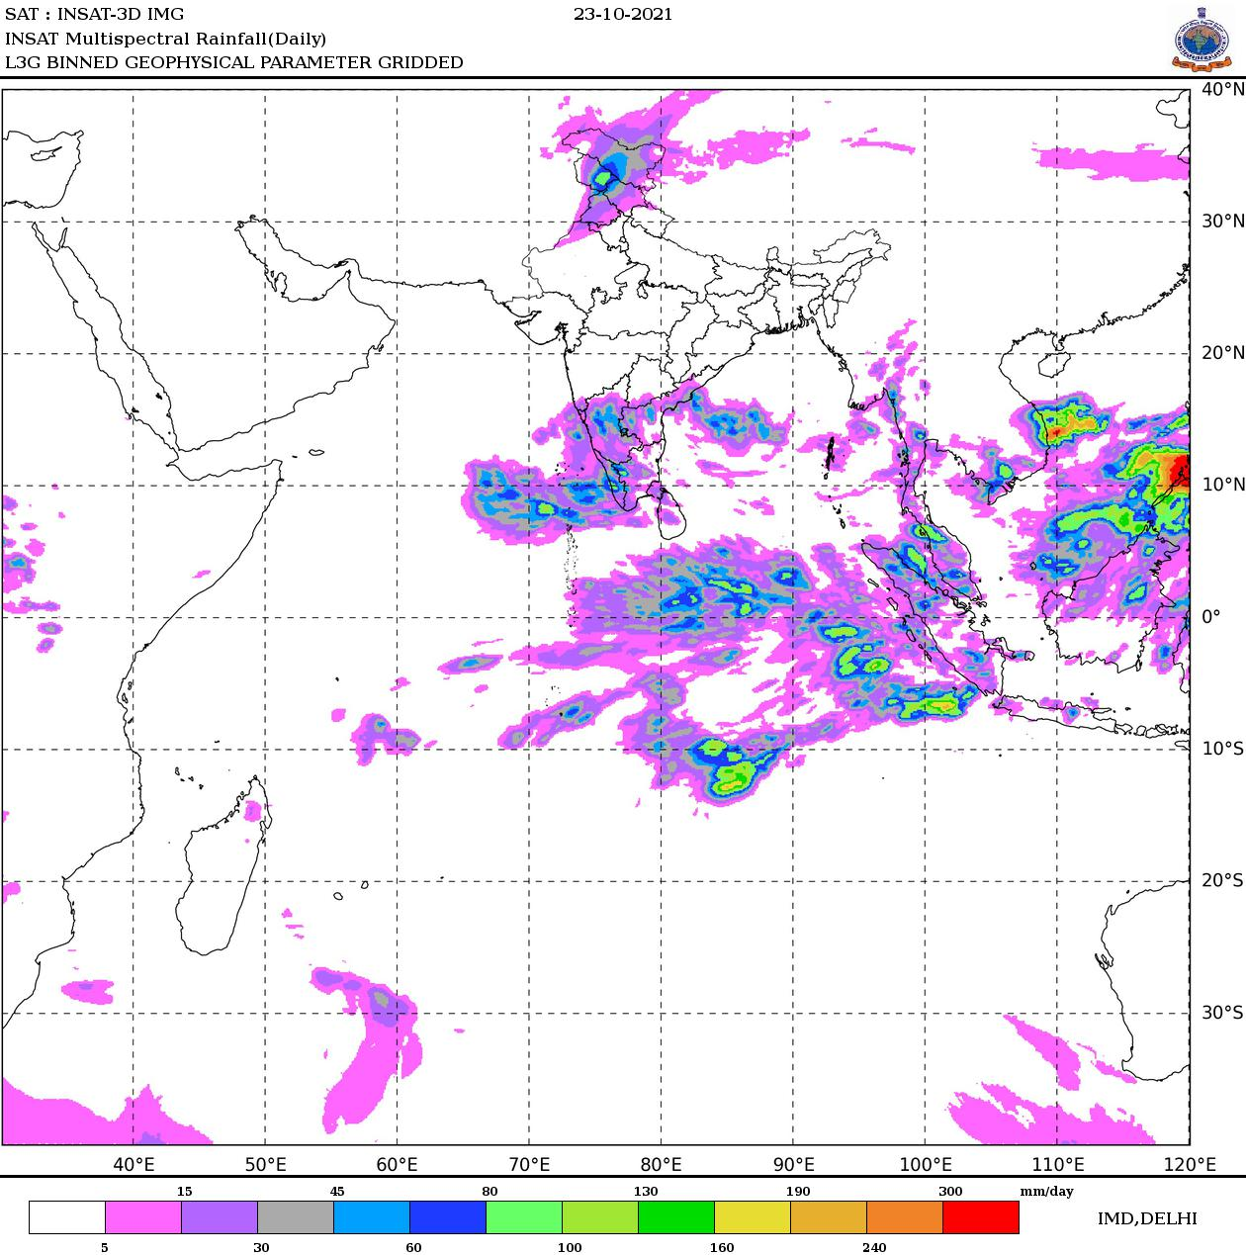
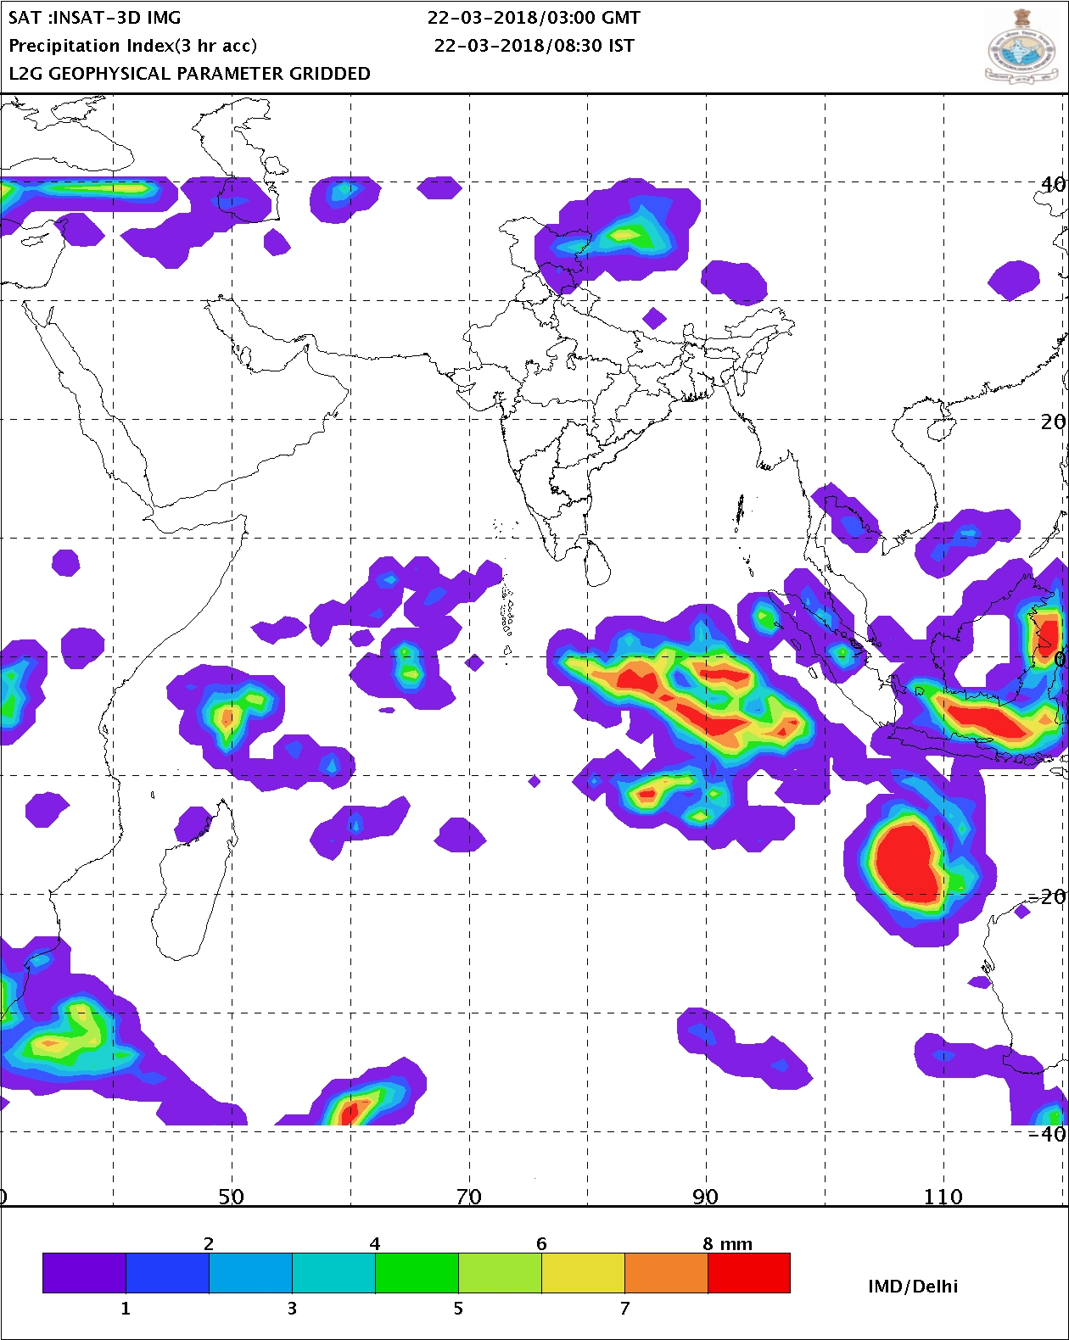
Showcase: Sri Lanka
Satellite data used: INSAT-3D (via IMD website), FY-4 (via CMACast), METEOSAT-9, GK-2A, Himawari-9. LEO data also: ASCAT, FY-3 (via CMACast), MIMIC (via CIMSS), GSMaP (via JAXA website)
Main applications:
Monitoring clouds properties and convective systems – these are the sources for heavy precipitation triggering flood related disasters
Tropical cyclones monitoring and analysis
Quantitative precipitation monitoring
Aviation. Himawari-9 used for monitoring significant convective activities and volcanic ash.
Marine services. ASCAT for ocean surface winds – used to estimate wave height, state of the seas, issue warnings/advisories for fishermen
Challenges: training, visualisation tools
"Data from Meteorological satellites have become vital for forecasting the weather in Sri Lanka, monitoring the climate, and producing timely warnings and other information that support public and private decision making for our social and economic well-being and sustained development."
INSAT images of rainfall. Estimates of rainfall can be used understanding of regional and global climates. Estimation over sea areas are significant in learning the characteristics of ocean-atmosphere interaction.
Credit: M. M. P. Mendis, Department of Meteorology, Sri Lanka

Slide 8
EW4All Activities in Asia-Pacific
Identified available products: Satellite operators provided a list of all available satellite data and products that address the top 5 hazards.
Identified user requirements using inputs from previous surveys, VLab expertise, AOMSUC Country Reports, Country Hydromet Diagnostics reports, WMO Rapid Assessment and 1:1 correspondence.
Data and product requirements
Training requirements
Infrastructure requirements
Gap analysis: Draft report "EW4All Report – preliminary gap analysis"
Launch of the EW4ALL Satellite Products Dashboard :
rapwmo.github.io/WMO-EW4All-Satellite-Products-Dashboard

Slide 9
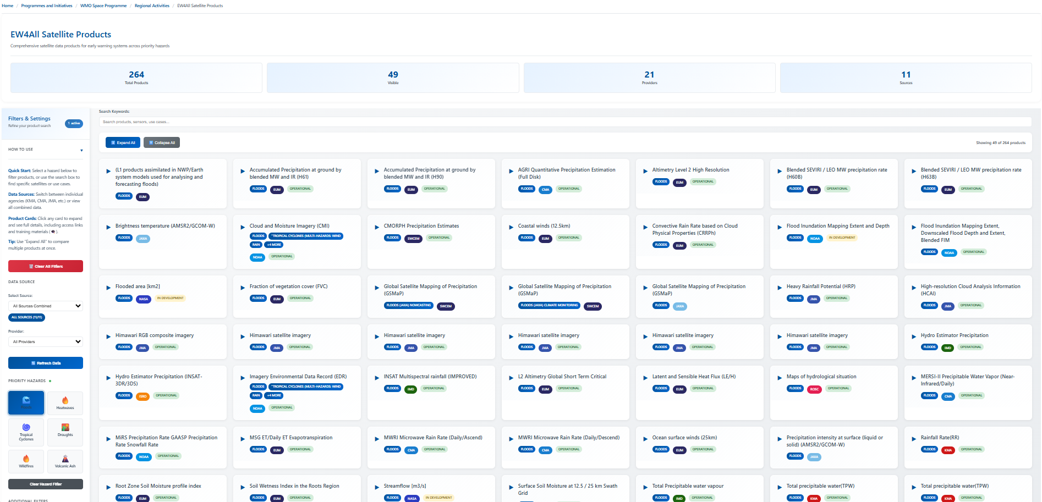
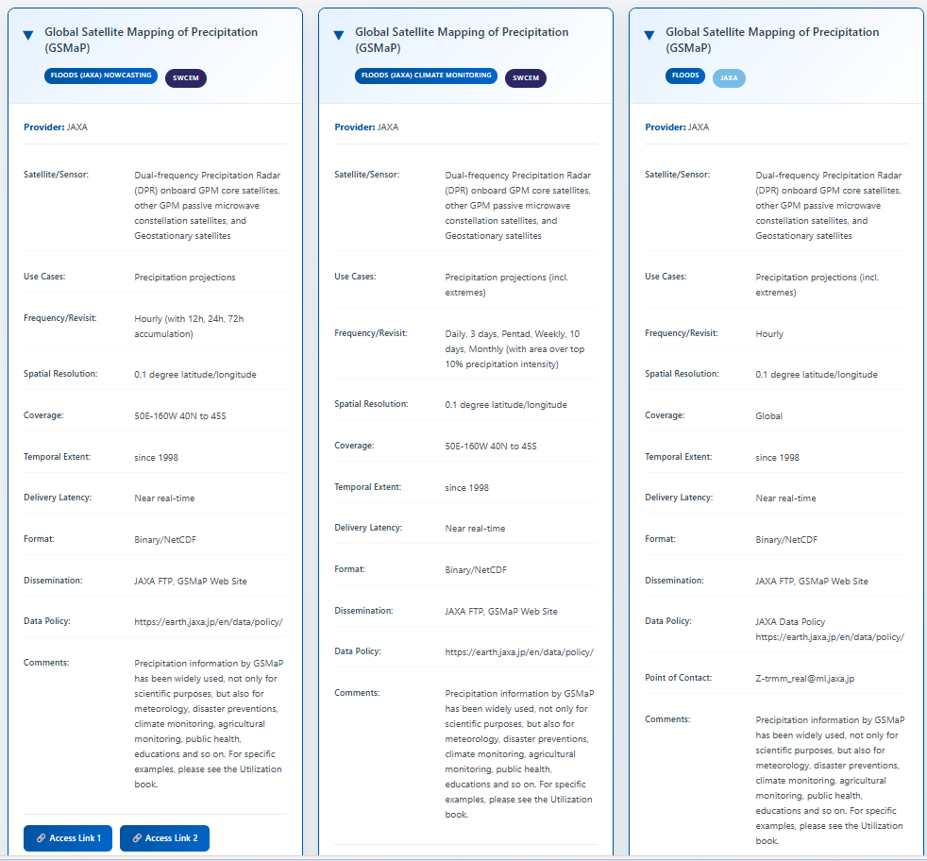
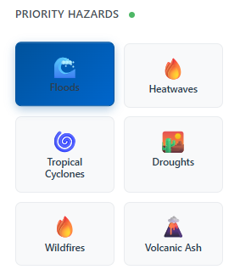
EW4All Satellite Products Dashboard

Slide 10
Summary of gap analysis
User needs:
more frequent observations of surface winds and wind fields for tropical cyclones
higher temporal and spatial resolution rainfall products
drought monitoring products
lightning observations
Satellite operators provide many products – it's possible that users don't know where to find the products, or how to use them. Needs further investigation
Infrastructure gaps:
slow internet connectivity can impact the ability to receive 10 minute and 2.5 minute geo satellite images in NRT
some countries report a lack of data storage, archival and retrieval systems, for analysis, climate monitoring
visualisation systems that integrate all observations. Online tools widely used (e.g. CIRA SLIDER, Eumetview, Worldview, EO Browser, Fengyun Live, FengYun Earth)
Ongoing training required
Utilisation: where to find data and products,, how to use data and products
IT related: data processing, server management, troubleshooting

Slide 11
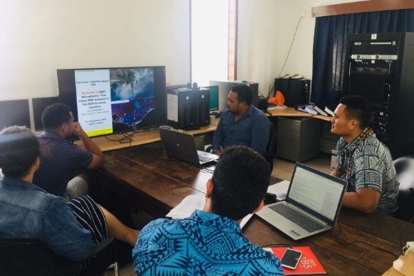
Next steps
Investigate the gaps further with the users in Asia-Pacific
Next opportunity is at the Asia Oceania Meteorological Satellite Users Conference (AOMSUC) in Dec 2026
Finalise the gap analysis report and implement recommendations
Promote the EW4ALL Satellite Products Dashboard within the Asia-Oceania region
Continue the monthly WMO VLab Regional Focus Groups
Explore opportunities to work with CEOS in related activities
Samoan Meteorologists attending an online VLab Regional Focus Group meeting hosted by BoM

Slide 12
Presenter Guidelines
Presenters should name their file using the following convention:
AgendaItemNumber_LastName_Subject (e.g., 1.1_Surname_Welcome)
Documents and presentations should be uploaded to the shared folder to allow for streamlined self service
Shared Presentation Folder (default view only, ask for upload/edit permission as required)
For support contact the SIT Chair Team: nasa-sit-chair-2026-27@googlegroups.com
Presentations and documents for information should be submitted by 7 April 2026
Documents to support decision-making should be submitted to the SIT Chair Team by 31 March 2026
Reporting to engage discussion or decision is encouraged, but detailed reporting should be provided as pre-meeting reading material or in background slides.
Please explicitly highlight the decisions, outcomes, or actions you are seeking. The more explicit you are, the better. i.e., feel free to provide text for a proposed action – it may be revised later, but this approach will help with the efficient preparation of the actions record of the SIT meeting.

