Slide 1
WGDisasters
Early Warning For All (EW4ALL) Subgroup
Lorant Czaran, UNOOSA
Agenda Item 3.3
CEOS SIT-41 2026
Irvine, California, USA
14-16 April 2026

Slide 2

Background
Four pillars of EW4ALL
Pillar 1. Disaster risk knowledge - led by the United Nations Office for Disaster Risk Reduction (UNDRR)
Pillar 2. Detection, observation, monitoring, analysis, and forecasting - led by the World Meteorological Organization (WMO)
Pillar 3. Warning dissemination and communication - led by the International Telecommunication Union (ITU)
Pillar 4. Preparedness and response capabilities - led by the International Federation of Red Cross and Red Crescent Societies (IFRC)
EW4All coordination between WG Secretariat, CEOS CEO, CEOS SEO, GEO DRR, UNOOSA, etc + SDGs.
In SIT-39 meeting April 2024 in Tokyo, WMO requested CEOS to support the EW4ALL initiative.
In SIT Technical Workshop September 2024 in Sydney, CEOS discussed and decided WGDisaster to consider how CEOS will support the initiative.
Subsequently, WGDisaster organized a subgroup to coordinate the topic.
Workshop Mid 2025 to interact with the Pillars of EW4ALL especially with Pillar 1 and 2 which is more in sync with CEOS WG-Disaster.
Proposal for carrying out EW4ALL within CEOS-WGD in selected areas.
IN WGD-24 IT HAS BEEN DECIDED TO CONTINUE THE EW4ALL SUBGROUP AS AN INTERNAL ACTIVITY OF CEOS WGD AND EXPLORE HOW THE PILLARS CAN BE ONBOARDED

Slide 3
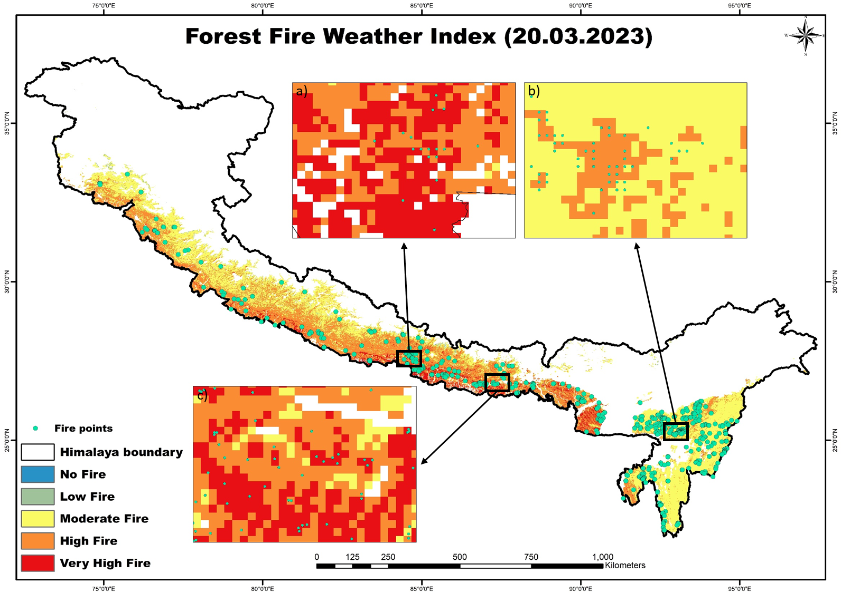
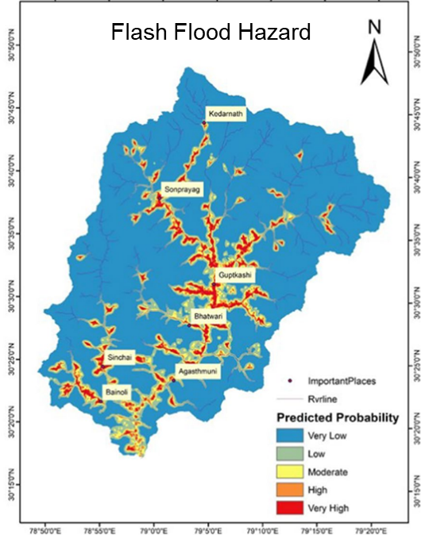
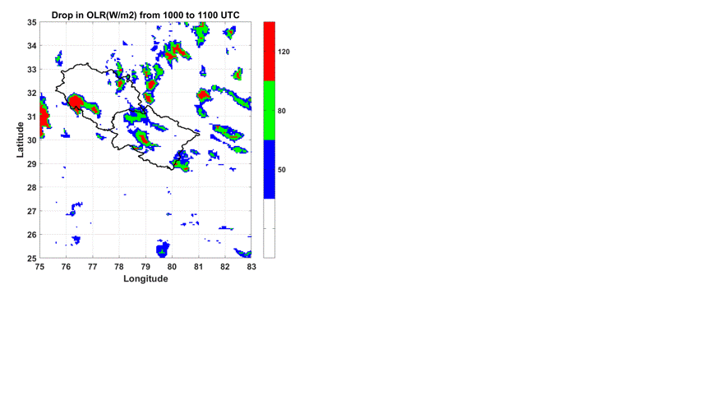
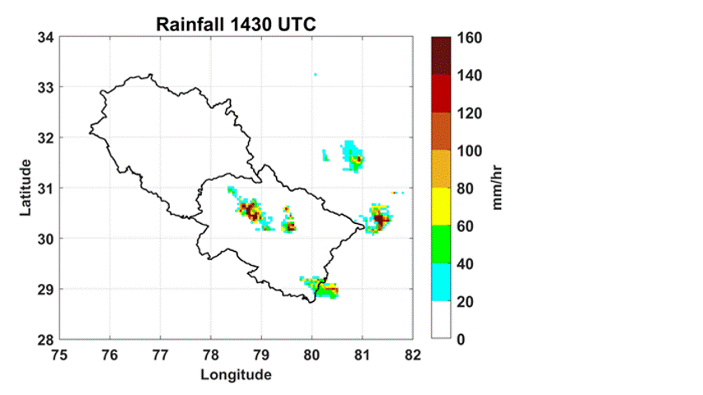
Satellite Remote Sensing for development of Early Warning Systems
Hazard Detection & Monitoring
Cyclones, floods, droughts, wildfires, landslides, avalanche, volcanoes tracked in near-real time, Glacial Lakes.
Risk & Vulnerability Mapping
Identifies flood plains with return period, slope deformation, deforestation, glacier retreat zones, wildfire regimes, heat waves and extreme rainfall events, Avalanche hazard zonation.
Forecasting & Prediction
Inputs for weather, climate, cyclones/typhoons,
hydrological modelling for GLOFS and flood inundation.
Geological hazard modeling (landslide, earthquake precursor, etc.),
fire weather, heat wave forecast, etc.
Vegetation indices & soil moisture for drought prediction.
Real-time Decision Support
Thermal/infrared for fire & volcanic eruption monitoring.
SAR/InSAR for land deformation & landslide precursors.

Slide 4
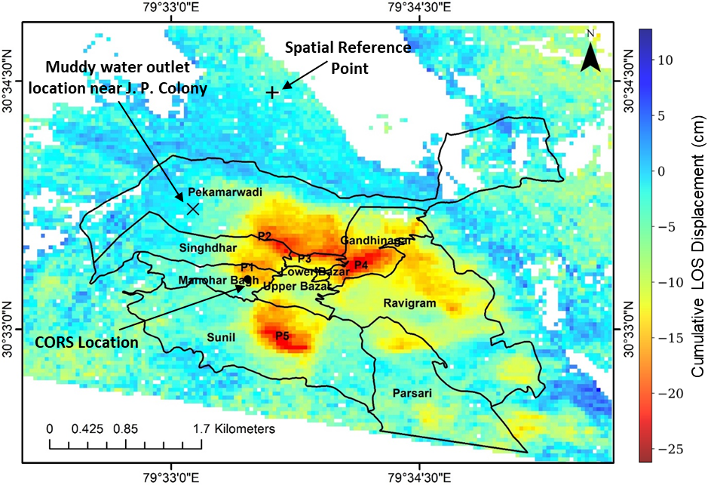
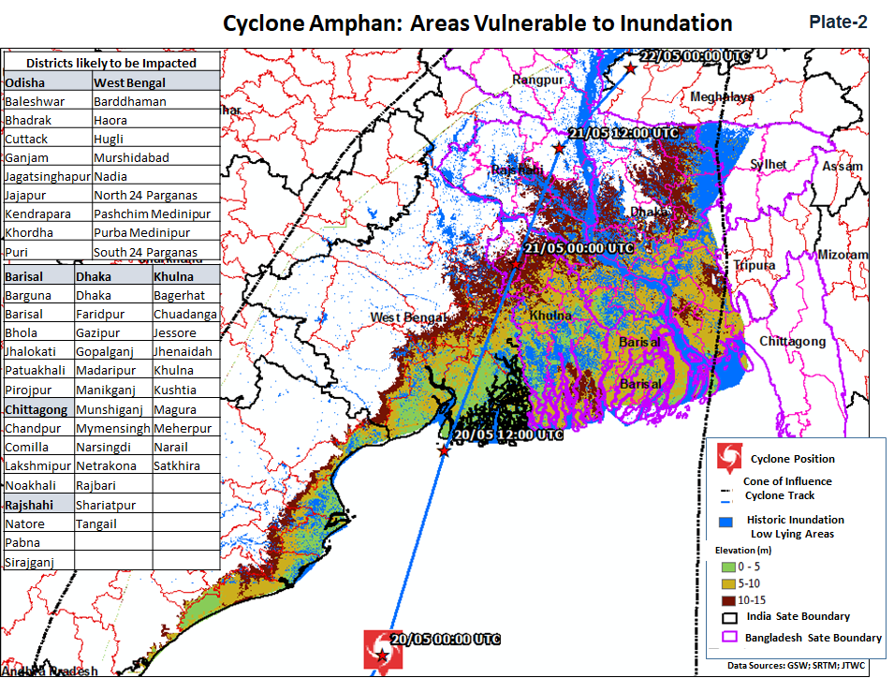
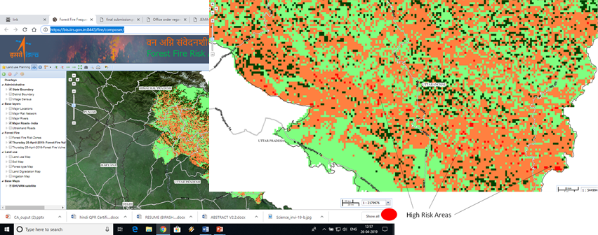
Tentative areas for EO based EW for CEOS
Advance InSAR techniques for landslide risk and slope deformation– PS-InSAR/SBAS techniques and free SAR data (Sentinel 1 and NISAR)
Cyclone prediction and forecasting: Cyclogenesis, Predicting path and landfall – Using Geo-Stationery satellites (GEOS, INSAT…..) and Models
Extreme Rainfall Events: Macro Physical studies and cloud-resolving modeling.
Satellite based fire weather Indices for fire risk and wild fire regimes for mitigation policies.
………………………….

Slide 5
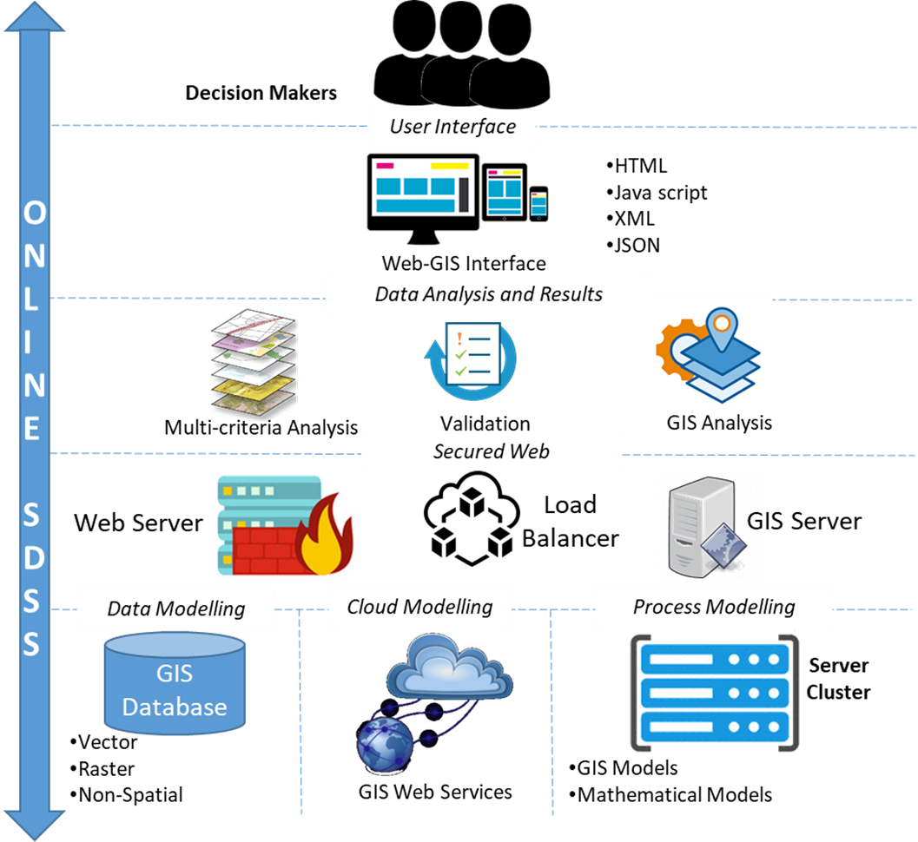
Decision Ready Data in EW4ALL
Reference: WGISS - 60
Actionable data Linked to specific decision Goal
Clear associated actions for each of the scenario
Accurate and Reliable
Relevant for a specific Time
DRD and Decision Support System
Generating Clear Insights from satellite data
Improved Interoperability
Make Information accessible to Non-Experts
Bridge Scientific Data Providers and Decision Makers
Courtesy: Harish Karnatak, IIRS

Slide 6
Points for discussion………
Subgroup Membership
Identification of domains and Leads – Expression of Interest
Source of funds – Internal Resources / Existing projects???
Formation of groups and Coordination
Explore possibility of UNDRR & WMO to be a part of subgroup
ARD – DRD – Actionable Data – Joint proposal with WGISS
Dissemination through web-portals and Development of DSS
Training, Capacity building and Handholding
Thank you

