Slide 1
Biodiversity Establishment of a CEOS Biodiversity Virtual Constellation
Gary Geller, NASA
Jet Propulsion Laboratory
California Institute of Technology
Shaun Levick, CSIRO
Marc Paganini, ESA
Agenda Item 4.1
CEOS SIT-41 2026
Irvine, California, USA
14-16 April 2026
© 2026. All rights reserved.

Slide 2
Agenda
How we got here
Proposal
Full Proposal
Terms of Reference
Implementation Plan

Slide 3
Timeline to Today
~2012: “Biodiversity Activity” initiated
~2020: Discussions on increasing engagement
2022-2024: Ecosystem Extent Task Team
2024: CSA Chair theme on Biodiversity
2024-2026: Biodiversity Study Team
Notes:
2012. CEO Tim Stryker recognized the need and initiated the activity. Low level of activity until 2020.
Ecosystem Extent Task Team was co-led by Gary Geller (NASA), Shaun Levick (CSIRO), Sandra Luque (CNES), and Roger Sayre (USGS)
Biodiversity Study Team was co-led by Gary Geller (NASA), Shaun Levick (CSIRO), and Marc Paganini (ESA)

Slide 4
Ecosystem Extent Task Team
Task: Explore and demonstrate use of EO for mapping ecosystem extent (current and forthcoming sensors)
Develop White Paper
Develop a Demonstrator
Hudson Bay Lowlands (ECCC)
Costa Rica Forests (CNES)
Great Western Woodlands (CSIRO)

Slide 5
Biodiversity Study Team
Overall Task: Assess CEOS options for an enduring engagement with biodiversity
Phase 1: Stakeholder assessment
Phase 2: Explore connections with CEOS WGs and VCs
Phase 3: Assess options and make a recommendation

Slide 6
BST Recommendation
Establish a Biodiversity Virtual Constellation
Endorsed at 2025 Plenary 🡺 Develop proposal
[BST Report and Recommendation available here]

Slide 7
Proposal Overview

Slide 8
Core Proposal Elements
Mission statement and objectives
Planned activities
Coordination with CEOS activities and entities
Membership and leadership
Resources
Details in the full documents

Slide 9
B-VC Mission Statement
Advance biodiversity understanding, monitoring, and applications
for the benefit of society by strengthening the community’s use
of space-based Earth observations and data products

Slide 10
B-VC Objectives
Maximize Impact
Focus: biodiversity understanding, monitoring, and decision making
Engage Users
Track and maintain understanding of evolving user needs
Leverage CEOS’ Collective Capabilities and Resources
Coordinate with activities of other CEOS entities
Notes:
B-VC impact will be through its users, so engagement is essential

Slide 11
Activity Areas

Slide 12
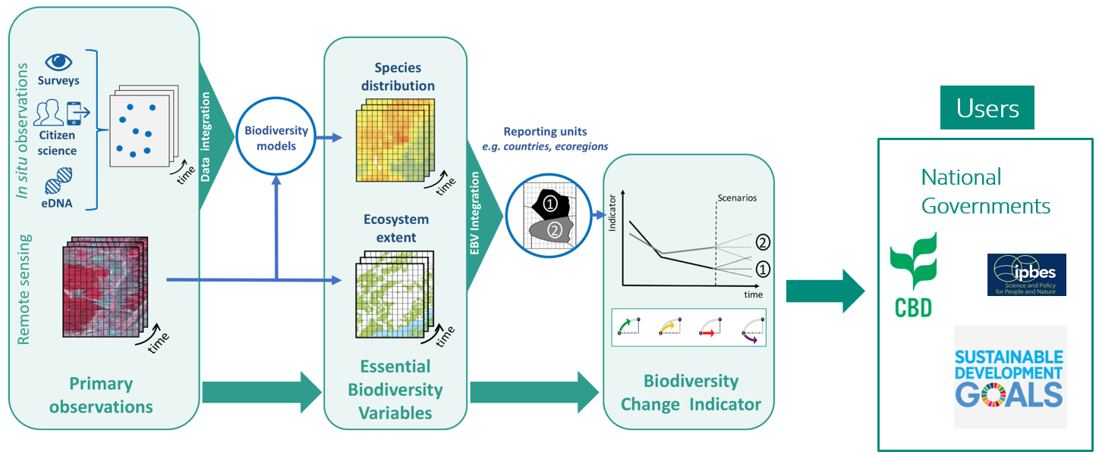










Conceptual Framework
Essential Biodiversity Variables and other key products:
Ecosystem
Structure
Function
Composition
Condition
Species
Distribution
Habitat quality
Secretariat
National governments
Services (viz, analysis tools…)
Services (algorithms/software, models…)
Services (algorithms/software, models…)
Government agencies
NGOs
Universities
Research Institutes
Products
Ex: Biodiversity change indicators
Primary observations
Intermediate, precursor
products
Others
Users
Based on Navarro et al 2017

Slide 13
B-VC Activities
Six activity categories
Data product gaps
Data utilization tools
Stakeholder engagement
Prototype monitoring system development
Capacity building
Space arm of GBiOS

Slide 14
1) Data Product Gaps
Identify and facilitate filling gaps in priority observations and data products
Prioritize products based on balance among value to users, data availability, and cost of implementation
Develop plan to fill gaps
Implement the plan (incremental, with partners)
Outcome: Increased availability of needed products and utilization of space-based EO

Slide 15
2) Data Utilization Tools
Facilitate enhancement of data utilization tools
Assess current tools and prioritize enhancements
2) Develop plan
3) Implement the plan (incremental, with partners)
Outcome: Better tools, increased utilization & impact
Tool examples
Data access
Analysis and visualization (e.g. trends over time)
Notes:
Data access is an important part of this area

Slide 16
3) User Engagement
Webinars, brochures, presentations at user meetings…
Seek out joint activities (papers, requirements development….)
Embed users in prototype monitoring systems (“demonstrators”)
Outcome: understanding of user needs & limitations…partnerships, collaborative development…

Slide 17
4) Prototype Systems (“demonstrators”)
Provides framework for B-VC activities
Goals
Facilitate development of new data products and utilization tools
Engage end users
Increase impact of Agency observations, products, activities
Value
Platform for developing, exploring, and testing data products and tools
Mechanism for user interaction and co-development

Slide 18
4) Prototype Systems (“demonstrators”)
Examples
Tropical forest inundation
Marine
Kelp monitoring
GOOS BioEco Essential Ocean Variables monitoring
Exploring ideas—yours are invited!
Agencies are invited to propose and support new protype systems
Notes:
Suggested by Ake Rosenqvist/JAXA

Slide 19
5) Capacity Building
Work with WGCapD to prioritize and enhance capacity
Emerging topic as B-VC progresses and interacts with users
More discussions will be needed
Outcome: Increased EO-awareness, utilization, and impact

Slide 20
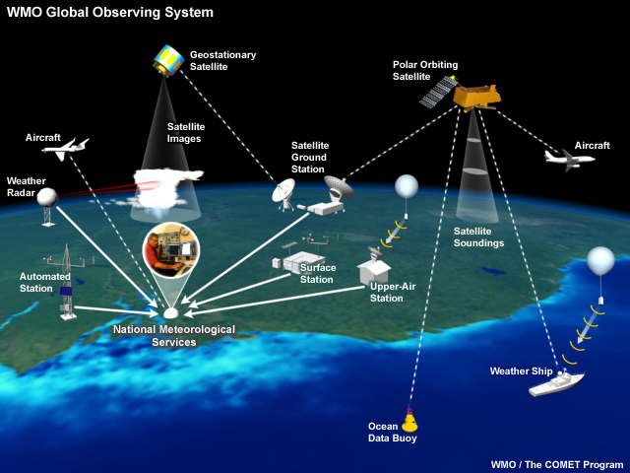
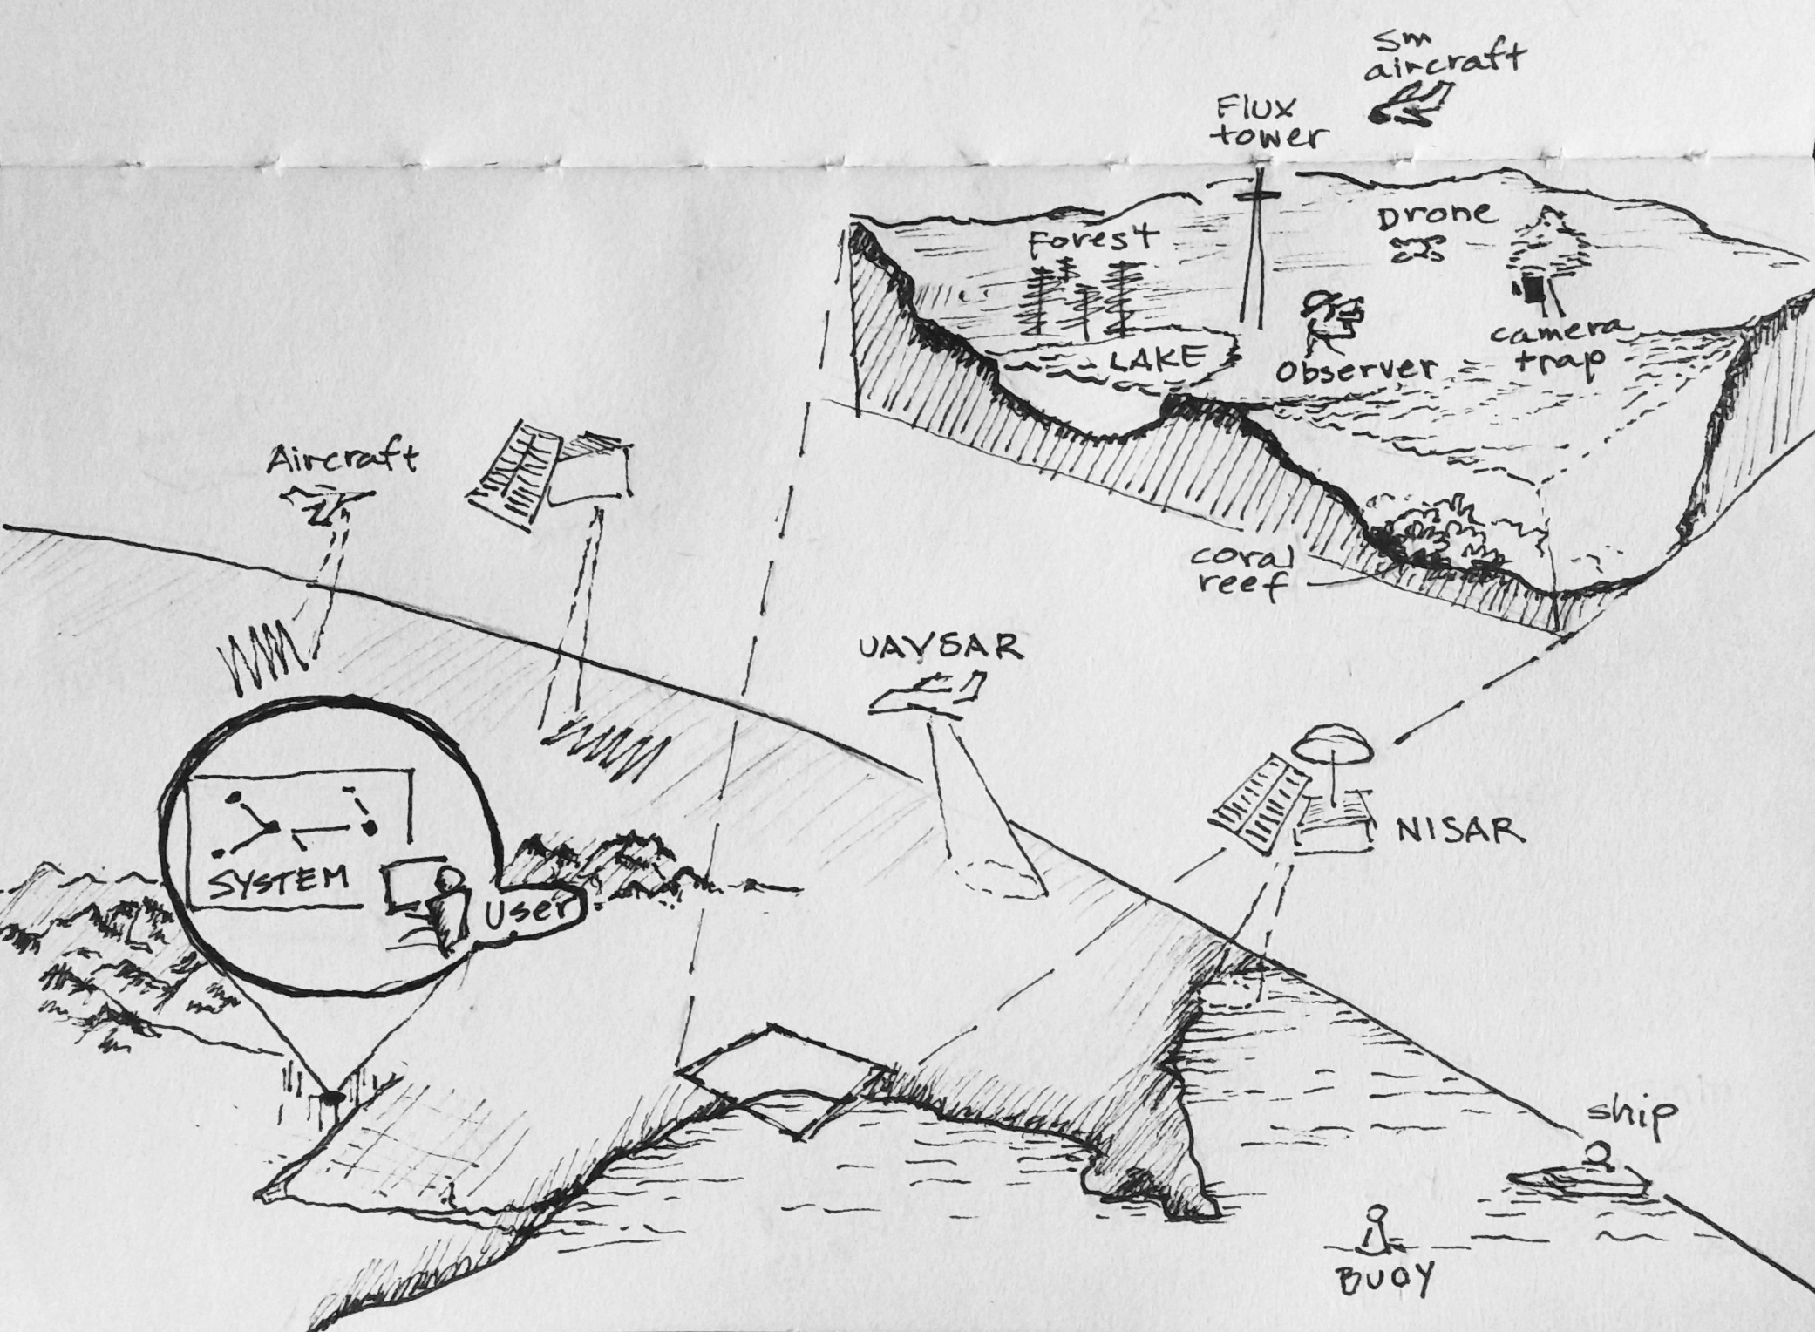
6) GEO BON GBiOS “Space Arm”
Thinking Big: GBiOS: Global Biodiversity Observing System
Weather
Biodiversity
https://public.wmo.int/en/programmes/global-observing-system
Notes:
Long term, ambitious concept. Provides a good vision to gradually grow towards.

Slide 21
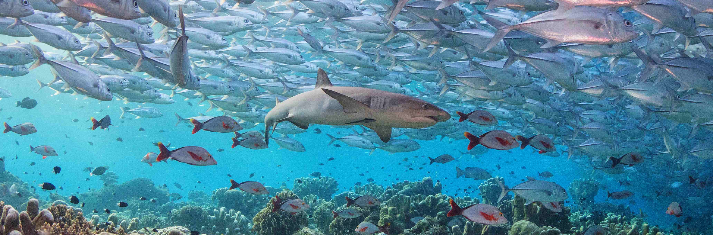
Marine Activity
Now active
Known gap in many BST activities
Engaging with GOOS BioEco panel
Discussions with marine VCs: COAST, OCR, OST, SST
Considering options for a marine prototype (“demonstrator”)
Wikimedia Avoini

Slide 22
Existing Activities (examples)
Many activities by CEOS Agencies (here: sample from CNES, CSA, CSIRO, ESA, NASA, JAXA)
Fill gaps in products and tools
CSA: SaMBA (20 project applications portfolio)
CSIRO: Habitat Condition Assessment System; Bioclimatic Ecosystem Resilience Index; NatureIQ
ESA: “EO for EBVs and GBF Indicators” and “EO for EWVs and Wetland Restoration/Conversation Indicators” tenders; WEED ecosystem extent project
NASA: Biodiversity & Ecosystem Conservation programs (R&A & Applications solicitations)
Convention on Wetlands (Ramsar): ESA and JAXA support to Ramsar STRP and GEO Wetlands
Product Generation & tools (SDI): CSIRO EASI platform, ESA OpenEO/BON-in-a-Box integration, NASA-ESA MAAP, NASA Science Cloud
User engagement and capacity building
Continuation of EETT demonstrators (CNES, CSIRO, ECCC)
B-VC: “network map” showing connections among missions/data products/user needs
Notes:
WEED: ESA’s World Ecosystem Extent Dynamics project
SaMBA: CSA’s Satellite Mobilization for Biodiversity Action AO released in 2025
NatureIQ: CSIRO’s Environmental and biodiversity digital assessment tool
BDEC: NASA’s Biodiversity and Ecosystem Conservation programs (R&A and Applications, respectively) has funded more than 300 projects from 2020 to 2025 and supported major airborne campaigns

Slide 23
Outreach to WGs and VCs
Commented on connections to user needs
Exploring potential connection areas
Guidance (e.g.., WGISS)
Providing data (e.g., Marine VCs)

Slide 24
B-VC Membership & Leadership
Leadership
CSA: Lucie Viciano
ESA: Marc Paganini (transitioning to Federica Marando)
NASA: Gary Geller (transitioning to Yoseline Angel)
Membership
CEOS Agency personnel (including CEOS WGs & VCs)
Augmented with outside expertise
Goal for geographic diversity and range of expertise

Slide 25
B-VC Resources
In-Kind support (for Team members)
By CEOS Agencies (including WGs & VCs)
For invited external experts
CEOS Agency Research and Development programs
Proposals for projects submitted by B-VC team members or external experts
Ex: Algorithm or product development; prototype development
External organization programs
Proposals for projects to national agencies, institutions, philanthropic organizations…
Submitted by B-VC team members or outside experts
Notes:
Three flavors of support are anticipated
BST membership was supported by 12 Agencies, including three co-leads

Slide 26
Invitation to Participate
We invite all Agencies, Working Groups, and Virtual Constellations to share their knowledge and skills
Participation by all CEOS Agencies is welcome regardless of whether their support is for surface-based in situ, airborne, or spaceborne data and activities

Slide 27
Request to Principals
For endorsement: Endorse the proposal to establish a Biodiversity Virtual Constellation (B-VC), as described in the Full Proposal, Terms of Reference and Implementation Plan
For consideration: Consider supporting the activities of the B-VC through the provision of personnel time and/or contributions from relevant Research and Development programmes

Slide 28
Thank you

Slide 29
Backup

Slide 30
Spinning up the B-VC
An iterative process including these steps:
Develop team membership (including outside experts)
Identify and prioritize specific B-VC activities
Bring members up to speed and identify member roles
Connect with end user organisations. Provide appropriate Points of Contact and discuss potential activities and contributions

Slide 31
Demonstrators
What we learned
Excellent place to experiment and explore
Develop and test methods, products, tools, use of new observations…
Enables direct user interaction and engagement
Enables assessment of feasibility, challenges, value

Slide 32
Examples of Prototype Concepts
Bring new insights to an understudied ecosystem or understudied ecosystem process, particularly those for which new and forthcoming sensors are used
Combine data from different types of sensors to create a new product and demonstrate the importance of interoperability
Build on an existing platform or product to reveal new insights (e.g., employing data from underused sensors or technologies)
A marine-based prototype on any of the above ideas
Address a specific gap that a partner user has identified, using a co-development approach

Slide 33
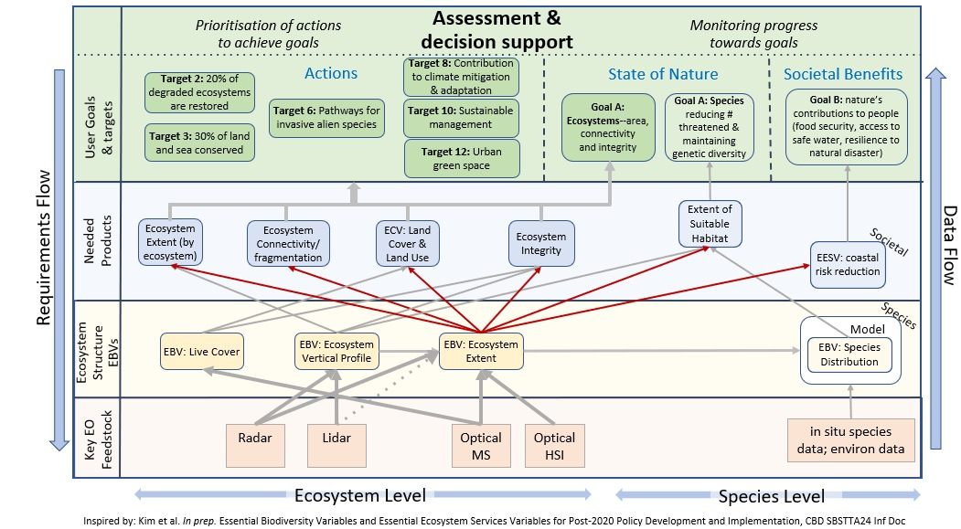
Mapping Missions to User Needs
Sample only
Updated version will provide context for many B-VC activities

Slide 34

BON in a Box Product Generation Pipeline Concept
Algorithm and Tool Development
This is an initial concept to generate missing biodiversity products such as specific indicators. Satellite data are processed by OpenEO and products passed to the BiaB Server. The server continues processing using a variety of other inputs to generate the final product.
Space agencies*
Other agencies
Research Institutes
Universities
NGOS…
GitHub BiaB algorithm
& tool repository
BON in a Box Server
EO Product Generation
Platforms
Accept user parameters, execute pipeline, return results, support analysis
EO setup, send, & receive
Parameters
ESA OpenEO
API
Results
Other platforms TBD
* Support could be via solicitations on various topics that Agencies such as NASA and ESA release. These sometimes include support for algorithm research.
EO
in situ
Any
Many
sources
Notes:
One of the biggest factors limiting the application and impact of EO data is the lack of end products that biodiversity users need; indicators such as those in the CBD Monitoring Framework are a good example. The reasons for this include compute cost, the large number of such products needed, and ecosystem variability that limits transferability of algorithms among them. This range of products and ecosystems makes a space agency-based solution that provides all the needed products and 100% geographic coverage impractical. However, collaborations can take advantage of complementary capabilities, many of which (e.g., BON in a Box, OpenEO, space agency R&D support, scientific expertise) already exist. Utilizing this range of collaborators will help fill some of the most important gaps. Note also that if additional EO product generation platforms can be added, perhaps by other agencies, this would increase production capability and share cost.
If CEOS engages more with biodiversity, as currently planned, it could play a role in facilitating parts of implementing the concept.

Slide 35
Options Considered
0) No action
Working Group
Virtual Constellation
Subgroup under the LSI-VC
Ad Hoc Team
Federated Approach
See BST Report and Recommendation for complete option assessment

