Slide 1
CEOS SIT-41
Organizational
GitHub
Governance
David Borges, SEO
Agenda Item 4.2
CEOS SIT-41
Irvine, CA, USA
15 April 2026

Slide 2

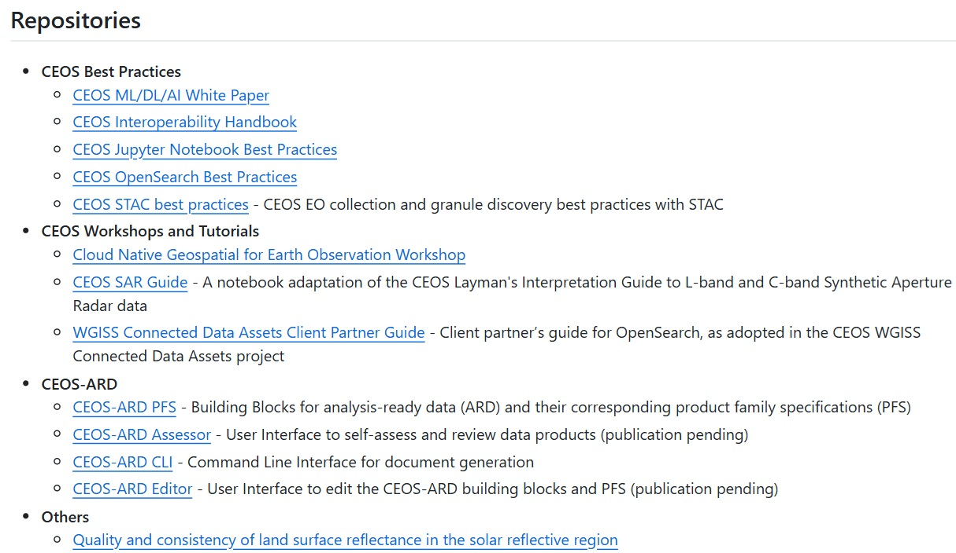
CEOS GitHub Organization
Current Status
  Organization Adoption:
    36 members
    6 outside collaborators
    19 repositories
    9 projects
    7 teams (Working Groups)
    64 followers
  Operating under GitHub Free tier with unlimited public/private repositories
Draft Governance framework established
  Followed from community discussions in December 2025 with 20 participants across CEOS agencies
Governance documentation developing on GitHub (governance repository)
Higher-level governance summary for review at SIT-41

Slide 3
GitHub Governance Decisions
Organizational Structure
  Teams mirror CEOS groups (WGs, VCs) with Admin and Exec teams for administration
  No institutional teams for now; groups nominate 1-2 points of contact (Chair by default)
  Ownership reduced from 7 to ~3, with admin team for broader operational support
Account and Repository Standards
  Real names required on all GitHub accounts
  Multi Factor Authentication enforced organization wide
  Kebab-case naming convention for all repositories
  Standardized files required: README, LICENSE, CONTRIBUTING, CODE_OF_CONDUCT
  Organization-wide Code of Conduct deployed
  Membership criteria is determined at WG/VC level with membership status managed by chairs and oversight by admins
Platform Positioning
  GitHub complements Google Docs; guidance on when each is most appropriate
  Particularly suited to version-controlled technical content with community input
  Remaining on the GitHub Free tier (adequate for current needs)

Slide 4
Default Licensing
Agreed Default Licenses
  Apache 2.0 for software (permissive, includes patent grant)
  Creative Commons Attribution 4.0 (CC-BY 4.0) for documentation and publications
Consensus and Status
  Consensus reached across multiple technical meetings (WGISS, WGCV, LSI-VC, ARD-OG, SEO)
  Reported to CEOS leadership with no objections raised
  Both licenses enable broad reuse while protecting contributors
Why These Licenses?
  Without a license, default copyright applies and content cannot legally be reused or redistributed
  Permissive licenses allow commercial and institutional use without restricting downstream application
  Consistent with how CEOS agencies already release open-source work

Slide 5
Contribution Framework Need
The Challenge
  When contributors across agencies submit work to a shared repository, two questions arise:
    Who owns what was contributed? Copyright applies automatically since every contribution has an owner, whether acknowledged or not
    Under what terms can others use it? Without an explicit agreement, there is no confirmed legal right to redistribute
Why Standard Approaches Don’t Work for CEOS
  Most open-source projects use a Contributor License Agreement (CLA): a legal agreement where contributors grant rights to an organization that holds the project’s IP
  CEOS cannot use a standard CLA because CEOS has no legal entity it cannot be party to contracts, hold IP, or serve as a counterparty to a licensing agreement
Additional Complexity
  CEOS contributors span agencies across multiple jurisdictions (ESA, CSIRO, ISRO, JAXA etc.) with different work-for-hire rules and copyright frameworks
  This reflects the nature of CEOS as a voluntary collaborative framework and the contribution framework must work within this constraint

Slide 6
Hybrid Contribution Framework
SEO recommends a three-layer approach where each component compensates for limitations in the others:
Layer 1: Enhanced CONTRIBUTING.md (all repositories)
  Establishes the core legal relationship: contributors explicitly agree their work is licensed under the project license (Apache 2.0 or CC-BY 4.0), retain their own copyright, and certify their right to contribute
  This is the actual license grant piece which a standard CLA would normally provide. Acknowledged via a PR-template checkbox: low-friction but documented
Layer 2: Selective DCO Sign-off (software repositories only)
  Adds per-commit provenance tracking via the Developer Certificate of Origin which records who contributed what and confirms their right to do so
  Applied only to software repositories to avoid creating friction for documentation contributors, who are often non-developers
Layer 3: Distributed Copyright (with optional institutional letters)
  Contributors and their institutions retain copyright. No IP is transferred to CEOS which sidesteps the legal entity problem entirely
  Agencies could optionally provide a one-time acknowledgment letter confirming employees are authorised to contribute adding confidence without creating a mandatory bureaucratic step

Slide 7

Implementation Progress
Completed
  Governance repository established on GitHub
  MFA requirement enforced for all organization members
  Organization-wide Code of Conduct deployed
  Ownership structure reduction with owners and admin team
  Guidance on GitHub vs. Google Docs usage
In Progress
  Team structure created; population with working group members underway
  Hybrid contribution framework under SEO review (see previous slide)
  Publishing template for GitHub Pages in development
  Dedicated training repository planned
  Expand guidance and add policies to Governance

Slide 8
Next Steps & Community Input
Contribution Framework
  Hybrid DCO/contribution framework prepared for broader community review
  IP policy may need elevation for broader review given the complexity
  Outreach to GEO Data Working Group legal/licensing subgroup and OSGeo community
Training and Adoption
  Coordination with WGCapD on training materials
  Tiered proficiency model: baseline (issue reporting, markdown), intermediate (PRs, branching), advanced (repo maintenance, Actions)
  Creation of a sandbox repository for hands-on practice
Governance
  Add guides about how to operate within the organization
  Expand repository migration guidelines for bringing existing projects under ceos-org
  Retirement and archival policies to be established

Slide 9
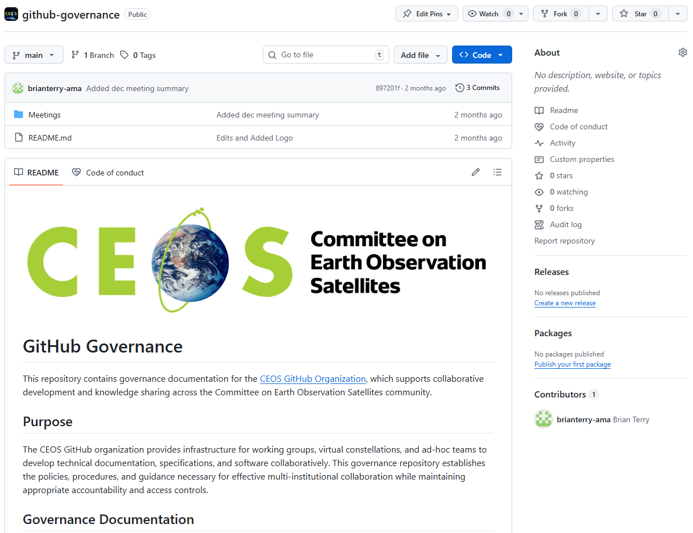
GitHub Governance Repository
Seeking endorsement of current GitHub Governance
  GitHub repository, not traditional document format
  Potential for this governance to continue evolving over time. If so, changes will be brought to future Principal-level meetings for further endorsement

