Slide 1
2026-2027 CEOS Communications Strategy
Libby Rose, SEO Comms Team
Agenda Item 4.3
CEOS SIT-41 2026
Irvine, California, USA
14-16 April 2026

Slide 2

2026-2027 CEOS Communications Strategy
Update from the 2024-2025 Strategy
  Revising target audiences
  Describing new campaigns aligned with CEOS Chair & SIT Chair priorities
  Revising approach to social media
Seeking endorsement from SIT

Slide 3
CEOS Communications
Managed by the SEO
  Dave Borges, Libby Rose, Harvey Jones, Riza Singh, Matt Steventon
Supporting team members:
  CEOS Exec Officer
  JAXA CEOS Newsletter Team
  USGS: Chris Barnes
  ESA: Marie-Claire Greening
  NOAA: Adria Schwarber
  CSIRO: Flora Kerblat

Slide 4
Objectives
Supporting the CEOS Mission:
Increase awareness of access to, and applications of, EO data, as well as the tools and services needed to effectively use EO data for the greatest societal benefit.
The impact of CEOS work should be shared, especially when applicable to other international organisations.
Enable information sharing and discussion with CEOS internally, between CEOS entities and across the CEOS membership
CEOS ensures international coordination of civil space-based Earth observation programs and promotes exchange of data to optimise societal benefit and inform decision making for securing a prosperous and sustainable future for humankind.

Slide 5

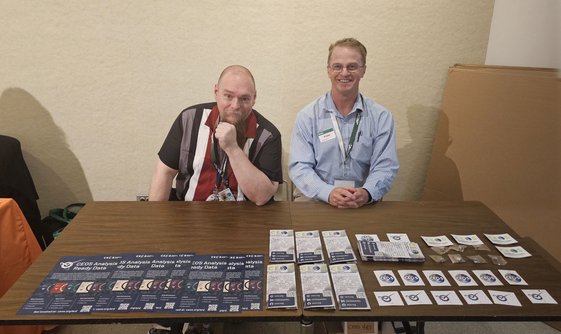
Content Types
Blog: ceos.org/news
Newsletter: https://earth.jaxa.jp/ceos-newsletter/
Quarterly Revisit: mailing list
Social Media:
  LinkedIn (primary)
  X & Facebook (secondary)
Youtube: youtube.com/@ceosdotorg
Exhibition Booths: e.g. LPS, IGARSS, JACIE, VH-RODA
Related activities:
  ESA MIM Database Quarterly Report
  CEOS-ARD Newsletter
ceos.org/quarterly-revisit-sign-up

Slide 6
Stakeholders
Internal CEOS
CEOS Principals
CEOS Working Teams
External CEOS
Data Providers & Distributors
Data Users
Decision Makers
Will align with SIT Chair Team Value Chain outputs

Slide 7
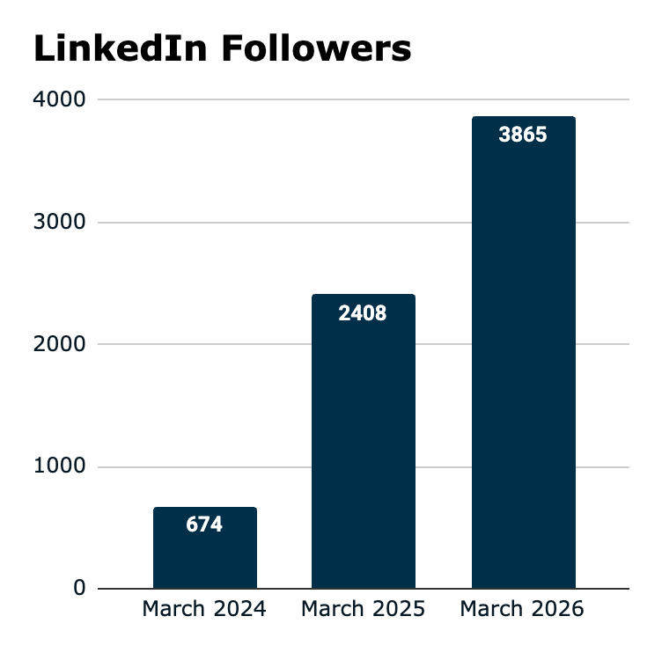
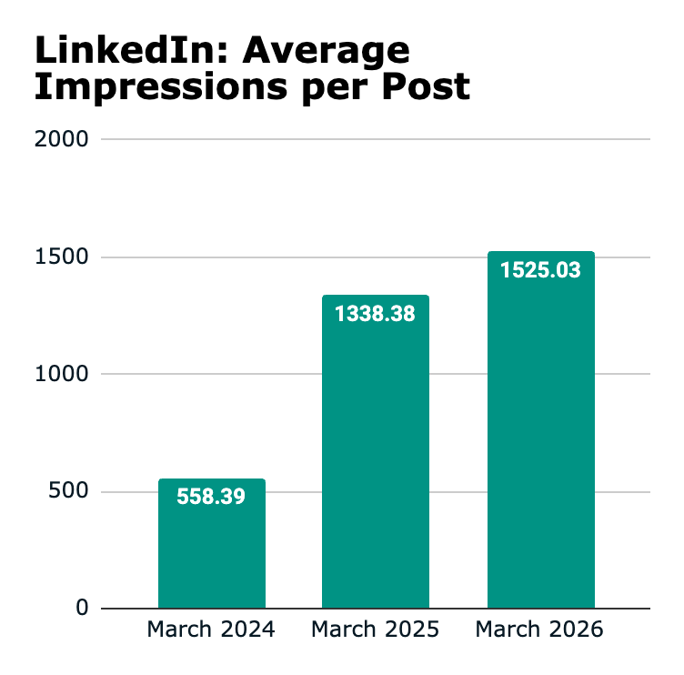
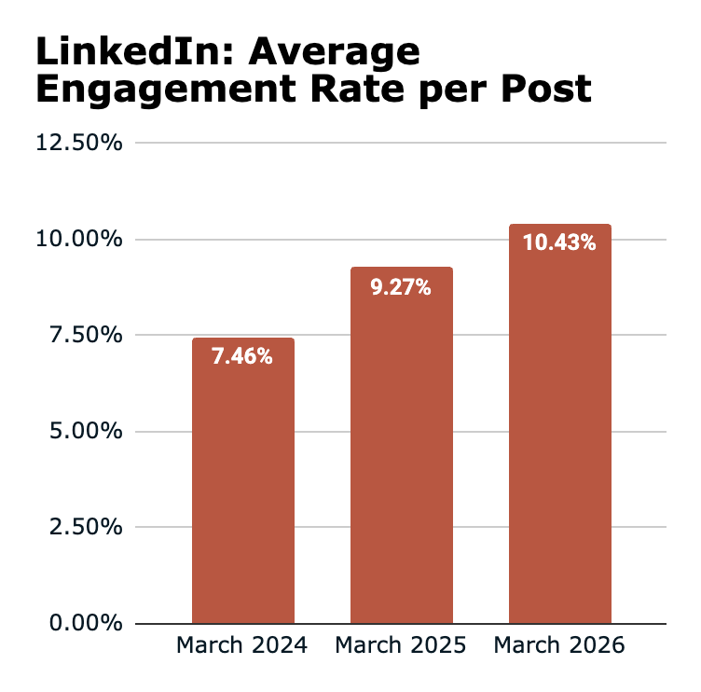
Social Media Success
* Engagement rate = number of people clicking links / liking / sharing / commenting as a proportion of the number who saw the post
Benchmark: 2-4%

Slide 8


2026-2027 Campaigns
Supporting with CEOS Chair & SIT Chair Priorities:
Future of CEOS Analysis Ready Data
  Continue to share updates on current and new activities (new datasets, PFS, etc.)
  Support development of 2026 CEOS-ARD Strategy - encourage community input via LinkedIn
Adaptation & Resilience
  Promotion of 2026 EO Handbook
  History of the handbook, ‘teaser’ case studies ahead of publication
Water Quality Workshops
  Outcomes of workshops
  Inviting inputs to discussions where appropriate
Interoperability
  Series of articles - focused on the Interoperability Factors from the Handbook
  Part 1 (overview) & Part 2 (Vocabulary) already published

Slide 9
CEOS Website Refresh
The website serves wide variety of users and purposes
  Primary outward facing channel
  Internal information sharing
  Communication of CEOS services, tools and publications
Current website is not up to date with design best practices and styles
SEO plans to undertake a comprehensive design refresh of the website in 2026-2027
  Bringing style in line with contemporary websites
  Review existing CEOS websites outside primary Content Management System
  Incorporating GitHub pages / content more systematically

Slide 10
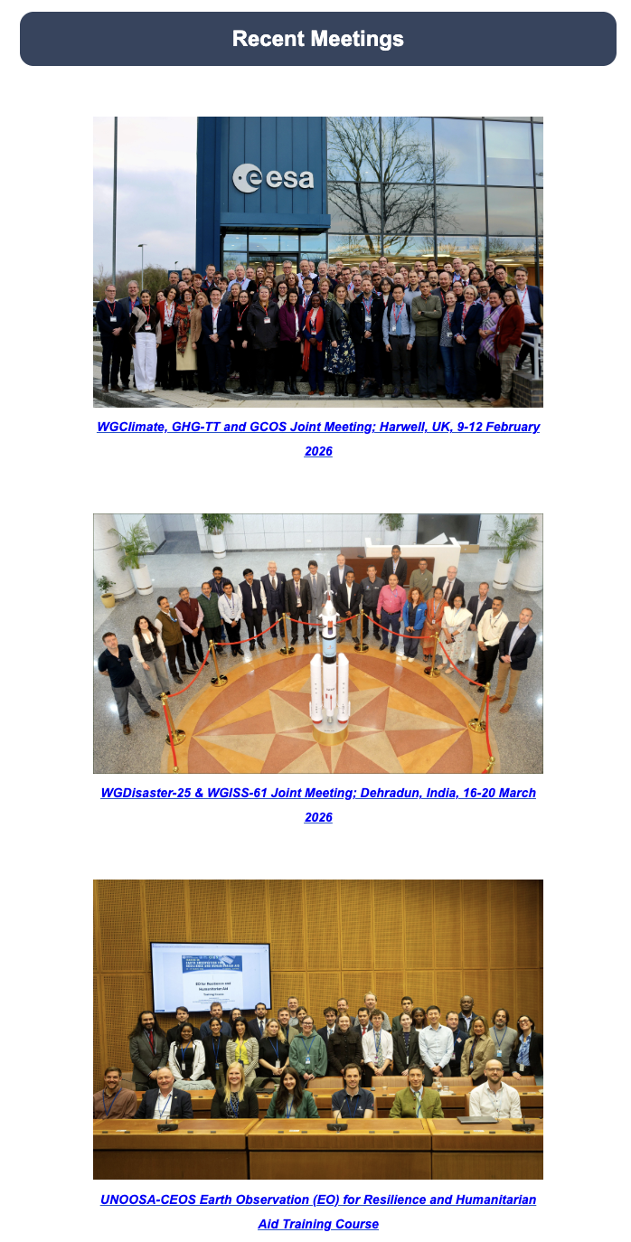
Contributions from WGs/VCs
Any CEOS Working Team is welcome to provide content for CEOS Communications
  Email Dave, Libby, Harvey
  Social media, blog posts, or other items
  E.g. published papers, new initiatives, discussion/editorial pieces
Please always share photos from your meetings and events!

Slide 11
2026-2027 CEOS Communications Strategy
Seeking endorsement from SIT

Slide 12
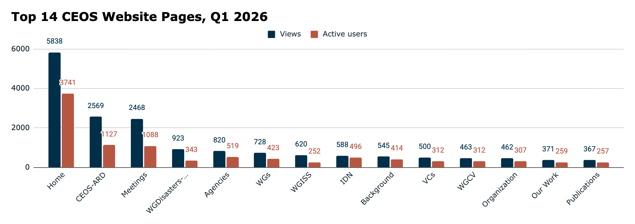
Website Stats (backup)

Slide 13
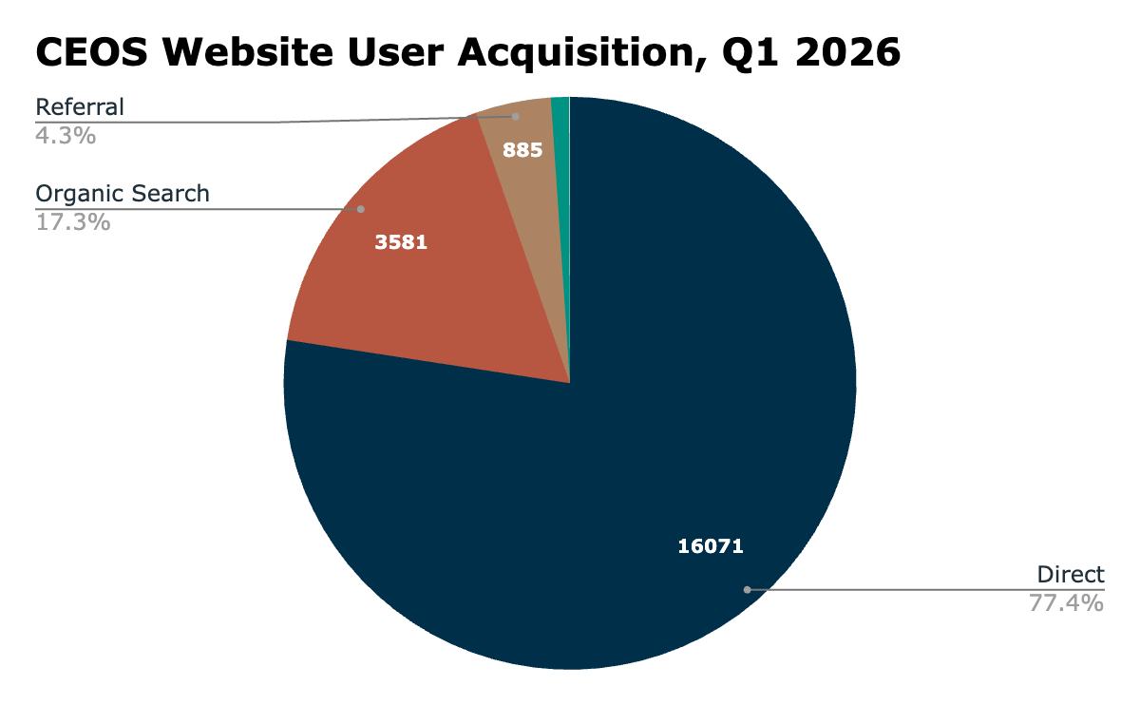
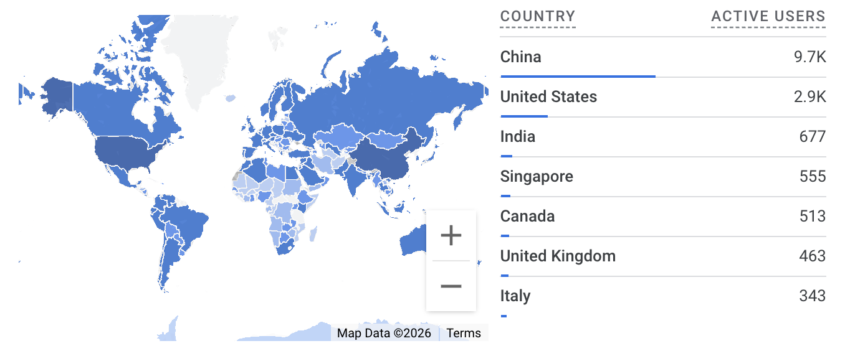
Website Stats (backup)

