Slide 1
CEOS SIT-41
April 2026
CEOS in Schools: 2026 Programme Update
Agnes Lane
BoM – CEOS Chair Team
Agenda Item 4.4
CEOS SIT-41 2026
Irvine, California, USA
14-16 April 2026

Slide 2
CEOS Youth Initiative
Continuing the successful program piloted by UKSA in 2025
Objectives of the Programme:
Educate: Show young people how to apply satellite EO to address real global challenges
Collaborate: Provide an opportunity for students to work collaboratively across international borders using the platform of CEOS
Engage: Facilitate a discussion between CEOS principals and youth representatives on key CEOS topic areas
Student benefits:
Students learn about satellites and the data they collect about our planet
Experience working across international borders with other students in the global CEOS community
Engage with world-leading Earth Observation scientists
Present to and ask questions of senior leaders in the satellite Earth Observation field
Three components to the programme:
International webinars, poster / video challenge and the Youth Summit in Hobart Australia in November

Slide 3
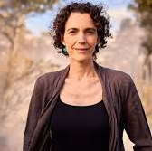
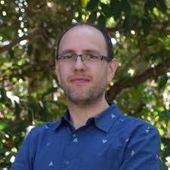
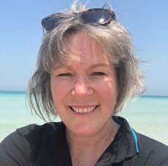
International Webinars
Students aged 12-14 were invited to attend international online webinars
Pre-reading material was provided to the schools and students
The webinars consisted of presentations and then a breakout session for students to work together on an activity
Webinars were held on two themes
Monitoring fires from space – Presenters: Marta Yebra, Nicolas Younes
ANU, Fenner School of Environment & Society and the School of Engineering
Monitoring water quality from space - Presenters: Janet Anstee + team
CSIRO AquaWatch Program

Slide 4
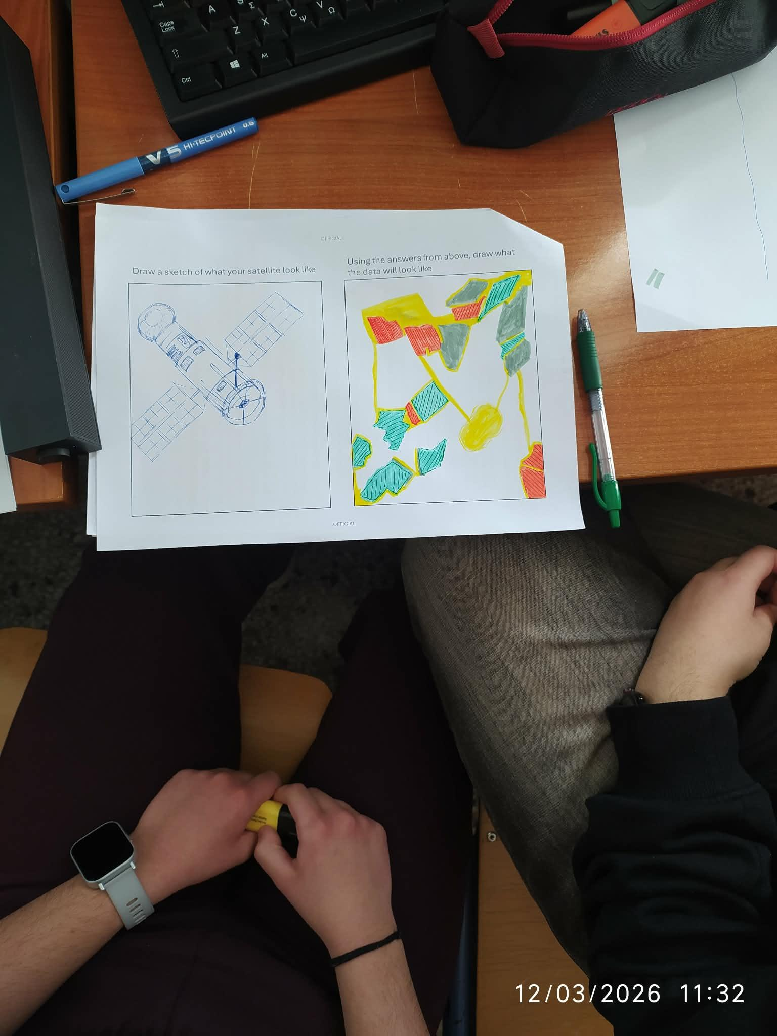
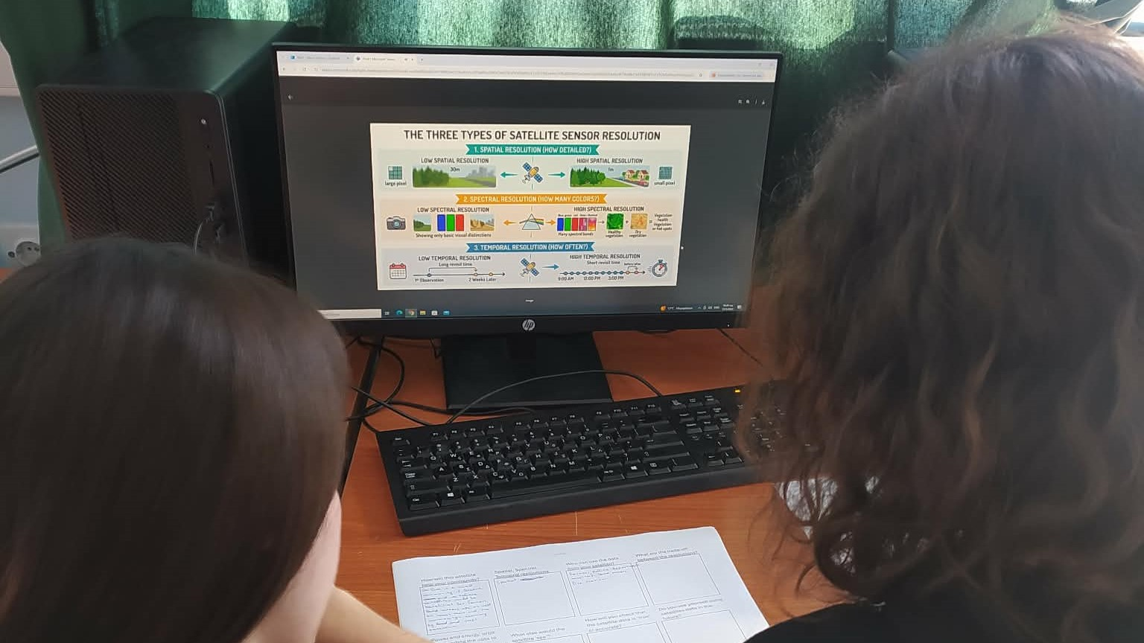
International Webinars
4 webinars were held between 12-20 March
Webinars were delivered in English and Spanish
~200 students from South Africa, UK, Greece, Norway, Japan, Ecuador and Australia
Students listened to the presentations, and worked together in breakout groups on activities e.g. designing a satellite
The webinars program was really exciting and educational. It gave us a chance to learn about things we would never do otherwise such as how satellites can determine the quality of the water and locate endangered areas for the fire breakouts from long distance. It also helped us interact both with each other and with other students around the world. Overall, we believe it was a great and one in a lifetime experience for both us and our teacher. Thank you for giving us the opportunity to participate in this program.
Maria, George, Yrw, 1st General High School of Nafplio.

Slide 5

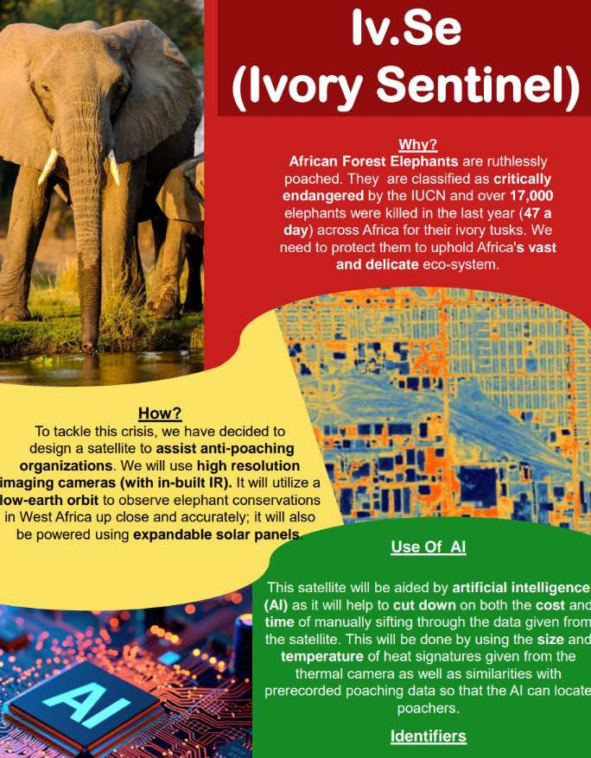
Poster / Video Challenge
Students will have the opportunity to develop a poster or video presentation on what they have learnt or ideas they have for Earth Observation in the future. The posters will presented in person (for Australian students) and virtually at the second CEOS Youth Summit in Hobart Australia in November 2026.
Droughts
alert
Elephant monitoring
Posters submitted by students in 2025

Slide 6
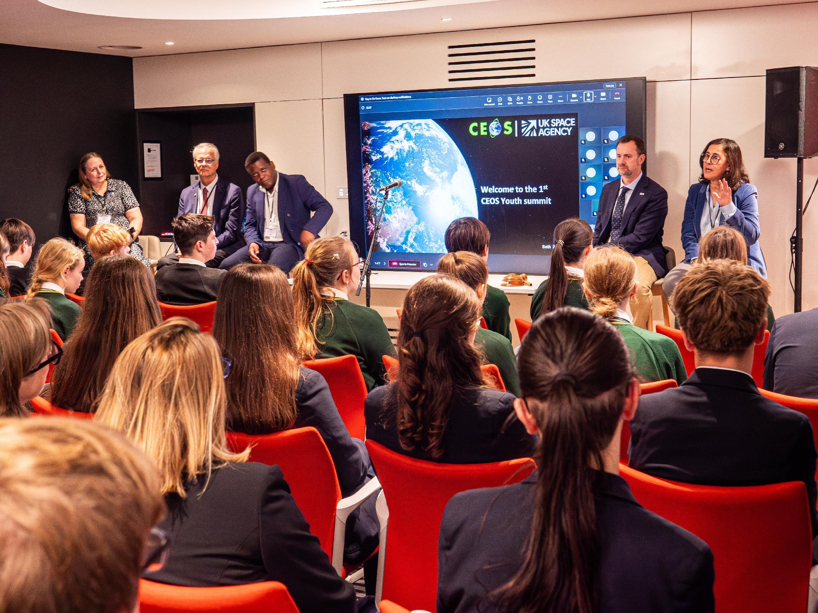
Second CEOS Youth summit
Australia will host the 2026 CEOS Plenary and Youth summit in Hobart in November
Posters will be on display, students will be able to talk about their posters with the CEOS participants
International students will present their submissions via pre-recorded videos that will be displayed during the youth summit
Q&A panel session with students and CEOS leads
Q&A panel session in Bath in 2025

