Slide 1
International Coordination Group for Spaceborne SAR
Report to CEOS SIT-41
Paul Rosen, NASA/JPL
CEOS SIT-41
Irvine, CA
14-15 April, 2026

Slide 2
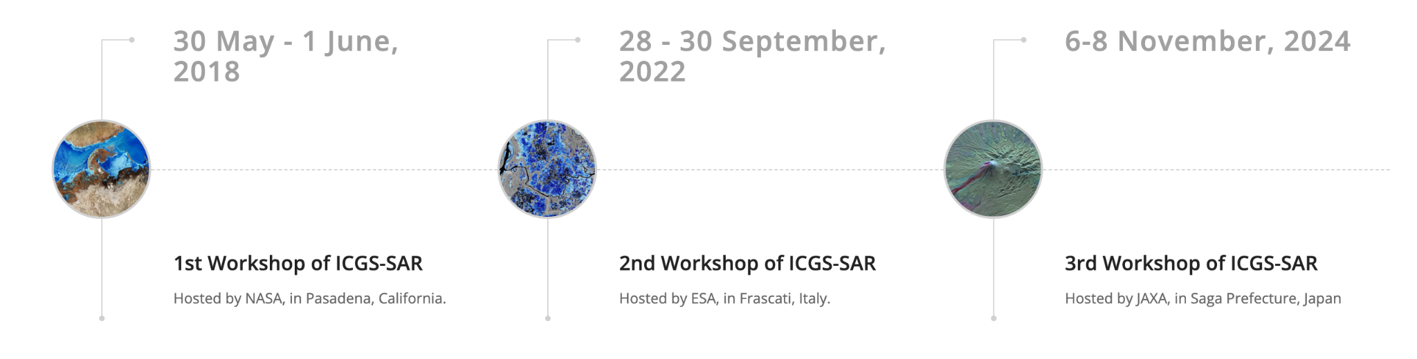
ICGS-SAR Overview
Closer coordination and collaboration for SAR missions can significantly enhance the overall utility of the present and planned systems for the benefit of all
In 2018, a group of space agencies began community-wide discussions on ways to improve the international coordination of SAR missions to maximum science and societal returns.

Slide 3
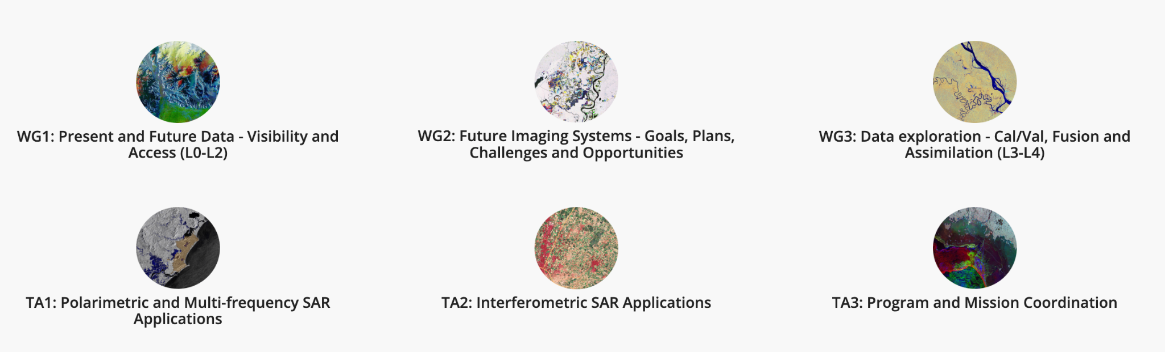
ICGS-SAR Overview
More information: https://intl-sar-coord-group.space/

Slide 4


ICGS-SAR Overview
Participating CEOS Agencies:

Slide 5
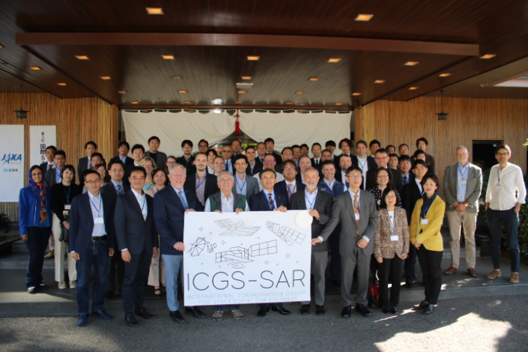
Workshop #3: Japan, November 2024
Developed a series of recommendations to be considered by Space Agencies in future SAR Activities
Available here*: Recommendations Intl SAR Workshop Nov 2024
Separated into three main groups:
Data access and tasking
Future mission coordination
Science and applications research enhancement
* https://intl-sar-coord-group.space/wp-content/uploads/2025/04/ICGS-SAR-WS3_-Recommendations-v1.1.pdf

Slide 6
Workshop #4: October/November 2027
Cadence for Workshops has been every 3 years (originally dictated by COVID)
WGs and TAs meet virtually in between
Cadence can be modified as needed
Possible locations for Workshop #4: Germany or US (TBD)

Slide 7
Need for SAR-specific coordination
The recommendations from Workshop #3 illustrate the need for SAR-specific agency-level coordination
Though some could be generalized to all sensor types, unique SAR capabilities often change the nature of the coordination; e.g.
1b: Disaster response for SAR generally does not need to consider illumination conditions or weather
1d: Interoperability of cloud data systems is best coordinated if products are of a similar nature; SAR missions tend to focus on sensor products (complex images, polarimetric covariances, interferograms) rather than bio/geophysical products.
1f: Observations of polar regions as previously coordinated by the WMO Polar Space Tasking Group only addressed SAR systems which can produce interferograms

Slide 8
Need for SAR-specific coordination (cont.)
2a: Companion Satellites coordination are particular to the techniques and technology of SAR
2c: Cross-validation of agency mission planning tools is SAR specific due to unique imaging scenarios and modes as well as SAR-specific metrics such as surface displacement
3d: 3d-InSAR coordination is clearly specific and unique to SAR
3h: Coordinated commercial X-band SAR data buy is of limited interest outside the SAR community

Slide 9
ICGS-SAR -> CEOS SAR Virtual Constellation
The group is currently informal, however international coordination for SAR missions is important to maximize societal benefit
Preliminary exploration of the options to become integrated with CEOS as a Virtual Constellation was promising
Terms of Reference/purpose of VCs generally match well the ICGS Charter
Better coordination with other activities (LSI-VC, CEOS-ARD, WGDisasters, etc.)
Formalisation of activities within the CEOS Work Plan
Ensure continuity of the activities beyond the engagement of individuals
Principal concerns expressed by some
SAR is sensor specific but existing VCs are thematic (land, ocean, etc.), leading to potential overlap in purpose with respect to sensor-specific coordination
E.g. LSI-VC subgroups rely on coordinated SAR observations also
ICGS-SAR is currently flexible and lightweight, with self-imposed reporting requirements; CEOS may change that
Limited progress in 2025 due to NASA/JPL funding turmoil, NISAR launch, leadership issues, all of which have been resolved

Slide 10
What are the Pros of joining CEOS?
Terms of Reference and Implementation Plan will clarify understanding of the group’s role and objectives
Including with respect to the commercial providers
The work would be included in the annual CEOS Work Plan - which is reviewed and approved by CEOS Principals
Place for recommendations to be implemented
Helping ensure the necessary resources are provided by agencies to conduct high priority activities
Addressing the fundamental concern of efficiency from CEOS Principals
Coordination and engagement with other CEOS groups (via meetings, leadership, etc.)
e.g. WGDisasters, WGCV SAR Subgroup, ARD Oversight Group, Ocean Surface Vector Winds VC, etc.
Reducing duplication of work, and leaning on others’ expertise
Continuity beyond the engagement of individuals
CEOS System Engineering Office resources: Communications, Analytics Lab, etc.

Slide 11
What are the Cons/overheads?
Leadership continuity needs to be assured with at least two agencies agreeing to be nominated as co-leads at any given time
Reporting and participation overhead as a CEOS VC, including as needed at SIT (March-April), SIT Technical Workshop (September-October) and/or Plenary (October-November)
Usually when there is something to be endorsed / discussed / proposed
Co-leads catch up once or twice a year on calls with the SIT Chair Team
Reporting to CEOS Secretariat once or twice a year
Provide inputs to the CEOS Work Plan (annually, January-February timeframe)
Support requests from other CEOS groups as they arise (cross-coordination of activities)
CEOS doesn’t necessarily bring any new resources or capacity

Slide 12
What would change about the group?
Not much has to change!
2-3 identified co-leads as POCs for the group
Someone affiliated with a CEOS Member or Associate
Can still rotate workshop hosts as you like
Re-name the WGs to ‘subgroups’
Maybe consider a reorganisation of the current WGs & TAs
The group should coordinate with WGCV SAR Subgroup - perhaps with occasional joint/back-to-back meetings/sessions (as atmospheric composition does)
Probably bring CEOS-ARD SAR work under the new group
Meeting schedule / format does not have to change - up to the group on how they organise that

Slide 13
Does ICGS-SAR meet the requirements to be a VC?
DEFINITION: A CEOS Virtual Constellation is a set of space and ground segment capabilities operating together in a coordinated manner, in effect a virtual system that overlaps in coverage in order to meet a combined and common set of Earth observation requirements. The individual satellites and ground segments can belong to a single or multiple owners. The Constellation concept builds upon or serves to refocus already existing projects and activities. The Virtual Constellations (hereinafter referred to as Constellations) effort provides a unique forum to achieve political visibility and increase mutual benefit among space and other environmental agencies in support of crosscutting GEO Activities. In particular, it offers opportunities to share experience in the development of algorithms; standardize data products and formats; exchange information regarding the calibration and validation of measurements; facilitate timely exchange of and access to data products from existing and planned missions; and facilitate planning of new missions— ranging from coordinating orbits to optimizing observational coverage to sharing implementation of mission components. The interim goal of a Constellation is to demonstrate the value of a collaborative partnership in addressing a key observational gap; the end goal is to sustain the routine collection of critical observations. Implementation of Constellation activities is ultimately dependent on the coordination of formal agreements among participating agencies.
SAR-VC would fit into the category of “Multiple-property/domain-based with multiple measurement techniques” - same as Land Surface Imaging
And why not a Working Group?
Working groups are a much bigger lift in terms of leadership overhead
More strenuous proposal process
Reporting requirements are a bit heavier than for a VC
ICGS-SAR would probably meet the requirements to be a WG, but it would be overkill

Slide 14
Takeaways from April 14 Side Meeting
There was general consensus that ICGS-SAR makes senses as a CEOS entity
ICGS-SAR is flexible to adapt or evolve its subgroups
There is interest in integrating/synergizing with existing WGCV SAR subgroup
There is interest in exploring linkages and conducting co-meetings with LSI-VC, WGDisasters, and other application groups as well (e.g. COAST)
It is recognized that co-meetings are important
Terms of reference have been drafted, ready for review

Slide 15
Next Steps
As per VC Process Paper:
Initial proposal presented today
Request approval to proceed to full proposal for SAR-VC to be presented at CEOS Plenary 2026

Slide 16
Backup: Recommendations from WS #3

Slide 17
Recommendation 1b
Agencies should explore establishing automated disaster monitoring tasking and data sharing on Web GIS systems and coordinate with existing international frameworks such as the International Disaster Charter (International Charter Space and Major Disasters) and Sentinel Asia. Agencies should advocate for the automation of tasking requests following activation of the International framework, as well as consider automated or facilitated tasking for forecasted disasters (e.g. typhoons). Low latency data products (<=1 hr, SLC, L1 or higher) need to be provided to ensure the appropriate response to a disaster management.

Slide 18
Recommendation 1d
Agencies should consider the interoperability of their cloud systems by using APIs, standard metadata (STAC, YAML, etc.) and data formats, such that multi-mission data analysis is streamlined.

Slide 19
Recommendation 1f
Observations for the polar regions (Greenland, Arctic sea ice, and Antarctica) should be coordinated to maximize science and applications needs with right-, left-, and multi-looking missions (i.e. Sentinel-1, NISAR, and ALOS-2/4) while filling polar observational gaps. Agencies should support and propose membership for the evolution/re-establishment of WMO's Polar Space Task Group (PSTG).

Slide 20
Recommendation 2a
To improve digital elevation models and 4D change observations, future SAR missions (of any band) should consider companion satellites, passive or active, such as Harmony for Sentinel-1.

Slide 21
Recommendation 2c
Agencies should cross-validate agency mission planning tools with other agencies, to ensure optimal mission plans, aligned with the observation requirements from Thematic Areas 1 & 2.

Slide 22
Recommendation 3d
Agencies should consider establishing an activity similar to the CEOS LSI-VC POLINSAR task for 3D-InSAR to coordinate imaging geometry diversity at regional sites worldwide.

Slide 23
Recommendation 3h
Commercial VHR X-band SAR missions have a potential complementary role to play to public medium-resolution SAR missions through their capacity for targeted observations at high spatial and temporal resolution. However, dedicated observation scheduling is imperative to make the data useful. Agencies considering governmental data purchases for science (e.g. NASA CSDA, ESA EDAP) are recommended to consider tasking rights a requirement for procurement.

Slide 24
Recommendation 4a
Agencies should continue to advocate to their national frequency authorities for protection of the radar band (X-, C-, S-, L-, P-band) allocations for use for Earth observation, and not be used by the telecommunication sector looking for additional spectrum, to ensure the missions can continue to operate. Commercial companies should also advocate for this.

