Slide 1
Water Quality Workshop #1 Outcomes
Remote Sensing of Water Quality: Requirements for Comprehensive Catchment-to-Coast Observation
CEOS SIT-41 2026 | Irvine, California, USA
14-16 April 2026
Item 5.1
Alex Held, CSIRO, CEOS Chair

Slide 2
AGENDA
Time | Session
9:50–10:30 | Welcome, context, goals and introductions
10:30–11:20 | 1: User Driven Design for supporting impact and value for water quality
11:20–11:30 | Morning Tea
11.30–12.30 | 2: Critical EO variables for water quality
12.30-13:00 | 3: Products, ARD, access & services: initial product gap analysis
13:00–13:40 | Lunch
13:40–14:45 | 4: Current CEOS satellite missions for catchment-to-coast water quality modelling.
14:45–15:45 | 5: Prioritization & commitments next steps
15:45–16:00 | 6. Wrap up

Slide 3
Background & Purpose
Challenge: Rising demands, extreme weather (droughts/floods), and contamination threaten freshwater and nearshore coastal ecosystems, jeopardizing up to 3 billion people globally.
Potential: Integrating satellite data, field data, and models offers powerful tools for tracking water quality, monitoring ecosystems, and identifying risks. This integration is essential to connect upstream events to downstream coastal impacts and transform this science into actionable early-warning forecasts.
Gap: Terrestrial hydrology, inland water quality, and coastal oceanography are often siloed. Furthermore, significant barriers remain in translating complex EO data into accessible, actionable insights that decision-makers and managers need and can actually use.
Action: Two 2026 CEOS Workshops will unite CEOS agencies, experts, and partners to identify key EO data needs to improve water resources management across the catchment-to-coast continuum.
Notes:
This work acknowledges that CEOS agencies support the development of accessible, actionable insights for water quality that decision-makers and water managers need and can actually use

Slide 4
Goals
Primary Aim: Overcome translation barriers by advancing the use of EO data to deliver actionable insights that inform water quality management, hazard mitigation, sustainable land use, and seafood safety.
Holistic Approach: Bridge existing scientific silos by strengthening data and modeling linkages across the entire inland freshwater-to-coastal continuum.
Critical Scientific Priority: Improve the modeling of upstream-to-downstream water quality impacts (such as post-hazard sedimentation, saltwater intrusion, HABs, and plumes) to support better local management.
Global Need: Identify critical observational and interoperability gaps to ensure satellite data translates into practical, proactive solutions for community well-being and water resilience.

Slide 5
Key Objectives
Coordinate a Systems Approach: Map specific gaps in existing EO products, data coverage, predictive capabilities, and interoperability across ecosystems to set collaborative priorities for CEOS.
Facilitate Collaboration: Align CEOS agencies, commercial partners, and end-users to collectively prioritize EO product development, data quality, and scale efforts.
Overcome Translation Barriers: Identify solutions for technical, scalability, and data accessibility limitations to enabling real-time water quality monitoring.
Empower Decision-Makers: Define concrete pathways to transform complex EO data into actionable, proactive tools early warning, adaptation management, and innovation.

Slide 6
KEY WORKSHOP HIGHLIGHTS
PARTICIPANT STATS:
In person and virtual participants 45, intentionally mainly from CEOS agencies, with a few key external SME guests invited.
HIGHLIGHTS:
  The workshop balanced informative content with open discussion to work towards the workshop’s objectives. Representation of excellent Chair and SIT team collaboration.
  Recognition of the catchment to coast complexity, and the importance of interoperability, cooperation and inclusive partnerships .
  Important focus on end user needs to ensure that robust science can support informed/evidence based decision making.
  Recognition of potential complementarity and linkages to other CEOS work, including (but not limited to), Aquatic Carbon Roadmap and Biodiversity-VC , COAST-VC, CEOS Analytics Lab, LSIVC and WGISS , and SIT-Chair themes.
  Eagerness to progress to the next phase and workshop 2, which will include participant representations from different stakeholder groups.

Slide 7
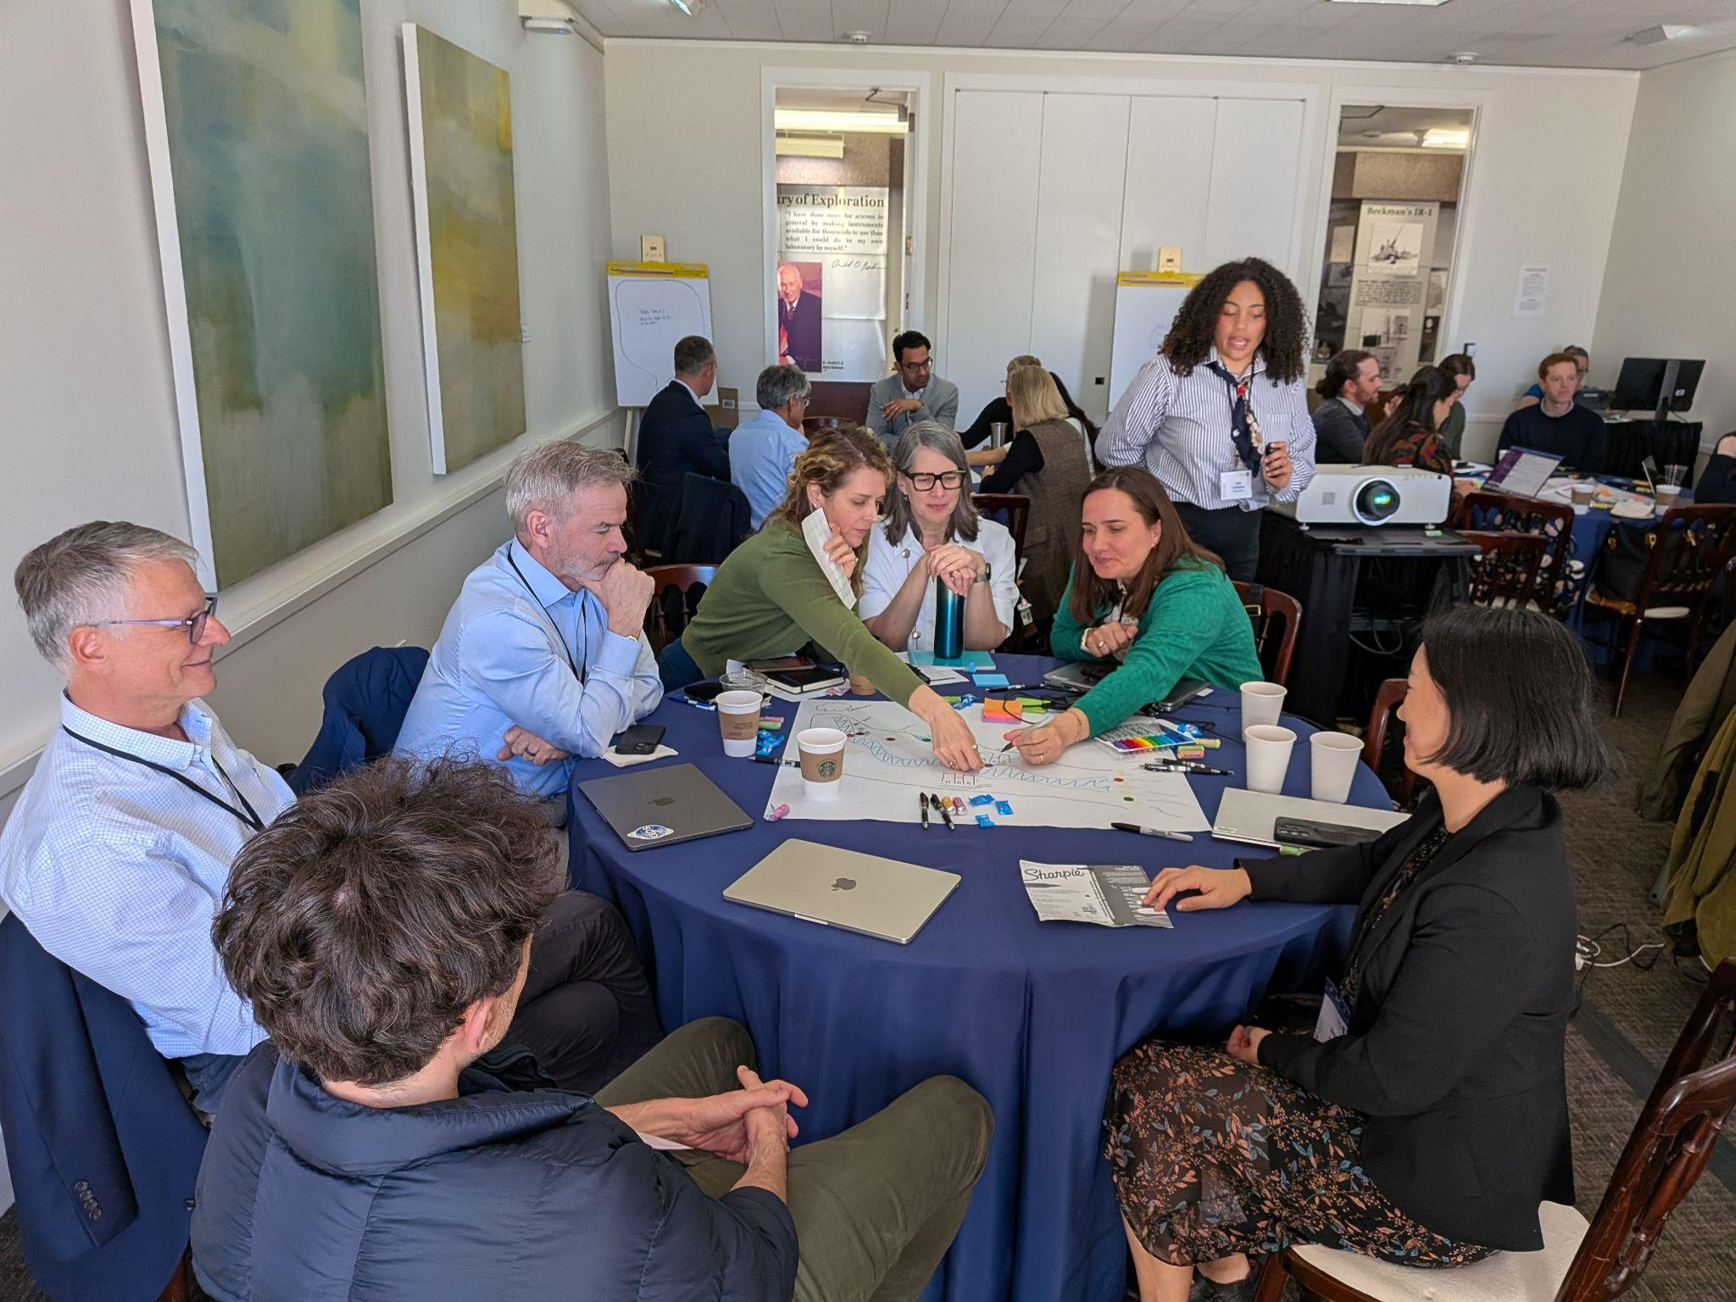
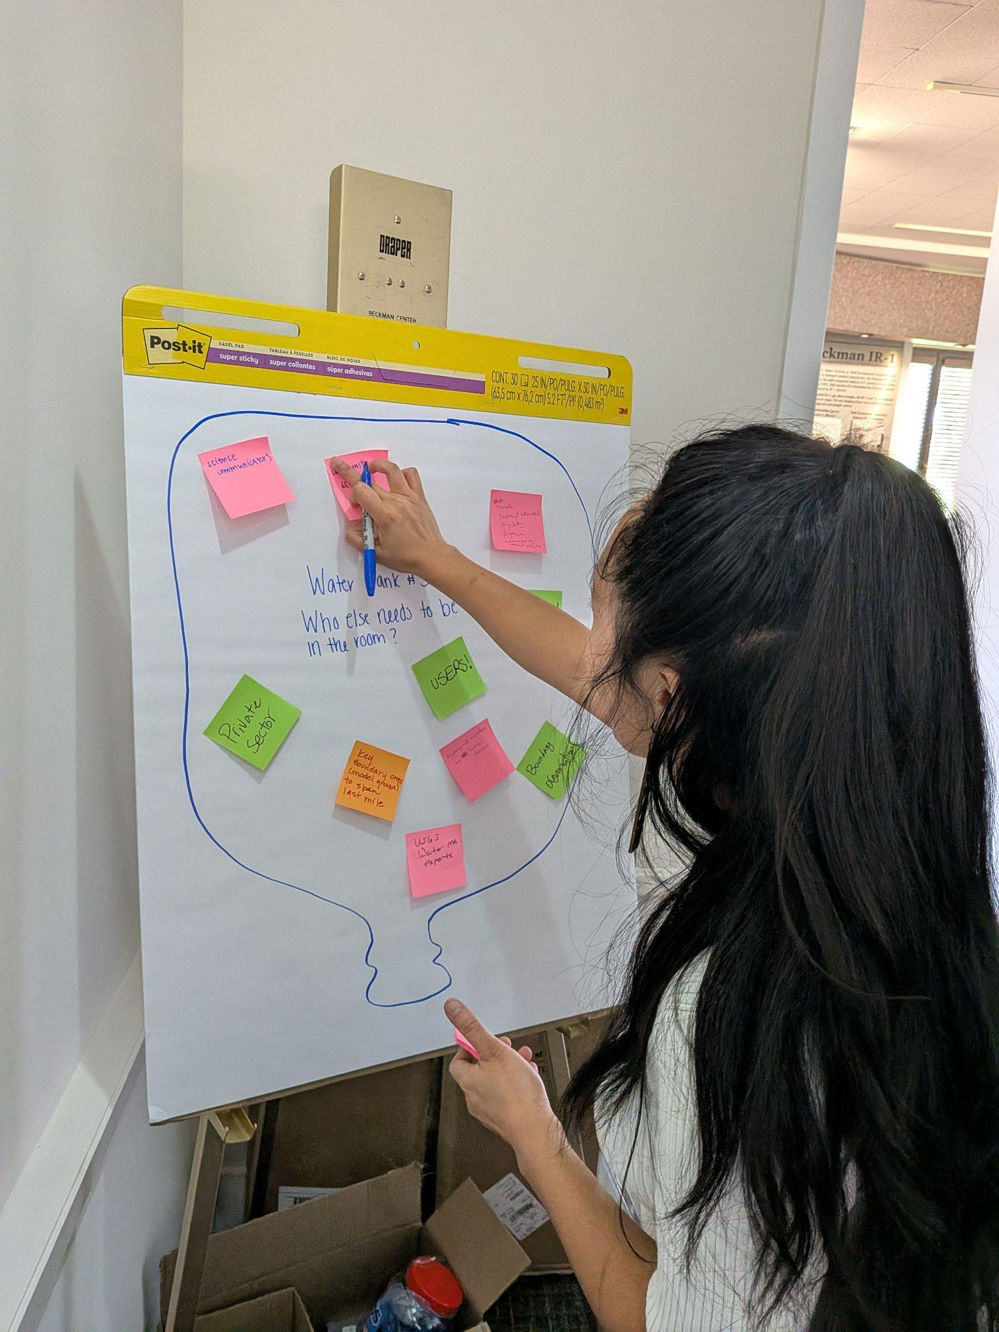
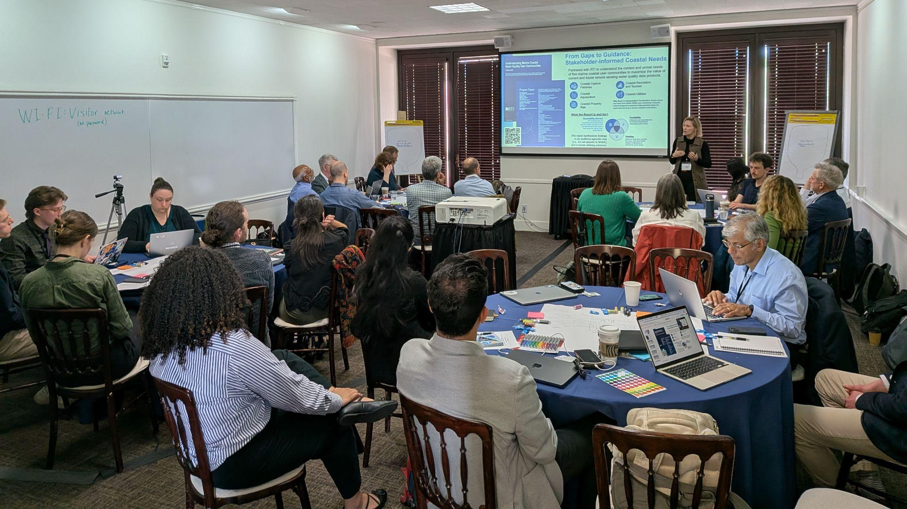
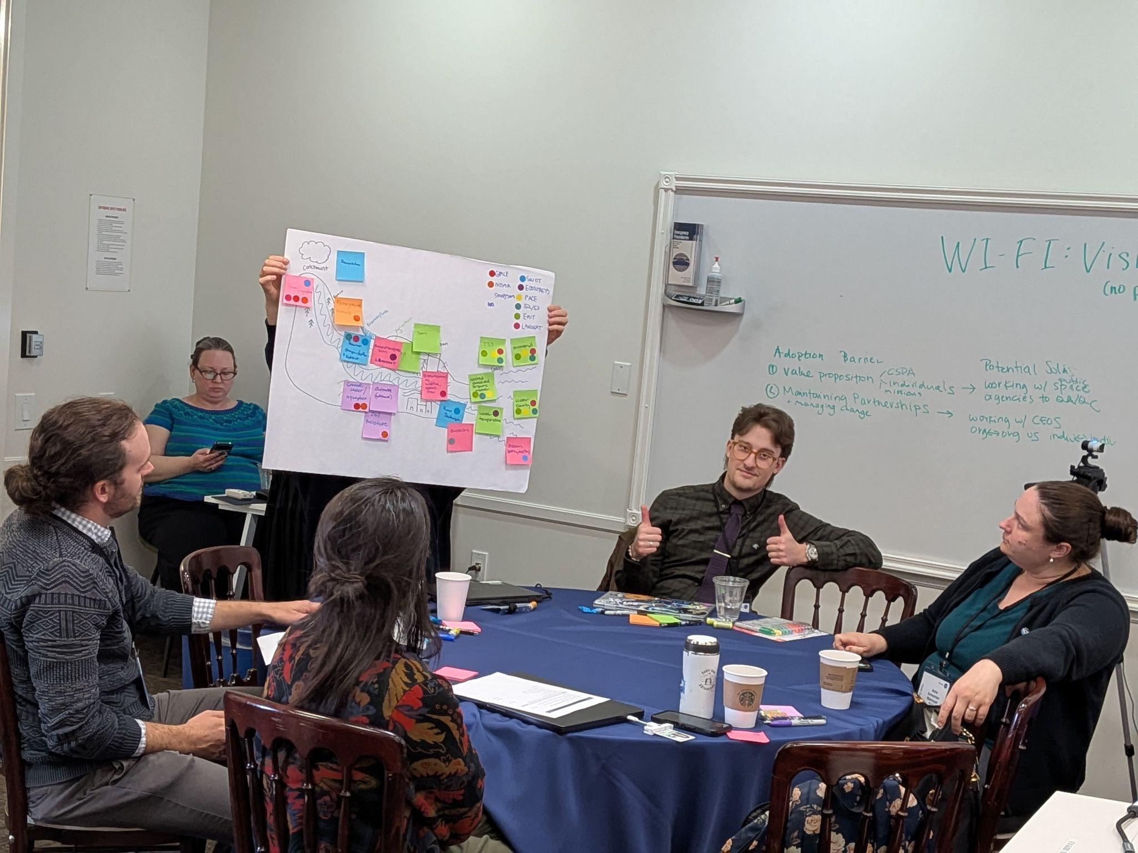
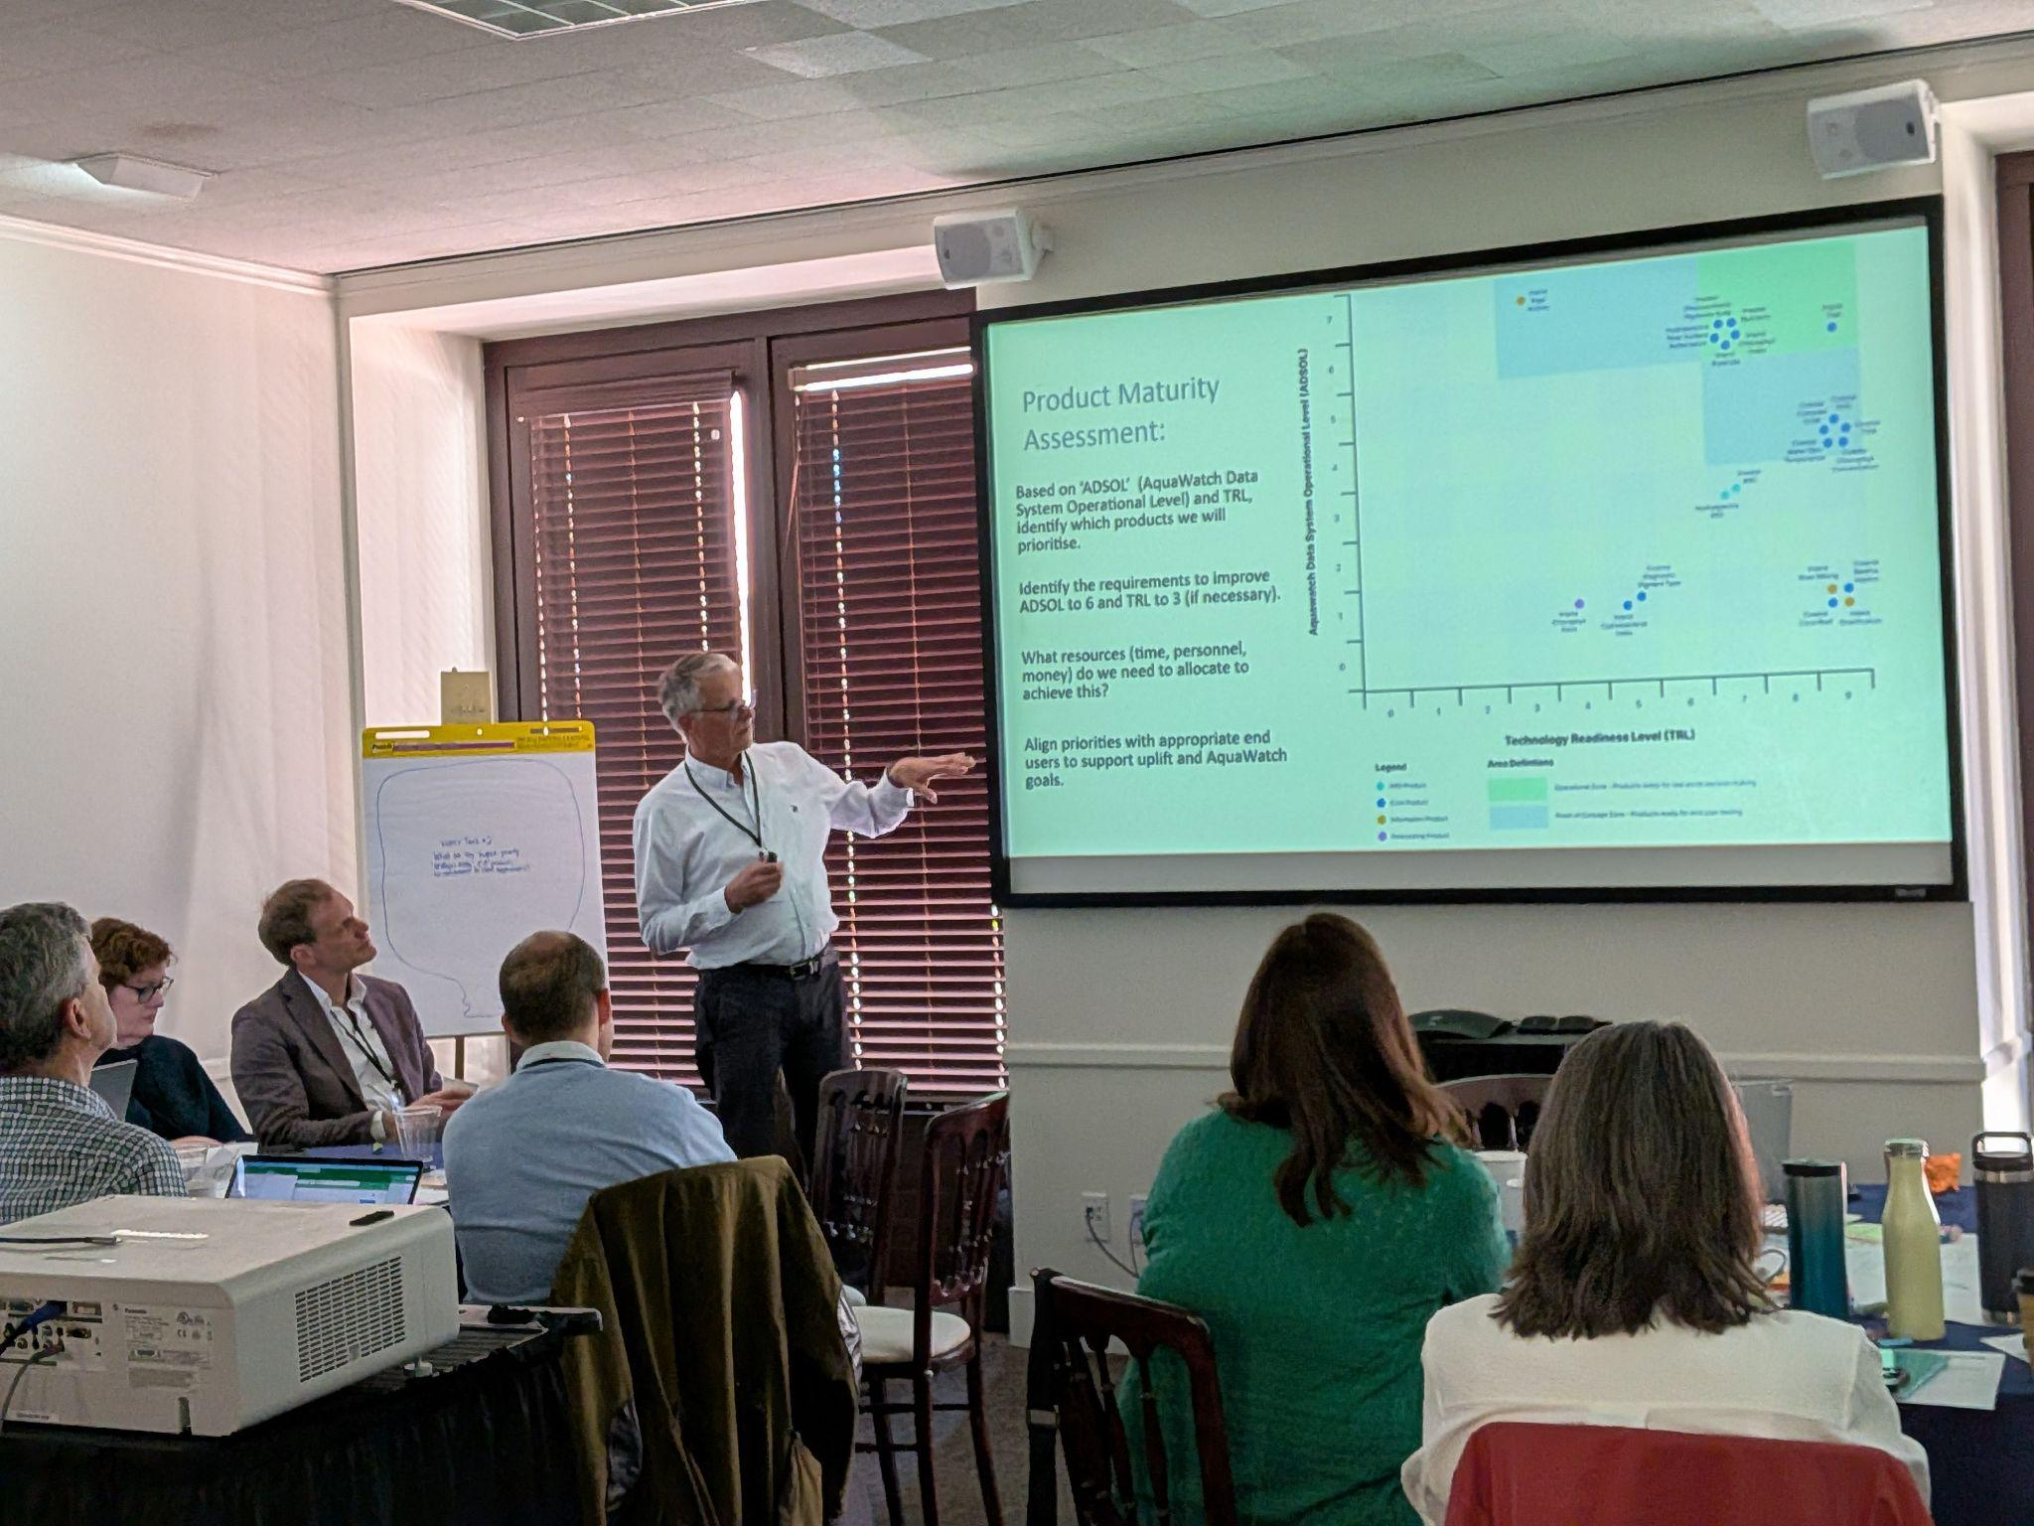
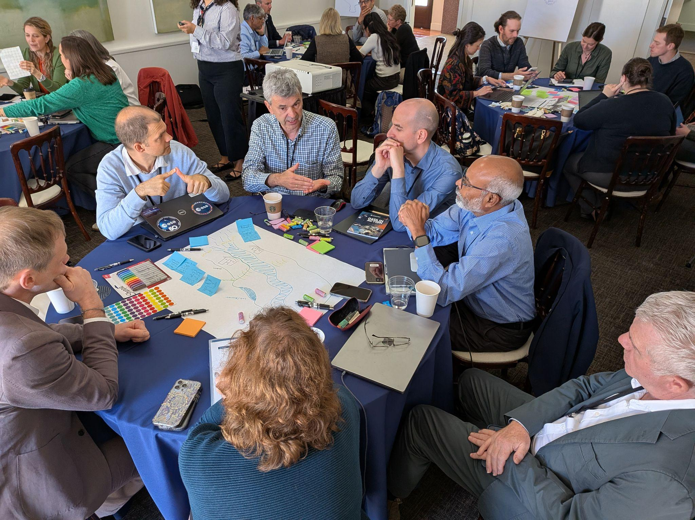

Slide 8
NEXT STEPS:
Consolidation of Workshop Findings into a post-workshop report
Seeking participant feedback and further input to inform Workshop 2
Commence planning for September 2026 workshop to be held in Washington
Begin White Paper development

Slide 9
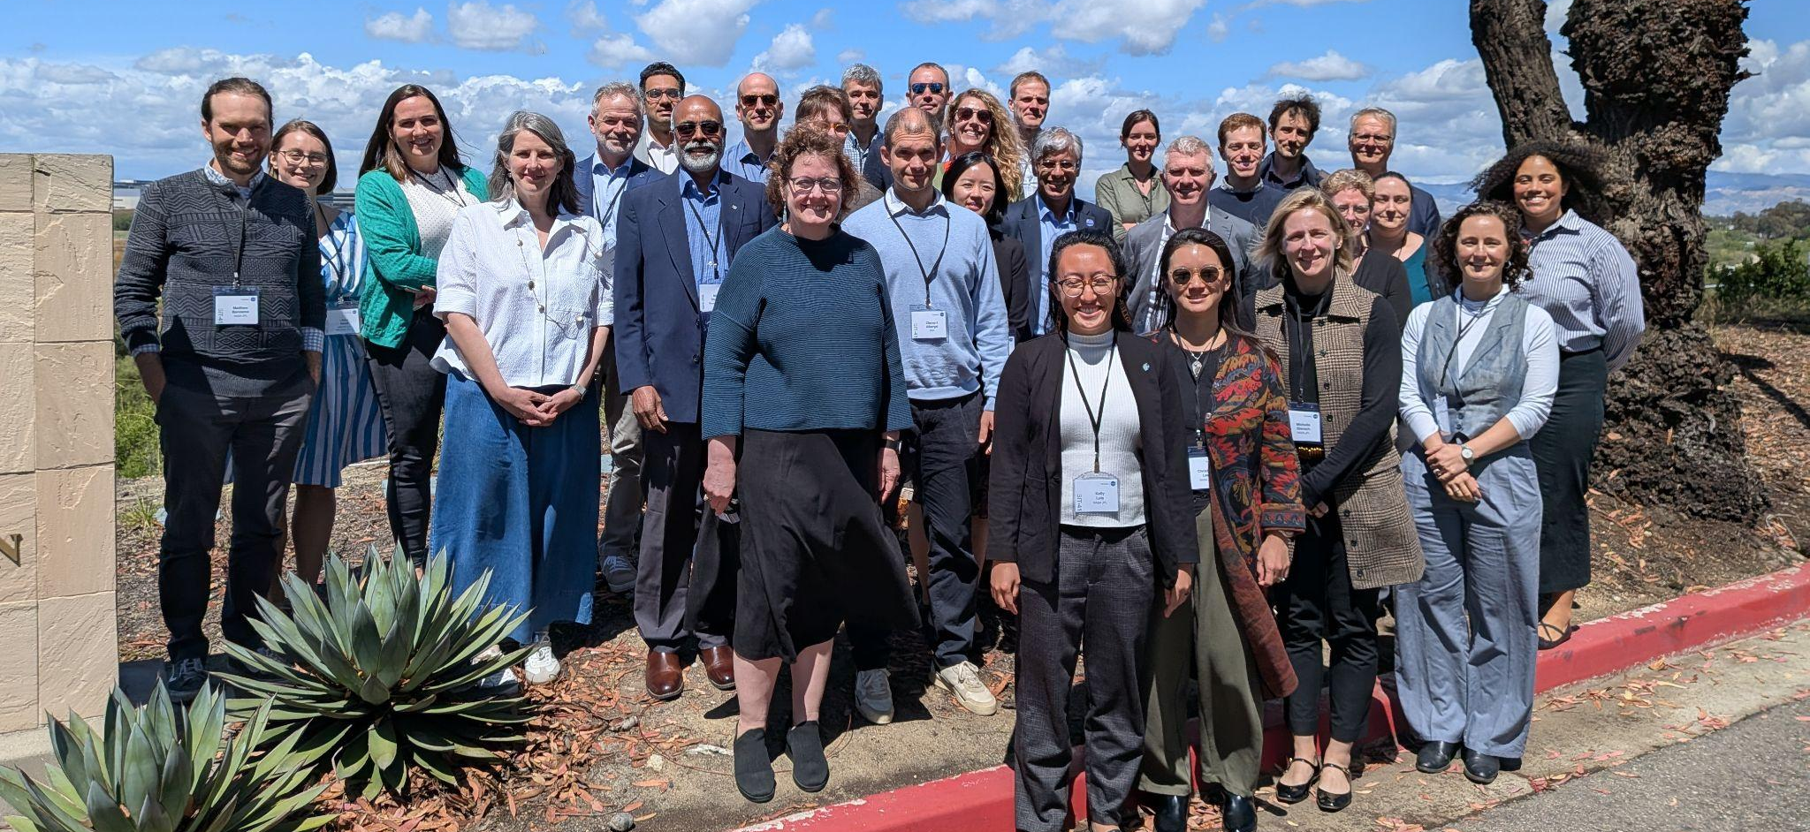
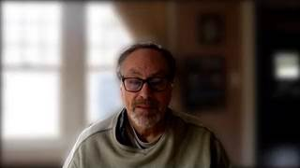
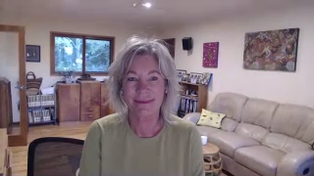
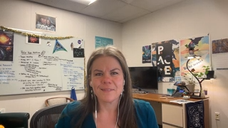
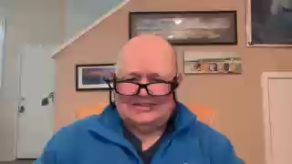

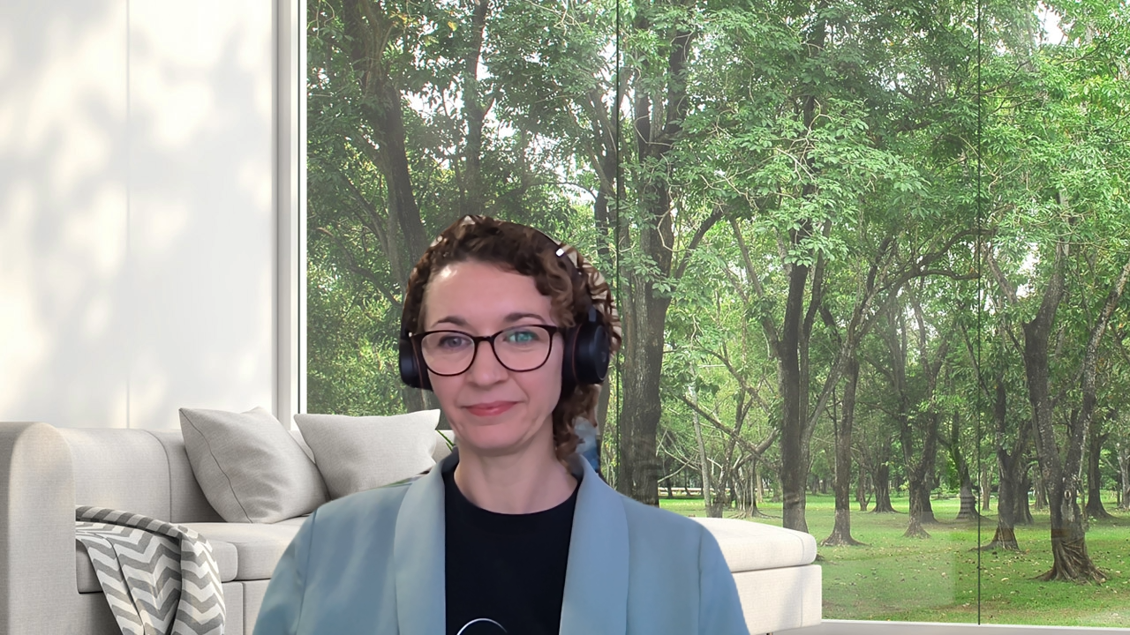
GROUP PHOTO

