Slide 1
CEOS SIT-41
April 2026
SIT Chair Water Planet Activities
Erin Urquhart, NASA
David Borges, NASA
Agenda Item 5.2
CEOS SIT-41 2026
Irvine, California, USA
14-16 April 2026

Slide 2
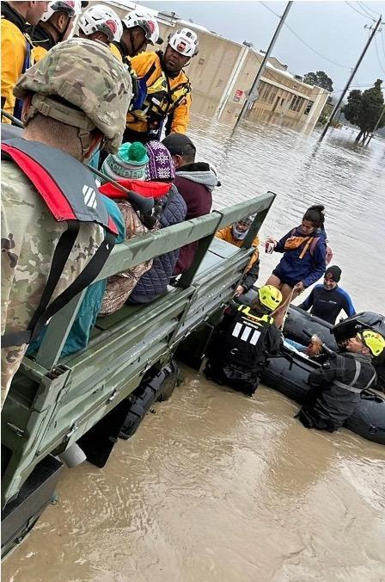

NASA SIT Chair Priorities
Priority 1: Water Planet- Seeing Earth's Water from Space
Advance understanding of Earth's water cycle by monitoring terrestrial waters, coastal regions, and oceans from space. Transform this knowledge to actionable insights to enhance water use efficiency, improve water quality, and enhance resilience to water-related hazards such as droughts, floods, and storms.

Slide 3
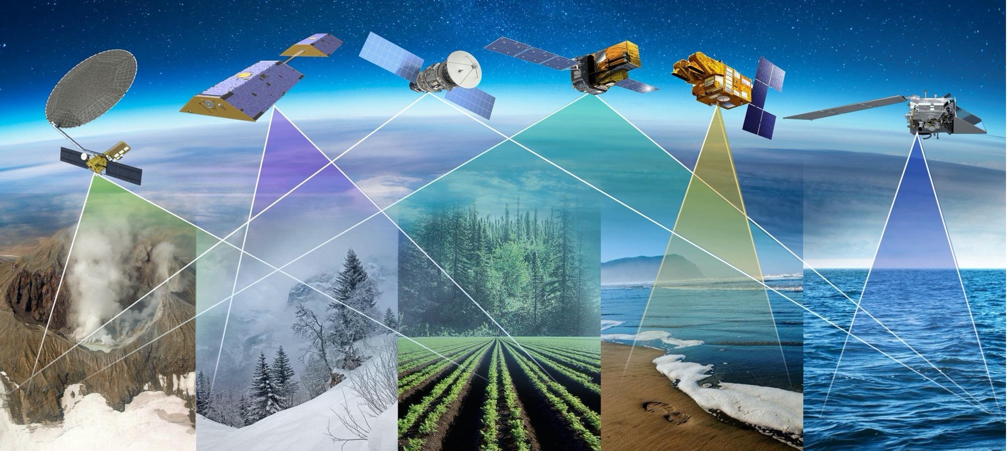
Priority 1: Key Objectives
Coordinated Water Observations
Accessible and Interoperable Water Data Products
User-Center Solutions for Water Challenges
Assessment of Benefits & Impact

Slide 4
Priority 1: Deliverables Timeline
Seeing Earth’s Water from Space
Plenary
2025
SIT-41
SIT TW
2026
Plenary
2026
SIT-42
SIT TW
2027
Plenary
2027
Objectives
Coordinated Water Observations
Gap analysis of water variables
Best practice guidance for integrating multispectral (optical + SAR) data for water
Coordinate and promote multisource integrated water products
Accessible & Interoperable Water Data Products
Define application specific requirements for water variables
CEOS-ARD Self Assessments
CEOS-ARD for Water
Encourage and contribute CEOS ARD Water products related to water resources & quality
Align and promote user-driven tools for water management and resilience
User-centered Solutions for Water Challenges
Water Quality Workshop Series
Advancing EO data for water resources solutions (TBD)
Assess data needs for water resources / water quality management
Assess Impact & Benefits
Impact assessment of existing CEOS activities related to water/resilience (w/ Priority 2)
Use cases on the benefits of EO for water

Slide 5
CEOS SIT-41 Best Practice Guidance for Integrating Multiplatform & Multispectral Data for Water Science and Applications
Erin Urquhart, NASA
Agenda Item 5.2
CEOS SIT-41 2026
Irvine, California, USA
14-16 April 2026

Slide 6


Background & Context
2015 Strategy for Water Observations from Space
The Observation Landscape Changed
Strategy Recommendations: Provided 22 recommendations covering satellite acquisition, in-situ networks, research, data sharing, and capacity development Focus:
Strong on data acquisition, sharing, and standards with a primary audience of CEOS member organizations
Gap: No unified, user/practitioner-facing guidance on how to combine optical and SAR data for water applications nor the increased operational value of integration for decision-making purposes and impact.
Sentinel-1/2 Global SAR + optical baseline (2014–)
SMAP Global soil moisture, operational (2015) GRACE-FO Groundwater/storage monitoring (2018)
IceSat-2 Ice sheet height changes (2018)
SWOT Global surface water elevation (2022) PACE Hyperspectral ocean color & water quality (2024) OPERA DSWx Operational SAR water product (2024)
ALOS-4 L-band SAR; land deformation/subsidence (2024)
NISAR L-band SAR; soil moisture, SWE (2025)
Commercial/Smallsat Various
Examples of new water-relevant missions since 2015 from across the Earth observing system (list not exhaustive)
Opportunity: There has been an explosion in water-relevant Earth observations across the intergovernmental and private space since 2015. The resulting data is larger than ever and spans multiple formats and specifications. Therefore, there's a critical need for updated guidance on combining, processing, and applying these data to water management needs. This document aims to fill that gap—providing practitioners with use cases and best practices for optimally combining these sensors to significantly advance water science and decision-making impact.

Slide 7

Purpose & Scope
What This Document Is
What It Is Not
Who It Serves
A community-driven best practice guide for combining optical, SAR, passive microwave, and gravity satellite data to derive water variables, with a strong emphasis on decision-making impact, not just methods.
A living document hosted on GitHub which can be updated as missions evolve, contributable by all CEOS agencies.
This document reflects established data frameworks but is not prescriptive of any specific methodology.
Not a comprehensive review of every possible sensor or application.
Not intended to be a rewrite of the 2015 CEOS Strategy for Water Observations from Space. Instead, it builds on it with an integration and decision-making first lens.
Scientists and practitioners already working with satellite data who need step-by-step guidance on multi-sensor/ spectral integration.
CEOS entities seeking a shared integration guidance for science innovation and applications impact.
Researchers writing proposals who need to know what best practice looks like.

Slide 8

Audience
Scientists and practitioners
Researchers who are experienced in working with satellite data for water but need guidance on best practices for combining optical and SAR datasets for applications.
CEOS member agency scientists and programme managers
Seeking a shared guidance for how the community integrates water data across missions — especially relevant for agencies assessing CEOS-ARD compliance and planning future mission contributions.
Operational water managers and decision makers
The document is technical but use cases are framed to demonstrate actionable societal value: flood response, drought early warning, drinking water safety, food security.
Proposal writers and early-career researchers
Writing proposals for multi-mission water work — need to cite community-endorsed best practices and understand what the right approach looks like before designing a study.

Slide 9
Table of Contents
Best Practice Guidance for Integrating Multiplatform and Multispectral Data for Water Science & Applications
Executive Summary
Introduction
Overview of Satellite Data for Water
Societal Challenges and Multi-Sensor Integration Opportunities
Integration & Best Practices
In-situ Network and Cal/Val Adequacy
Summary Gap Table
Way Forward & References

Slide 10
Table of Contents
Executive Summary
Introduction
2. Overview of Satellite Data for Water
1.1 Background and context
1.2 Purpose and objectives
1.3 Scope — catchment-to-coast continuum
1.4 Audience
1.5 How to navigate this document
1.6 Relationship to CEOS-ARD 2026, 2015 CEOS Water Strategy, and other related efforts
1.7 CEOS-ARD standards and interoperability
2.1 Optical multispectral
2.2 Ocean color and hyperspectral
2.3 Thermal infrared
2.4 Synthetic Aperture Radar (SAR)
2.5 Passive microwave
2.6 Surface water and altimetry
2.7 Gravity and groundwater
2.8 CEOS-ARD standards and interoperability

Slide 11
Table of Contents
3. Societal Challenges and Multi-Sensor Integration Opportunities ​
Thematic Area A — Water Availability
Thematic Area B — Water Use
River Height, Lake and Reservoir Storage
Groundwater Dynamics / Water Table Height
Seasonal Water Supply from Mountain Snowpack
Water Availability for Agriculture, Irrigation Management, and Flood Forecasting
Industrial and Residential Use Crop Water Consumption and Agricultural Water Demand at Field Scale
Thematic Area C — Water Quality
Thematic Area D — Water Extremes
Harmful Algal Blooms in Inland and Coastal Waters
Sargassum Inundation Events Disrupting Fisheries and Coastal Economies
Water Quality Monitoring in Optically Complex Coastal Environments
Drinking Water Utilities
Wastewater plume monitoring/management
Drought—Multi-Variable Impact on Water Supply and Demand
Flood - Flood Inundation and Surface Water Mapping
Landslides
Wildland Fires

Slide 12

Use Cases
Each use case asks: Why does this water challenge require multiple sensors? What impact does integrated SAR + Optical provide? What are the pitfalls?
Post-Storm Water Supply & Quality
Drought Impact on Agriculture & Water Quality
River Floods & Coastal Water Quality
SAR + NISAR + PACE + SWOT
2024 Gulf Coast hurricanes Helene & Milton
GRACE-FO + SMAP + OPERA DSWx + PACE/CyAN
Drought-driven HAB intensification in reservoirs
SAR + SWOT discharge + PACE turbidity
Mississippi River flood pulses & Gulf hypoxia
Crop Health Monitoring & Food Security
Snow Water Supply & Security
Wildfire Impact Assessment
Sentinel-1 SAR + Sentinel-2/Landsat optical
Multi-freq SAR fusion: Sentinel-1 + NISAR + Airbus
Iowa, Michigan, Florida
NISAR + AMSR2 SWE validated at ASO sites
Sierra Nevada → Hindu Kush-Himalaya
Sentinel-1 SAR + Sentinel-2/Landsat optical
Canada

Slide 13
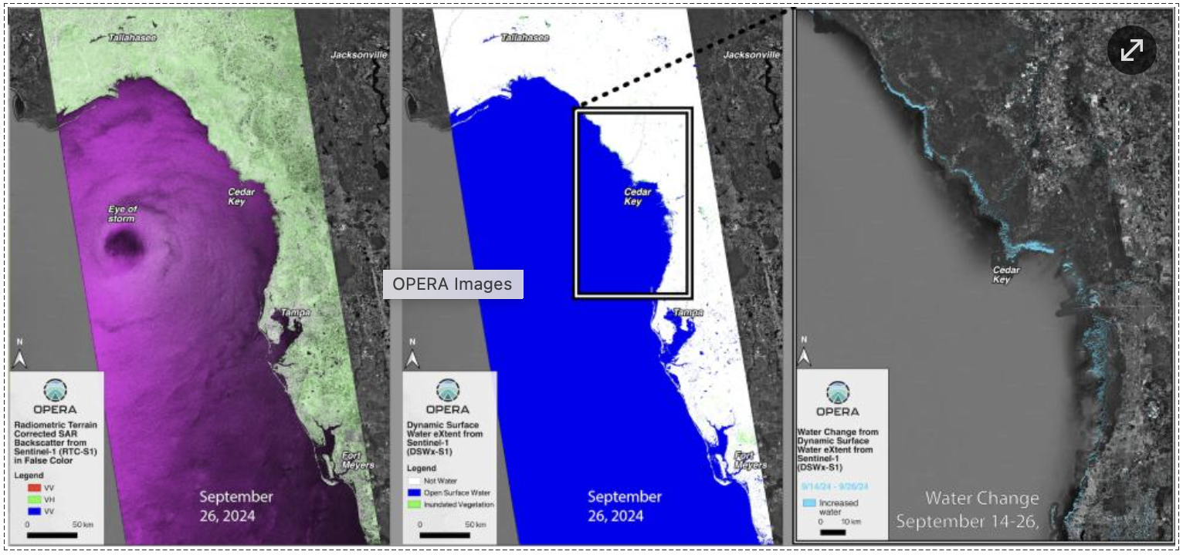
Use Cases: Post-Storm Water Supply & Quality
CHALLENGE
After major storms, decision-makers need to assess flood extent, water supply status, and contamination risk
Cloud cover blocks optical satellites for days and no single sensor provides all three
SAR sees through clouds but revisits only every 6–12 days — potentially missing peak flooding
Water quality assessment must wait until skies clear — no all-weather solution exists
SOLUTION
NISAR tracks soil saturation at high resolution to identify areas at risk of continued flooding
Commercial SAR (ICEYE, Capella) can improve temporal coverage but interoperability guidance is needed
SWOT monitors reservoir and river water levels to assess whether drinking water supply and flood control capacity have been compromised
PACE assesses water quality (sediment plumes, contamination, algal blooms) once clouds clear
Source: NASA JPL OPERA, PO.DAAC (podaac.jpl.nasa.gov). Credit: Alexander Handwerger
IMPACT
Complete post-storm water assessment — from flood extent to water supply to contamination — across the full disaster timeline
Enables faster, better-informed emergency response and recovery decisions

Slide 14
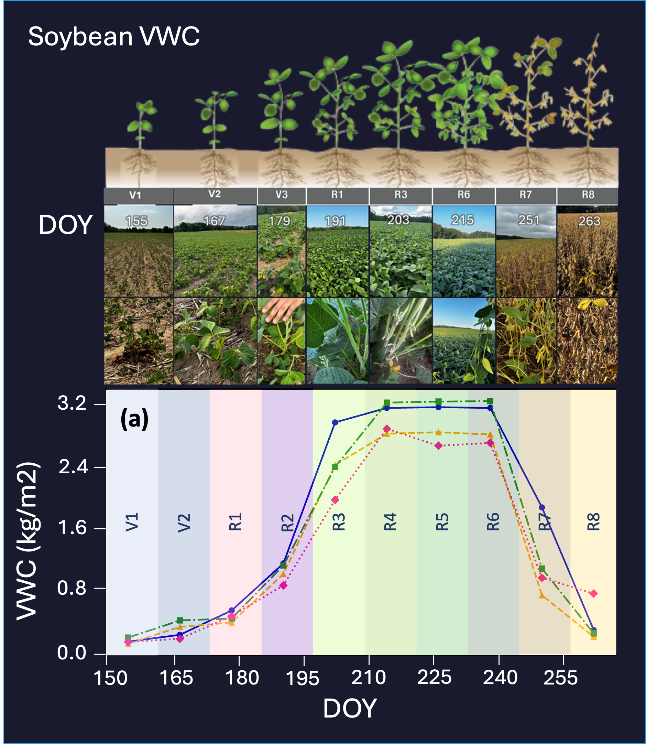
Use Cases: High-resolution Vegetation Water Content Estimation for Food Security
CHALLENGE
Farmers and food security agencies need timely crop water stress information for irrigation, harvest, and drought decisions
Optical sensors can't see through clouds
Optical lose accuracy in dense crops
Radar satellites pass over too infrequently to track rapid changes during the growing season
Without continuous monitoring, water stress goes undetected until yield losses are already locked in
Sentinel-1 revisit = 12 days — one observation per growth stage
SOLUTION
Multi-freq SAR fusion: Sentinel-1 (C-band) + NISAR (L-band) + Commercial SAR (X-band)
+ Sentinel-2/Landsat optical
Generative AI to synthesize intermediate imagery and fill SAR and optical temporal gaps
VWC time series: field measurements vs. AI model predictions across soybean growth stages (V1–R8)
IMPACT
All-weather, high-res (10-30 meter) and high-temporal (2-3 days) VWC maps across full crop growth cycle
Scalable to unseen regions with minimal field labels
Actionable crop monitoring for food security at continental scale

Slide 15
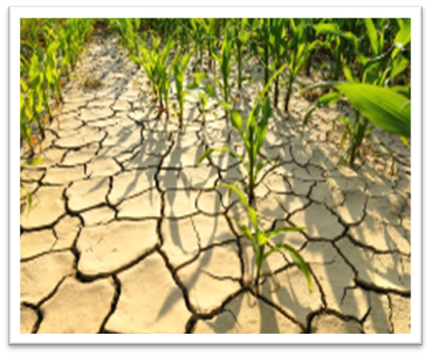
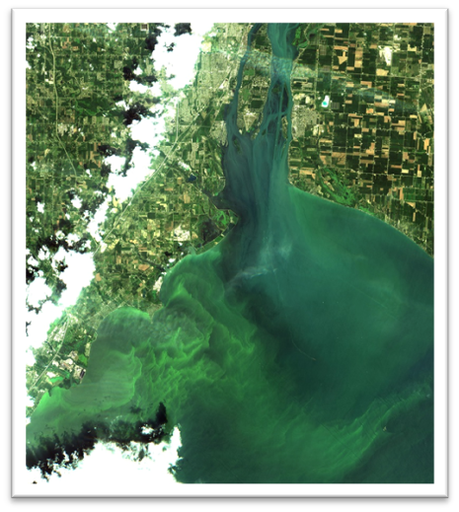
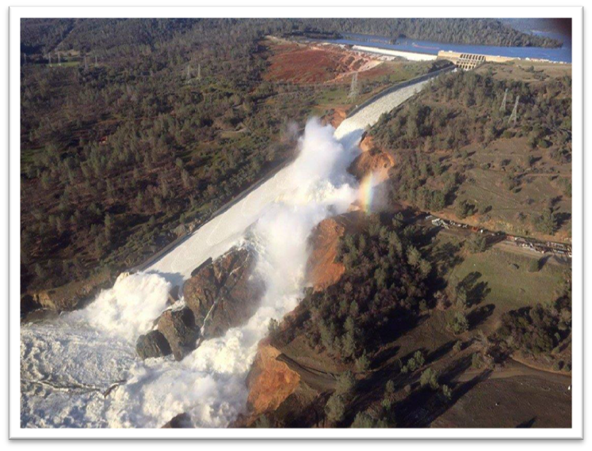
Table of Contents
4. Integration Protocols and Best Practices
Common best practice table (cross-variable)
CEOS-ARD interoperability
Inter-mission calibration
Machine learning and foundation models— when and how to use them
Uncertainty quantification and reporting
5. In-Situ Network and Cal/Val Adequacy
6. Summary Gap Table
7. Way Forward and References

Slide 16

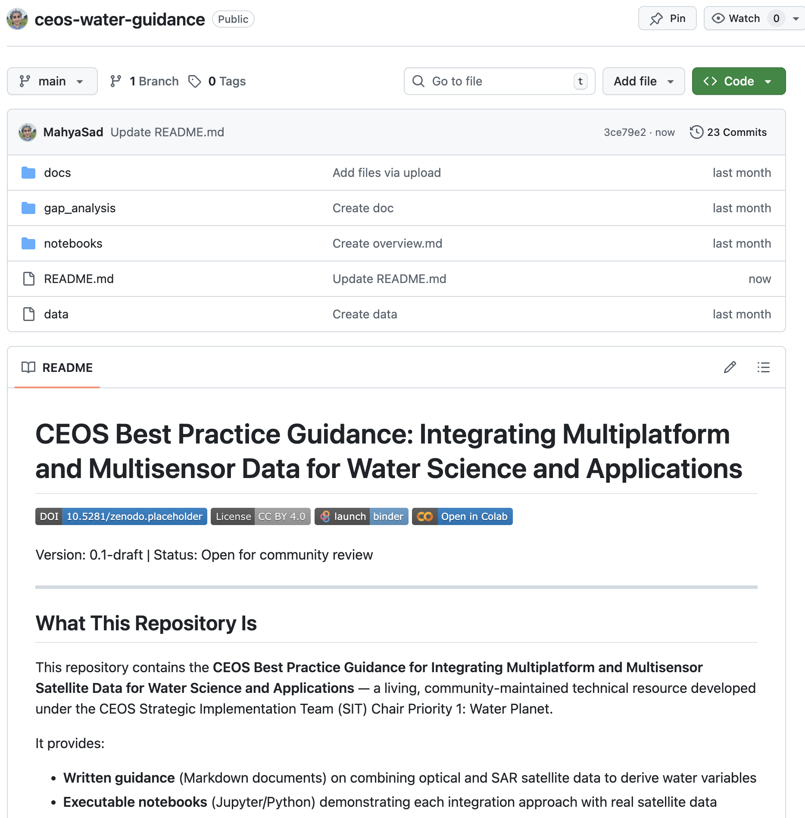

A Living, Open Resource
Our Best Practices Document will not just be a PDF — resources will be hosted on the CEOS GitHub with open-source code, reproducible notebooks, and community contributions welcome!

Slide 17
Next Steps
Next Steps
Finalize scope and table of contents based on CEOS SIT-41 feedback
Coordinate with CEOS-ARD for Water Thematic to ensure alignment
Target draft for review at 2026 SIT TW (September) and again at Plenary (November);
Final deliverable will be shared for endorsement at SIT-42
The CEOS ask…
Do CEOS principals agree with the strategic direction of guidance document (scope, audience, and objectives)?
We welcome CEOS entities to provide feedback and contribute to sections relevant to their missions and expertise
Contribution sought: use cases, datasets, code and/or successful integration examples

Slide 18
CEOS SIT-41 CEOS-ARD Water Thematic
David Borges, NASA
Agenda Item 5.2
CEOS SIT-41 2026
Irvine, California, USA
14-16 April 2026

Slide 19
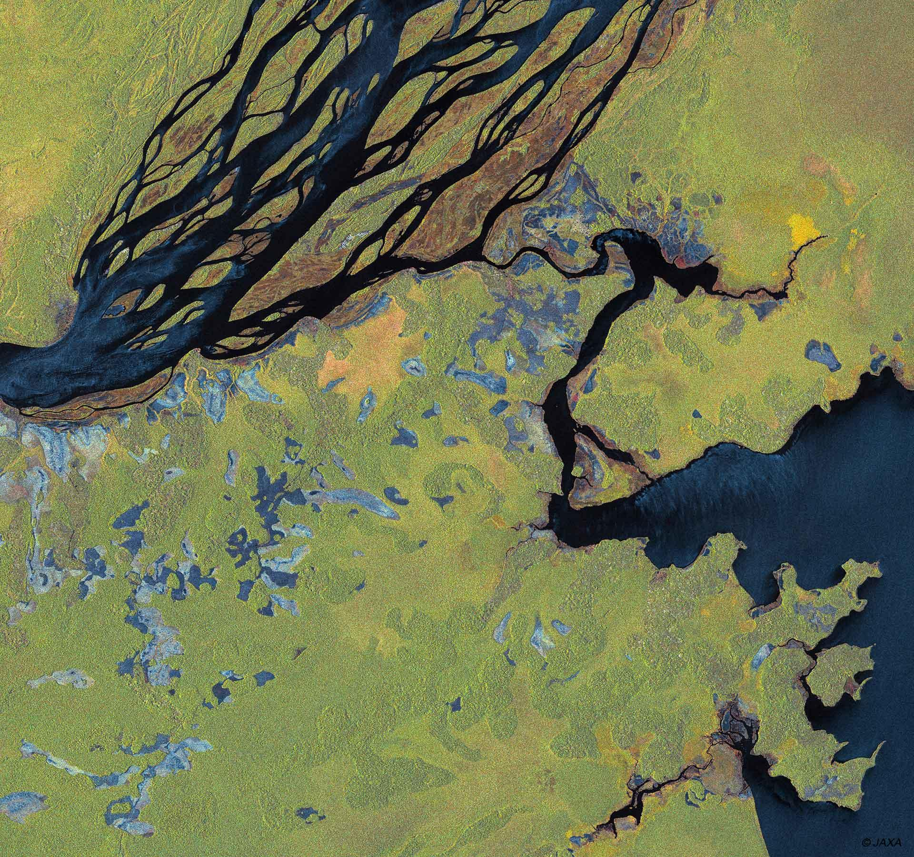

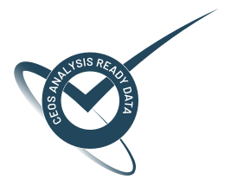
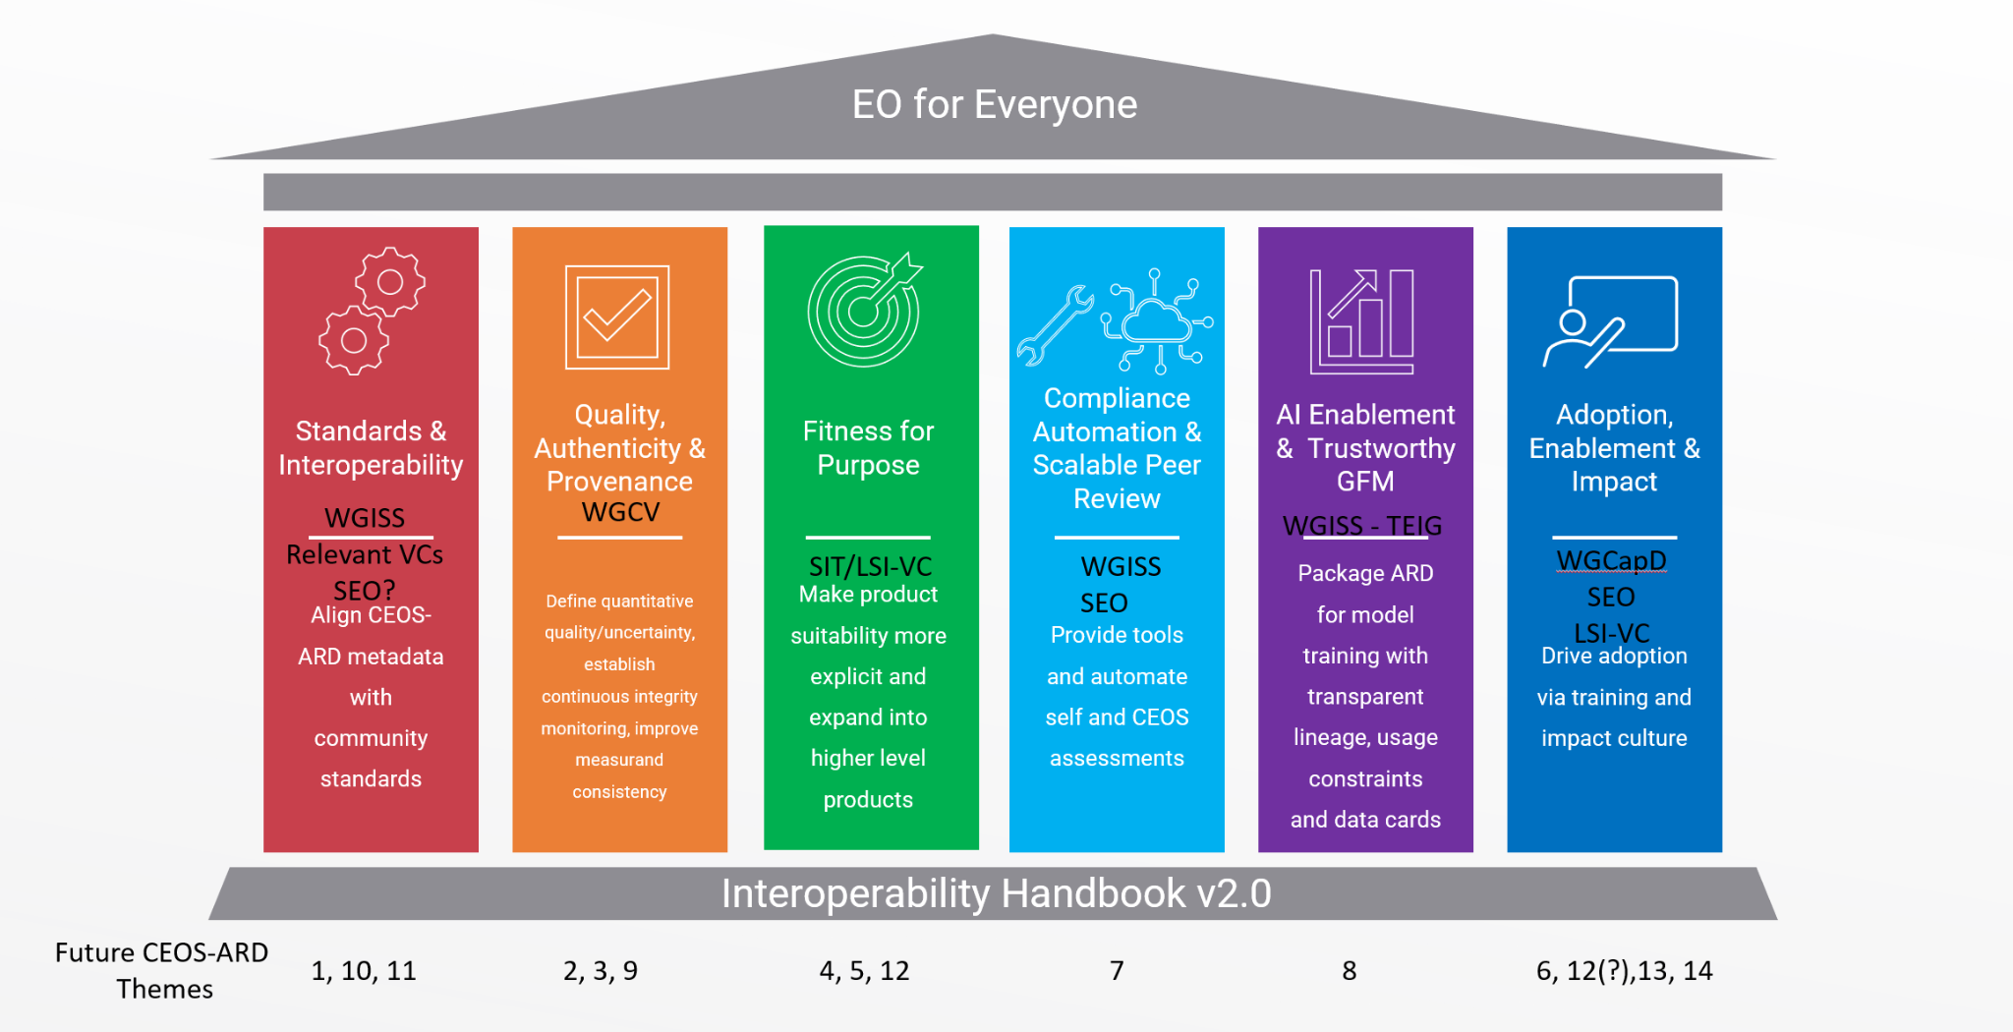
CEOS-ARD Strategy Pillars
Underpinned by CEOS Interoperability Handbook conventions

Slide 20
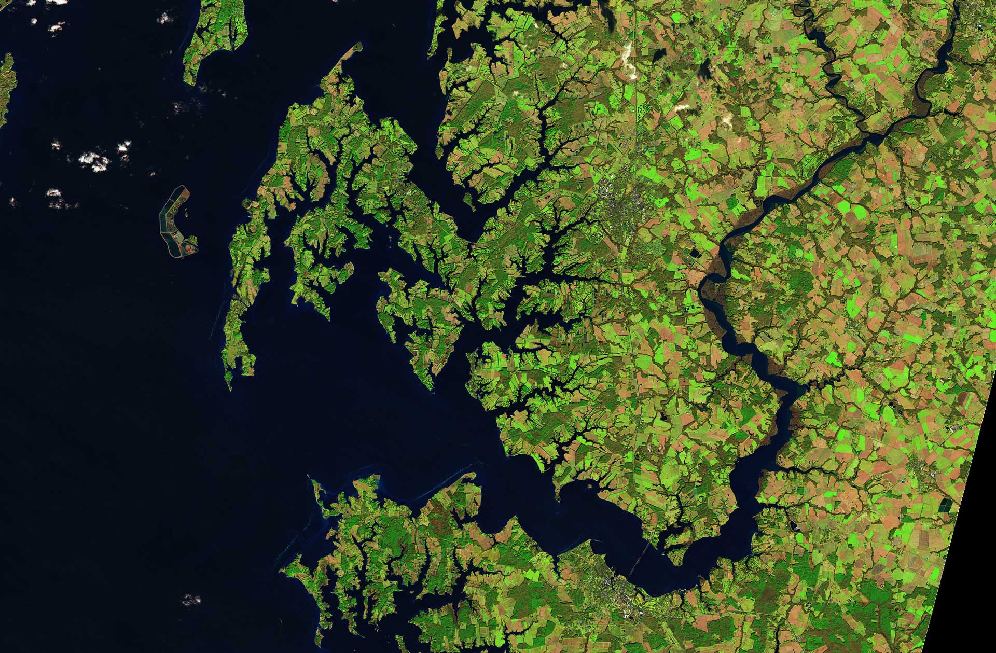

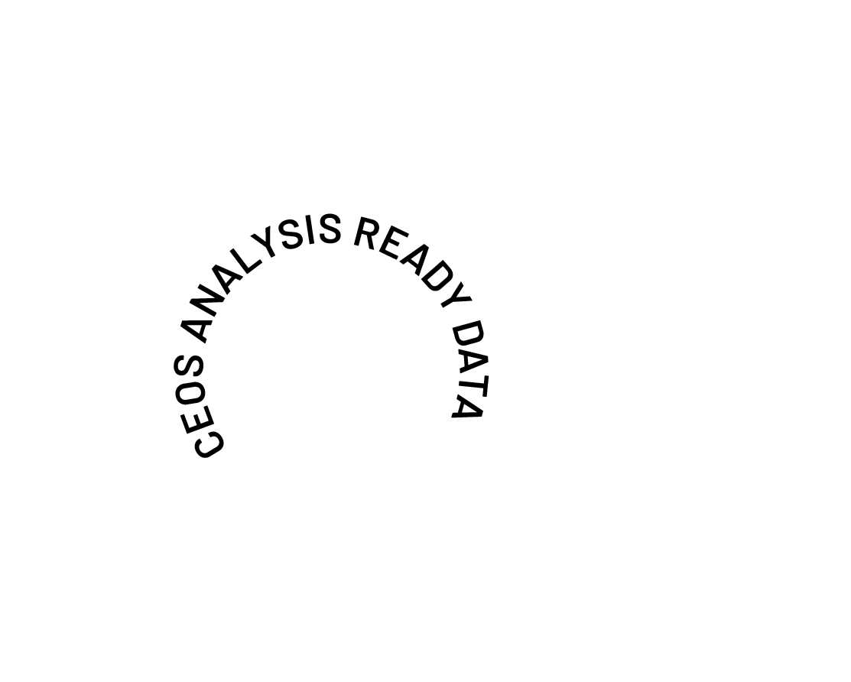
CEOS-ARD for Water
SIT Chair Priority #1: Water Planet- Seeing Earth's Water from Space has CEOS-ARD as a focus.
Deliverable: Contribute a water thematic section to updated CEOS-ARD strategy (in collaboration with CEOS Chair) by 2026 SIT-TW.
Where do we want to be in 5 years time to ensure CEOS-ARD is serving the needs of the water community?
Can we prepare a holistic vision for CEOS-ARD for water?
What do we need to cover the whole water cycle system?
What are the analysis-ready products needed by the water community?
Essential Water Variables, or an expanded list of products?
What Product Family Specs do we need to meet those requirements?
Are they derivatives of Aquatic Reflectance and/or SAR PFS?
Who will develop those specs?
What is the appropriate ‘Level’ of CEOS-ARD product?
Can we use the CEOS WQ workshop series to elicit requirements and determine a development roadmap?

Slide 21
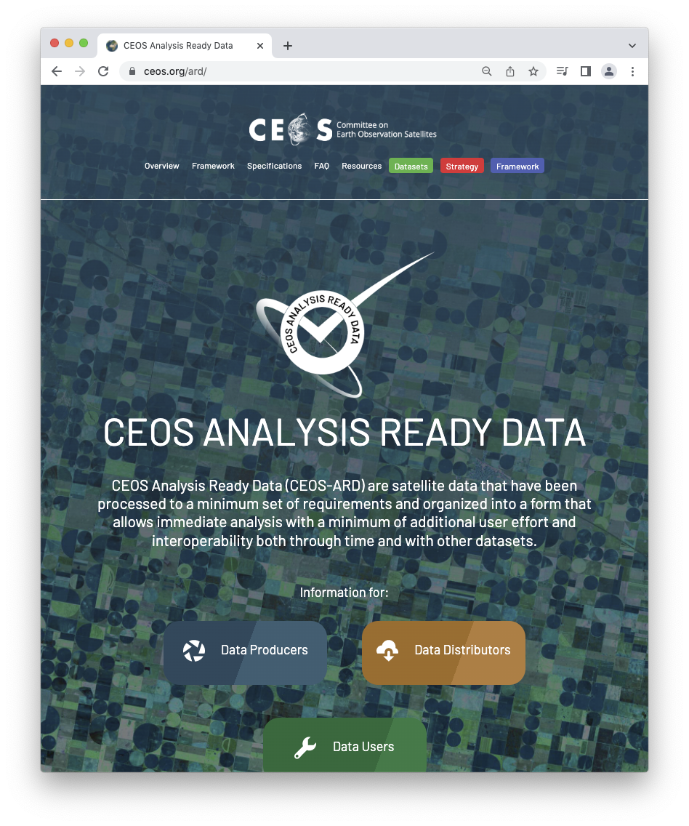
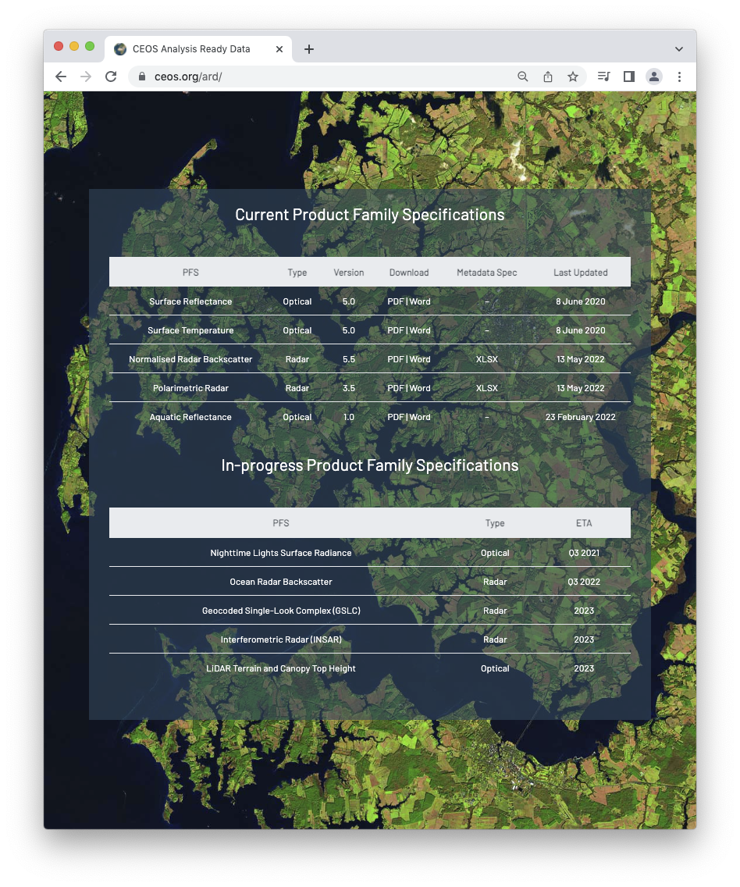
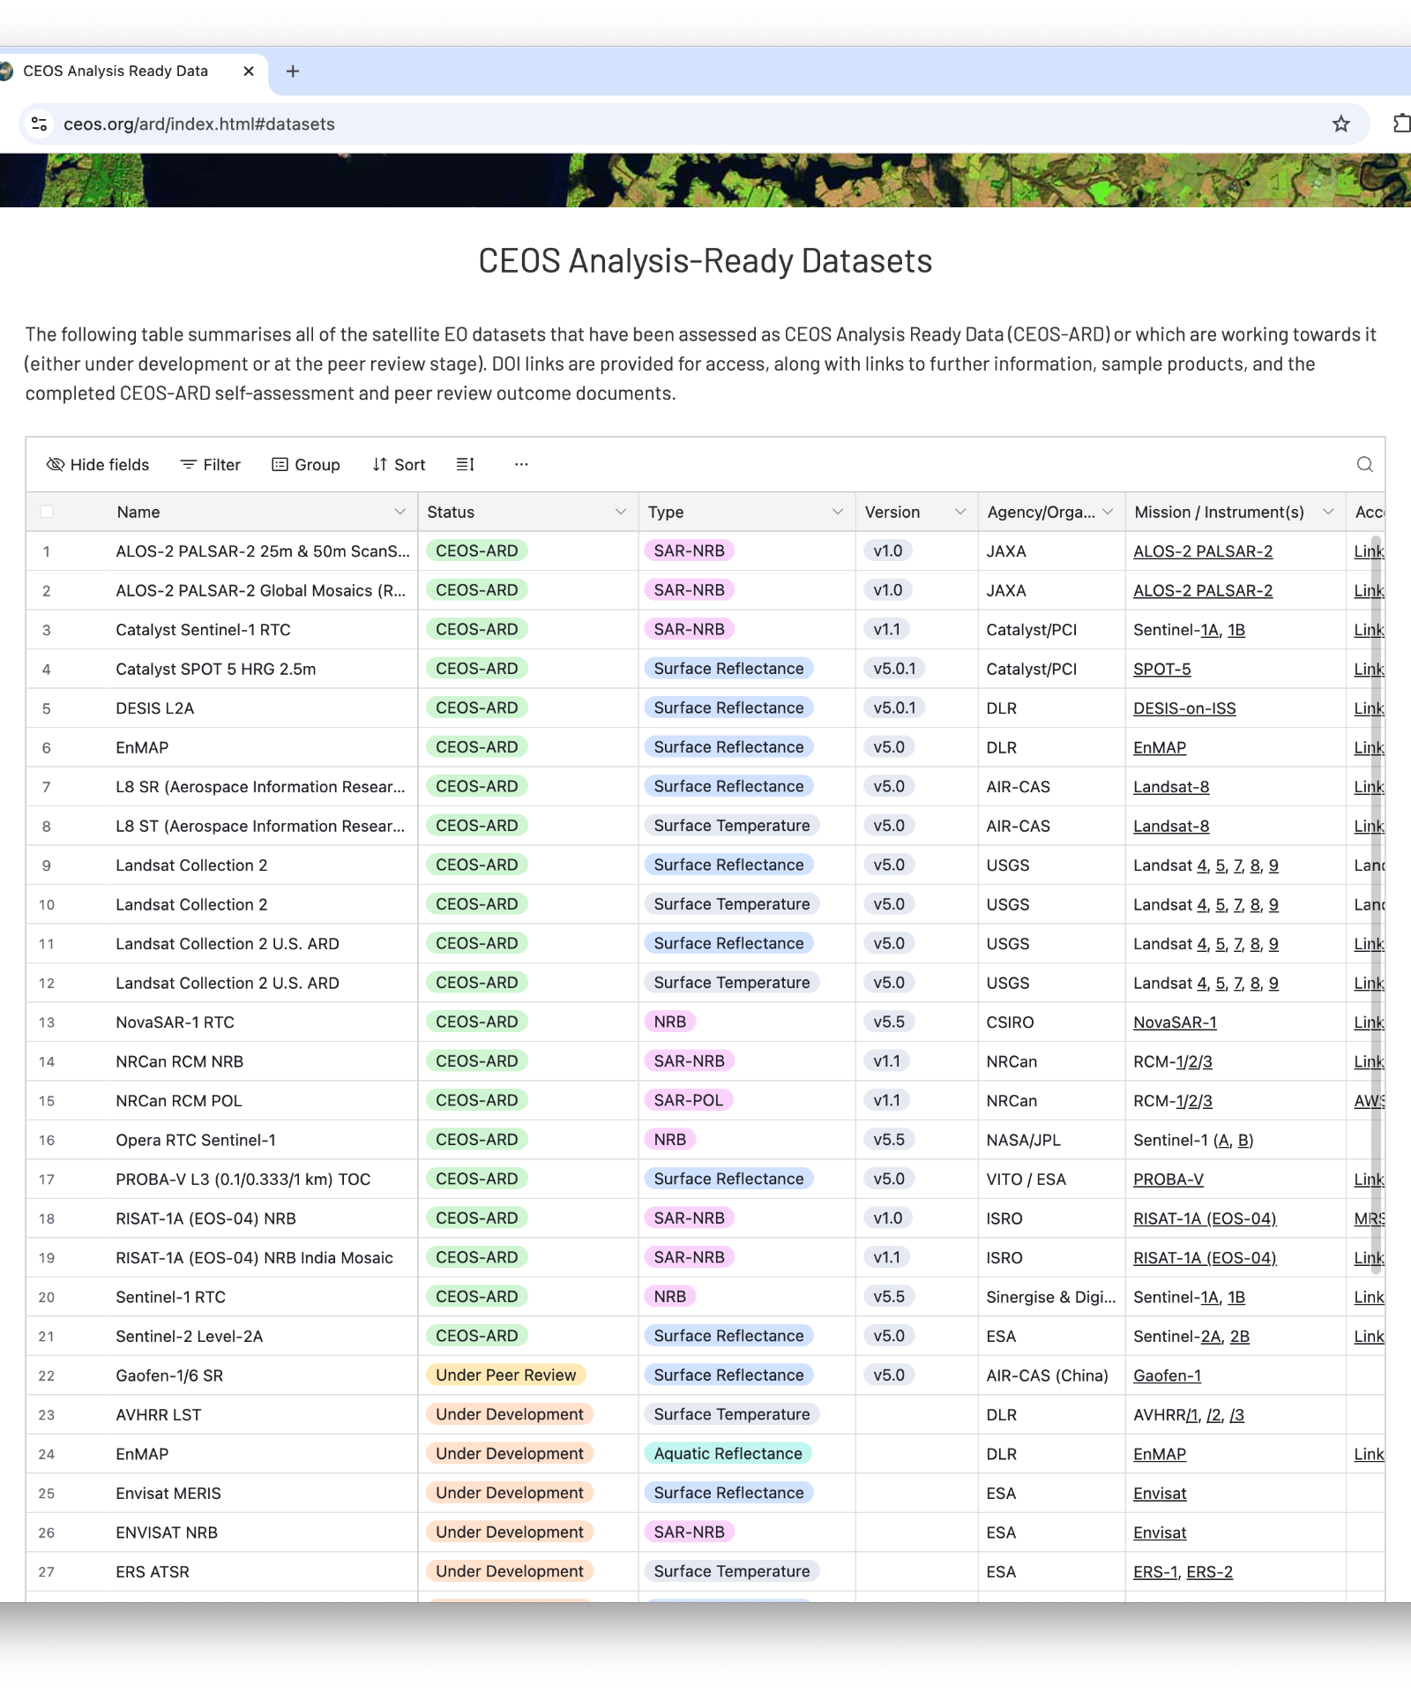
CEOS-ARD for Water
Self-Assessments have been initiated under NASA SIT Chair Priority #1
PACE (Aquatic Reflectance PFS)
SWOT (SAR PFS)
Compliance findings expected to be mutually beneficial to potential future NASA data practices as well as evolving ARD specifications.
Higher level water products review following initial Self-Assessments, to support “Fitness for Purpose” Pillar

Slide 22
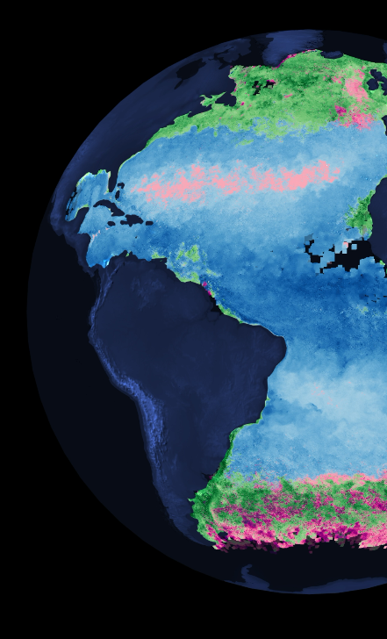

PACE: Initial self-assessment of product compliance with CEOS-ARD

Slide 23

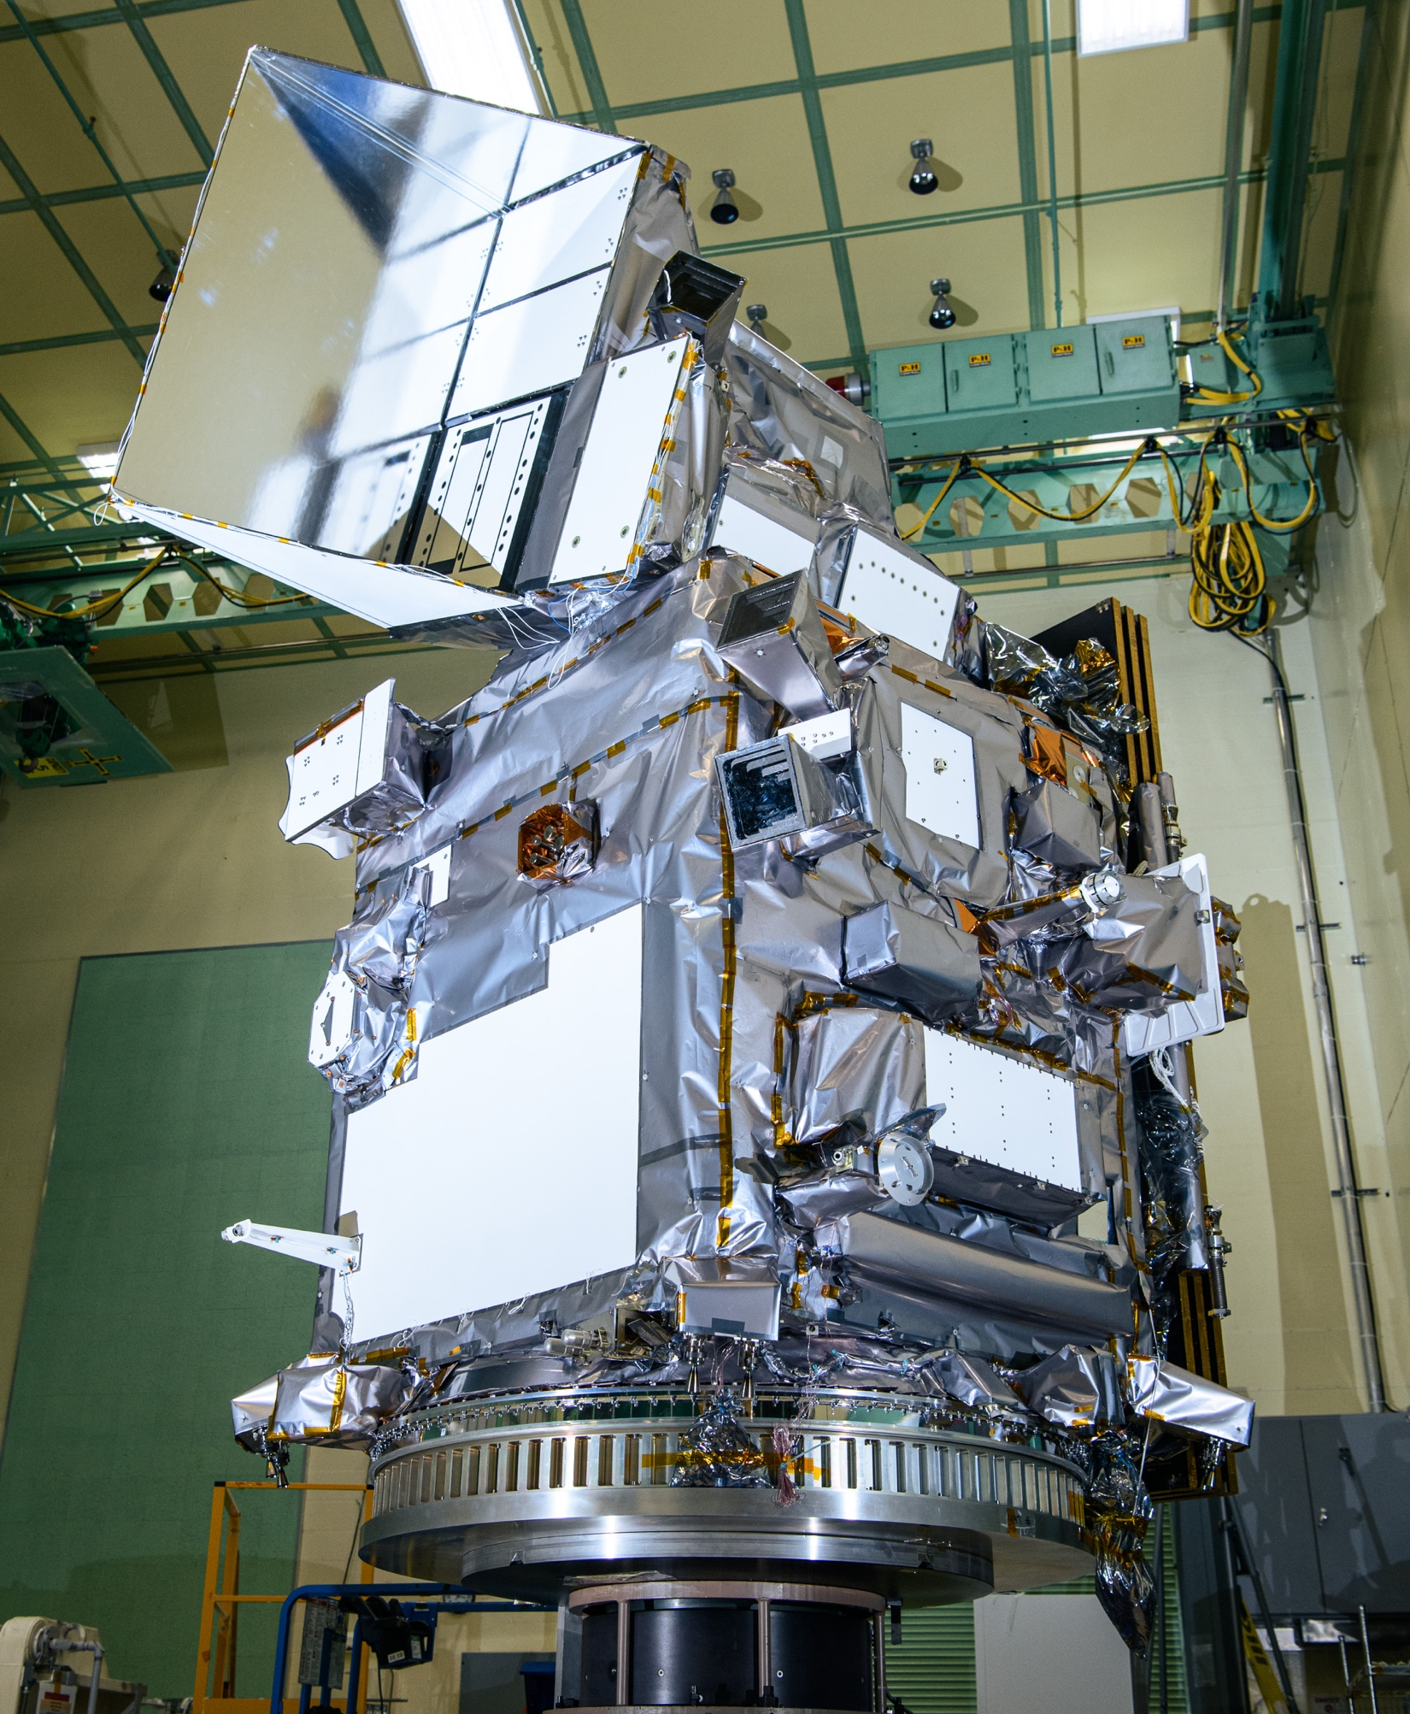




PACE key characteristics
OCI
340-890 nm in 2.5 nm steps
7 discrete SWIR: 940-2260 nm
1-2 day coverage; ±20° tilt; 1km
NASA Goddard Space Flight Center
launch 8 Feb 2024
initial data release on 11 Apr 2024
science data products include:
aquatic surface reflectances
aquatic biogeochemistry
terrestrial surface reflectances
terrestrial ecology metrics
atmospheric aerosol properties
atmospheric trace gases
cloud (micro)physical properties
HARP2
440, 550, 670, 870 nm
10-60 viewing angles
wide swath polarimeter; 3 km
University of Maryland Baltimore Co.
data access via NASA EarthData Search
SPEXone
380-770 nm in 2-4 nm steps
5 viewing angles
narrow swath polarimeter; 2.5 km
SRON, Airbus NL
polar, ascending, 98º inclination
13:00 local Equatorial crossing time
676.5 km altitude
6-9 hrs data latency
direction of flight

Slide 24
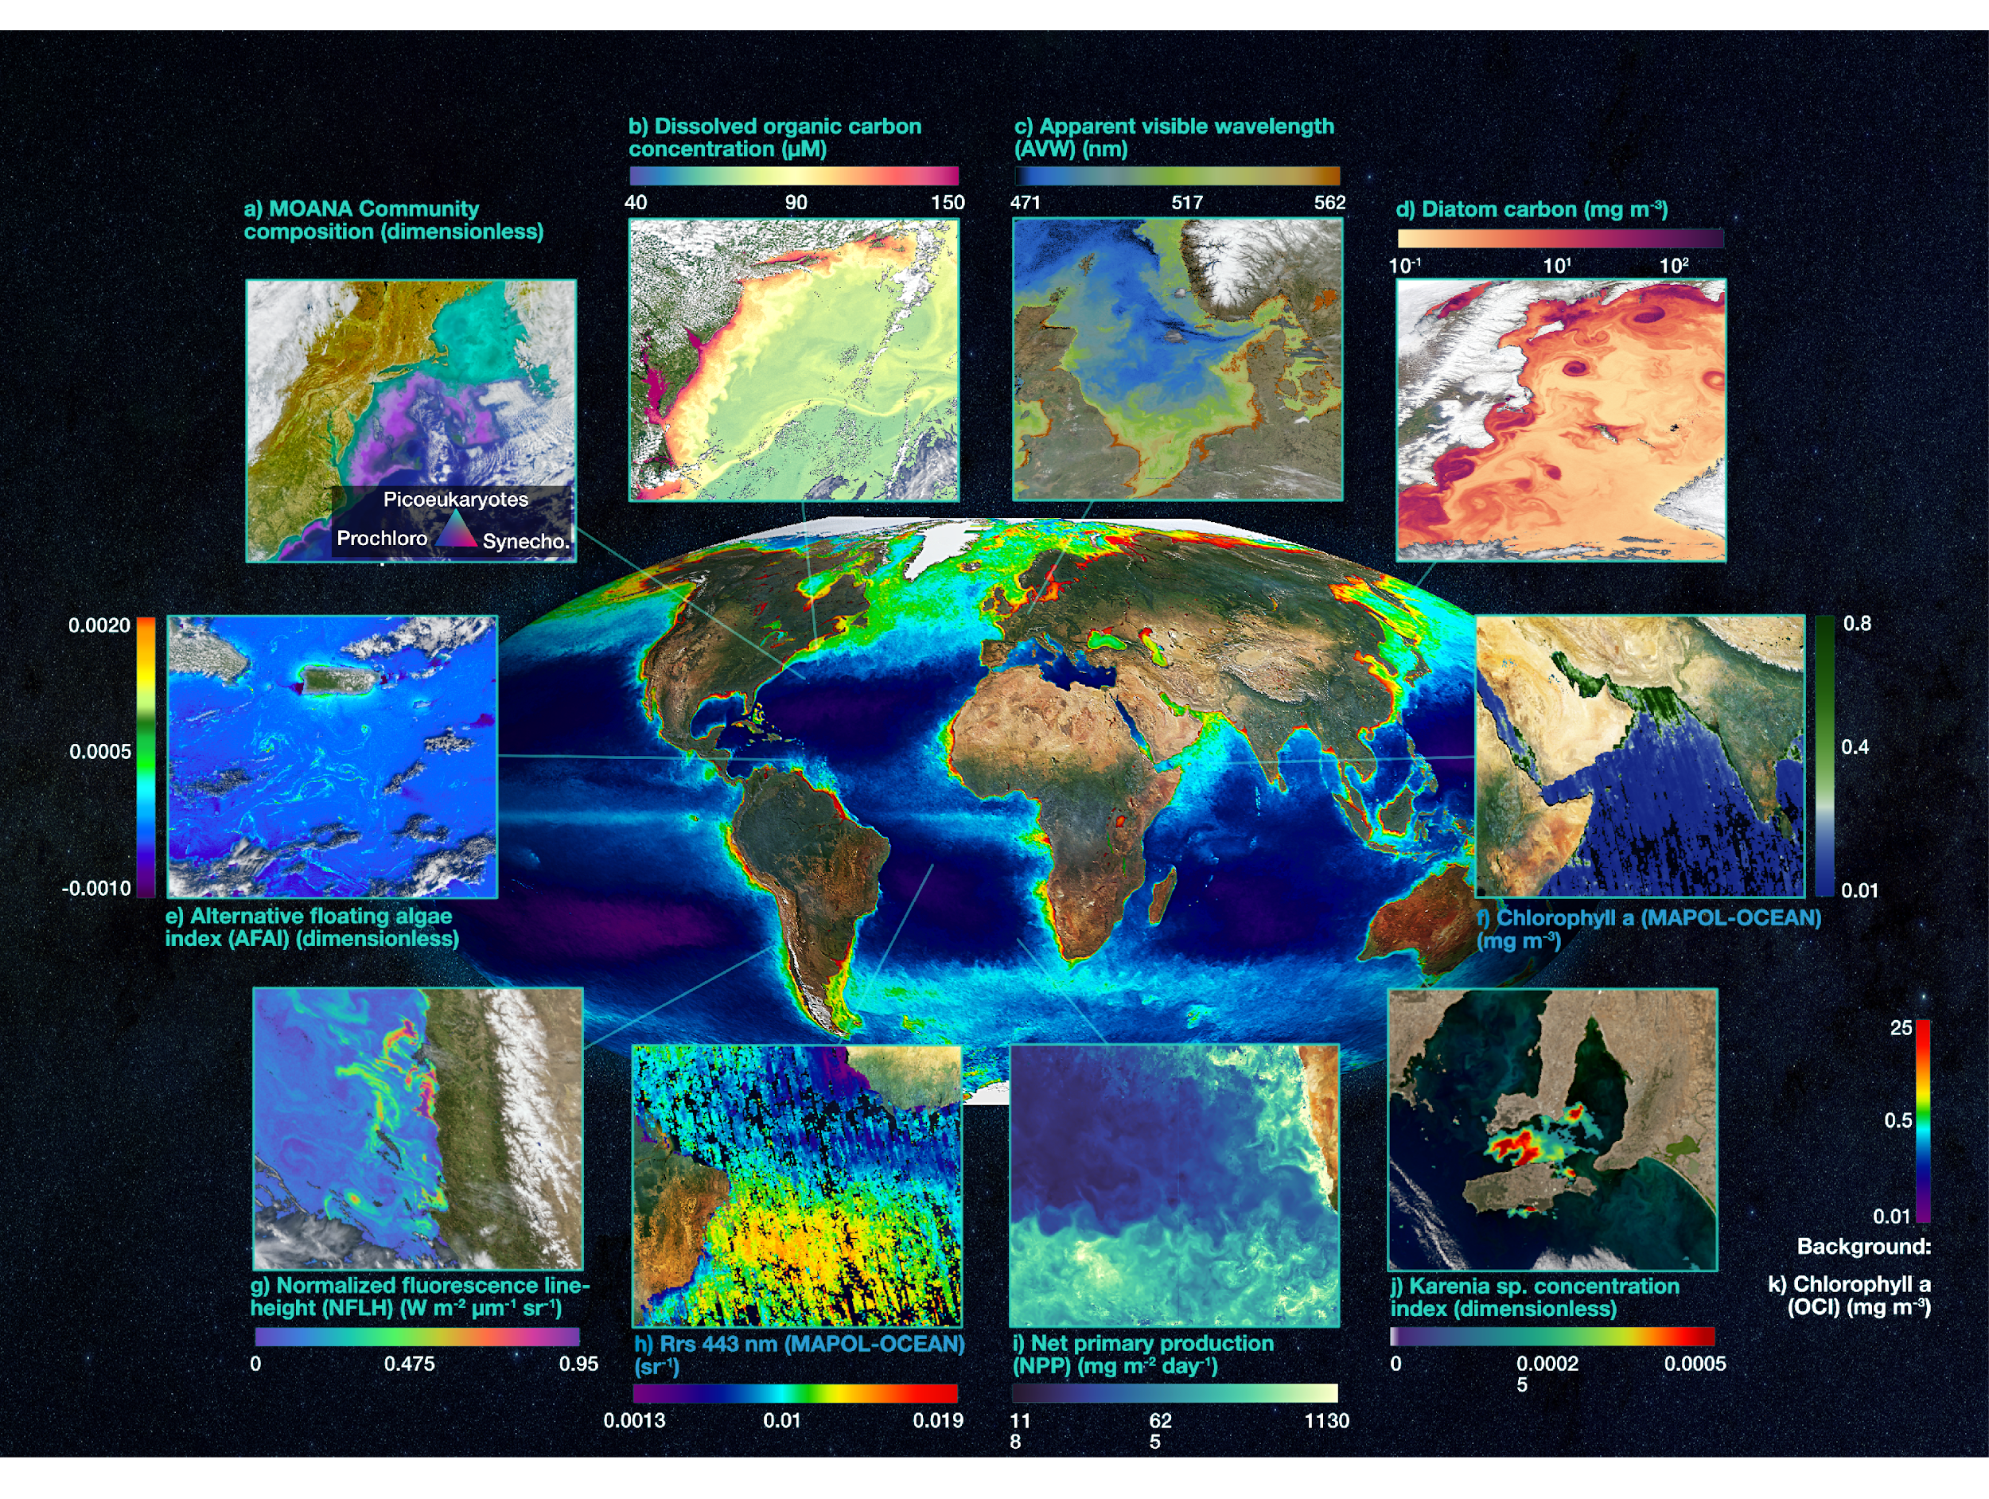

Slide 25
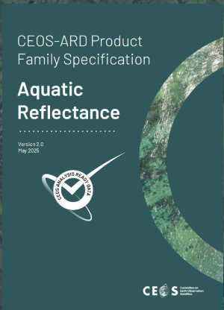
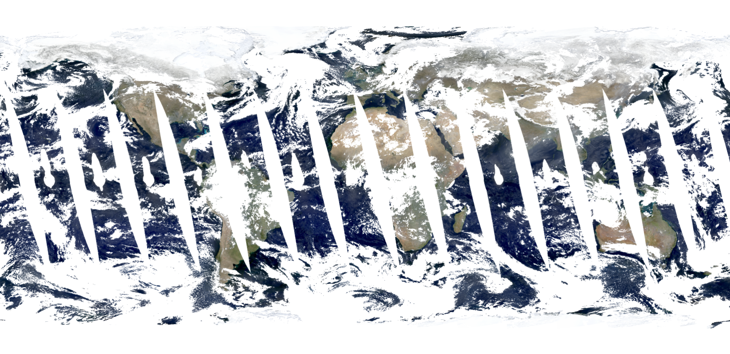
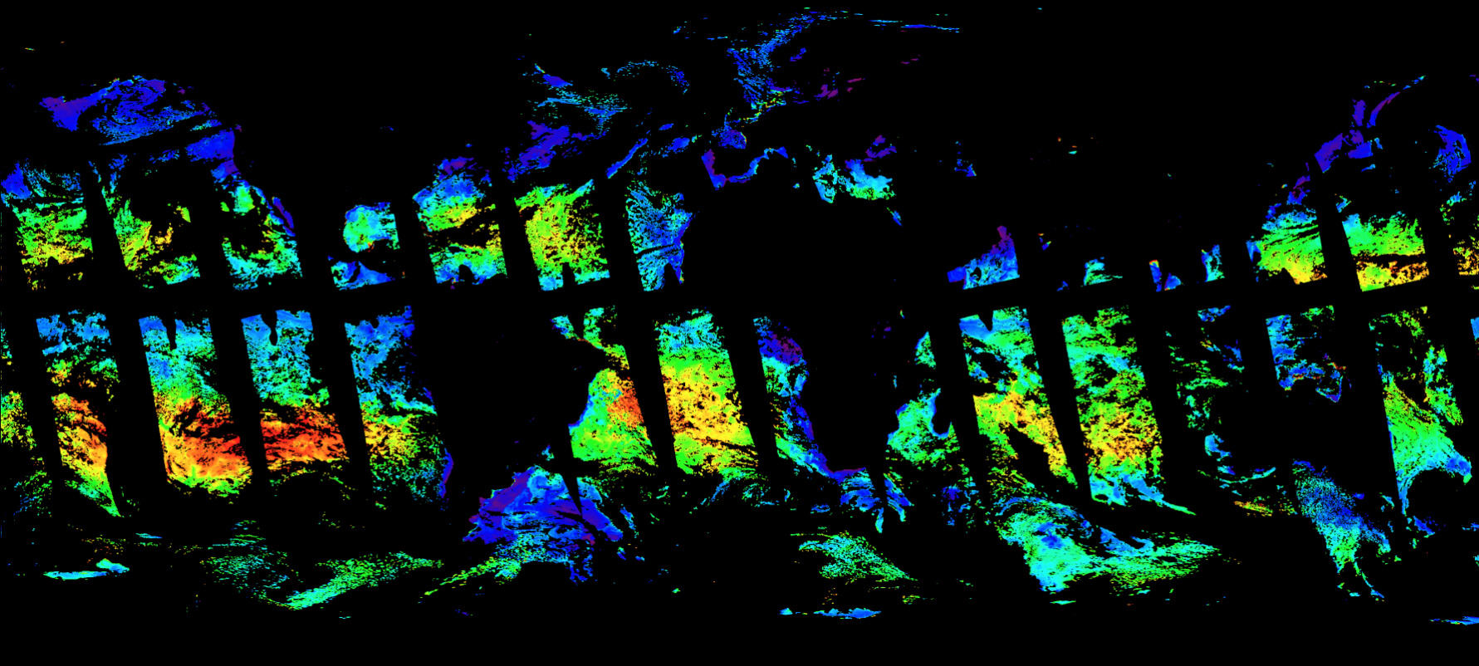
aquatic reflectance ARD update
Contributed to the Aquatic Reflectance PFS
NASA rep from the Ocean Biology Distributed Active Archive Center (OB.DAAC) provided input
The OB.DAAC supports and hosts PACE data processing, archival, and distribution
PACE self-assessment began in March 2026
Aquatic spectral surface reflectances (unitless) and spectral remote-sensing reflectances (sr⁻¹)
Keen on contributing higher level ARD products (Chlorophyll, CDOM, NPP)

Slide 26

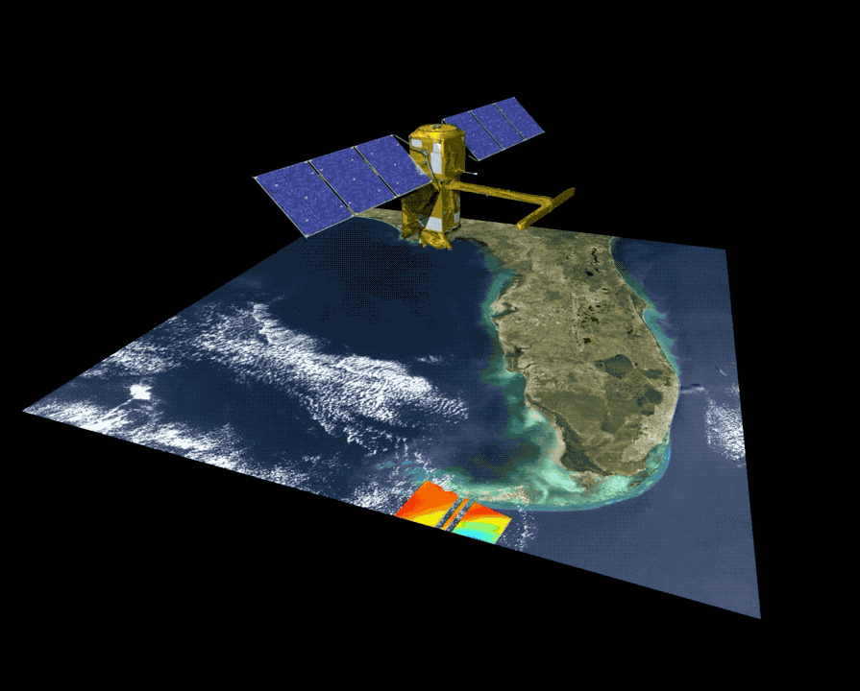
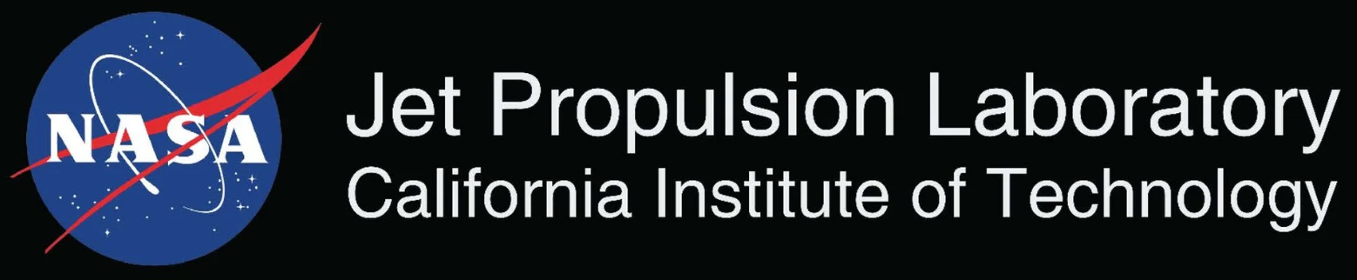
Surface Water and Ocean Topography Mission Provides heights of the world’s oceans and inland waters
Data Information
Observations of:
Coastal sea level and ocean heights at unprecedented resolution over a swath
Heights, widths, and slopes of rivers wider than 30m
Heights, extents, and storage changes of all lakes larger than 1 hectare
Global coverage below 78 degrees latitude
21-day orbit cycle yielding observations of any given location every 10 days on average
Applications Areas
Water resource management and reservoir monitoring
Coastal and inland flooding
Maritime and river operations and commerce
Coastal zone management

Slide 27
SWOT - Data Products
Data Product Short Name | Data Product Description
L1B_LR_INTF | Low rate interferogram
L1B_HR_SLC | High rate single-look complex (SLC)
L2_LR_SSH | Low rate sea surface height (SSH), significant wave height, and wind speed
L2_HR_PIXC | High rate pixel cloud (PIXC) geolocated heights and backscatter
L2_HR_RiverSP | High rate river single pass product providing water surface elevation, slope, width, and derived discharge
L2_HR_LakeSP | High rate lake single pass product providing water surface elevation, area, and derived storage change
L2_HR_Raster | High rate raster product providing rasterized water surface elevation and inundation extent
Level 1 Radar Products
Level 2 Ocean Product
Level 2 Surface Water Products

Slide 28
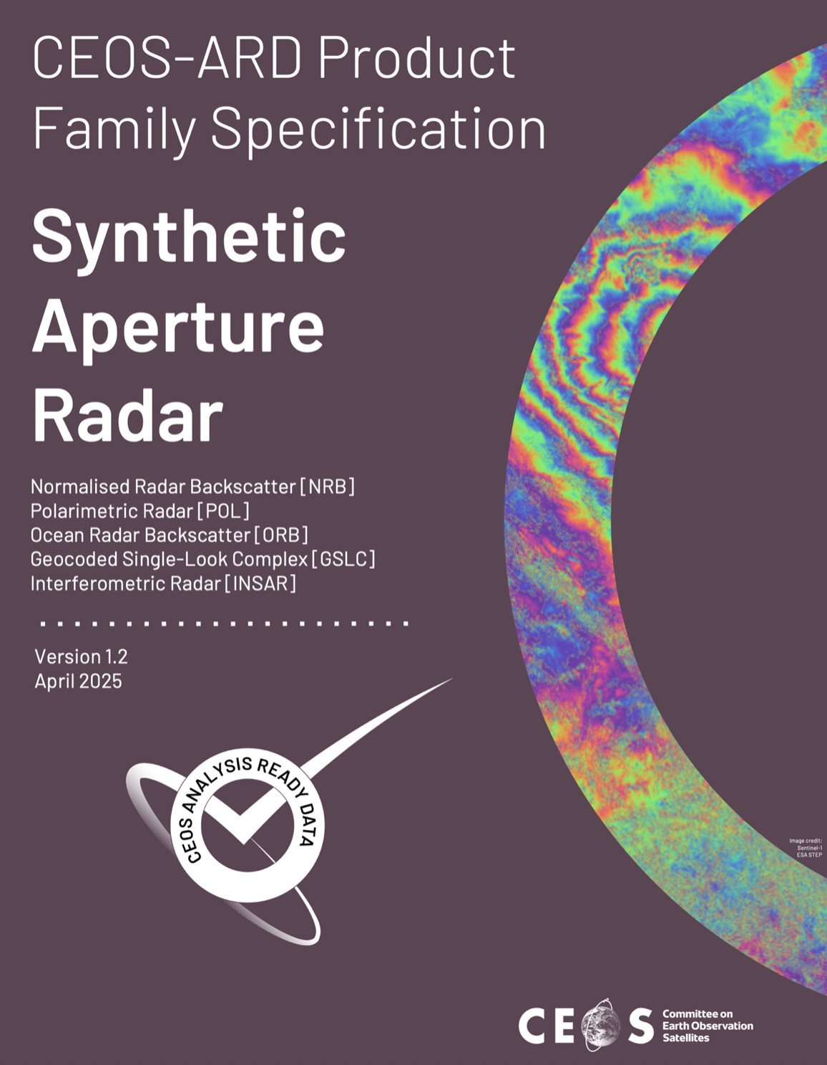
SWOT - Data Products - ARD
Data Product Short Name | Data Product Description
L1B_LR_INTF | Low rate interferogram
L1B_HR_SLC | High rate single-look complex (SLC)
L2_LR_SSH | Low rate sea surface height (SSH), significant wave height, and wind speed
L2_HR_PIXC | High rate pixel cloud (PIXC) geolocated heights and backscatter
L2_HR_RiverSP | High rate river single pass product providing water surface elevation, slope, width, and derived discharge
L2_HR_LakeSP | High rate lake single pass product providing water surface elevation, area, and derived storage change
L2_HR_Raster | High rate raster product providing rasterized water surface elevation and inundation extent
Level 1 Radar Products
Level 2 Ocean Product
Level 2 Surface Water Products

Slide 29
SWOT - Data Products - ARD
Data Product Short Name | Data Product Description
L1B_LR_INTF | Low rate interferogram
L1B_HR_SLC | High rate single-look complex (SLC)
SWOT ARD Self Assessmnet (Preliminary):
Focused on Interferometric Radar [InSAR]
Potential for Ocean Radar Backscatter [ORB]
Not meeting requirements, but working to determine delta
Keen to discuss ARD for higher level water products (i.e., water surface elevation, slope, width, and derived discharge)

Slide 30
Discussion
Where do you want CEOS to be in 5 years time to ensure CEOS-ARD is serving the needs of the water community?
What are the analysis-ready data, and products needed by the water community?
Essential Water Variables, or an expanded list of products?
What Product Family Specs do we need to meet those requirements?
Are they derivatives of Aquatic Reflectance and/or SAR PFS?
What is the appropriate ‘Level’ of CEOS-ARD product?

