Slide 1


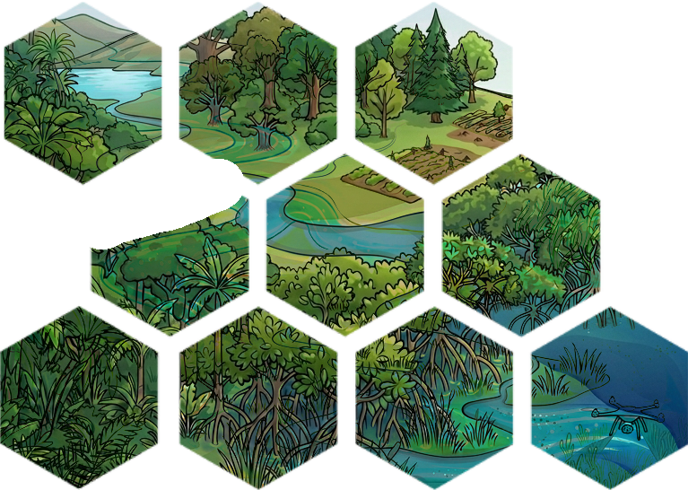
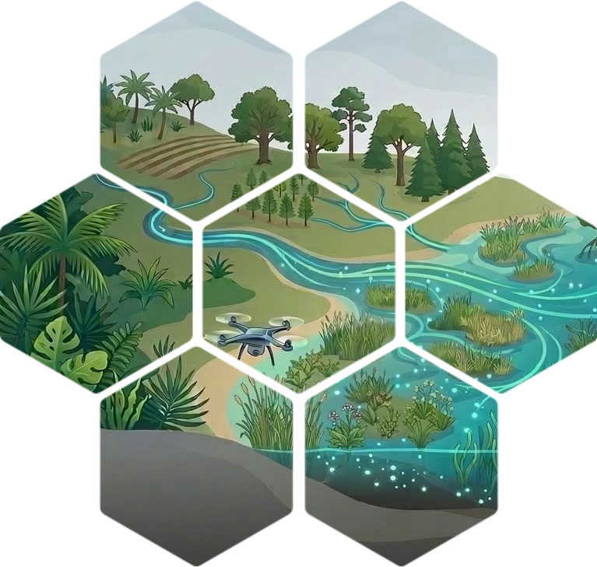
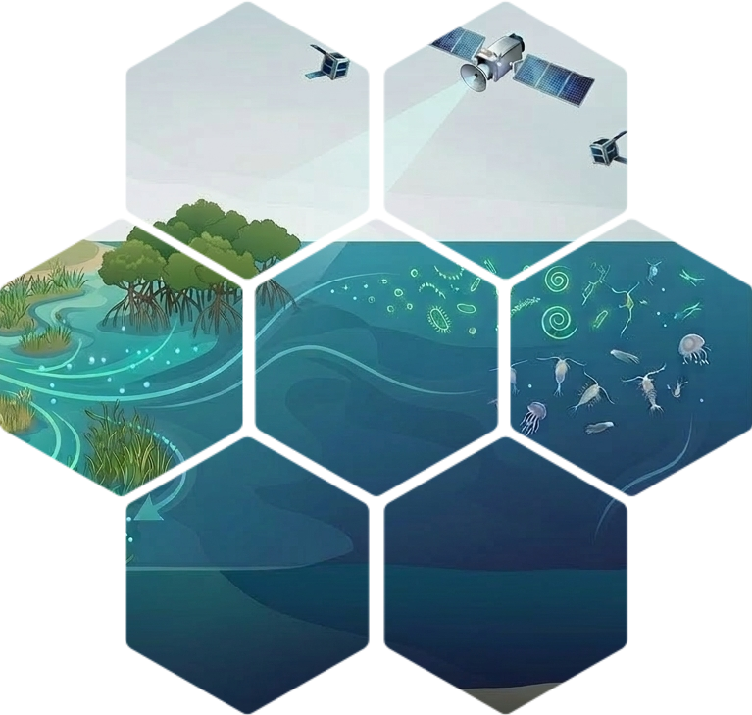
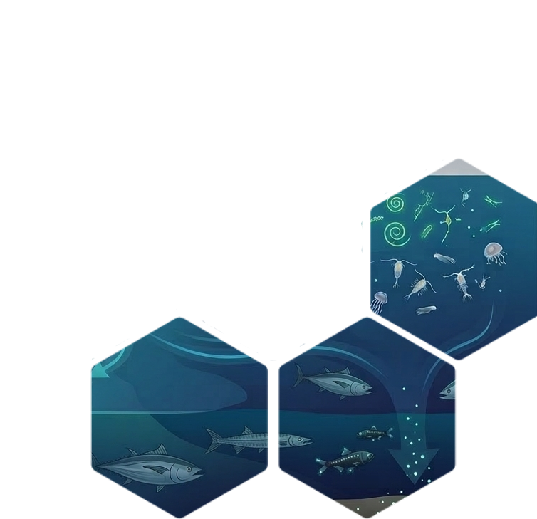

Get to know the
AQUATIC
CARBON
ROADMAP

Slide 2
AQUATIC CARBON ROADMAP TIMELINE
2025
2026
Apr
May
Jun
Jul
Aug
Sep
Oct
Nov
Dec
Jan
Feb
Mar
Apr
Sept
Nov
CEOS MEETINGS
SIT-40: Apr. 8th-10th 2025
SIT Tech. Workshop: Sept. 9th-11th 2025
39th CEOS plenary: Nov. 4th -6th , 2025
            CEOS SIT-41:
            April 15th-16th
            CEOS Plenary:
            Nov 3rd-6th
OTHER RELEVANT EVENTS
Living Planet Symposium
23rd -27th June 2025
Ocean Carbon From Space Workshop (23-26 November 2025, virtual)
6th IOCS Dec 1st - 4th Darmstadt
AQUATIC CARBON ROADMAP DEADLINES
Apr
May
Jun
Jul
Aug
Sep
Oct
Nov
Dec
Jan
Feb
Mar
Apr
Sept
Nov
1st Draft, bullet points per section
2nd Draft
3rd draft
Aquatic Carbon Roadmap Final Draft Delivery
On April 1st 2026
Aquatic Carbon Roadmap Final Delivery

Slide 3

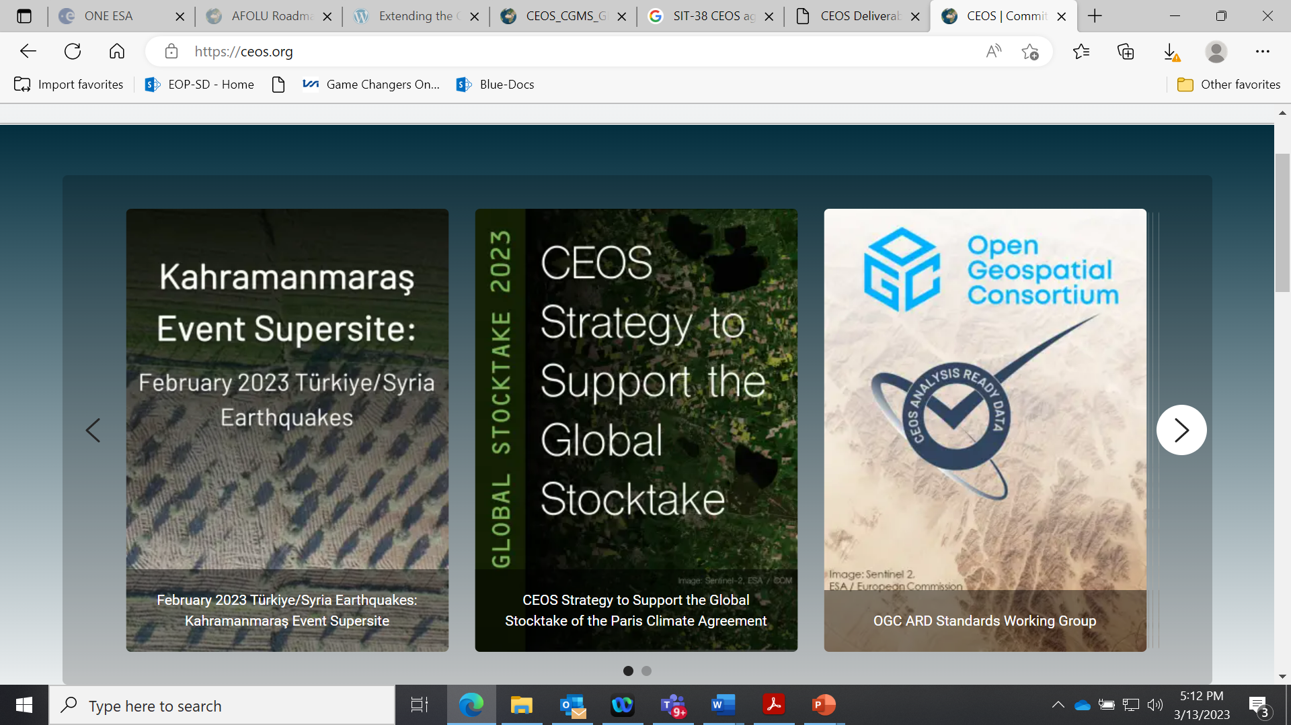
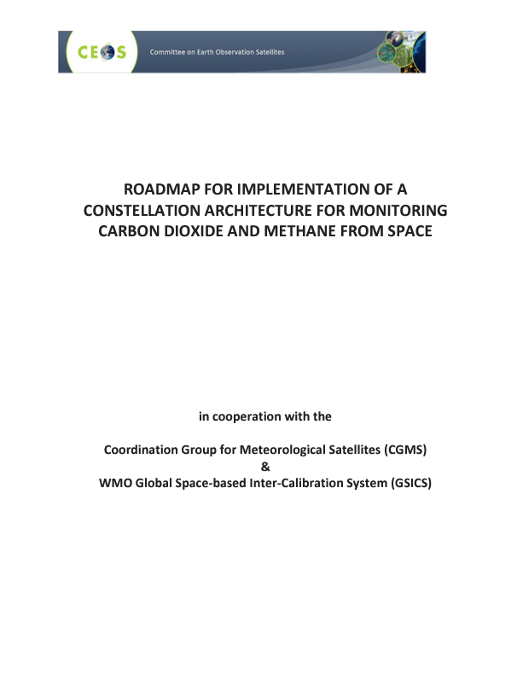
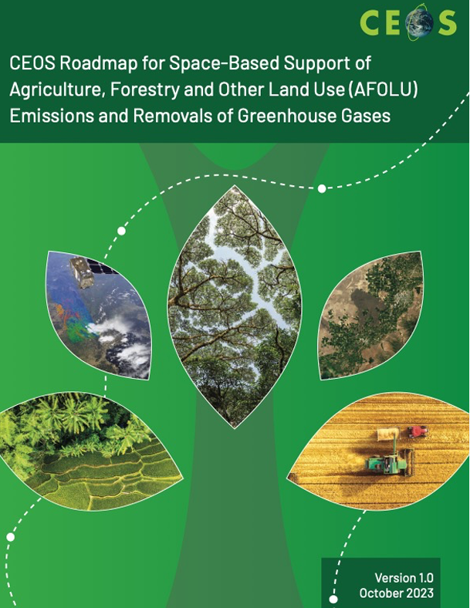
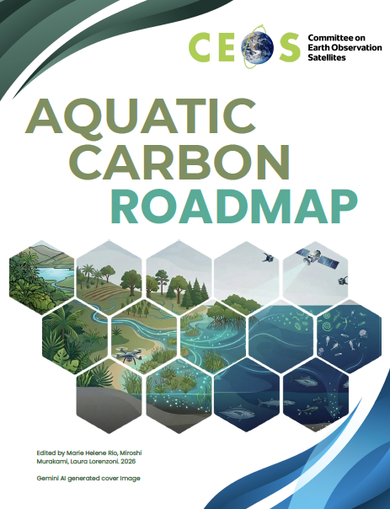
Aquatic Carbon Roadmap Focus
Deliverable VC-23-01
CEOS commitment to demonstrate the value of Earth Observation satellite datasets to support the Global Stocktake process.
GHG and AFOLU roadmap have a strong focus on major milestones of GST1 (2023) and subsequently for GST2 (2028) and how remote sensing data can effectively support these by providing means to monitor carbon emissions and removals, based either on a top-down approach (GHG roadmap) or a bottom-up approach (AFOLU roadmap).
The Aquatic Carbon Roadmap (ACR) completes coverage of the Earth System by addressing fluxes of carbon across systems and accounting for the second largest, long-term store of carbon on Earth, second only to the Earth’s core.
Roadmap concept presented and endorsed at CEOS plenary in November 2023 as the “Aquatic leg” of the CEOS Carbon strategy, in complement to the GHG and AFOLU roadmaps. Deadline for completion was Q1 2026; ACR draft was delivered to CEOS April 1, 2026.
Notes:
An improved understanding and monitoring of the aquatic carbon components will enhance the accuracy and reliability of global carbon stocktake assessments by providing insights into the role of the aquatic/oceans as a carbon sink and the factors influencing carbon storage dynamics.

Slide 4

Aquatic Carbon Roadmap Scope
Aquatic Systems: The roadmap addresses carbon dynamics across a "land-to-ocean-aquatic-continuum" (LOAC), specifically focusing on:
Open Oceans and Shelf Seas: The largest aquatic environments, covering roughly 94% of the global aquatic area.
Coastal and Blue Carbon Ecosystems: Specifically coastal areas and ecosystems such as seagrasses, tidal marshes, and mangroves.
Inland Waters: Including lakes, reservoirs, and rivers.
Technical and Scientific Focus: The roadmap takes into consideration the following:
Earth Observation (EO) Capabilities: It examines the current state of remote sensing to monitor different, relevant carbon pools (dissolved, particulate, organic, and inorganic) and fluxes (such as air-sea gas exchange and exchange across systems) and the current gaps and opportunities.
Prioritization of Needs: The roadmap identifies specific priority areas and opportunities that could be executed across different timelines, leveraging existing and planned activities by the EO community.
Foundational Science: While the roadmap focuses on carbon accounting, it notes that this hinges on foundational science to advance critical applications, though it does not go into exhaustive scientific depth itself.
Global Assessments: The document aims to support the Global Stocktake, National Greenhouse Gas (GHG) Inventories, and IPCC assessments, amongst other activities.
Dissemination and Capacity Building: The roadmap includes considerations to increasing global capacity for EO data use and improving communication across communities.
Notes:
The ocean acts as a significant carbon sink, by absorbing large amounts of carbon dioxide from the atmosphere through the ocean biological, solubility and injection pumps.
The coastal ocean also host crucial blue carbon ecosystems (mangroves, seagrass, salt marshes)
The inland waters also play crucial roles in the global carbon cycle by storing, sequestering, and transporting carbon, as well as influencing regional and global climate dynamics.

Slide 5
Contributing Authors
Coordinating Agencies and Editors
Marie-Helene Rio (ESA), Laura Lorenzoni (NASA), Hiroshi Murakami (JAXA)
Scientific leaders
Jamie Shutler (University of Exeter), Bob Brewin (University of Exeter), Cecile Rousseaux (GSFC-NASA), Kelsey Bisson (NASA)
More than 25 contributors from the CEOS OCR-VC / IOCCG space agencies and the scientific community
Lionel Arteaga (NASA GSFC, US), Benoit Beguet (I-Sea, France), Dustin Carroll (SJSU, US), Aurelien Carbonniere (CNES, France), Abhishek Chatterjee (NASA/Schmidt, US), David Crisp (US), Christine Dupuy (La Rochelle Univ. France), Helen Findlay (PML, UK), Joaquim Goes (Columbia Univ., US), Luke Gregor (Swiss Data Science Center, Switzerland), Meghan Halabisky (Univ. of Washington, US), Kevin Kroeger (US Geological Survey, US), Tiit Kutser (Estoninan Marine Institute, Estonia), Peter Landschutzer (Flanders Marine Institute, Switzerland), Antonio Mannino (NASA, US), Merrie Beth Neely (NOAA, US), Ben Poulter (NASA GSFC, US), Dimitris Poursanidis (FORTH, Grece), Rosa Roman (JRC, EC), Raphael Savëlli (SJSU, US), Amelie Sechaud (I-Sea, France), Oscar Serrano (CSIC, Spain), Stefan Simis (PML, UK), Kesav Unnithan (CSIRO, Australia), Vincent Vantrepotte (CNRS – IRD, France), Tom Worthington (Univ. of Cambridge, UK)

Slide 6
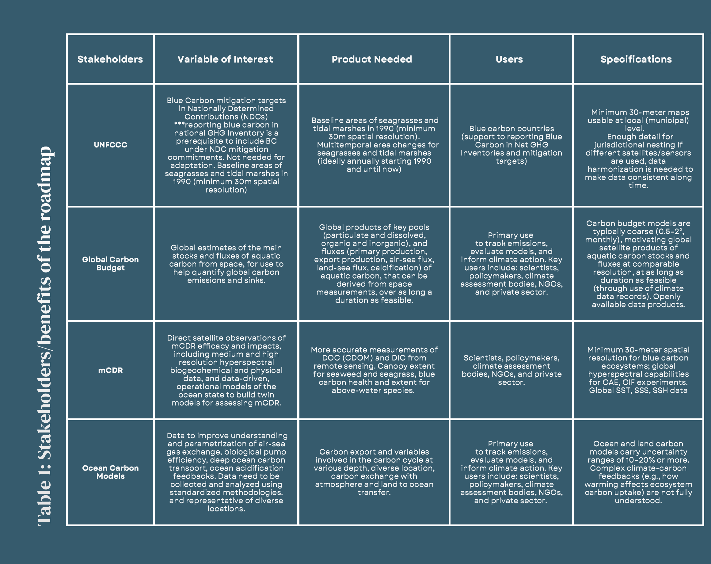

Slide 7


Recommendations
Key priority areas – short term
a. Continue support of and expand aquatic carbon basic research and advanced products (7 recommendations)
b. Leverage existing observational platforms and models to gap fill aquatic carbon flux priority areas (5 recommendations)
c. Support science that will advance aquatic carbon markets (3 recommendations)
Key priority areas – medium term
a. Coordinate and plan future observational needs that will address gaps in aquatic carbon flux estimates (4 recommendations)
b. Support science that will advance aquatic carbon markets (3 recommendations)
c. Support community standards and capacity building (2 recommendations)
Key priority areas – long term
a. Support and sustain the provision of satellite datasets for ocean carbon and further develop satellite-based climate data records so that they may continue to be used in global carbon assessments
b. Equitably coordinate and support the fiducial in situ infrastructures and best practices that climate measurements require, so the tracking of changes in Earth’s environmental health continues and further evaluation of the impact on the Environment of policy decisions.
c. Invest in technology maturation and frontier research that furthers the information extracted from EO signals and the different carbon pools in aquatic systems, as well as process-based understanding of aquatic carbon cycling.
Notes:
A - Continue to encourage and support inter-disciplinary science that promotes integration of remote sensing into broader biological and chemical models (Sec. 4). Consider science that integrates EO, field data, and models to support carbon estimates, Monitoring, Reporting, and Verification (MRV) for markets, and forecasting risks to guide restoration (Sec. 4.2)
Invest in science that will develop and validate tools to detect change and the rate of change in the ocean carbon cycle, Leverage activity-based (“bottom up” in situ efforts, e.g. Pangea, Arctic COLORS/FORTE) carbon quantification approaches that use atmospheric-based and oceanic-based approaches to enable carbon estimates to converge, invest in science focused on indicators of bio- and functional diversity and the flow of carbon through the marine ecosystem into ocean carbon research to improve understanding of carbon flows and feedbacks. Link this science to activities such as mCDR.
Maintain and improve the accuracy and stability of primary observables needed for ocean carbon research by sustaining robust calibration and validation (cal/val) activities. Continue improvements and advances in atmospheric correction, especially in complex coastal waters, and develop a more robust science-based approach to reduce uncertainty and error in carbon estimates for coastal waters
B - Exploit multi-sensors (active/passive) and multi-platforms (satellite, in-situ) synergy to access the three dimensionality of the ocean and refine/develop improved carbon cycling estimates.
Advance the estimation of ocean circulation to better constrain aquatic carbon pathways
Further develop and support dedicated in situ networks, drones, and CubeSats to provide high-resolution validation measurements. Expand hyperspectral in situ measurements of inland water bodies to improve validation of EO
Build integrated modeling frameworks linking inland waters, coasts, and ocean. Research should focus on developing approaches that consider this land to ocean continuum, its heterogeneity and cascade of scales and the carbon flow within this, so linking inland waters, estuarine and coastal seas.
C- Strengthen cross-roadmap (Aquatic–GHG–AFOLU) coordination, synergies, and co-benefits through shared use cases
Further the development of blue carbon ecosystem accounting from EO, especially seagrasses. Further the development of EO data products that align with IPCC inventory and stocktake requirements, which includes consistent definitions, comprehensive uncertainty characterization, and scalability from global to national levels. This strengthens global ass.
MEDIUM TERM - develop active space-based (lidar) systems
Develop geostationary missions for high frequency measurements of open and coastal zones. Assess current novel sensing techs for carbon apps and inform new missions.
Improve the accuracy and spatial and temporal coverage of key physical observations (e.g., winds, surface turbulence, surface ocean circulation) needed for ocean carbon research through new and improved retrieval algorithms, better integration of satellite and in situ observations (Roadmap-broad).
Evaluate and address the latency between science advances and policy uptake, including evaluating the uptake of key ocean carbon research information into decision-making, in addition to the products to advance IPCC
Further the development of Tier 2 and 3 reporting from EO (Sec. 5.2)
Encourage fiducial reference measurement networks that collect measurements relevant to multiple communities on the same platform or frameworks and support the development of science based standards for these measurements e.g., atmospheric (e.g. XCO2) and oceanic (e.g. pCO2) data (Sec. 6)
Increase global capacity, especially in the Global South, for EO data use and inventory support (Sec. 7).

Slide 8


Other Sections of Interest
5.0 Demonstrating the power of aquatic carbon Earth observation to inform diverse stakeholders
6.0 Complementarities and linkages to the GHG and AFOLU and other roadmaps
7.0 Expanding visibility, utilisation and capacity development
8.0 Forward Look

Slide 9
Aquatic Carbon Roadmap: What’s Next
Roadmap was delivered as planned April 1, 2026.
CEOS Sec proposed consideration for endorsement at Plenary in Q4 2026
This is a unique opportunity to provide feedback on a mature draft of the Roadmap, in preparation for endorsement at Plenary.
Plan to deliver final document after summer, well ahead of next CEOS plenary on November 3rd-6th 2026 (exact deadline for delivery?) where it will be presented for Acknowldgement.
Thus, we will be collecting feedback until June 30, 2026. Please email Marie-Helene Rio (Marie-Helene.RIO@esa.int); Hiroshi Murakami (murakami.hiroshi.eo@jaxa.jp); Laura Lorenzoni (laura.Lorenzoni@nasa.gov) your thoughts/questions!
CEOS OCR-VC WP 2026: Metrics will be developed to track implementation of actionable Priority Areas and Areas of Opportunity, in coordination with other CEOS and non-CEOS stakeholders.

