Slide 1
Validation of atmospheric observations over the ocean
Yasjka Meijer, ESA
Agenda Item 5.4
CEOS SIT-41 2026
Irvine, California, USA
14-16 April 2026

Slide 2
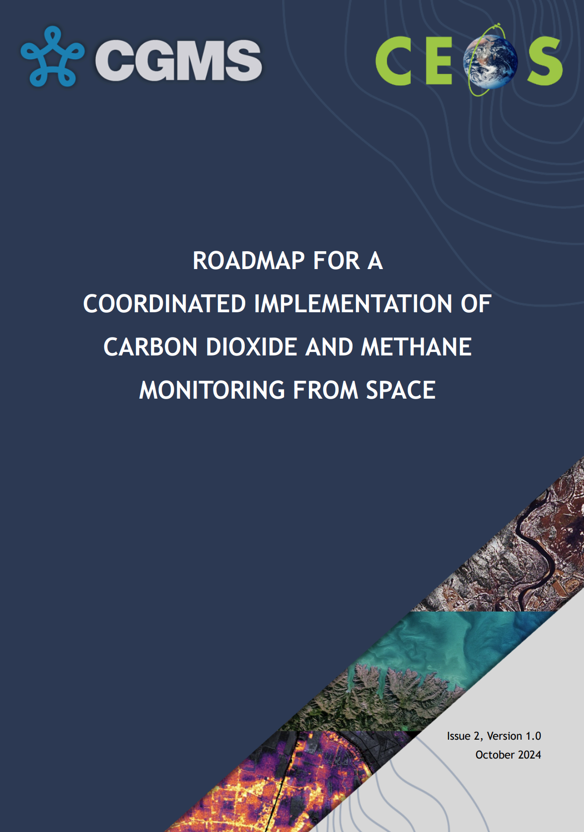
Confluence of carbon roadmaps
GHG RM was endorsed in 2024
Aquatic RM is in advanced draft
These roadmaps are connected at their interfaces
In response to NASA’s SIT focus on oceans, the GHG Task Team aims to specifically improve science on atmospheric fluxes over the Southern Ocean

Slide 3
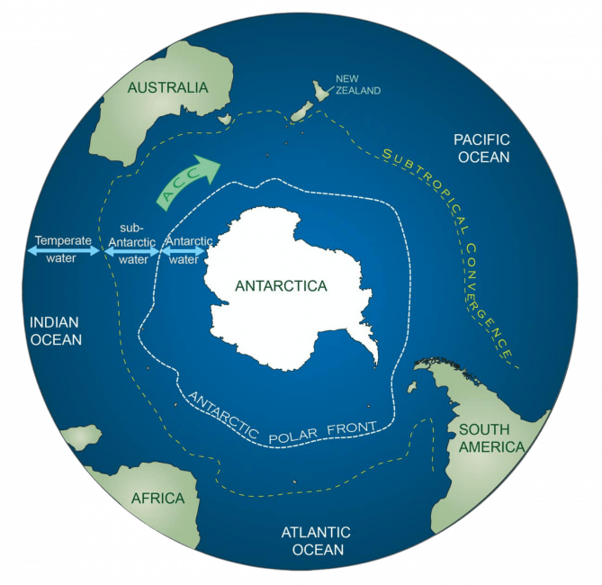
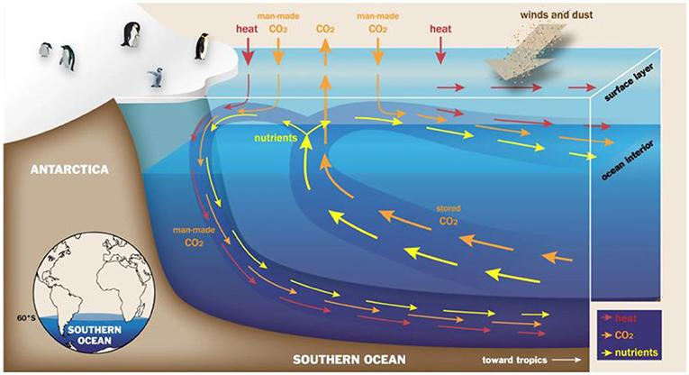
Southern Ocean
Deep ocean with stored concentrations meets new world resulting in fluxes

Slide 4
Improved sat. capabilities & needs
Net flux is large as an accumulation of small fluxes over the vast Southern Ocean
Improved satellite observations, e.g. from the Copernicus CO2M mission, might meet the needs
Requires establishing L2 validation of atmospheric observations
At joint WGClimate and GCOS meeting contact made with South African Environmental Observation Network (SAEON)

Slide 5
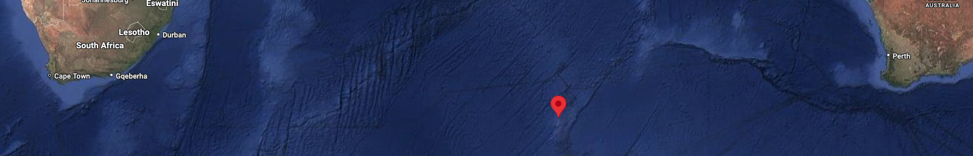
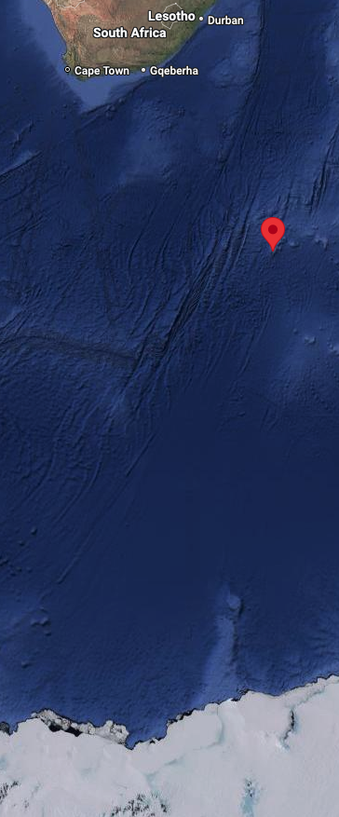
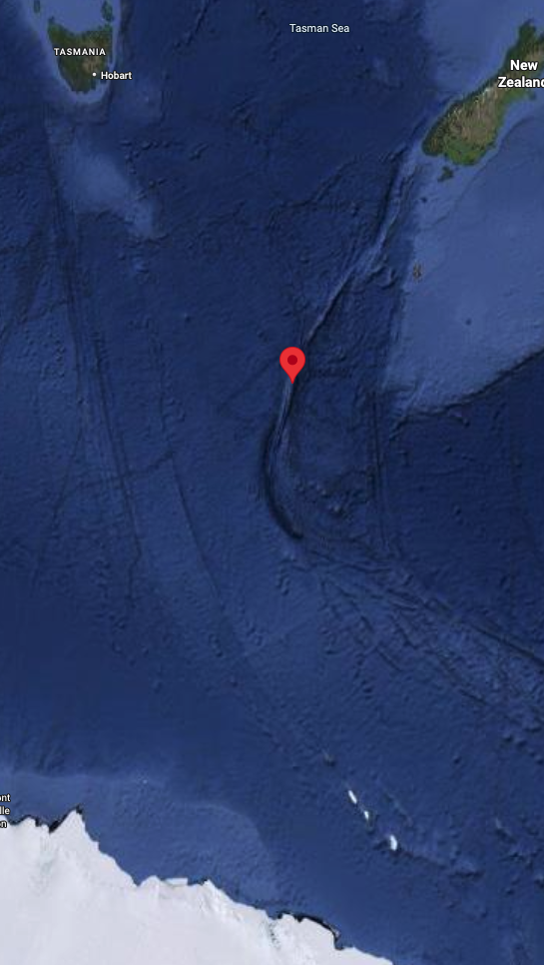
Potential validation sites
SAEON has regular cruises to their Antarctic base
SAEON operates a manned research station on Marion Island
France has a research station on Ile Amsterdam
BoM (AU) has stations on Macquarie Island and Cape Grim, Tasmania (AU)
In South American / Atlantic region, Argentinian Orcadas Base, BAS King Edward Point on South Georgia, or Gough Island

Slide 6
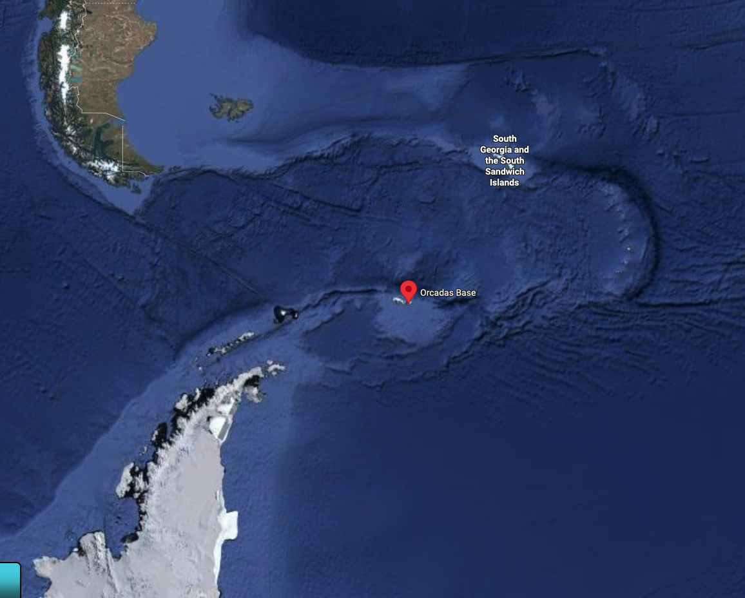
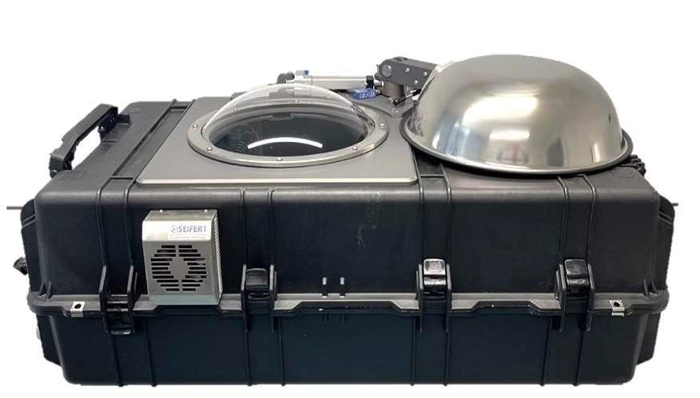
Potential validation equipment
Sub-Antarctic islands are rather hostile regions and require robust, weatherproof equipment
Seawater, ice and clouds will make it challenging
For GHGs (CO₂ & CH₄), the EM-27 instrument with housing would be suitable

Slide 7
Request for enabling validation
Agencies are requested in supporting:
Enabling contact & reaching out to host agencies
Informing the GHG TT on potential funding schemes
Provision of weatherproof, equipped EM-27s
Network optimisation exercise testing optimal locations
Suggestions for exploiting other instruments/ measurements, e.g. ship-born pCO₂
THANKS! TIME FOR QUESTIONS & FEEDBACK

