Slide 1
CEOS SIT-41
April 2026
Turning Data into Decisions:
Fire Intelligence for the Fireline
Chief Phillip SeLegue, CalFire
Dr. Michael Falkowski, Earth Fire Alliance
Agenda Item 6.1
CEOS SIT-41 2026
Irvine, California, USA
14-16 April 2026

Slide 2
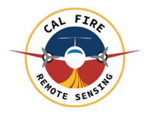
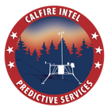

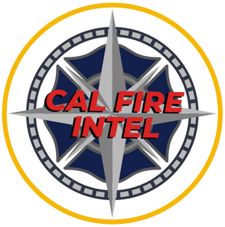
Fire Intelligence Briefing
Operational Intelligence for modern wildfire response

Slide 3
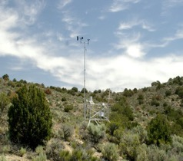
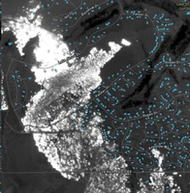
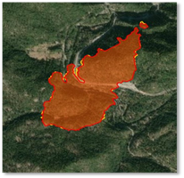
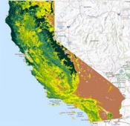
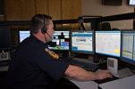
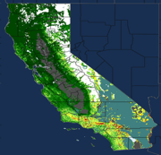
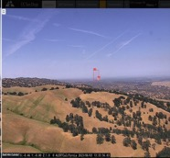
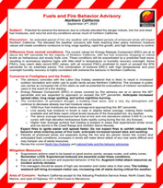
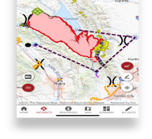
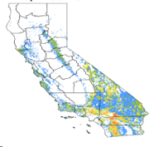
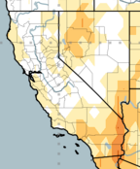
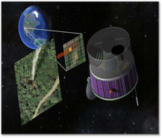

Fire Intelligence
Ongoing Assessment
Predictive Services
Wildfire Threat Assessment
Early Detection

Slide 4




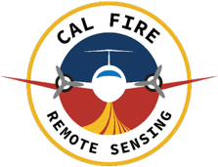
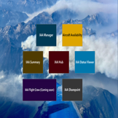








What platforms / software we use

Slide 5
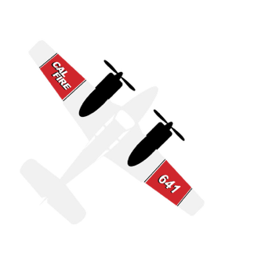
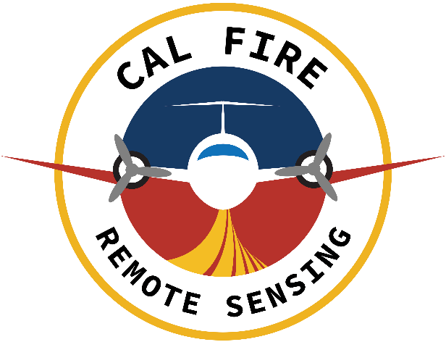
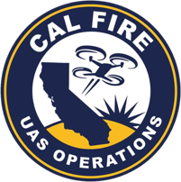





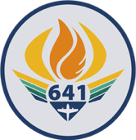

Remote Sensing Program
EFA - FireSat
CWN / FIRIS

Slide 6
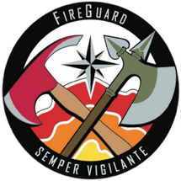
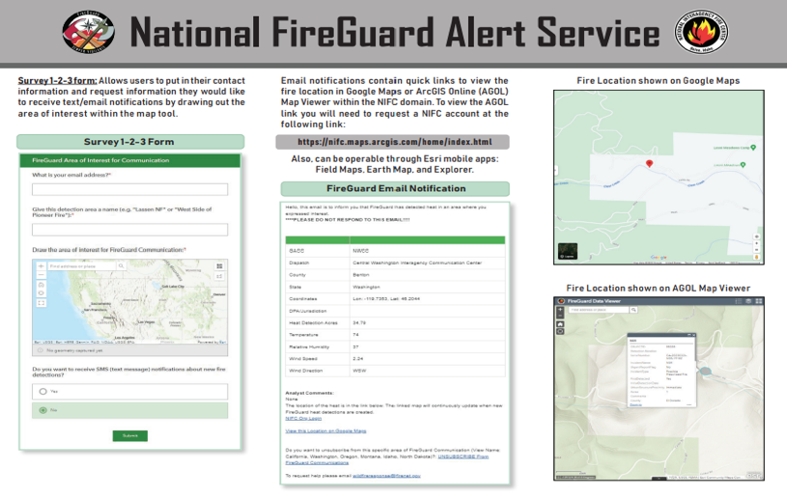
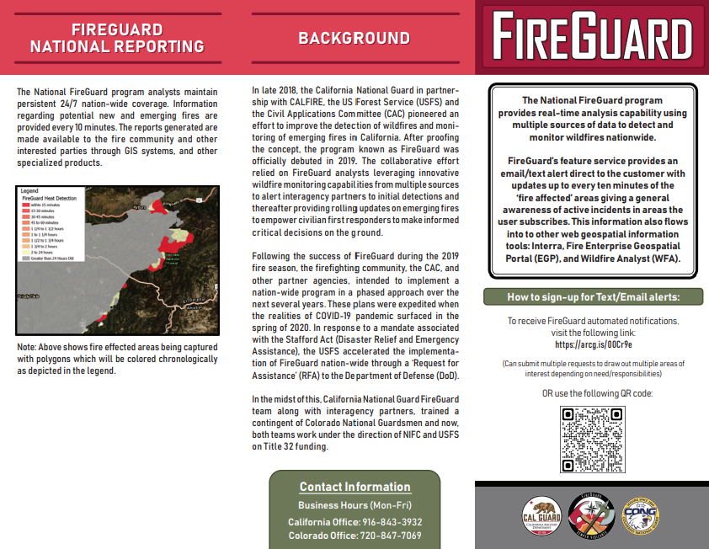
FireGuard
Notes:
1156 Cameras
689 Sites

Slide 7
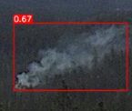
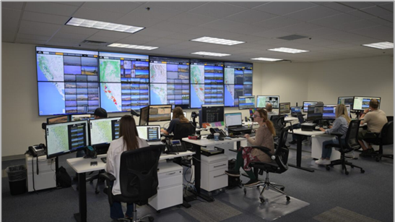
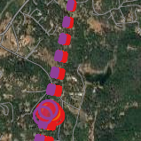
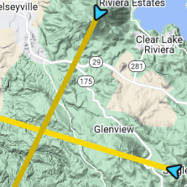
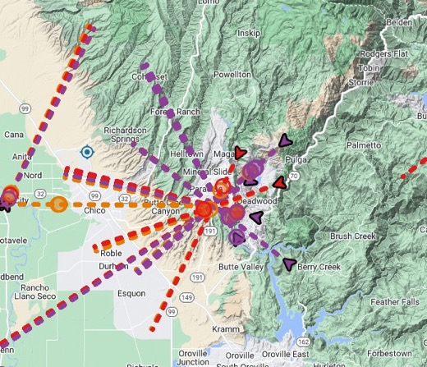
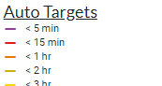
AI Operations
AI Operations Technicians analyze the detections, dismiss false positives, & verify or refine lat/lons, using the following tools:
Visual comparison between satellite imagery & camera feed
Triangulation through multiple AI target lines
Moving cameras within viewshed of the fire to create triangulation

Slide 8

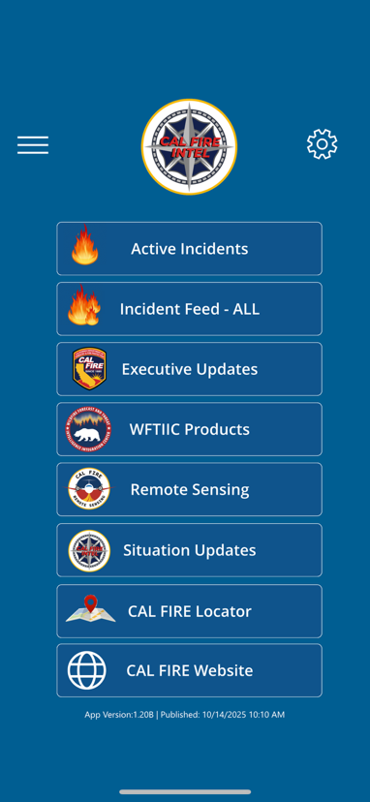
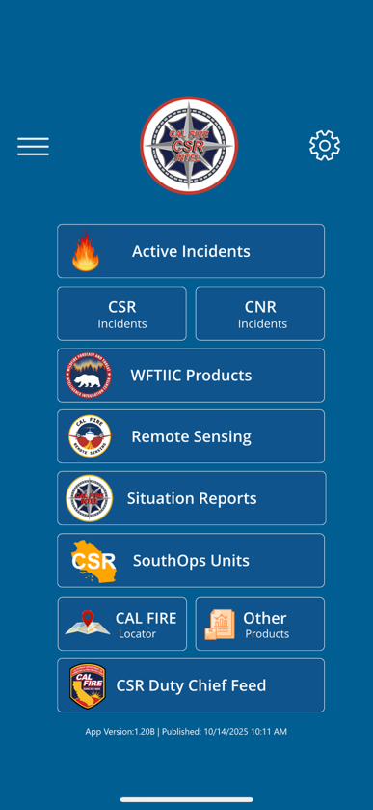
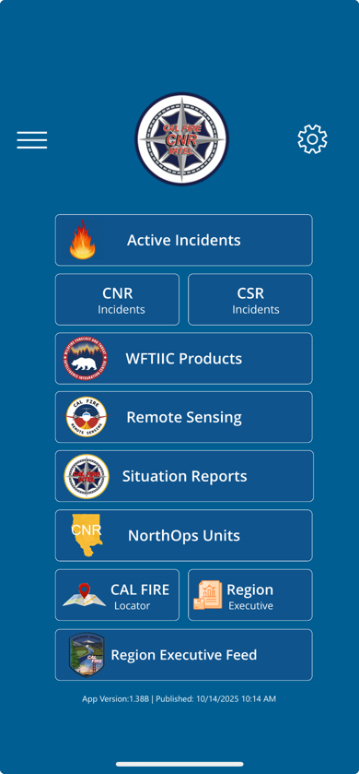

CAL FIRE Intel App
SAC Intel App
CSR Intel App
CNR Intel App
Notes:
In 2025, we rolled out the CAL FIRE Intel App as a situational awareness tool for Duty Chief level audience.
In 2026, we will be rolling this App down to the unit BC level and above and also IMT’s. If you would like to be added will be a QR code in a few slides to get it or visit the Intel Booth.
This was developed through the Powerapps Application.
3 Intel App Platforms built for Northern Region, Southern Region, and Sacramento.
For outside organization use, those with fire.ca.gov email addresses and/or those who have ROC credentials should be able to get it as well.

Slide 9
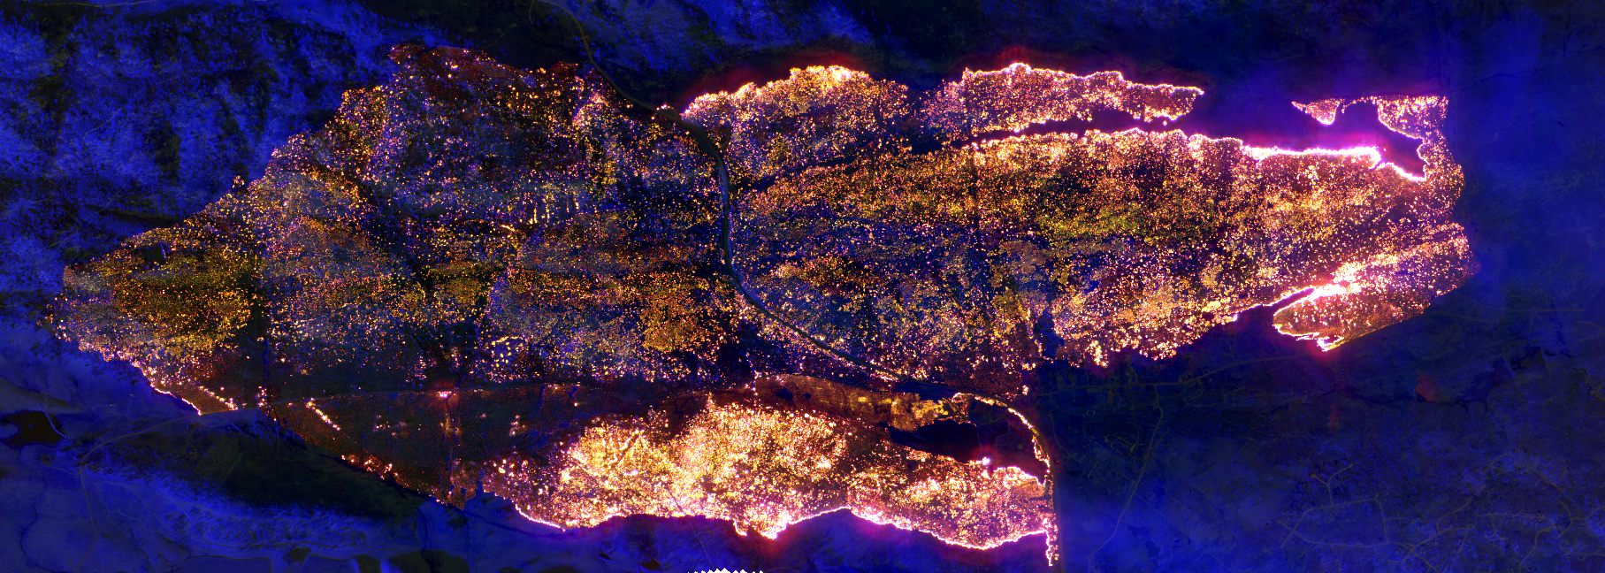

Thank You
Phillip SeLegue
Staff Chief – Intel

Slide 10
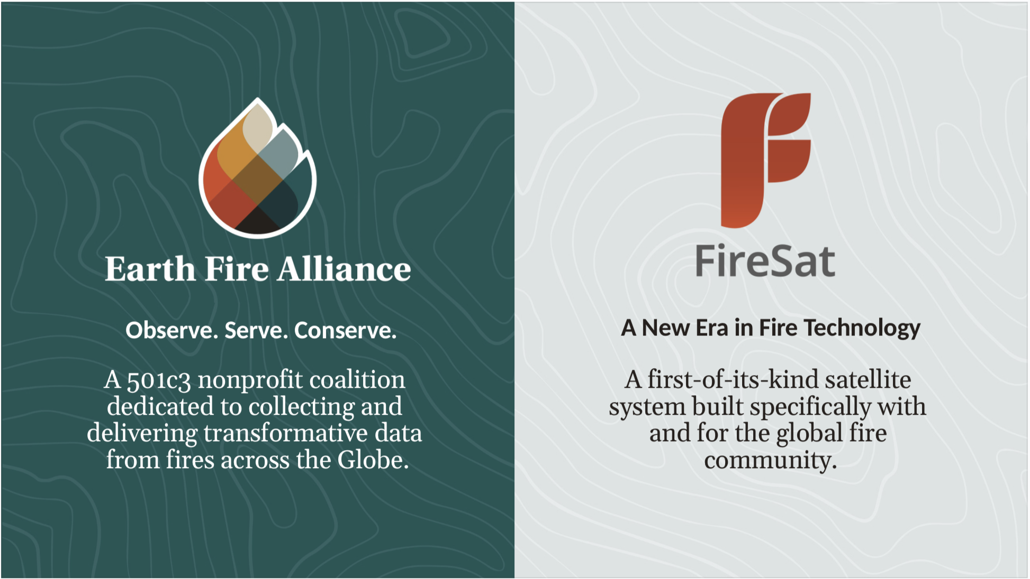

Slide 11
EFA delivers high-fidelity, globally accessible data to fundamentally change how humanity anticipates, manages, and ultimately thrives with fire
Observe fire across our planet comprehensively
Serve communities worldwide with timely and trustworthy fire information
Conserve ecosystems and natural resources while protecting human lives and livelihoods through data-driven wildfire mitigation, response, and resilience stratiges
EFA believes that a collaborative global response to the wildfire crisis is possible, and that a data-driven approach to understanding and managing fire will enhance humanity’s ability to adapt to a changing wildfire environment
Notes:
EFA was founded on the simple but powerful belief: that high-fidelity, consistently collected, and equitably accessible data—captured before, during, and after a fire—is essential to solving the wildfire crisis in the United States and around the world.

Slide 12
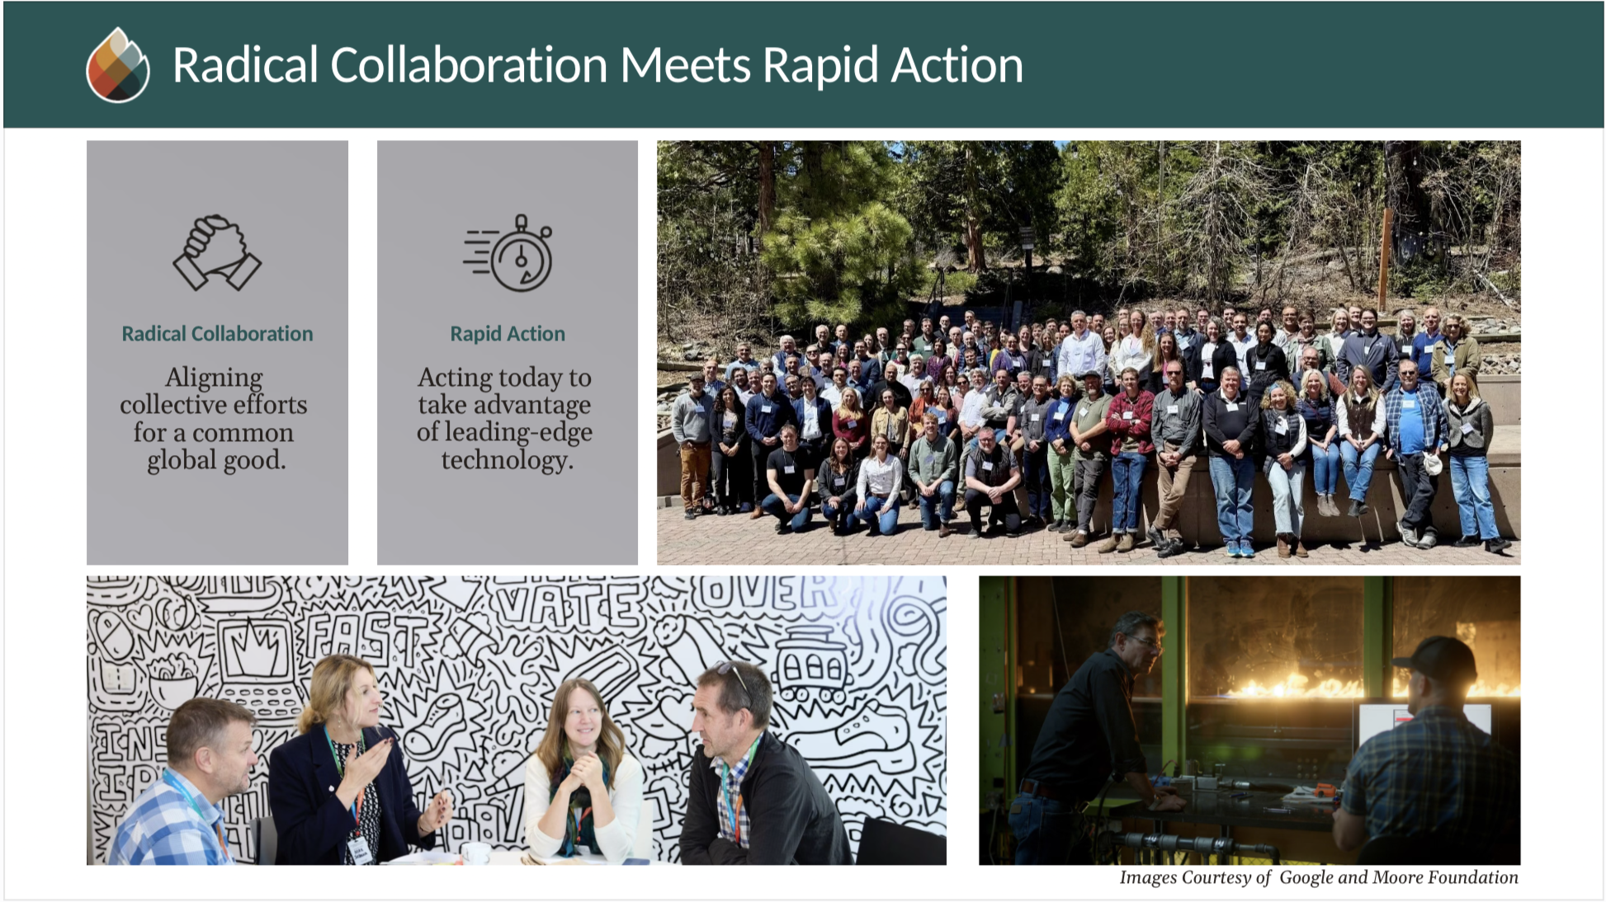

Slide 13
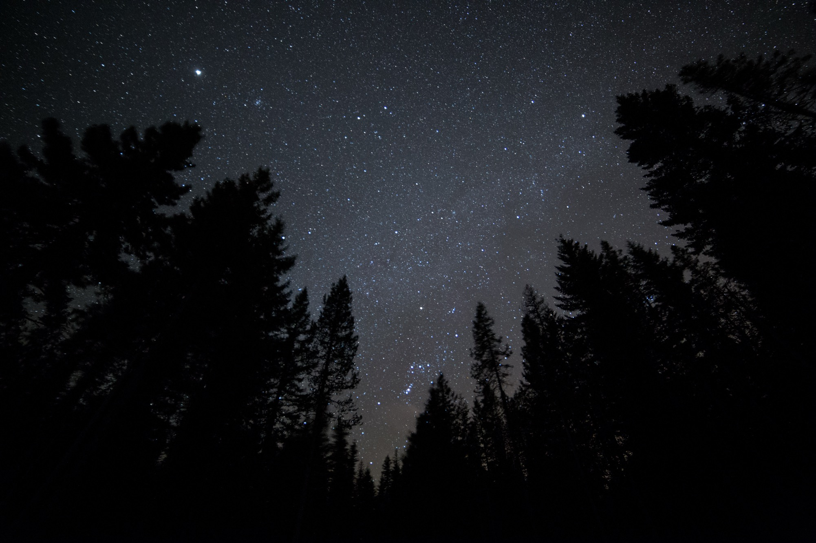










FireSat Roadmap
Alliance begins
to convene. EFA officially founded in 2024.
Government funding and data revenue will support Full Operational Capability.
Philanthropy supports Initial Operational Capability.
2022 - 2024
2025
2026
2030
Design, Build,
Test
Cross-community
planning and system requirements definition
1 Satellite
Protoflight Launched
Risk reduction and data testing with Early Adopters
~20 Satellites
1 hr Revisit
Unlocks significant impact targets
~50 Satellites
20 min Revisit
Global coverage and data distribution
3 Satellites
Twice Daily Revisit
Coverage and data for key fire geographies
Notes:
●We have set a very ambitious timeline to achieve our FireSat goals, and we are moving very fast!
●EFA was founded in 2024 with an ambitious plan to have near-real-time fire data on a global scale within 5 years.
● The protoflight instrument was launched just one year after the founding of EFA, and We will be launching our next 3 satellites this summer, with more soon to follow.
●Our goal is to have a fully operational satellite constellation by 2030, providing a 20 min revisit rate globally.
●We have garnered generous support from philanthropies to derisk and demonstrate this technology, and are always looking for more partners and opportunities, including form governments across the globe to accelerate implementation and sustain operations into the future.
————-
EFA is raising funds to add capacity to the FireSat constellation toward our ultimate goal of 20-minute revisit for every point on Earth by 2030.
We have dedicated funders helping us march toward this goal, but additional funding will be necessary to ensure we maintain or can even accelerate this timeline.
One year after the founding of EFA… our partners at Muon Space launched our first satellite, protoflight, to reduce risk and test and demonstrate capabilities.
(Talk to the idea of FireSat being an exemplar of cross-collaboration that could be modeled if a Wildfire Intelligence Center is formed.)

Slide 14












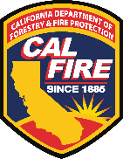





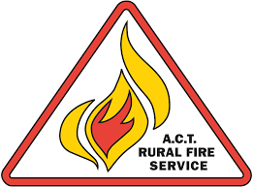

Public-Private-Philanthropic Partnership
We work with philanthropic, private industry, government, fire agency, and fire science collaborators.
Earth Fire Alliance Supporters
12 Early Adopters from 3 continents
Notes:
Public-Private-Philanthropic Partnerships
EFA is a nonprofit with a unique business model that combines philanthropic funding and private sector innovation to kickstart rapid, first-of-its-kind technology for public good.
While it may be impractical for most agencies and governments to launch a satellite constellation like FireSat for their individual use, collectively every agency and country can benefit from our global program… which provides economies of scale.
●And finally, we understand that we cannot solve this problem alone, and we have no intention in doing so. As an alliance, we are embracing radical collaboration, recognizing that fast change requires leveraging the best of what the public sector, private sector, and non-governmental organizations (NGOs) have to offer.
What we are doing at EFA is an example of how barriers can be broken down across sectors and silos to address critical technology needs in wildfire management and resilience through radical collaboration.
——
Early Adopters
EFA is also building an Early Adopter program, which is an opportunity for fire agencies and fire scientists around the world to help refine data products, define data delivery mechanisms, and harness the full potential of FireSat.
We’re partnering with Early Adopter fire agencies and research institutions to understand their workflows and determine the most efficient, effective way to deliver FireSat data
when the first three operational —satellites launch later this year.
●We are sincerely using a big tent model and welcome an open discussion with folks that are interested in joining our Alliance to help meet our mission as effectively and quickly as possible.
Don’t need all this:
We’re also steadily adding a cohort of fire scientists and modelers to the program:
FireSat data will be used to support academia and other organizations that contribute to wildfire resilience through fire science, planning, and research.
FireSat will enable more accurate prediction of fire start conditions, fuel sources, growth, decay, and regrowth post-fire by helping fire scientists and modelers better understand how fire behavior is changing over time.

Slide 15
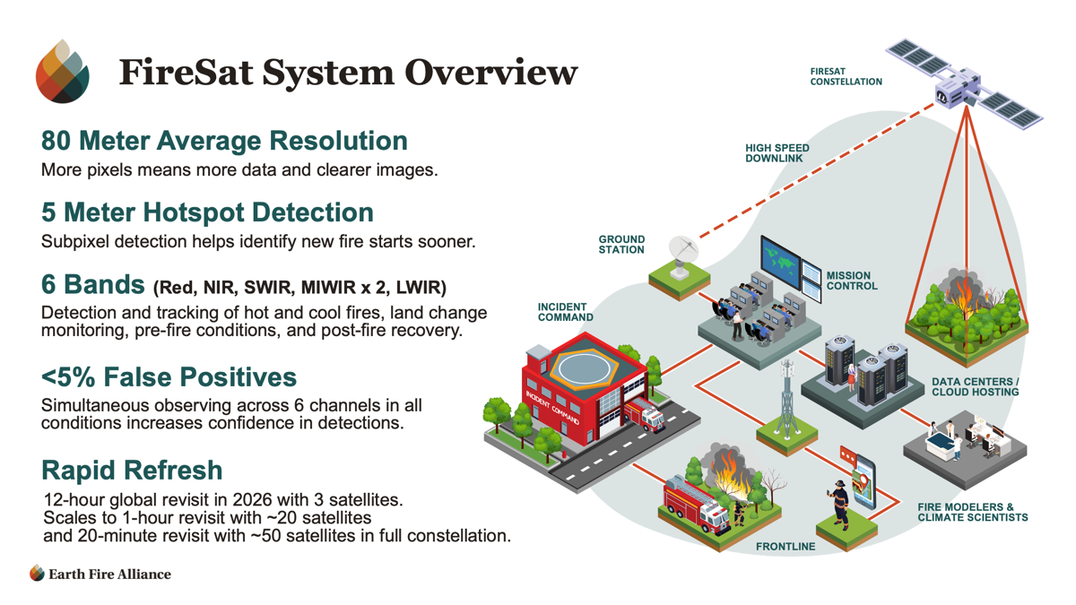
Notes:
Here is a very broad overview of the FireStat system and capabilities.
When fully operational, this system will be able to quickly identify and track fires as small as 5X5 meters with a revisit rate of 20 minutes across the across the globe.
This is an unprecedented capability to detect and track wildfires as compared to existing satellite systems.
Our data system architecture allows for low latency data delivery to first responders on the front line, along with storage and distribution of long-term datasets to the fire science and modelling community.
Collectively this system will help first responders optimize fire response and resource allocation throughout a fire’s entire lifecycle
It will also deliver as world-class dataset for scientific applications, AI-based predictive modeling, ultimately supporting improved wildfire mitigation and resilience strategies

Slide 16
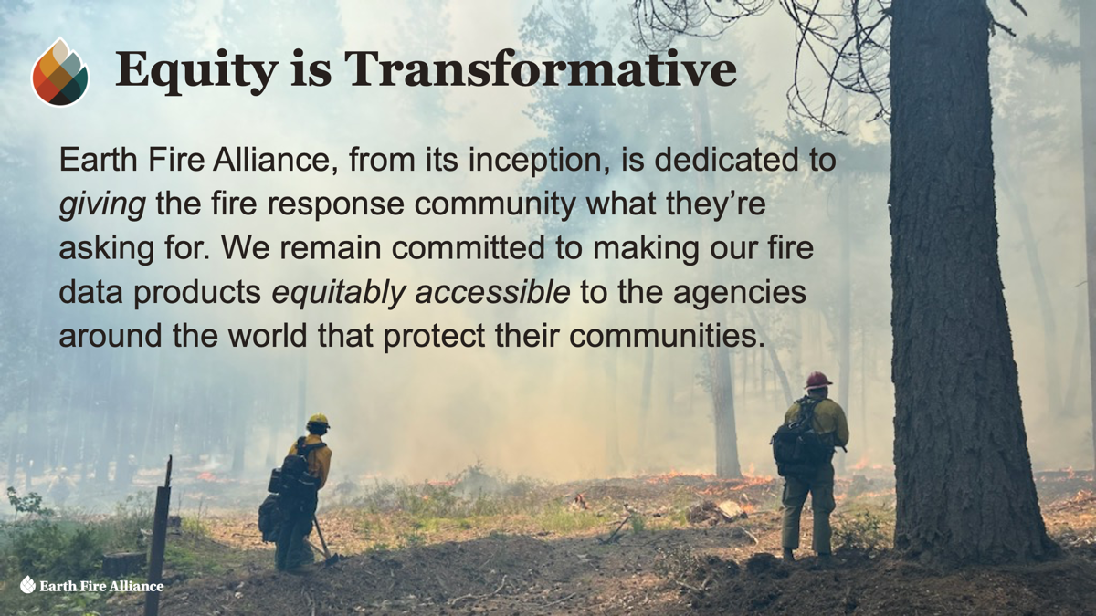

VIIRS
Images Courtesy of Muon Space and NOAA

Slide 17
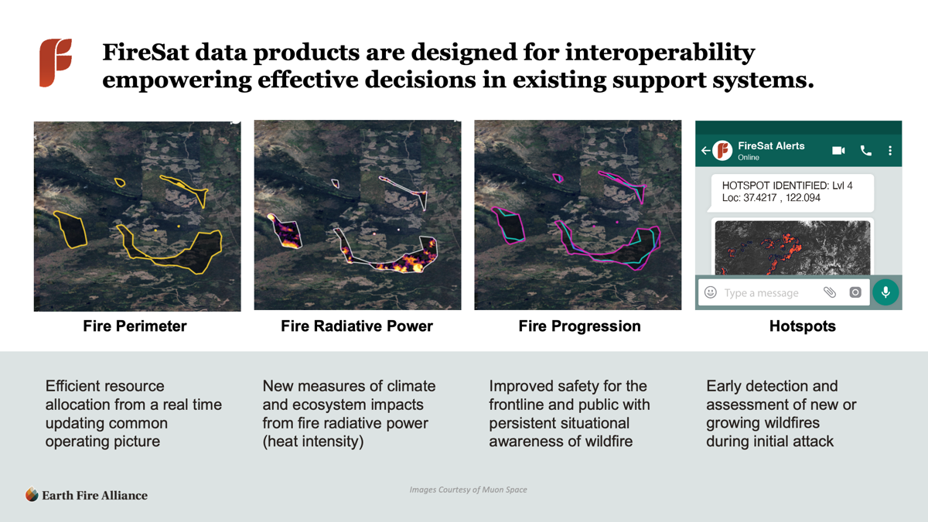
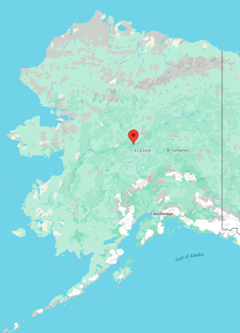




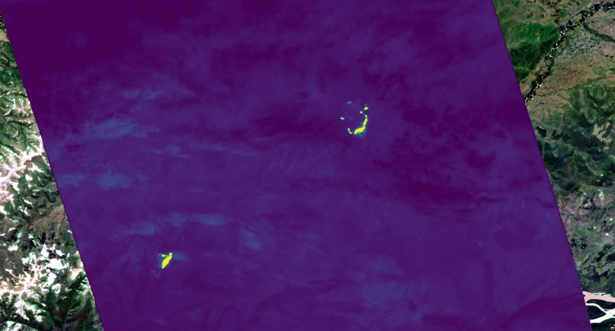
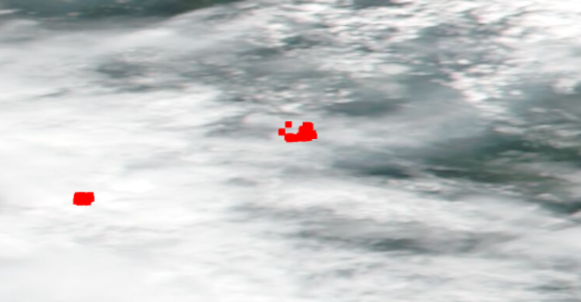
FireSat Protoflight Imagery vs VIIRS
TANANA, ALASKA, USA — JUNE 21, 2025
FireSat Mid-Wave Infrared (MWIR) channel
VIIRS hotspot detections
VIIRS
Images Courtesy of Muon Space and NOAA

Slide 18

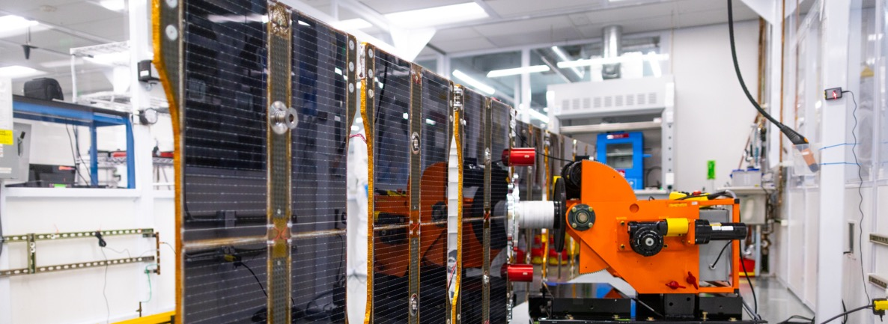
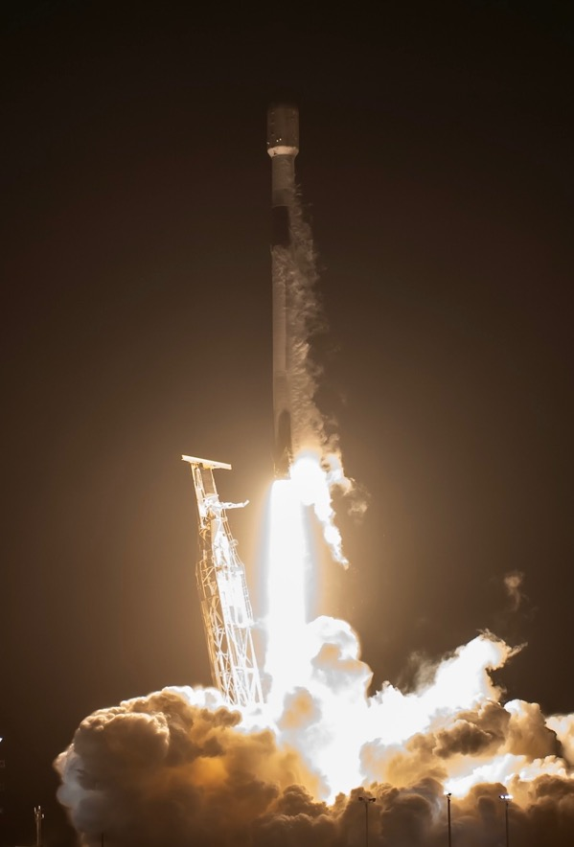
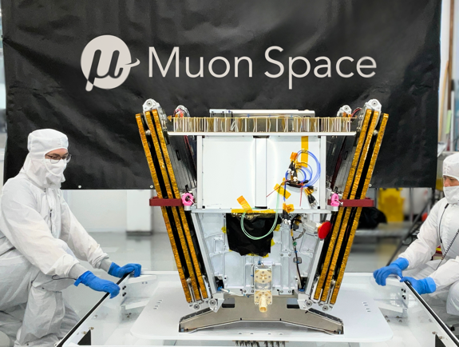
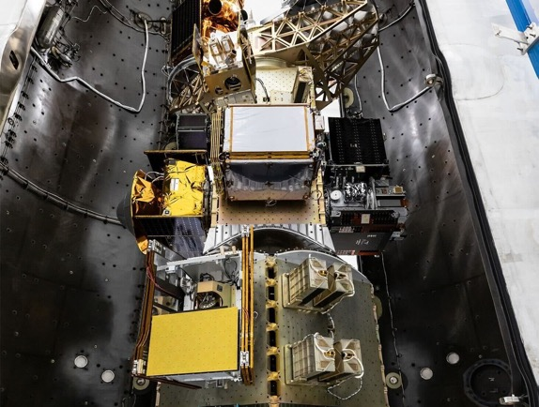
FireSat0 (AKA protoflight) Launch
Protoflight Launched March 2025
FireSat
Images Courtesy of Muon Space and SpaceX
Notes:
With this commitment to Radical Collaboration and Rapid Action, EFA and our partners can quickly design, build, and deploy new solutions urgently needed by federal, state, and local fire management and response organizations.
As an example of this, our first satellite, called protoflight, was built by our industry partners at Muon space and launched into orbit just after one year of the founding of EFA. By comparison, Government satellite programs typically require significantly more time to formulate, gather momentum, and fund. The ability to rapidly innovate and deploy fire management relevant technology is a key strength of our effective collaboration with our industry and operational fire management partners.
Protoflight, which you see in these images, launched in March of 2025. It is a fully functional system that we are using for on-orbit testing and demonstration, which allows us to reduce risk and validate the end-to-end performance of the satellite system, including its advanced sensors and data delivery pipeline, prior to launching our next 3 operational FireSats this summer,
We are able to take lessons from this risk reduction and demonstration phase to optimize and maximize the reliability and impact of our future satellites.

Slide 19

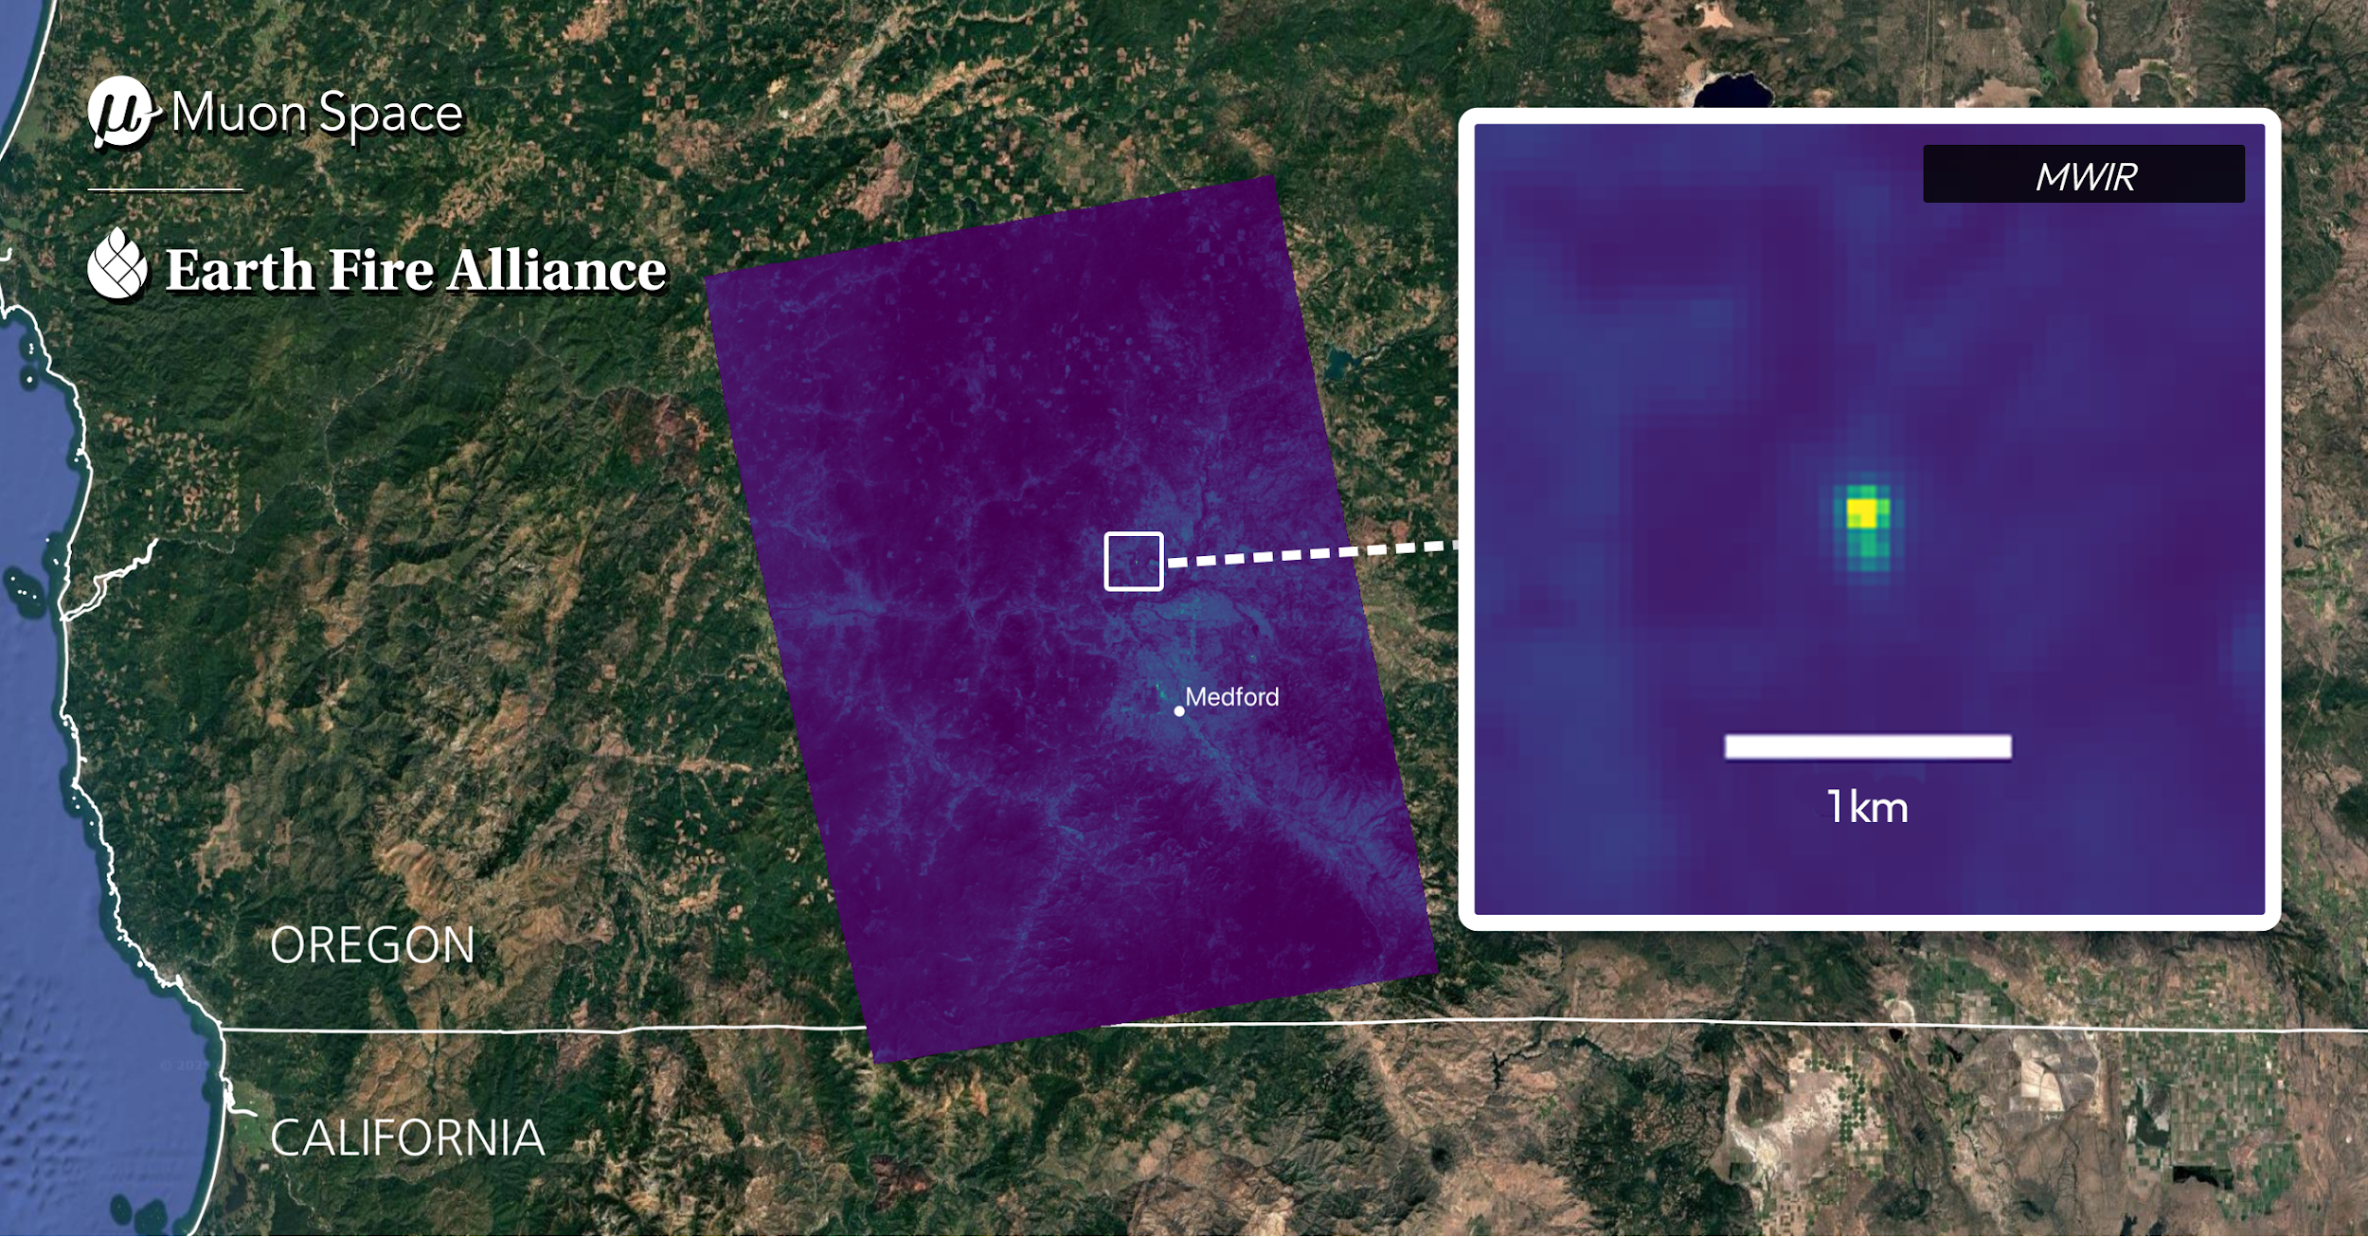



Table Rock Fire, Oregon
FireSat detects active fire
Local media photo
FireSat active fire
Images Courtesy of OHAZ/University of Oregon and Oregon Department of Forestry
Notes:
(video set to autoplay on loop)
Here is another series of images showing this particular fire.
You can see the smoke plume in the alert west camera video on the left, and just how small this fire was in the media photo in the middle.
●This showcases fire stats ability to detect small fires, at a spatial resolution that far exceeds existing satellite systems.
This example also demonstrates how firesat can integrate within the existing fire technology ecosystem, providing complimentary data and unique insights to help inform fire response strategies.
——
This slide is useful to provide context for the small scale of this fire.
Also a great opportunity to talk to how FireSat will integrate with and complement other data types such as ground-based cameras, drones/aircraft (obviously none were launched for this fire), other gov sat systems, etc.

Slide 20
FireSat Protoflight Imagery vs VIIRS
TANANA, ALASKA, USA — JUNE 21, 2025
FireSat Mid-Wave Infrared (MWIR) channel
VIIRS hotspot detections
VIIRS
Images Courtesy of Muon Space and NOAA

Slide 21


Notes:
BEEF TRAIL CREEK FIRE
This animation shows Mid-Wave Infrared (MWIR) data of the Beef Trail Creek Fire across 3 consecutive nights, with active wildfire areas visible in bright yellow.
The progression reveals the fire's evolution over 72 hours, with intensity visibly decreasing by September 7.
FireSat's spatial resolution enables precise tracking of fire behavior and spread patterns, while nighttime imaging ensures 24/7 operational awareness regardless of daylight or smoke conditions.
This multi-day monitoring capability provides fire managers with critical intelligence on fire progression and containment effectiveness.

Slide 22

Notes:
FireSat protoflight nighttime image over Queensland, Australia.
Collected at 10:26 pm local time on November 20, 2025.
This full swath image demonstrates the sensor’s remarkable 1,500 km imaging capacity in one pass.
Inset fire detail shows a detected fire in the midwave infrared band relative to a 5 km scale.

Slide 23

FireSat Protoflight Imagery vs VIIRS
TANANA, ALASKA, USA — JUNE 21, 2025
FireSat Mid-Wave Infrared (MWIR) channel
VIIRS hotspot detections
VIIRS
Images Courtesy of Muon Space and NOAA

Slide 24


Slide 25


Slide 26


Observe. Serve. Conserve.
​ mike@earthfirealliance.org
www.earthfirealliance.org
Notes:
Thanks for your attention this afternoon.
Please feel free to reach out to me if you have questions or would like more information.

