Slide 1

Mike Budde, US Geological Survey
Executive Secretariat Member – International Charter
41st CEOS Strategic Implementation Team Meeting (SIT-41)
Contact: mbudde@usgs.gov
April 16, 2026
Notes:
Last update: 2026-03-30: Changed minimum font and stats update.
Speaker notes
Welcome the audience and introduce the topic
Explain that this presentation will cover what the Charter is, how it works, and why it is important

Slide 2

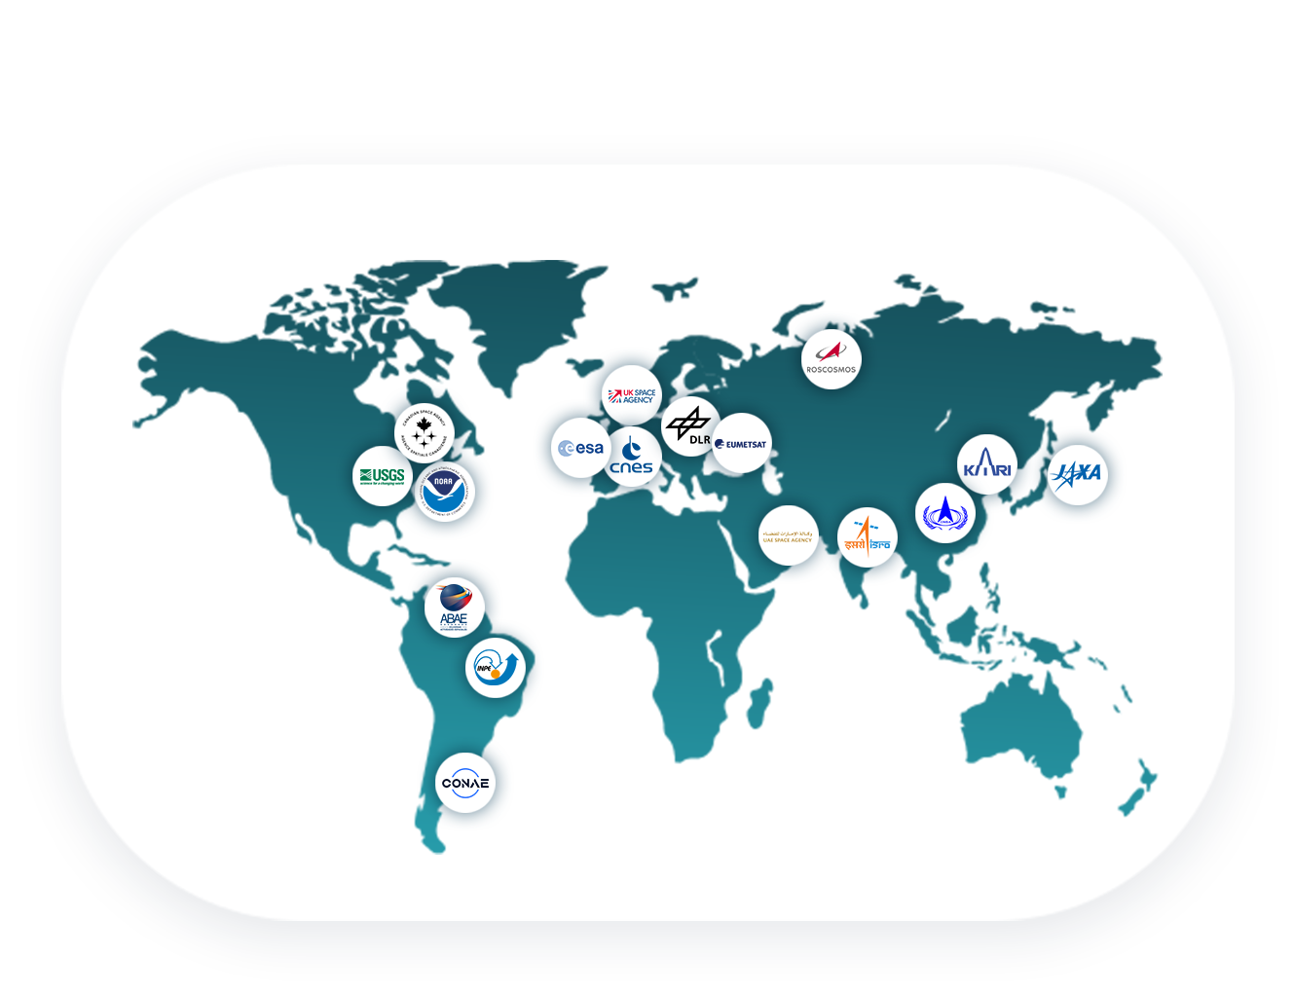

WHAT IS
THE CHARTER?
Established in 2000
A global space agencies initiative that provides satellite data to support disaster relief organizations in saving lives, property, infrastructure and the environment following major disasters
Includes 17 members and
15 data contributors worldwide
Notes:
Speaker notes
The Charter is an international agreement by global space agencies to provide priority access to critical satellite data in times of crisis.
Established in 2000 by the European Space Agency (ESA), the French Space Agency (CNES), and the Canadian Space Agency (CSA)
It ensures quick access to high-resolution images for disaster response.
The data helps emergency responders to plan evacuations, assess damage, and allocate resources more effectively.

Slide 3


WORKING WITH
PARTNERS
Together with member agencies and partners, the Charter:
Provides free satellite data in support of major disasters from a large pool of data contributors
Facilitates the creation and delivery of Value-Added Products covering the damaged area
Maintains a network of expert Project Managers and Value-Adders
Works with UN agencies and other partners to enable capacity building in the use of satellite data in support of major disasters
Notes:
Speaker notes
Briefly explain the following terms:
What are Data Contributors
What are Project Managers
What are Value-Adders
What is a Value-Added product
*Available extra slides about Data Contributors, Project Managers and Value-Adders

Slide 4

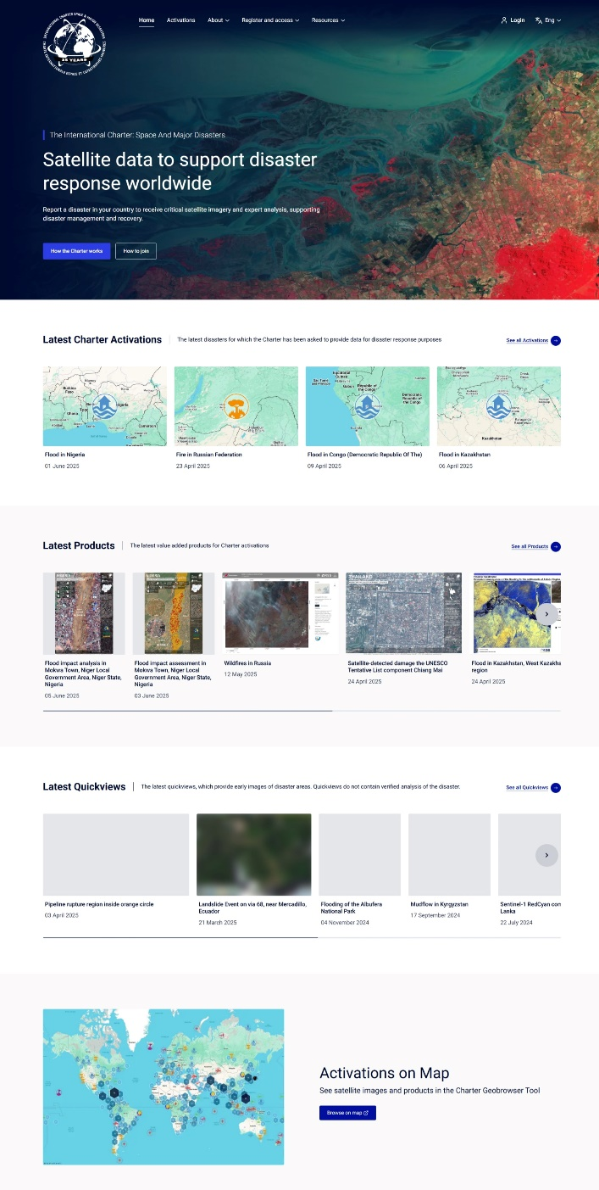
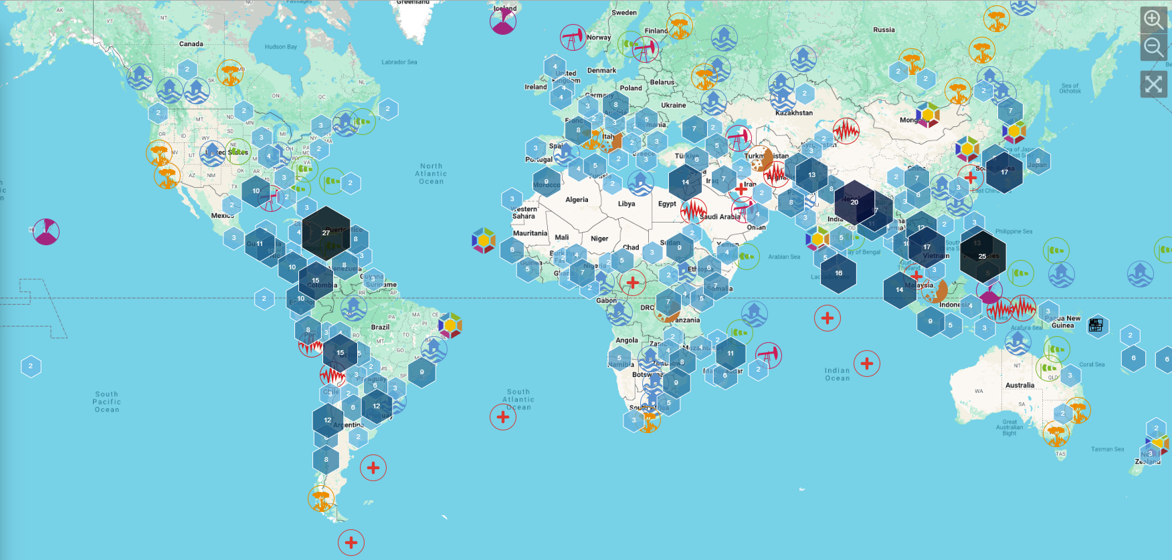


CHARTER
ACTIVATIONS
As of April 14, 2026, the Charter has supported 1,027 activations
Notes:
Speaker notes
___________
How to update the statistics above.
Go to https://disasterscharter.org/about-the-charter
Scroll further down the page and a table with the latest data will appear.
Latest update on: XX
To show the interactive map functionalities:
1. Go to : https://cgt.disasterscharter.org/en
To update the screenshot of the map:
Go to: https://cgt.disasterscharter.org/en
On the map, zoom out using the minus symbol button.
Use the Snipping Tool to take a screenshot of the map. Right-click on the image generated by the Snipping Tool, then copy and paste it onto the page above.

Slide 5












TYPICAL
DISASTER TYPES
NATURAL EVENTS
MAN-MADE EVENTS
Earthquakes
Fires
Floods
Oil Spills
Explosion Events
Industrial Accidents
Snow Hazards
Landslides
Tsunamis
CHARTER CANNOT BE
ACTIVATED FOR:
War or armed conflict
Slow-onset disasters (i.e., drought)
Disaster is not in a state of crisis
(i.e., minor earthquake)
Hurricanes
Storms
Volcanic
Eruption
Others
Notes:
Speaker notes
Explain what are the typical disaster types
Explain what the Charter cannot be activated for

Slide 6


BENEFITS OF ACTIVATING THE CHARTER
Access to data from 270+ satellites
Rapid tasking of a wide variety of Earth observation satellites
Crucial insights into a disaster that are impossible to obtain from the ground
Global collaboration in humanitarian aid by providing free, 24/7 access to a community of experts and decision makers
Notes:
Speaker notes
Enables a rapid tasking of a wide variety of Earth observation satellites.
Helps deliver faster emergency response on the ground.
Satellite imagery offers crucial insights into a disaster that are impossible to obtain from the ground.
Enables improved support for remote communities
Fosters global collaboration in humanitarian aid by providing free, 24/7 access to a community of experts and decision makers.
Enables better support for countries that couldn't afford this kind of technology.

Slide 7
HOW CAN THE CHARTER BE ACTIVATED?
BY DIRECT ACTIVATION
THROUGH AN AU FROM ANOTHER COUNTRY
Authorized Users (AU) can request the activation of the Charter in the event of a disaster occurring in their own country.
AU can request the activation of the Charter for a disaster occurring in another country that does not have an AU.
BY THE UNITED NATIONS
THROUGH SENTINEL ASIA
UNOOSA and UNITAR/UNOSAT can submit requests on behalf of United Nations’ agencies and countries that do not have an AU.
The Asian Disaster Reduction Center can submit activation requests on behalf of national users of Sentinel Asia.
Notes:
Speaker notes
By direct activation: Organizations authorized to request the activation of the Charter in the event of a disaster occurring in their own country are known as Authorized Users (AU). These are typically civil protection agencies, government relief organizations, or other authorities with a disaster management mandate.
Through an AU from another country: Authorized Users may request the activation of the Charter for a disaster occurring in another country that does not have an AU.
By the United Nations: The Charter has agreements with UNOOSA (Vienna) and UNITAR/UNOSAT (Geneva) to support United Nations agencies. UNOOSA and UNITAR/UNOSAT can submit requests on behalf of UN users.
Through Sentinel Asia: Is a regional initiative supporting emergency response in the Asia-Pacific region using satellite data. The Asian Disaster Reduction Center (since 2009) can submit activation requests on behalf of national users of Sentinel Asia.

Slide 8



CHARTER MAPPER SERVICE
What is the ESA Charter Mapper?
Who can use it?
It is a Processing Environment in the Charter Operational System, implemented by ESA, to support operations with online services to access, process and visualize EO data products.
  Charter Project Managers (PMs) and Value Adding (VA) providers can use the ESA Charter Mapper during activations. The Charter members may also use it for monitoring operations and for promotion and training purposes.
Notes:
Speaker notes:
The PM and VA are able to browse, filter and select images in full resolution and, analyse and process imagery using online Earth observation services and tools.
Notes:
Charter Mapper User Manual : https://docs.disasterscharter.org/
What is the point of contact concerning User Support?
If experiencing issues in the usage of the Charter Mapper implemented by ESA or would like to report a problem, please send an e-mail to helpdesk@disasterscharter.org from 08:00 to 16:00 UTC (or 07:00 to 15:00 UTC end March - end October, daylight saving time period) and outside above hours and days also to cos_support@disasterscharter.org.

Slide 9
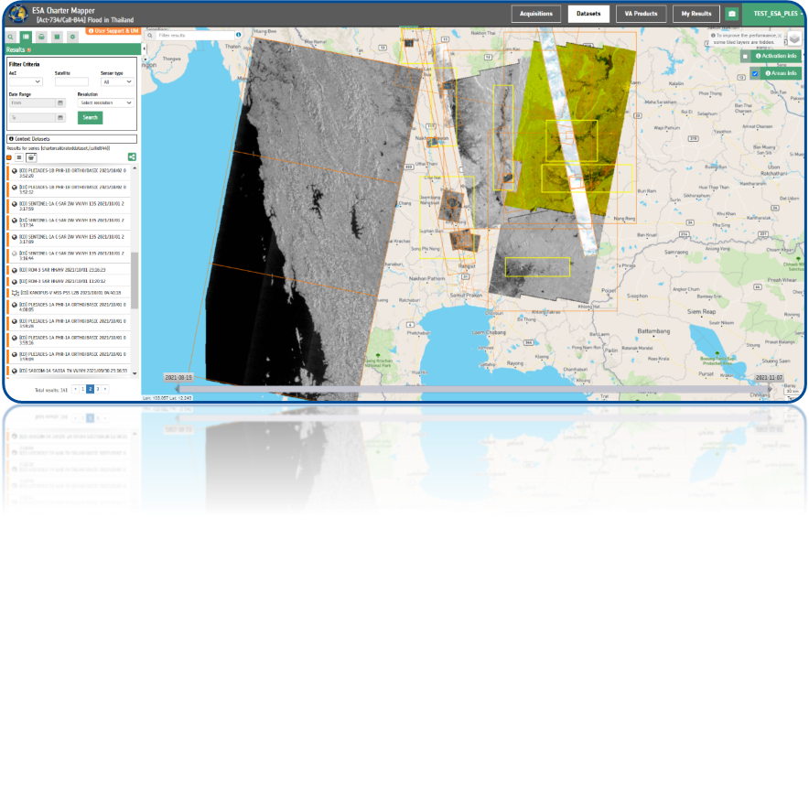



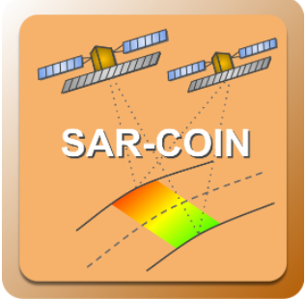








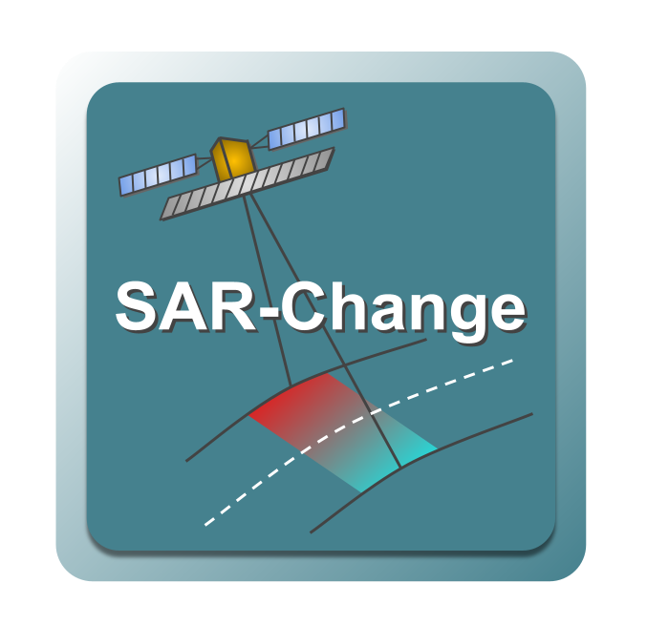
CHARTER MAPPER SERVICE
Large volumes of disparate EO data are collected for a given Charter activation
ESA Charter Mapper addresses data interoperability through pre-processing of acquisitions to a common format and systematic calibration across sensors
Provides analysis ready data for comparison and evaluation
Allows data to be used as input into downstream processing services within the Mapper that support multi-sensor and multi-mission acquisitions
Notes:
Speaker notes:
The PM and VA are able to browse, filter and select images in full resolution and, analyse and process imagery using online Earth observation services and tools.
Notes:
Charter Mapper User Manual : https://docs.disasterscharter.org/
What is the point of contact concerning User Support?
If experiencing issues in the usage of the Charter Mapper implemented by ESA or would like to report a problem, please send an e-mail to helpdesk@disasterscharter.org from 08:00 to 16:00 UTC (or 07:00 to 15:00 UTC end March - end October, daylight saving time period) and outside above hours and days also to cos_support@disasterscharter.org.

Slide 10
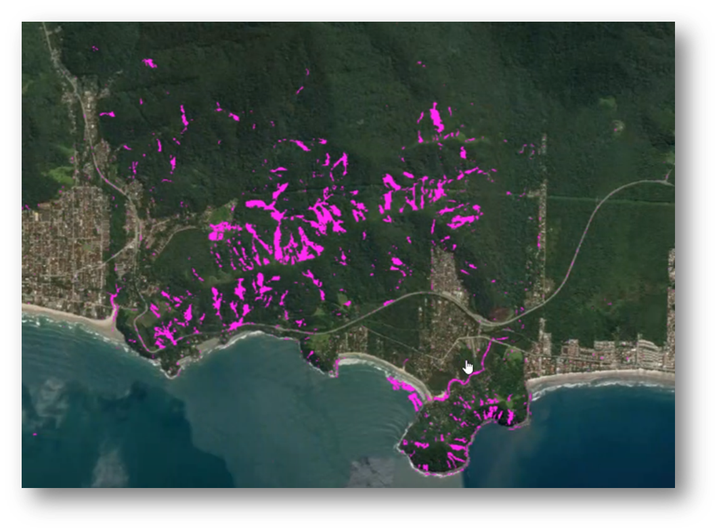
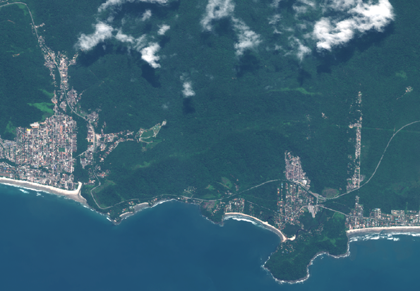
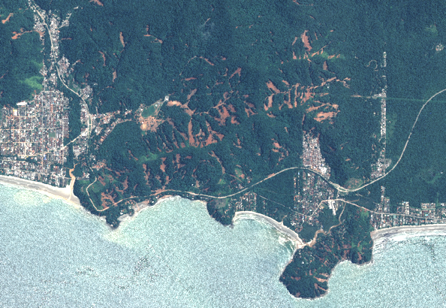

CHARTER MAPPER SERVICE – Process Example
The landslide map (magenta) has been generated using Geoeye-1 pre-event image (11/21/22) and Pleiades post-event image (02/25/23), performing an NDVI change detection using the NDVI-CD service
GEOEYE-1 acquisition – 21/11/2022
PLEIADES-1A acquisition – 25/02/2023
Notes:
Speaker notes:
The PM and VA are able to browse, filter and select images in full resolution and, analyse and process imagery using online Earth observation services and tools.
Notes:
Charter Mapper User Manual : https://docs.disasterscharter.org/
What is the point of contact concerning User Support?
If experiencing issues in the usage of the Charter Mapper implemented by ESA or would like to report a problem, please send an e-mail to helpdesk@disasterscharter.org from 08:00 to 16:00 UTC (or 07:00 to 15:00 UTC end March - end October, daylight saving time period) and outside above hours and days also to cos_support@disasterscharter.org.

Slide 11
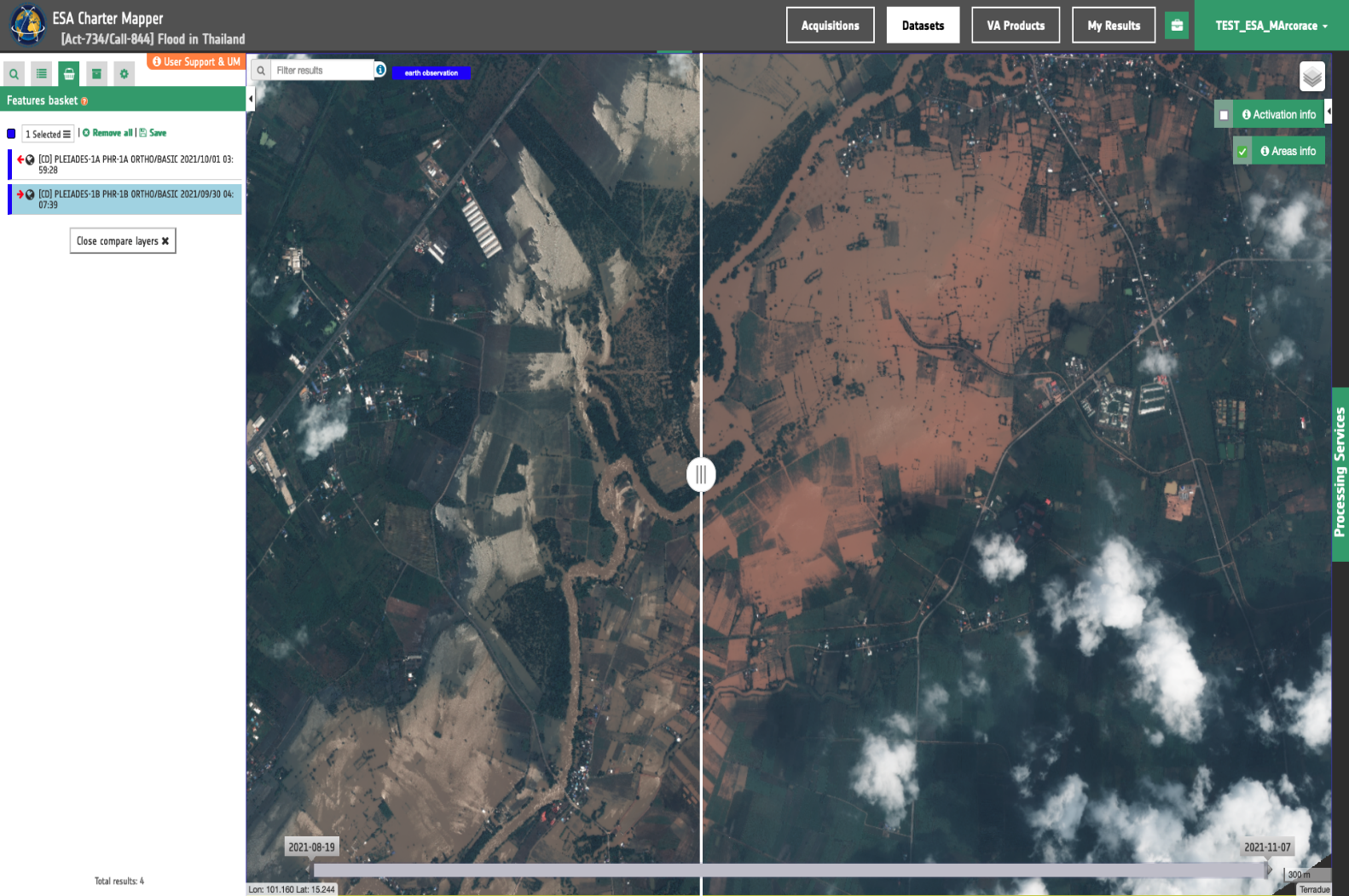
CHARTER MAPPER SERVICE – Visualization
Illustration of processed Charter data, generated by ESA in the ESA Charter Mapper: visual comparison of pre- and post-event images during a flood event near Ban Lam Narai in Thailand
The Compare Layers tool aids the user in quickly identifying changes in pre- and post-event imagery
Contains modified Pleiades-1A and 1B data. © CNES, Airbus
Act-734 Flood in Thailand
Requestor:
UNITAR on behalf of UNHCR
Project Manager:
UNITAR/UNOSAT
Value-Adding providers:
UNITAR/UNOSAT
Notes:
Speaker notes:
The PM and VA are able to browse, filter and select images in full resolution and, analyse and process imagery using online Earth observation services and tools.
Notes:
Charter Mapper User Manual : https://docs.disasterscharter.org/
What is the point of contact concerning User Support?
If experiencing issues in the usage of the Charter Mapper implemented by ESA or would like to report a problem, please send an e-mail to helpdesk@disasterscharter.org from 08:00 to 16:00 UTC (or 07:00 to 15:00 UTC end March - end October, daylight saving time period) and outside above hours and days also to cos_support@disasterscharter.org.

Slide 12
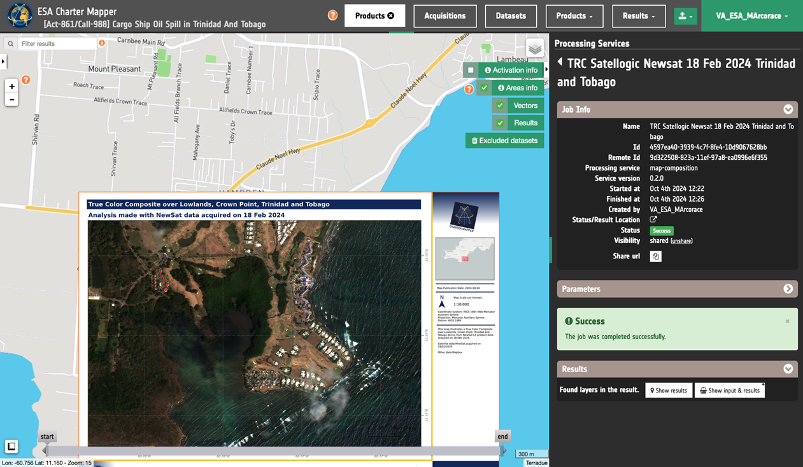
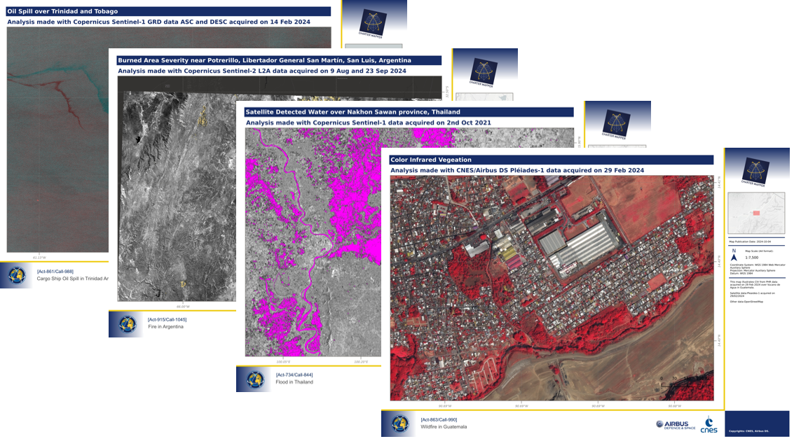
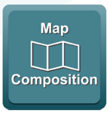
CHARTER MAPPER SERVICE – Map Composition
The Map composition tool allows the end-to-end production of a value-added product fully online within the platform, without the need to download any data or GIS software
Processing results can be applied directly to a pre-made template with the option to add logos and legends
Notes:
Speaker notes:
The PM and VA are able to browse, filter and select images in full resolution and, analyse and process imagery using online Earth observation services and tools.
Notes:
Charter Mapper User Manual : https://docs.disasterscharter.org/
What is the point of contact concerning User Support?
If experiencing issues in the usage of the Charter Mapper implemented by ESA or would like to report a problem, please send an e-mail to helpdesk@disasterscharter.org from 08:00 to 16:00 UTC (or 07:00 to 15:00 UTC end March - end October, daylight saving time period) and outside above hours and days also to cos_support@disasterscharter.org.

Slide 13
CEOS Working Group Disasters – Observer Status
The Charter Board Members approved the request from the CEOS Working Group Disasters (WGD) to be granted observer status in March of 2020
Observer Status means that the CEOS WGD activity leads are able to access information on current Charter activations and gain access to the Charter Operational System (COS-2)
Observers can view the following:
  Ongoing (open) activations list
  Activation areas of interest (KML files and mapped)
  Activation timeline details
  Emergency Request Forms (tasking requests for specific satellites/constellations)
  Acquisition and Archive Plans (what tasking is planned/archive available)
  Metadata and quicklooks of data products
  Value-added Products
  Project Manage and Value-Adding providers contact details
Observers do not have access to full-resolution data but can be given such access if they are assigned as value-adding providers

Slide 14









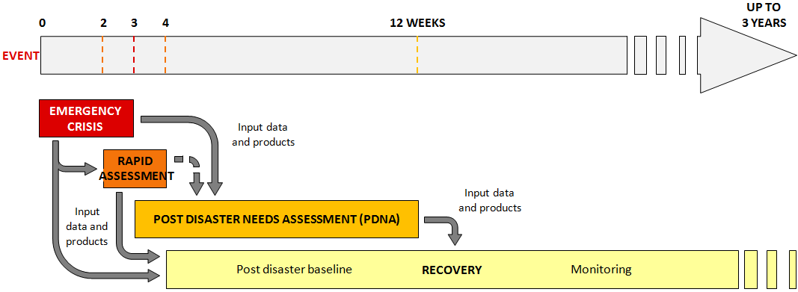
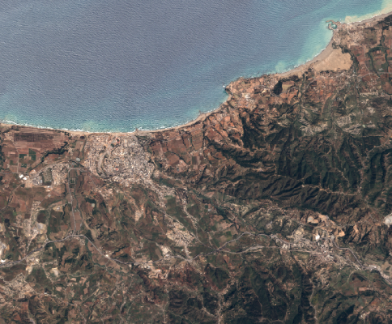





CEOS Recovery Observatory (RO)
A partnership between CEOS-EU-World Bank-UNDP
Satellites are critical for response to disasters… but what about Recovery?
Collection of satellite images and maps at several scales during ~ 6 months after a major disaster
Interactive links with PDNA partners and government
Overview
AOI
Whole impacted area
Several Hot Spots
Rapid Assessment
Urban
Zoom 1
National Recovery Plan
Hot Spot
Zoom 2
Planning
‹#›
  “Recovery Observatory” : Process allowing operational use of EO for PDNA, Recovery Planning, then M&E
Ancillary data are indispensable:
terrain validation data, aerial and drone data, statistics, cartography, ….

Slide 15
Potential Charter-RO collaboration : Benefits
Avoid duplication in data provision and leverage complementarities that can be more effectively utilized (cf. Copernicus model)
Highlight gaps, overlaps, and opportunities for more systematic collaboration
Test the Charter’s potential to provide a more complete solution that addresses longer-term challenges, such as damage assessment, and reconstruction planning
Expanding beyond the response phase into recovery could significantly enhance the Charter’s value for local end users (local governments, NGOs...)
Raise awareness among a wider set of end users about the Charter’s capabilities and encourage broader and sustained use of the Charter

Slide 16
Charter-CEOS Recovery Observatory
  During the Oct 2025 Charter Board Meeting, a Charter-RO Joint Team was established to report back on:
  How a potential collaboration could work and explore its different aspects
  How such a collaboration procedure could be implemented in the Charter operational system
  Policy adjustments required to enable the potential extension of Charter data provision for recovery, aligned with the formal Charter–CEOS coordination mechanism, and to define the role of tripartite agreement partners in future collaboration
  Definition of activation thresholds (e.g., number of VAPs, scale of event) for RO engagement and examine limits of large-scale contributions
  The Joint Team will report to next Board Charter meeting (April 22-23, 2026)

Slide 17

FUTURE OF THE CHARTER
Welcoming new Authorized Users, Project Managers, Value-Adders and members
Fostering greater collaboration among Earth observation disaster services
Expanding the network of satellites and data sources
Enhancing image processing capabilities
Incorporating new technologies, using AI opportunities
Delivering faster and more accurate information to disaster responders worldwide
Notes:
Speaker notes
As technology advances, the Charter is evolving to provide faster and more accurate data.
The future focus is on automation and making the data even more accessible.

Slide 18




LEARN MORE
General requests for information should be addressed to:
executivesecretariat@disasterscharter.org
x.com/disasterschart
disasterscharter.org
Notes:
Speaker notes
Wrap up with a strong takeaway message: Space technology is making a real difference in disaster response.
Encourage the audience to explore further resources and share what they’ve learned.
Answer audience’s questions

