Slide 1
LSI-VC Wildfire Subgroup
Mark de Jong
Natural Resources Canada
Agenda Item 6.3
CEOS SIT-41 2026
Irvine, California, USA
14-16 April 2026

Slide 2
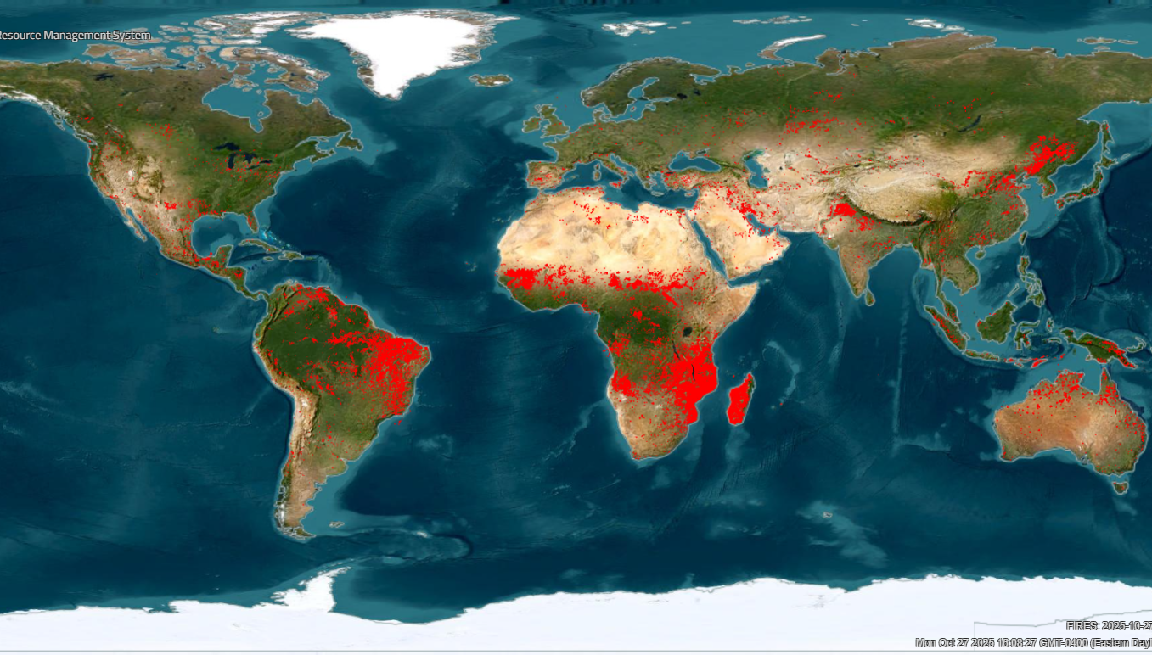
Active Fire Monitoring
Wildfire is a natural disturbance agent influenced by humans
poses management challenges
Infrared EO is widely used for active fire detection & monitoring
science: human-ecological-climate research questions
applications: operational wildfire management
LEO active fire products provided by a small number of missions
Global wildfire activity detected using satellite Earth Observation on 2025/10/27. Data from NASA FIRMS

Slide 3
Active Fire Monitoring
Challenges & Opportunities
MODIS Terra & Aqua: end of life, with no direct replacement
New opportunities from commercial and philanthropic wildfire satellite EO data providers – but how do we navigate this?
Overall: unclear future capability & continuity to meet global science & application needs
Global wildfire activity detected using satellite Earth Observation on 2025/10/27. Data from NASA FIRMS

Slide 4
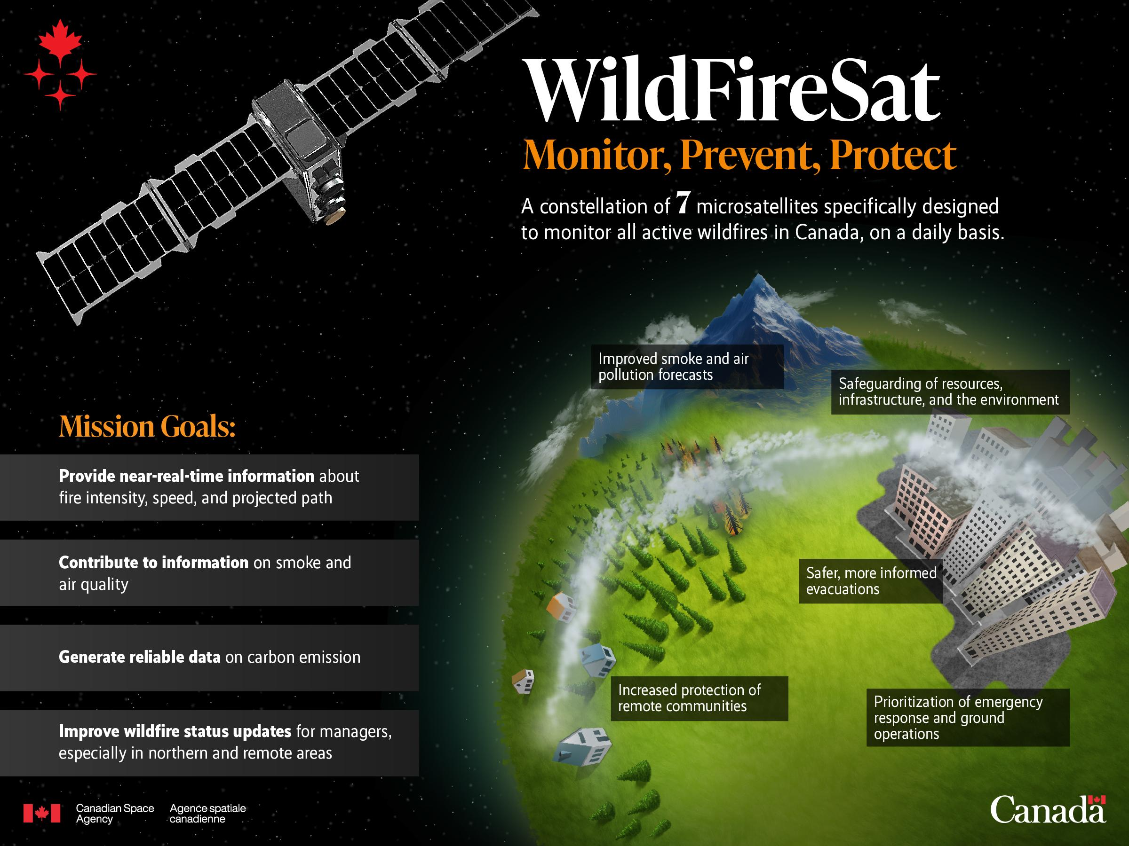
WildFireSat
Canada has been working on a dedicated active fire monitoring mission for many years, building on international experience
WildFireSat – a purpose built, government funded wildfire monitoring mission will provide free and open global active fire monitoring & Level 1B data
launch date ~2029
Support for international coordination of EO for fire management

Slide 5
CEOS WG Disasters Wildfire Pilot (1)
Gap analysis of LEO civil space agency missions for active fire Earth observation
Pilot co-leads:
NRCan, CSA, NASA, FAO
Initiated 2021, finished 2025
“Supply”-side
analysis
Orbital modelling of current & future active fire monitoring system coverage
“Demand”-side analysis
Survey, bibliometric, & web traffic data analysis to understand
who is using active fire products for management?

Slide 6
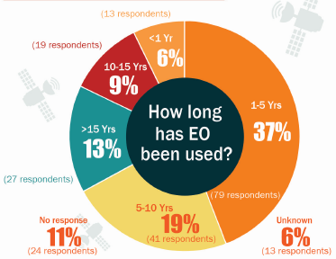
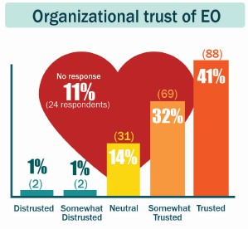
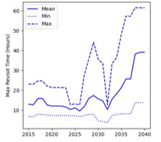
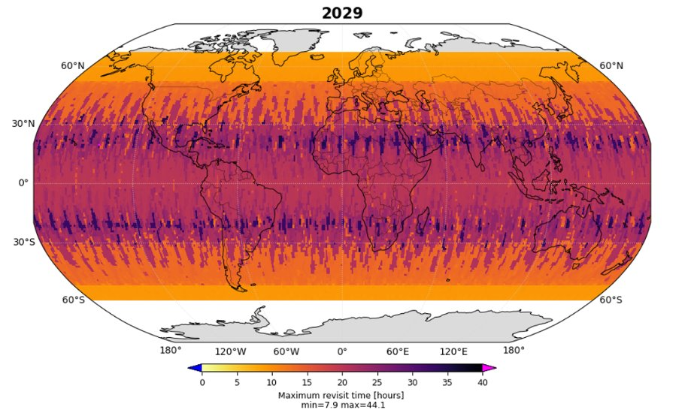
CEOS WG Disasters Wildfire Pilot (2)
Large recent increase in use of active fire EO and high user trust
EO active fire monitoring capabilities from LEO systems are unstable and may decline in future periods
Reduced capabilities -> less user trust -> negative consequences for fire management
Recommendation: need for increased international coordination and governance of global active fire monitoring satellites
Figure 1. Global end user survey outcomes (M^{c}Fayden et al., 2024)
Figure 2. Maximum revisit time (global)
baseline scenario for fire monitoring/detection
Figure 3. Maximum revisit time in 2029
baseline scenario for fire monitoring

Slide 7
LSI-VC Wildfire Subgroup - Process
The concept of a new CEOS initiative on the coordination of wildfire monitoring was supported by participants of a CEOS Plenary 2025 side meeting
~12 agencies in attendance
After further discussion and options analysis, the Chairs of the LSI-VC and the SIT Chair supported the formation of a new Wildfire subgroup under LSI-VC
SEC-344 action: requested expression of interest for membership and leadership of this new group from CEOS members and associates

Slide 8
LSI-VC Wildfire Subgroup - Membership
CEOS Agencies
Co-leads: CSA & NRCan, ESA, SANSA
EC
HSC
INPE
NASA
UKSA
Wider community
GOFC-GOLD FireIT
New space entities (TBD)

Slide 9
Purpose & potential activities
Purpose: to provide a venue to support coordination between agencies producing EO data used to generate wildfire monitoring products and the downstream community, to enhance reliability and support wildfire management with current and future satellite missions.
Initial scope is active fire and potentially recent burned area, could expand to other areas e.g., pre-fire, in the future
Potential activities (to be refined):
Assess the existing & planned implicit virtual constellation of fire monitoring satellites
Document the case for sustained, refined & improved fire EO products
Support interoperability of fire EO data and missions, and support the development of harmonized user & mission requirements for wildfire monitoring
Support development of EO fire product best practices/endorsement process

Slide 10
Activities & Next steps
Initial “meet-and-greet” kick-off meeting for members held last week
Near future:
Develop priorities to inform objectives & activities
Develop Terms of Reference and work plan
additional membership interest from other agencies is welcome

