Slide 1
CEOS Wildfire Portal
Libby Rose
Agenda Item 6.4
CEOS SIT-41 2026
Irvine, California, USA
14-16 April 2026

Slide 2
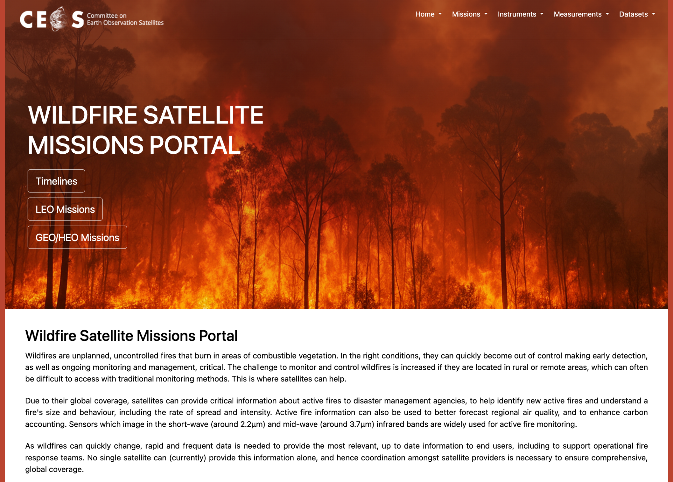
ceos.org/wildfires

Slide 3
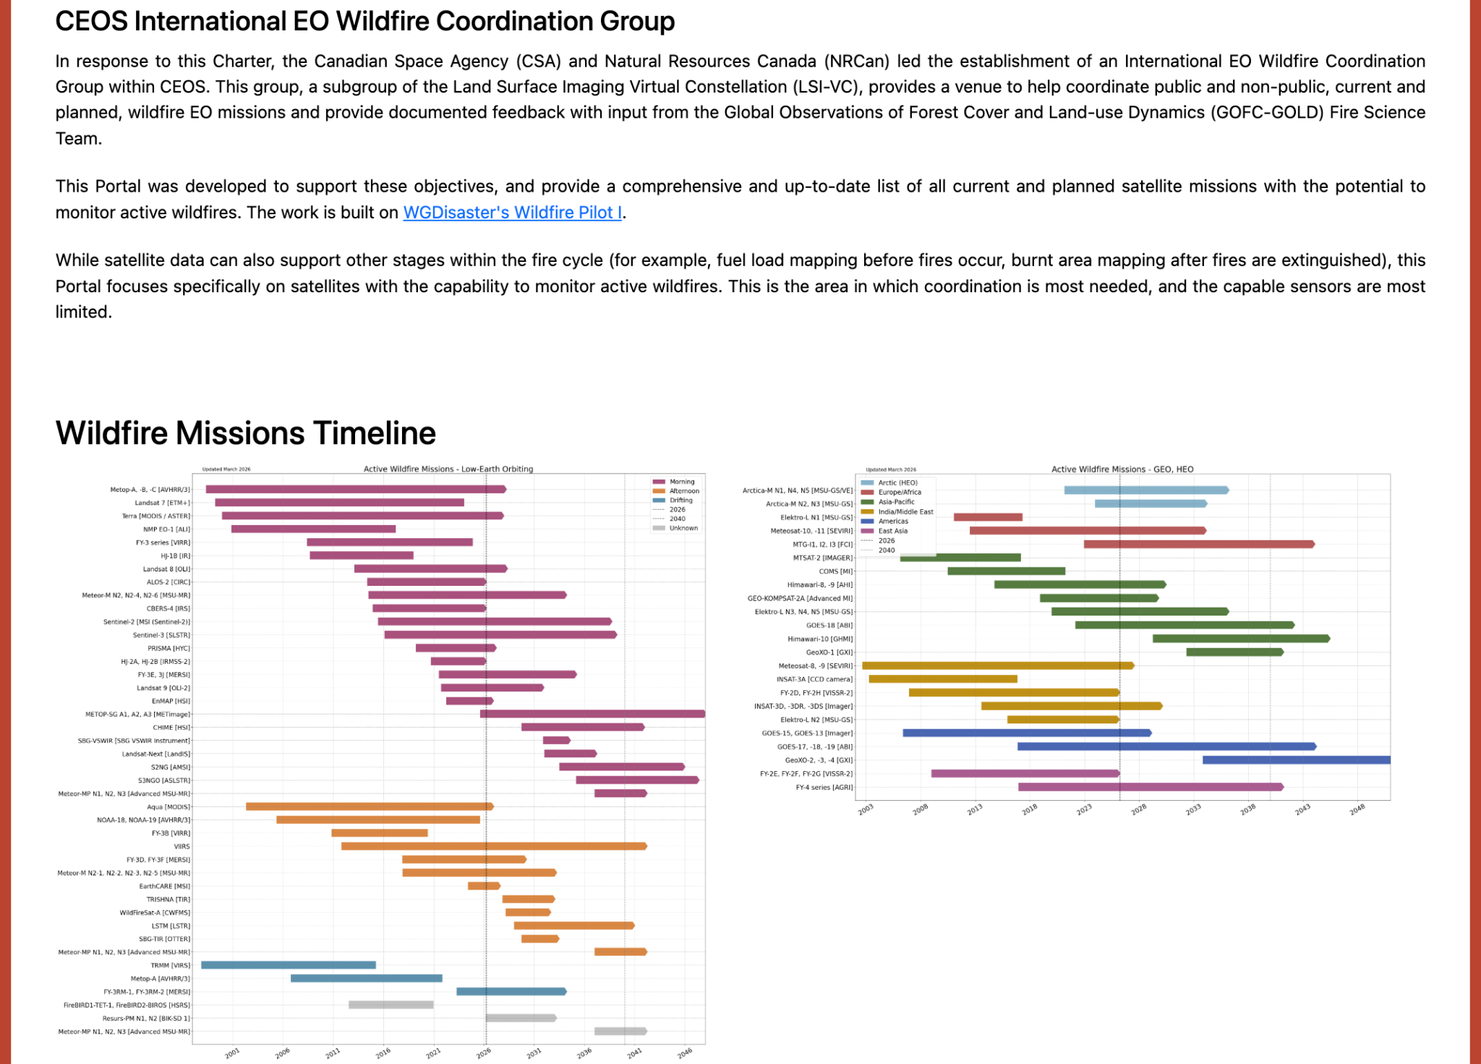
ceos.org/wildfires

Slide 4
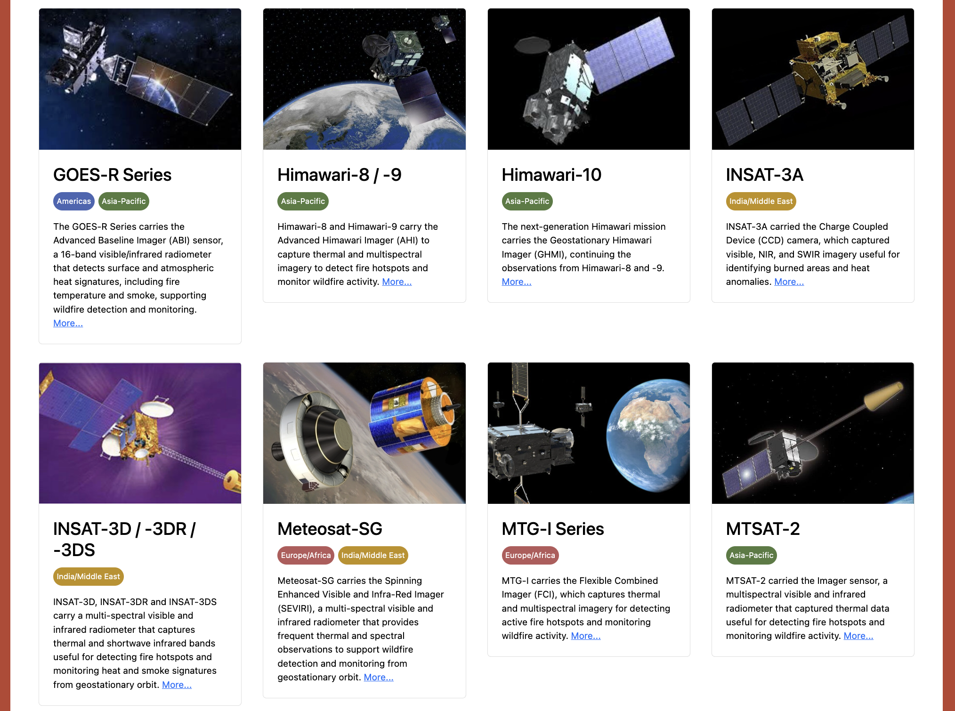
ceos.org/wildfires

Slide 5
Future Expansions
Add commercial sensors
Categorise into actual contribution to wildfire monitoring
  potential / demonstrated application / operational products
Historical missions
  Currently includes missions from 2015
  Separate out completed missions into dedicated ‘historical missions’ section
  Add other historical missions
Create subpages for other elements of the fire cycle
  Smoke
  Fuel load (WGDisasater Wildfire Pilot II)
  Burnt area mapping

Slide 6
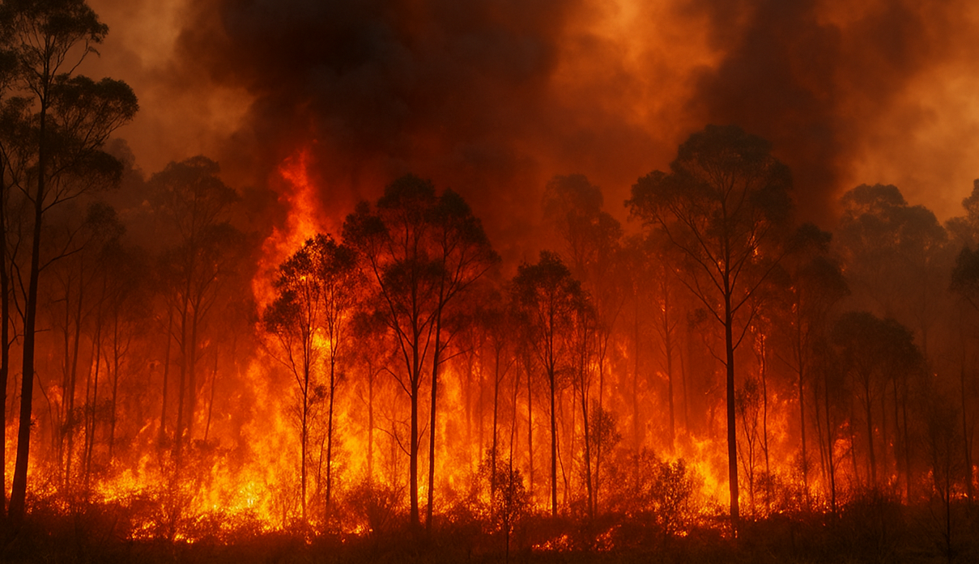
ceos.org/wildfires
Share feedback with team@symbios.space

