Slide 1
WGDisasters Pilot Projects
Lorant Czaran, UNOOSA
Agenda Item 6.5
CEOS SIT-41 2026
Irvine, California, USA
14-16 April 2026

Slide 2
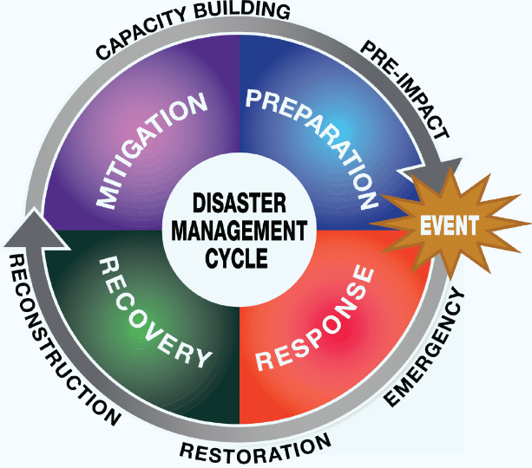


WGDisasters Fundamentals
Earth observations to address risk: identification of natural hazards, exposure of people, assets and livelihoods, and related vulnerabilities
CEOS WG Disasters Work Plan is aligned with the Sendai Framework on Disaster Risk Reduction (DRR)
GEO4DRM
International Charter
Space and Major Disasters
and Copernicus EMS
https://ceos.org/ourwork/workinggroups/disasters/

Slide 3
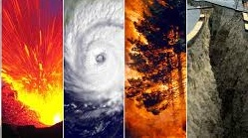
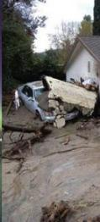
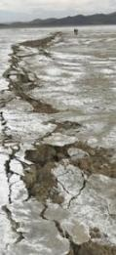

WGDisasters Objectives
Support Disaster Risk Management (DRM) authorities by means of satellite-based EO and science-based analyses.
Support the UNDRR Sendai Framework, (mainly Priority1 “Understanding Risk”, Priority4 “Build Back Better”).
Support international initiatives such as GEO.
Raise the awareness of Governments, policy-makers, decision-makers, and major stakeholders of the benefits of using satellite EO in all phases of DRM.
Foster increased use of EO in support of DRM and DRR, and express related EO capabilities and needs.

Slide 4
WGDisasters Activities
Pilots and Demonstrators (e.g. Wildfire, Flood, Seismic, Biodiversity):
Provide inventory of EO systems for a specific themes at hotspots.
Explore existing data gaps and new methodologies, and articulate global stakeholder and user requirements.
Global Volcano Early Warning and Emergency Response System (GVEWERS)
Provide integrated observations to support DRR and EW at Holocene era volcanoes.
Early Warnings for All Subteam (EW4All)
Examine possible contributions to UN activity and possible joint work with WGISS.
Recovery Observatory
Explore better use of satellite data and for recovery following major disaster events.
Direct input to Post Disaster Needs Assessments and long-term contribution to Recovery Framework.
Currently examining joint activities with International Charter.
Geohazards Supersites and Natural Laboratories (GSNL)
Improve geophysical and geohazard assessment, promoting EO products uptake for societal benefits over 13 supersites globally.
New Cyprus Supersite.

Slide 5
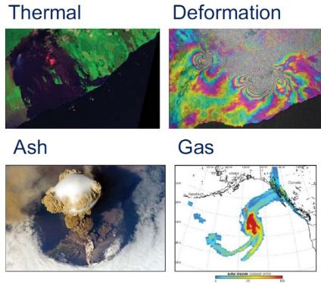
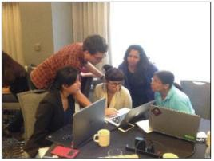
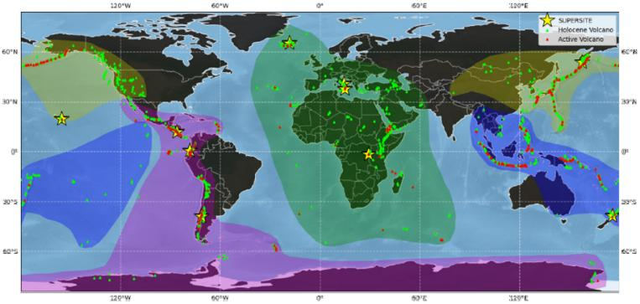
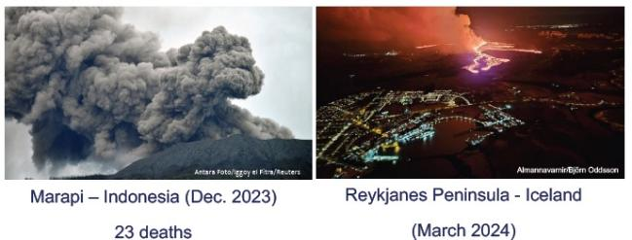
Recent WGDisasters Activities 1
Lead: Mike Poland (USGS), Susanna Ebmeier (Leeds Univ.)
G-VEWERS
Permanent volcano observations building on Demonstrator success
Provide eruption response and early warning capabilities
Assist local capacity for EO data analysis
Train scientist at volcano observatories

Slide 6
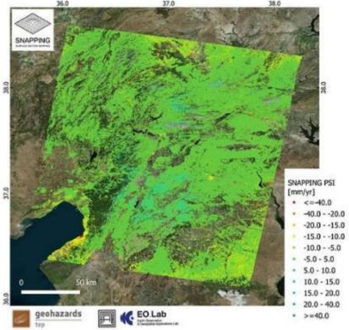
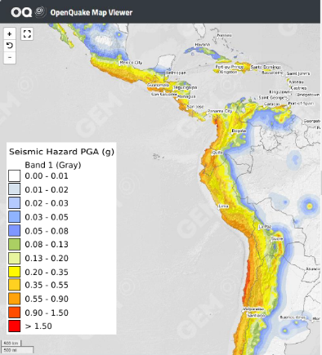
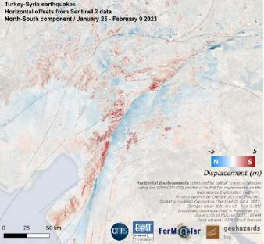
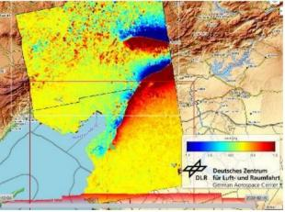
Recent WGDisasters Activities 2
Seismic Hazards Demonstrator
Develop and demonstrate advanced science products for rapid earthquake response.
EO active faults mapping.
Articulate relationship with Int. Charter.
Support seismic exposure mapping.
Initial focus on Latin America and Caribbean (LAC) now expanded to be global (2026)
Examples of displacement map retrieved for 2023 Turkey-Syria earthquake with TSX (lower-right), Sentinel-1 (lower-left and upper-left) created on the Geohazards Exploitation Platform (GEP).
Lead: Philippe Bally (ESA), Stefano Salvi (INGV), Zach Foltz (ARGANS)

Slide 7
Activities approved in principle March 2026
Landslide Initiative (ASI lead)
Multi-sensor data-based approaches for landslide detection
Impact on urban environments and infrastructure, fragility curves
Drought Pilot (CONAE and ASI leads)
Evaluate EO satellite and CEOS contributions to drought monitoring and early warning systems
Identify main geographic areas most prone to drought phenomena.
Identify users and stakeholders for mitigation, preparedness and response activities.
Biodiversity Pilot (ISRO lead)
Assess biodiversity status and risks using EO data, focusing on biodiversity hotspots.
Define disasters and related impacts in the context of biodiversity.
Study ecosystem regeneration in damaged areas.
Wildfire Preparedness Pilot (ANU and ISRO lead)
Multi-sensor data-based approaches for determining status of wildfire fuels
Development and validation of new methodologies and early demonstrators with users
Interoperability Demonstrators and EO-GPT Demonstrator (biodiversity and flood) being considered for joint implementation with WGISS

Slide 8
Landslide Pilot
Identified 5 initial topics, partially rejuvenating the Demonstrator and partially expanding the portfolio:
#1 – Multi-sensor EO data-based approaches for landslides
#2 – AI 4 Landslides (New topic)
#3 – EO-based landslide vulnerability assessment (New topic)
#4 – Landslides in humanitarian contexts
#5 – Landslides & Climate Change (New topic)
Cross-cutting scope: enable transfer of science/algorithmic advances into benefits for operational DRM
Risk focus – not only hazard -> see discussion point in “Reviewing WG Strategy & Objectives”
Address SIT Chair priorities over Earth’s water cycle (Priority 1).
Further topics may be added upon specific requests from the members in due course – however, need for groups who can support such further topics

Slide 9
Landslide Pilot Timeframe
Schedule
Approval of New Landslide Pilot proposal at WGDisasters-25 (March 2026)
Pilot Kick-off: WGDisasters-26 meeting (Implementation Plan to be approved)
Pilot duration: 3 years (end 2026 – 2029) – also to match ASI’s vice-chairmanship + chairmanship
Mid-term review: after 1.5 years (also to check achievements towards existing objectives and/or opportunity to add further objectives or expand the existing ones)
Intermediate Milestones: presentations at WGDisasters meetings (2/yr) with updates during periodic WG Teleconferences + annual reporting to CEOS Plenary
Final Milestone: final presentation and report of pilot activities at WGDisasters-33

Slide 10
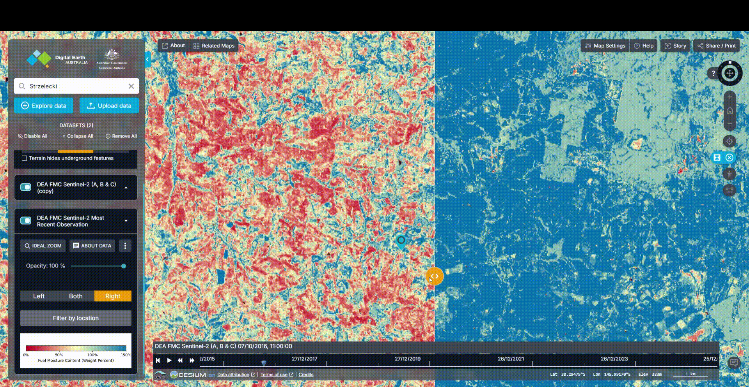
Wildfire Preparedness Pilot
Benchmark and operationalise globally consistent fuel dryness indicators to support anticipatory fire management.
An increase in wildfire EO focus to anticipatory risk forecasting.
Increased uptake of EO by wildfire agencies for prevention and preparedness.
Clear global requirements for fuel dryness products.
A coordinated CEOS pathway to purpose-built pre-fire monitoring satellites and operational services, addressing SIT “water cycle” priority.
Source: https://maps.dea.ga.gov.au

Slide 11
Wildfire Pilot Workplan (2026-2029)
Phase 1 – Literature Review
(2026)
• Review EO-based LFMC estimation methods
• Assess integration of LFMC indicators in operational fire danger and fire management systems
Phase 2 – Algorithm Benchmarking
(2027)
• Develop standard protocoles for LFMC field data collection
• Benchmark EO-based LFMC algorithms using Globe-LFMC
• Expand validation through additional ground observations and regional datasets
Phase 3 - Sensor Evaluation
(2028)
• Assess capability of current and future EO missions to detect flammability traits
• Provide recommendations for future EO mission capabilities
Phase 4- Operational Integration & Uptake
(2028-2029)
• Recommend globally (regional) consistent dryness algorithms
• Deliver products via operational platforms (GWIS, Digital Earth platforms, GEE)
• Demonstrate integration in fire management use cases with operational agencies

Slide 12
Use case and End-User Applications
Clear operational pathways ensure mission relevance and uptake.
Fire Danger Rating Systems
Integrate LFMC into FFDI, CFFDRS, NFDRS
Improve ignition probability and spread forecasts
Prescribed & Cultural Burning Planning
Identify safe burning windows
Support Indigenous fire stewardship practices
Reduce risk of escaped burns
Seasonal & Strategic Outlooks
Inform agency preparedness levels
Anticipate high-risk periods under climate variability
Fire Detection & FRP
Guide deployment of fire detection technologies
Link pre-fire dryness to FRP anomalies

Slide 13
Biodiversity Pilot
Examine selected disaster-prone areas in biodiversity hotspots on each continent to track impact of disasters on biodiversity (using mature ISRO methodology adapted to global ecosystems)
Forest fires: Spatio-temporal distribution of Heatwave Indices
Heat Waves: Long-term NDVI variability in the biodiversity hotspots and comparison with Dendrochronological variations (if possible)
Climate Change and Long-term Ecological changes: Cascading hazard in ecologically fragile regions (Himalaya, Andes…), viz. extreme rainfall, landslides
Multi-Hazard vulnerability: River-flow variation and inundation induced vulnerability to Riparian ecosystems
Approved March 2026; Implementation Plan Sept 2026; coordination with Biodiversity VC

Slide 14
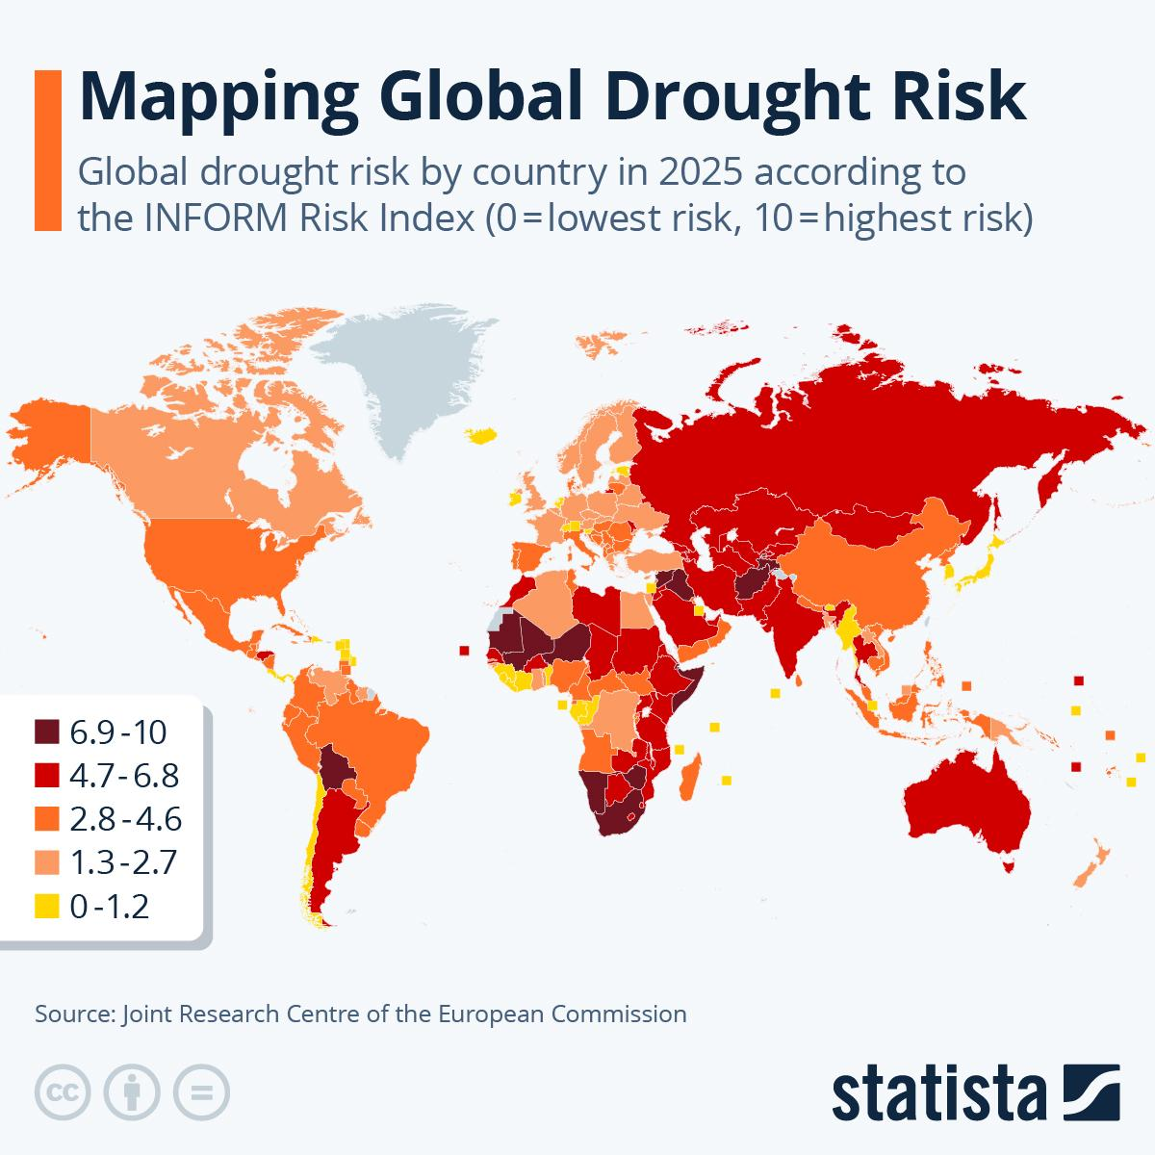
Overview – Why droughts?
Drought is a weather-related natural hazard, which can affect vast regions for months or years, significantly impacting economic performance, particularly food production.
Millions of people are affected by droughts each year and it is expected that vulnerability to drought will increase due to population increases, environmental degradation, development pressures and climate change.

Slide 15
Drought Pilot: Objectives and Benefits
The proposed pilot seeks to address the following Objectives:
Identify and evaluate how EO satellite sources, measurements and processing techniques could improve drought monitoring and early warning systems (IDM Pillar 1), drought vulnerability and impact assessment (IDM Pillar 2), as well as mitigation, preparedness and response activities (IDM Pillar 3).
Identify main geographic areas most prone to drought phenomena, distinguishing those covered or not by satellite acquisition (IDM Pillar 2), in order to identify: a) those areas where EO data processing and protocols could be applied, in view of testing activities to be promoted within a “Demonstrator project” framework; b) a possible EO strategy to put in place and proposed for adoption to face drought phenomena within IDM framework pillars.
Identify users and stakeholders to be involved in mitigation, preparedness and response activities (IDM Pillar 3), as priority, for possible future demonstrator project activities.
Risk focus – not only hazard -> see discussion point in “Reviewing WG Strategy & Objectives”.
Address SIT Chair priorities over Earth’s water cycle (Priority 1).
Further topics may be added upon specific requests from the members in due course.

Slide 16
Drought Pilot Key Outputs
Key output | Geographic focus | Target users | Output format
A Regional Multi-Scale Observation Framework defining appropriate temporal and spatial scales for drought monitoring, including integration pathways toward national-level meteorological datasets. | Global & Regional to local (minimum targets: at least 2 per year and, overall, at least 1 per continent) Prioritize areas where multi-mission data are already available (e.g. Italy, ASI’s SAOCOM ZoE, Argentina/Andes, sites covered by BCK missions) | Scientific community, geospatial services companies, CEOS Agencies, Pilot partners, decision-makers, technical officers in administration in charge of DRM, Civil Protection and supporting Centres, professionals (e.g. geologists, engineers, urban planners) | Report (e.g. in the form of a white paper or a PPT) To be agree and defined
A Consolidated Inventory of Drought Parameters, Indices and Datasets, compiling established methodologies, literature references, and global drought management practices.
A Geospatial Drought-Prone Areas Assessment Report, identifying and mapping regions affected by past drought events using EO data archives.
A User Requirements and Gap Analysis Report, documenting observational needs, identified limitations, and priority areas for improvement.
An EO Data Sources and Constellation Assessment Study, evaluating current and upcoming space missions, including analysis of their contribution to drought risk components (hazard, vulnerability, exposure), and assessing data policy and sustainability aspects.
A Methodological Framework for EO and Big Data Processing, outlining recommended techniques to derive drought hazard indicators and proxies at multiple scales.
A Scientific Validation and Data Integration Plan, identifying priority study areas and defining validation activities based on EO and in-situ datasets.

Slide 17
WGDisasters
ceos.org/wgdisasters
Lorant Czaran (UNOOSA) - Chair
Antonio Montuori (ASI) – Vice Chair
Andrew Eddy (Athena Global) - Secretary

