Slide 1
CEOS SIT-41
GEOGLAM
Alyssa Whitcraft
GEOGLAM Secretariat
Agenda Item # 7.1
CEOS SIT-41 2026
Irvine, California, USA
14-16 April 2026

Slide 2
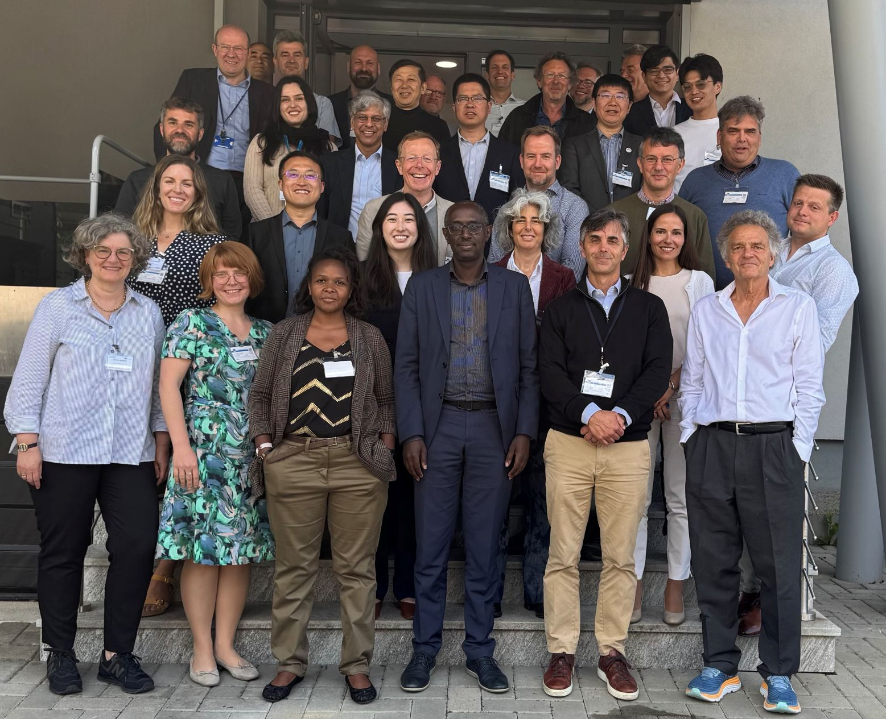
REMINDER:
Major EAV Accomplishments 2025
Successful reactivation of the EAV WG
  Beginning at EAV Workshop @ EU-JRC in May 2025
  >50 people participated in 2025 EAV effort so far from dozens of organizations worldwide
Adopted a new framework for documenting EAVs, inc:
  Definition + Descriptions
  EAV Product Requirements
  “Stocktake” of current and past products and related satellites
  Assessment of gaps and prioritisation
Executed and refined framework for 5 variables:
  Crop type
  Crop yield
  Field boundaries
  Cover crop
  Actual ET
Presented Phase 1 Report at Plenary-39
Details available in the Phase 1 EAV Report

Slide 3
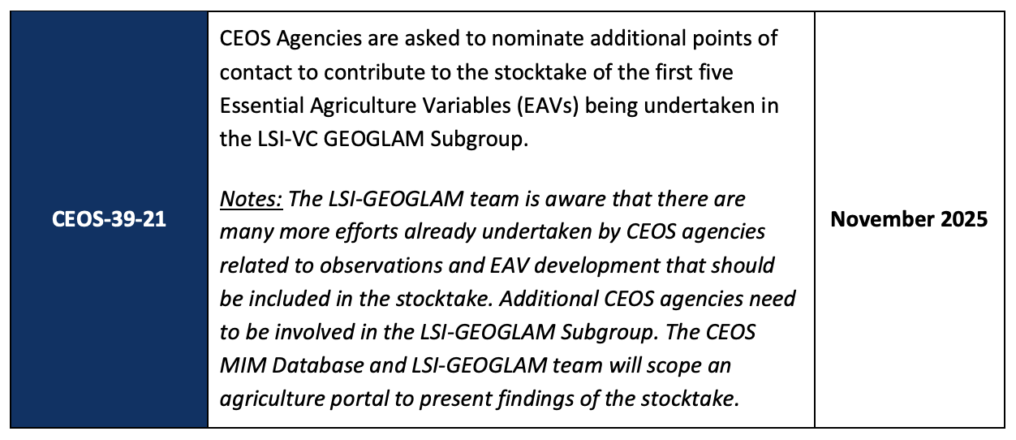
Plenary-39 Action:
Action Rationale:
We are not fully accounting for efforts already undertaken by the agencies related to observations and EAV development.
This minimizes agency ROI and impact.
We want to help users find relevant methods, tools, and products.
We want to develop optimization priorities for what to do next.
SIT-41 Action Preview →
We want to keep this going and we need more help

Slide 4
Updates: EAV Stocktake & Gap Analysis
Phase 1
GEOGLAM portion presented at Plenary-39:
Improved framework
Definition, requirements, inventory, and preliminary gap analysis for 5 variables
CEOS Role to Complete Phase 1
Agency input (CEOS-39-21):
  Add missing stocktake info for Phase 1 EAVs
    Missing satellites, products, etc.
  Get input on priorities
Notes:
❖I'll provide updates:
▪- WGCV + GEOGLAM ET Meeting... had to be postponed to ~October from the planned June date because of Copernicus LMS General Assembly being rescheduled to the week we were planning, but UN FAO is going to host and we have a solid agenda.
▪- European Commission will fund a consultant to help us get through Phase 1 of the EAVs and develop a plan / start Phase 2 of the EAVs.
▪- Show briefly that I developed some materials to teach people how to fill in the EAV table and the consultant (if ready in time), or Sven or I, can set up times with them to walk them through it - so that the CEOS people can do their part in the Phase 1 EAVs
❖- On that latter point, I need to take a look at the GEOGLAM Subgroup membership list (Matt, have you been maintaining a list other than this, I see it was updated in September but not since Plenary) and see which organizations are on it vs. who has responded to the stocktake so far.
❖- Based on that, Julie suggested that I "ask for help instead of an action and then let NASA offer an intervention" because even though I asked for an action at Plenary, "because no one championed it it didn't get captured it in the official minutes/actions". I was confused by this because we DO have an action on the record... but because it she said this just now during the big NASA prep call and I wasn't planning to request a specific action, I didn't feel that was appropriate to dig in further with her.
❖- The "help" she recommended I ask for is showing who has not yet responded to the action that I think should (i.e. who may have science or satellites that are relevant to the Phase 1 EAVs), and let NASA and/or others intervene.

Slide 5

Updates: EAV Stocktake & Gap Analysis
Phase 1 & Phase 2
GEOGLAM portion presented at Plenary-39:
Improved framework
Definition, requirements, inventory, and preliminary gap analysis for 5 variables
CEOS Role to Complete Phase 1
Agency input (CEOS-39-21):
  Add missing stocktake info for Phase 1 EAVs
    Missing satellites, products, etc.
  Get input on priorities
Status:
CEOS agencies with confirmed interest→
  There are MANY others on the mailing list, but are they official?
We have not convened the subgroup yet because we need help.
GA
ESA
ISRO
CSIRO
SANSA
CONAE
NASA
EC/JRC
INPE
NOAA
UKSA
USGS
JAXA
Great news:
  European Commission is supporting a 40-day consultancy:
    Complete Phase 1
    Improve public content on EAVs (inc. website)
    Phase 2 plan → prioritize, plan, recruit participants
Notes:
❖I'll provide updates:
▪- WGCV + GEOGLAM ET Meeting... had to be postponed to ~October from the planned June date because of Copernicus LMS General Assembly being rescheduled to the week we were planning, but UN FAO is going to host and we have a solid agenda.
▪- European Commission will fund a consultant to help us get through Phase 1 of the EAVs and develop a plan / start Phase 2 of the EAVs.
▪- Show briefly that I developed some materials to teach people how to fill in the EAV table and the consultant (if ready in time), or Sven or I, can set up times with them to walk them through it - so that the CEOS people can do their part in the Phase 1 EAVs
❖- On that latter point, I need to take a look at the GEOGLAM Subgroup membership list (Matt, have you been maintaining a list other than this, I see it was updated in September but not since Plenary) and see which organizations are on it vs. who has responded to the stocktake so far.
❖- Based on that, Julie suggested that I "ask for help instead of an action and then let NASA offer an intervention" because even though I asked for an action at Plenary, "because no one championed it it didn't get captured it in the official minutes/actions". I was confused by this because we DO have an action on the record... but because it she said this just now during the big NASA prep call and I wasn't planning to request a specific action, I didn't feel that was appropriate to dig in further with her.
❖- The "help" she recommended I ask for is showing who has not yet responded to the action that I think should (i.e. who may have science or satellites that are relevant to the Phase 1 EAVs), and let NASA and/or others intervene.

Slide 6

ToR for European Commision Supported
Expert Consultant for EAVs
Contact akwhitcraft@GEOGLAM.org for the post
Description | Activities
Consolidated and Cleaned EAV Inventory | Cleaned and harmonised EAV tables Traceability to workshop outcomes and previous EAV versions
Validated EAV Definitions and Phase 1 Framework and summary report | Refined technical definitions for priority EAVs Documented feedback from EAV stewards and CEOS contributors
Presentation package for Input to CEOS–GEOGLAM governance | Final versions of all Phase 1 EAV tables and definitions Prepare and deliver slide deck outlining inventory and framework Review and and provide updated content for an improved EAV website to reflect revised definitions Provide recommendations on improving accessibility and clarity of EAV materials for different user communities (e.g. policy, early warning, farming).
Prioritisation and Options Document | Clear prioritisation criteria (policy relevance, technical readiness, community demand, CEOS alignment) Prioritised shortlist of EAVs for Phase 2 Recommended Phase 2 approach/implementation plan
Open Now, Closing Soon

Slide 7


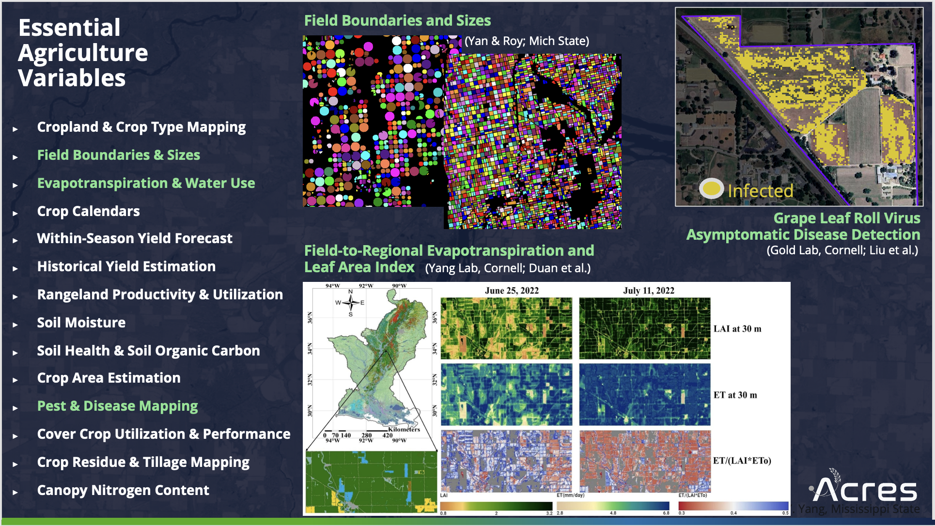
Quick Interlude of Gratitude
Several EAVs supported!
Many other agencies are already mobilising to support EAVs!
Reinvigorating Rangeland & Pasture Productivity (RAPP):
GEOGLAM recently convened a working group that included CSIRO, ILRI, JRC, AAFC, AIRCAS, SANSA, ITC, Colorado State, and many others…
~20 rangeland products mentioned… and most were unknown to us!
  This is why the stocktake is so needed!
We are ID’ing opportunities to redeploy product-ready science
  This is why the gap analysis is so critical!

Slide 8
Other CEOS-GEOGLAM Topics
Joint LPV-GEOGLAM Workshop: Evapotranspiration (ET)
Host: UN FAO
Both communities engaged
Agenda in good shape
Date TBC (likely Oct/Nov)
  Had to be rescheduled from June due to Copernicus LMS General Assembly schedule overlap
Agriculture Component of the MIM Database
Synergy with Consultant’s efforts
Synergy with thematic database push
Review and and provide updated content for an improved EAV website to reflect revised definitions
Provide recommendations on improving accessibility and clarity of EAV materials for different user communities (e.g. policy, early warning, farming).

Slide 9
Nov 2025
Apr 2026
Sept / Nov 2026
Winter - Spring 2027
Nov 2027
Plenary-39
Actions:
Agencies Add to Stocktake for 1st 5 Variables
Backburner:
CEOS MIM Ag Component Database Design Scoping
SIT-41
Interim Update::
- EAV Consultancy
- Planned Onboarding of new Subgroup Members
Requests
Continue Plenary-39-21 action
Agencies: please identify accountable/lead points of contact
Agencies: please respond to and collaborate with EAV Consultant
SIT-TW-41 / Plenary-40
Milestones:
- Updated EAV website
- Onboarding and engagement of Subgroup members (see appendix)
Documents
- Full Phase 1 Report (with CEOS input)
- Phase 2 Prioritisation and implementation plan
Actions
Agencies: participate in Phase 2
CEOS SEO: co-develop conceptual design of Ag-MIM
SIT-42
Milestones:
- Phase 2 Progress (or even completion!)
- Ag-MIM Design + Phase 1 implementation
Plenary-41
Completed?
- Req’s
- Stocktake
- Gap Analysis
- Prioritisation
Plan / Execute ET Workshop
(Oct or Nov 2026)
Design & Populate Ag-MIM
Legend
Boxes = Events
Arrows = Work
Hire EAV Consultant
Onboard New Subgroup Members
Asynchronous Work on Phase 2
Def’s + Req’s for Other Variables
GEOGLAM
CEOS/Agencies
Shared
Notes:
Documents:
- Phase 2 Report
- Agency feedback on level of interest in remaining EAVs
Report:
- EAV Req’s
- Agency Foci for next phase of EAV Stocktake
Action:
Agencies continue Stocktake based on their foci
WG Cal-Val Workshop “Green-light”

Slide 10
Requests
Org | GEOGLAM LSI Subgroup PoC | Status
GA | Michael Wellington | Confirmed
ESA | Zoltan Szantoi | Confirmed
ISRO | Bimal Bhatticharya | Confirmed
CSIRO | Roger Lawes | Confirmed
SANSA | Abel Ramoelo, Siyamthanda Gxokwe | Confirmed
CONAE | Ignacio Pascual | Confirmed
NASA | Alyssa Whitcraft (as NASA Acres) | Confirmed
EC/JRC | Michel Massart, Felix Rembold | Confirmed
INPE | Gilberto Camara | Unconfirmed
NOAA |  | In progress
UKSA |  | In progress
USGS |  | In progress
JAXA |  | Need name
CNES |  | Unknown
CSA |  | Unknown
OTHERS?
Continue Plenary-39-21
  Agencies: please identify accountable/lead points of contact
  Then: GEOGLAM will onboard them to EAVs
Agencies: please respond to and collaborate with EAV Consultant
  Contract is short-term, strike while iron is hot!
Looking Ahead:
We will need support for a ~0.5 FTE coordinator to implement Phase 2 (6-12 months)
after the EC-supported Expert Consultant completes their work

Slide 11
Backup slides

Slide 12
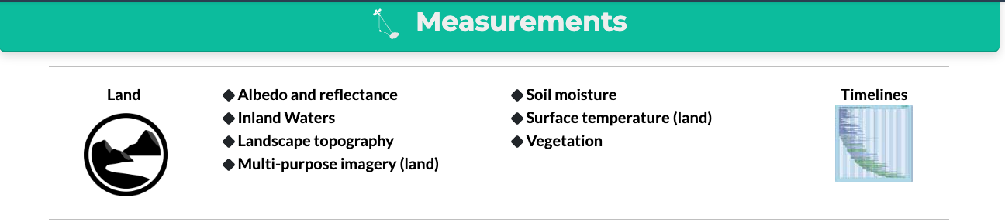

MIM Database - We need to scope
Can add another Category “Agriculture” or add
“Agriculture” under “Land”
Agriculture
Agriculture

Slide 13
The following slides briefly illustrate how to fill in the EAV Framework, which preview part of the “onboarding”

Slide 14
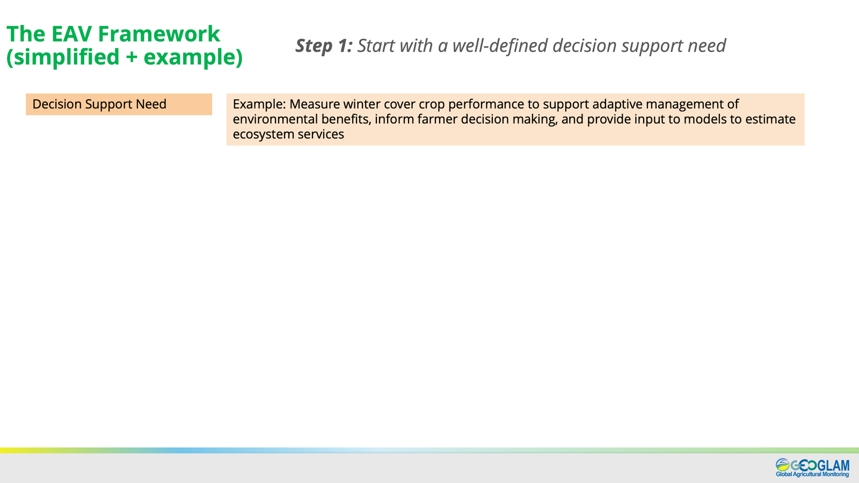
Slides; AK Whitcraft

Slide 15
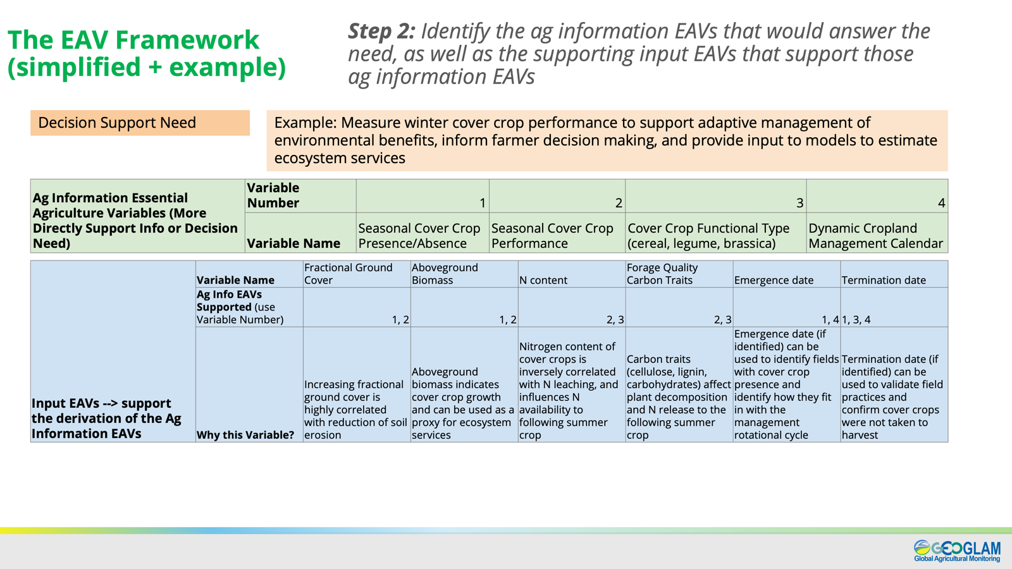
Slides; AK Whitcraft

Slide 16
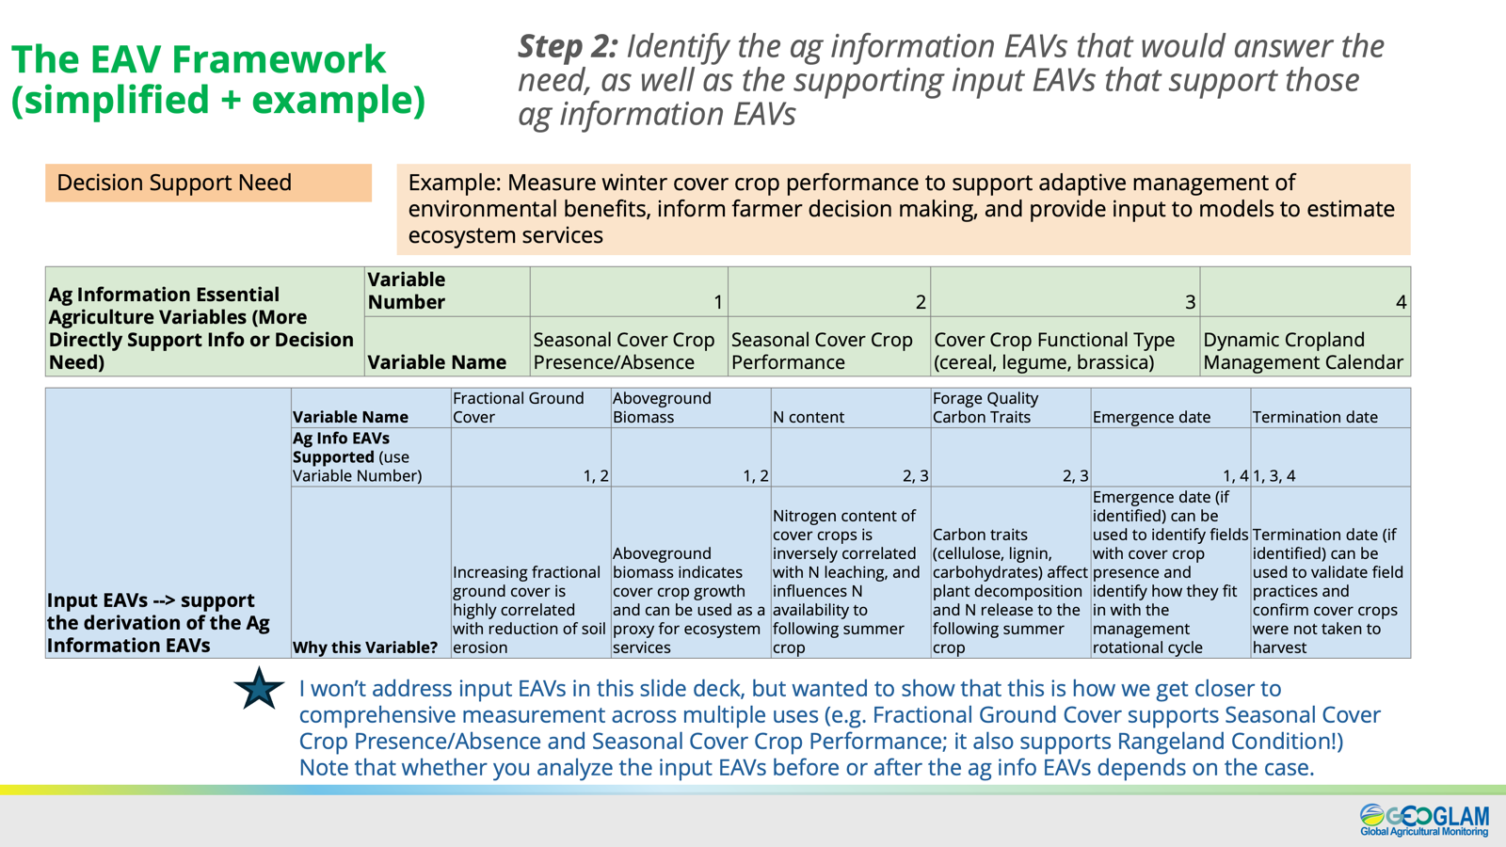
Slides; AK Whitcraft

Slide 17
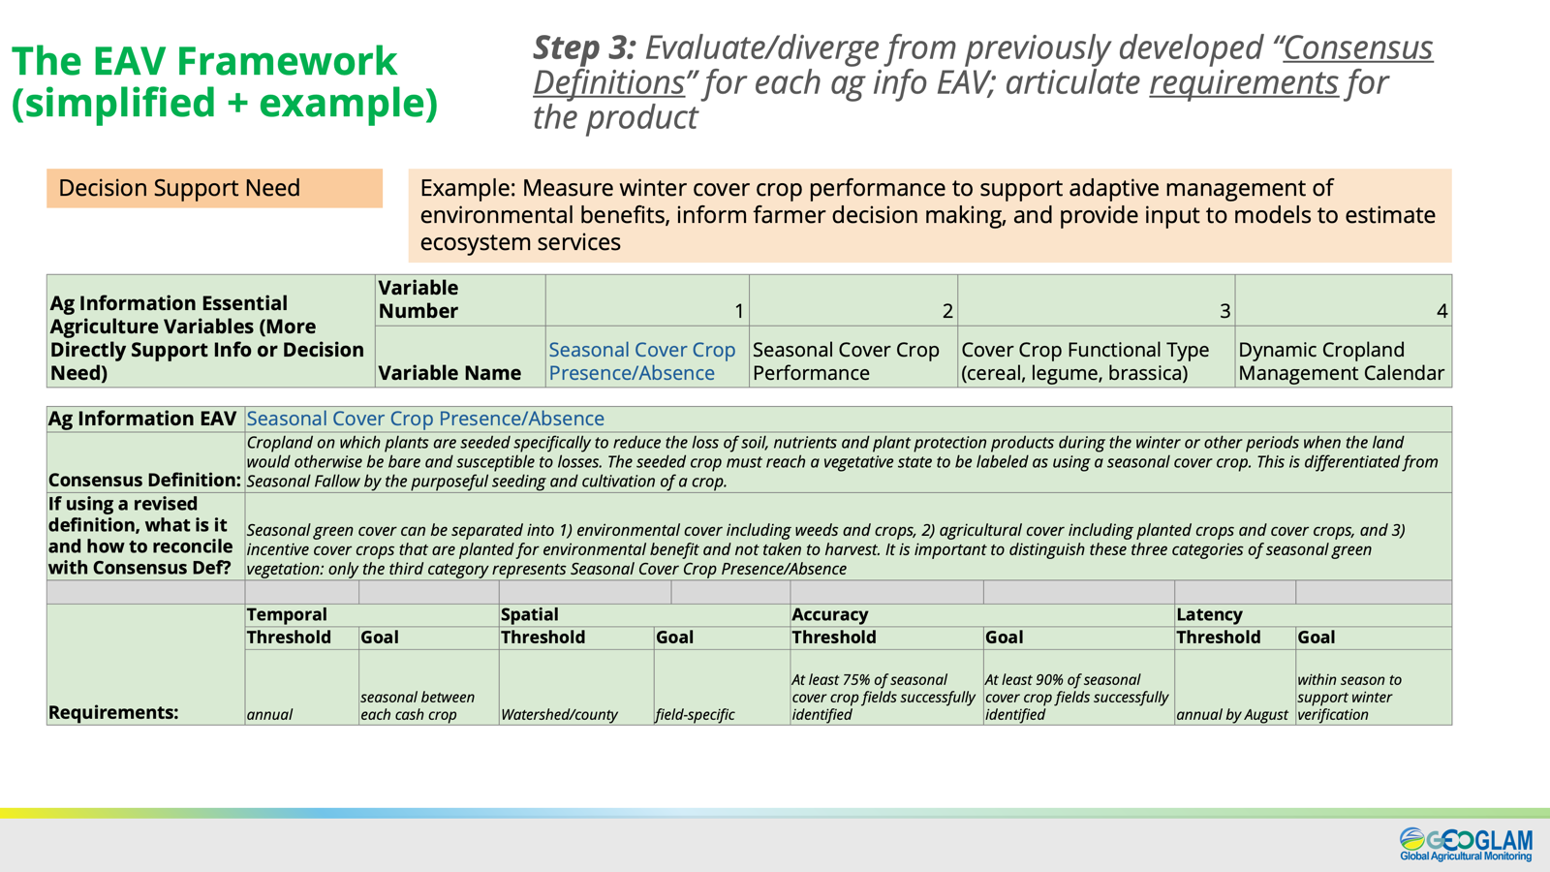
Slides; AK Whitcraft

Slide 18
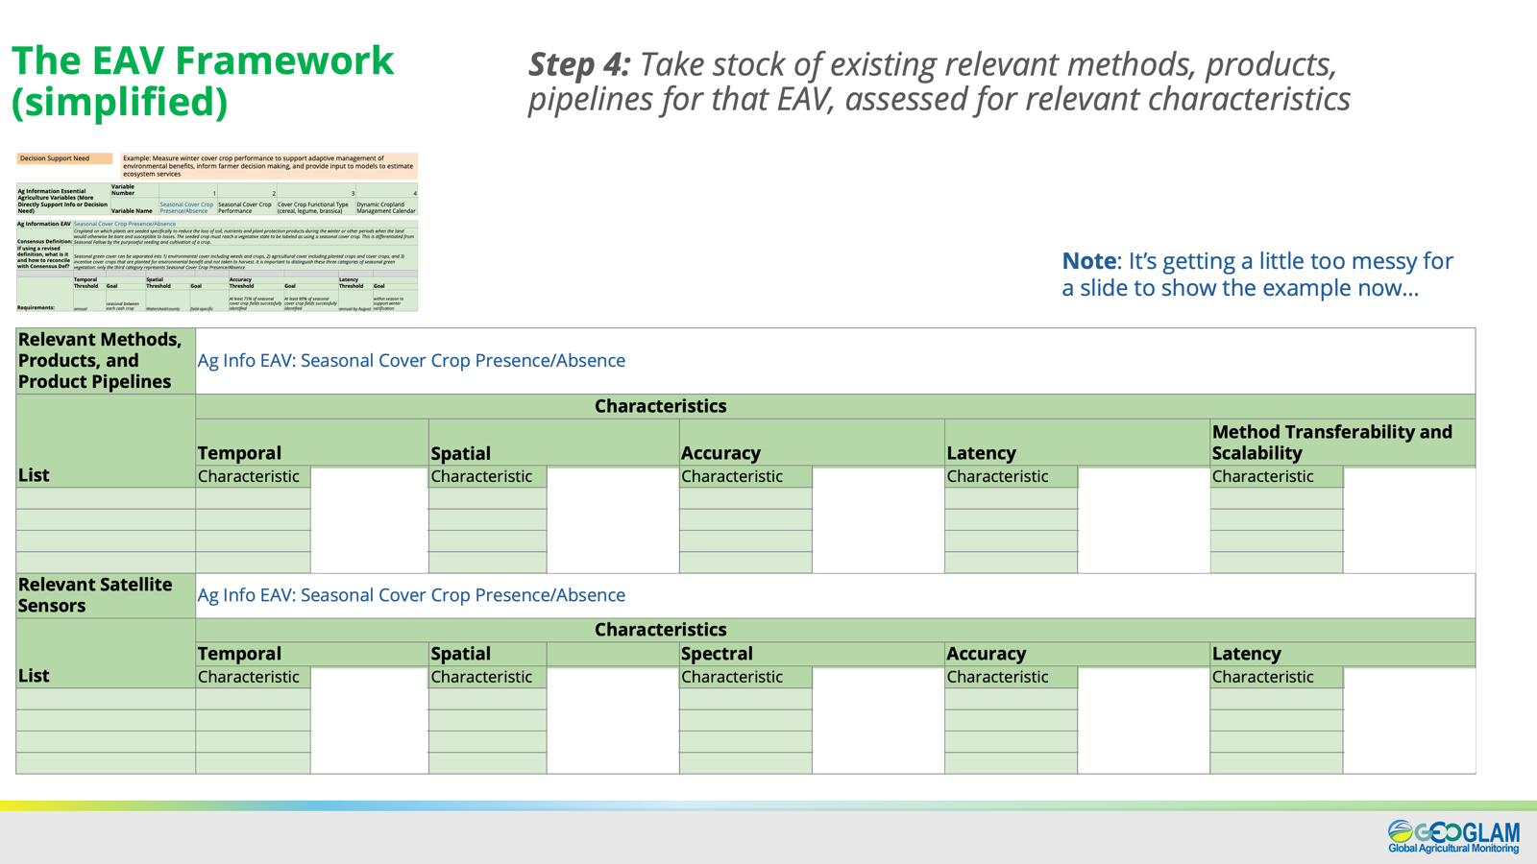
Slides; AK Whitcraft

Slide 19
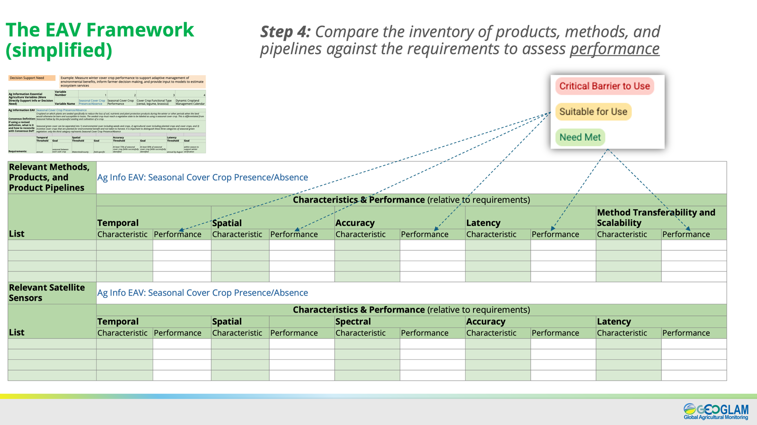
Slides; AK Whitcraft

Slide 20
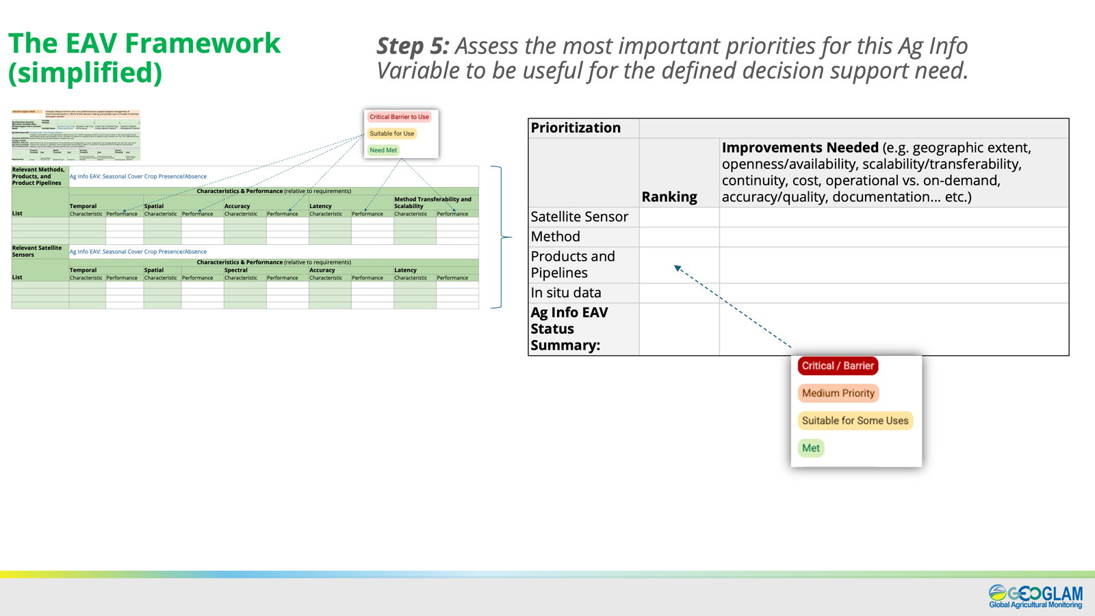
Slides; AK Whitcraft

Slide 21
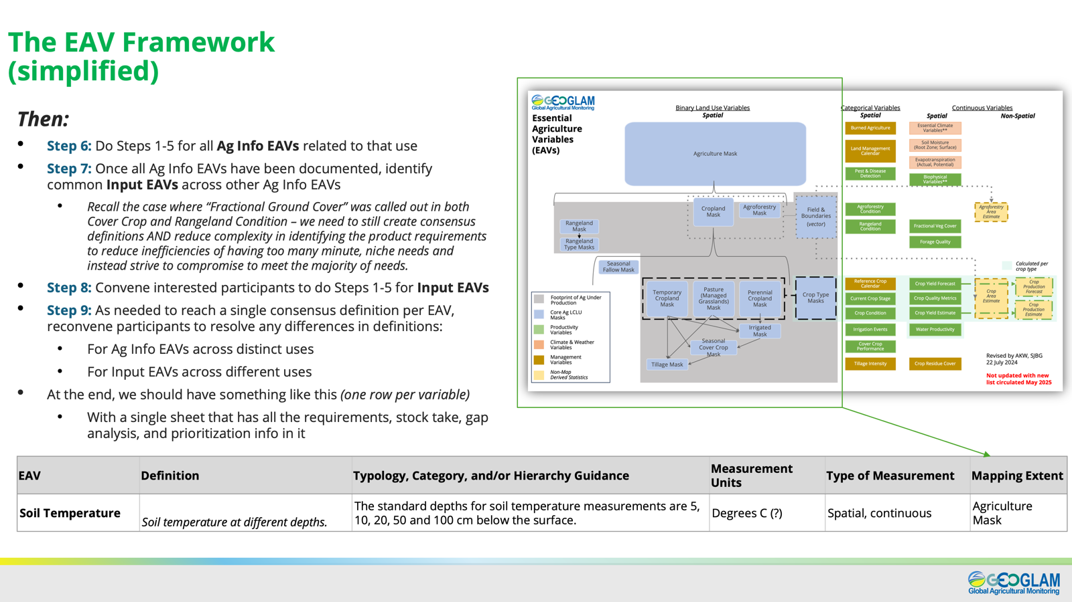
Slides; AK Whitcraft

