Slide 1
Virtual Constellation Synthesis Report
Sid Boukabara, NASA
SIT Chair Team
Agenda Item 7.2
CEOS SIT-41 2026
Irvine, California, USA
14-16 April 2026
Notes:
Based on VC consultations held in Jan - Feb 2026, plus their inputs to work plan

Slide 2
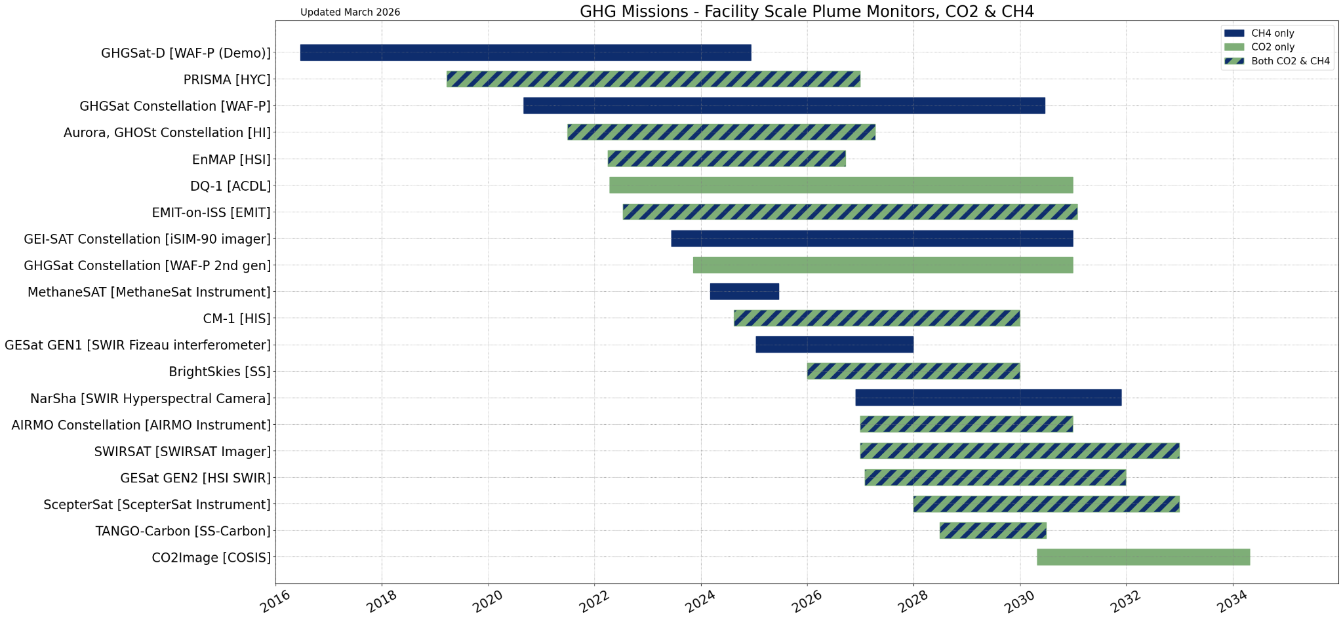
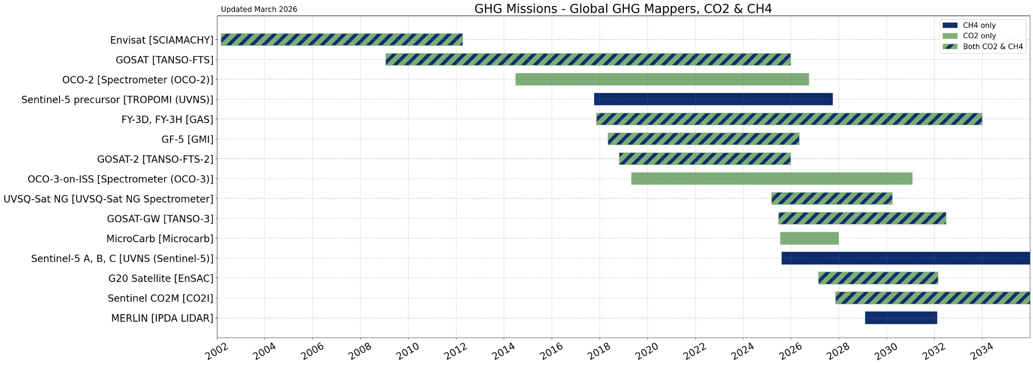
AC-VC - GHG Missions
From GHG Portal:
ceos.org/ghg
Notes:
AC is much bigger than GHG, for simplicity focusing on CO2 and CH4, charts from GHG portal (ESA MIM Database).
Top: facility scale - point source mapper (GHGSat, Sentinel-5, hyperspectral - EMIT, PRISMA etc). Bottom: area mappers (OCO, GOSAT, CO2M)
Database team have developed some tooling to generate these timelines automatically, based on the inputs provided by Agencies in the database survey
No apparent gap. A number of commercial providers for facility scale.

Slide 3
AC-VC
Co-leads: Ben Veihelmann (ESA), Emma Knowland (NASA), Hiroshi Tanimoto (NIES)
Geostationary Atmospheric Composition Paper: see item 7.5
Supporting WGClimate & GHG-TT in implementation of GHG Roadmap
Harmonisation of tropospheric ozone datasets is complete
  Peer-reviewed publication in the Phase-II Tropospheric Ozone Assessment Report (TOAR) Community Special Issue: https://amt.copernicus.org/articles/18/6893/2025/
  Phase-III TOAR ideas are being formulated, such as geostationary observations of the diurnal cycle, AI-based prediction of surface ozone, and the impacts of wildfires on ozone.
The validation and harmonisation of products from the air quality missions in orbit (TEMPO, GEMS and S5P/TROPOMI) is progressing well.
Developing the PM2.5 Roadmap, following the white paper & recommendations published in 2022.
  Includes presentation of use cases
  Review article on vertical distribution information from satellite is in progress and is expected to be submitted for peer-review by spring 2026.
AC-VC meeting in person in June 2026, with WGCV ACSG
Notes:
AC-VC supporting GHG-TT with GST Strategy actions as well, part of GHG Roadmap action annex, included in work plan
Harmonisation of tropospheric ozone datasets was a completed deliverable - harmonise the spatiotemporal perspective of sixteen satellite ozone data records, thereby accounting as much as possible for differences in vertical smoothing and sampling.
PM2.5 white paper & recommendations presented to plenary in 2022, working on roadmap to implement recommendations

Slide 4
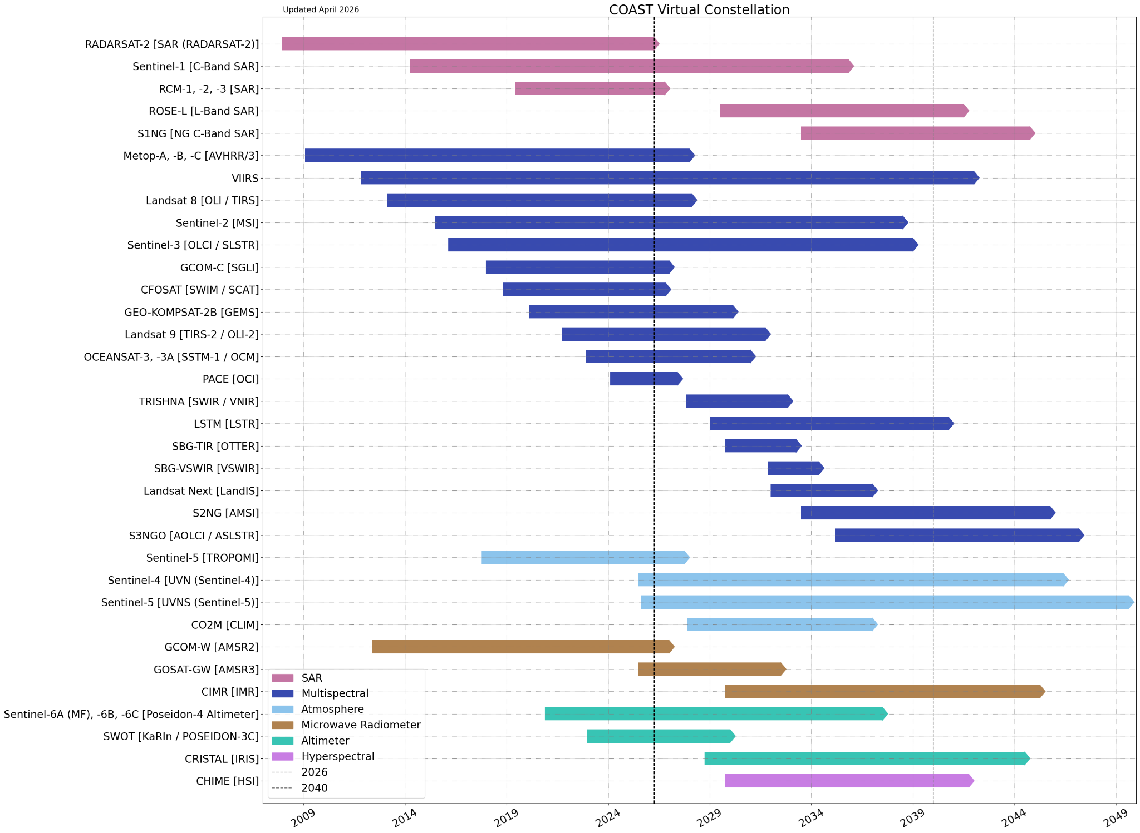
COAST-VC
Notes:
Not comprehensive, but the most important missions for COAST-VC’s work.
SAR (Sentinel-1, Radarsat), Multispectral (Landsat, Sentinel, PACE), Atmsophere (Sentinel-4, -5, CO2M), Microwave Radiometers (GCOM-W (AMSR)), Altimeters (SWOT, Sentinel-6), Hyperspectral (CHIME)

Slide 5
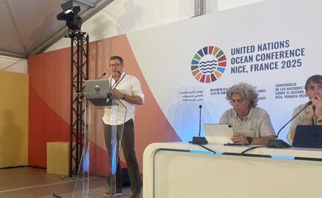
COAST-VC
Co-leads: Aurelien Carbonniere (CNES), Rashmi Sharma (ISRO), Nima Pahlevan (NASA, replacing Paul DiGiacomo (NOAA))
Satellite-derived bathymetry focus group convened October 2025
  Members includes CNES, ISRO & GA - others welcomed
Continuing to develop improved satellite derived biogeochemical products within 1km of the land-sea interface (from 2022 GCOS IP)
Leading CEOS-wide Subject Matter Expert meetings for Gap Analysis and Limitations Reporting
COAST-VC has been invited to deliver the keynote address on for the 2026 CoSPAR General Assembly (August 2026, Florence, Italy) and to the CoastPredict General Assembly on April 2026 on links to the UN Ocean Decade Programme.
Aurelien Carbonierre (CNES, COAST-VC Co-lead) presenting the COAST talk during the One Ocean Science Congress on June 5th, 2025
Notes:
Nima Pahlevan (NASA, replacing Paul DiGiacomo (NOAA))
Gap analysis - COAST their methodology at WQ workshop on monday, supporting CEOS Chair & SIT Chair activities
Presenting keynote at CoSPAR general assembly, UN Ocean Decade

Slide 6
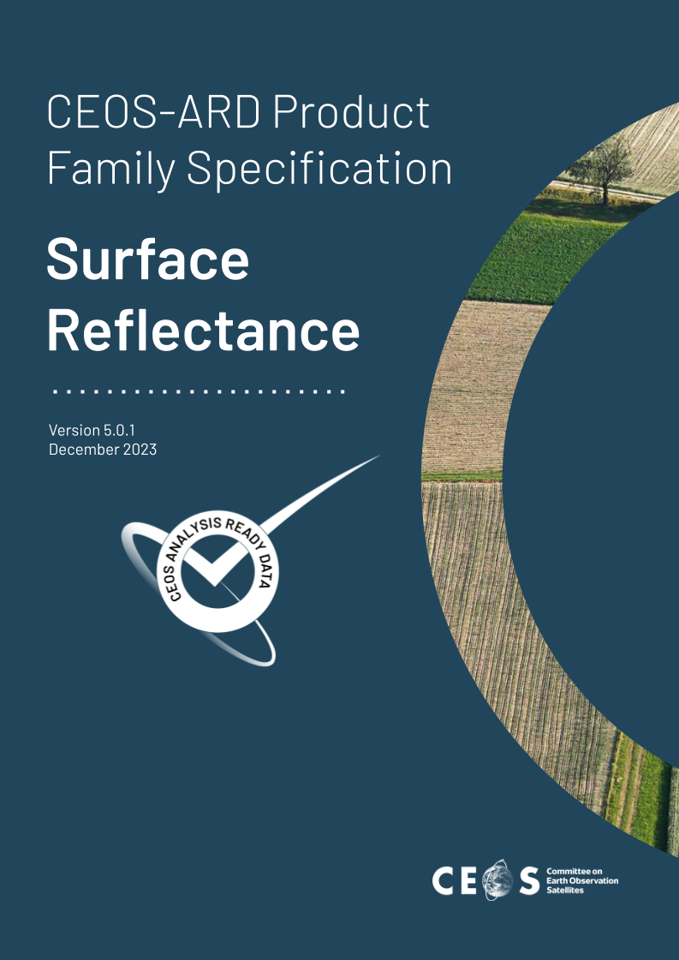
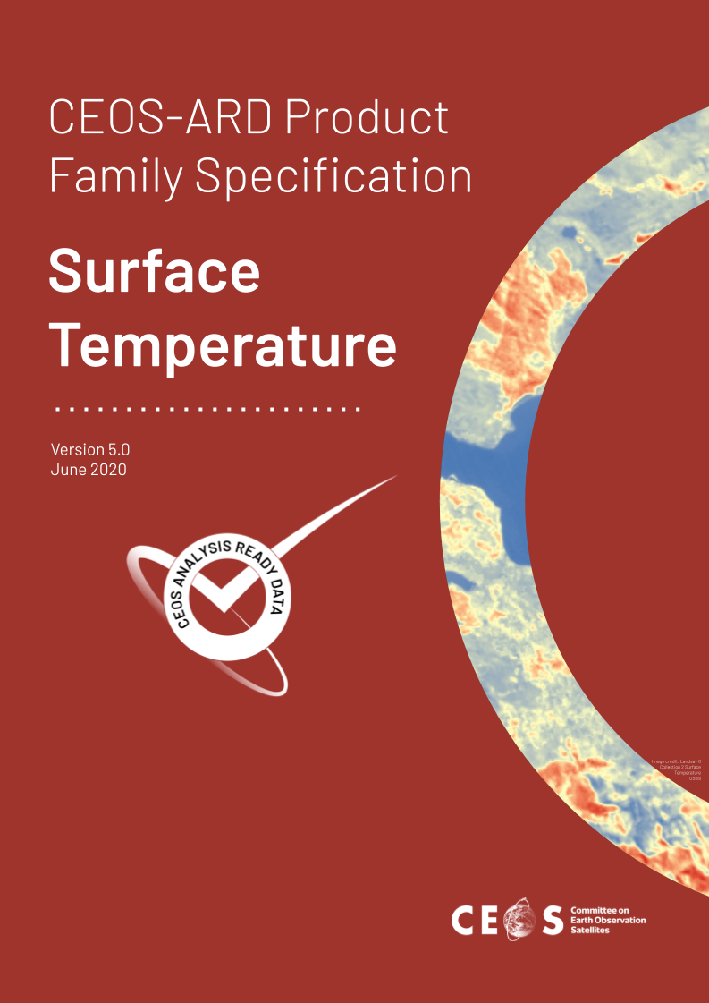


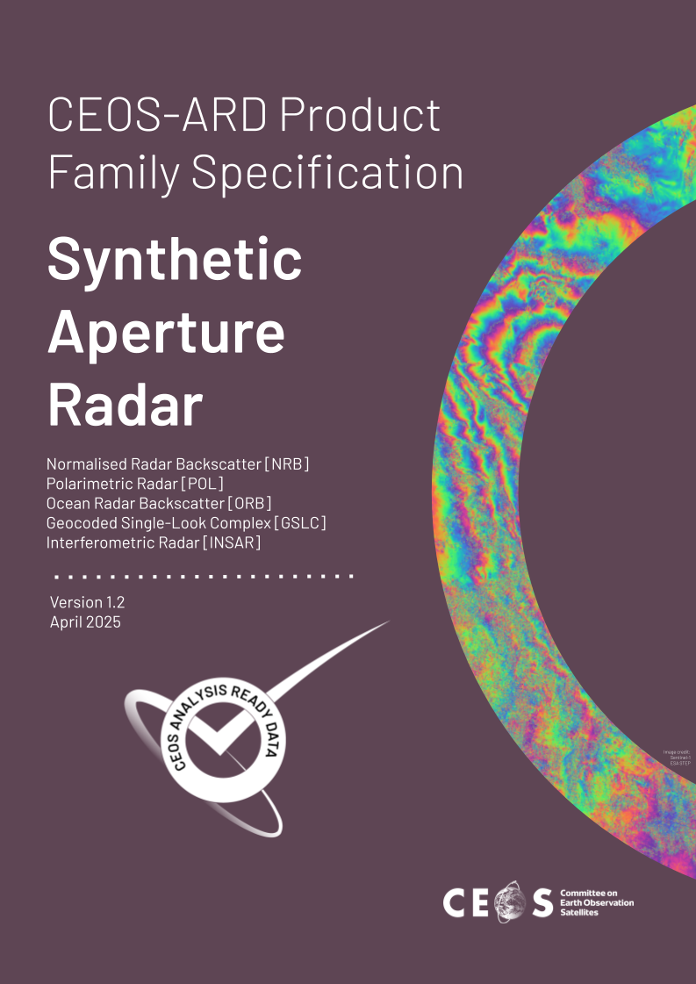
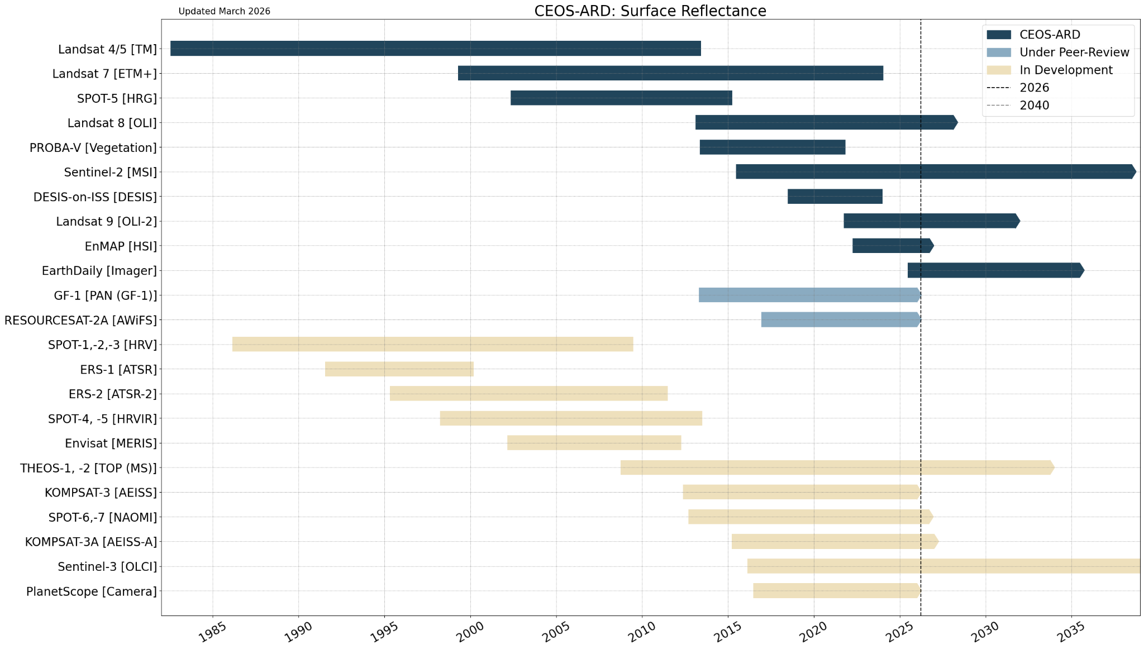
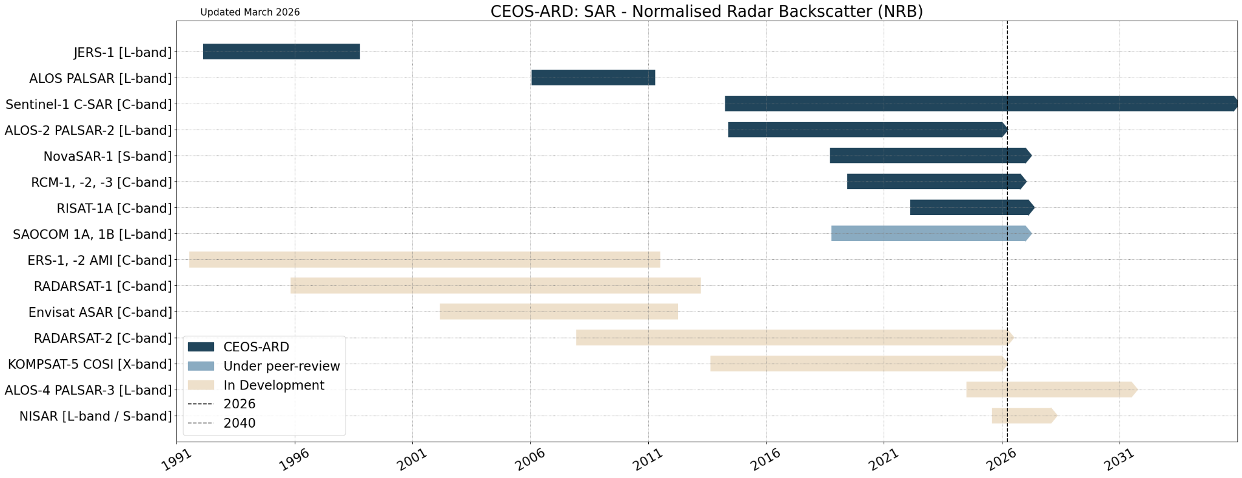
LSI-VC - CEOS-ARD Compliant Products
CEOS-ARD Product Status
24 Total Compliant Products (to date)
  12 Optical
  12 Synthetic Aperture Radar
Pipeline
  4 Under Peer Review
  30+ Under Development
Notes:
Timelines restricted to missions contributing CEOS-ARD products - dark blue = compliant, light blue = under peer review, beige = in development.
Some missions provide multiple products.
Five Product Family Specifications produced by LSI-VC for CEOS-ARD: Surface Reflectance, Surface Temp, Nighttime lights surface radiance, aquatic reflectance, and SAR. What the products are assessed against.

Slide 7
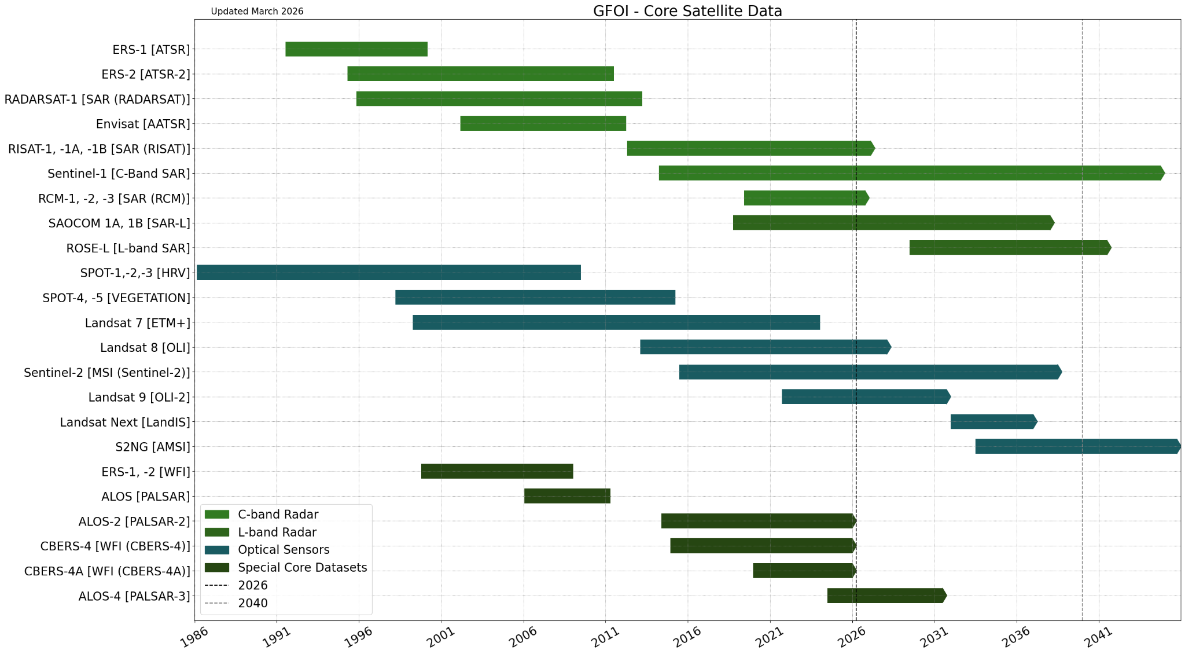

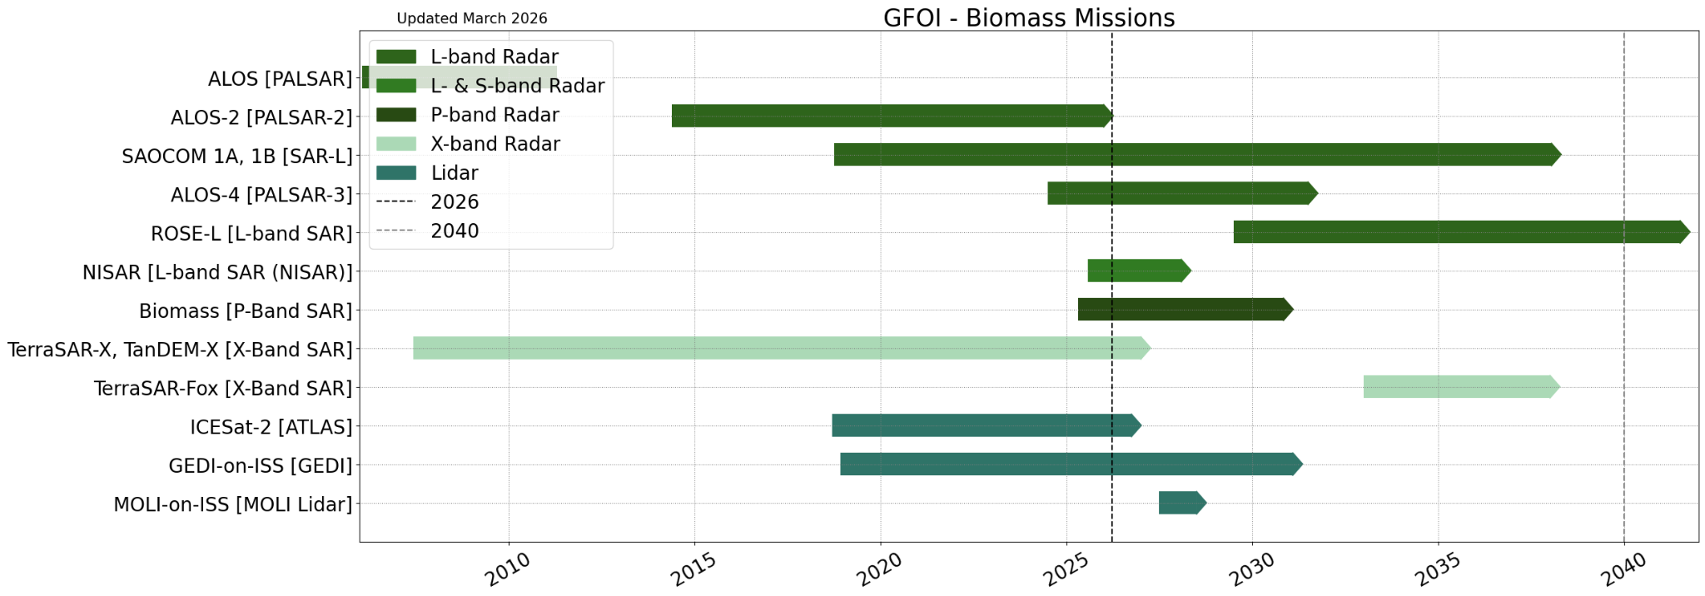
LSI-VC - GFOI Contributing Missions
Notes:
LSI-VC supports space data component for GFOI.
Charts originally developed by space data coordination group within CEOS, who ensured data access for GFOI activities.
Core mission include C-band, L-band, optical and ‘special’ (ALOS series and CBERS series).
Mission providing biomass products (L-band, P-band, X-band, Lidar - e.g. GEDI)

Slide 8
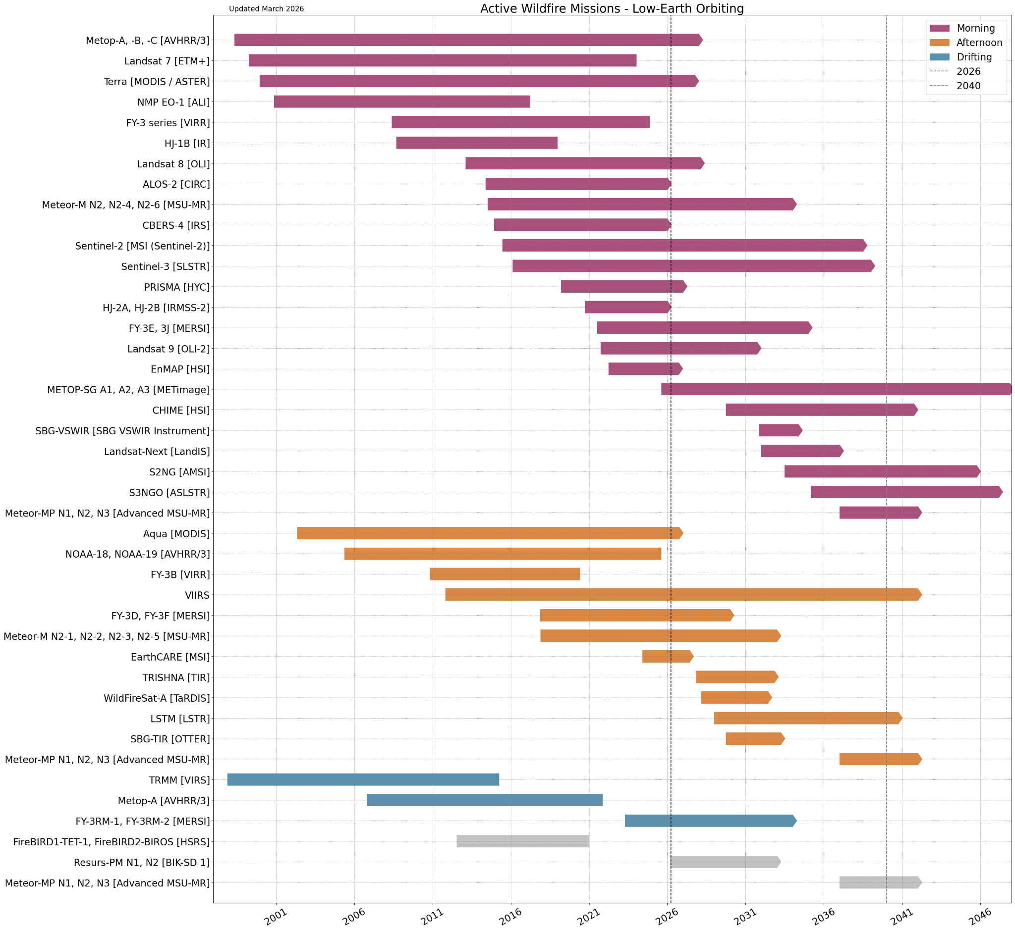
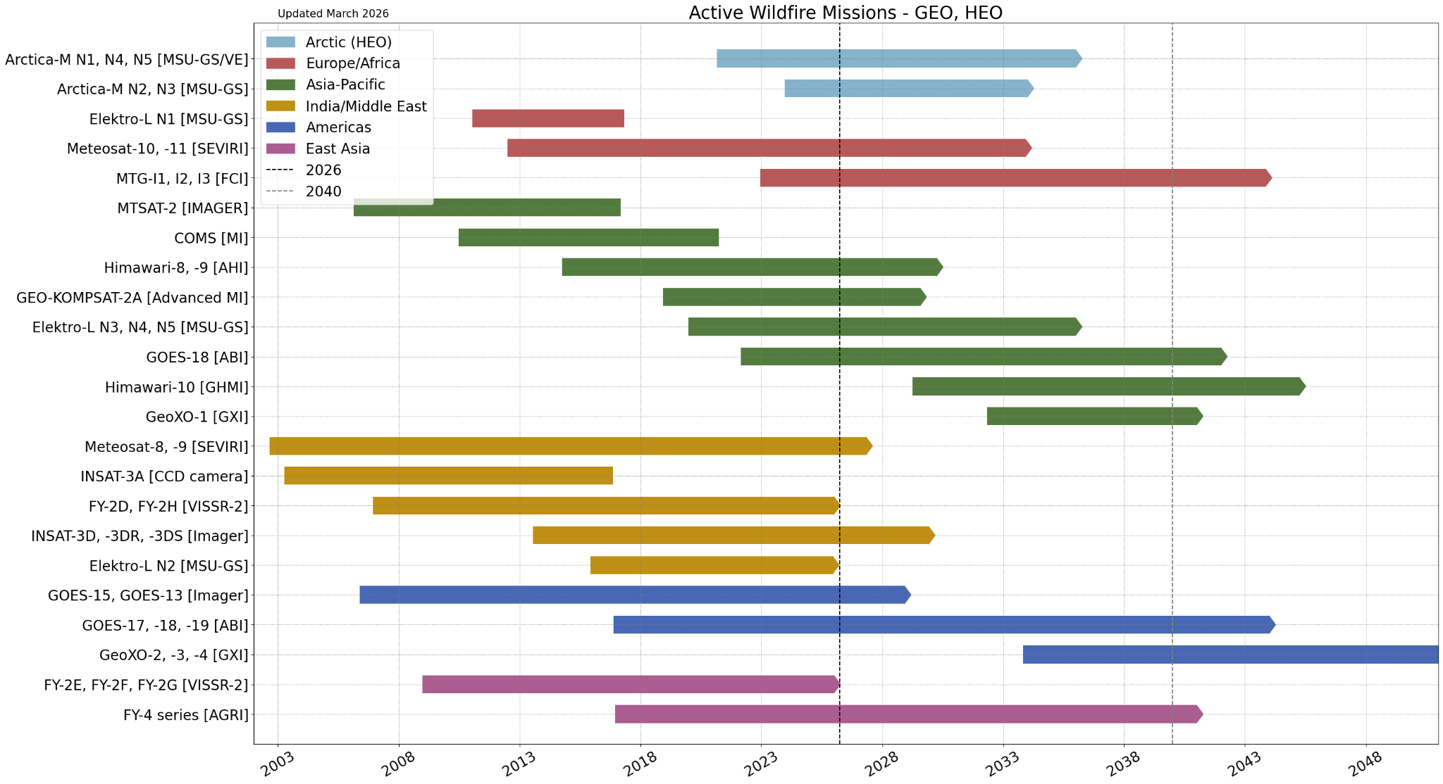
LSI-VC - Wildfire Contributing Missions
From Wildfire Portal:
ceos.org/wildfires
Notes:
From Wildfire Portal, supporting new LSI-VC wildfire subgroup. Only active wildfires.

Slide 9
LSI-VC
Co-leads: Peter Strobl (EC-JRC), Chris Barnes (USGS/KBR), Takeo Tadono (JAXA),
Update: Matt Adams replacing Jonathon Ross for GA
Wildfires Subgroup Established
  Launched under LSI-VC in response to Canada’s call for international EO coordination on wildfire
Forests & Biomass
  Progressing AFOLU Roadmap implementation and stocktake
  Renewed collaboration with GFOI
Agriculture (GEOGLAM)
  Defining Essential Agriculture Variables (EAVs) and stocktaking their EO contributions
Commercial Sector Engagement
  Ongoing global engagement series
  Sessions held in Japan, Australia, Europe, and upcoming in the USA
Standards Coordination
  Active engagement with ISO & OGC
Surface Temperature CEOS-ARD
  Product Family Specifications (PFS) update underway
  Co-developed with commercial sector and SST-VC
  Expanding scope to include surface brightness temperature and microwave
Product-Level Definitions
  Introducing clearer CEOS-ARD product categorization
Upcoming Meetings
  USGS EROS hosting joint LSI-VC-19/WGCV-56 next week!
  Focus on CEOS-ARD Strategy development
Notes:
Matt Adams replacing Jonathon Ross for GA
At each of the LSI-VC meetings, have commercial engagement session
Standards - coordinating with ISO & OGC for CEOS-ARD standards

Slide 10
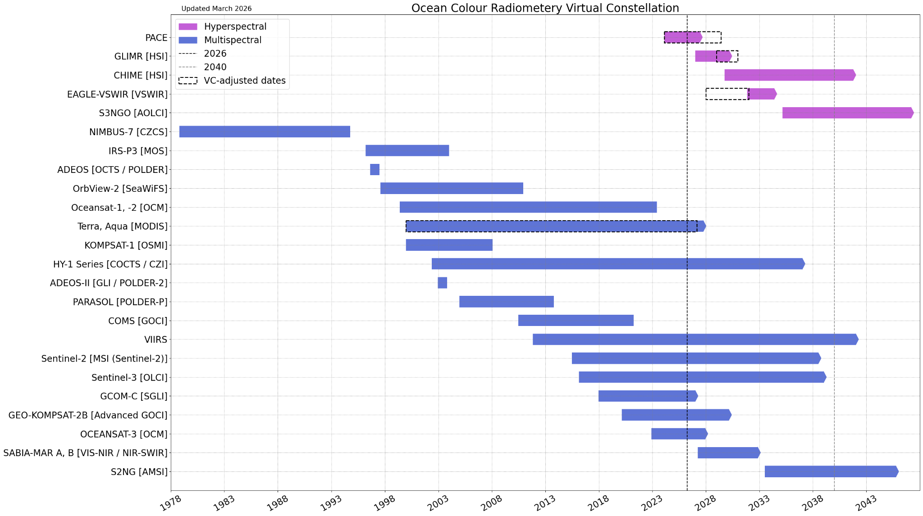
OCR-VC
GEO (Americas)
GEO (Asia-Pacific)
GEO (Asia-Pacific)
Notes:
Dotted boxed are VC adjusted dates - based on latest knowledge of launch and mission extensions
Potential gap in global, daily LEO hyperspectral O/C coverage:
Gap between PACE OCI (top row pink) and Sentinel-3 Next Gen AOLCI (bottom row pink) likely
Concern is a lack of observation at ~2 day global coverage
Geostationary ocean colour radiometry gap (missions highlighted in green):
Ocean Color (O/C) instrument for GeoXO mission no longer planned to fly
Encourage CEOS Agencies to consider O/C instruments on GEO missions

Slide 11
OCR-VC
Co-leads: Marie-Helene Rio (ESA), Ewa Kwiatkowska (EUMETSAT), Jeremy Werdell (NASA)
Geostationary ocean colour radiometry gap:
  Ocean Color (O/C) instrument for GeoXO mission no longer planned to fly
  Encourage CEOS Agencies to consider O/C instruments on GEO missions
Potential gap in global, daily LEO hyperspectral O/C coverage:
  Gap between PACE OCI and S3NG AOLCI likely
  Concern is a lack of observation at ~2 day global coverage
Focus for OCR-VC is the Aquatic Carbon Roadmap (see item 5.3)
OCR-VC supports the implementation of the International Network for Sensor InTercomparison and Uncertainty Assessment for Ocean Colour Radiometry (INSITU-OCR).
Notes:
INSITU-OCR is a white paper published in 2012, which sets out recommendations that work towards consistency and accuracy in the development of essential climate variables from multiple missions. Core OCR-VC work is to implement the recommendations from this paper

Slide 12
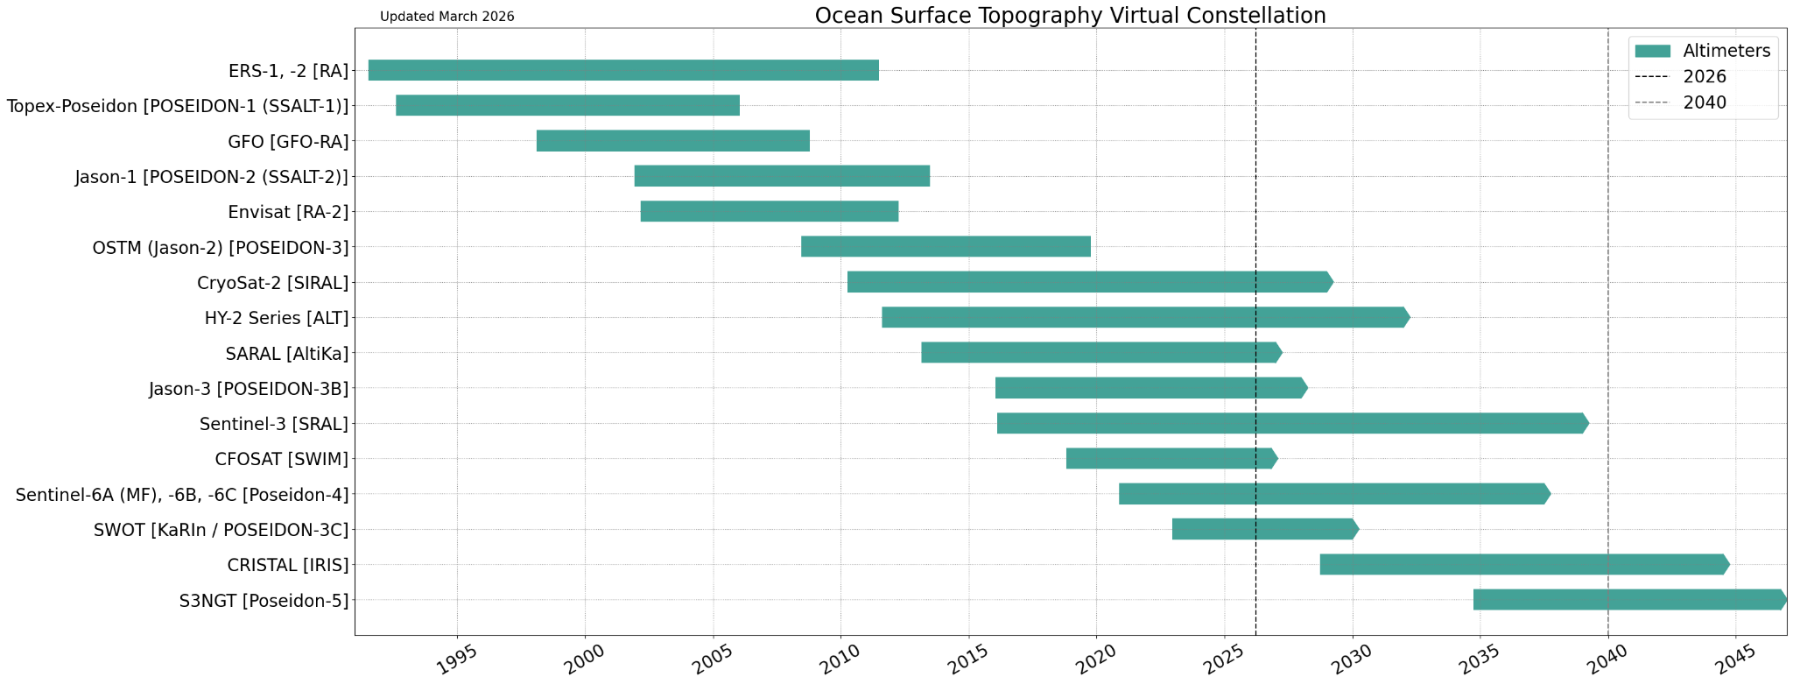
OST-VC
Notes:
Starting to plan beyond the chart - with the A Coordinated International Satellite Altimetry Virtual Constellation: Towards 2050 published in 2025

Slide 13
OST-VC
Co-leads: Estelle Obligis (EUMETSAT), Yannice Faugere (CNES)
A Coordinated International Satellite Altimetry Virtual Constellation: Towards 2050 published in 2025
  Considering publishing in peer-reviewed journal
OST Science Team meeting organized 22-26 June 2026, in Wiesbaden, Germany
In 2026, a large part of the community will be interested and involved in the commissioning of the Copernicus Sentinel-6B mission, which was launched in November 2025 and of the Copernicus Sentinel-3C mission, which will be launched in September 2026.
Notes:
A Coordinated International Satellite Altimetry Virtual Constellation: Towards 2050 published in 2025 (delivered to CEOS Plenary).
Sentinel-6B launched last year, commissioning underway
Sentinel-3C will launch later this year

Slide 14
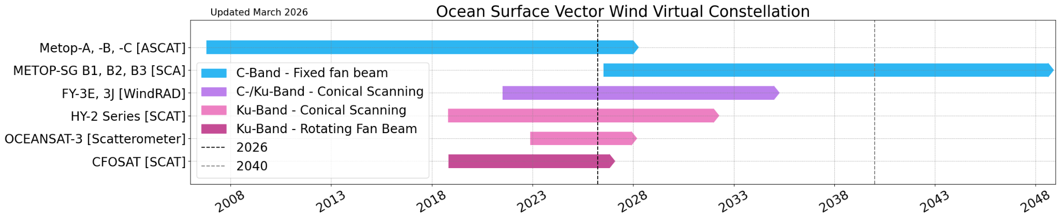
OSVW-VC
Notes:
Multiple missions within each row. Good continuity

Slide 15
OSVW-VC
Co-leads: Stefanie Linow (EUMETSAT), Paul Chang (NOAA), Abhisek Chakraborty (IRSO), Suchandra Bhowmick (ISRO)
Advancing coordination for the development of a coordinated multi-mission global wind product to improve temporal resolution, particularly for capturing high-frequency extreme weather events.
Coordination for synthesizing feedback from the International Ocean Vector Winds Science Team (IOVWST) to refine user requirements for next generation scatterometers.
CEOS FRM (Fiducial Reference Measurements) for in situ wind observations, ensuring that buoy data, ship-based and aircraft-based observations used for validation meet rigorous international quality standards, and also address performance in the extreme winds
Notes:
Devloping multi-mission products for high wind extreme events to improve temporal res
Looking forward at next generation scatterometers
The CEOS FRM framework developed by WGCV provides specifications for trustworthy calibration and validation measurements. Some in-situ measurements used for OSVW Cal/Val are candidates for CEOS-FRM assessment.
FRM means: “A suite of independent, fully characterised, and traceable measurements, tailored specifically to address the calibration and validation needs of a class of satellite borne sensor”. CEOS WGCV is currently developing an assessment framework for FRMs to support a wide range of product validation across thematic domains, and encourages coordination with OSVW and the other VCs.

Slide 16
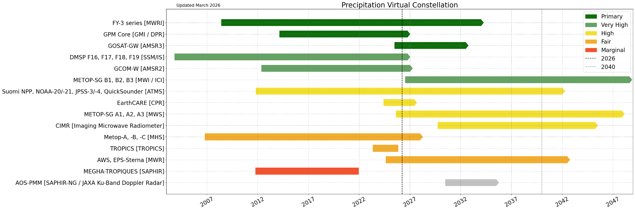
P-VC
Notes:
Categorised based on relevance to precipitation.
Good coverage by primary missions

Slide 17
P-VC
Co-leads: Takuji Kubota (JAXA), Will McCarty (NASA, replacing Chris Kidd)
Working on definition of what CEOS-ARD looks like for the precipitation community
Investigating the integration of data from commercial sources into the P-VC pipeline
  Defining methods to quantify the utility these data.
The International Precipitation Working Group (IPWG) will meeting in July 2026.
  Review current satellite products and recommend future directions to national and international agencies
Notes:
Will McCarty (NASA, replacing Chris Kidd)
User community for precipitation quite different from LSI - need to understand what community needs from ARD products, influence what the Precip PFS looks like
Some challenges with integrating commercial data - lisencing etc. for international user base

Slide 18
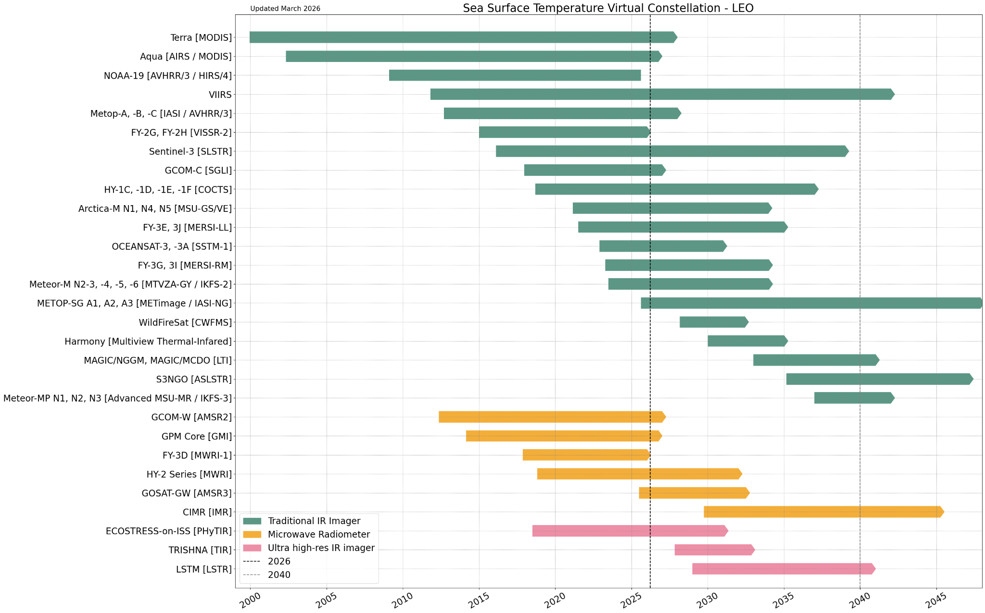
SST-VC - LEO
Notes:
Missions separated by orbit type - LEO & GEO.
Missions for LEO categorised by type, green - traditional IR (MetOp - AVHRR, VIIRS, Oceansat-3), orange - microwave radiometers (GCOM-W AMSR, CMIR), pink - ultra high res IR imagers (ECOSTRESS, TRISHNA, LSTM)
High resolution imagers coming up.

Slide 19
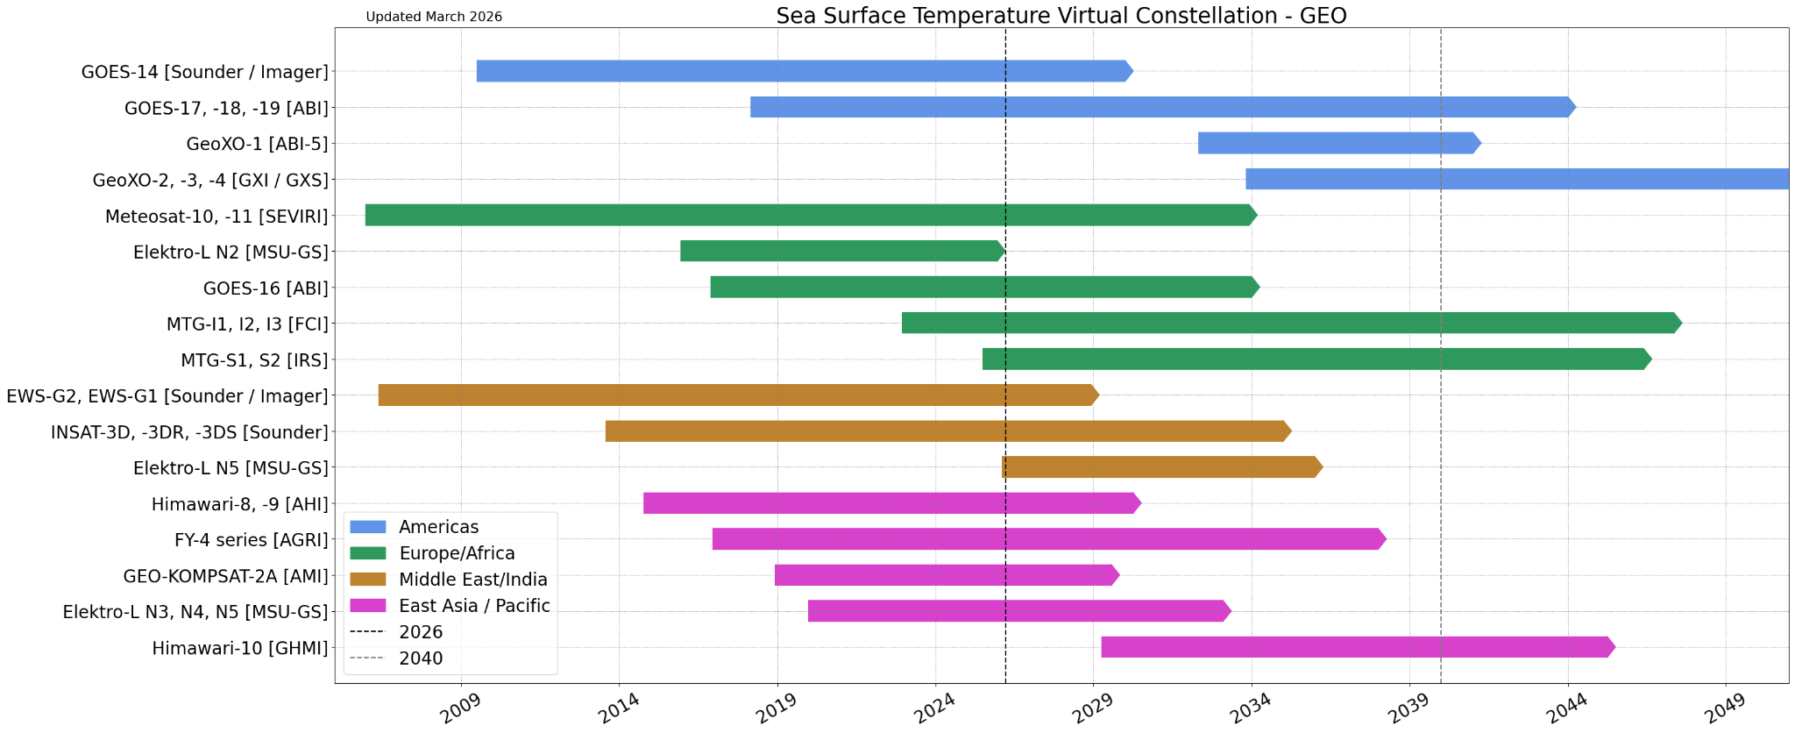
SST-VC - GEO
Notes:
GEO missions categorised by longitude - americans, europe/africa, middle east/india, east asia / pacific.
Good continuity for all regions

Slide 20
SST-VC
Co-leads: Misako Kachi (JAXA), Christo Whittle (CSIR)
Working with LSI-VC on updating the Surface Temperature CEOS-ARD PFS
Engaging with COAST-VC - looking into how to combine different data sources to achieve actionable information
Looking at collaborating with Biodiversity VC
Coordinates closely with the Group for High Resolution Sea Surface Temperature (GHRSST)
Produces and provide sea surface temperature (SST) and related parameters by the past and current GEO TIR imagers, LEO TIR imagers, and LEO microwave imagers in the GHRSST Data Specification (GDS) format, and made available via GHRSST Data Centers.
Notes:
Good collaboration between SST and others group, LSI, COAST, Biodiversity.
PFS update with LSI ensures consistent product across both land and sea surface temperature.
Previous work with COAST on sea surface temperature in the coastal region. Combining datasets to fill gaps in coastal obseravtions - go closer to coast.
Core work is to provide data in the GHRSST (grist) Data Specification format

Slide 21
Commercial Sector Engagement
LSI-VC: regular engagement on CEOS-ARD & other topics
AC-VC: engaging with a few companies on GHG aspects
P-VC: engaged with companies, but has faced licensing challenges around integrating commercial data into the VC
SST-VC: Not actively seeking commercial collaboration in the VC, but one company did join 2025 GHRSST meeting.
OSVW-VC: agencies are nurturing commercial scatterometry possibilities and GNSS-R capabilities, but not captured under the VC yet.
OCR-VC: IOCCG engages on the topic of water quality
COAST-VC: Individual agencies engaging with commercial users (e.g. fisheries)
OST-VC: No participation of commercial sector in altimetry
Most Active Engagement
Least Active Engagement
Notes:
LSI-VC: regular commercial sector engagement sessions alongside their biannual meetings - mostly focused on CEOS-ARD
AC-VC: commercial sector engagement in the common practices for facility scale methane measurements - GHGSat, CarbonMapper etc. providing quality data.
P-VC: working to integrate data, some challenges
SST-VC: good engagement of commercial sector in the CEOS-ARD surface temperature specification development activity - with LSI. One company joined last year’s meeting (ororatech).
OSVW: individual agencies working with commercial companies, but not in the VC yet. Looking at new technologies and possibilities to support the global observing system
OCR-VC: limited engagement - only some engagement on IOCCG.
COAST: Individual agencies are engaging with commercial users - NASA has recently joined the industry advisory board of a fisheries consortium.
OST-VC: no commercial players

